Slide 1


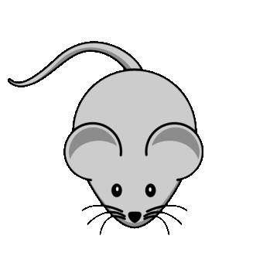
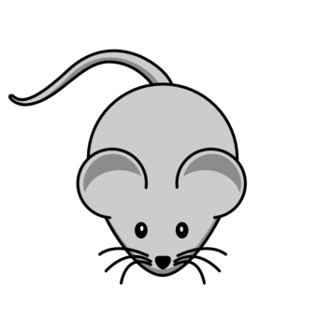

High-dimensional blue noise
Problem:
Fill high-dimensional space
Blue noise points
Sandia National Laboratories is a multimission laboratory managed and operated by National Technology and Engineering Solutions of Sandia, LLC., a wholly owned subsidiary of Honeywell International, Inc., for the U.S. Department of Energy’s National Nuclear Security Administration under Contract DE-NA0003525.
Features:
Gaps Not too close No big gaps
Runtimes exponential-in-d

Slide 2
Bridson, SIGGRAPH 2007
Solution:
local annular neighborhood around prior samples
rejection sampling, 30 tries
point-sampling
Features:
Big gaps? Unknown? Dimension dependence?
scalable algorithm

Slide 3

Spoke-Darts, SIGGRAPH 2018
Bridson, SIGGRAPH 2007
Solution:
local annular neighborhood around prior samples
rejection sampling, 30 tries
point-sampling
Solution:
local annular neighborhood around prior samples
rejection sampling, 12 tries
line-sampling
Solution:
local annular neighborhood around prior samples
rejection sampling, 12 tries
line-sampling
Solution:
local annular neighborhood around prior samples
rejection sampling, 30 tries
point-sampling
New recipe !!!
Features:
Big gaps? Unknown? Dimension dependence?
scalable algorithm

Slide 4
Spoke-Darts, SIGGRAPH 2018
Solution:
local annular neighborhood around prior samples
rejection sampling, 12 tries
line-sampling
Solution:
local annular neighborhood around prior samples
rejection sampling, 12 tries
line-sampling
Solution:
local annular neighborhood around prior samples
rejection sampling, 30 tries
point-sampling
New recipe !!!
Features:
Big gaps? Unknown? Depends on dimension?
scalable algorithm
Features:
Big gaps? Unknown? Dimension dependence?
scalable algorithm
Features:
Big gaps? No! Proven! Dimension invariance!
scalable algorithm
Features:
Big gaps? Unknown? Depends on dimension?
scalable algorithm
Crunchy guarantee !!!
Same speedy action !!!
linear in dimension

Slide 5
Spoke-Darts, SIGGRAPH 2018
Solution:
local annular neighborhood around prior samples
rejection sampling, 12 tries
line-sampling
Solution:
local annular neighborhood around prior samples
rejection sampling, 12 tries
line-sampling
Solution:
local annular neighborhood around prior samples
rejection sampling, 30 tries
point-sampling
New recipe !!!
Features:
Big gaps? Unknown? Depends on dimension?
scalable algorithm
Features:
Big gaps? Unknown? Dimension dependence?
scalable algorithm
Features:
Big gaps? No! Proven! Dimension invariance!
scalable algorithm
Features:
Big gaps? Unknown? Depends on dimension?
scalable algorithm
Crunchy guarantee !!!
Come see it in action !!!
Same speedy action !!!
linear in dimension

