Slide 1
Course Order Python+Qlik Project Demo

Slide 2
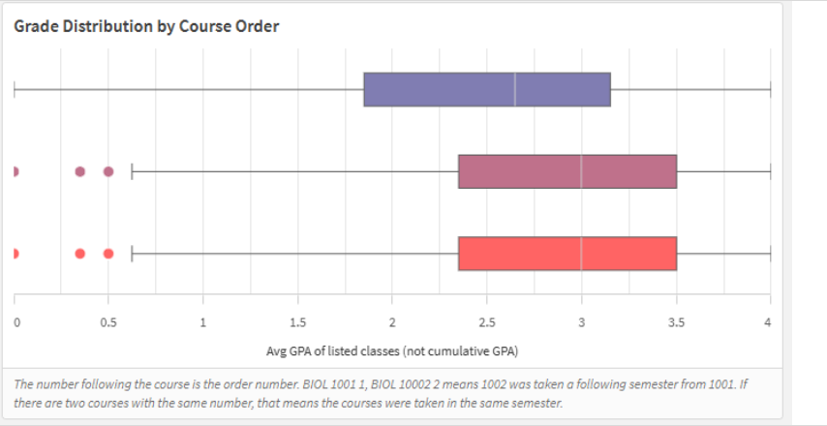
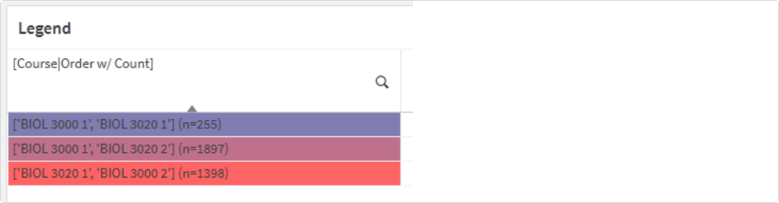
This process queries historical grade data
Allows users to see how students have performed in a given list of classes depending on which sequence they took the classes
Useful for academic advisors

Slide 3
Data pipeline
Log file
PowerShell automation
Python Analysis
UBI Server: User Selections Folder
UBI Server: User Results Folder
.csv user selections
.xlsx user results
IRA Course & Grade data
Qlik: User input
.csv user selections
.xlsx user results
Qlik results dashboard
.csv user selections
.xlsx user results

Slide 4
Some nice features
Powershell script runs automatically each day
This solves the problem of multiple users inputting data at the same time
Adds minimal load to Qlik servers
Python script does error checking
Validates user input
Throws errors for various ways user can give bad input
An error on one request shouldn’t affect another request
Errors are logged and populated in qlik dashboard
Several optional user parameters included

