Slide 1
Get Started with Splunk Reports & Dashboards
Notes:
Background: This is a workshop designed to introduce new and experienced users to Splunk reports and dashboards. It was a little surprising, but not uncommon, to learn from some of our favorite Splunkers they didn’t know Splunk could create interactive, smart visuals like graphs/charts/reports and arrange them quickly on custom dashboards. This 30-45 minute workshop will catapult searchers into a whole new world of visualizations.

Slide 2
Workshop Setup
This slide deck is meant only for preparation.
Slides near the end of the deck are provided for display.
The actual workshop should be performed in Splunk.
This is meant to be a 30-45 minute product walkthrough.
Concepts can be demonstrated using any dataset so choose one which is relevant to your audience.
For illustration purposes, this workshop will use Apache access data commonly sourcetyped as ‘access_combined’.

Slide 3
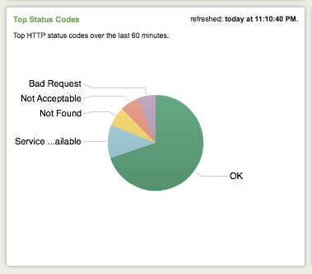
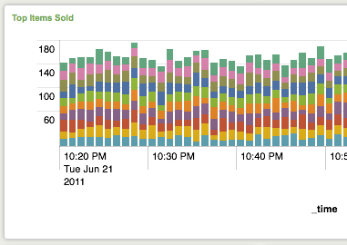
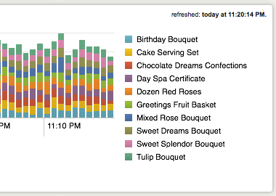
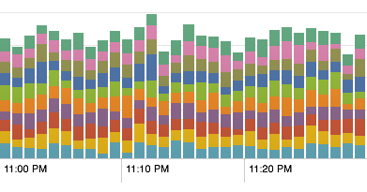
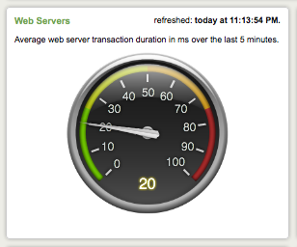
Graphic for Spreading the Word
Get Started with Splunk Reports & Dashboards
You already know Splunk as a powerful search and analytics engine. Did you know Splunk can also present data as smart graphs, gauges and dashboards? Join us for a workshop on how to build interactive visuals. We will cover the basics of the Splunk Report Builder, saving/sharing reports, arranging reports
on dashboards, and how to leverage existing visualizations with Splunk Apps. No need to bring markers or crayons, but feel free to follow along on your own Splunk instance.
For some help marketing the workshop, take a screenshot of this graphic.
You might also add specifics on date/time and meeting place.
Notes:
Before

Slide 4
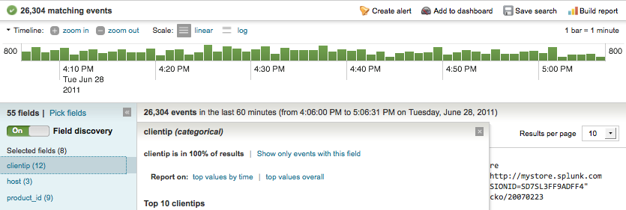
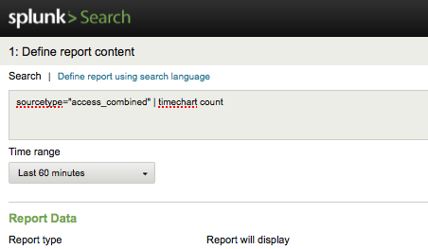
Workshop Structure
Provide orientation on Search Flash Timeline View
show option to launch Report Builder from 'Build report' link above timeline
show option to launch Report Builder from the filter menu on a particular field

Slide 5
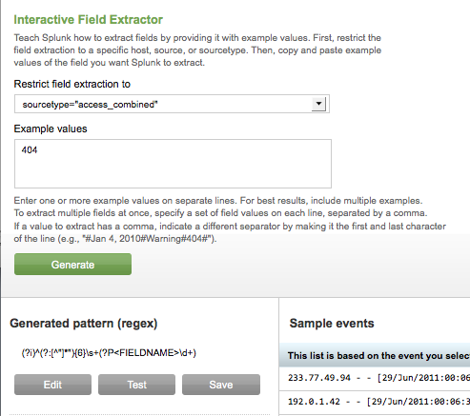
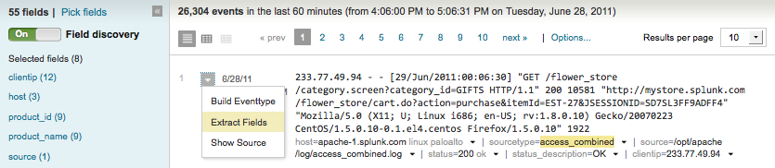
Discuss what should be done if no field is available
short overview of fields (what are they and why they matter)
show how to use the Interactive Field Extractor (IFX)

Slide 6
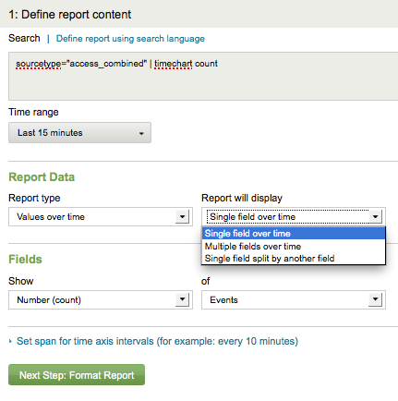
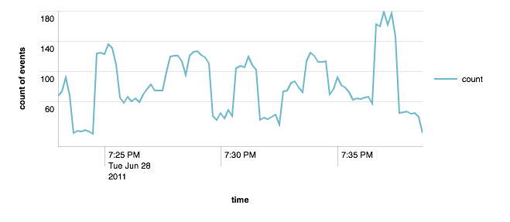
Provide orientation of Report Builder
show how to build a graph over time
Single field over time
example: sourcetype=access_combined | timechart count
For each graph type:
- relate the widget options to what is generated in the search bar
- it may help to close and relaunch the Report Builder after each report

Slide 7
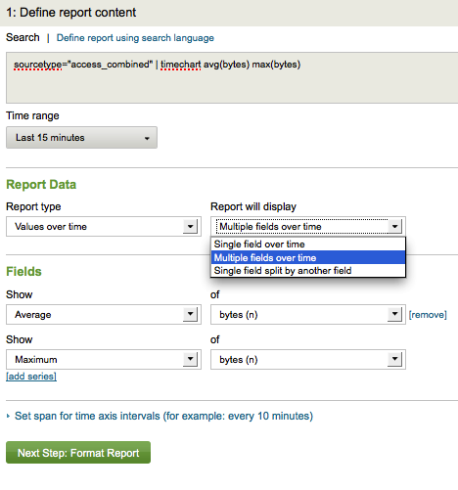
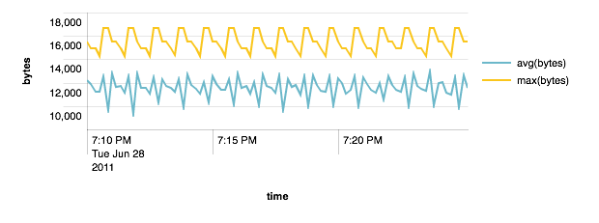
Provide orientation of Report Builder
show how to build a graph over time
Multiple fields over time
example: sourcetype=access_combined | timechart avg(bytes) max(bytes)

Slide 8
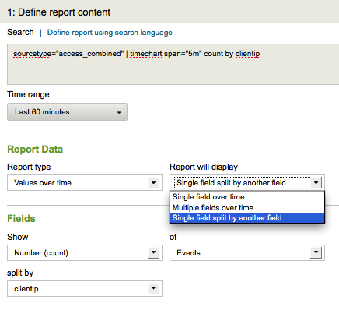
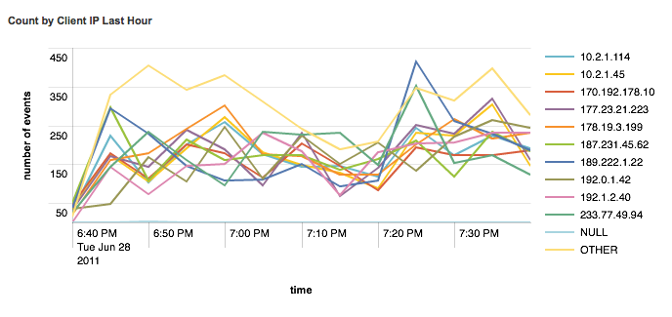
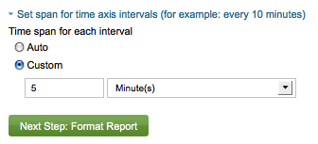
Provide orientation of Report Builder
show how to build a graph over time
Single field split by another field
example: sourcetype=access_combined | timechart span=5m count by clientip

Slide 9
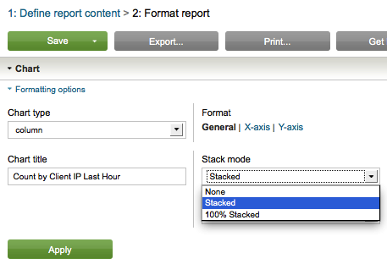
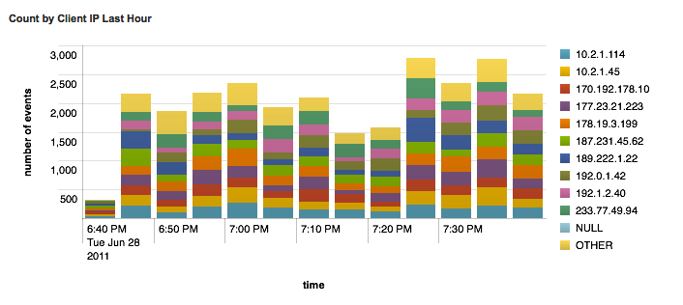
Provide orientation of Report Builder
show how to stack values

Slide 10
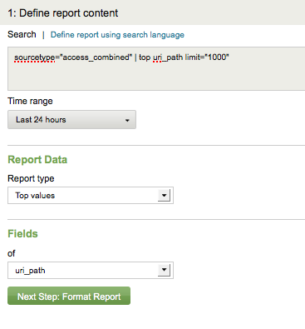
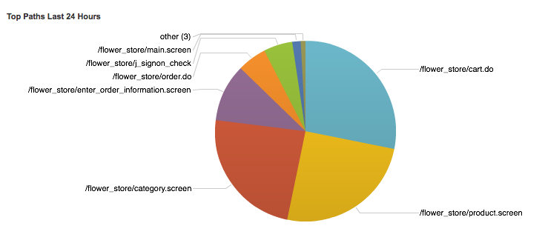
Provide orientation of Report Builder
show how to build a graph on values
example: sourcetype=access_combined | top uri_path

Slide 11
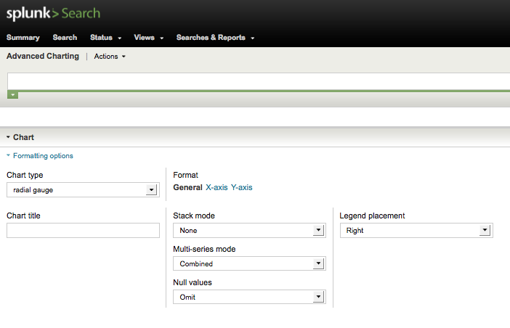
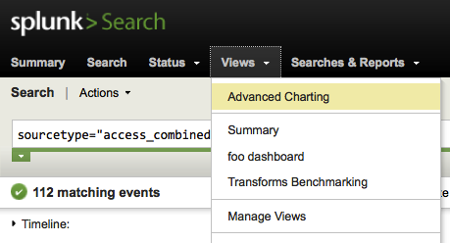

Show alternate Advanced Charting (AC) view
from the Views menu > Advanced Charting
AC assumes familiarity with the search language
it may be faster to use the search bar to define reports and toggle options
limit = #
useother = false
usenull = false
sourcetype=access_combined | timechart limit=20 count by status usenull=f useother=f

Slide 12
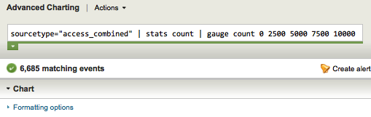
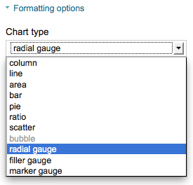
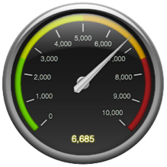
Show alternate Advanced Charting view
show how to build a gauge
- requires setting thresholds via search
- also requires selections in UI
If you want to save or put this gauge on a dashboard, you must save it from the AC or RB. Saving it as a regular search does not associate a proper viewstate and you’ll end up with the default column graph instead of the gauge graphic.

Slide 13
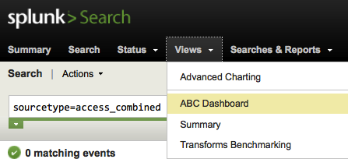
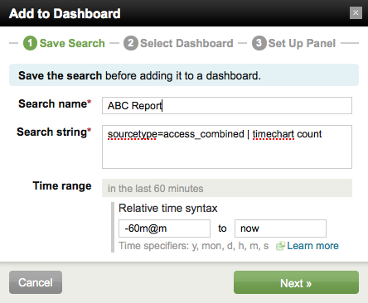
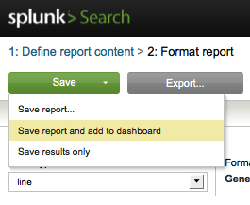
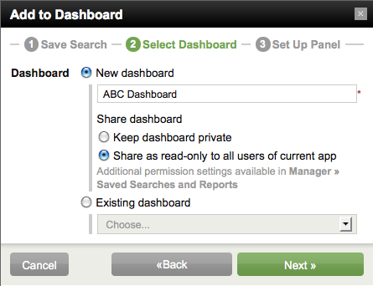
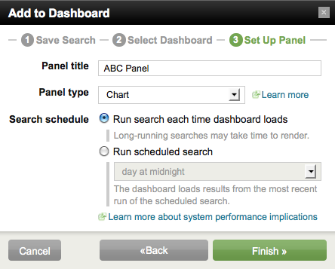

Show how to save a report and put it on a dashboard
use the 'Save report and add to dashboard' option
discuss why you would want to schedule a report if you are going to share it
create a new dashboard
add the saved report to the dashboard
show where the saved report and dashboard can be accessed after saving
3
1
2

Slide 14
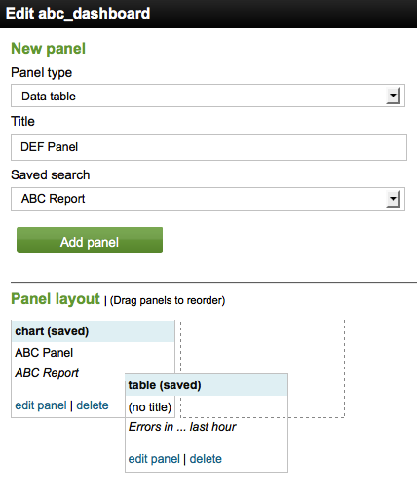
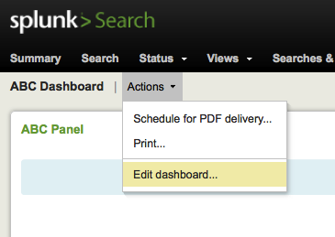
Show how to edit a dashboard and add more saved reports
just edit the dashboard and add 1 saved report (“Errors in the last hour”)
drag the 2nd report to create a 2 column layout
save it and re-render the dashboard

Slide 15
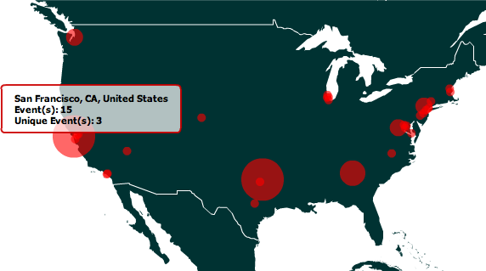
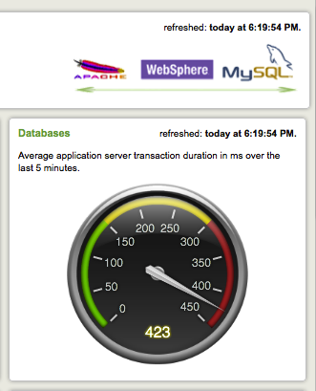
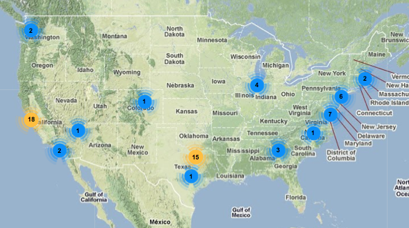
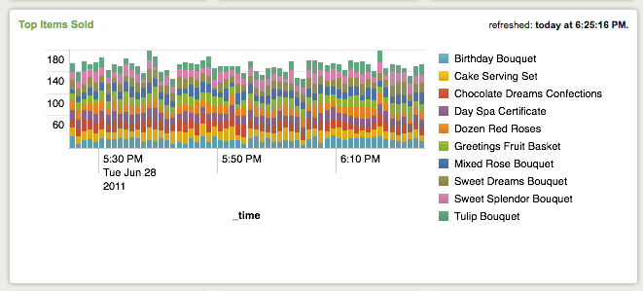
Show examples of more advanced dashboards
use the Application Management dashboards
use dashboards from other Apps
show a dashboard with a geoip panel (GoogleMaps or AmMap)

Slide 16
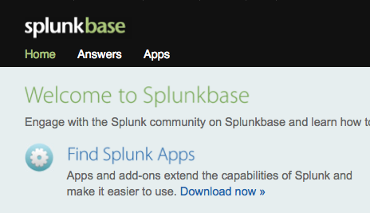
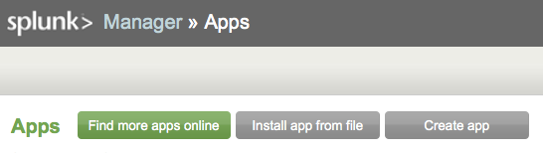
Briefly discuss how searches/reports/dashboards can be shared/downloaded via Apps
Briefly discuss summary indexing
maybe offer a future workshop on it

Slide 17
Be Prepared to Address These Questions
How can I schedule the report or dashboard to be sent via email?
Hint: PDF Server
How can I report over large amounts of data?
Hint: Summary Indexing
How can I make my reports load faster?
Hint: Schedule it
How can I make my dashboards load faster?
Hint: Summary Indexing + scheduled searches
Is there an App for JBoss? Apache? <insert App here>?
Hint: Show SplunkBase and available Apps, mention build your own and the Splunk UI Development Course

Slide 18
Getting Started with Splunk Reports & Dashboards
Name Title
Date
Notes:
This portion of the deck is meant to be used during the workshop to communicate agenda and avenues to get help.

Slide 19
Workshop Agenda
Introduction to the Splunk Report Builder
Build 6 Different Types of Reports
Save/Share Reports
Arrange Reports on Dashboards
Leverage Existing Visualizations with Splunk Apps

Slide 20
Reporting/Dashboard Walk Thru

Slide 21
Need a Hand?

Slide 22
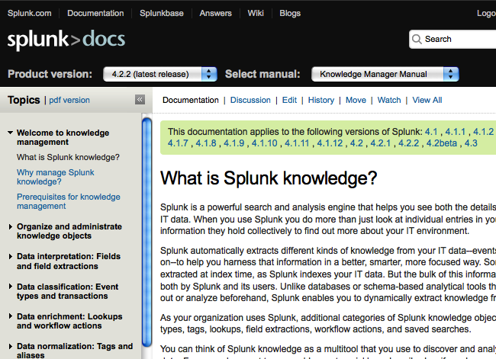
Splunk Documentation
http://docs.splunk.com
Official Product Docs
Wiki and community topics
Updated daily
Can be printed to .PDF
User Manual for Reporting
Developer Manual for UI / dashboard customization
Notes:
“After this workshop, if you want more information, all the product documentation is available online. The documentation is divided into several manuals. For reporting and dashboards you will likely be most interested in the User and Developer Manuals.”

Slide 23
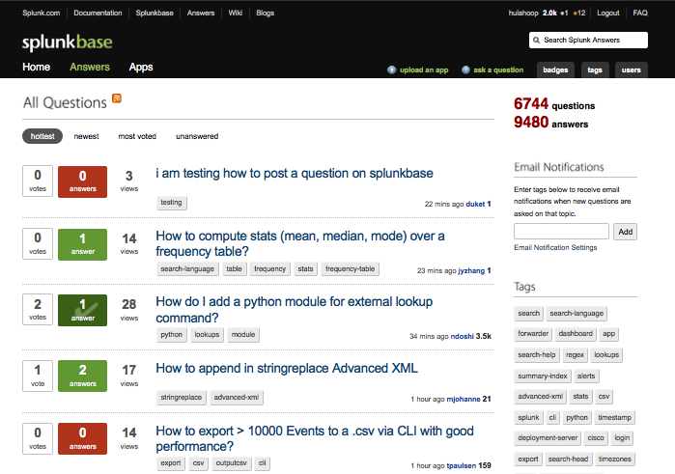
Splunk Answers
http://answers.splunk.com
Community driven
Splunk supported
Knowledge exchange
Q & A
Notes:
“For a more interactive approach to getting your questions addressed there is Splunk Answers. It is a web based Splunk community of Splunkers like you. Splunk employees are also regular experts on the site.”

Slide 24


Splunk Education
Recommended for Users
Using Splunk
Searching & Reporting
Recommended for UI/Dashboard Developers
Developing Apps
Instructor-Led Courses
Web
Onsite
Notes:
“It is not possible to cover everything you need to know about building reports and dashboards in 30-45 minutes. For more structured training with labs, consider Splunk education courses. These are available as instructor-led web-based courses or onsite if there is enough participants per class.”

Slide 25
Thank You :)

