Slide 1
CS250 Final Project: Agile Presentation
Keith Tomany 03/01/26
Notes:
TITLE

Slide 2
Agile Roles
Product Owner
Scrum Master
They represent the stakeholders and are responsible for the Product Backlog. Without a strong PO, the team risks building features that don't meet market needs (Schwaber & Sutherland, 2020).
The "Servant Leader." They don't manage the people; they manage the process. They remove "impediments" (roadblocks) and coach the team on Scrum theory.
Key Responsibilities: Backlog Management: Creating and clearly communicating Product Backlog items. Prioritization: Deciding which features are "must-haves" vs "nice-to-haves". Stakeholder Alignment: Managing expectations and gathering requirements from the business side.
Key Responsibilities:
Removing Impediments: "Clearing the path" by fixing issues that slow the team down (e.g., a broken tool or a distracting meeting).
Facilitation: Leading the Daily Stand-up, Sprint Planning, and Retrospectives.
Shielding the Team: Protecting the developers from outside interference or "scope creep" during a sprint.
Developer
Tester
The builders who create the code. This cross-functional group is responsible for turning backlog items into a "Done" increment of product.
Often integrated into the "Developer" role in modern Scrum, the specialized focus on Quality Assurance ensures that testing happens during development, not as an afterthought.
Key Responsibilities: Sprint Execution: Writing code, designing interfaces, and building the actual product. Self-Management: Deciding how to organize their own work to meet the Sprint Goal. Quality Ownership: Ensuring the work meets the "Definition of Done" (DoD).
Key Responsibilities:
Test Automation: Creating scripts to verify functionality quickly.
Exploratory Testing: “Break" the product in ways the PO may not have considered.
Feedback Loop: Providing immediate data to Developers on bugs or usability issues before the Sprint ends.
Notes:
Agile Roles - Explain the various roles on a Scrum-Agile Team by identifying each role and describing its importance.

Slide 3
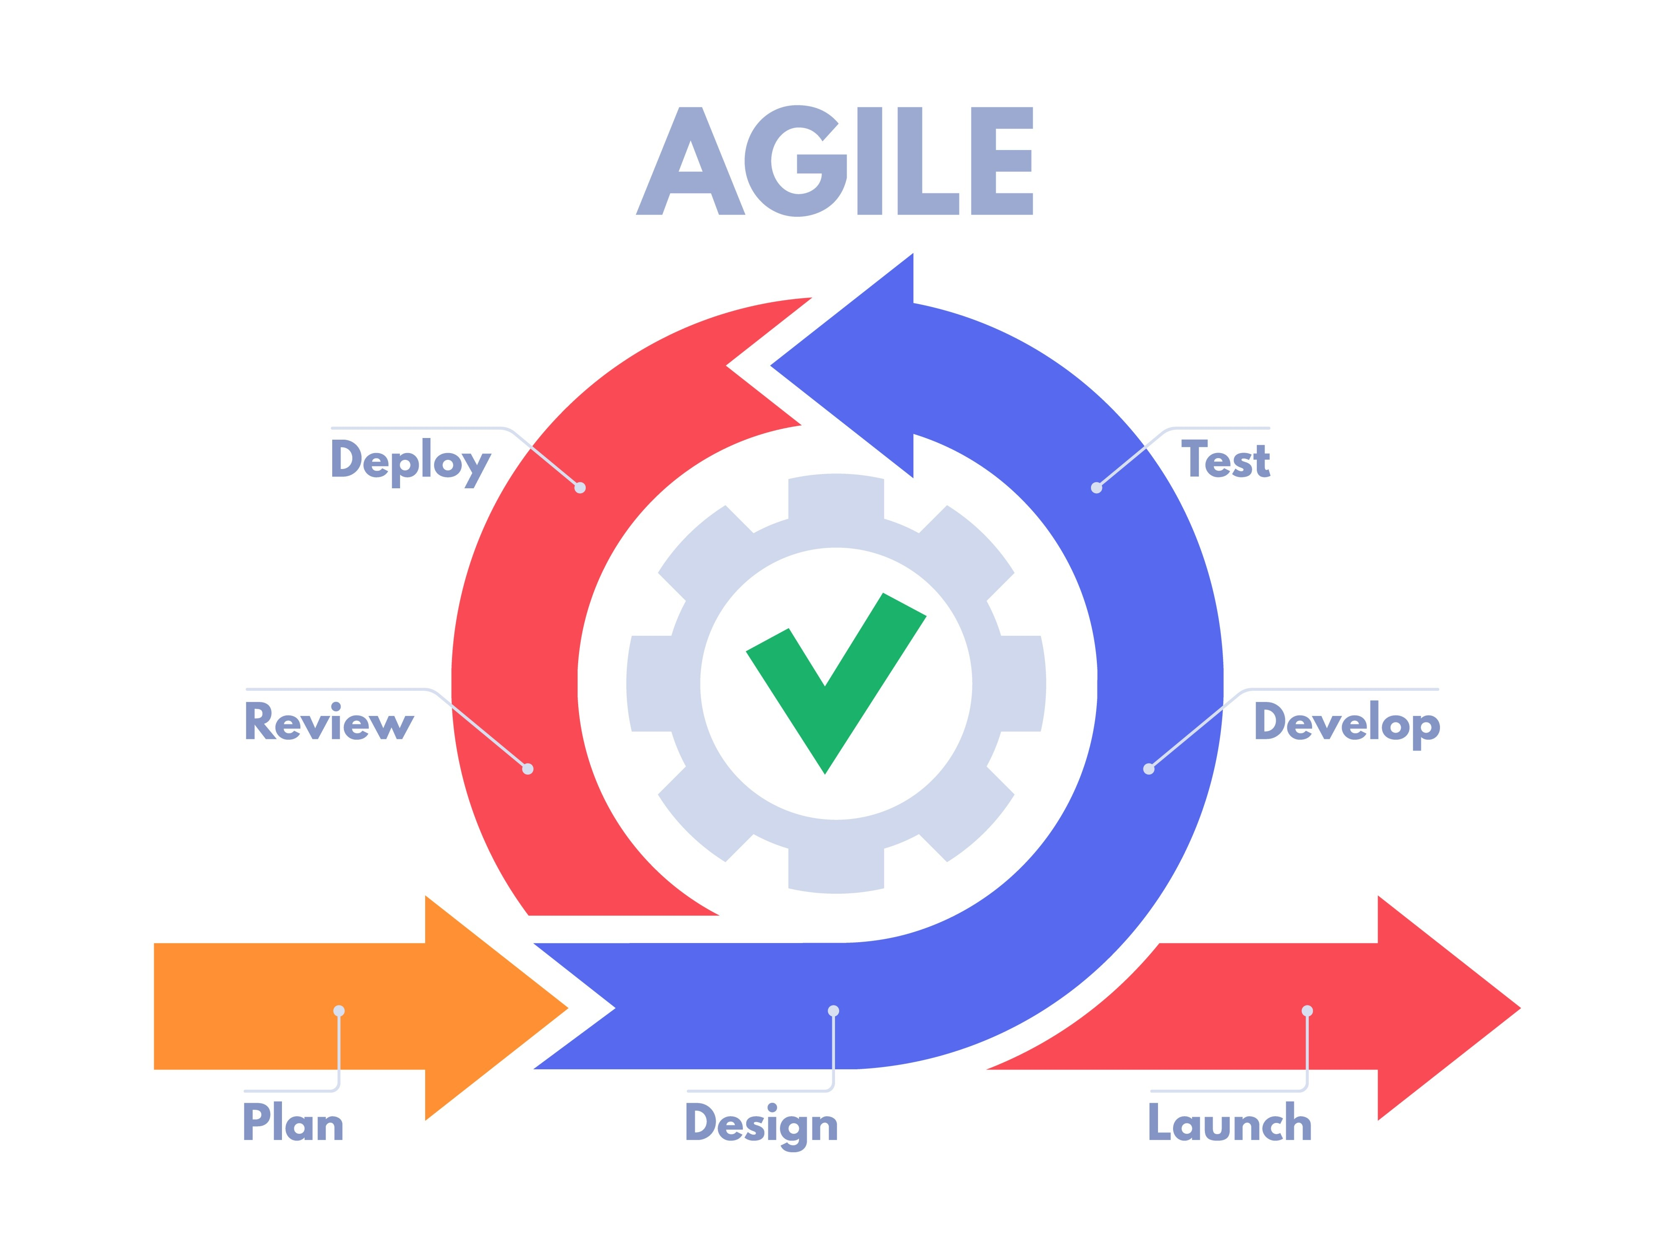
Agile Phases
The Agile Software Development Life Cycle (SDLC) is a repetitive, iterative process. Unlike the traditional "Waterfall" method where you finish one giant phase before starting the next, Agile breaks the project into small chunks called Sprints (usually 1–4 weeks). allowing you to pivot based on feedback. Think of it as a loop rather than a straight line. Here are the core phases:
Concept/Inception: High-level visioning and backlog creation.
Requirements/Refinement: Breaking down "User Stories" so they are ready for development.
Iterative Development: The actual coding and building of the increment.
Testing/Quality Assurance: Continuous testing happens during development, not at the end, ensuring "Definition of Done" is met.
Release/Deployment: Delivering the increment to a production-like environment for feedback (Rigby et al., 2020).
Notes:
Agile Phases - Explain how the various phases of the SDLC work in an Agile approach. Identify each phase and describe its importance.

Slide 4


Waterfall vs Agile
The primary difference between the Waterfall and Agile methods is flexibility versus sequence. In a Waterfall approach, a project moves like a relay race: one phase must finish before the next begins. All requirements are gathered and documented in a massive Software Requirement Specification (SRS) at the very beginning. Changing a requirement later usually requires a formal request and can be very expensive. The Waterfall method prioritizes a "Fixed Scope" where plans are set early, while Agile prioritizes "Fixed Time/Cost" (iterations are set, but the scope can evolve based on learning) (West, 2021).
Imagine a bug is found in the final testing phase. In Waterfall, this could require restarting the entire design phase, leading to massive delays and sunk costs. Because testing is integrated into every Sprint, the Agile Scrum team would have identified the issue within days. During the SNHU Travel project, the client required us to pivot to detox- and wellness-focused travel. Using the Agile development method, we were able to quickly implement this change while remaining on schedule. If we had been further along in development using the Waterfall method, it could set the project back multiple phases
Notes:
Waterfall Model - Describe how the process would have been different in a waterfall development approach rather than the Agile approach you used. For instance, you might discuss how a particular problem in development would have proceeded differently.

Slide 5
Choosing Your Path
Deciding between the two depends on project certainty. Based on industry standards and development experience, consider these three factors:
Requirements Clarity: If the goal is 100% known (e.g., a simple hardware upgrade), Waterfall is efficient. If the goal is a "disruptive" new app, Agile is safer.
Stakeholder Involvement: Agile requires frequent "check-ins." If stakeholders are too busy to meet bi-weekly, an Agile project will stall.
Regulatory Environment: Highly regulated industries with strict documentation requirements sometimes lean toward Waterfall, though "Agile-at-scale" is increasingly bridging this gap (Plowman, 2023).
Notes:
Waterfall vs Agile Approach - Explain the factors to consider when choosing a waterfall or Agile approach, using your course experience to back up your explanation.

Slide 6
References
Plowman, N. (2023). Agile vs. Waterfall: Navigating the Project Management Landscape. Tech Management Press.
Rigby, D. K., Elk, S., & Berez, S. (2020). Doing Agile Right: Transformation Without Chaos. Harvard Business Review Press.
Schwaber, K., & Sutherland, J. (2020). The Scrum Guide: The Definitive Guide to Scrum: The Rules of the Game. Scrum.org.
West, D. (2021). The State of Agile: Navigating the Digital Transformation. Forrester Research.
Notes:
REFERENCES

