Slide 1

Getting Started with SignalR
Kevin Griffin ComponentOne SEVDNUG – 2/23/2012

Slide 2



About Me
Technical Evangelist for @ComponentOne
@1kevgriff
keving@componentone.com

Slide 3
WIJMO
UI widgets powered by HTML5 & jQuery

Slide 4
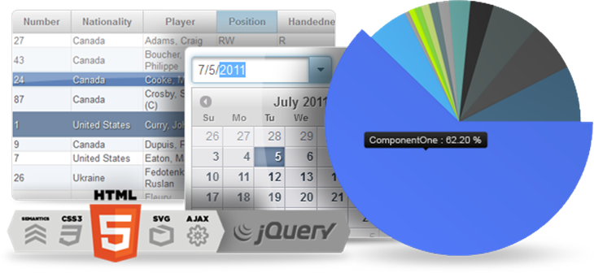
EVERYTHING YOU NEED TO BUILD A BETTER WEB
Wijmo is a complete kit of over 40 UI widgets with everything from interactive menus to rich charts. If you know jQuery, you know Wijmo. Complete with documentation and professional support, every widget is hand-crafted and includes premium themes.
Notes:
Complete kit of UI widgets for HTML5 and jQuery development
Unmatched Data Visualization and Grid components
Handcrafted CSS3 Themes and infinite possibilities with Themeroller
Works everywhere – devices and browsers supported
40+ jQuery UI Widgets

Slide 5
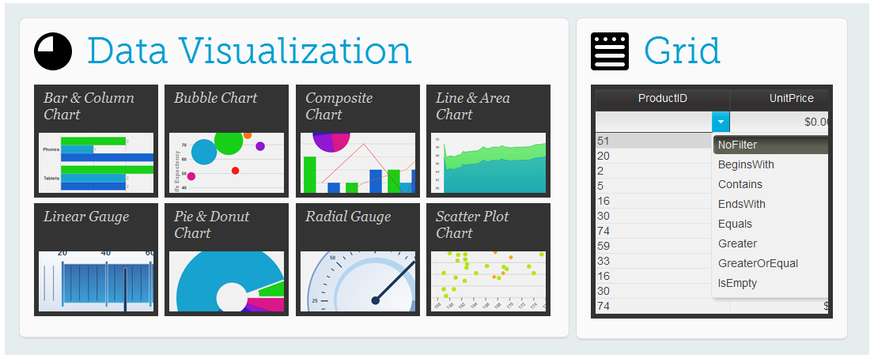
UNMATCHED DATA VIZ AND GRID COMPONENTS

Slide 6
WHAT’S NEW IN V2?
Widget | Version 1 | Version 2
Accordion | ✔ | ✔
Bar Chart | ✔ | ✔
Bubble Chart |  | ✔
Calendar | ✔ | ✔
Carousel |  | ✔
Combobox | ✔ | ✔
Composite Chart |  | ✔
Date Pager |  | ✔
Dialog | ✔ | ✔
Editor |  | ✔
Events Calendar |  | ✔
Expander | ✔ | ✔
Form Decoarator | ✔ | ✔
Gallery |  | ✔
Grid | ✔ | ✔
Input | ✔ | ✔
Lightbox |  | ✔
Linear Gauge |  | ✔
Line Chart | ✔ | ✔
List | ✔ | ✔
Menu | ✔ | ✔
Pager | ✔ | ✔
Pie Chart | ✔ | ✔
Progress Bar | ✔ | ✔
Radial Gauge |  | ✔
Rating |  | ✔
Ribbon |  | ✔
Scatter Chart |  | ✔
Slider | ✔ | ✔
Splitter | ✔ | ✔
Superpanel | ✔ | ✔
Tabs | ✔ | ✔
Tooltip | ✔ | ✔
Tree | ✔ | ✔
Upload | ✔ | ✔
Video Player | ✔ | ✔
Wizard | ✔ | ✔
Bubble Chart
Carousel
Composite Chart
Date Pager
Editor
Events Calendar
Gallery
Lightbox
Linear Gauge
Radial Gauge
Rating
Ribbon
Scatter Chart
Video Player

Slide 7


Slide 8
Agenda
A Little Bit of History
Introducing SignalR
Demos Demos Demos!

Slide 9



The Web v1.0.0.0
RESPONSE
REQUEST

Slide 10
The Web v2.0.0.0
RESPONSE
REQUEST

Slide 11

The Web v2.0.0.0
“Real Time”
Applications
AJAX
Single Page
Applications
jQuery

Slide 12
“Real Time”?

Slide 13
The Web v3.0.0.0
Connection

Slide 14
Approaches
Interval Polling
Long Polling
WebSockets
MOST
COMMON
SignalR
LEAST
COMMON

Slide 15
WebSockets
The future of asynchronous applications.
Client opens socket connection to server.
IE10, Firefox 7, Chrome 14+
http://dev.w3.org/html5/websockets/
SignalR can use WebSockets if supported…
Hint: IIS8 is needed for ASP.NET ☺

Slide 16
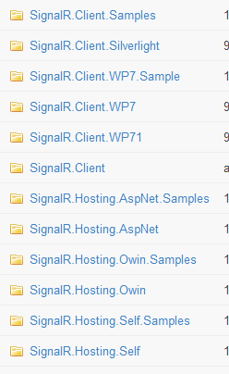
Not Just for ASP.NET
SignalR is separate from ASP.NET as of version .4
Silverlight
Windows Phone
Self Hosted

Slide 17
SignalR – Demo Checklist
File, New -> Getting SignalR
Creating a Hub
Send messages from Server
Send messages from Client(s)
Handling Completion and Failures (done & fail)
Tracking clients
Clients
Group
ConnectionId
Caller

Slide 18
Questions?
Source: http://c1.ms/GriffSignalR
https://github.com/signalr/
@1kevgriff
KevinG@ComponentOne.com

