Slide 1
Building Asynchronous Web Applications with SignalR
March 27th, 2012
Kevin Griffin
Technical Evangelist
ComponentOne

Slide 2



About Me
Technical Evangelist for @ComponentOne
@1kevgriff
keving@componentone.com

Slide 3
Agenda
A Little Bit of History
Introducing SignalR
Demos Demos Demos!

Slide 4


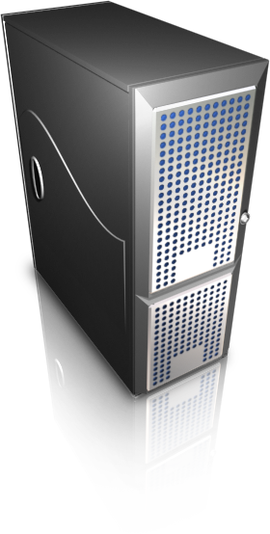
The Web v1.0.0.0
RESPONSE
REQUEST

Slide 5
The Web v2.0.0.0
RESPONSE
REQUEST

Slide 6

The Web v2.0.0.0
“Real Time”
Applications
AJAX
Single Page
Applications
jQuery

Slide 7
“Real Time”?

Slide 8
The Web v3.0.0.0
Connection

Slide 9
Approaches
Interval Polling
Long Polling
WebSockets
MOST
COMMON
SignalR
LEAST
COMMON

Slide 10
WebSockets
The future of asynchronous applications.
Client opens socket connection to server.
IE10, Firefox 7, Chrome 14+
http://dev.w3.org/html5/websockets/
SignalR can use WebSockets if supported…
Hint: IIS8 is needed for ASP.NET ☺

Slide 11
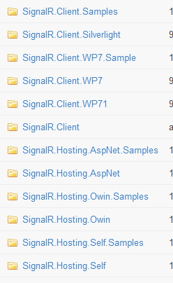
Not Just for ASP.NET
SignalR is separate from ASP.NET as of version .4
Server
ASP.NET
OWIN
Self Hosted
Clients
Silverlight
Windows Phone
iOS
Micro Framework

Slide 12
SignalR – Demo Checklist
File, New -> Getting SignalR
Creating a Hub
Send messages from Server
Send messages from Client(s)
Handling Completion and Failures (done & fail)
Tracking clients
Clients
Group
ConnectionId
Caller

Slide 13
Questions?
Source: http://c1.ms/GriffSignalR
https://github.com/signalr/
@1kevgriff
KevinG@ComponentOne.com

