Slide 1
Getting Started with SignalR
Kevin Griffin ComponentOne CMAP – 2/7/2012

Slide 2
About Me

Slide 3
Agenda
A Little Bit of History
Introducing SignalR
Demos Demos Demos!

Slide 4

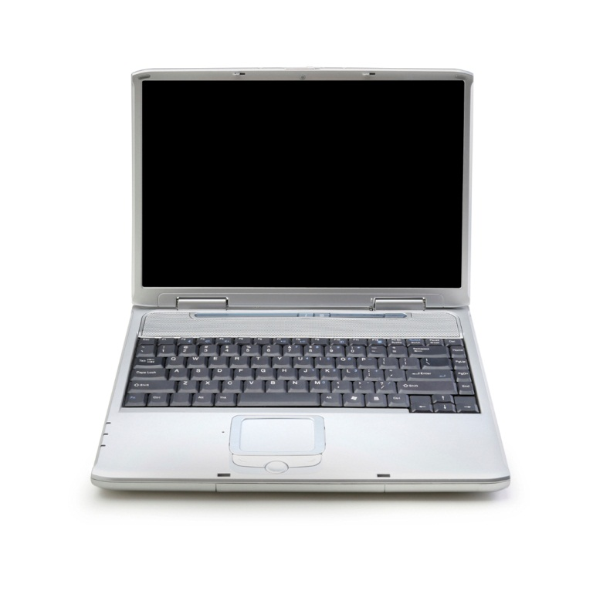
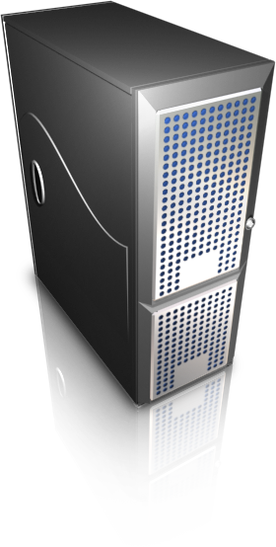
The Web v1.0.0.0
RESPONSE
REQUEST

Slide 5
The Web v2.0.0.0
RESPONSE
REQUEST

Slide 6
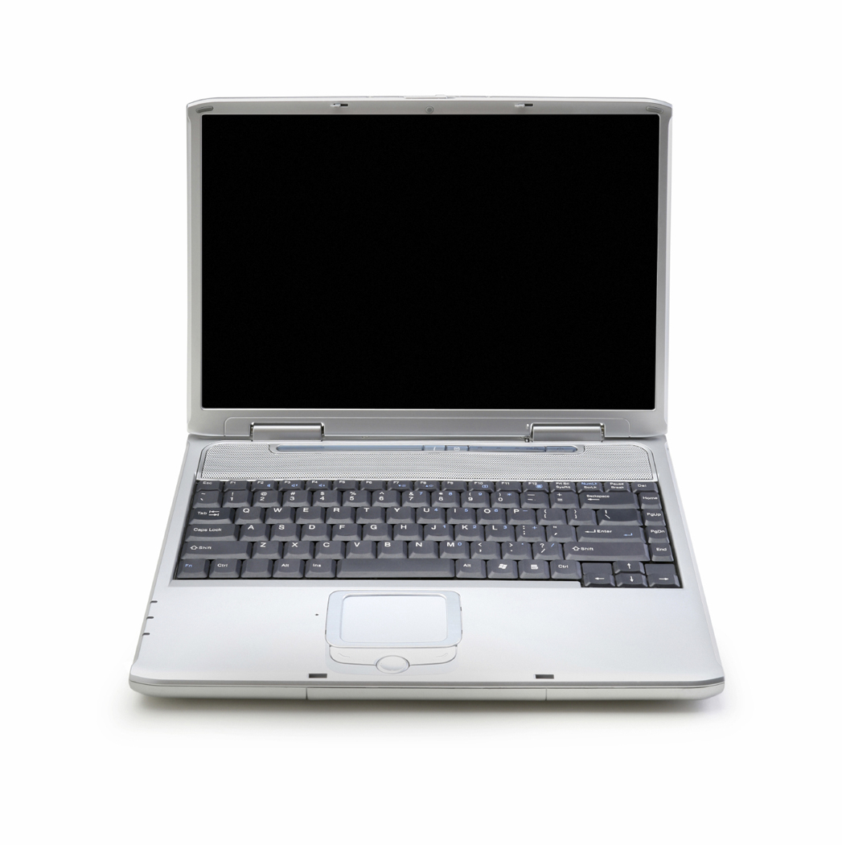
The Web v2.0.0.0
“Real Time”
Applications
AJAX
Single Page
Applications
jQuery

Slide 7
“Real Time”?

Slide 8
Approaches
Interval Polling
Long Polling
WebSockets
MOST
COMMON
SignalR
LEAST
COMMON

Slide 9
SignalR

