Slide 1
Preparing Your ASP.NET Application for Liftoff
Welcome

Slide 2

About Us: Kevin Griffin
12-time Microsoft MVP
Independent Consultant
@1kevgriff
consultwithgriff.com

Slide 3
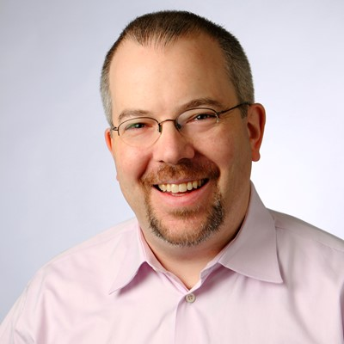
About Us: Kendall Miller
Founder, Gibraltar Software
@kendallmiller
gibraltarsoftware.com

Slide 4
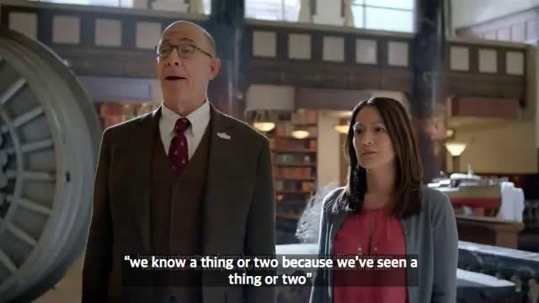

Slide 5
Agenda
Part 1 – Build It
Design for Speed
LAB + Break
Telemetry for Everyone
LAB
Part 2 – Ship It / See It
Shipping with Confidence
Real World Examples + Discussion

Slide 6
Make it so…
This workshop is supposed to be a conversation!
ASK QUESTIONS!
All resources are available at
https://github.com/1kevgriff/ Workshop-ASPNETCore-Liftoff

