Slide 1
Prepare Your ASP.NET Core Application for Liftoff
Design for Speed

Slide 2
Designing for Speed and Scalability

Slide 3
Scaling is the ability to cope and perform under an increasing workload.
Notes:
Why?

Slide 4
Being available is really about a request being completed in a period of time.
Notes:
What’s an acceptable request response time?
1 seconds? 10 seconds? 5 minutes?

Slide 5
ACD⚡C
Notes:
What’s an acceptable request response time?
1 seconds? 10 seconds? 5 minutes?

Slide 6
Asynchronous Processing
Caching
Distribution
Consistency
Notes:
What’s an acceptable request response time?
1 seconds? 10 seconds? 5 minutes?

Slide 7
Asynchronous Processing
Work doesn’t need to happen “on demand”
Decouple operations to reduce the workflow for a critical path
What is the “critical path” for a process?
Meaning: what steps need to happen NOW to make sure to give a user 👍or 👎?

Slide 8
Asynchronous Processing
Check Inventory
Create Fulfillment
POST /orders
Charge Payment
Send Confirmation
Ship

Slide 9
Asynchronous Processing
Check Inventory
Confirm Order
Create Fulfillment
POST /orders
Order Queue
Charge Payment
Create Confirmation
Send Confirmation
Ship

Slide 10
Demo/Discussions
Let’s Send Some Emails
Notes:
Email demo…

Slide 11
Caching
Applications ask a lot of repeating questions
Especially stateless applications!
Answers don’t change often
What is the price of product “XYZ”?
What is the average rating of SignalR Mastery?
Notes:
What is caching?

Slide 12


Slide 13


Slide 14


Slide 15
Caching
SQL
Database
GET /whisky
7500ms
Notes:
Types or levels of caching

Slide 16
Caching
SQL
Database
GET /whisky
Cache
500ms
Notes:
Types or levels of caching

Slide 17
Caching
Cache
KEY => VALUE
KEY => VALUE
KEY => VALUE
KEY => VALUE
KEY => VALUE
KEY => VALUE
KEY => VALUE
KEY => VALUE
KEY => VALUE
KEY => VALUE
KEY => VALUE
KEY => VALUE
KEY => VALUE
KEY => VALUE
KEY => VALUE
KEY => VALUE
KEY => VALUE
KEY => VALUE
KEY => VALUE
KEY => VALUE
Notes:
Types or levels of caching

Slide 18
Caching
Cache
“Product:ABC123” => “…”
“Product:ACC123” => “…”
“Product:AEC123” => “…”
“Product:QBC123” => “…”
“Product:RBC123” => “…”
“Product:FBC123” => “…”
“Product:ABC433” => “…”
“Product:ADC233” => “…”
“Product:A1C123” => “…”
I need the details for “Product:ABC123”
Notes:
Types or levels of caching

Slide 19
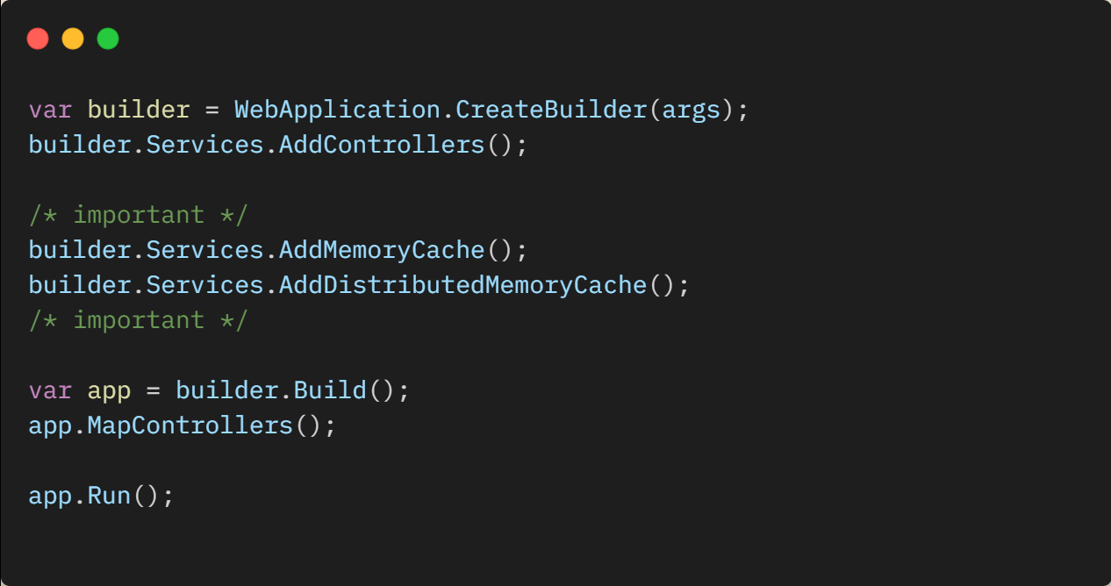
Caching in ASP.NET Core
Notes:
IMemoryCache usage

Slide 20
Caching in ASP.NET Core
Memory Cache
Notes:
IMemoryCache usage

Slide 21
Caching
IDistributeCache
Notes:
IDistributedCache with Redis

Slide 22
Demo/Discussions
Making some Cache

Slide 23
Distribution
Notes:
The “problem” with having one server for all requests
What if you get hit with massive number of requests
What if the services fails for some reason
Example: ASP.NET has *hard* exception and has to restart itself. That’s not an immediate process

Slide 24
Distribution
Notes:
Simple “scale out” example
Internet -> LB -> Instance A/B/C -> Database

Slide 25
Distribution
Notes:
Benefits
Internet -> LB -> Instance A/B/C -> Database
What if instance B dies more some reason?
LB will direct only to instance A or C

Slide 26
Distribution
Notes:
Stateless requests
The server shouldn’t have to have any prior knowledge of the session
ASP.NET WebForms apps were notorious for this – as many folks would hang on SessionState that was in-memory and difficult to scale
Requests to the server should provide everything the server needs to:
Authenticate the request
Authorize the request
Perform the request

Slide 27
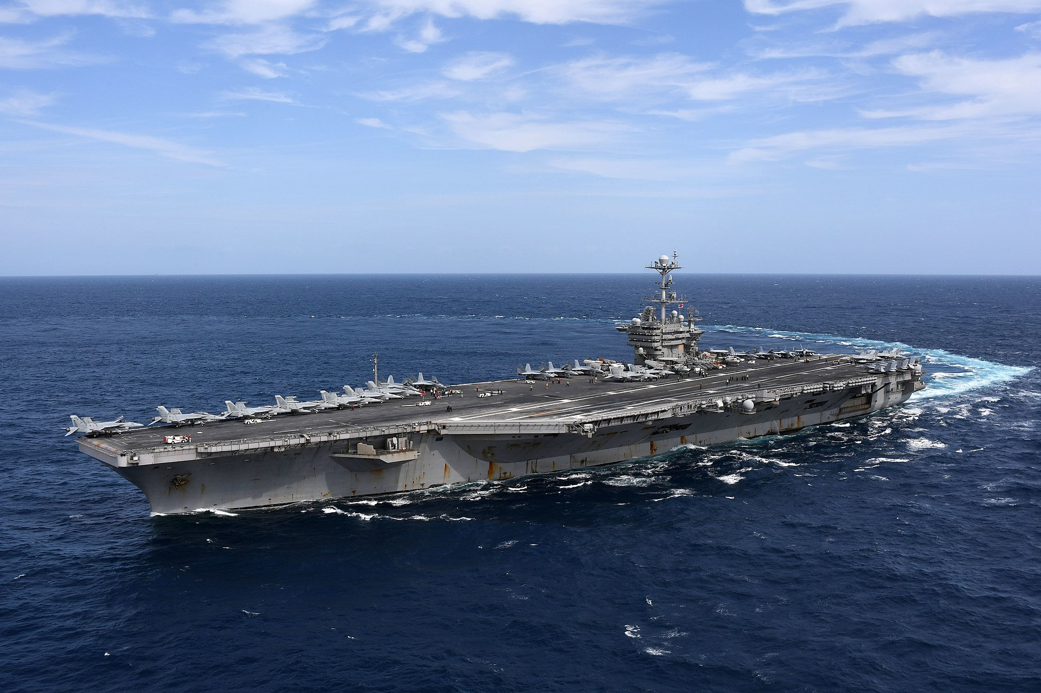
Consistency
Notes:
Use SKED example here
Example real fast what SKED does (not classified and if any navy guys are in the audience they might hate me… lol)
Ship has disconnected database (from the internet/world) as it’s common for ships to be in/out of range for internet – just like hotel/conference wifi!
The database uses sequential (identity) keys for all it’s primary tables.
By U.S. Navy photo by Mass Communication Specialist 2nd Class Thomas Gooley - This image was released by the United States Navy with the ID 180911-N-EA818-2106 (next)

Slide 28
Consistency
Id | FK_ID | Column
1 | 1 | AAA
2 | 1 | AAB
3 | 2 | AAC
4 | 3 | AAD
5 | 4 | AAE
Id | Column | Column
1 | Foo | Bar
2 | Bar | Foo
3 | Boo | Far
4 | Far | Boo
5 | Hello | World
Id | FK_ID | Column
1 | 1 | XYZ
2 | 1 | YZX
3 | 2 | ZXY
4 | 3 | AQR
5 | 4 | TRY
Notes:
Over the course of time, Ship go about its business and continues to create new rows in the database with sequential keys.

Slide 29

Consistency
Notes:
Over the course of time, Ship go about its business and continues to create new rows in the database with sequential keys.

Slide 30
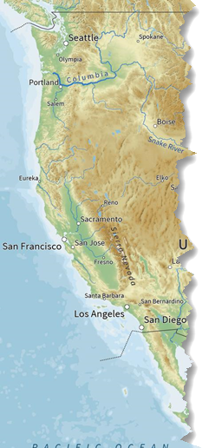

Consistency
Sync
Notes:
NEW REQUIREMENT
Shore stations want to be able to create/assign/manage scheduled maintenance and sync with ships when they’re in port or have internet connectivity.
This causes a problem, because database uses sequential keys.

Slide 31
Consistency
Id | Column | Column
1 | Foo | Bar
2 | Bar | Foo
3 | Yellow | Green
4 | Brown | Black
5 | Boo | Far
Send to Shore
Id | Column | Column
1 | Foo | Bar
2 | Bar | Foo
3 | Boo | Far
4 | Far | Boo
5 | Hello | World
Notes:
HOW WE TRIED TO SOLVE IT
SHIP and SHORE both write to databases as they normally would. And as you might thinking SHIP PK 500 <> SHORE PK 500.
SHORE was designated ultimate source of truth for database keys.
SHIP would send a transaction log to SHORE

Slide 32
Consistency
Id | Column | Column
1 | Foo | Bar
2 | Bar | Foo
3 | Yellow | Green
4 | Brown | Black
5 | Green | Pink
3 | Boo | Far
4 | Far | Boo
5 | Hello | World
Id | Column | Column
1 | Foo | Bar
2 | Bar | Foo
3 | Boo | Far
4 | Far | Boo
5 | Hello | World
Notes:
Shore would figure out where both databases agreed.

Slide 33
Consistency
Id | Column | Column
1 | Foo | Bar
2 | Bar | Foo
3 | Yellow | Green
4 | Boo | Far
5 | Far | Boo
6 | Hello | World
7 | Brown | Black
Send to Ship
Id | Column | Column
1 | Foo | Bar
2 | Bar | Foo
Notes:
Then it would rollback all the rows that happened to the SHIP and SHORE after they agreed.
Then it would replay the events, in the order they happened (in ‘real time’). Then it would send this data back to the ship, telling the ship how it should rebuild its databases.

Slide 34
Consistency
Id | FK_ID | Column
Id | Column | Column
1 | Foo | Bar
2 | Bar | Foo
3 | Yellow | Green
4 | Boo | Far
5 | Far | Boo
6 | Hello | World
7 | Brown | Black
Id | FK_ID | Column
Notes:
BUT don’t forget, we didn’t have to rewrite ONE table – we had to rewrite the primary table and all the tables with foreign key relationships.
It.
Was.
Painful.

Slide 35

Should’ve used a GUID
Notes:
It “worked” -- but it wouldn’t been so much easier to work if we designed these tables with GUIDs instead of sequential integers.

Slide 36
Hands On Lab
Help us fix the Whisky API

