Slide 1
Prepare Your ASP.NET Core Application for Liftoff
Design for Speed

Slide 2
Designing for Speed and Scalability

Slide 3
Notes:
Why?

Slide 4
Asynchronous Processing

Slide 5
Demo/Discussions
Let’s Send Some Emails

Slide 6
Caching
Notes:
What is caching?

Slide 7
Caching
Notes:
Types or levels of caching

Slide 8
Caching
Notes:
IMemoryCache usage

Slide 9
Caching
Notes:
IDistributedCache with Redis

Slide 10
Demo/Discussions
Making some Cache

Slide 11
Distribution
Notes:
The “problem” with having one server for all requests
What if you get hit with massive number of requests
What if the services fails for some reason
Example: ASP.NET has *hard* exception and has to restart itself. That’s not an immediate process

Slide 12
Distribution
Notes:
Simple “scale out” example
Internet -> LB -> Instance A/B/C -> Database

Slide 13
Distribution
Notes:
Benefits
Internet -> LB -> Instance A/B/C -> Database
What if instance B dies more some reason?
LB will direct only to instance A or C

Slide 14
Distribution
Notes:
Stateless requests
The server shouldn’t have to have any prior knowledge of the session
ASP.NET WebForms apps were notorious for this – as many folks would hang on SessionState that was in-memory and difficult to scale
Requests to the server should provide everything the server needs to:
Authenticate the request
Authorize the request
Perform the request

Slide 15
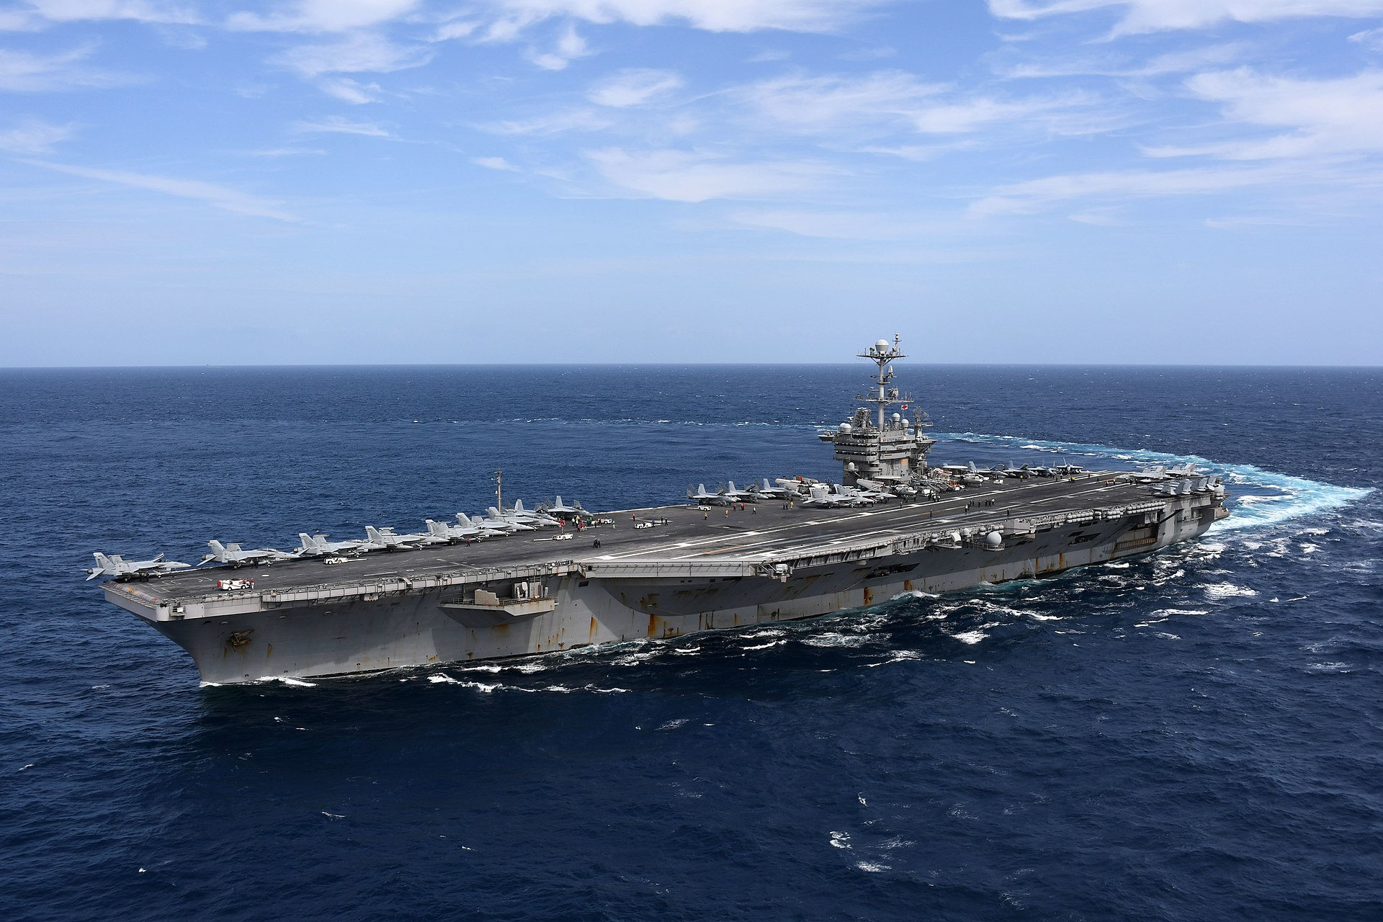
Consistency
Notes:
Use SKED example here
Example real fast what SKED does (not classified and if any navy guys are in the audience they might hate me… lol)
Ship has disconnected database (from the internet/world) as it’s common for ships to be in/out of range for internet – just like hotel/conference wifi!
The database uses sequential (identity) keys for all it’s primary tables.
By U.S. Navy photo by Mass Communication Specialist 2nd Class Thomas Gooley - This image was released by the United States Navy with the ID 180911-N-EA818-2106 (next)

Slide 16
Consistency
Notes:
Over the course of time, Ship go about its business and continues to create new rows in the database with sequential keys.

Slide 17
Consistency
Notes:
Over the course of time, Ship go about its business and continues to create new rows in the database with sequential keys.

Slide 18
Consistency
Notes:
NEW REQUIREMENT
Shore stations want to be able to create/assign/manage scheduled maintenance and sync with ships when they’re in port or have internet connectivity.
This causes a problem, because database uses sequential keys.

Slide 19
Consistency
Notes:
HOW WE TRIED TO SOLVE IT
SHIP and SHORE both write to databases as they normally would. And as you might thinking SHIP PK 500 <> SHORE PK 500.
SHORE was designated ultimate source of truth for database keys.
SHIP would send a transaction log to SHORE

