Slide 1
Preparing Your ASP.NET Application for Liftoff
Welcome

Slide 2
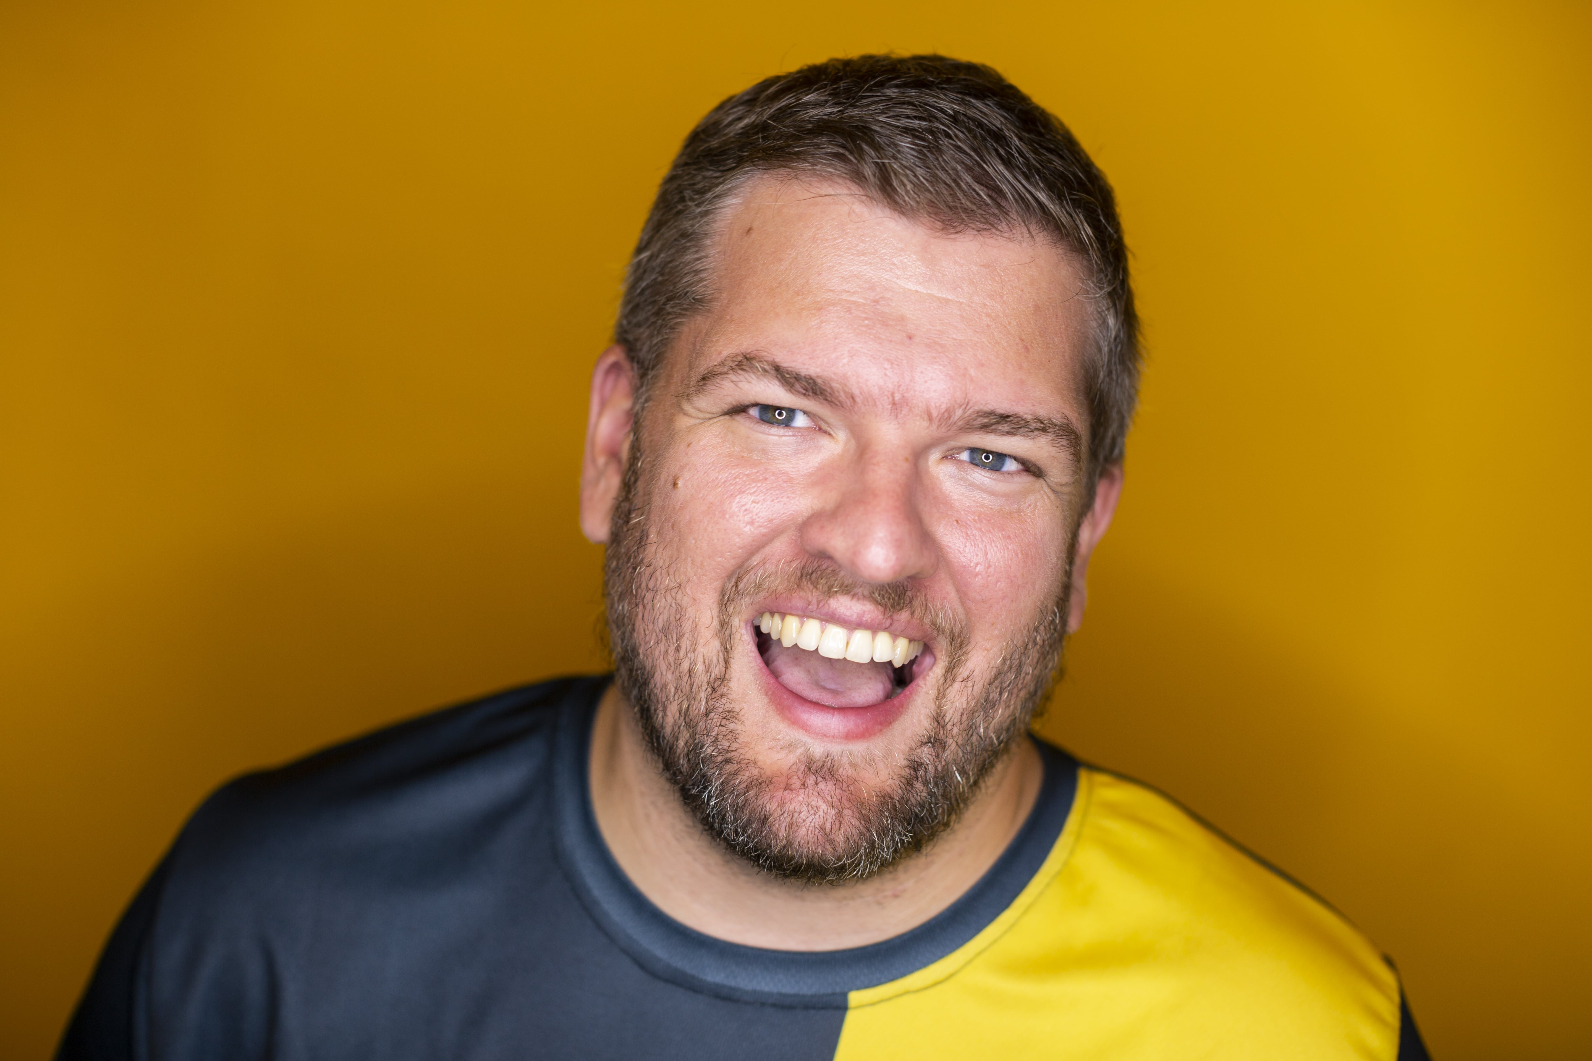
About Us: Kevin Griffin
12-time Microsoft MVP
Independent Consultant
@1kevgriff
consultwithgriff.com

Slide 3
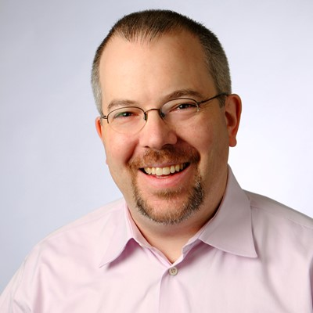
About Us: Kendall Miller
Founder, Gibraltar Software
@kendallmiller
gibraltarsoftware.com

Slide 4
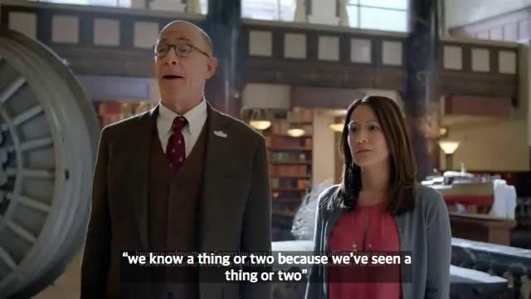

Slide 5
Agenda
Part 1
Design for Speed
Async Processes
Caching
Distribution
Consistency
Telemetry for Everyone
LAB
Part 2
DevOps Soup to Nuts
LAB???

Slide 6
Make it so…
This workshop is supposed to be a conversation!
ASK QUESTIONS!
All resources are available at
https://github.com/1kevgriff/ Workshop-ASPNETCore-Liftoff

