Slide 1
Building Single Page Applications with VueJS and ASP.NET Core

Slide 2
Welcome

Slide 3

Hello, I’m Kevin!
12-time Microsoft MVP
Focused on ASP.NET / ASP.NET Core / Azure
🐦 twitter.com/1kevgriff
📺 twitch.tv/1kevgriff
💌 kevin@consultwithgriff.com
🕸 consultwithgriff.com
Kevin Griffin
Owner, Swift Kick
Notes:
About Me

Slide 4
Assumptions

Slide 5
Assumptions
Existing knowledge of HTML, JavaScript, and CSS
Existing knowledge of C#
Not necessarily building applications ASP.NET Core

Slide 6
Exercise Structure

Slide 7
Breaks

Slide 8
GitHub

Slide 9
DevTools

Slide 10
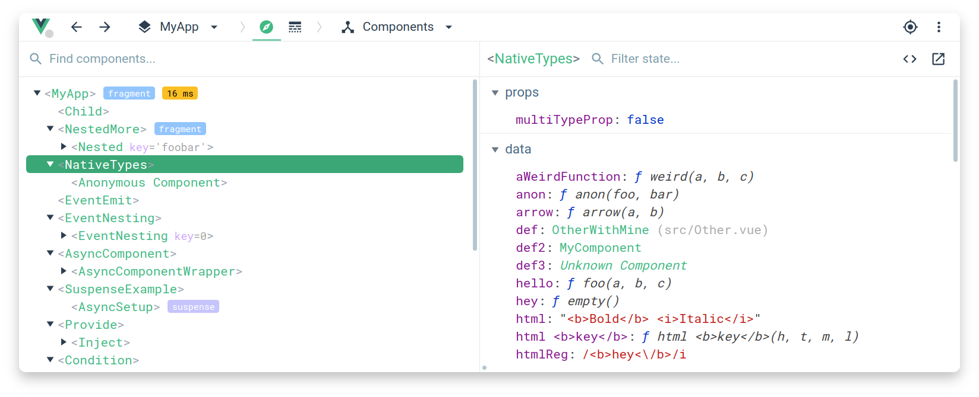
DevTools
https://github.com/vuejs/devtools

Slide 11
Q&A

