Slide 1
Single Page Applications

Slide 2
Client-Side Applications of the Past (for .NET)
ASP.NET WebForms
Razor
Raw HTML + JS
Notes:
A quick history of user interface design on top of ASP.NET
WebForms
Razor
Raw HTML / Single Applications / Webpack

Slide 3
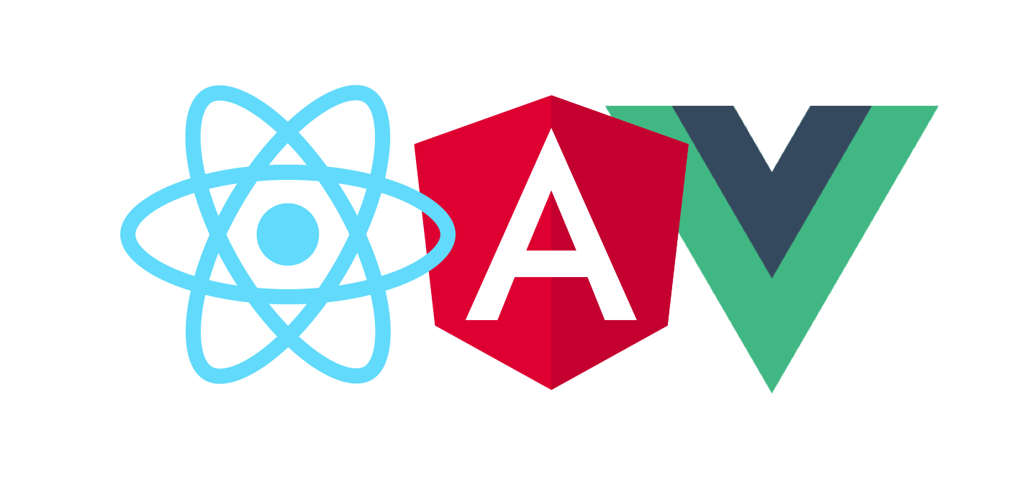
New Ways To Develop Client-Side Applications
Notes:
Introducing new ways to developing client side applications
Angular
React
Vue
CLI based, meaning the development and deployment happen outside of backend application
Front end app doesn’t CARE where the data comes from, it cares about UI assets

Slide 4
New Ways To Develop Client-Side Applications
CLI-based
Development and Deployment happens outside of the backend application
Front end doesn’t care where it is served from.
Front end doesn’t care where it gets data from.
Notes:
Introducing new ways to developing client side applications
Angular
React
Vue
CLI based, meaning the development and deployment happen outside of backend application
Front end app doesn’t CARE where the data comes from, it cares about UI assets

Slide 5
Architecture of a Single Page Application
ASP.NET Core Application (Back-end)
Data Access
Authentication
Authorization
Vue.JS Application
(Front-end)
Routing
State Management (Vuex)
Data fetching (Axios)
Notes:
Architectural drawing
Front-end (Vue) -> Back-end (ASP.NET Core) -> Other services (Database, etc)

Slide 6
Question: How does a SPA work?
<App>
</App>
<Slot />
https://myDomain/routeA
<Slot />
https://myDomain/routeB

