Slide 1
VueJS Fundamentals

Slide 2
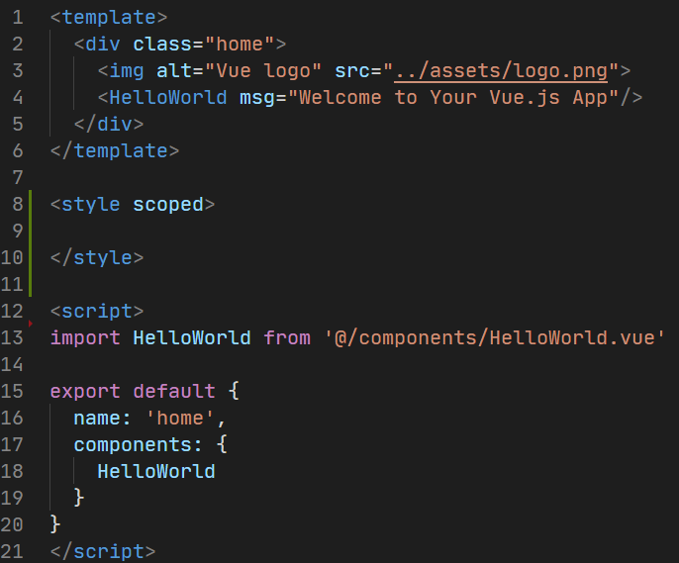
What is VueJS?
VueJS is a client-side framework for building web applications.
It is component-based.
Each component can maintain its own:
Template
Styles
State
Properties
Events
Limited opinion

Slide 3
Creating a New VueJS Application

Slide 4
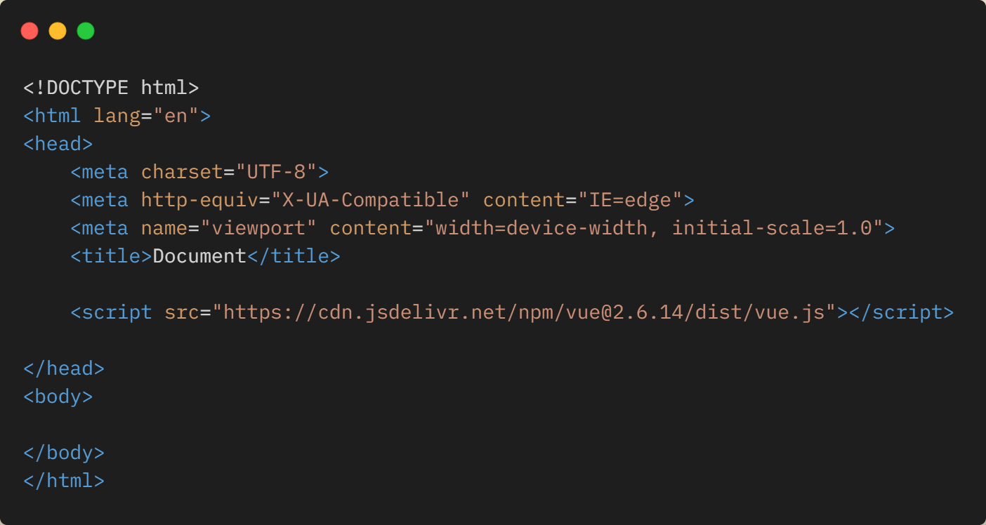
Creating a New VueJS Application
Drop in Vue.JS CDN

Slide 5
Creating a New VueJS Application
Vue Command Line Interface (https://cli.vuejs.org)

Slide 6
Creating a New VueJS Application
Vite (https://vitejs.dev)

Slide 7
Demo
Creating a New Application with Vite

Slide 8
Hands On Lab: Setting up Vite
If you haven’t already, pull the latest GitHub repo for this workshop
Go to the /exercises/1_SettingUpVite folder and open the README.md
Length: 15 minutes

Slide 9
Components Explained
Vue.JS

