Slide 1
Building Single Page Applications with VueJS and ASP.NET Core

Slide 2
Welcome

Slide 3

Hello, I’m Kevin!
12-time Microsoft MVP
Focused on ASP.NET / ASP.NET Core / Azure
🐦 twitter.com/1kevgriff
📺 twitch.tv/1kevgriff
💌 kevin@consultwithgriff.com
🕸 consultwithgriff.com
Kevin Griffin
Owner, Swift Kick
Notes:
About Me

Slide 4
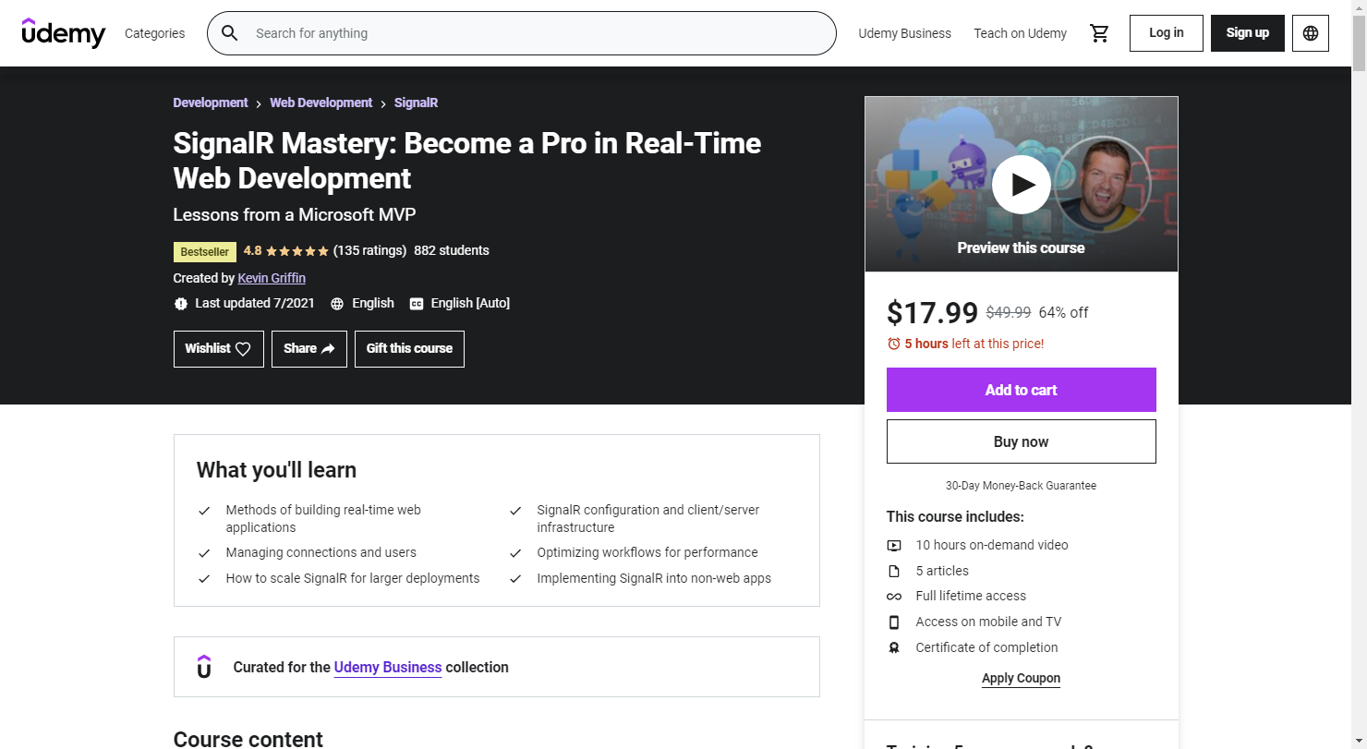
https://SignalRMastery.com

Slide 5
Assumptions

Slide 6
Assumptions
Existing knowledge of HTML, JavaScript, and CSS
Not necessarily building applications with Vue
Maybe experience with Angular or React
Existing knowledge of C#
Not necessarily building applications ASP.NET Core

Slide 7
Exercise Structure

Slide 8
Breaks

Slide 9
GitHub
http://go.consultwithgriff.com/ws-aspnet-vue

Slide 10
DevTools
https://devtools.vuejs.org/guide/installation.html

Slide 11
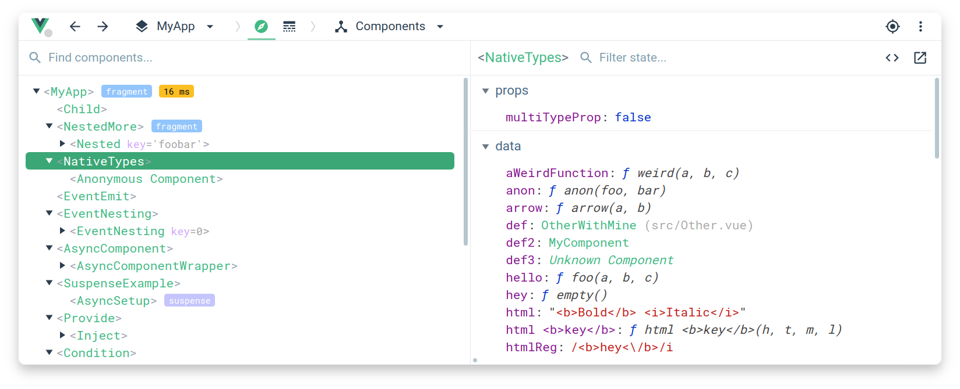
DevTools
https://github.com/vuejs/devtools

Slide 12
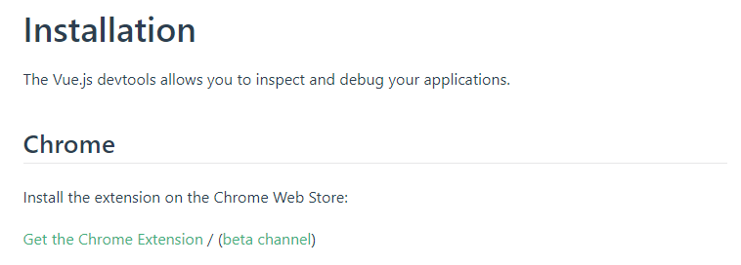

Slide 13
Q&A

Slide 14
Join the Launch Team
Coming soon: Building Single Page Applications with VueJS and ASP.NET video course
More in depth than this workshop
Get free access to the course when it launches!
Email me: kevin@consultwithgriff.com and mention this workshop

Slide 15
Break Time

