Slide 1
Vuex
Global State Management

Slide 2
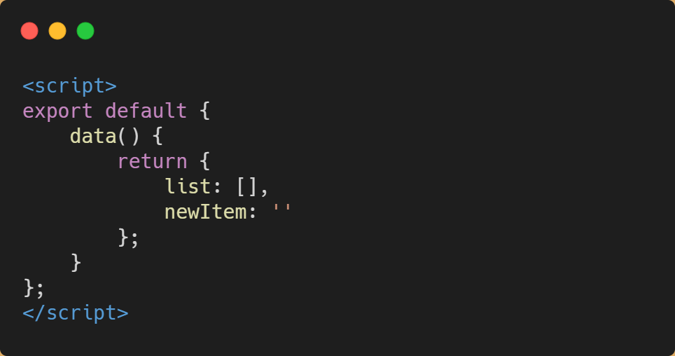
Working with State in VueJS

Slide 3
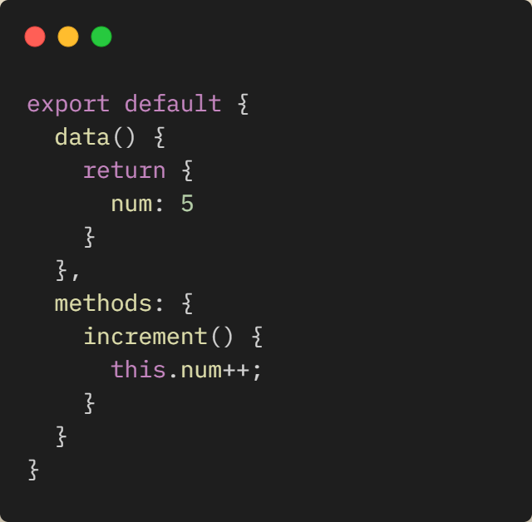
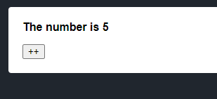
Working with State in VueJS
Notes:
https://jsfiddle.net/1kevgriff/6cxtqg0u/11/

Slide 4
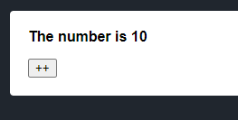
Working with State in VueJS

Slide 5
Working with State in VueJS
Component A
Component B
State
Methods
State
Methods

Slide 6
Working with State in VueJS
<App>
</App>
Component A
Component B
Methods
Methods
State
State

Slide 7
Working with State in VueJS
<App>
</App>
Component A
Methods
State
Component B
Component C
Methods
State

Slide 8
Introducing Vuex

Slide 9
State
<App>
</App>
Component A
State
Component B
Component C

Slide 10
Mutations
<App>
</App>
Mutations
Component A
Component B
State
Component C

Slide 11
Actions
<App>
</App>
Mutations
Actions
Component A
Component B
State
Component C

Slide 12
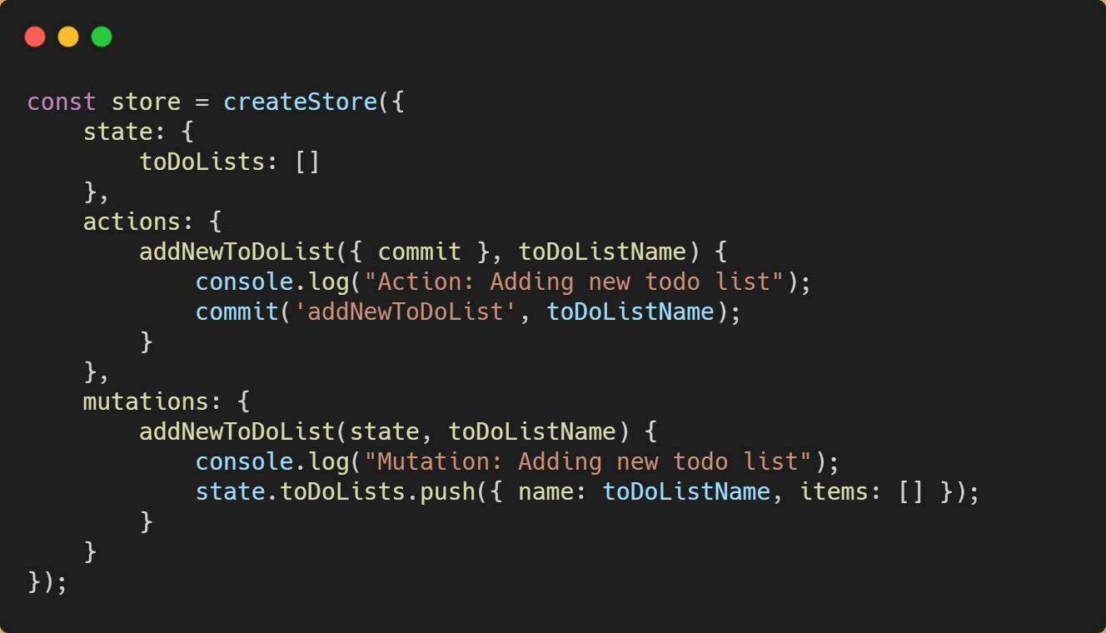
Code Sample

Slide 13
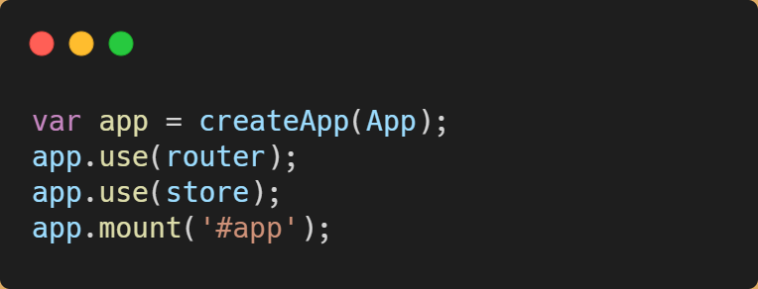
Code Sample

Slide 14
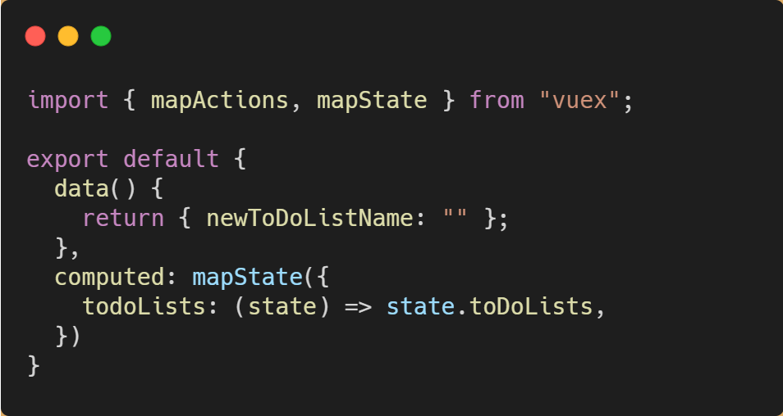
Subscribing to State

Slide 15
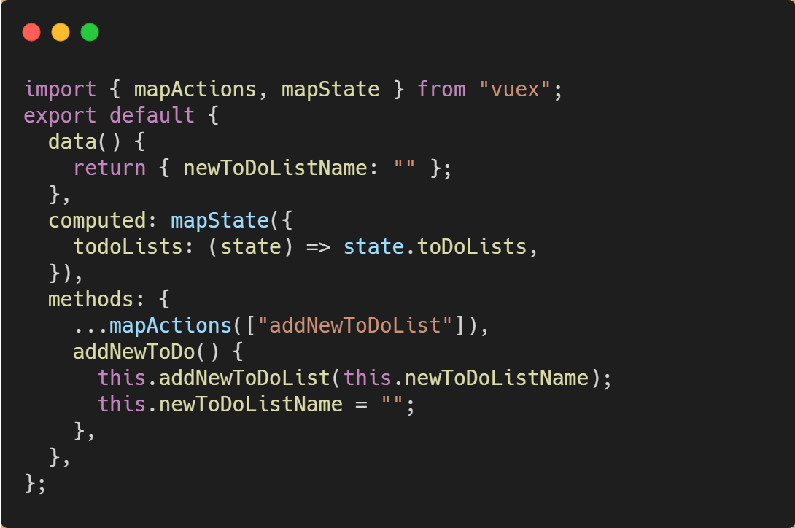
Subscribing to Actions

Slide 16
Demo
Playing Around with Vuex

Slide 17
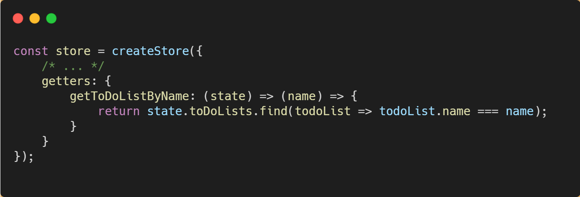
Getters

Slide 18
Hands On Lab: Vuex
If you haven’t already, pull the latest GitHub repo for this workshop
Go to the “/exercises/4_Vuex” folder and open the README.md.
Length: 20 minutes

