Slide 1
VueJS Fundamentals

Slide 2
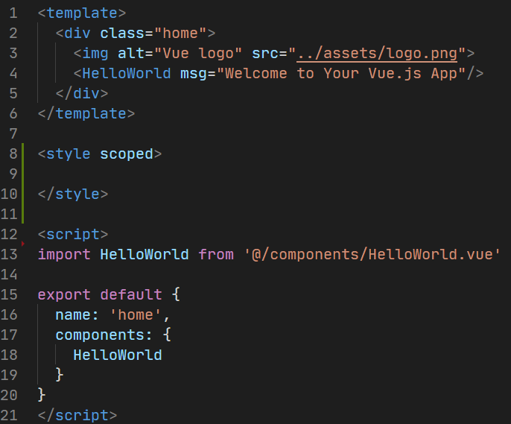
What is VueJS?
VueJS is a client-side framework for building web applications.
It is component-based.
Each component can maintain its own:
Template
Styles
State
Properties
Events
Limited opinion

Slide 3
Vue v2 vs Vue v3
Discussion

Slide 4
Creating a New VueJS Application

Slide 5
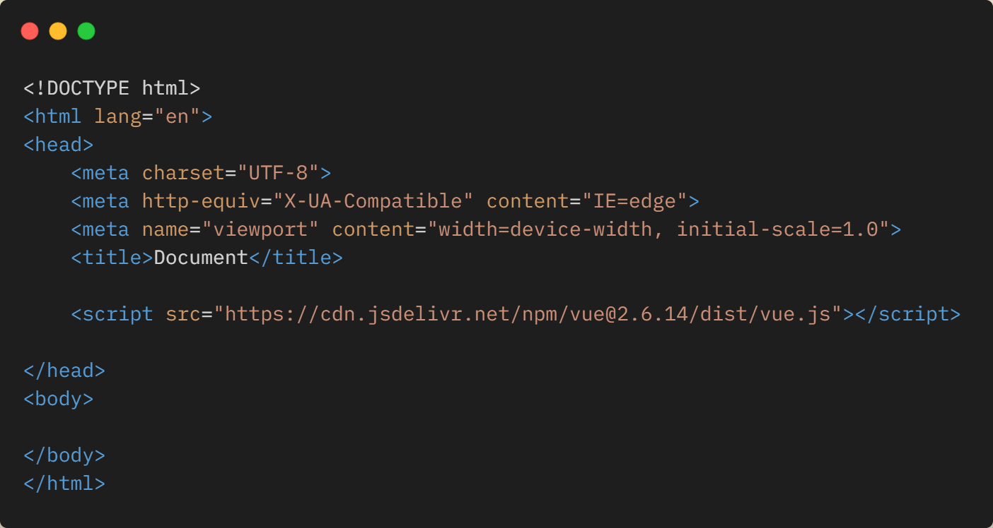
Creating a New VueJS Application
Drop in Vue.JS CDN

Slide 6
Creating a New VueJS Application
Vue Command Line Interface (https://cli.vuejs.org)

Slide 7
Creating a New VueJS Application
Vite (https://vitejs.dev)

Slide 8
Demo
Creating a New Application with Vite

Slide 9
Hands On Lab: Setting up Vite
If you haven’t already, pull the latest GitHub repo for this workshop
Go to the /exercises/1_SettingUpVite folder and open the README.md
Length: 15 minutes

Slide 10
Components Explained
VueJS

Slide 11
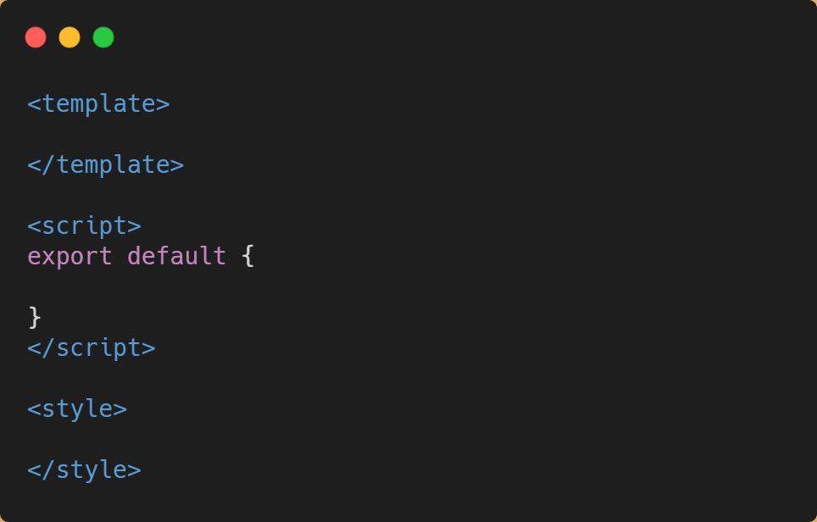
Let’s Build a “List” Component

Slide 12
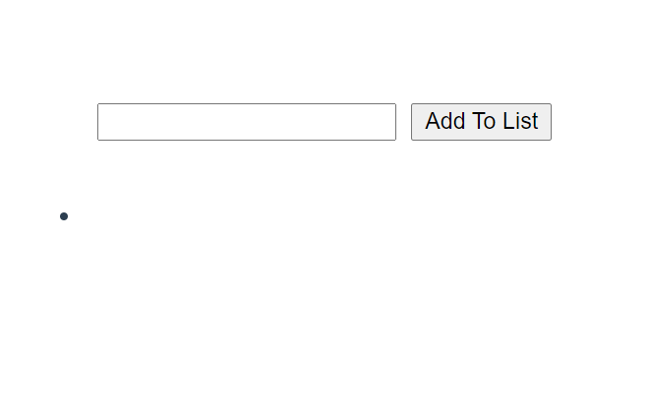
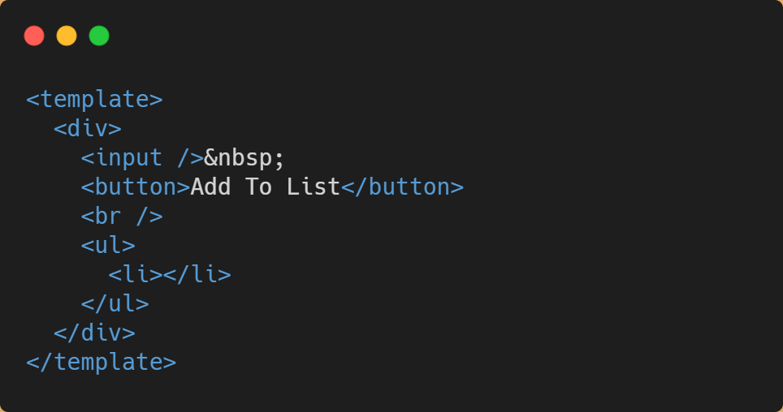
Template

Slide 13
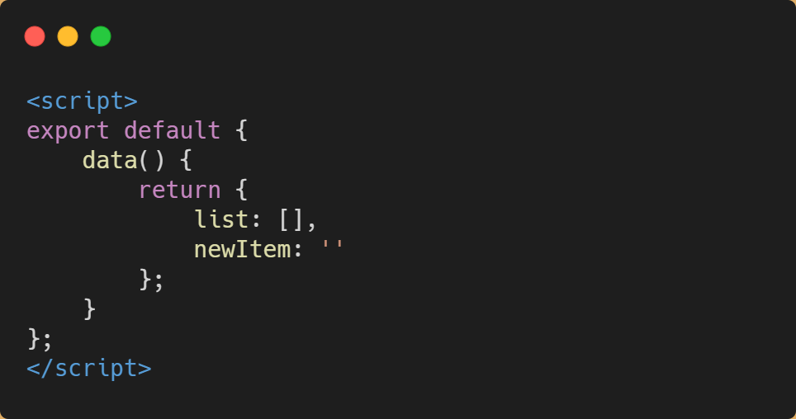
Code

Slide 14
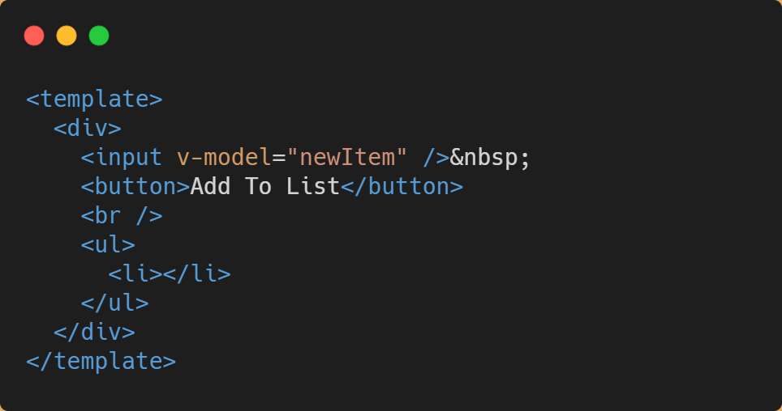
v-model
Provides a basis for creating two-binding between the value of an object in the component state and element it’s being bound to.

Slide 15
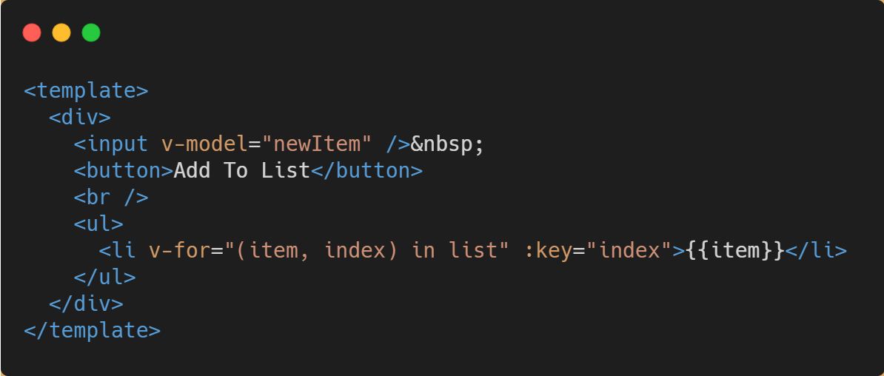
v-for
Similar to a for-each loop
Iterates over an array of objects, returning the object and also it’s position in the array (index).

Slide 16
v-for
The “:key” binding is used by Vue for change tracking.
You could also say “v-bind:key” to mean the same thing!

Slide 17
{{ template syntax }}
Handlebars {{ }} are used to dynamically insert content from the component model into the template

Slide 18
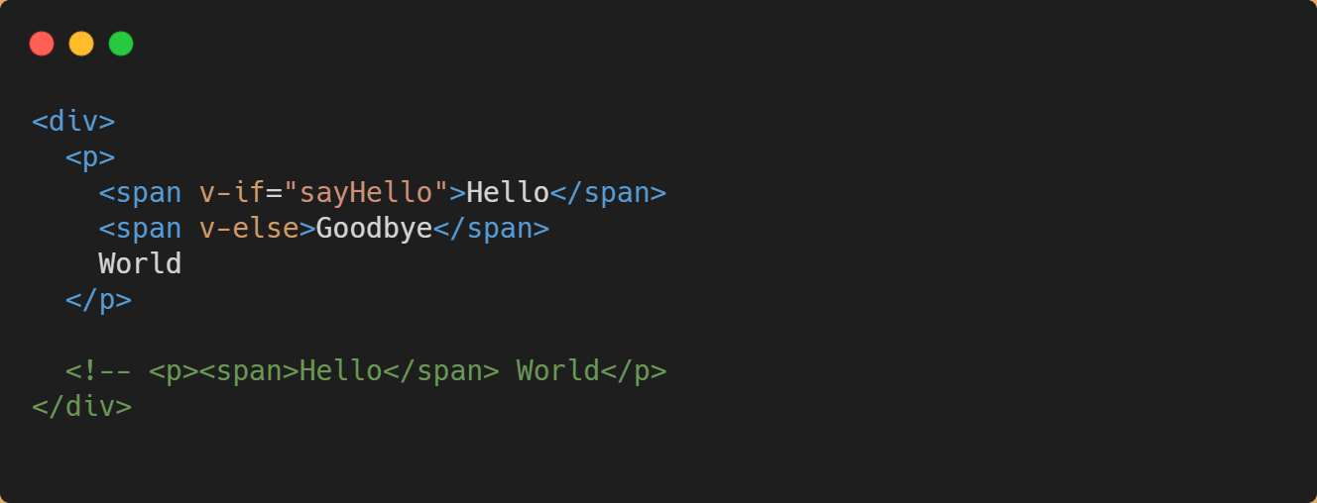
v-if / v-else
Conditionally adds or hides content in the DOM
If condition is TRUE, the content is added to DOM. If condition is FALSE, content is removed.

Slide 19
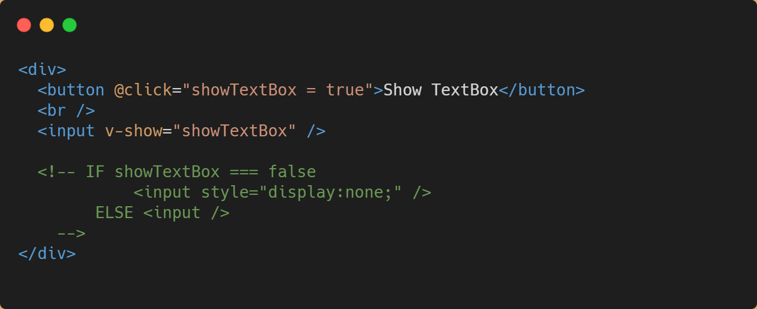
v-show
Conditionally hides content in the DOM using “display: none”
Useful for components if you need to maintain state
If condition is FALSE, “display: none” is used to hide the content.

Slide 20
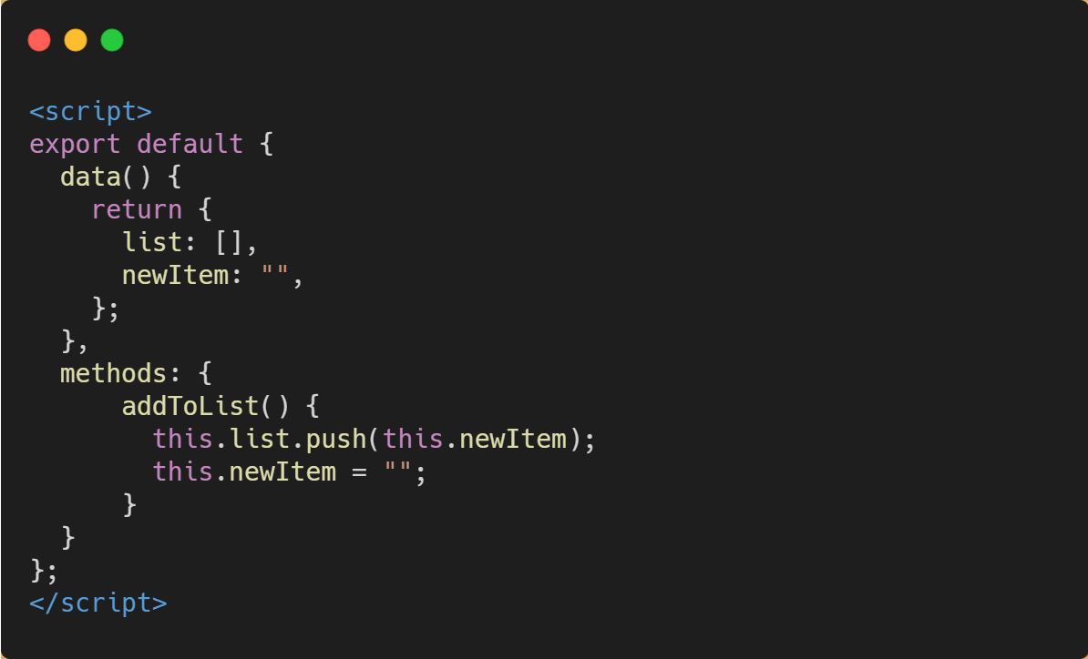
Methods
Methods allow you to create event handlers that can be called directly from your templates.

Slide 21
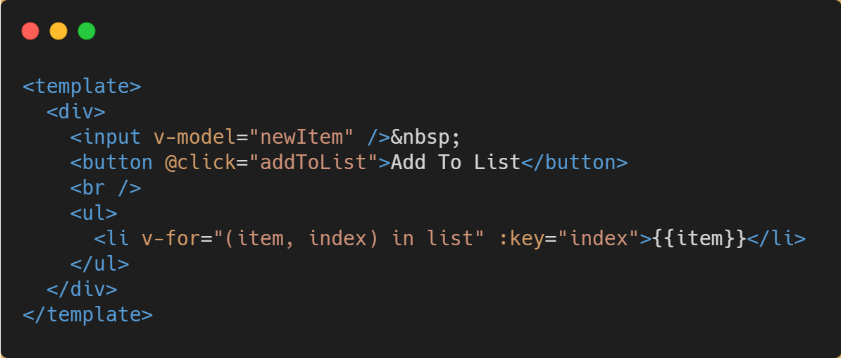
Methods

Slide 22
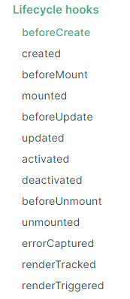
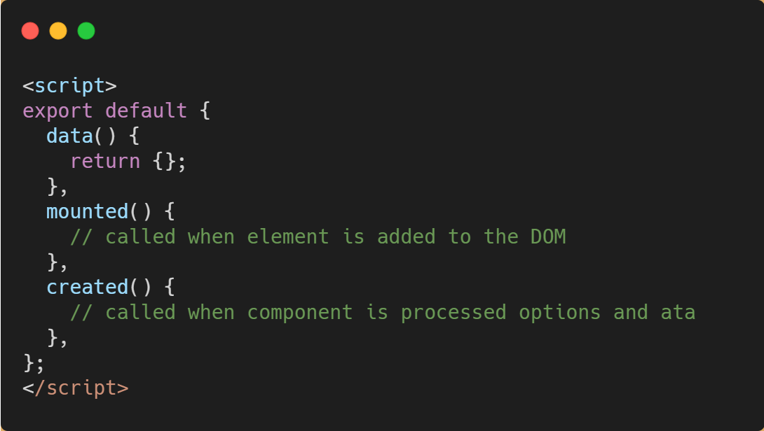
Lifecycle Events

Slide 23
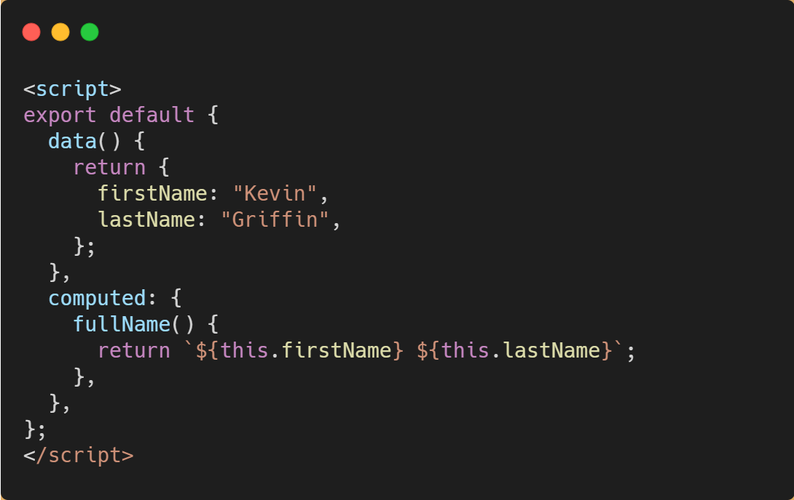
Computed Methods
Some data you might want to create and bind in real-time.
Example:
String manipulation
Array filtering

Slide 24
Demo
Custom Components

Slide 25
Hands On Lab: Custom Components
If you haven’t already, pull the latest GitHub repo for this workshop
Go to the “/exercises/2_Custom Components” folder and open the README.md.
Length: 20 minutes

