Slide 1
VueJS Fundamentals

Slide 2
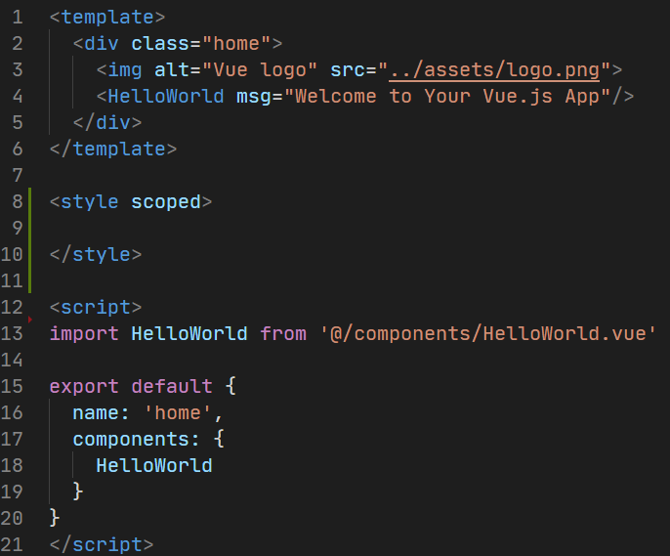
What is VueJS?
VueJS is a client-side framework for building web applications.
It is component-based.
Each component can maintain its own:
Template
Styles
State
Properties
Events
Limited opinion

Slide 3
Creating a New VueJS Application

Slide 4
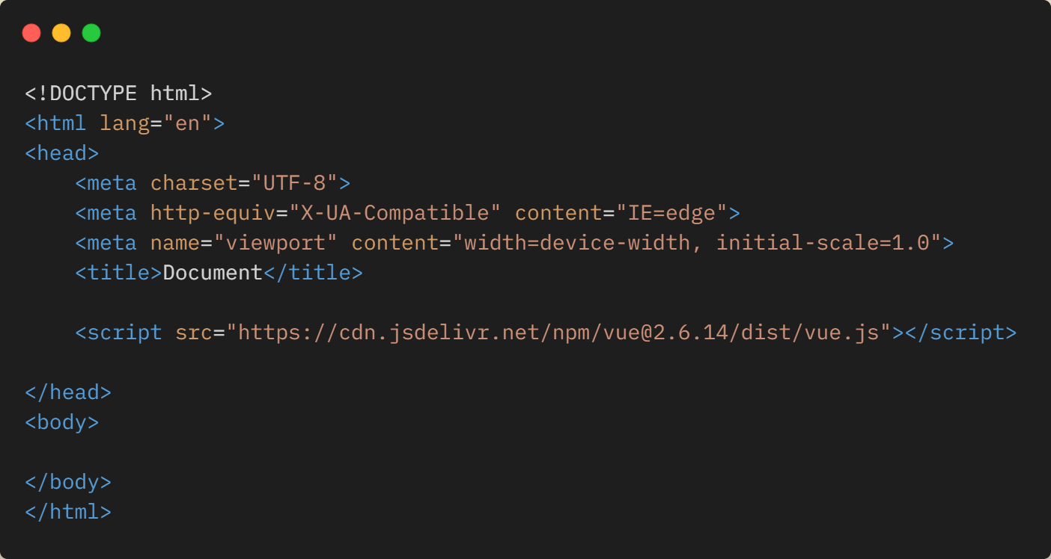
Creating a New VueJS Application
Drop in Vue.JS CDN

Slide 5
Creating a New VueJS Application
Vue Command Line Interface (https://cli.vuejs.org)

Slide 6
Creating a New VueJS Application
Vite (https://vitejs.dev)

Slide 7
Demo
Creating a New Application with Vite

Slide 8
Hands On Lab: Setting up Vite
If you haven’t already, pull the latest GitHub repo for this workshop
Go to the /exercises/1_SettingUpVite folder and open the README.md
Length: 15 minutes

Slide 9
Vue v2 vs Vue v3

Slide 11
Components Explained
VueJS

Slide 12
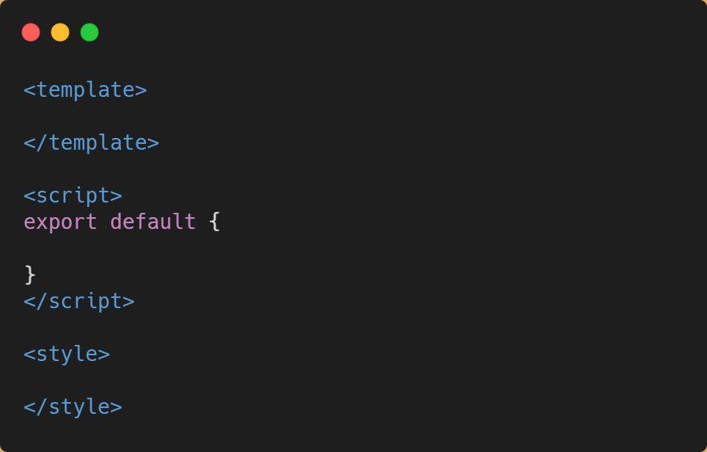
Let’s Build a “List” Component

Slide 13
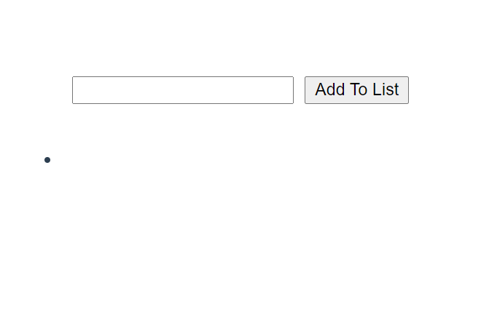
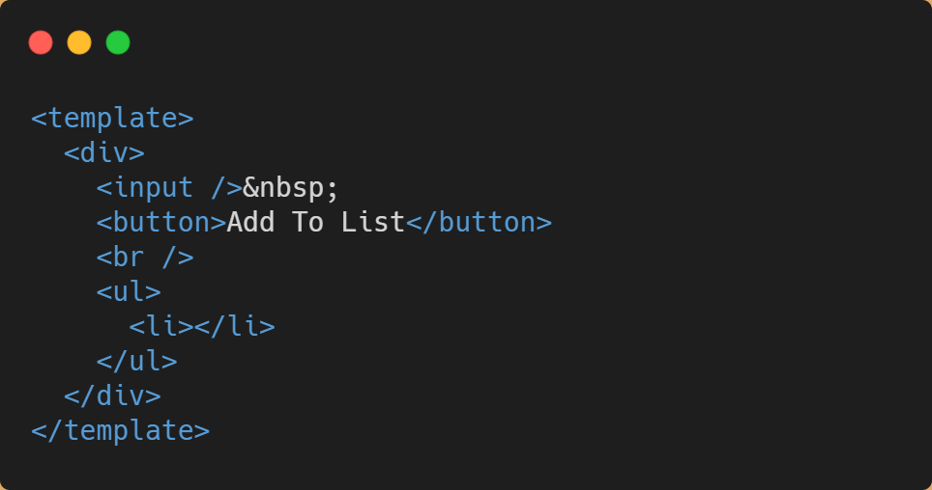
Template

Slide 14
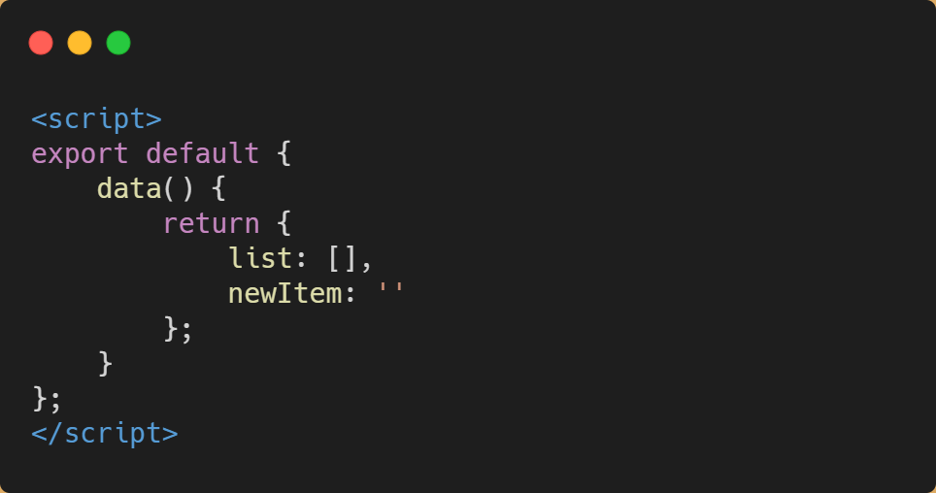
Code

Slide 15
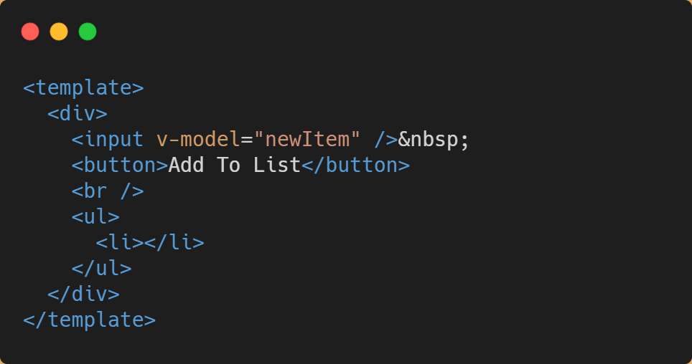
v-model
Provides a basis for

Slide 16
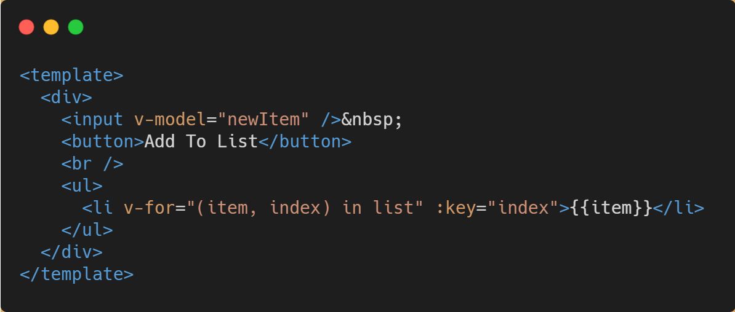
v-for
Similar to a for-each loop
Iterates over an array of objects, returning the object and also it’s position in the array (index).

Slide 17
v-for
The “:key” binding is used by Vue for change tracking.
You could also say “v-bind:key” to mean the same thing!

Slide 18
{{ template syntax }}
Handlebars {{ }} are used to dynamically insert content from the component model into the template

Slide 19
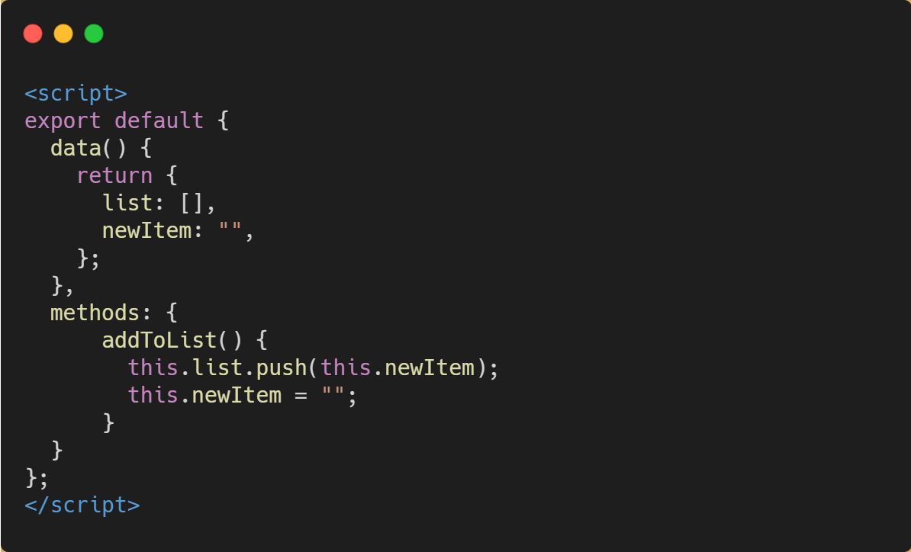
Methods
Methods allow you to create event handlers that can be called directly from your templates.

Slide 20
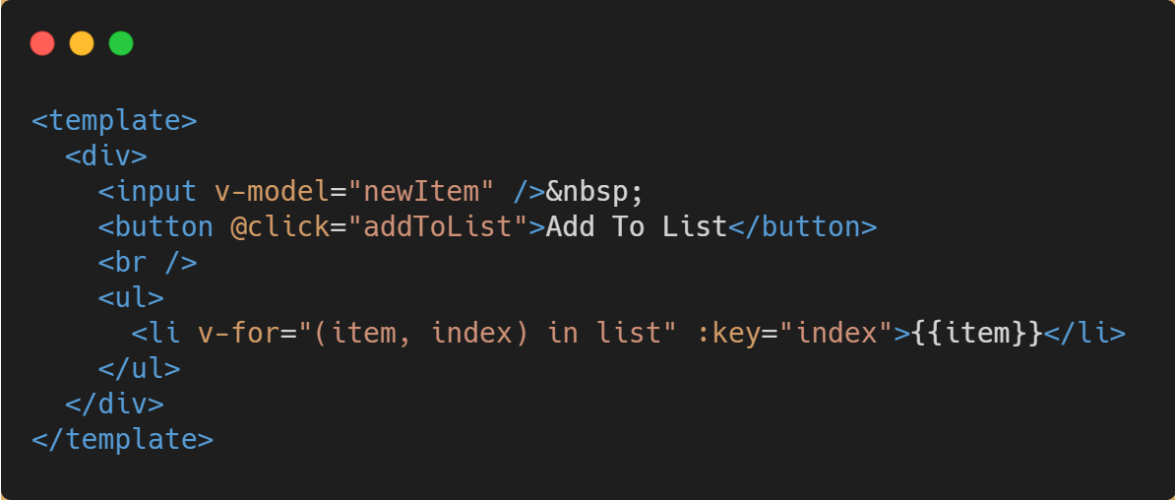
Methods

Slide 21
Demo
Custom Components

Slide 22
Hands On Lab: Custom Components
If you haven’t already, pull the latest GitHub repo for this workshop
Go to the “/exercises/2_Custom Components” folder and open the README.md.
Length: 15 minutes

Slide 23
Computed Methods

Slide 24
Change Tracking / Watching

Slide 25
Lifecycle Events

