Slide 1
Success
Success meaning and the concepts

Slide 2

It is the favorable outcome of an action. It is growth, development, improvement, and getting better. This word means the achievement of what you have set out to do. It means getting good grades at school. Success means passing your driving test and getting a driver’s license. Success means getting the job you wanted. The result of promotion at work.

Slide 3
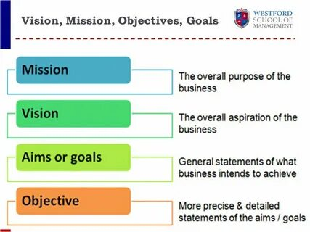

Slide 4
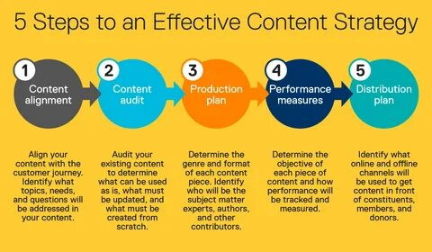
Every successful person starts their journey with a clear and concise aim. Without aim, a person does not know where his journey will lead to. It’s like working hard without knowing what you want or get.
History is filled with examples of successful people who had a definite chief aim before anything in their life. For example, Lincoln dreamt of freeing the slaves and he became one of the greatest American presidents.
As we know, we encounter a myriad of thoughts throughout the day which determines our actions. If we have a definite aim in our life, then our thoughts are focused to achieve that aim. These thoughts then help us in taking action to realize our aim.
“A fixed definite aim held in mind with determination saturates the subconscious mind which automatically allows the body to take actions toward the attainment of the aim.”
2. It helps in concentrating on important tasks

Slide 5


As we know, we encounter a myriad of thoughts throughout the day which determines our actions. If we have a definite aim in our life, then our thoughts are focused to achieve that aim. These thoughts then help us in taking action to realize our aim.
“A fixed definite aim held in mind with determination saturates the subconscious mind which automatically allows the body to take actions toward the attainment of the aim.”
2. It helps in concentrating on important tasks
Hence, don’t just think and daydream about your goals and the success you want. Make this year your best year ever by using these 10 ways to achieve your goals. If you need a little reminder, you can always print out or save the summarized tips for achieving your goals below:

Slide 6


