Slide 1


Slide 2

Dmitry Larko

Slide 3
Robust approach to ML models comparison

Slide 4
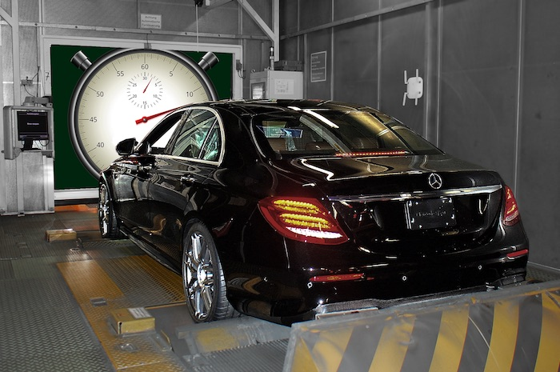
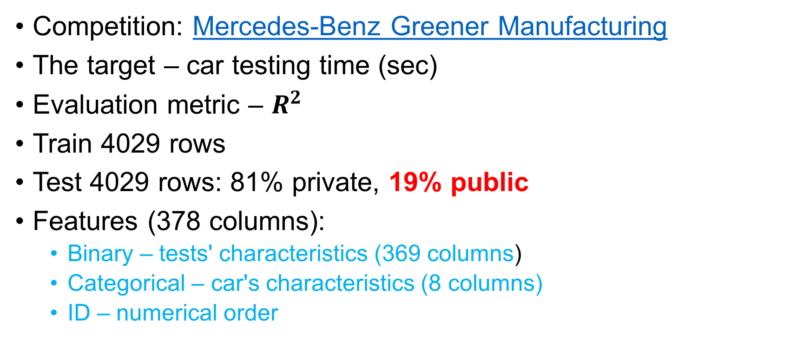
Problem and data
Competition: Mercedes-Benz Greener Manufacturing
The target – car testing time (sec)
Evaluation metric – $R^{2}$
Train 4029 rows
Test 4029 rows: 81% private, 19% public
Features (378 columns):
Binary – tests' characteristics (369 columns)
Categorical – car's characteristics (8 columns)
ID – numerical order

Slide 5

What could possibly go wrong?

Slide 6
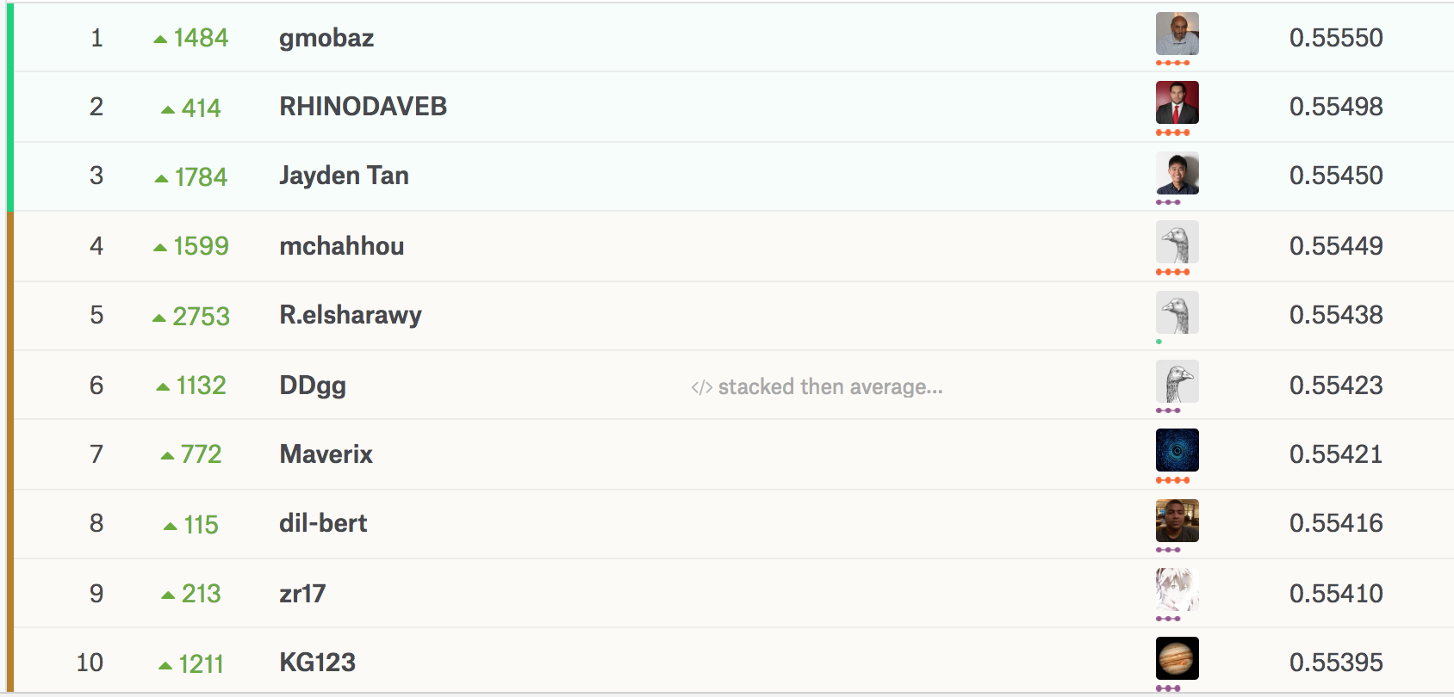

Leaderboard shake-up stats
Biggest improvement: 3808 places ($\text{3923}⇒\text{115}$)
Second biggest improvement: 2838 places ($\text{2843}⇒5$)
Biggest fall: 3564 places (I won't point anyone out)
Source: https://www.kaggle.com/c/mercedes-benz-greener-manufacturing/discussion/36103

Slide 7
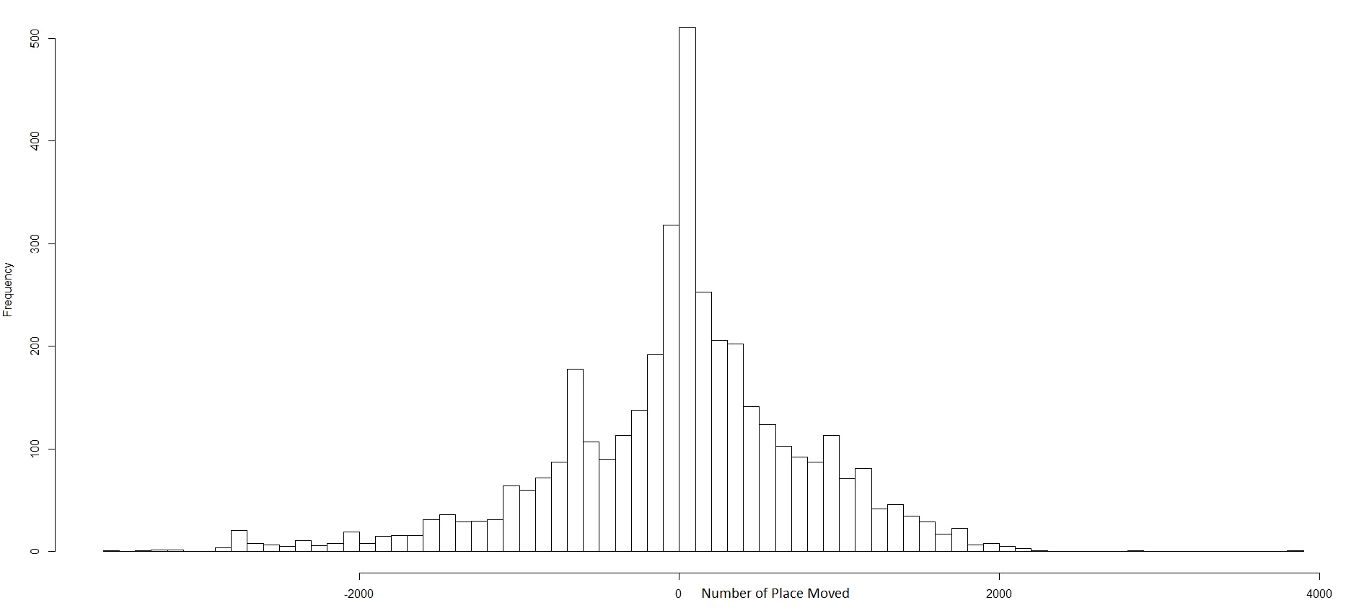
Leaderboard shake-up
Source: https://www.kaggle.com/c/mercedes-benz-greener-manufacturing/discussion/36103

Slide 8
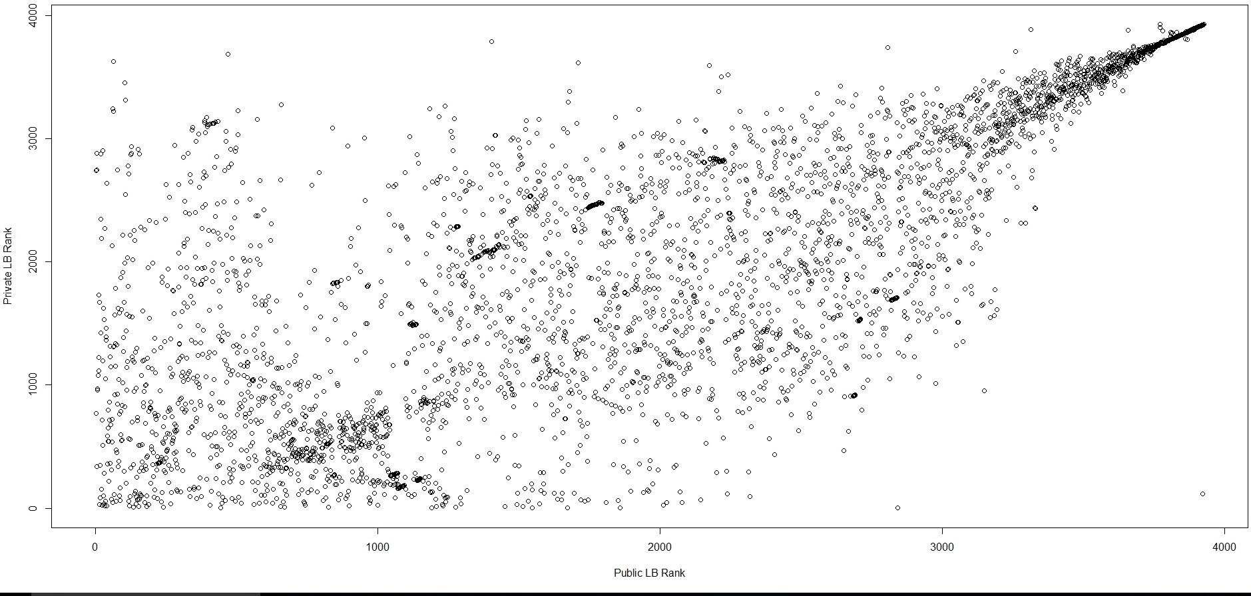
Leaderboard shake-up
Source: https://www.kaggle.com/c/mercedes-benz-greener-manufacturing/discussion/36103

Slide 9
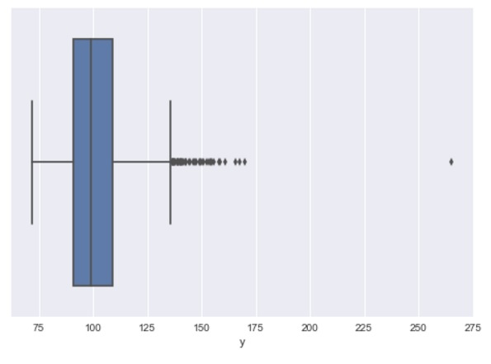
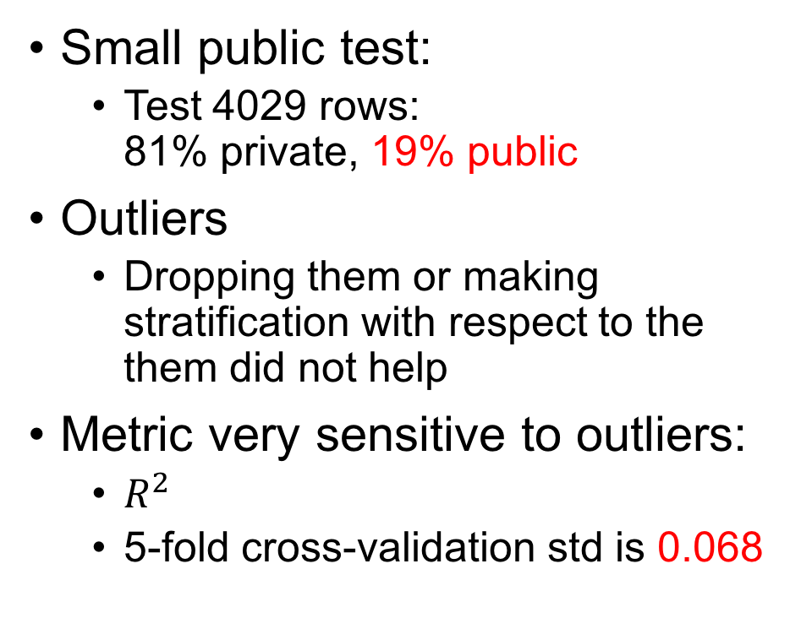
Why?
Small public test:
Test 4029 rows: 81% private, 19% public
Outliers
Dropping them or making stratification with respect to the them did not help
Metric very sensitive to outliers:
$R^{2}$
5-fold cross-validation std is 0.068
Most of the competitors overfit to public leaderboard

Slide 10
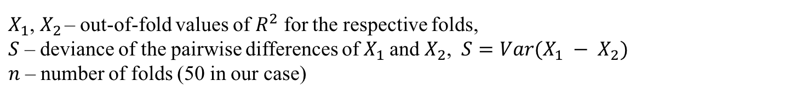

Better approach to cross-validation
10 splits into 5 folds – 50 scores for each fold
To compare two models we use the t-test for related samples (scipy.stats.ttest_rel)
We asses the significance of the difference between two models
$$T\left(X_{1}^{n},X_{2}^{n}\right)=\frac{\overline{X_{1}}−\overline{X_{2}} }{S/{\sqrt{n}}}$$
$X_{1}$, $X_{2}$ – out-of-fold values of $R^{2}$ for the respective folds,
$S$ – deviance of the pairwise differences of${ X}_{1}$ and $X_{2}$, $S=Var(X_{1} − X_{2})$
$n$ – number of folds (50 in our case)
Wiki: http://en.wikipedia.org/wiki/T-test#Dependent_t-test

Slide 11
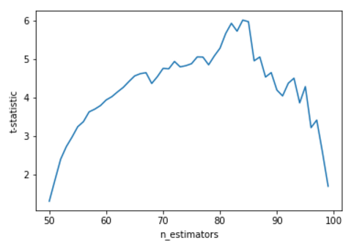
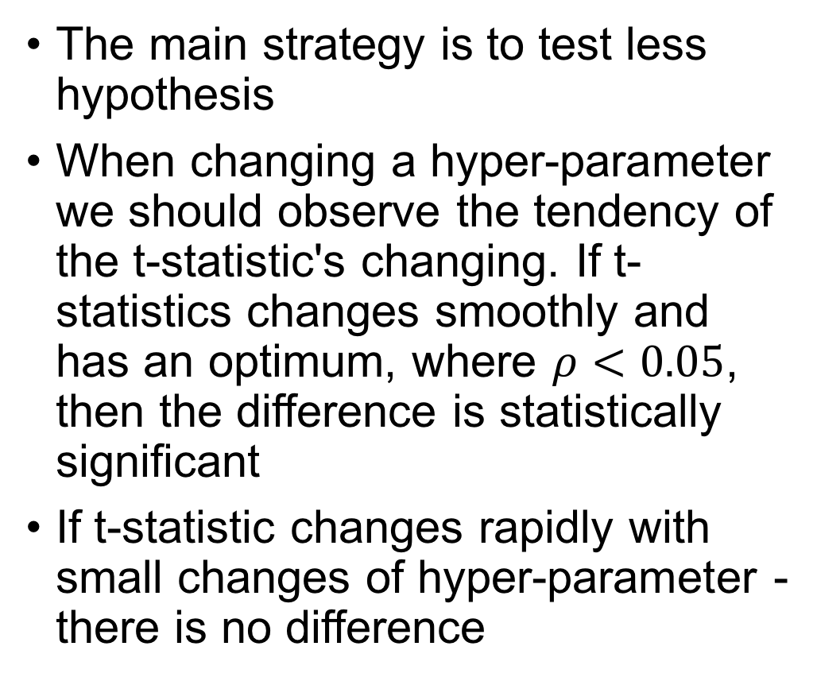
Better approach to cross-validation
The main strategy is to test less hypothesis
When changing a hyper-parameter we should observe the tendency of the t-statistic's changing. If t-statistics changes smoothly and has an optimum, where $ρ<0.05$, then the difference is statistically significant
If t-statistic changes rapidly with small changes of hyper-parameter - there is no difference

Slide 12
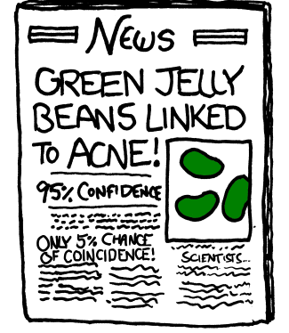
Why testing a lot of hypothesis is a bad thing?
The more hypothesis tests you do, the higher probability to get significant score by pure chance is (bad luck)
There are a lot of approaches how to avoid this but the easiest one is to do less tests and a lot of careful thinking what to test ☺
*https://xkcd.com/882/

Slide 13
- Is that enough? - Well, no ☹

Slide 14


Slide 15
Outliers
ML algorithms get distracted by outliers and spend most part of the learning process trying to predict them
Let’s say we identify outliers, 2 ways to fight it:
Remove outliers from dataset and train and validate your models without them. An overview of this approach can be found here: https://www.kaggle.com/c/sberbank-russian-housing-market/discussion/35684. Guys took 1st place using it.
Keep outliers in train part but remove them from validation, so your model will be trained with outliers but decision regarding performance will be made without considering outliers impact. Check cross_validation_score_statement function in this repo: https://github.com/Danila89/cross_validation_custom

Slide 16
Dealing with outliers. Approach 1.
Dataset
Train
Remove outliers
Validation

Slide 17
Dealing with outliers. Approach 2.
Dataset
Train
Validation
Validation

Slide 18
Which approach to choose?
That depends, but as a rule of thumb:
If outliers are introduced by mistake (all records in millions, a few in thousands) – Approach 1 is preferable
If outliers are defined by nature of the data – use 2nd approach

Slide 19
Wrapping up
I did not participate in this competition, but I found this approaches very promising to share with you.
All kudos goes to Danila Savenkov who place in this competition 11th and shared his insights here (he covers much more stuff than this presentation):
https://www.kaggle.com/c/mercedes-benz-greener-manufacturing/discussion/36242
https://www.youtube.com/watch?v=0qHXNeuNOAE (English subtitles available)
slides: https://github.com/yandexdataschool/ml-training-website/raw/gh-pages/presentations/Savenkov_KaggleMercedes_2017_eng.pdf

