Slide 1

Scalable Machine Learning
Using H2O
Tom Kraljevic
October 22, 2015
Las Vegas, NV @ innevation

Slide 2
Outline for today’s talk
About H2O (10 minutes)
Demo of Scalability and H2O Flow (10 minutes)
Demo of R with H2O (Loan app) (15 minutes)
Demo of Python with H2O (Notebook) (10 minutes)
Demo of Sparkling Water (Spark + H2O)
(Ask Craig) (15 minutes)
Q & A (up to 30 minutes)
Content for today’s talk can be found at:
https://github.com/h2oai/h2o-meetups/tree/master/2015_10_22_H2O_LV
H₂O.ai Machine Intelligence

Slide 3
What is H2O?
Math Platform
Open source in-memory prediction engine
Parallelized and distributed algorithms making the most use out of multithreaded systems
API
Easy to use and adopt
Written in Java – perfect for Java Programmers
Big Data
More data? Or better models? BOTH
Use all of your data – model without down sampling
GLM, Random Forest, GBM, Deep Learning, etc.
REST API (JSON) – drives H2O from R, Python, Excel, Tableau
Run a simple GLM or a more complex GBM to find the best fit for the data
More Data + Better Models = Better Predictions
Spark and Scala integration via Sparkling Water
H₂O.ai Machine Intelligence

Slide 4

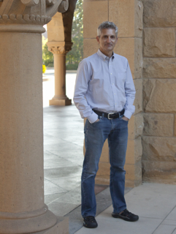
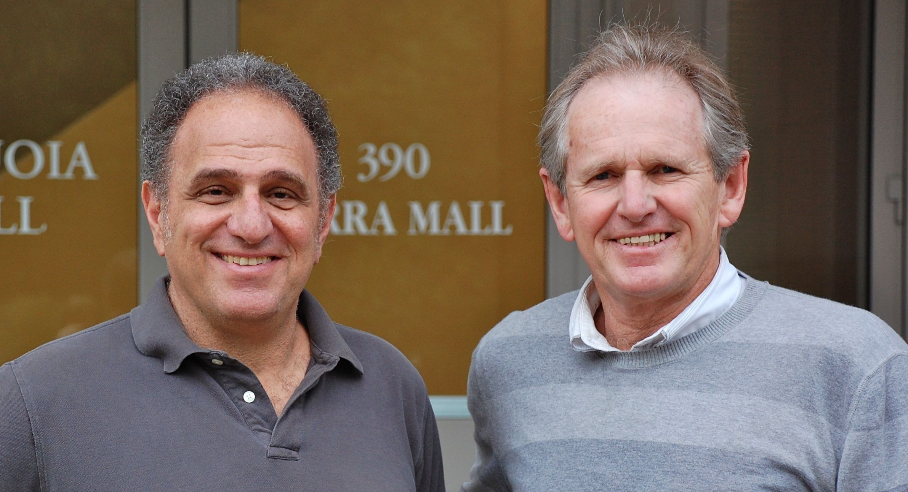
cientific Advisory Council
Stephen Boyd
Professor of EE Engineering
Stanford University
Rob Tibshirani
Professor of Health Research
and Policy, and Statistics
Stanford University
Trevor Hastie
Professor of Statistics
Stanford University
H₂O.ai Machine Intelligence

Slide 5
Algorithms on H2O
Supervised Learning
Statistical Analysis
Generalized Linear Models: Binomial, Gaussian, Gamma, Poisson and Tweedie
Naïve Bayes
Ensembles
Distributed Random Forest: Classification or regression models
Gradient Boosting Machine: Produces an ensemble of decision trees with increasing refined approximations
Deep Neural Networks
Deep learning: Create multi-layer feed forward neural networks starting with an input layer followed by multiple layers of nonlinear transformations
H₂O.ai Machine Intelligence

Slide 6
Algorithms on H2O
Unsupervised Learning
K-means: Partitions observations into k clusters/groups of the same spatial size
Clustering
Dimensionality Reduction
Principal Component Analysis: Linearly transforms correlated variables to independent components
Anomaly Detection
Autoencoders: Find outliers using a nonlinear dimensionality reduction using deep learning
H₂O.ai Machine Intelligence

Slide 7
Demo of H2O Flow

Slide 8
H2O and R / Python

Slide 9

Reading Data from HDFS into H2O with R
STEP 1
h2o_df = h2o.importFile(“hdfs://path/to/data.csv”)
R user

Slide 10
Reading Data from HDFS into H2O with R
STEP 2
2.3
Initiate distributed ingest
H2O Cluster
2.2
R
H₂O
HTTP REST API request to H₂O
has HDFS path
H₂O
h2o.importFile()
H₂O
2.1
R function call
2.4
Request data from HDFS
HDFS
data.csv
Notes:
Data never goes into or through R
R tells H2O what to do
R has a pointer to the big data that lives in H2O
Operations on the R object are intercepted using operator overleading and forwarded to H2O via the REST API
H2OFrame object in R is a proxy for the big data in H2O
R: df= H2O.imporrtFile(“hdfs://path/to/data.csv”)
h2o>_df is an H2OFrame object in R

Slide 11
Reading Data from HDFS into H2O with R
STEP 3
3.2
Distributed H₂O
Frame in DKV
H2O Cluster
3.3
R
H₂O
h2o_df
Return pointer to data in REST API JSON Response
H₂O
H₂O
Frame
Cluster IP
Cluster Port
Pointer to Data
H₂O
3.4
h2o_df object created in R
3.1
HDFS provides data
HDFS
data.csv
Notes:
Data never goes into or through R
R tells H2O what to do
R has a pointer to the big data that lives in H2O
Operations on the R object are intercepted using operator overleading and forwarded to H2O via the REST API
H2OFrame object in R is a proxy for the big data in H2O
R: df= H2O.imporrtFile(“hdfs://path/to/data.csv”)
h2o>_df is an H2OFrame object in R

Slide 12
R Script Starting H2O GLM
TCP/IP
HTTP
HTTP
REST/JSON
REST/JSON
Legend
.h2o.startModelJob()
POST /3/ModelBuilders/glm
/3/ModelBuilders/glm endpoint
Network layer
Job
REST layer
h2o.glm()
GLM algorithm
H2O - algos
GLM tasks
H2O - core
R script
Fork/Join framework
K/V store framework
User process
Standard R process
H2O process
H2O process

Slide 13
Demo of Consumer Loan App Demo of iPython Notebook

Slide 14
Sparkling Water
(H2O and Spark)

Slide 15
Sparkling Water Application Life Cycle
Sparkling Water Cluster
Spark
Worker
JVM
Spark
Executor
JVM
H₂O
(3)
(4)
(2)
Spark
Master
JVM
Spark
Worker
JVM
Spark
Executor
JVM
Sparkling App
jar file
H₂O
spark-submit
(1)
Spark
Worker
JVM
Spark
Executor
JVM
H₂O
Notes:
Striking similarity to hadoop
(1) User submits App to Spark cluster Master node
(2) App distributed to Spark cluster Worker nodes
(3) Spark Executor JVMs start for App
(4) H₂O instance starts within each Executor JVM
(5) App’s Scala main program runs
Once scala program drives both your H2O and Spark workloads

Slide 16
Sparkling Water Data Distribution
Sparkling Water Cluster
Data
Source
(e.g. HDFS)
Spark Executor JVM
H₂O
(1)
Spark
RDD
H₂O
RDD
(2)
H₂O
(3)
Spark Executor JVM
H₂O
Spark Executor JVM
Notes:
Use Spark SQL to read data into a Spark RDD
Convert Spark RDD to H₂O RDD; H₂O RDD is column-based and highly compressed
(Not shown) Run modeling and prediction workflows with H₂O
(3) Convert H₂O RDD (e.g. predictions) back to Spark RDD

Slide 17
Demo of Ask Craig App

Slide 18
Q & A
Thanks for attending!
Content for today’s talk can be found at:
https://github.com/h2oai/h2o-meetups/tree/master/2015_10_22_H2O_LV
H₂O.ai Machine Intelligence

Slide 19
H2O Software Stack
Customer Algorithm
JavaScript
R
Python
Excel/Tableau
Flow
Network
Rapids Expression Evaluation Engine
Scala
Customer Algorithm
GLM
GBM
RF
Deep Learning
K-Means
PCA
Parse
In-H2O Prediction Engine
Customer Algorithm
Fluid Vector Frame
Job
Distributed K/V Store
MRTask
Non-blocking Hash Map
Fork/Join
Spark
Hadoop
Standalone H2O

Slide 20
R Script Retrieving H2O GLM Result
TCP/IP
HTTP
HTTP
REST/JSON
REST/JSON
Legend
h2o.getModel()
GET /3/Models/glm_model_id
/3/Models endpoint
Network layer
REST layer
h2o.glm()
H2O - algos
H2O - core
R script
Fork/Join framework
K/V store framework
User process
Standard R process
H2O process
H2O process

