Slide 1

Kaggle competition Grupo Bimbo Inventory Demand Winning solution by “The Slippery Appraisals” team
Dmitry Larko, Sr. Data Scientist @ H2O.ai
dmitry@h2o.ai
January 19th, 2017

Slide 2
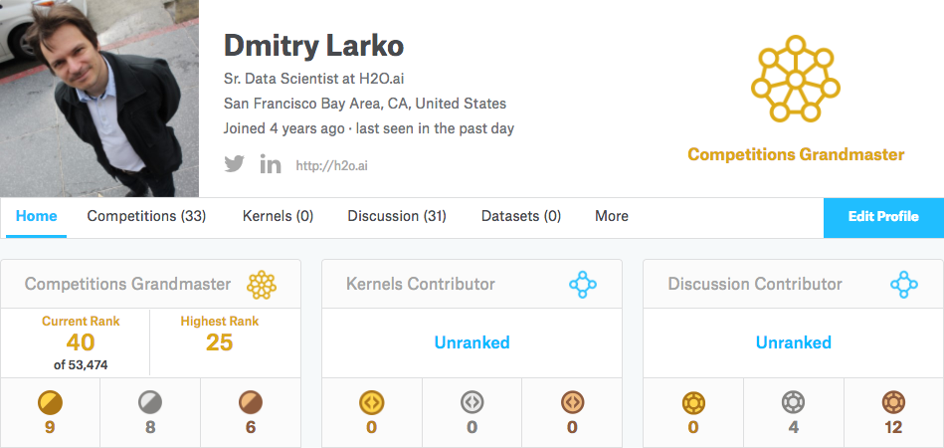
About me

Slide 3
Team
Alexander Larko - MSc in Computer Science. 10 years in Data Mining.
Dmitry Larko – Sr Data Scientist, H2O.ai
Bohdan Pavlyshenko - Ph.D., Data Scientist at SoftServe, assoc.prof. at Lviv National University (Ukraine)
Philip Margolis – Freelancer Data Scientist and Consultant
Stanislav Semenov – Data Scientist and Quantitative Researcher

Slide 4





Team

Slide 5
Solution overview
XGBoost - main workhorse
Interesting feature: Product cluster ID
Tools: Python 2/3 and R
Full training: ~ 2 week on 8 cores to train 1st level models and another 3-4 days to build ExtraTrees and linear models on top of that

Slide 6
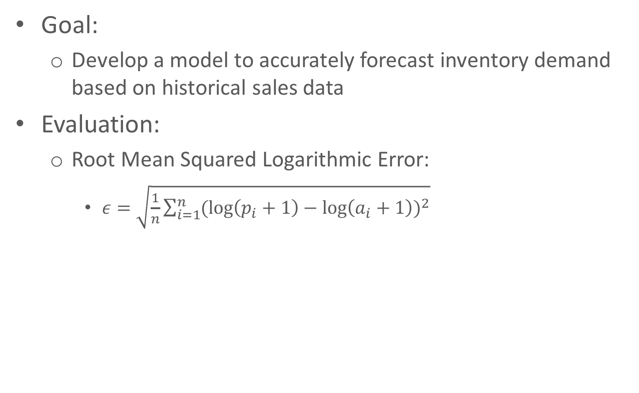
Problem
Goal:
Develop a model to accurately forecast inventory demand based on historical sales data
Evaluation:
Root Mean Squared Logarithmic Error:
$ε=\sqrt{\frac{1}{n}\sum_{i=1}^{n}{{(\log\left(p_{i}+1\right)−\log\left(a_{i}+1\right))}^{2}}}$

Slide 7
Dataset
Train.csv (74 million observations)
Test.csv (7 million observations)
Cliente_tabla.csv (Client Names)
Producto_tabla.csv (Product Names)
Town_state.csv (Town and State information)

Slide 8
Target variable
Mean: 7.22
Median: 3
Min: 0
Max: 5000
75% of data is between 0 and 6
Right-skewed
Most of ML models can optimize RMSE, to optimize RMSLE, log-transform target variable:
log(target+1)

Slide 9
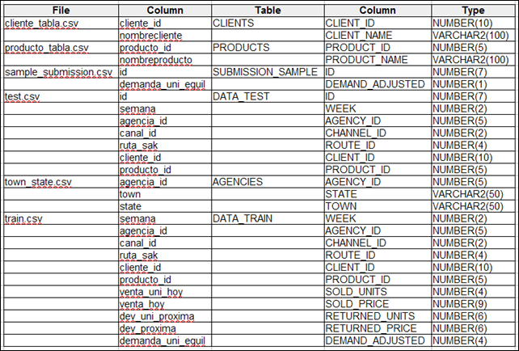
Dataset
Slide based on Mario Talavera Writes blogpost: https://mtalavera.wordpress.com/2016/06/30/kaggle-grupo-bimbo-inventory-demand/

Slide 10
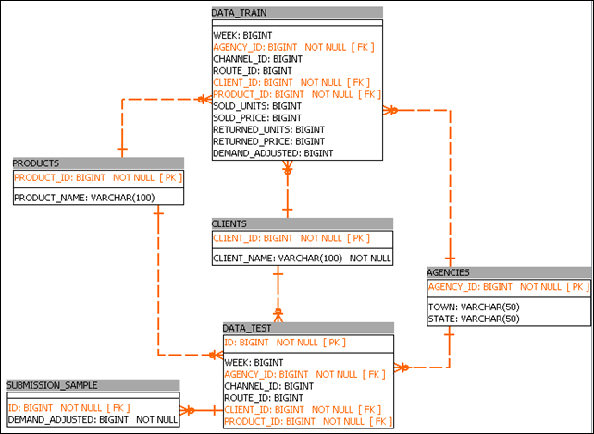
Schema
Slide based on Mario Talavera Writes blogpost: https://mtalavera.wordpress.com/2016/06/30/kaggle-grupo-bimbo-inventory-demand/

Slide 11
Stats
930,500 Clients. Of these clients, 9,663 show up in the test data set (the one to predict demand for) that do not exist in the train set.
2,592 Distinct Products. 34 new products in test data.
790 Agencies across 260 towns in 33 states in Mexico.
Each of these agencies, also known as sales depots, contain several delivery routes.
Each route serves multiple clients delivering and collecting returned products.
9 Sales Channels.
9 weeks of sales data broken into 7 weeks of sales data (from week 3 to week 9) and 2 weeks (week 10 and 11) of test data.
3,603 routes on train data, 2,608 routes on test data.
For the 7 weeks of train data, 1,799 different products were delivered across 552 agencies on 3,603 routes to 880,604 clients.
Slide based on Mario Talavera Writes blogpost: https://mtalavera.wordpress.com/2016/06/30/kaggle-grupo-bimbo-inventory-demand/

Slide 12
Validation schemas
Direct
Validation
and stacking
Week 3
Week 4
Week 5
Week 6
Week 7
Week 8
Week 9
Week 10
Week 11
Full train
Week 3
Week 4
Week 5
Week 6
Week 7
Week 8
Week 9
Week 10
Week 11
Recursive
Validation
and stacking
Week 3
Week 4
Week 5
Week 6
Week 7
Week 8
Week 9
Week 10
Week 11
Week 3
Week 4
Week 5
Week 6
Week 7
Week 8
Week 9
Week 10
Week 11
Full train
Week 3
Week 4
Week 5
Week 6
Week 7
Week 8
Week 9
Week 10
Week 11
Week 3
Week 4
Week 5
Week 6
Week 7
Week 8
Week 9
Week 10
Week 11
Used for feature extraction (lags)
Used for training
Validation/stacking
Not used
Used for prediction
Submit

Slide 13
Features Selection / Engineering
Feature transformations / engineering
Value’s frequency for categorical variables (e.g. Producto_ID, Cliente_ID, Agencia_ID, etc. ) and different combinations of them
Target variable Demanda_uni_equil, grouped by factors variables (mean,median, max, min, sum)
Numeric features (Venta_hoy, Venta_uni_hoy, Dev_uni_proxima, Dev_uni_proxima), grouped by factors variables (mean,median, max, min, sum)

Slide 14
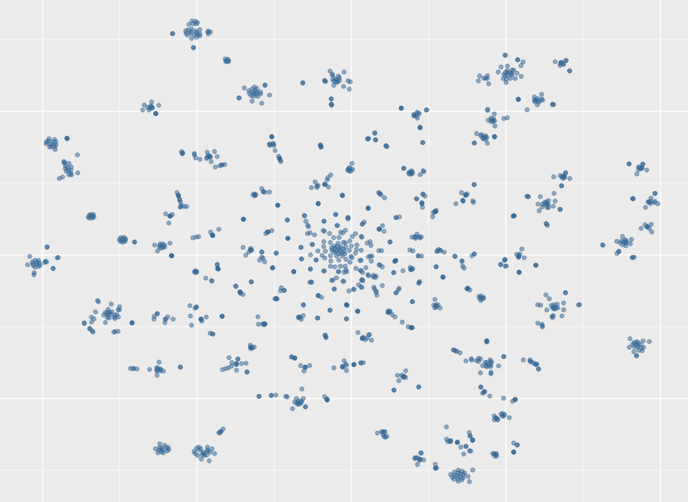
Features Selection / Engineering
Feature transformations / engineering
Products clustering
Using product names to cluster products into 864 clusters
(3 products per cluster)

Slide 15
Features Selection / Engineering
Best 5 features:
Mean target value per client and product
Mean target value per client and product cluster
Mean target value per route and product
Max target value per client and product
Mean target value per agency and product

Slide 16
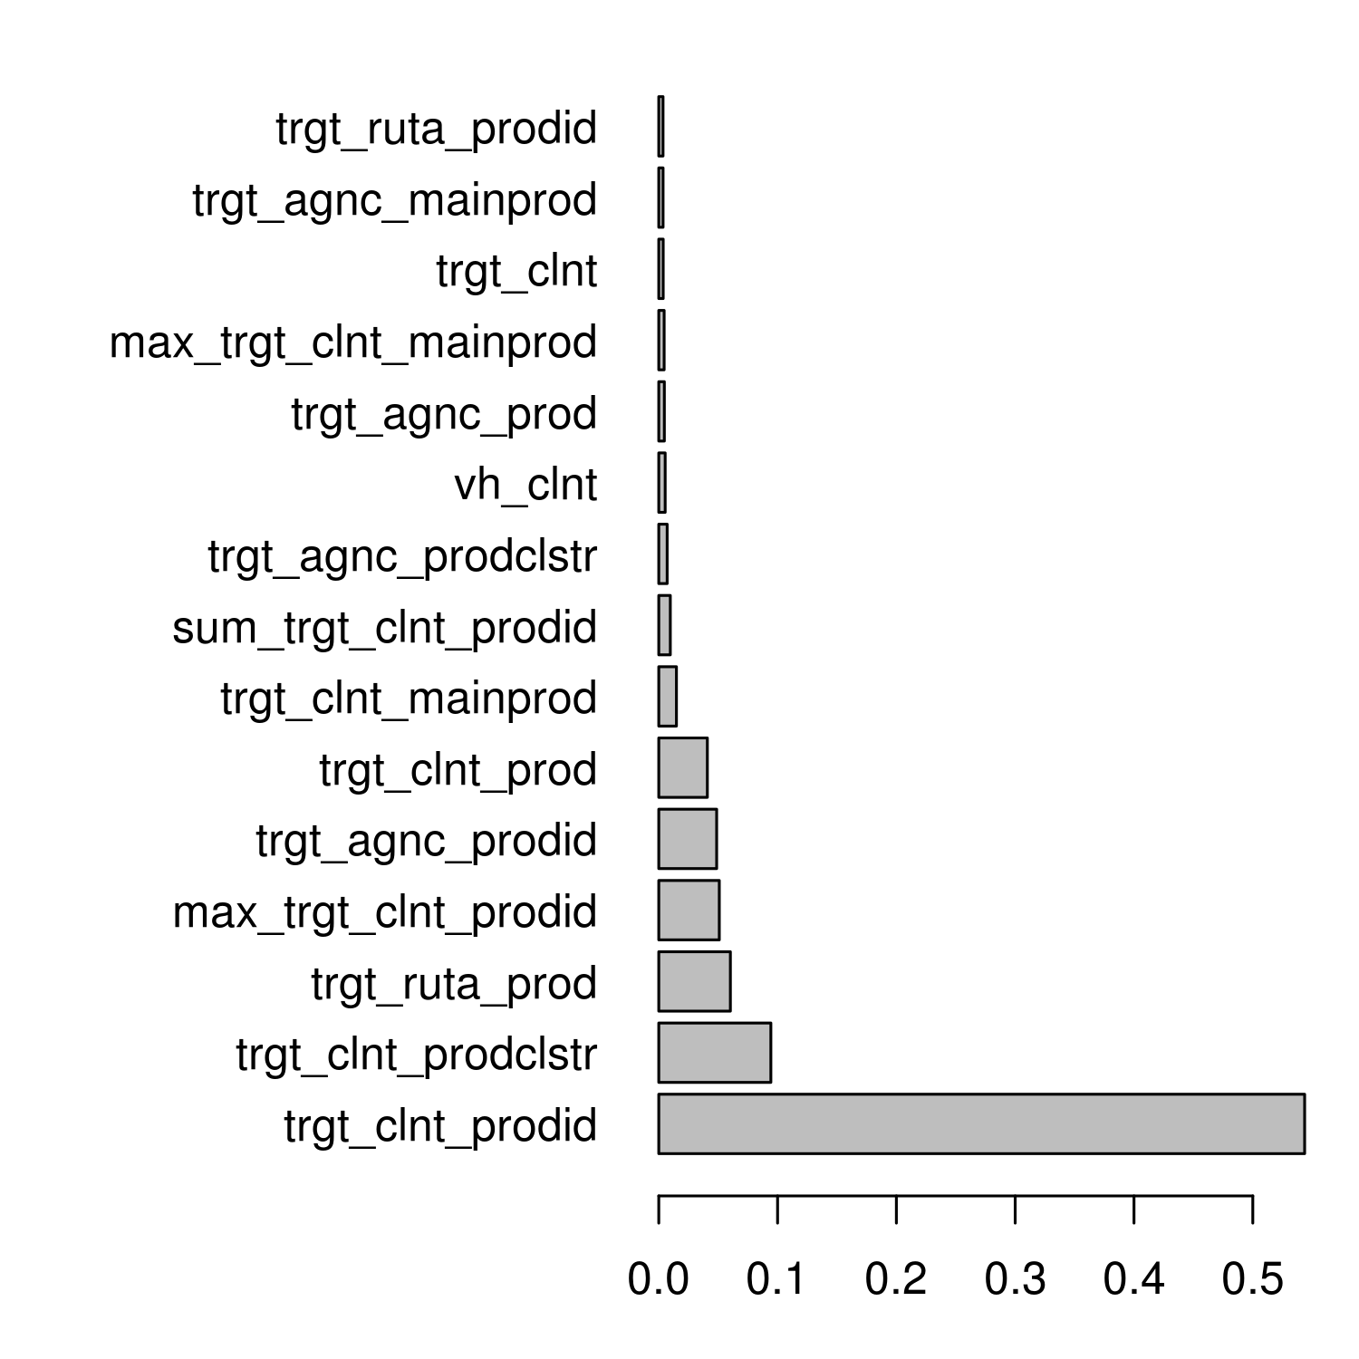
Variable Importance Plot

Slide 17
Training Methods
1st level: XGBoost build on full dataset and using features subsets and different target variables (Venta_hoy, Venta_uni_hoy, Dev_uni_proxima, Dev_proxima)
2nd level: Linear and ExtraTrees regressor
3rd level: Weighted average (weights based on LB feedback)

Slide 18
Some tricks for XGBoost
After tuning your parameters you should adjust number of rounds (nrounds) for training on the whole dataset:
Validation nrounds = 1089 -> Full dataset train nrounds = 1903
Reducing eta and increasing nrounds usually improve results:
eta = 0.025 -> eta = 0.0125
nrounds = 1903 -> nrounds = 3806

Slide 19
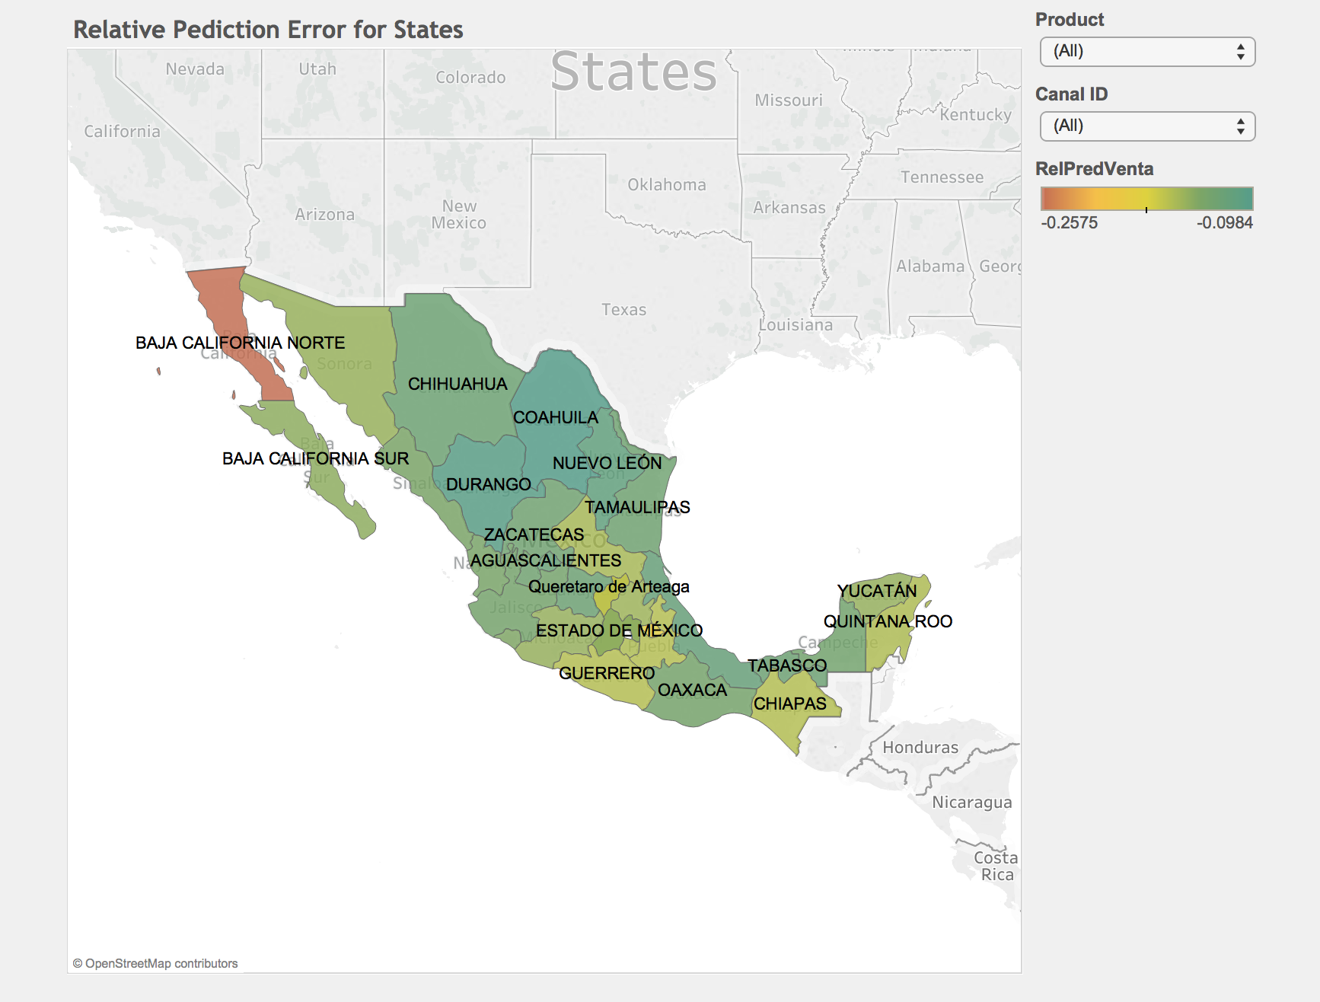
Important and Interesting Findings
Calculated for 9th week based on 7th week data

Slide 20
Simple Model
XGBoost model can be build using only top 50 features without significant loss of quality
Best single XGBoost:
0.43794 / 0.45171 (17th place on private LB)
XGBoost on 175 features:
0.43487 / 0.45316 (19th place on private LB)

Slide 21
What else to try?
Categorical embedding:
https://github.com/entron/entity-embedding-rossmann
https://arxiv.org/pdf/1604.06737v1.pdf
FTRL and Factorization Machines

Slide 22
Thank you!
Q & A

