Slide 1
[ H₂O – The Open Source In-Memory Prediction Engine for Big Data ]
H₂O on Hadoop
Workshop Café, San Francisco, Dec. 12, 2013
Tom Kraljevic

Slide 2
Outline
H₂O as a Standalone HDFS client
H₂O on Hadoop
Configuration settings
Stuff we learned
Questions

Slide 3
Using H₂O as an HDFS client
Why
I want to do run a Generalized Linear Model, and my data lives in HDFS.
What
Use H₂O standalone.
Why
Let’s also use the CPUs and Memory of my Hadoop cluster!
What
Run H₂O on Hadoop.

Slide 4
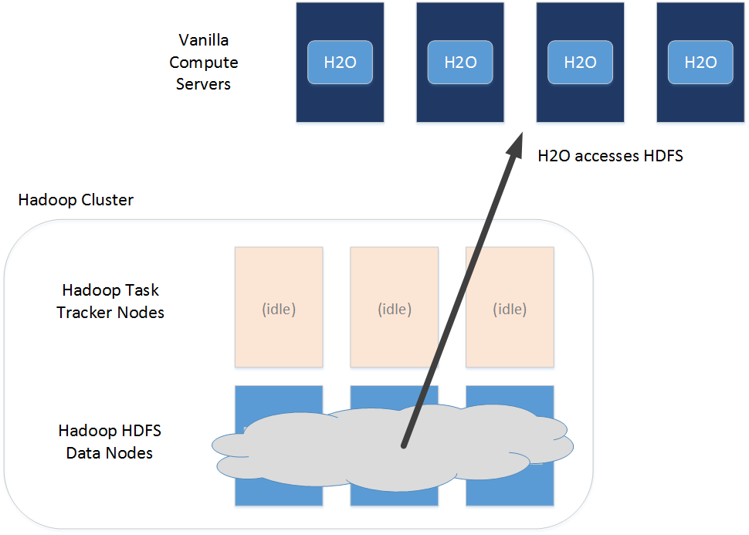
H₂O Standalone Deployment Using HDFS
java -jar h2o.jar
java -jar h2o.jar

Slide 5
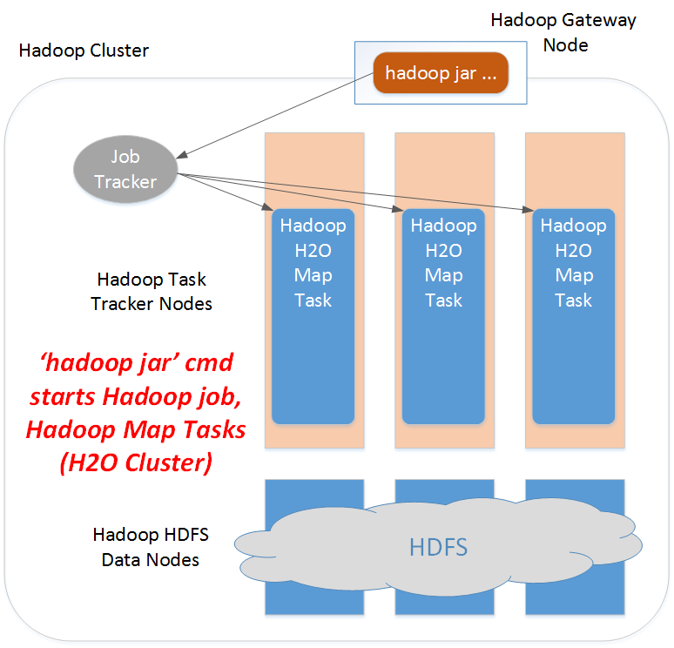
H₂O on Hadoop Deployment

Slide 6
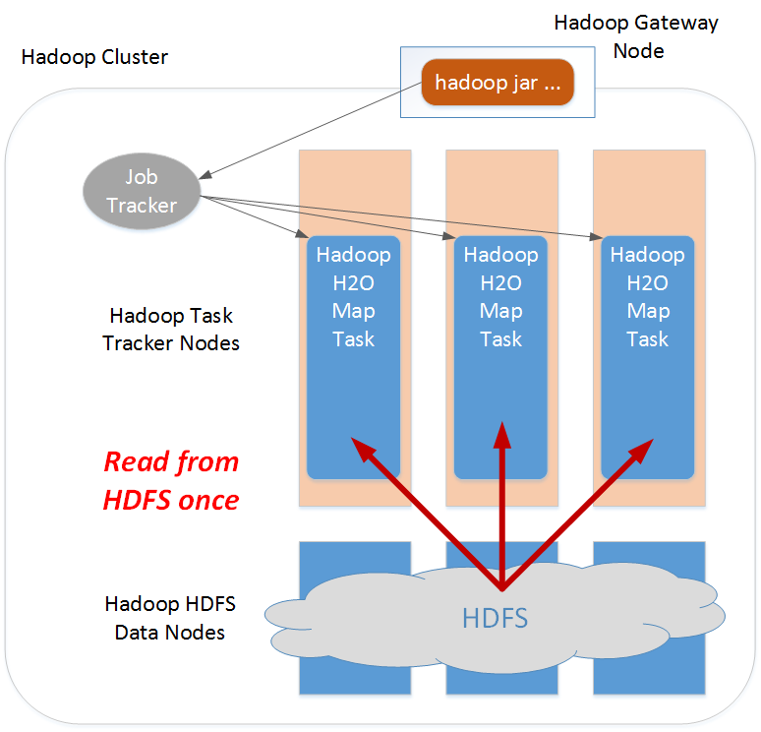
H₂O on Hadoop Deployment

Slide 7
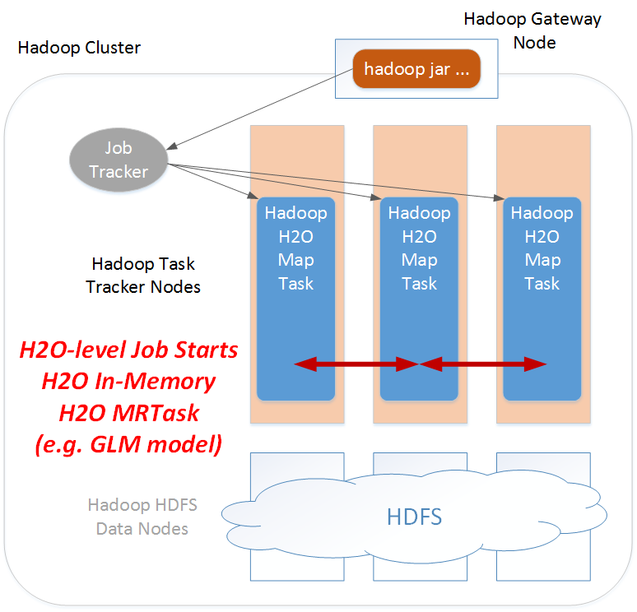
H₂O on Hadoop Deployment

Slide 8
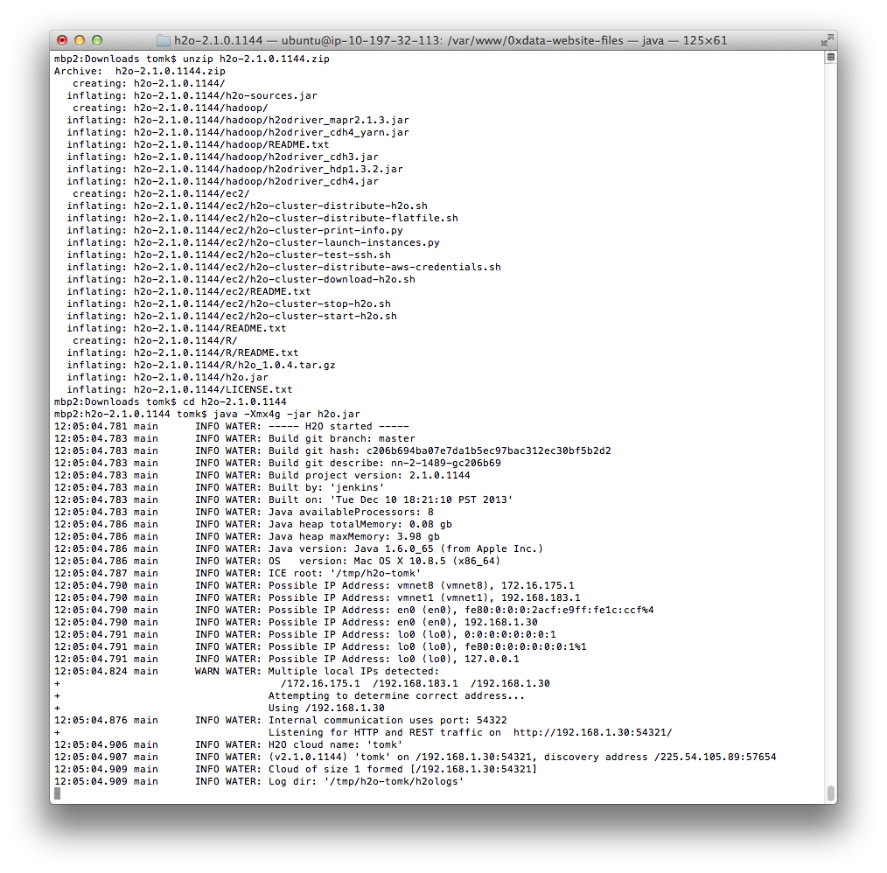
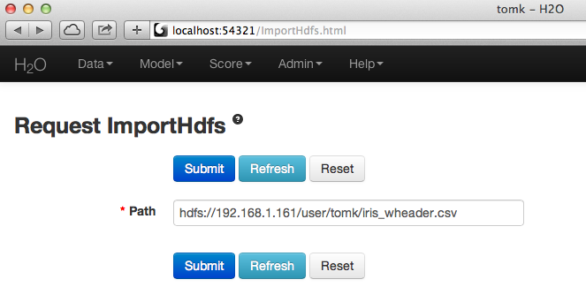
Standalone Mode Command-Line Invocation
unzip
java -jar

Slide 9
H2O on Hadoop Client Invocation
tomk@mr-0xb1:~/h2o-2.1.0.1144/hadoop$ hadoop jar h2odriver_cdh4.jar water.hadoop.h2odriver -libjars ../h2o.jar -mapperXmx 30g -nodes 3 -output hdfsOutDir
Determining driver host interface for mapper->driver callback...
[Possible callback IP address: 192.168.1.161]
[Possible callback IP address: 127.0.0.1]
Using mapper->driver callback IP address and port: 192.168.1.161:60576
(You can override these with -driverif and -driverport.)
Driver program compiled with MapReduce V1 (Classic)
13/12/12 13:25:29 WARN conf.Configuration: mapred.map.child.java.opts is deprecated. Instead, use mapreduce.map.java.opts
Memory Settings:
mapred.child.java.opts: -Xms30g -Xmx30g
mapred.map.child.java.opts: -Xms30g -Xmx30g
Extra memory percent: 10
mapreduce.map.memory.mb: 33792
Job name 'H2O_49792' submitted
JobTracker job ID is 'job_1386713862878_0002'
Waiting for H2O cluster to come up...
H2O node 192.168.1.163:54321 requested flatfile
H2O node 192.168.1.161:54323 requested flatfile
H2O node 192.168.1.162:54339 requested flatfile
Sending flatfiles to nodes...
[Sending flatfile to node 192.168.1.163:54321]
[Sending flatfile to node 192.168.1.161:54323]
[Sending flatfile to node 192.168.1.162:54339]
H2O node 192.168.1.161:54323 reports H2O cluster size 1
H2O node 192.168.1.163:54321 reports H2O cluster size 1
H2O node 192.168.1.162:54339 reports H2O cluster size 1
H2O node 192.168.1.162:54339 reports H2O cluster size 3
H2O node 192.168.1.163:54321 reports H2O cluster size 3
H2O node 192.168.1.161:54323 reports H2O cluster size 3
H2O cluster (3 nodes) is up
(Note: Use the -disown option to exit the driver after cluster formation)
(Press Ctrl-C to kill the cluster)
Blocking until the H2O cluster shuts down...

Slide 10
H₂O is not the typical Hadoop MapReduce job
Long-lived Hadoop mapper tasks that take up CPUs and memory
No Hadoop reduce tasks
No mapper task retry (user needs to restart H₂O cloud on failure)
No HDFS “input file” to the Hadoop map phase
Null splits define number of Hadoop map tasks
No HDFS “output files” produced by the Hadoop job.
Multithreaded
Big Java heap (e.g. 128 GB)
Mappers talk to each other
Mappers need to be run at the same time

Slide 11
Hadoop Configuration

Slide 12
Client-side (Driver) Hadoop Configuration
mapreduce.job.ubertask.enable false
[ mapreduceMapMemoryMb = Xmx + 10% fudge factor; ]
mapreduce.map.memory.mb mapreduceMapMemoryMb
[ mapChildJavaOpts = "-Xms" + mapperXmx + " -Xmx" + mapperXmx; ]
mapred.child.java.opts mapChildJavaOpts
mapred.map.child.java.opts mapChildJavaOpts
mapreduce.map.speculative false
mapred.map.tasks.speculative.execution false
mapred.map.max.attempts 1
mapred.job.reuse.jvm.num.tasks 1

Slide 13
YARN Settings in CDH4
mapreduce.map.memory.mb 128 GB
mapreduce.map.java.opts.max.heap 100 GB
yarn.nodemanager.resource.memory-mb 128 GB
ResourceManager Configuration Safety Valve for yarn-site.xml
<property>
<name>yarn.scheduler.maximum-allocation-mb</name>
<value>131072</value>
</property>

Slide 14
Stuff We Learned
Empty splits determine the mapper count
Use Hadoop counters to avoid having Hadoop kill your job (which doesn’t map anything) after 10 minutes
Hook System.exit() to get mappers to exit properly
YARN /etc/alternatives setting
YARN memory settings
YARN FIFO scheduler mapper clumping
Hortonworks -libjars distribution unpacks the .jar file

Slide 15
Debugging a mapper process is an experience
Finding the process is a challenge
Finding the output is a challenge
Convincing Hadoop not to delete the output on a failure is a challenge
Even if your logger setup code gets a chance to run, you still have to find the output.
Attaching with standard JDWP debuggers is a challenge
Finding the process is (again) a challenge
Debugger doesn’t understand the mapper environment; attach didn’t work.
Finally resorted to POST-code style printing techniques
“Log” output to /tmp, bypassing everything, so I get to keep it

Slide 16
Possible Future Work
Automated log collection upon failure
Fishing out logs from a cluster of 1000 Hadoop nodes is a great job for a tool.
Driver vs. host checking of Hadoop version
Helps avoid subtle errors
Custom YARN Application Master
Experiment further with I/O optimization for H₂O Node placement based on data locality
Your Contributions Welcome

Slide 17
Key Takeaways
H2O is the premier platform for In-Memory Predictive Analytics on Big Data
Open Source Apache 2 license
H₂O mapreduce (in-memory) is not Hadoop mapreduce (HDFS)!
H₂O can read your data from HDFS
Standalone or running on Hadoop
Run H₂O on Hadoop to use CPUs and Memory from your existing Hadoop cluster
Get started easily with the gear you’ve already got

Slide 18

H₂O on Hadoop in the Wild
K-Means on a Terabyte of data (Major Insurance Co.)

Slide 19




Partners
K-Means on a Terabyte of data (Insurance)

Slide 20
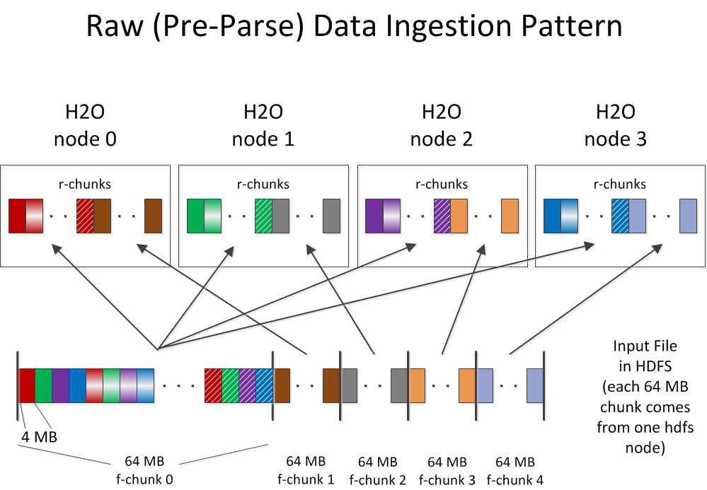

Slide 21
Using H₂O as an HDFS client
Why
I want to do run a Generalized Linear Model, and my data lives in HDFS.
What
Use H₂O.
How
(Command line) java -jar h2o.jar
(Web UI Menu) Data -> Import HDFS

Slide 22
Run H₂O as a Hadoop job
Why
I want to do Predictive Analytics on Big Data.
My data lives in HDFS.
I have an existing Hadoop cluster. Let’s utilize its CPUs and Memory!
What
Run H₂O on Hadoop.
How
hadoop jar h2odriver_<hadoop_version>.jar [...]
(Web UI Menu) Data -> Import HDFS

