Slide 1

Scalable Machine Learning
Using R and H2O
Tom Kraljevic
February 23, 2015
Las Vegas, NV @ innevation

Slide 2


Slide 3
Outline for today’s talk
About H2O.ai (the company) (5 minutes)
About H2O (the software) (10 minutes)
Scaling R with H2O (15 minutes)
Demo of GLM (15 minutes)
H2O’s Distributed GLM (15 minutes)
Q & A (up to 30 minutes)
Content for today’s talk can be found at:
https://github.com/h2oai/h2o-meetups/tree/master/2015_02_23_Scalable_ML_Using_R
H₂O.ai Machine Intelligence

Slide 4
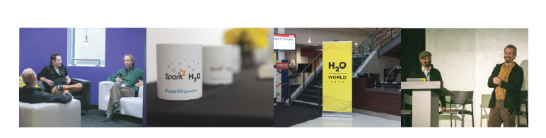
H2O.ai Overview
Founded: 2011 venture-backed, debuted in 2012
Product: H2O open source in-memory prediction engine
Team: 30
HQ: Mountain View, CA
SriSatish Ambati – CEO & Co-founder (Founder Platfora, DataStax; Azul)
Cliff Click – CTO & Co-founder (Creator Hotspot, Azul, Sun, Motorola, HP)
Tom Kraljevic – VP of Engineering (CTO & Founder Luminix, Azul, Chromatic)
H₂O.ai Machine Intelligence

Slide 5
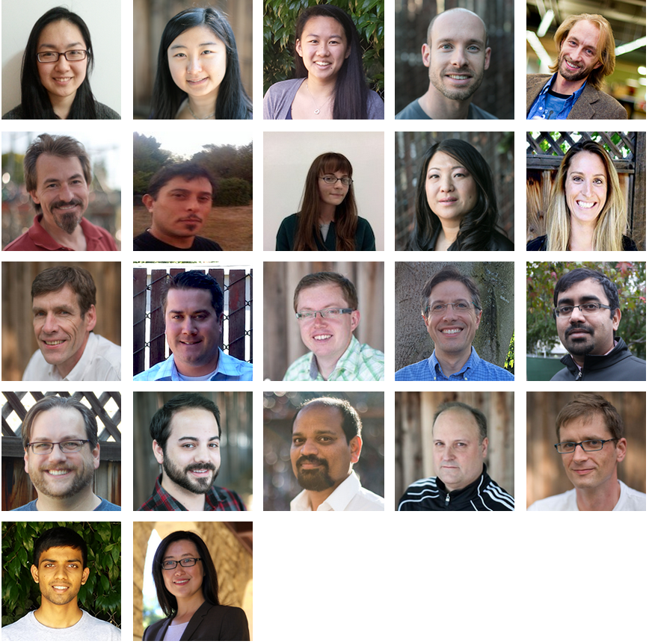
Distributed
Systems Engineers
Making ML Scale!
TBD. Customer Support
TBD
Head of Sales
H₂O.ai Machine Intelligence

Slide 6

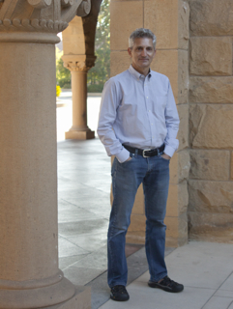
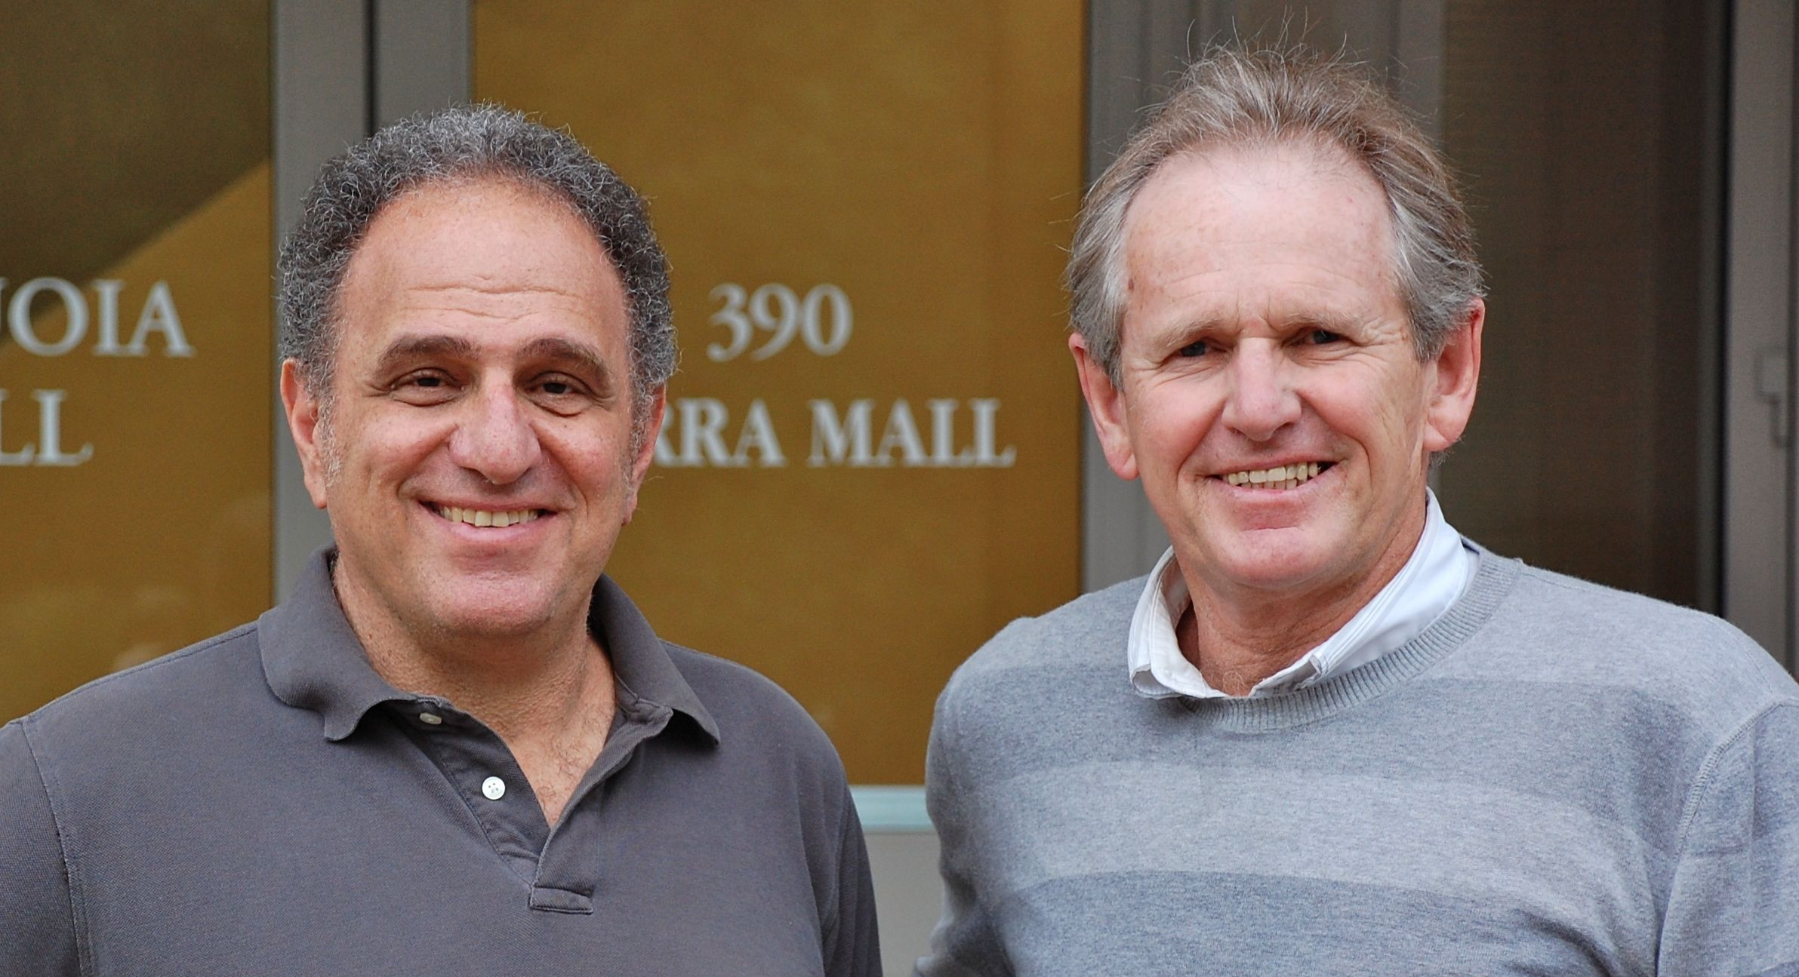
cientific Advisory Council
Stephen Boyd
Professor of EE Engineering
Stanford University
Rob Tibshirani
Professor of Health Research
and Policy, and Statistics
Stanford University
Trevor Hastie
Professor of Statistics
Stanford University
H₂O.ai Machine Intelligence

Slide 7
What is H2O?
Math Platform
Open source in-memory prediction engine
Parallelized and distributed algorithms making the most use out of multithreaded systems
API
Easy to use and adopt
Written in Java – perfect for Java Programmers
Big Data
More data? Or better models? BOTH
Use all of your data – model without down sampling
GLM, Random Forest, GBM, PCA, etc.
REST API (JSON) – drives H2O from R, Python, Excel, Tableau
Run a simple GLM or a more complex GBM to find the best fit for the data
More Data + Better Models = Better Predictions
H₂O.ai Machine Intelligence

Slide 8
Algorithms on H2O
Supervised Learning
Generalized Linear Models: Binomial, Gaussian, Gamma, Poisson and Tweedie
Cox Proportional Hazards Models
Naïve Bayes
Statistical Analysis
Ensembles
Distributed Random Forest: Classification or regression models
Gradient Boosting Machine: Produces an ensemble of decision trees with increasing refined approximations
Deep Neural Networks
Deep learning: Create multi-layer feed forward neural networks starting with an input layer followed by multiple layers of nonlinear transformations
H₂O.ai Machine Intelligence

Slide 9
Algorithms on H2O
Unsupervised Learning
K-means: Partitions observations into k clusters/groups of the same spatial size
Clustering
Dimensionality Reduction
Principal Component Analysis: Linearly transforms correlated variables to independent components
Anomaly Detection
Autoencoders: Find outliers using a nonlinear dimensionality reduction using deep learning
H₂O.ai Machine Intelligence

Slide 10
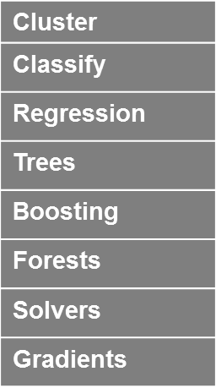
Python
R
Tableau
JSON
Java
Scala
Excel
H₂O Prediction Engine
On Premise
On Hadoop & Spark
On EC2
SDK / API
Rapids Query R-engine
Nano Fast Scoring Engine
In-Mem Map Reduce
Distributed fork/join
Deep Learning
Per Node
2M Row ingest/sec
50M Row Regression/sec
750M Row Aggregates / sec
Memory Manager Columnar Compression
Ensembles
H₂O.ai Machine Intelligence
HDFS
S3
SQL
NoSQL

Slide 11
Scaling R with H2O
H₂O.ai Machine Intelligence

Slide 12
R Objects are a Proxy for Big Data
R
H₂O
HTTP
REST
API
H₂O
H₂O
Frame
H₂O
H2O Frame
S3 Object
IP, Port, Key Name
H₂O.ai Machine Intelligence

Slide 13
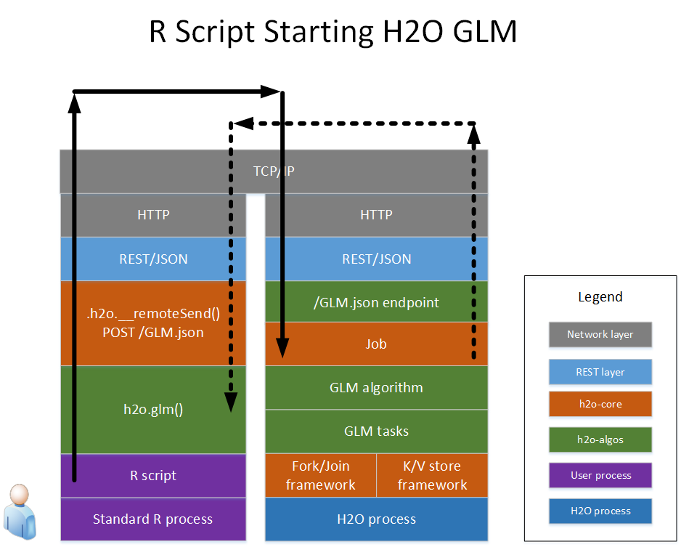

Slide 14
Demonstration We’re on CRAN! install.packages(“h2o”)
H₂O.ai Machine Intelligence

Slide 15
Distributed GLM
H₂O.ai Machine Intelligence

Slide 16
Distributed Data Taxonomy
Vector
H₂O.ai Machine Intelligence

Slide 17
Distributed Data Taxonomy
Vector
The vector may be very large
(billions of rows)
Stored as a compressed column (often 4x)
Access as Java primitives with
on-the-fly decompression
Support fast Random access
Modifiable with Java memory semantics
H₂O.ai Machine Intelligence

Slide 18
Distributed Data Taxonomy
Vector
Large vectors must be distributed over multiple JVMs
Vector is split into chunks
Chunk is a unit of parallel access
Each chunk ~ 1000 elements
Per-chunk compression
Homed to a single node
Can be spilled to disk
GC very cheap
H₂O.ai Machine Intelligence

Slide 19
Distributed Data Taxonomy
Distributed data frame
age
gender
zip_code
ID
A row of data is always stored in a single JVM
Similar to R data frame
Adding and removing columns is cheap
H₂O.ai Machine Intelligence

Slide 20
Distributed Fork/Join
Task is distributed in a tree pattern
JVM
task
Results are reduced at each inner node
Returns with a single result when all subtasks done
JVM
JVM
task
task
JVM
JVM
task
task
H₂O.ai Machine Intelligence

Slide 21
Distributed Fork/Join
JVM
JVM
task
task
task
task
chunk
task
task
chunk
chunk
On each node the task is parallelized using Fork/Join
H₂O.ai Machine Intelligence

Slide 22
H2O’s GLM Fit
min
(
1
1-α
)
log_likelihood(family, β)
+
λ(α β ₁
+
β ₂)
β
N
2
Classic GLM
Regularization
penalty
E(y) = link⁻¹(β₀ + β₁x₁ + β₂x₂ + … β_{n}x_{n})
Model interpretability
H₂O.ai Machine Intelligence

Slide 23
Features of H2O’s GLM
Support for various GLM families
Gaussian (numeric regression)
Binomial (binary classification / logistic regression)
Poisson
Gamma
Regularization
L1 (Lasso) (+ Strong rules)
L2 (Ridge regression)
Elastic-net
Automatic and efficient handling of categorical variables
Efficient distributed n-fold cross validation
Grid search over elastic-net parameter α
Lambda search for best model
Upper and lower bounds for coefficients
H₂O.ai Machine Intelligence
Notes:
L1 penalization (lasso) is a technique for eliminating predictors from the model.
L1 leads to a sparse solution, which is good for model interpretability
L2 penalization (ridge) is a technique that tends to improve numerical stability and push the coefficients of correlated columns toward each other
Elastic-net combines L1 and L2 with an alpha parameter

Slide 24
Input Parameters: Predictors, Response and Family
df = iris
df$is_setosa = df$Species == 'setosa'
library(h2o)
h = h2o.init()
h2odf = as.h2o(h, df)
# Y is a T/F value
y = 'is_setosa'
x = c("Sepal.Length", "Sepal.Width",
"Petal.Length", "Petal.Width")
binary_classification_model =
h2o.glm(data = h2odf, y = y, x = x, family = "binomial")
# Y is a real value
y = 'Sepal.Length'
x = c("Sepal.Width",
"Petal.Length", "Petal.Width")
numeric_regression_model =
h2o.glm(data = h2odf, y = y, x = x, family = "gaussian")
H₂O.ai Machine Intelligence

Slide 25
Input Parameters: Number of iterations
# Specify maximum number of IRLSM iterations
# (default is 100)
h2o.glm(…, iter.max = 50)
H₂O.ai Machine Intelligence

Slide 26
Input Parameters: Regularization
# Enable lambda_search
h2o.glm(…, lambda_search = TRUE)
# Enable strong_rules (requires lambda_search)
h2o.glm(…, lambda_search = TRUE, strong_rules = TRUE)
# Specify max_predictors (requires lambda_search)
h2o.glm(…, lambda_search = TRUE, max_predictors = 100)
# Grid search over alpha
h2o.glm(…, alpha = c(0.05, 0.5, 0.95))
# Turn off regularization entirely
h2o.glm(…, lambda = 0)
H₂O.ai Machine Intelligence

Slide 27
Input Parameters: Cross validation
# Specify 5-fold cross validation
model_with_5folds = h2o.glm(data = h2odf, y = y, x = x, family = "binomial", nfolds = 5)
print(model_with_5folds@model$auc)
print(model_with_5folds@xval[[1]]@model$auc)
print(model_with_5folds@xval[[2]]@model$auc)
print(model_with_5folds@xval[[3]]@model$auc)
print(model_with_5folds@xval[[4]]@model$auc)
print(model_with_5folds@xval[[5]]@model$auc)
H₂O.ai Machine Intelligence

Slide 28
Outputs
Coefficients
Normalized coefficients (variable importance)
Coefficients:
Dest.ABQ Dest.ACY Dest.ALB Dest.AMA Dest.ANC
0.80322 -0.06288 0.13333 0.14092 0.92581
Dest.AT Dest.AUS Dest.AVL Dest.AVP Dest.BDL
-0.21849 0.78392 -0.34974 -0.31825 0.38924
. .
. . . .
DayofMonth DayOfWeek CRSDepTime CRSArrTime FlightNum
-0.03087 0.02110 0.00029 0.00027 0.00007
Distance Intercept
0.00024 136.69614
H₂O.ai Machine Intelligence

Slide 29
Outputs
Null deviance, residual deviance
AIC (Akaike information criterion)
Deviance explained
Degrees of Freedom: 43942 Total (i.e. Null); 43668 Residual
Null Deviance: 60808
Residual Deviance: 54283 AIC: 54833
Deviance Explained: 0.10731
H₂O.ai Machine Intelligence
Notes:
The null deviance shows how well the response is predicted by the model with nothing but an intercept.
The residual deviance shows how well the response is predicted by the model when the predictors are included.
The Akaike information criterion (AIC) is a measure of the relative quality of a statistical model for a given set of data. That is, given a collection of models for the data, AIC estimates the quality of each model, relative to the other models. Hence, AIC provides a means for model selection.
AIC is founded on information theory: it offers a relative estimate of the information lost when a given model is used to represent the process that generates the data. In doing so, it deals with the trade-off between the goodness of fit of the model and the complexity of the model.
AIC does not provide a test of a model in the sense of testing a null hypothesis; i.e. AIC can tell nothing about the quality of the model in an absolute sense. If all the candidate models fit poorly, AIC will not give any warning of that.
Null and Residual deviance can be combined to give the proportion deviance explained, a generalization of r^2.

Slide 30
Outputs
Confusion matrix (for logistic regression)
AUC (for logistic regression)
Confusion Matrix:
Predicted
Actual false true Error
false 6747 14126 0.67676
true 2490 20580 0.10793
Totals 9237 34706 0.37813
AUC = 0.7166454 (on train)
H₂O.ai Machine Intelligence

Slide 31
GLM Lifecycle
Start
(1) Calc gradient of null model (mean)
(2) Get next λ
(3) Calc active predictors
Iterative
Reweighted
Least Squares
Method
to compute β
(4) Calc Gram Matrix (X^{T}X)
(5) ADMM + Cholesky decomposition
(6) Calc gradient on all predictors
(7) KKT checks
H₂O.ai Machine Intelligence
Done
Notes:
This diagram shows the full GLM lifecycle
(1) GLM starts by creating a null model, which is just the mean
(2) When using Lambda search, GLM tries many different values starting at LambdaMax and decreasing from there
(3) Strong rules calculate the active predictors based on a warm start from the previous iteration
(4, 5) We convert the log likelihood problem into an Iterative Reweighted Least Squares problem so we can distribute it across many nodes.
(4) The Gram matrix calculation (Green box) is distributed.
This is big data.
(5) The ADMM and Cholesky calculations are done on a single node (although the Cholesky is done in parallel).
ADMM solves for the non-differentiable Lasso penalty.
This is (usually) small data. ADMM solves on the smaller Gram, not the entire training dataset of X.
(6, 7) Calculate gradient again based on new Beta values. Check for KKT stopping criteria.

Slide 32
GLM Runtime Cost
CPU
Memory
M * N²
O(
)
O(M * N) + O(N² * p * n)
Calc Gram Matrix (X^{T}X)
p * n
(the training data)
N³
ADMM + Cholesky decomposition
O(
)
O(N²)
p
M Number of rows in the training data
N Number of predictors in the training data
p Number of CPUs per node
n Number of nodes in the cluster
H₂O.ai Machine Intelligence

Slide 33
Best Practices
GLM works best on tall and skinny datasets
But if you have a wide dataset, use L1 penalty and Strong Rules to eliminate columns from the model
Give lambda search a shot
But specify strong_rules and/or max_predictors if it is taking too long
90% of the time is spent on the larger models with the small lambdas, so specifying max_predictors helps a lot
Keep a little bit of L2 for numerical stability (i.e. don’t use alpha 1.0, use 0.95 instead)
Use symmetric nodes in your cluster
Bigger nodes can help the ADMM / Cholesky run faster
Impute if you need to before running GLM
H₂O.ai Machine Intelligence

Slide 34
Things to Watch Out for
Look for suspiciously different cross-validation results between folds
Look for explained deviance
Too close to 0: model doesn’t predict well
Too close to 1: model predicts “too” well (one of your input cols is cheating)
Same for AUC
Too close to 0.5: model doesn’t predict well
Too close to 1: model predicts “too” well
See if GLM stops early for a particular lambda that interests you (performing all the iterations probably means the solution isn’t good)
Too many N/As in your data (GLM discards rows with N/A values)
If you have a really bad column, you might accidentally be losing all your rows.
H₂O.ai Machine Intelligence

Slide 35
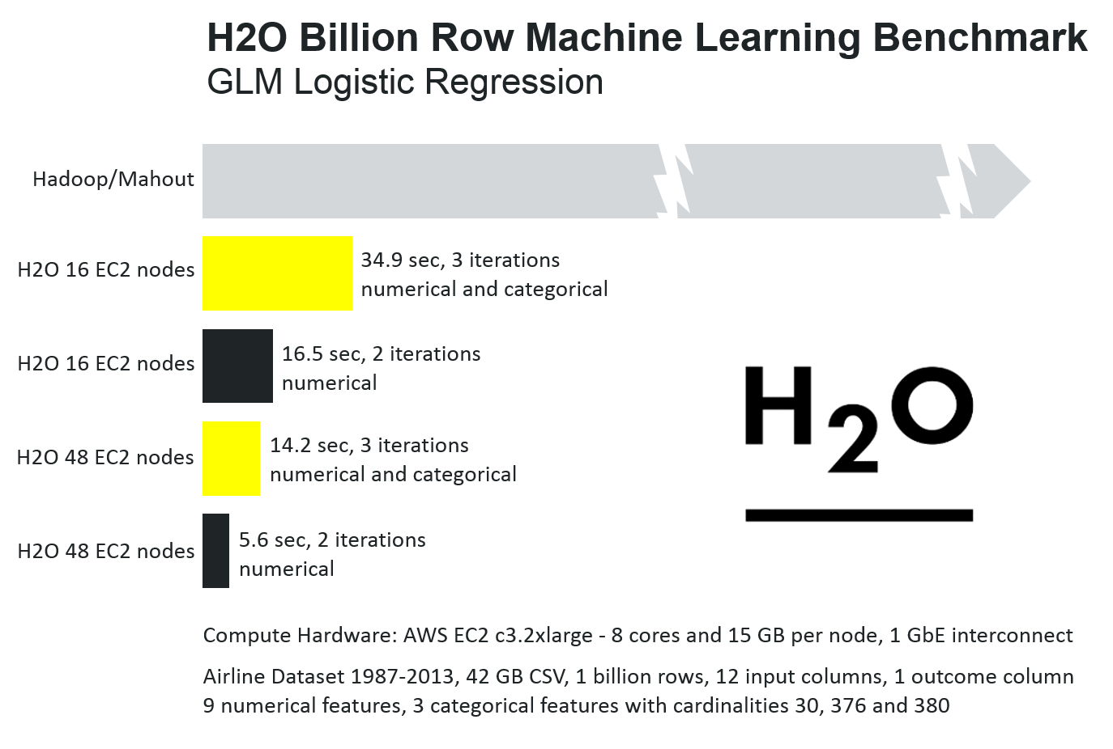
H₂O.ai Machine Intelligence

Slide 36
Q & A
Thanks for attending!
Content for today’s talk can be found at:
https://github.com/h2oai/h2o-meetups/tree/master/2015_02_23_Scalable_ML_Using_R
H₂O.ai Machine Intelligence

