Slide 1
H2O Time Series
Using machine learning for solving time series problems

Slide 2
Outline
Introduction
Time series modeling and processing
Machine learning with time series
Time series sources
Conclusions

Slide 3
Introduction
Motivation: many data come as time series. How can we use Machine Learning approaches to solve problems?
Problems:
Analysis and understanding
Prediction/forecasting, classification, detection
Decision making and control
Machine Learning and Time Series:
Different than standard machine learning problem
There are dynamic issues that need to be dealt with

Slide 4
Time series modeling and processing
Definitions
Operations with time series
Basic modeling: linear time-invariant models (LTI)
Advanced topics

Slide 5
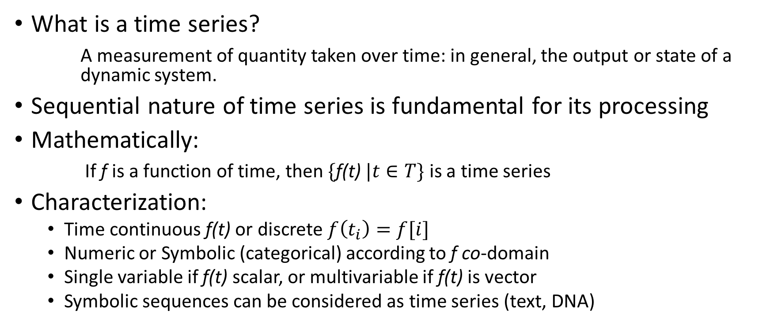
Definitions
What is a time series?
A measurement of quantity taken over time: in general, the output or state of a dynamic system.
Sequential nature of time series is fundamental for its processing
Mathematically:
If f is a function of time, then $\{\text{f}\text{(}\text{t}\text{)} |t∈T\}$ is a time series
Characterization:
Time continuous f(t) or discrete $f\left(t_{i}\right)=f[i]$
Numeric or Symbolic (categorical) according to f co-domain
Single variable if f(t) scalar, or multivariable if f(t) is vector
Symbolic sequences can be considered as time series (text, DNA)

Slide 6
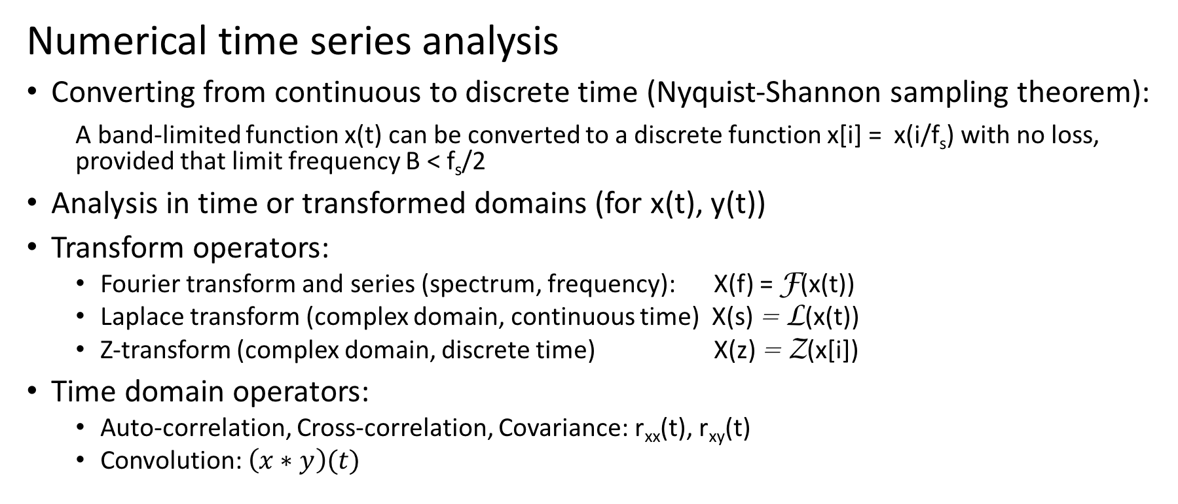
Time series analysis and processing
Numerical time series analysis
Converting from continuous to discrete time (Nyquist-Shannon sampling theorem):
A band-limited function x(t) can be converted to a discrete function x[i] = x(i/f_{s}) with no loss, provided that limit frequency B < f_{s}/2
Analysis in time or transformed domains (for x(t), y(t))
Transform operators:
Fourier transform and series (spectrum, frequency): X(f) = F(x(t))
Laplace transform (complex domain, continuous time) X(s) = L(x(t))
Z-transform (complex domain, discrete time) X(z) = Z(x[i])
Time domain operators:
Auto-correlation, Cross-correlation, Covariance: r_{xx}(t), r_{xy}(t)
Convolution: $\left(x∗y\right)(t)$

Slide 7
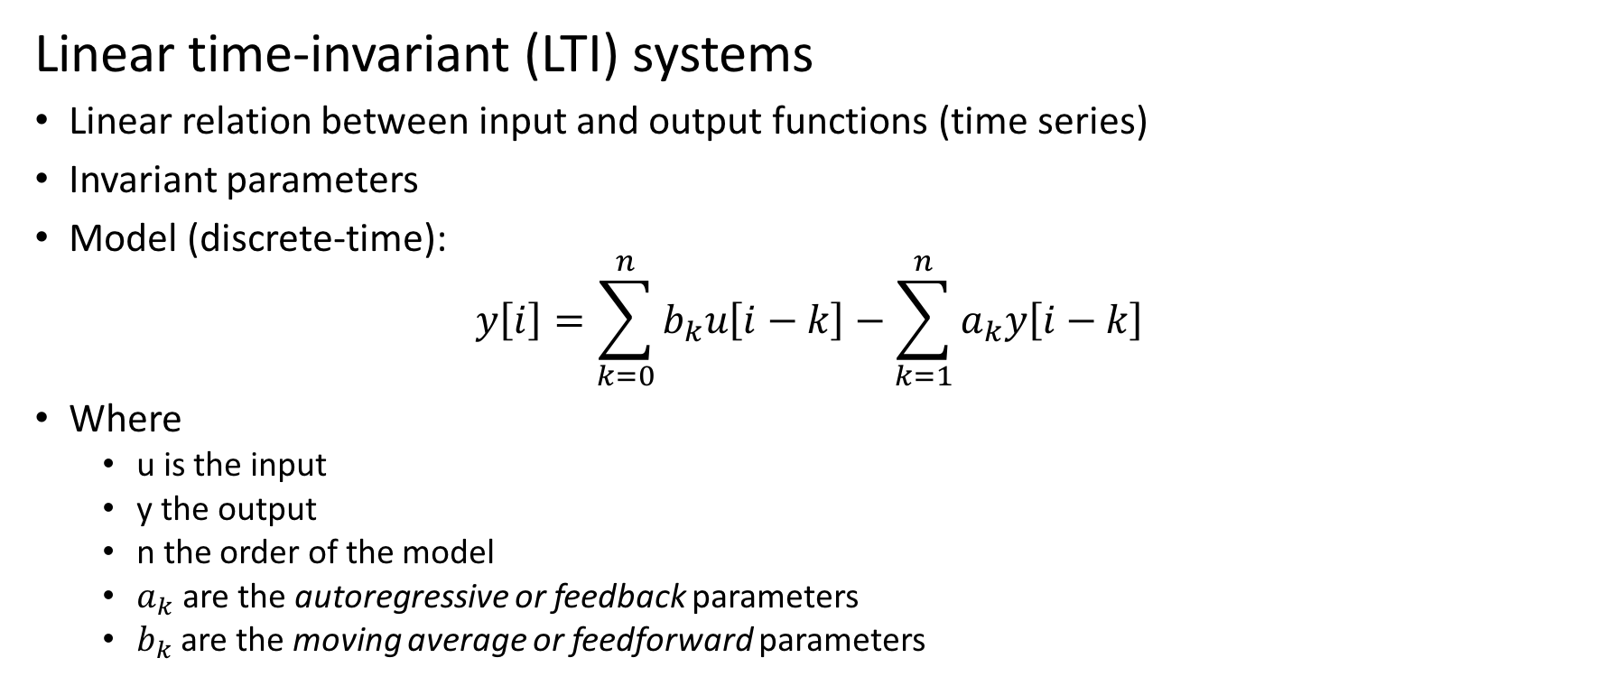
Time series analysis and processing
Linear time-invariant (LTI) systems
Linear relation between input and output functions (time series)
Invariant parameters
Model (discrete-time):
$$y\left[i\right]=\sum_{k=0}^{n}{b_{k}u\left[i−k\right]}−\sum_{k=1}^{n}{a_{k}y\left[i−k\right]}$$
Where
u is the input
y the output
n the order of the model
$a_{k}$ are the autoregressive or feedback parameters
$b_{k}$ are the moving average or feedforward parameters

Slide 8

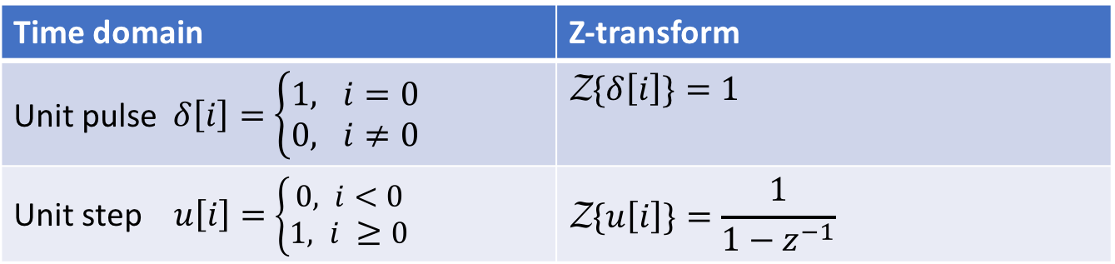
Time series analysis and processing
Z-transform
Converts function from discrete time domain into complex domain
Definition
$$\text{Z}\text{\{}\text{x}\left[i\right]\}=X(z)≝\sum_{i=−∞}^{∞}{x\left[i\right]{ z}^{−i}}$$
Examples
Time domain | Z-transform
Unit pulse $δ\left[i\right]=$ $\left\{\begin{matrix}1, i=0 \\ 0, i≠0\end{matrix}\right.$ | $$\text{Z}\text{\{}δ\left[i\right]\}=1$$
Unit step $u\left[i\right]=$ $\left\{\begin{matrix}0, i<0 \\ 1, i ≥0\end{matrix}\right.$ | $$\text{Z}\text{\{}u\left[i\right]\}=\frac{1}{1−z^{−1}}$$
Notes:
z1

Slide 9
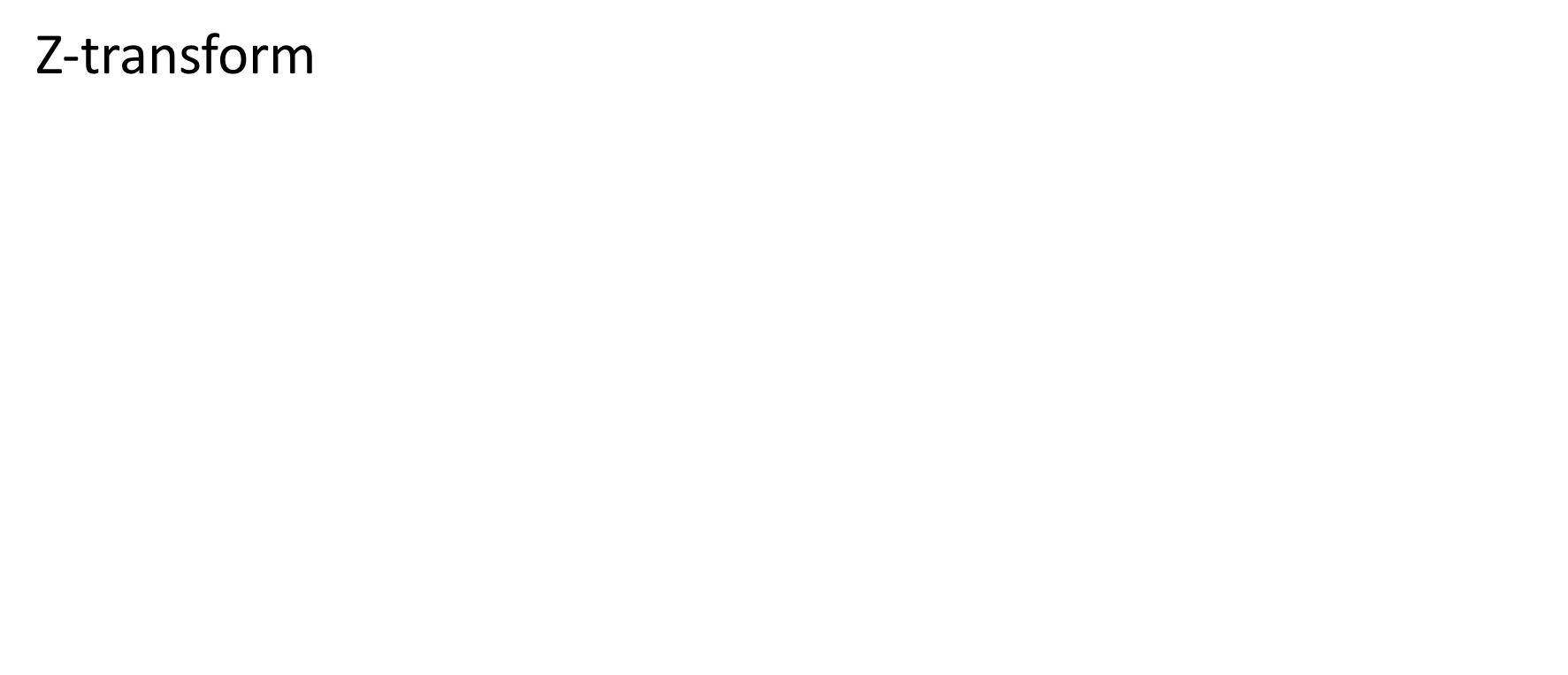
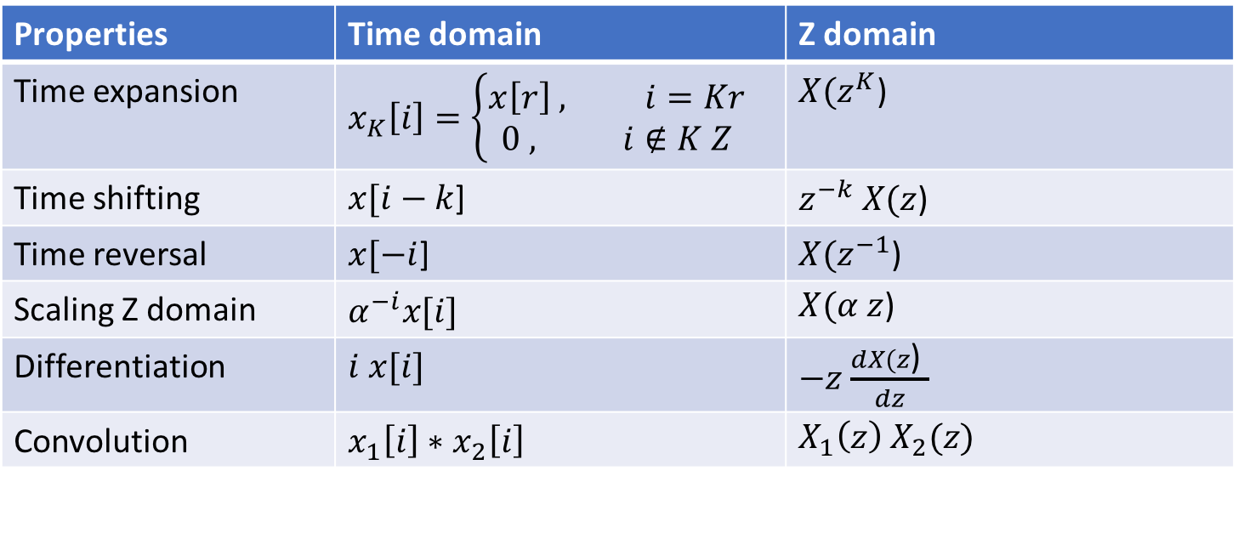
Time series analysis and processing
Z-transform
Properties | Time domain | Z domain
Time expansion | $$x_{K}\left[i\right]=\left\{\begin{matrix}x\left[r\right] , i=Kr \\ 0 , i∉K Z\end{matrix}\right.$$ | $X(z^{K}$)
Time shifting | $x[i−k$] | $z^{−k} X(z$)
Time reversal | $x[−i$] | $X(z^{−1}$)
Scaling Z domain | $$α^{−i}x[i]$$ | $X(α z$)
Differentiation | $$i x[i]$$ | $−z$ $\frac{dX(z\text{)} }{dz}$
Convolution | $x_{1}\left[i\right]$ $∗$ $x_{2}\left[i\right]$ | $$X_{1}\left(z\right) X_{2}(z)$$
Notes:
$$−z$$
z1

Slide 10
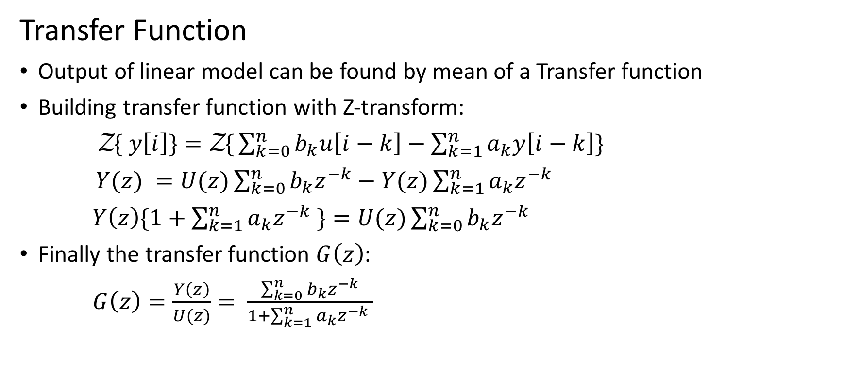
Time series analysis and processing
Transfer Function
Output of linear model can be found by mean of a Transfer function
Building transfer function with Z-transform:
$\text{Z}\text{\{} y\left[i\right]\}=\text{Z}\text{\{}\sum_{k=0}^{n}{b_{k}u\left[i−k\right]−\sum_{k=1}^{n}{a_{k}y\left[i−k\right]}\}}$
$Y(z) =U(z)\sum_{k=0}^{n}{b_{k}z^{−k}−Y(z)\sum_{k=1}^{n}{a_{k}z^{−k} } }$
$Y\left(z\right)\{1+\sum_{k=1}^{n}{a_{k}z^{−k} }\}=U(z)\sum_{k=0}^{n}{b_{k}z^{−k}}$
Finally the transfer function $G\left(z\right)$:
$G\left(z\right)=\frac{Y\left(z\right)}{U(z)}= \frac{\sum_{k=0}^{n}{b_{k}z^{−k}}}{1+\sum_{k=1}^{n}{a_{k}z^{−k} }}$
Notes:
$H\left(z\right)= \frac{\sum_{k=0}^{n}{a_{k}z^{−k}}}{1+\sum_{k=1}^{n}{b_{k}z^{−k} }}\text{Z}\text{\{} y\left[i\right]\}=$
z1

Slide 11




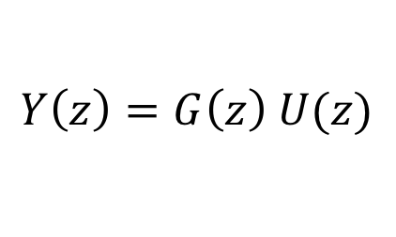

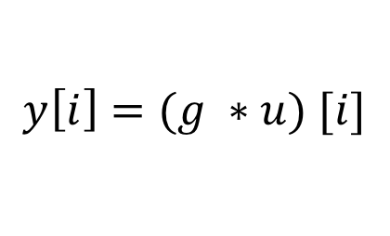
Time series analysis and processing
Transfer Function
The time-domain response of a linear model is the convolution between the input $u\left[i\right]$ and the unit pulse response $g\left[i\right]$
$G\left(z\right)$
Z-transform domain
$$U(z)$$
$$Y\left(z\right)=G\left(z\right) U(z)$$
$$g\left[i\right]$$
Time domain
$$u[i]$$
$$y\left[i\right]=(g ∗u) [i]$$
Notes:
X[i]x
$H\left(z\right)= \frac{\sum_{k=0}^{n}{a_{k}z^{−k}}}{1+\sum_{k=1}^{n}{b_{k}z^{−k} }}\text{Z}\text{\{} y\left[i\right]\}=$
z1

Slide 12
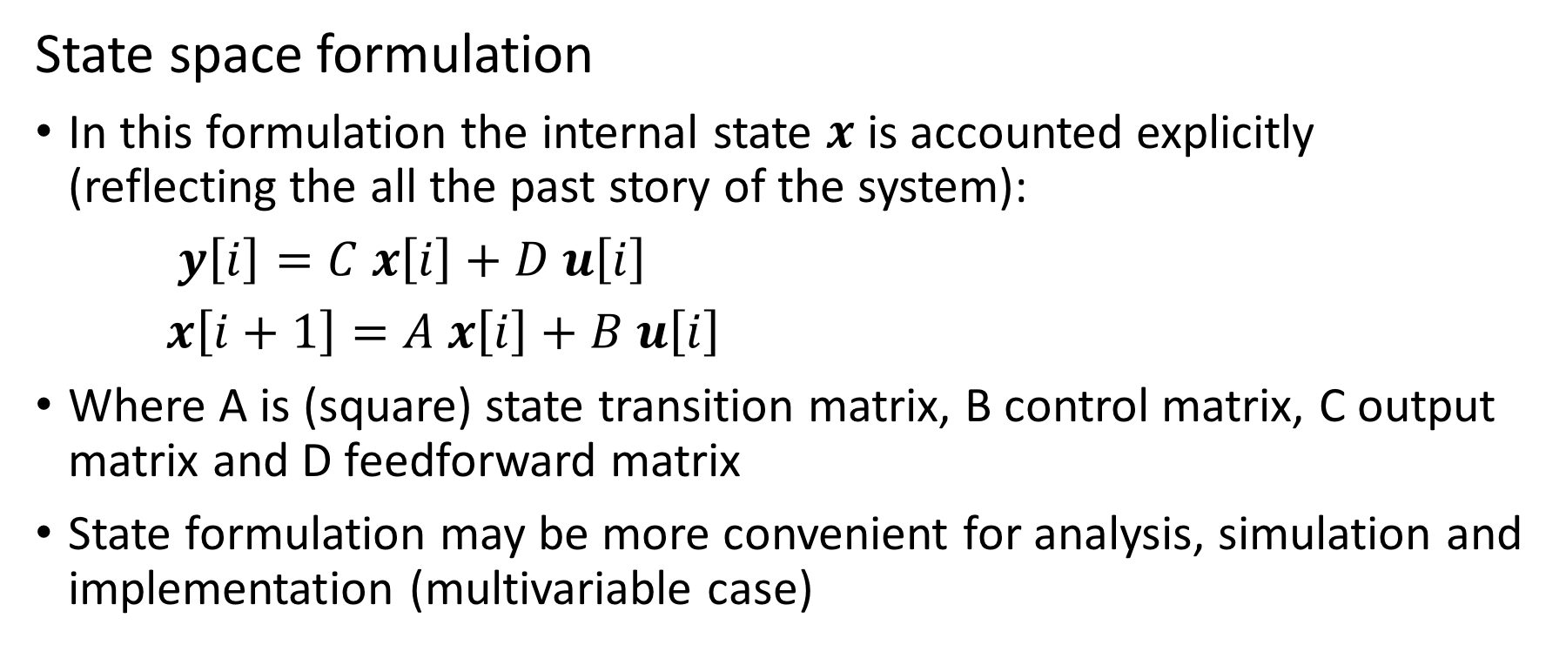
Time series analysis and processing
State space formulation
In this formulation the internal state $x$ is accounted explicitly (reflecting the all the past story of the system):
$y\left[i\right]=C x\left[i\right]+D u\left[i\right]$
$x\left[i+1\right]=A x\left[i\right]+B u\left[i\right]$
Where A is (square) state transition matrix, B control matrix, C output matrix and D feedforward matrix
State formulation may be more convenient for analysis, simulation and implementation (multivariable case)
Notes:
X[i]x
$H\left(z\right)= \frac{\sum_{k=0}^{n}{a_{k}z^{−k}}}{1+\sum_{k=1}^{n}{b_{k}z^{−k} }}\text{Z}\text{\{} y\left[i\right]\}=$
z1

Slide 13
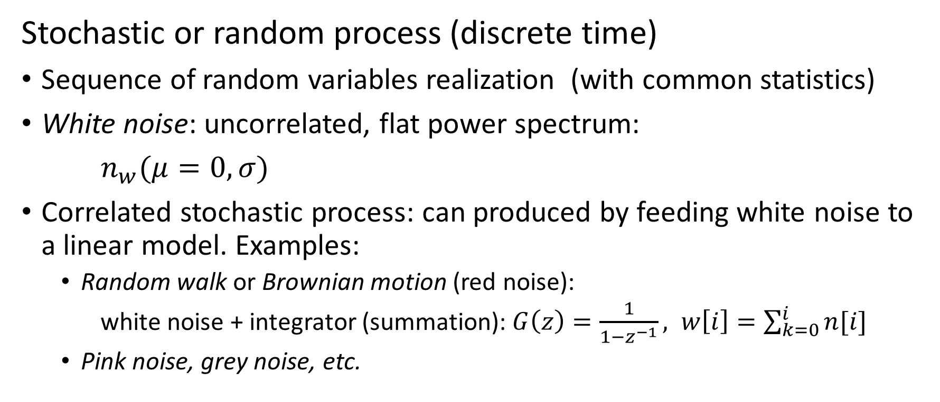
Time series analysis and processing
Stochastic or random process (discrete time)
Sequence of random variables realization (with common statistics)
White noise: uncorrelated, flat power spectrum:
$n_{w}(μ=0,σ)$
Correlated stochastic process: can produced by feeding white noise to a linear model. Examples:
Random walk or Brownian motion (red noise):
white noise + integrator (summation): $G\left(z\right)=\frac{1}{1−z^{−1}}, w\left[i\right]=\sum_{k=0}^{i}{n[i]}$
Pink noise, grey noise, etc.
Notes:
X[i]x
$H\left(z\right)= \frac{\sum_{k=0}^{n}{a_{k}z^{−k}}}{1+\sum_{k=1}^{n}{b_{k}z^{−k} }}\text{Z}\text{\{} y\left[i\right]\}=$
z1

Slide 14
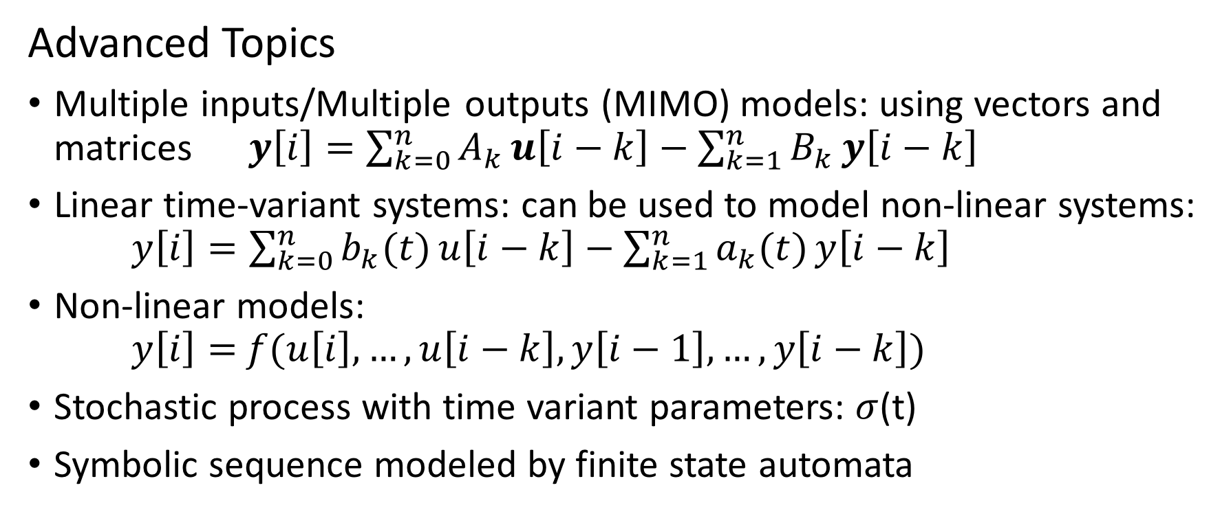
Time series analysis and processing
Advanced Topics
Multiple inputs/Multiple outputs (MIMO) models: using vectors and matrices $y\left[i\right]=\sum_{k=0}^{n}{A_{k}}u\left[i−k\right]−\sum_{k=1}^{n}{B_{k}}y\left[i−k\right]$
Linear time-variant systems: can be used to model non-linear systems: $y\left[i\right]=\sum_{k=0}^{n}{b_{k}(t)}u\left[i−k\right]−\sum_{k=1}^{n}{a_{k}(t)}y\left[i−k\right]$
Non-linear models: $y\left[i\right]=$ $f(u\left[i\right],…,u\left[i−k\right],y\left[i−1\right],…,y\left[i−k\right])$
Stochastic process with time variant parameters: $σ$(t)
Symbolic sequence modeled by finite state automata
Notes:
X[i]x
$H\left(z\right)= \frac{\sum_{k=0}^{n}{a_{k}z^{−k}}}{1+\sum_{k=1}^{n}{b_{k}z^{−k} }}\text{Z}\text{\{} y\left[i\right]\}=$
z1

Slide 15
Machine learning with time series
Typical steps:
Conversion data to regular time series (if needed)
Sampling rate or period to use
Convert irregular time data (or events) into regular sampled
Resample (in time) and convert to numeric categorical/symbolic variables
Dynamic preprocessing (optional): convert dynamic data into static pattern
Tapped delay line (time shift), fixed
Apply dynamic filter (time convolution), adjustable
Use transformed domain
Apply machine learning
Static (standard) if dynamic processing is available
Dynamic models: recurrent neural networks and variants

Slide 16
Time series sources
Medical and Biological
Language: Natural Language, Speech and Music
Nature and Environment
Energy
Industrial, Control, Machinery
Financial and Economic
Communication and Networks

Slide 17
Time series: Medical and Biological
Nervous and muscular systems activity: Electrical activity from neurons (in brain or muscles)
electroencephalogram (EEG),
electrocardiogram (ESG)
electromyography (EMG)
polysomnography (PSG)
Genomics: ADN sequences can be analyzed as time series

Slide 18
Time series: Natural Language, Music
Speech processing: speech understanding (speech to text), speech synthesis, translation, compression
Natural Language processing: understanding, translation, knowledge extraction, synthesis, summarizing
Music: classification, synthesis, intelligent composition

Slide 19
Time series: Nature and Environment
Meteorological variables: temperature, humidity, pressure, humidity, rainfall. Mapping, forecast
Pollutants: source detection, modeling, forecasting
Earthquakes: detection ground motion and waves, modeling, prediction(?). Water waves (tsunami)
Astronomy and Astrophysics data

Slide 20
Time series: Energy
Electric power consumption from large grid, micro grid or single consumer: modeling, forecast, control(?)

Slide 21
Time series: Industrial, Control, Machinery
Signal detection and measurement (smart/soft sensors)
System control: predictive, non-linear, multivariable, etc.
Distributed sensors (internet of things)

Slide 22
Time series: Financial and Economic
Financial markets values (stock, index, commodities, currencies):
Econometric and macroeconomic series (PGB, CPI, rates, etc.)
Consumer finance: credit risk, consumption, payments, fraud.

Slide 23
Time series sources: Communication and Networks
Baseline signals: production, detection, errors,…
Internet traffic, routing, information
Local networks: optimization, detection, assignments
Transportation networks: intelligent transportation

Slide 24
Conclusions
There are many machine learning problems that are based on time series data (most?)
Time series methods and models should be used when possible
Machine learning solutions can be integrated seamlessly to existing production networks.
Challenges: parallelize and on-line learning

