Slide 1
H2O-Flow: A Web-based Interactive Environment for Fast Scalable Machine Learning
Yan Zou
H2O.ai
January 14, 2015

Slide 2
Agenda For Today
H2O Introduction
H2O-Flow Intro
H2O-Flow Demo
Hands-on Session

Slide 3
What is H2O?
Scalable Machine Learning Software for Big Data
Bigger: distributed & in-memory compression
Faster: in-memory ML & JVM optimization
Better: superb out-of-box prediction accuracy
State-of-art algorithms (DRF, GBM, DL, …)
Handle missing values, better defaults, grid search
Less resource requirements: smaller clusters
Adoption
Open Source and easy to start (Web, R, Python, Spark interfaces)
Powerful & Production Ready
Customers range from tech startups to enterprises

Slide 4
H2O –
Fast
ScalableMachine Learning
Software
R
Tableau
Python
Java
JSON
Scala
Excel
H₂O Prediction Engine
SDK / API
Rapids Query R-engine
Nano Fast Scoring Engine
In-Mem MapReduce
Distributed fork/join
Deep learning
Memory Manager Columnar Compression
Cluster
Regression
Solvers
Classify
Trees
Boosting
Forests
Gradients
ensembles
H₂O.ai Machine Intelligence
HDFS
S3
SQL
NoSQL

Slide 5
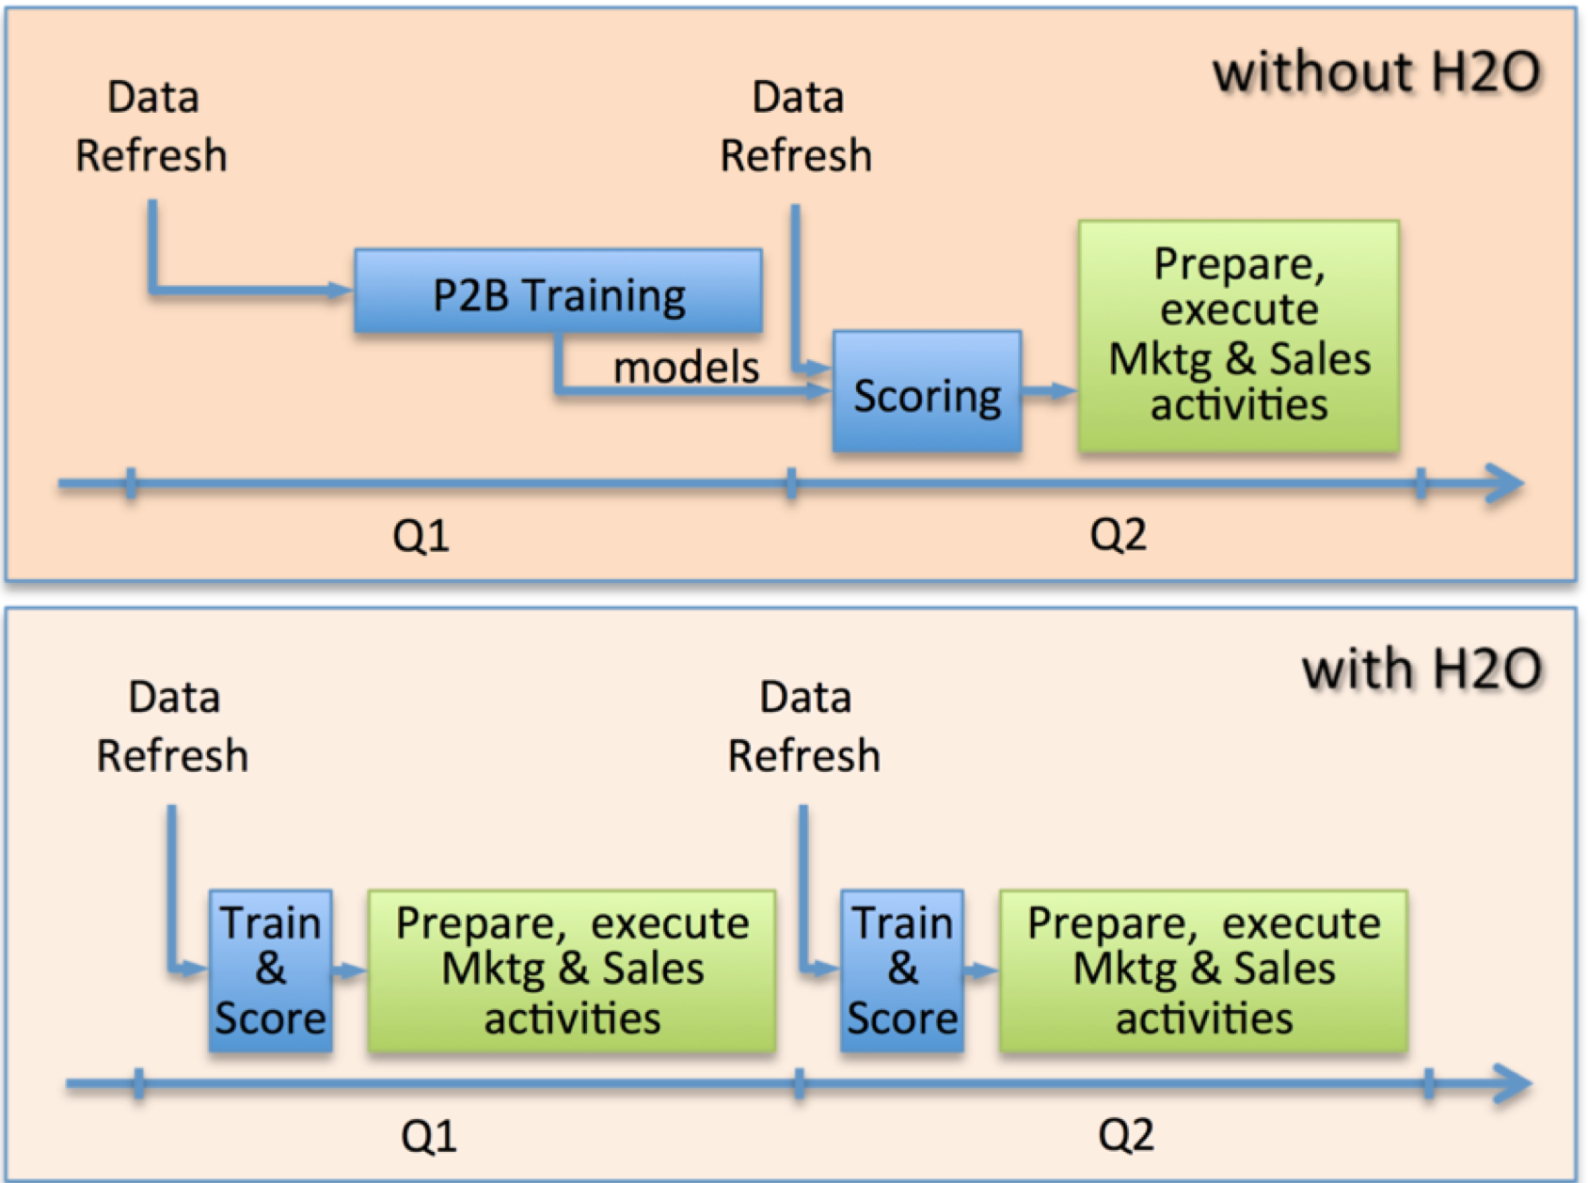
H2O in Production at Cisco
Modeling Factory
With H2O: < 2 Days
Before H2O: 30Days*
Lead scoring,
60K models,
160M+ rows,
1000+ attributes,
4 machines,
Training & Scoring
http://h2o.ai/blog/2014/11/predictive-modeling-at-scale/

Slide 6
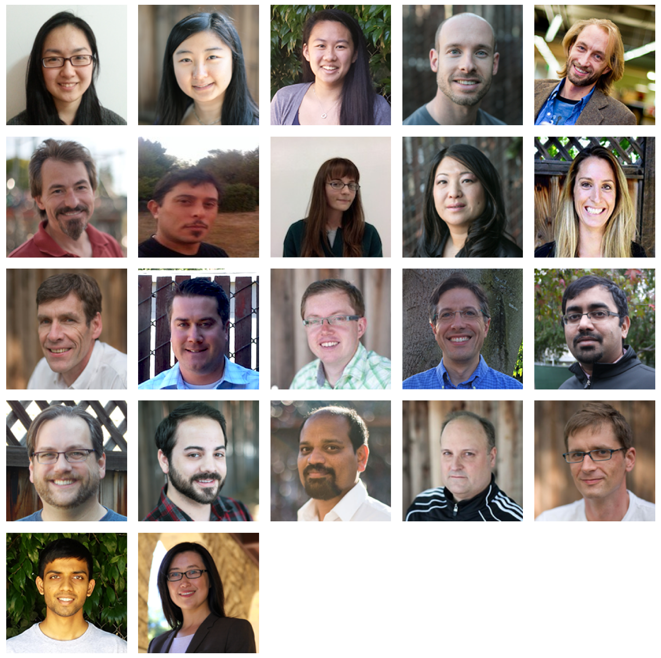
Community
Github
- https://github.com/h2oai
Google stream
- https://groups.google.com/forum/#!forum/h2ostream
Support – support@h2o.ai
Blogs - http://h2o.ai/blog/
Training Doc - http://learn.h2o.ai
Scientific Advisory Council:
Stephen Boyd – EECS Professor at Stanford
Trevor Hastie – Statistics Professor at Stanford
Rob Tibshirani – Statistics, Health Research and Policy Professor at Stanford
H₂O.ai Machine Intelligence

Slide 7
H2O-Flow
A Web-based Interactive Computing Environment for Big Data Machine Learning
New Web Interface of H2O
Mixed Environment for
Coffeescript
Text & Markdown
Charts & Visualization (more to come)
R/Spark/Python code (coming soon)
Mathematics Equations (coming soon)
Video & Rich Media

Slide 8
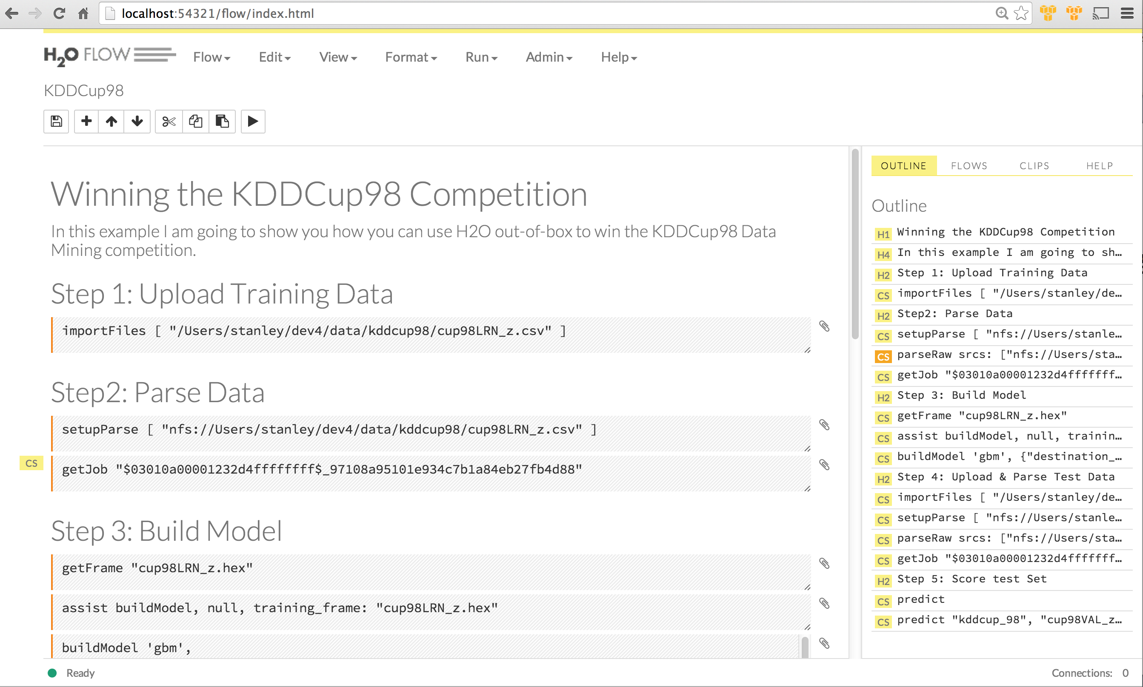
H2O Machine Learning Platform
H2O-Flow Basic Concepts
Markdown Cell
Command History
Code Cell: runnable

Slide 9
H2O-Flow Demo
KDDCup98: Campaign Targeting
Competition Task: to estimate the return from a direct mailing in order to maximize donation profits?
Costs $0.68 to process and mail one letter
Send mail if predicted donation > $0.68
Dataset
97K rows, 479 columns
Big burden on data scientists for
Missing values
“Massively categorical” features
Imbalanced samples
Sampling (otherwise no return in R)
See more details of the example at h2o.ai websitehttp://h2o.ai/blog/2014/12/winning-kdd/

Slide 10
Demo

Slide 11
Questions & Hands-on Practice

Slide 12
Hands-on session
Download & Start H2O-flow
http://h2o-release.s3.amazonaws.com/h2o-dev/master/1013/index.html or the H2O-dev link on h2o.ai/download/
Follow the steps
Download Data
data.h2o.ai
usecases/cup98LRN_z.csv as training dataset
usecases/cup98VAL_z.csv as testing dataset
Import Datasets
Parse Datasets
Build Model
Scoring Model

Slide 13
Enjoy and Have Fun!

