Slide 2
Outline
Driverless AI software distributions and supported environments
Hardware Recommendations
End-to-end steps of hardware uncrating to Machine Learning Pipeline-creating
Data Sources
Automating Driverless AI training
Productionizing Driverless AI pipelines
Top customer questions

Slide 3
Driverless AI Software Distributions and Supported Environments
Cloud marketplace BYOL offerings
Amazon AWS AMI
Microsoft Azure Marketplace
Google Cloud Platform
Nimbix, Paperspace
IBM Cloud Private
NVIDIA DGX Registry
Install on your own
Cloud (for experimenting or for serious use)
Servers (for serious use)
Desktop/Laptop (for experimenting with small data)

Slide 4
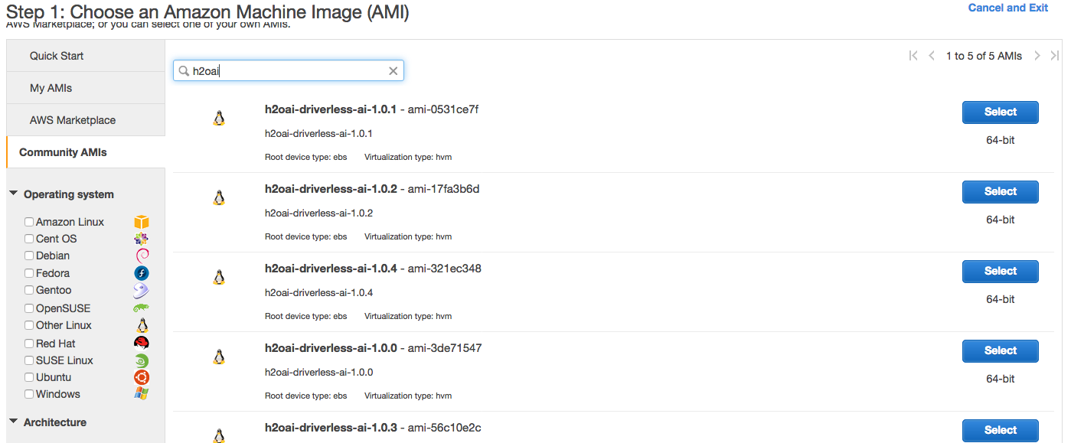
Cloud - Amazon AWS AMI

Slide 5
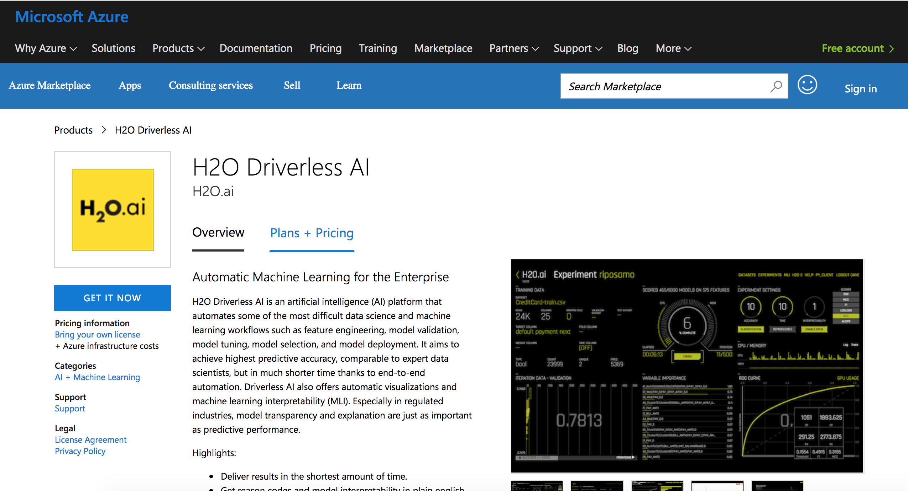
Cloud - Microsoft Azure Marketplace

Slide 6
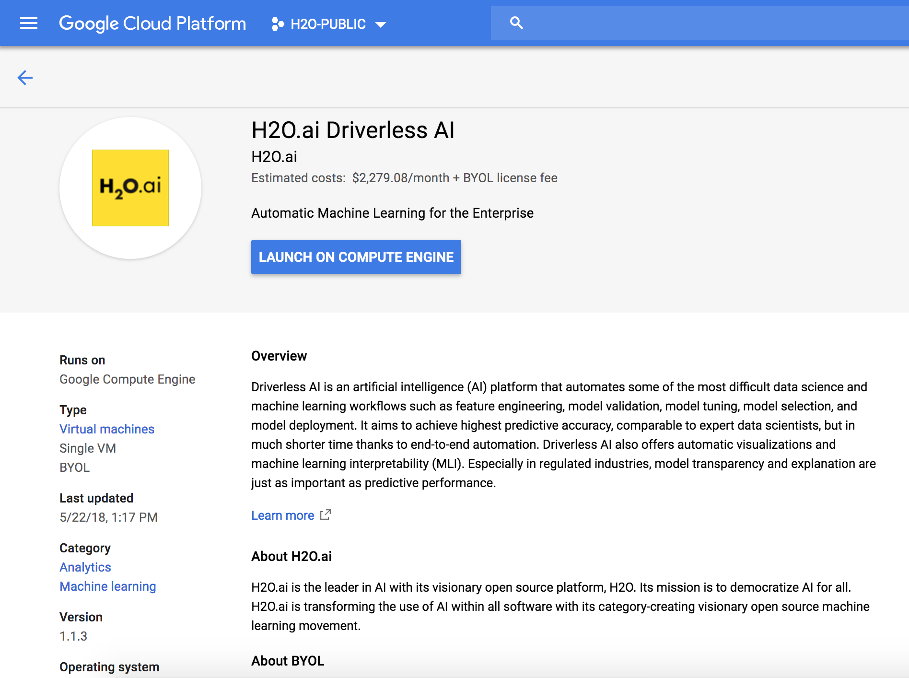
Cloud - Google Cloud Platform

Slide 7
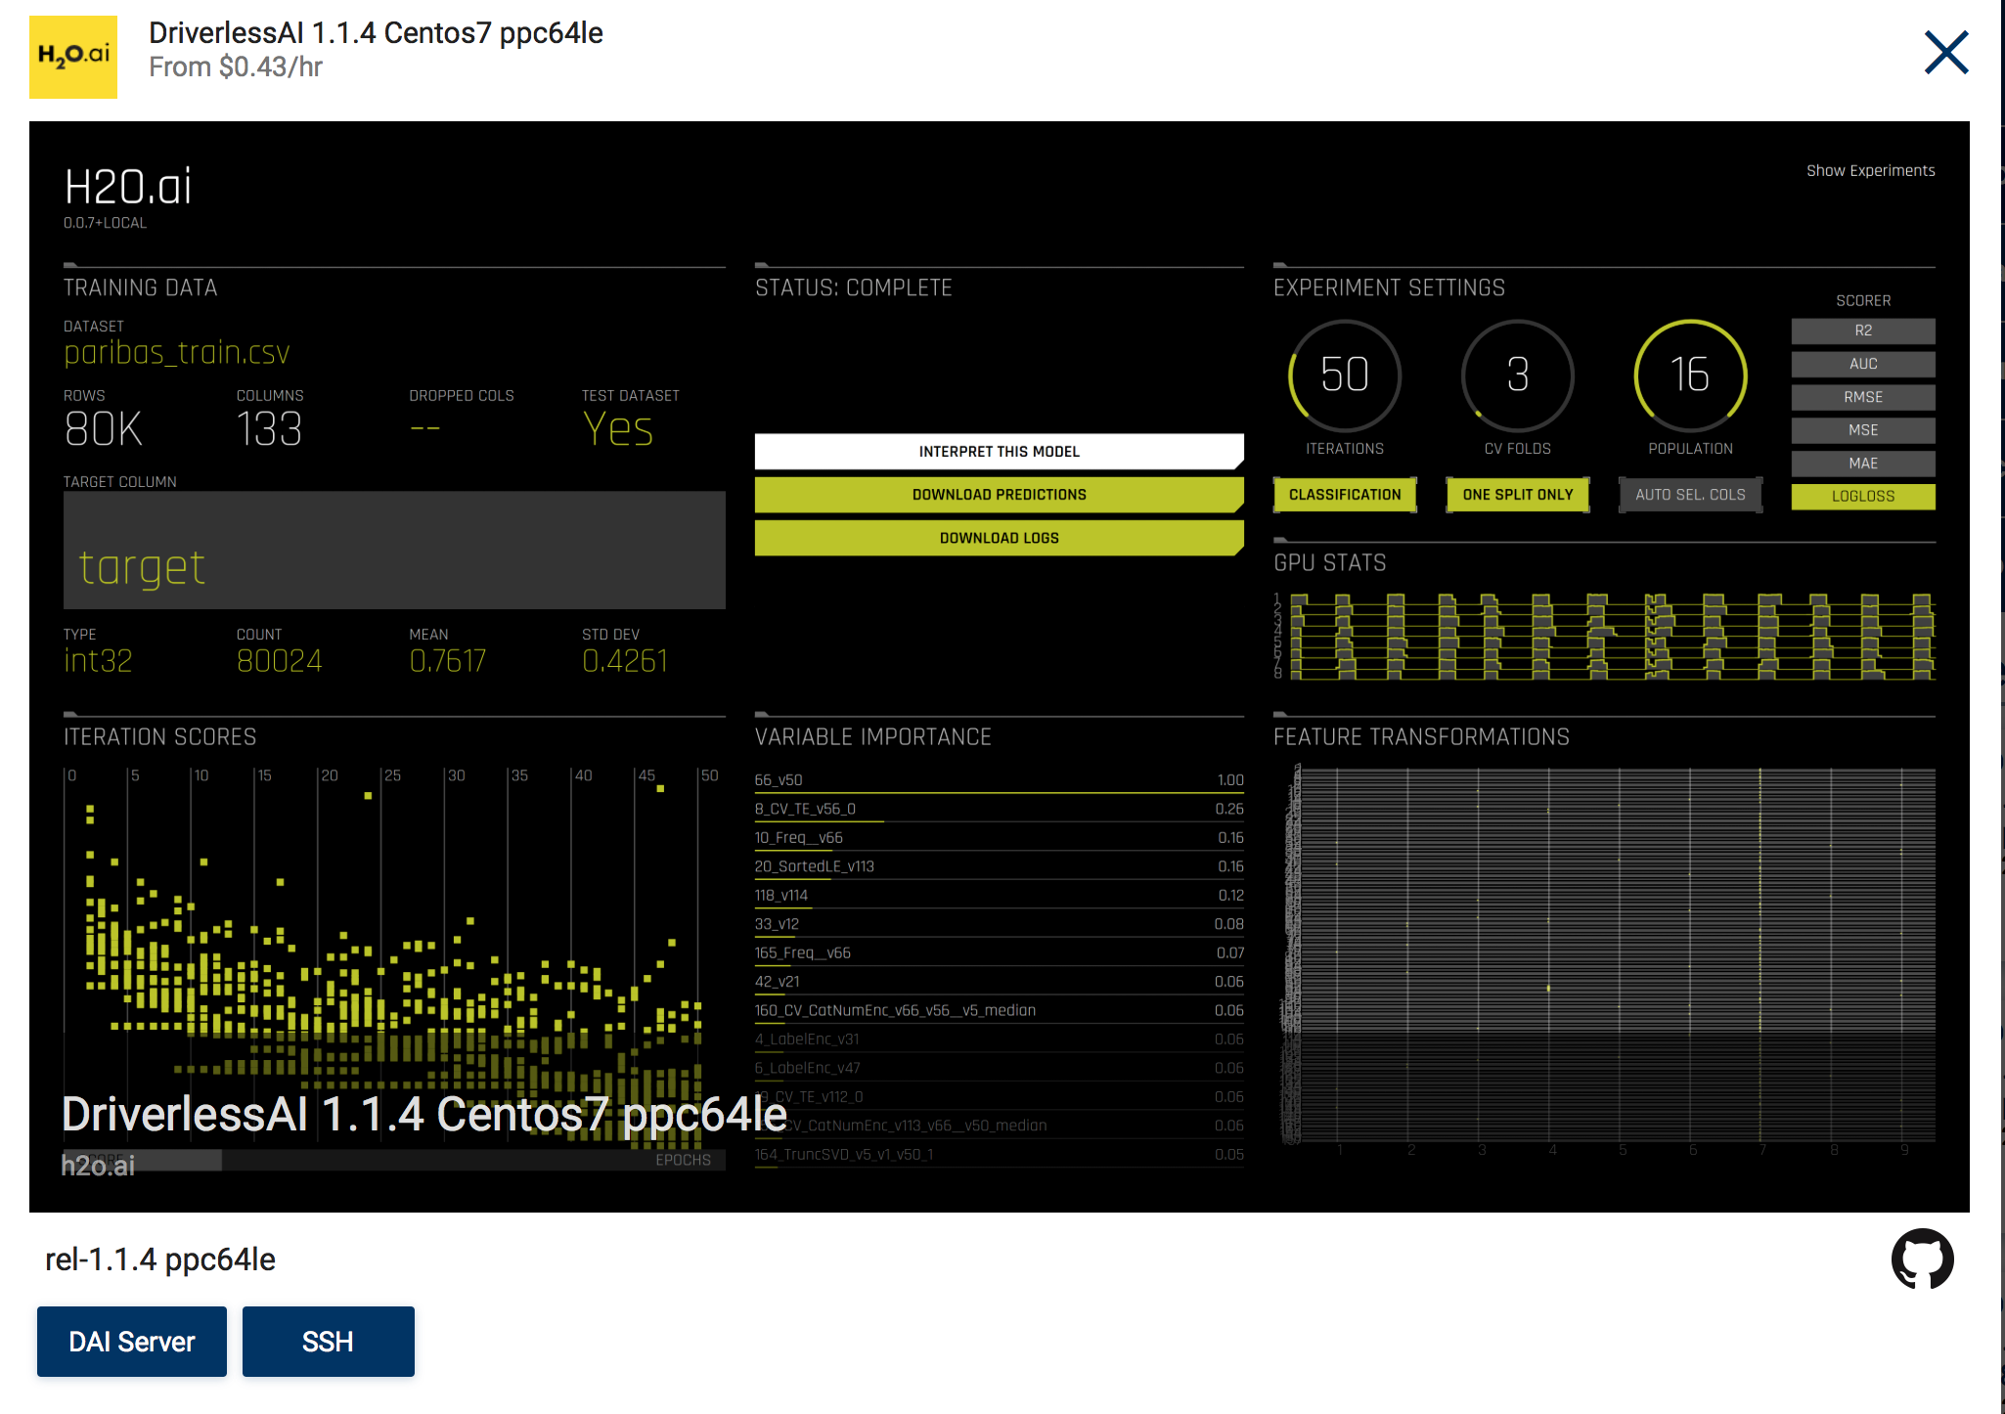
Cloud - Nimbix

Slide 8
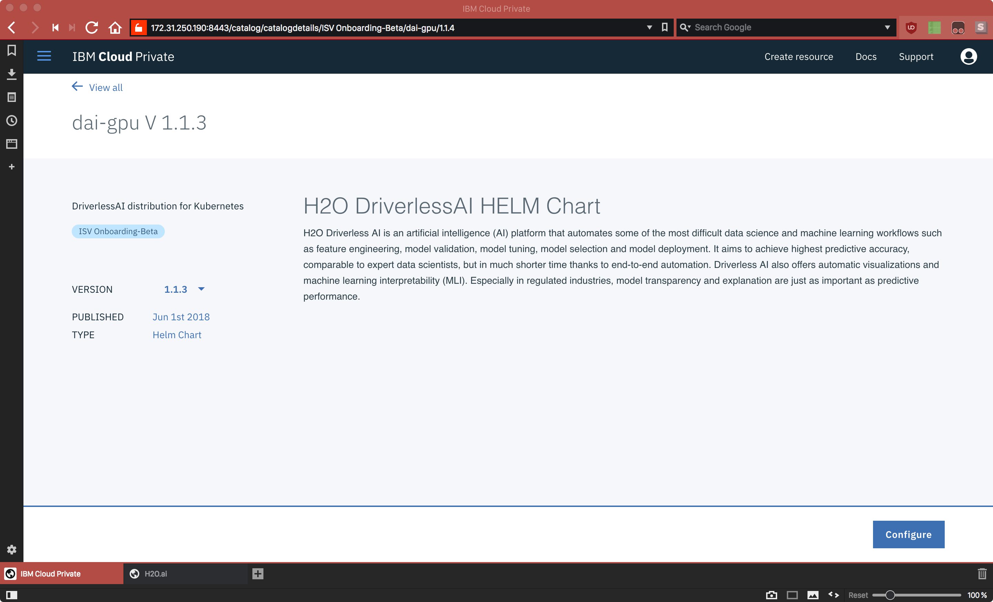
Cloud - IBM Cloud Private

Slide 9
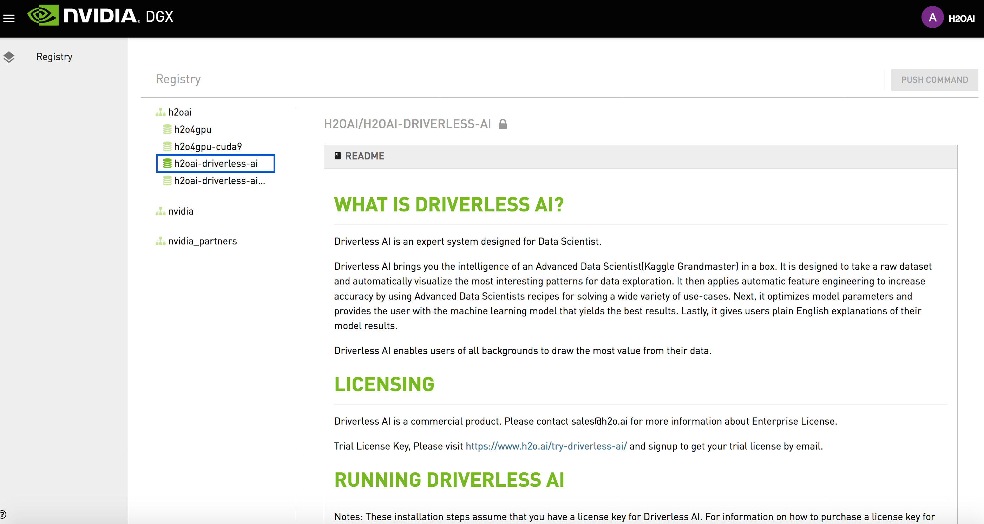
NVDIA DGX Registry

Slide 10
Install on Your Own
RPM package
DEB package
Docker image

Slide 11
RPM
Supported CPU | Supported OS | Supported CUDA | Supported GPU
IBM Power P8 | RHEL 7 | CUDA 8.0 CUDA 9.0 (CUDA 9.2 soon...) | Kepler Pascal Volta
IBM Power P9 | RHEL 7 | CUDA 9.0 (CUDA 9.2 soon...) | Volta
x86_64 | RHEL 7 SLES 12 | CUDA 8.0 CUDA 9.0 (CUDA 9.2 soon...) | Kepler Pascal Volta

Slide 12
DEB
Supported CPU | Supported OS | Supported CUDA | Supported GPU
IBM Power P8 | Ubuntu 16.04 | CUDA 8.0 CUDA 9.0 (CUDA 9.2 soon...) | Kepler Pascal Volta
IBM Power P9 | (Ubuntu GPU support not yet available...) | (Ubuntu GPU support not yet available...) | (Ubuntu GPU support not yet available...)
x86_64 | Ubuntu 16.04 | CUDA 8.0 CUDA 9.0 (CUDA 9.2 soon...) | Kepler Pascal Volta
x86_64 | Ubuntu 16.04 on Windows (via WSL) | none | none

Slide 13
Docker Image
Supported CPU | Supported Host OS | Supported Container CUDA | Supported GPU
IBM Power P8 | Ubuntu 16.04 | CUDA 8.0 CUDA 9.0 | Kepler Pascal Volta
IBM Power P8 | RHEL 7 | Soon... | Soon...
IBM Power P9 | (Ubuntu GPU support not yet available...) | (Ubuntu GPU support not yet available...) | (Ubuntu GPU support not yet available...)
IBM Power P9 | RHEL 7 | Soon... | Soon...
x86_64 | Ubuntu 16.04 | CUDA 8.0 CUDA 9.0 | Kepler Pascal Volta

Slide 14
Hardware Recommendations
IBM Power
P8 with 4 (or more) Pascal/Volta GPUs (“Minsky”)
Lots of CPU cores (100 +)
Lots of CPU memory (256 GB +)
Fast storage (SSD/NVMe)
P9 with 4 (or more) Volta GPUs (“Newell”)
Lots of CPU cores (one of my test systems has 160 cores)
Lots of CPU memory (256 GB +)
Fast storage (SSD/NVMe)
x86_64
2 or more Xeon sockets
4 or more Pascal / Volta GPUs
Lots of CPU memory (256 GB +)
Fast storage (SSD/NVMe)
Insights
Don’t skimp on CPU cores and memory; when GPUs aren’t working, this is the bottleneck
Fast storage makes a big difference for docker-based environments

Slide 15
End-to-End Uncrating to Creating – Bringing DAI to a new IBM P9 System
Enable RedHat Linux subscription
Install GPU drivers
Install CUDA 9.0
Grow the disk volume mounted at ‘/’
Open firewall port 12345
Download Driverless AI
Install Driverless AI
Use Driverless AI from your web browser

Slide 16
End-to-End Uncrating to Creating – Bringing DAI to a new IBM P9 System
firewall-cmd --zone=public --add-port=12345/tcp –permanent
wget http://.../dai-rpm.dai
yum localinstall dai.rpm
systemctl start dai
http://dai-host:12345
[ Import dataset ]
[ Run an experiment (the “Predict” menu item) ]
[ Enable RedHat Linux subscription ]
[ (Optional) Enable SELinux if you want it ]
yum install https://dl.fedoraproject.org/pub/epel/epel-release-latest-7.noarch.rpm
yum install dkms
yum groupinstall “Development Tools”
Needed to build GPU drivers
wget http://us.download.nvidia.com/tesla/396.26/nvidia-driver-local-repo-rhel7-396.26-1.0-1.ppc64le.rpm
yum localinstall nvidia-driver*.rpm
wget https://developer.download.nvidia.com/compute/cuda/repos/rhel7/ppc64le/cuda-repo-rhel7-9.2.88-1.ppc64le.rpm
yum localinstall cuda-repo*.rpm
yum install cuda-9-0.ppc64le
systemctl enable nvidia-persistenced
cp /lib/udev/rules.d/40-redhat.rules /etc/udev/rules.d
sed -i ‘/SUBSYSTEM==“memory”, ACTION==“add”/d’ /etc/udev/rules.d/40-redhat.rules
Needed for nvidia-smi to not say “Unknown error”
reboot
[ Grow size of the disk volume mounted at ‘/’ (default was really tiny) ]

Slide 17
Data Sources
File Formats
csv, tsv, txt, dat, tgz, gz, bz2, zip, xz, xls, xlsx, nff, feather, bin, arff, parquet
Connectors
Local filesystem
HDFS
S3
Google Cloud Storage
Google BigQuery
(in development) Minio
(in development) Snowflake
(in development) KDB
Adding these on a first-come-first-served basis...

Slide 18
Automating Driverless AI Training (Python)
address = 'http://ip_where_driverless_is_running:12345'
username = 'username'
password = 'password'
from h2oai_client import Client, ModelParameters, InterpretParameters
h2oai = Client(address = address, username = username, password = password)
train_path = '/data/Kaggle/CreditCard/CreditCard-train.csv'
test_path = '/data/Kaggle/CreditCard/CreditCard-test.csv'
train = h2oai.create_dataset_sync(train_path)
test = h2oai.create_dataset_sync(test_path)
target="default payment next month"
params = h2oai.get_experiment_tuning_suggestion(dataset_key = train.key,
target_col = target,
is_classification = True,
is_time_series = False)
experiment = h2oai.start_experiment_sync(params)
h2oai.download(src_path=experiment.test_predictions_path, dest_dir=".")

Slide 19
Productionizing Driverless AI Pipelines
Driverless AI MOJO pipeline (+ model) artifact
Small/lightweight footprint
Low latency
Designed for real-time applications (predicting one row at a time)
Java implementation
MOJO for both the feature-engineered pipeline, as well as for MLI (to get reason codes in production)
Driverless AI Python pipeline (+ model) artifact
Heavy footprint
Usable for batch applications
Used as a reference implementation for MOJO testing
Will usually have new features first

Slide 20
Driverless AI Python MOJO Code Example
import java.io.IOException;
import ai.h2o.mojos.runtime.MojoPipeline;
import ai.h2o.mojos.runtime.frame.MojoFrame;
import ai.h2o.mojos.runtime.frame.MojoFrameBuilder;
import ai.h2o.mojos.runtime.frame.MojoRowBuilder;
import ai.h2o.mojos.runtime.utils.SimpleCSV;
public class Main {
public static void main(String[] args) throws IOException {
// Load model and csv
MojoPipeline model = MojoPipeline.loadFrom("pipeline.mojo");
// Get and fill the input columns
MojoFrameBuilder frameBuilder = model.getInputFrameBuilder();
MojoRowBuilder rowBuilder = frameBuilder.getMojoRowBuilder();
rowBuilder.setValue("AGE", "68");
rowBuilder.setValue("RACE", "2");
rowBuilder.setValue("DCAPS", "2");
rowBuilder.setValue("VOL", "0");
rowBuilder.setValue("GLEASON", "6");
frameBuilder.addRow(rowBuilder);
// Create a frame which can be transformed by MOJO pipeline
MojoFrame iframe = frameBuilder.toMojoFrame();
// Transform input frame by MOJO pipeline
MojoFrame oframe = model.transform(iframe);
// Output prediction as CSV
SimpleCSV outCsv = SimpleCSV.read(oframe);
outCsv.write(System.out);
}
}

Slide 21
Top Customer Questions - Installation
Can Driverless AI run on CPU-only machines?
Can Driverless AI be installed without docker in a native install mode RPM, DEB package ?
Can Driverless AI be integrated with ActiveDirectory/LDAP for Authentication/Authorization ?
Can Driverless AI be secured with SSL support ?
Can I run multiple instances of Driverless AI on one GPU server ?
Can I run divide Driverless AI and divide GPU resources ?
Can Driverless AI run on my Windows 7 laptop ?
Can Driverless AI run in an air-gapped environment?

Slide 22
Top Customer Questions - Deployment
Can the model (& pipeline) be deployed as a docker container ?
Can the model (& pipeline) be deployed as a micro service in kubernetes ?
Does Driverless AI support one click model (& pipeline) deployment ?
How to scale Driverless AI MOJO model (& pipeline) in production ?
What are the different Driverless AI MOJO model (& pipeline) deployment patterns ?

