Slide 1
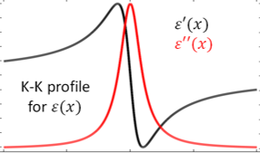

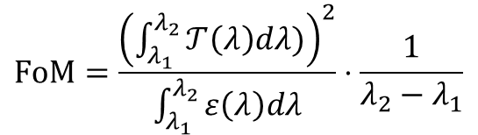


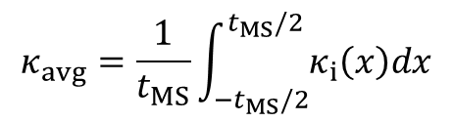
1 Stack
…
…
$$t_{MS}$$
…
…
$$κ_{avg}=\frac{1}{t_{MS}}\int_{{−t}_{MS}/2}^{t_{MS}/2}{κ_{i}\left(x\right)dx}$$
$$FoM=\frac{{\left(\int_{λ_{1}}^{λ_{2}}{𝒯\left(λ\right)dλ)}\right)}^{2}}{\int_{λ_{1}}^{λ_{2}}{ε\left(λ\right)dλ}}⋅\frac{1}{λ_{2}−λ_{1}}$$
$$T_{Bulk}\left(λ\right)=e^{−\frac{4π}{λ}κ_{avg}t_{MS}}$$
$$ε_{Bulk}\left(λ\right)=1−T_{Bulk}\left(λ\right)$$

Slide 2
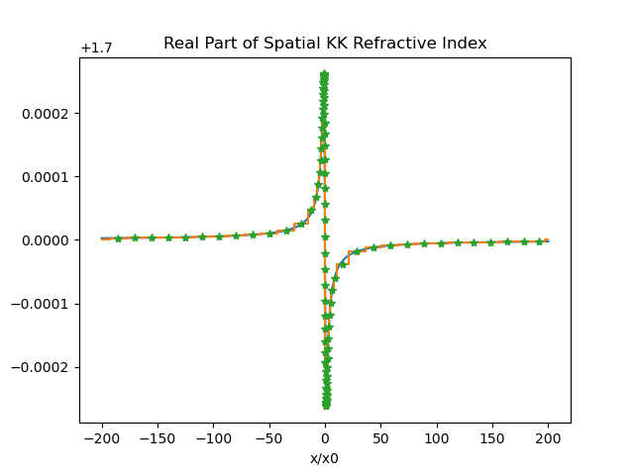
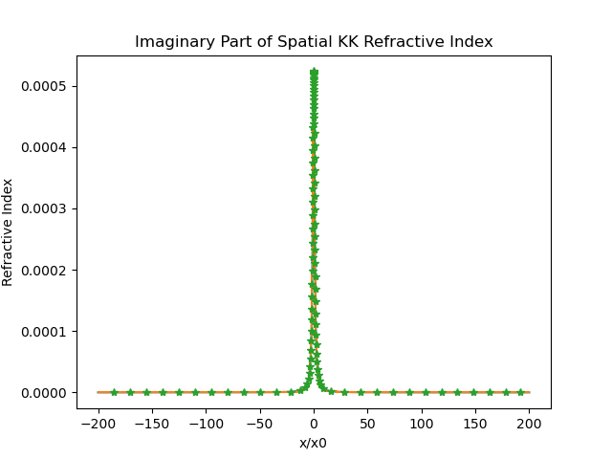
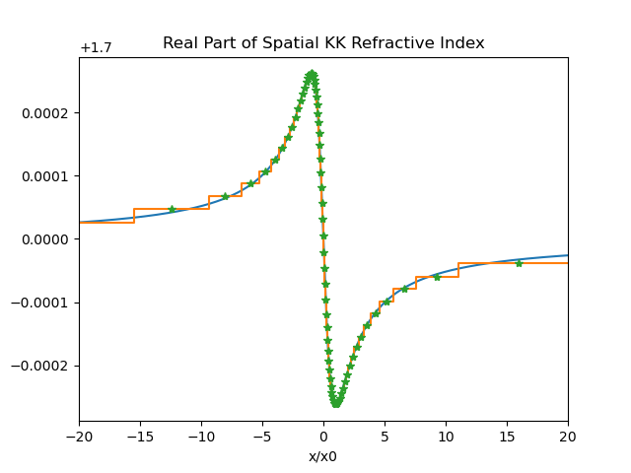
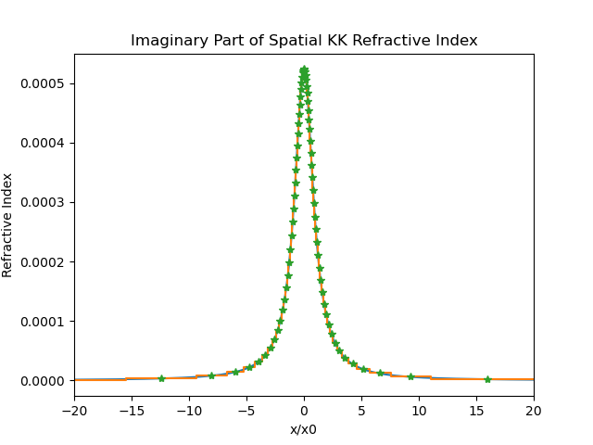
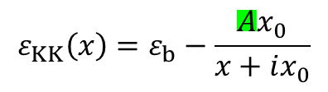
$$ε_{KK}\left(x\right)=ε_{b}−\frac{Ax_{0}}{x+ix_{0}}$$
ε_{b} = n_{s}² , x₀ = 0.01 μm
t_{KK} = 400*x₀ = 4 μm
Sapphire @ T=300K (averaged over 2-5μm): k_{bulk} = 4.268 x 10⁻⁶
Corresponding amp. A for same losses in spatial KK:
A = 0.00178
Single KK stack:
FOM_{RL} = 15681.37 FOM_{bulk} = 15680.43
FOM enhancement = 1.00006
Can we do better by adding more stacks?

Slide 3
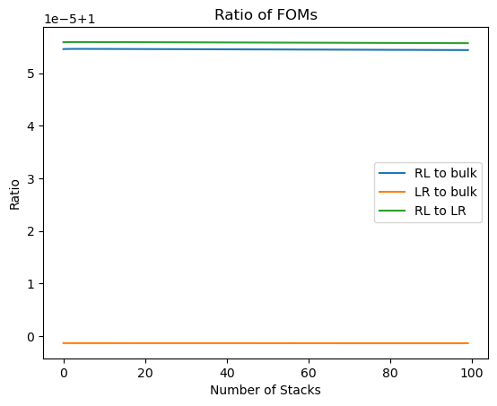
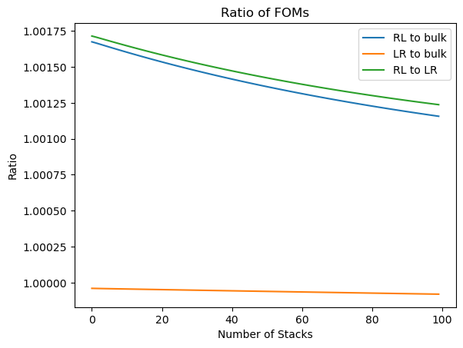
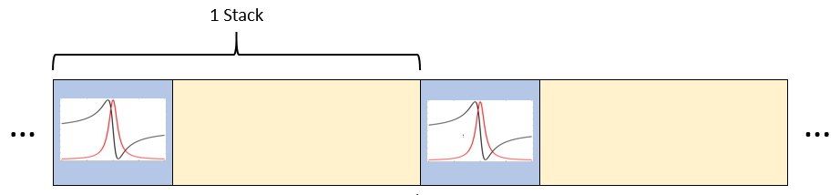
Short answer: no
Increase A by factor of 100:

