Slide 1
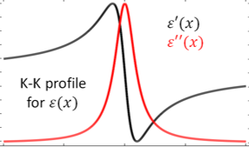

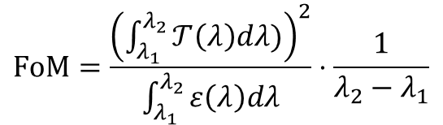


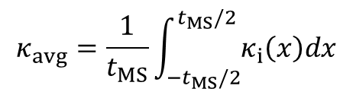
1 Stack
…
…
$$t_{MS}$$
…
…
$$κ_{avg}=\frac{1}{t_{MS}}\int_{{−t}_{MS}/2}^{t_{MS}/2}{κ_{i}\left(x\right)dx}$$
$$FoM=\frac{{\left(\int_{λ_{1}}^{λ_{2}}{𝒯\left(λ\right)dλ)}\right)}^{2}}{\int_{λ_{1}}^{λ_{2}}{ε\left(λ\right)dλ}}⋅\frac{1}{λ_{2}−λ_{1}}$$
$$T_{Bulk}\left(λ\right)=e^{−\frac{4π}{λ}κ_{avg}t_{MS}}$$
$$ε_{Bulk}\left(λ\right)=1−T_{Bulk}\left(λ\right)$$

Slide 2
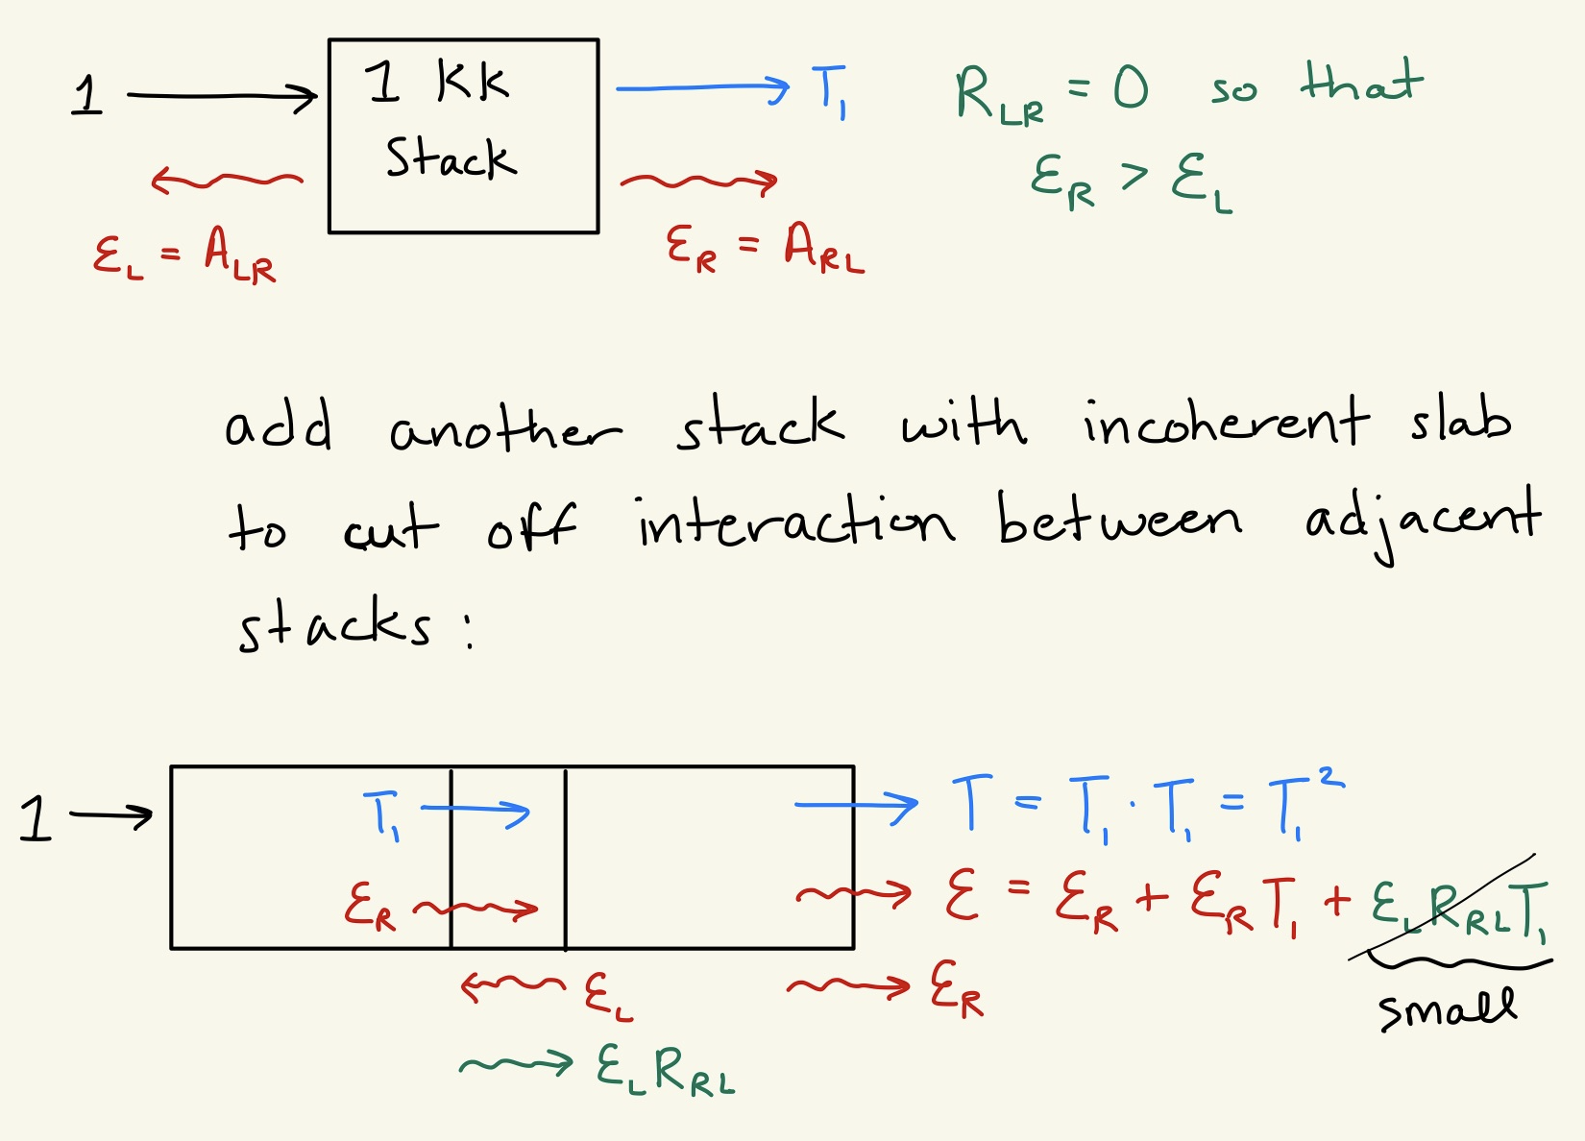
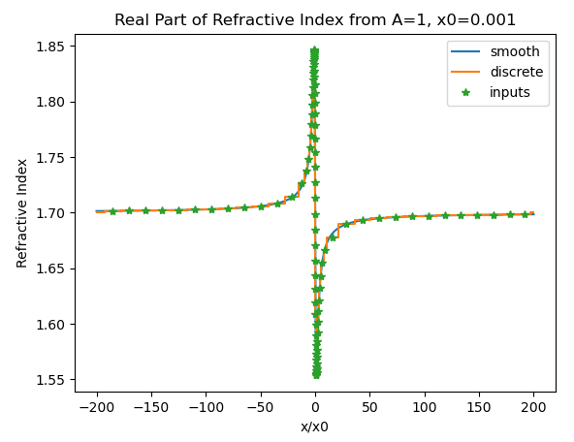
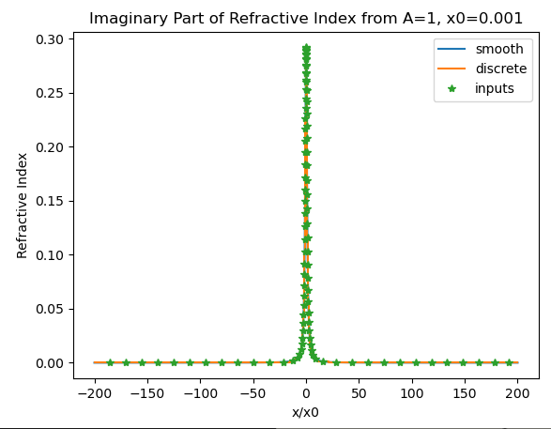

Slide 3
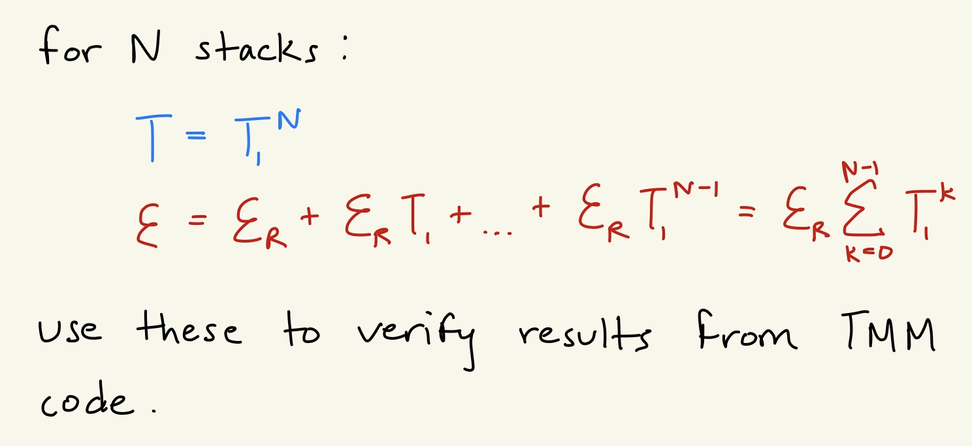
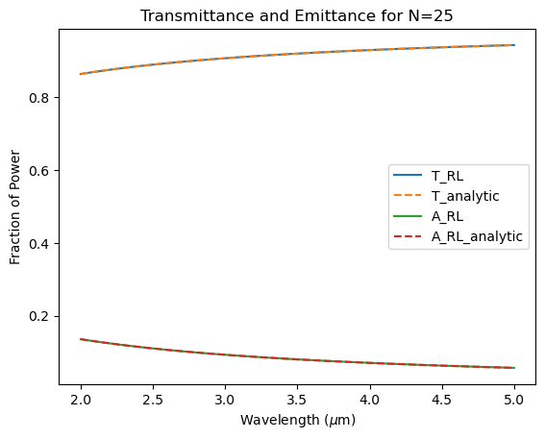
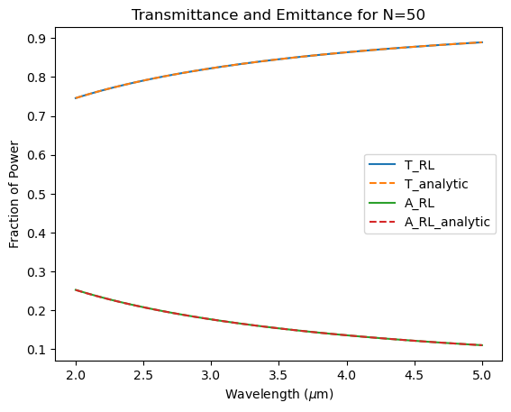
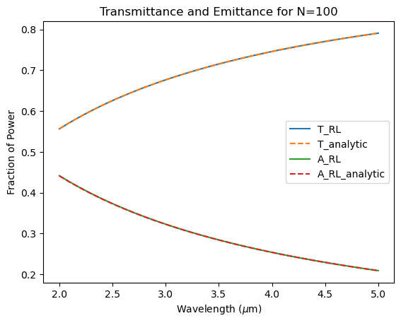

Slide 4
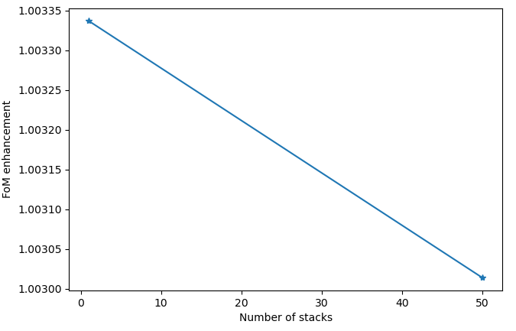
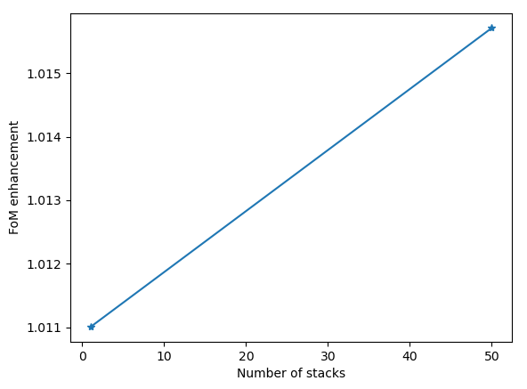
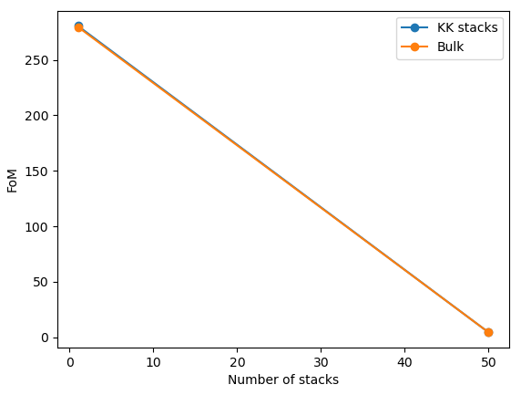
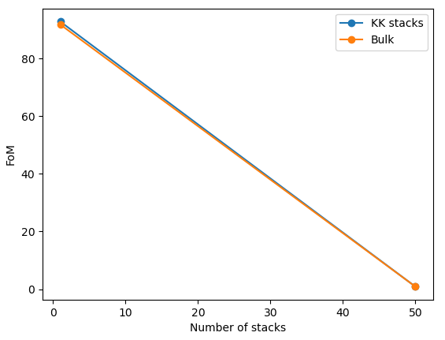
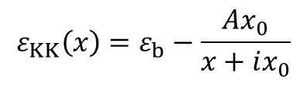
$$ε_{KK}\left(x\right)=ε_{b}−\frac{Ax_{0}}{x+ix_{0}}$$
A = 0.1, x0 = 0.01 um
A = 15, x0 = 0.0002 um
FOM enhancement decreases as a function of # of stacks N for one set of inputs but increases for another set of inputs.

Slide 5
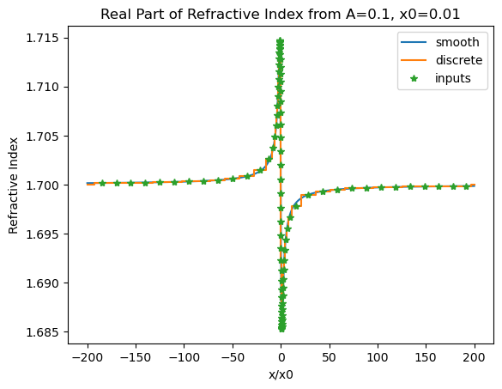
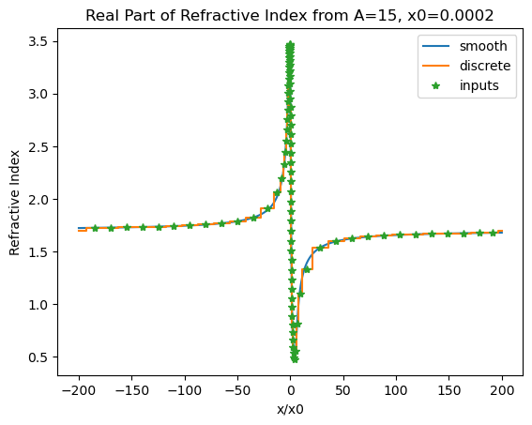
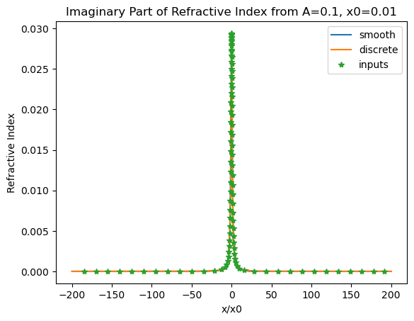
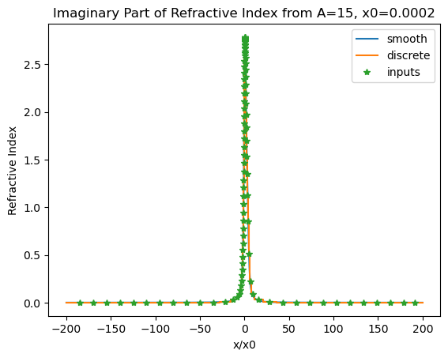
$$ε_{KK}\left(x\right)=ε_{b}−\frac{Ax_{0}}{x+ix_{0}}$$
A = 0.1, x0 = 0.01 um
A = 15, x0 = 0.0002 um

Slide 6
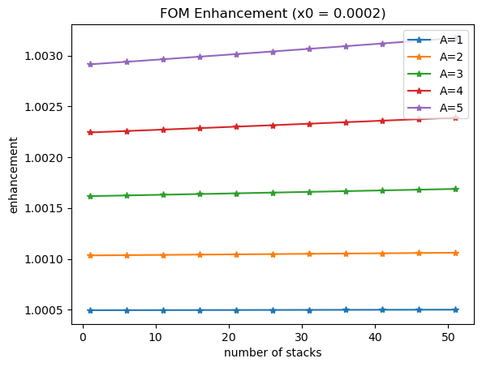
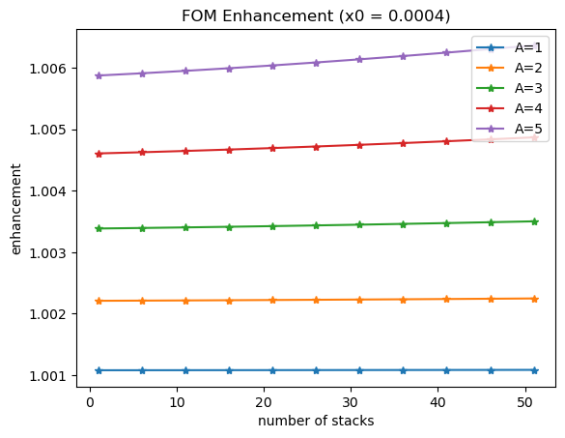
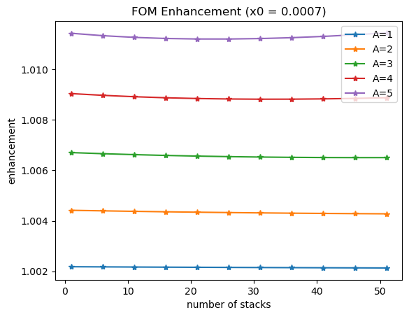
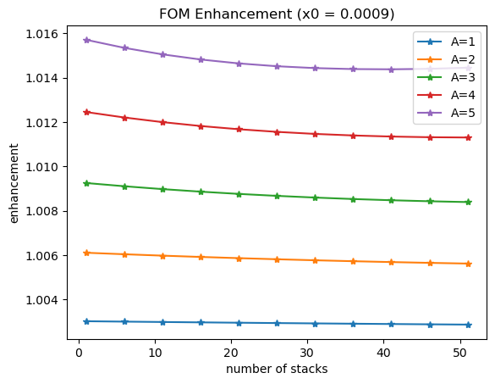
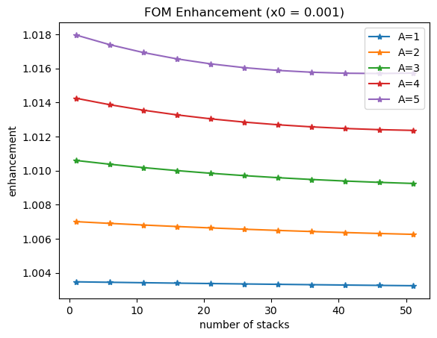
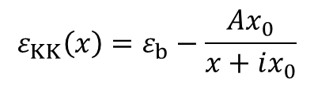
$$ε_{KK}\left(x\right)=ε_{b}−\frac{Ax_{0}}{x+ix_{0}}$$
Transition point at x0 ~ 0.0005 um . FOM enhancement goes from increasing with N to decreasing.

Slide 7
