Slide 1
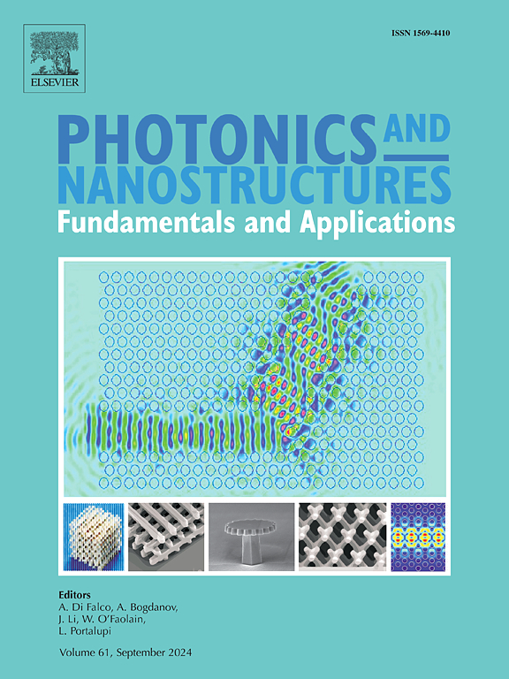
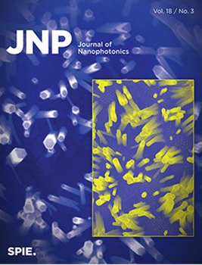
Two ideas for a paper:
Pure Theory: “Prospects and Limitations of Permittivity Spatial Engineering for Asymmetric Thermal Emission“
Theory + Experiment: “Asymmetric Thermal Emission in Multilayer Metasurface Obeying Spatial Kramers- Kronig Relations”
Journal to aim for: Physical Review B (IF: 3.2)
Henry’s Recommendations:
Advanced Optical Materials (IF: 10)
APL Photonics
Optica
ACS Photonics
Other journals:
PRApplied (IF: 3.8)
PRMaterials (IF: 3.1)
Optics Letters (IF: 3.1)
Photonics and Nanostructures - Fundamentals and Applications (IF: 2.5)
Applied Physics A (IF: 2.5)
Journal of Nanophotonics (IF: 1.1)

Slide 2
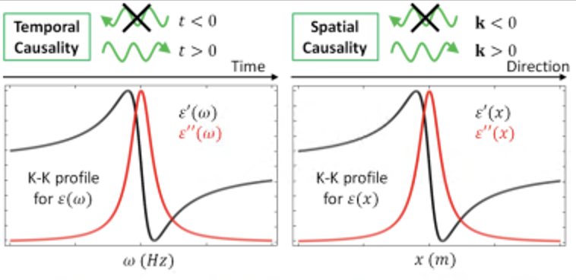
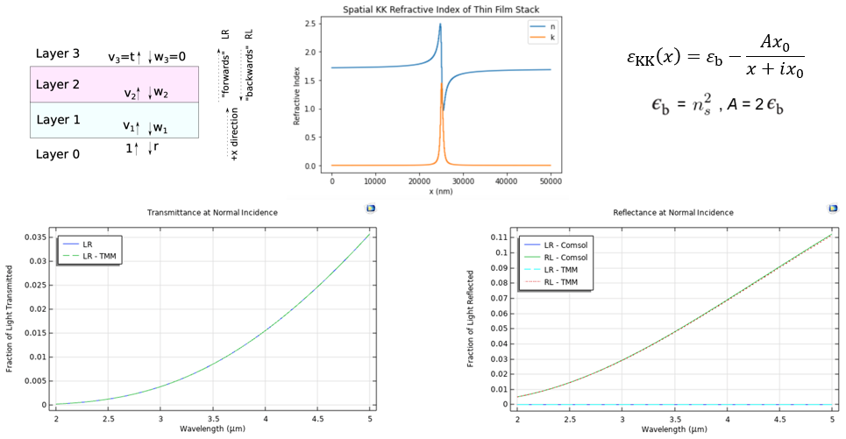
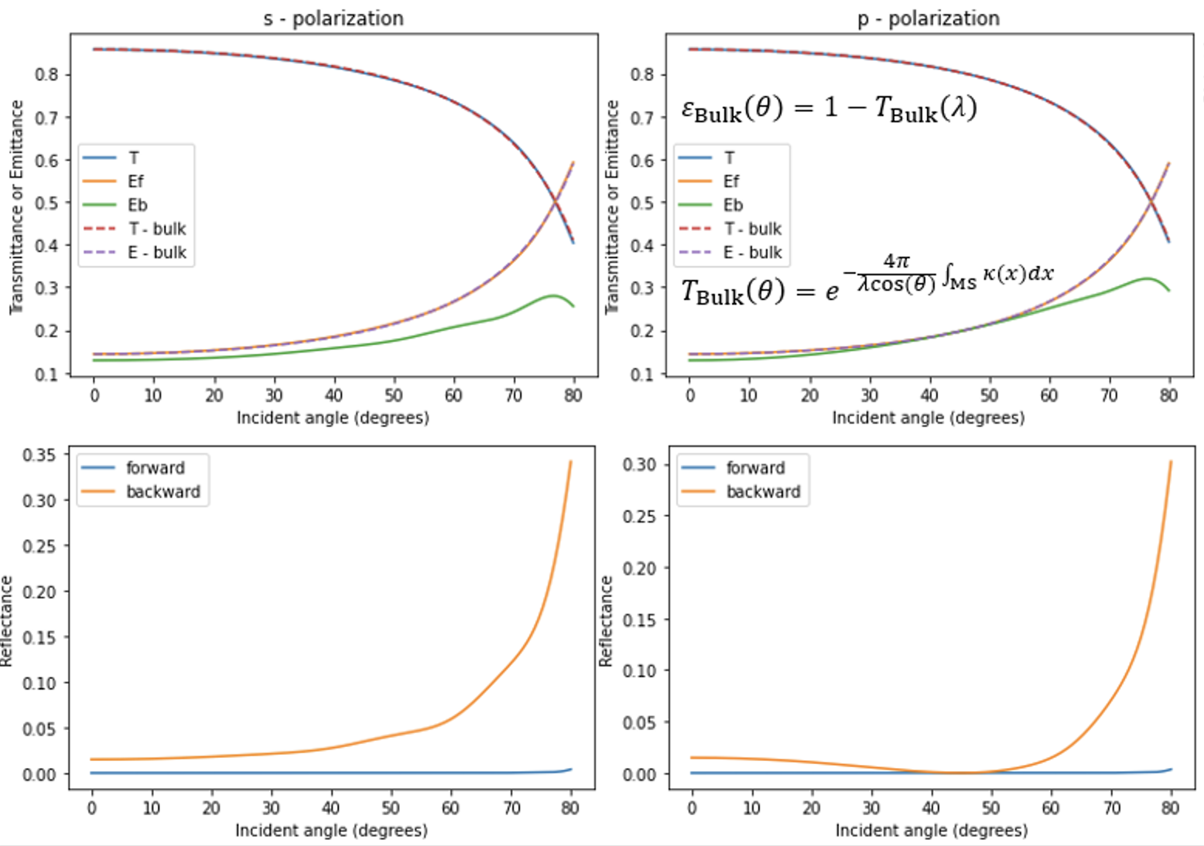
1. Introduction + Theory
Figure 1. Temporal and Spatial Kramers-Kronig relations for electric permittivity. Real, 𝜀′, and imaginary, 𝜀′′, part of the electric permittivity vs. frequency (left) and space (right) with corresponding causality effects.
Figure 2. Forwards and backwards transmittance (left) and reflectance (right) of a multilayer metastructure obeying spatial KK relations. The spatially varying refractive index (top) achieves zero reflectance for all wavelengths in one direction, allowing asymmetry in the emission (R + T + A = 1). Calculations were done at normal incidence using both Comsol and TMM software.
Figure 3. Transmittance and emittance (top) and reflectance (bottom) for different incident angles (s and p-polarization). Asymmetry in emission grows as incident angle increases.

Slide 3
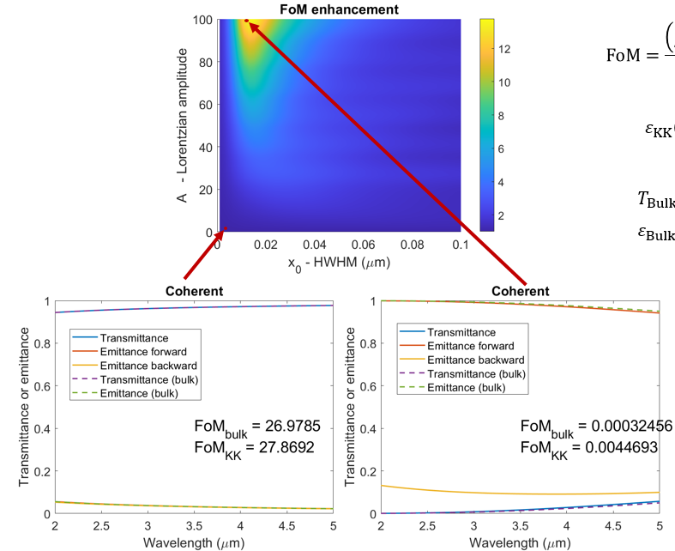
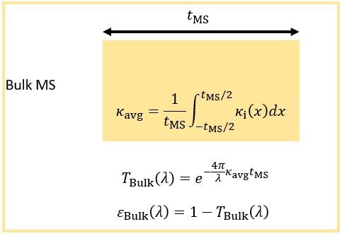

2. Limitations of Spatial KK as a Window
Kicker: Asymmetry is only advantageous when losses are high
Figure 4. Comparing the figure-of-merit (bottom left) of a spatial-KK varying metasurface to an equivalently lossy bulk window (top left). Although the FoM enhancement (top right) shows that an enhancement of over 12 is achievable, the transmittance is very low in this region (bottom right). Regions with good FoMs (bottom middle) show hardly any advantage to a spatially varied window.

Slide 4
3a. What is the best we can do with set amount of losses?
Concern: How can we guarantee that this is the highest FoM achievable? What is the fundamental limit?
Figure 5 (TODO). Given some total losses, find either using spatial Kramers-Kronig relations, or by optimization algorithm, the most asymmetry / highest FoM that can be achieved.

Slide 5
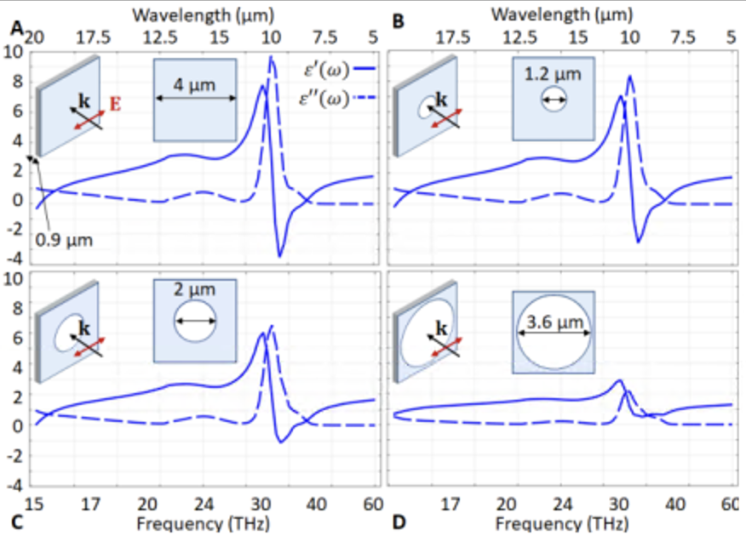
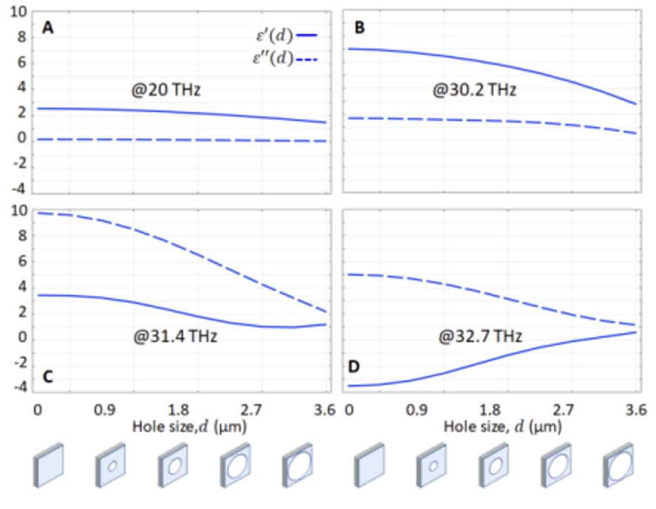
3b. Designing hole array metasurface
Figure 5. Retrieved permittivity (left) and permittivity range vs. hole size (right) for SiO2 slab and arrays of air holes. Real and imaginary part effective permittivity spectra for a 0.9 µm thick silica slab (A) and arrays with air holes of increasing size (B-D).

Slide 6
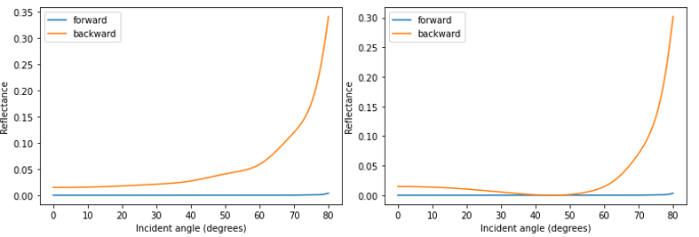
4b. Experimental Results
Figure 6 (TODO). Fabricate proposed hole-array metasurface, and measure forwards and backwards reflectance over a range of angles. Hopefully they match the calculations.

