Slide 1
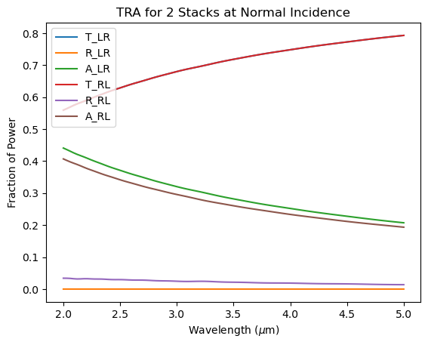
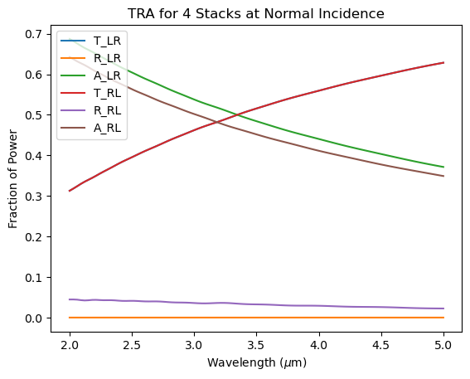
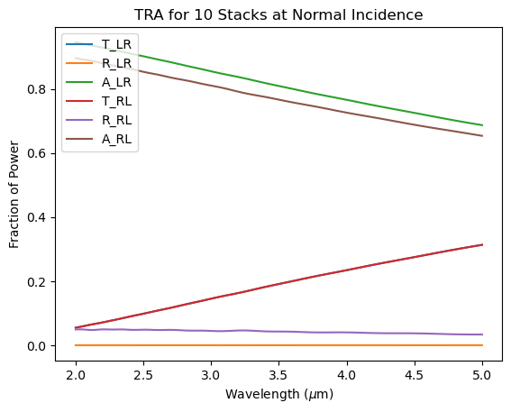
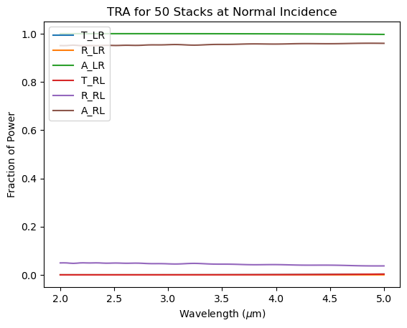
Stack of 2 MS
Stack of 4 MS
Want to maximize ratio of transmission (red curve) to emission (brown curve) using a stack of KK metasurfaces, separated by background material (sapphire)
Found that increasing number of MS in stack decreases transmission and increases absorption (opposite of what we want)
Stack of 10 MS
Stack of 50 MS

