Slide 1
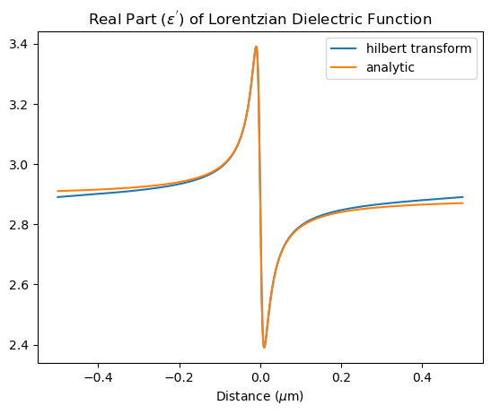
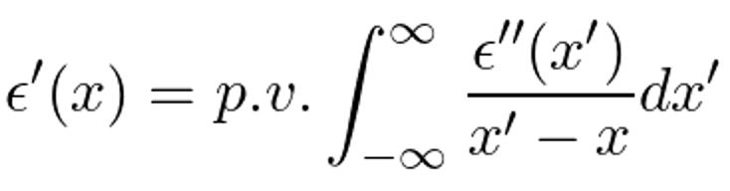
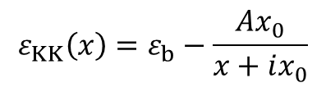
Using other Spatial KK Profiles
SciPy has a Hilbert transform function. Verify it by comparing to Lorentzian:
$$ε_{KK}\left(x\right)=ε_{b}−\frac{Ax_{0}}{x+ix_{0}}$$

Slide 2
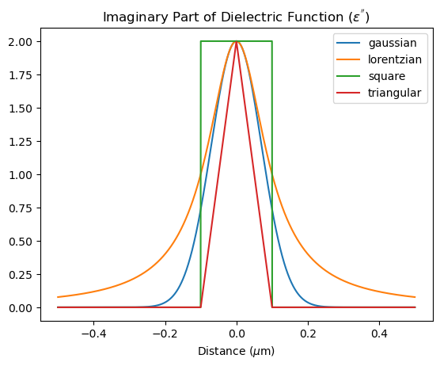
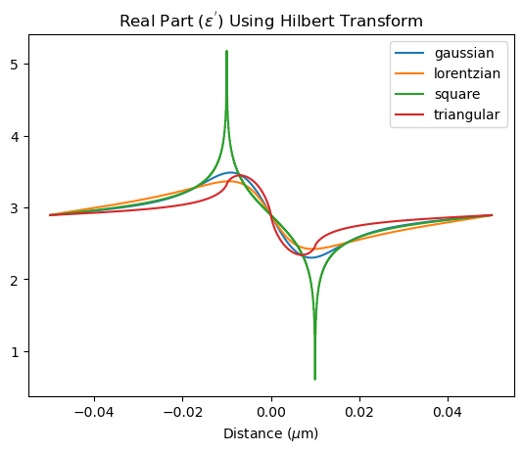

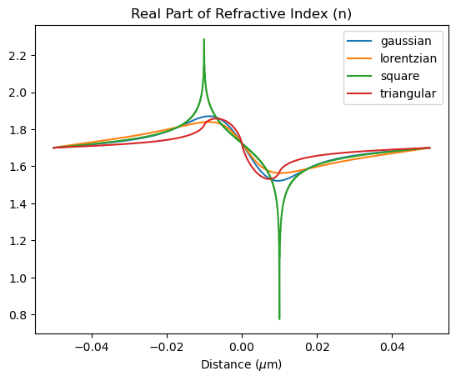
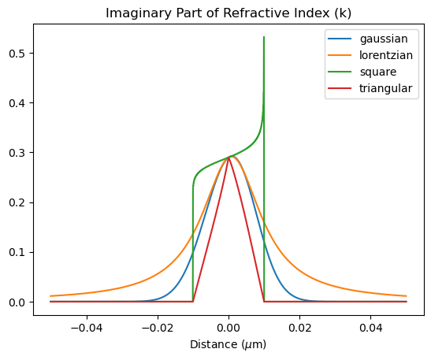

Slide 3
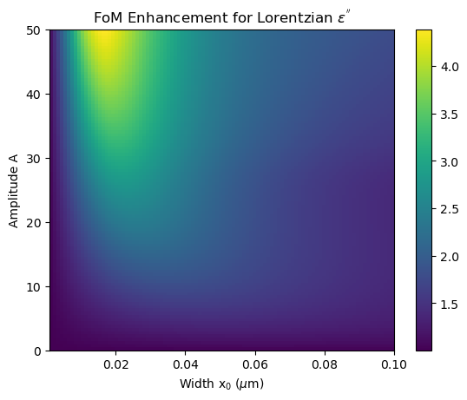
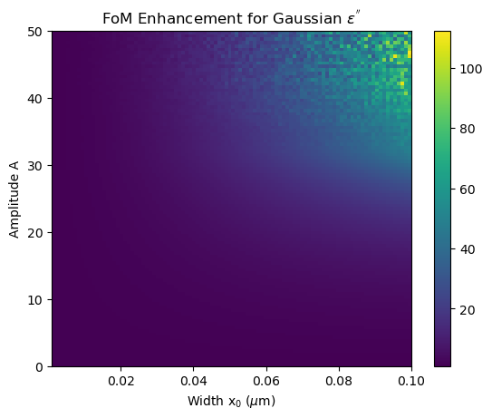
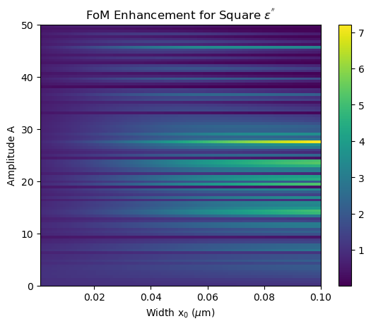
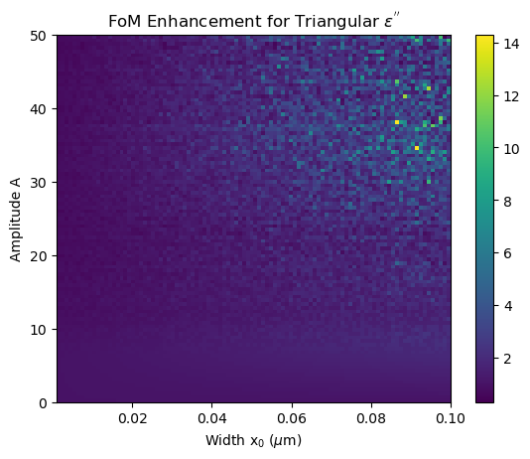
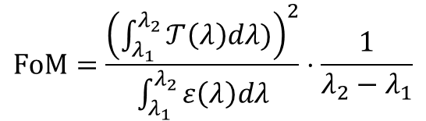
$$FoM=\frac{{\left(\int_{λ_{1}}^{λ_{2}}{𝒯\left(λ\right)dλ)}\right)}^{2}}{\int_{λ_{1}}^{λ_{2}}{ε\left(λ\right)dλ}}⋅\frac{1}{λ_{2}−λ_{1}}$$
A
x₀
plot transmittance and absorbance at max enhancement

Slide 4
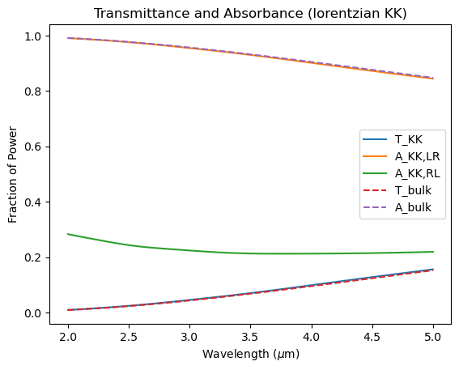
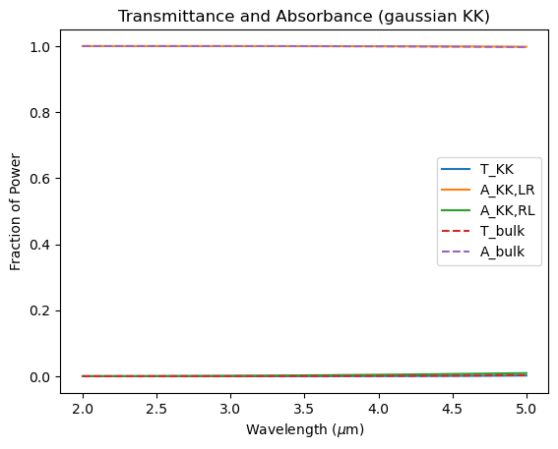
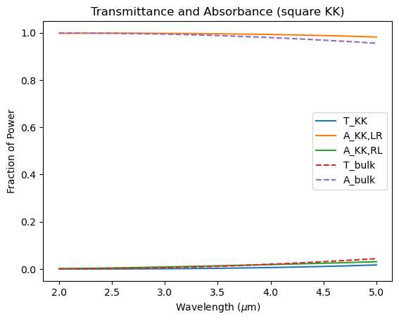
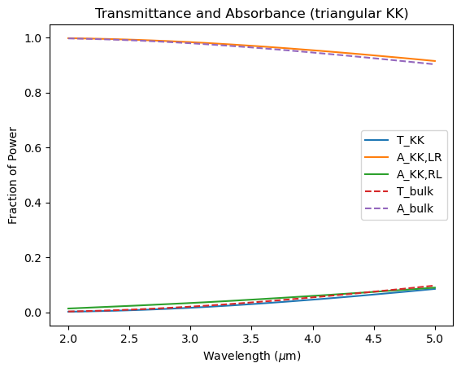
FOM_{KK} = 0.0247
FOM_{bulk} = 0.00563
FOM_{KK} = 5.58 x 10⁻⁵
FOM_{bulk} = 4.97 x 10⁻⁷
FOM_{KK} = 0.0168
FOM_{bulk} = 0.000232
FOM_{KK} = 0.0246
FOM_{bulk} = 0.00172
Spatial KK profiles that yield large enhancement have small FoM

