Slide 1
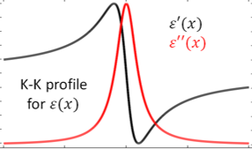

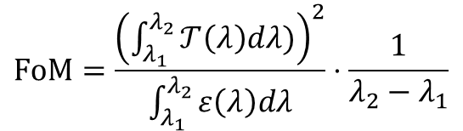


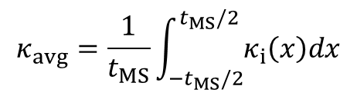
1 Stack
…
…
$$t_{MS}$$
…
…
$$κ_{avg}=\frac{1}{t_{MS}}\int_{{−t}_{MS}/2}^{t_{MS}/2}{κ_{i}\left(x\right)dx}$$
$$FoM=\frac{{\left(\int_{λ_{1}}^{λ_{2}}{𝒯\left(λ\right)dλ)}\right)}^{2}}{\int_{λ_{1}}^{λ_{2}}{ε\left(λ\right)dλ}}⋅\frac{1}{λ_{2}−λ_{1}}$$
$$T_{Bulk}\left(λ\right)=e^{−\frac{4π}{λ}κ_{avg}t_{MS}}$$
$$ε_{Bulk}\left(λ\right)=1−T_{Bulk}\left(λ\right)$$

Slide 2
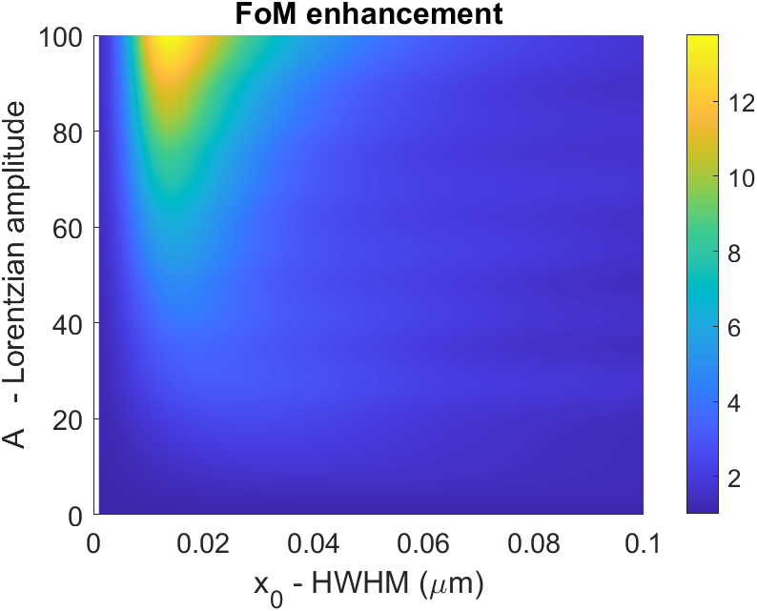
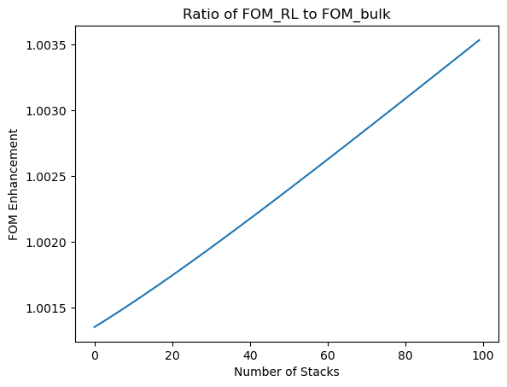
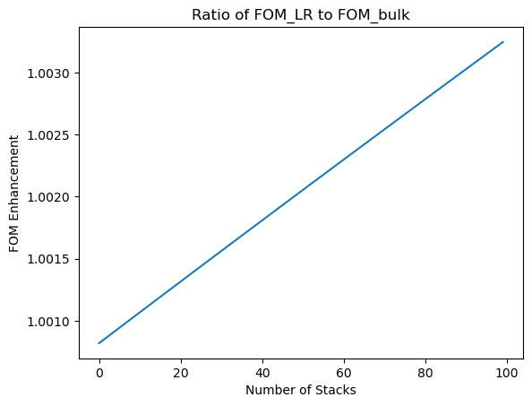
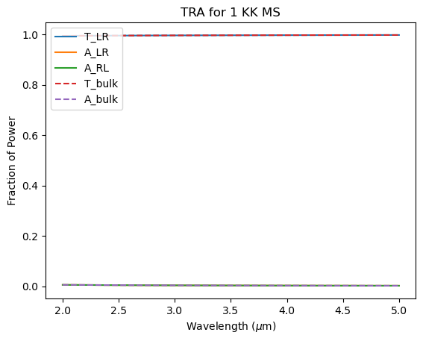
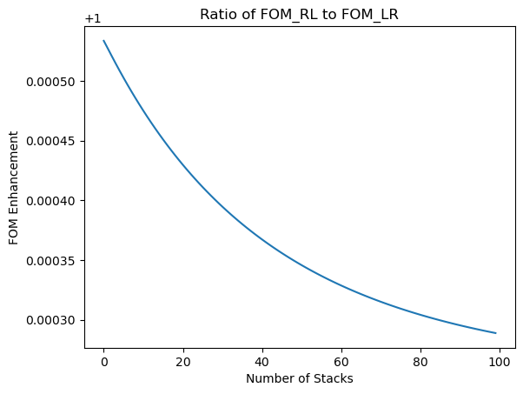
A = 0.1
gamma = 0.01
FOM_KK is: 281.4
FOM_bulk is: 279.1

Slide 3
