Slide 1
Particle Swarm Optimization for MS Window
Generate a set of candidate solutions, and try to find the best solution using a position-velocity update method:
Inputs:
- # of dimensions
- objective function / FOM
- bounds of each dimension
- number of “particles”
- weights: w (momentum), c₁ (personal best), c₂ (global best)
- # of iterations
hyperparameters to tune

Slide 2
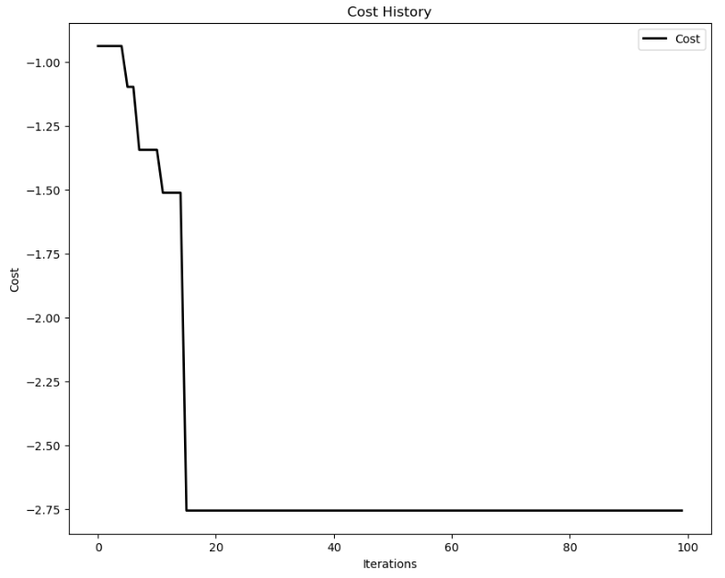
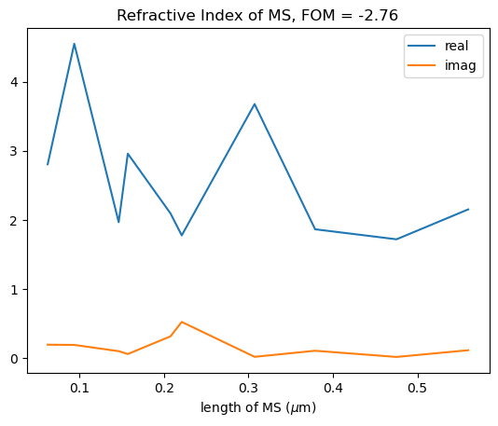
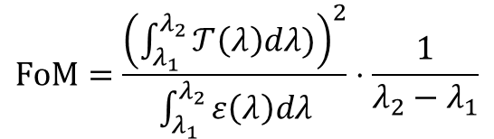
$$FoM=\frac{{\left(\int_{λ_{1}}^{λ_{2}}{𝒯\left(λ\right)dλ)}\right)}^{2}}{\int_{λ_{1}}^{λ_{2}}{ε\left(λ\right)dλ}}⋅\frac{1}{λ_{2}−λ_{1}}$$
N_{layers} = 10
Bounds: n_{min} = 1.3, n_{max} = 5,
k_{min} = 0.01, k_{max} = 1,
d_{min} = 0.01 μm, d_{max} = 0.1 μm
N_{particles} = 100
N_{iterations} = 100
Dimensions = 3*N_{layers} (n, k, d)

Slide 3
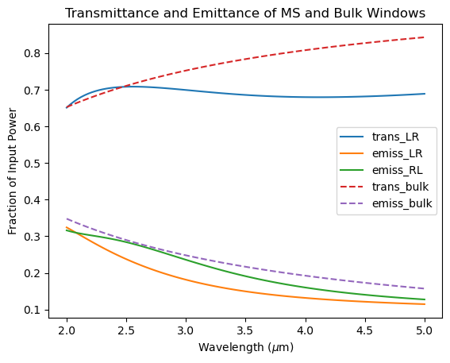
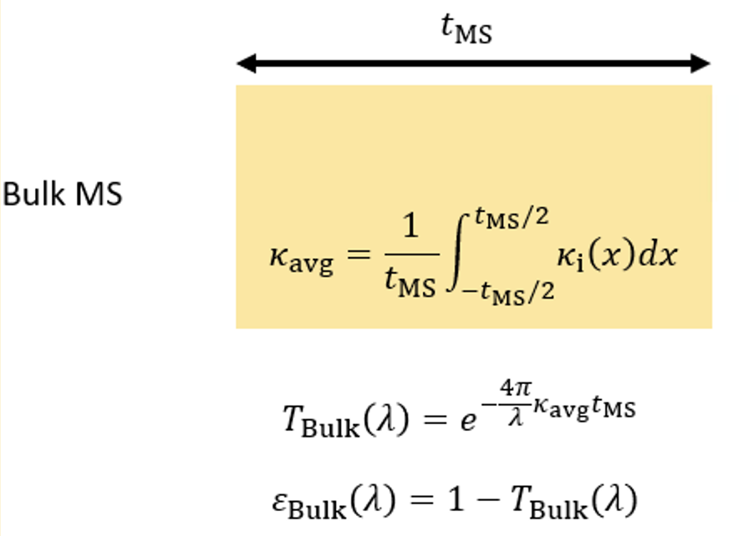
Compare bulk window with same total losses with proposed design:
Next steps:
- Compare with spatial KK (same losses)
- Tune hyperparameters in PSO, run several exps
- Compare FOM over a range of angles
FOM_{bulk} : 2.62 , FOM_{MS} : 2.76

