Slide 1
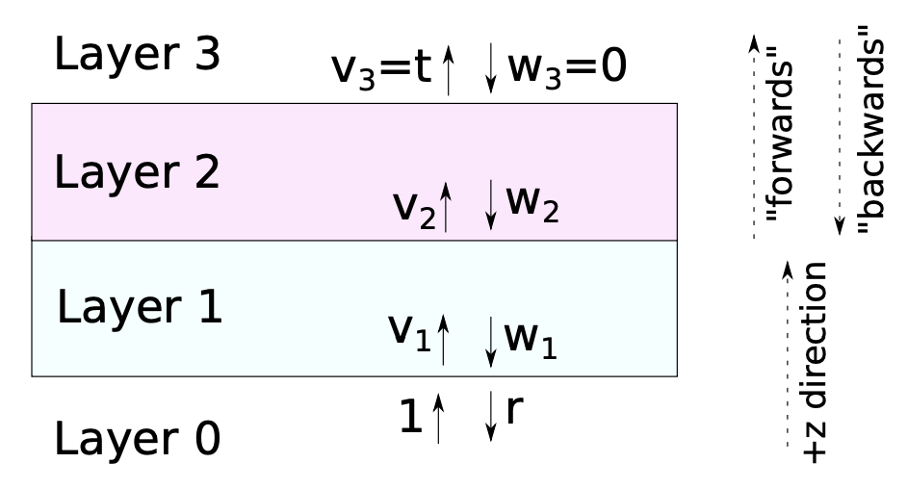
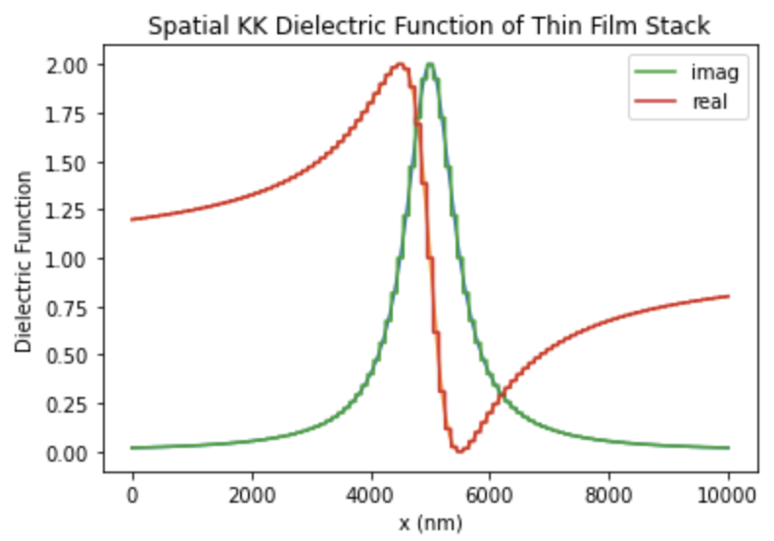
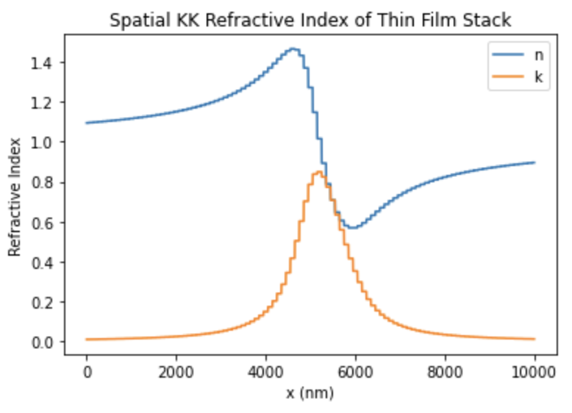
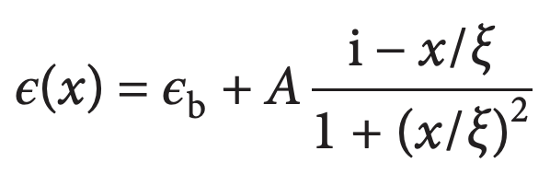

Spatial Kramers-Kronig Dielectric Function in Thin Film Stack
Number of layers N = 100
Thickness of each stack t = 100nm

Slide 2
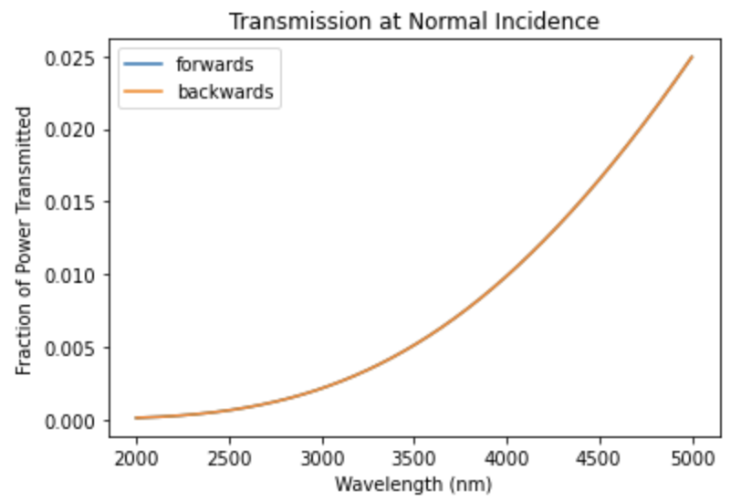
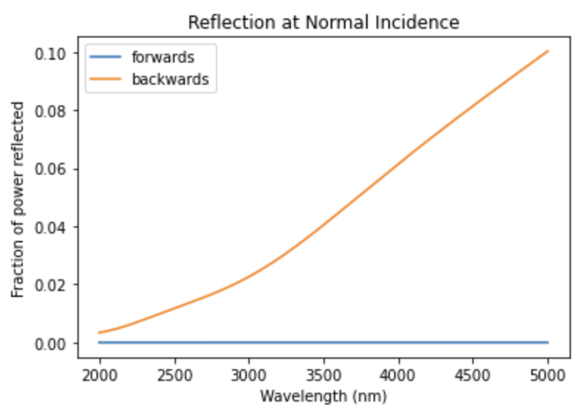
Spatial Kramers-Kronig Dielectric Function in Thin Film Stack

