Slide 1
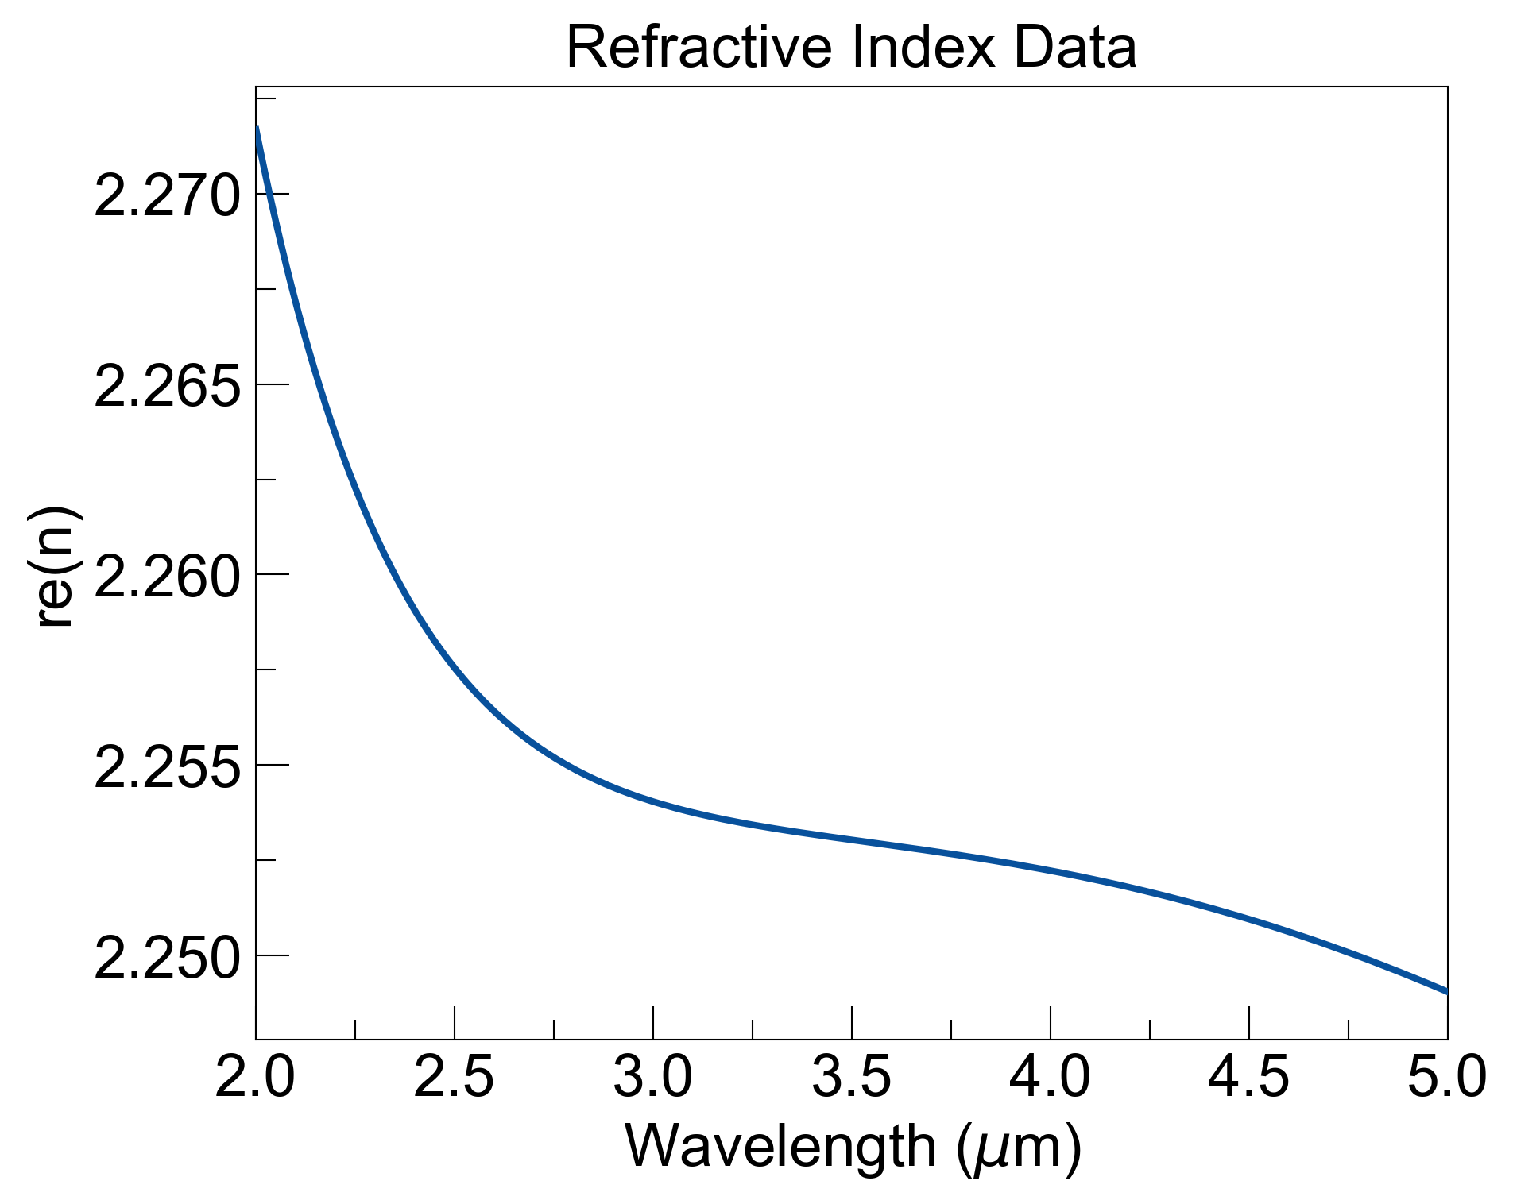
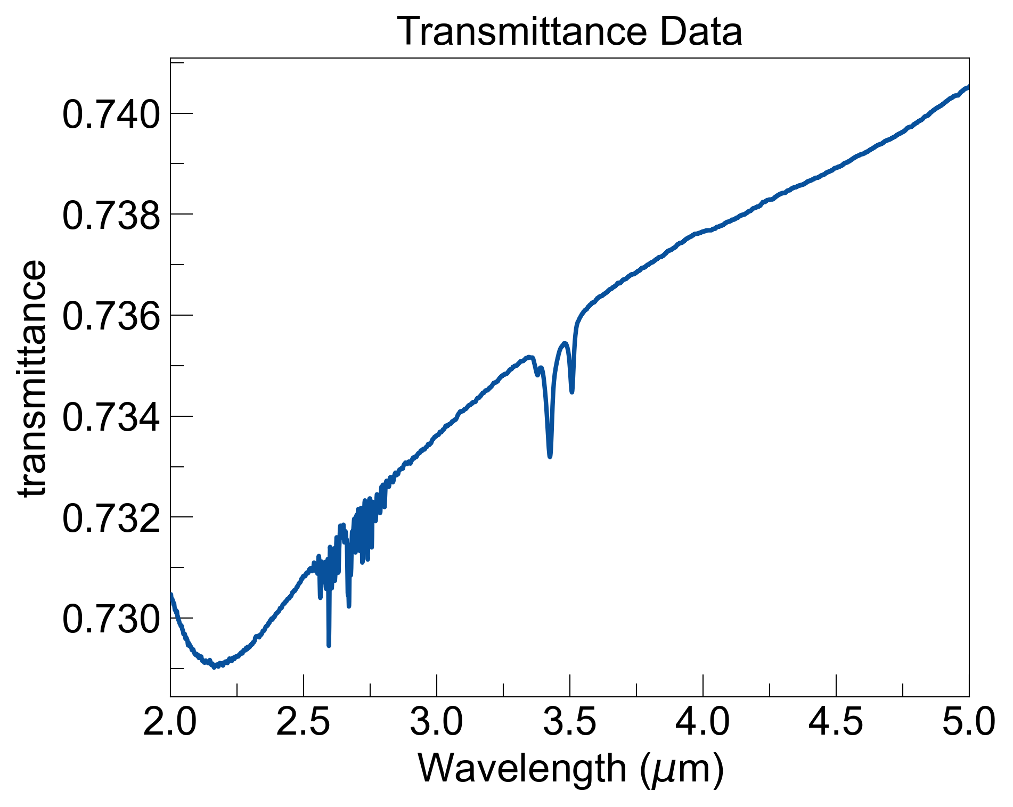
Approximated losses from ZnS data (2mm thick, normal incidence)
since transmittance increases with wavelength, im(n) needs to decrease in this region
try form k(λ) = m(λ – 2[um]) + b (m < 0 , b > 0)
Find ‘m’ and ‘b‘ empirically to match transmittance data

Slide 2
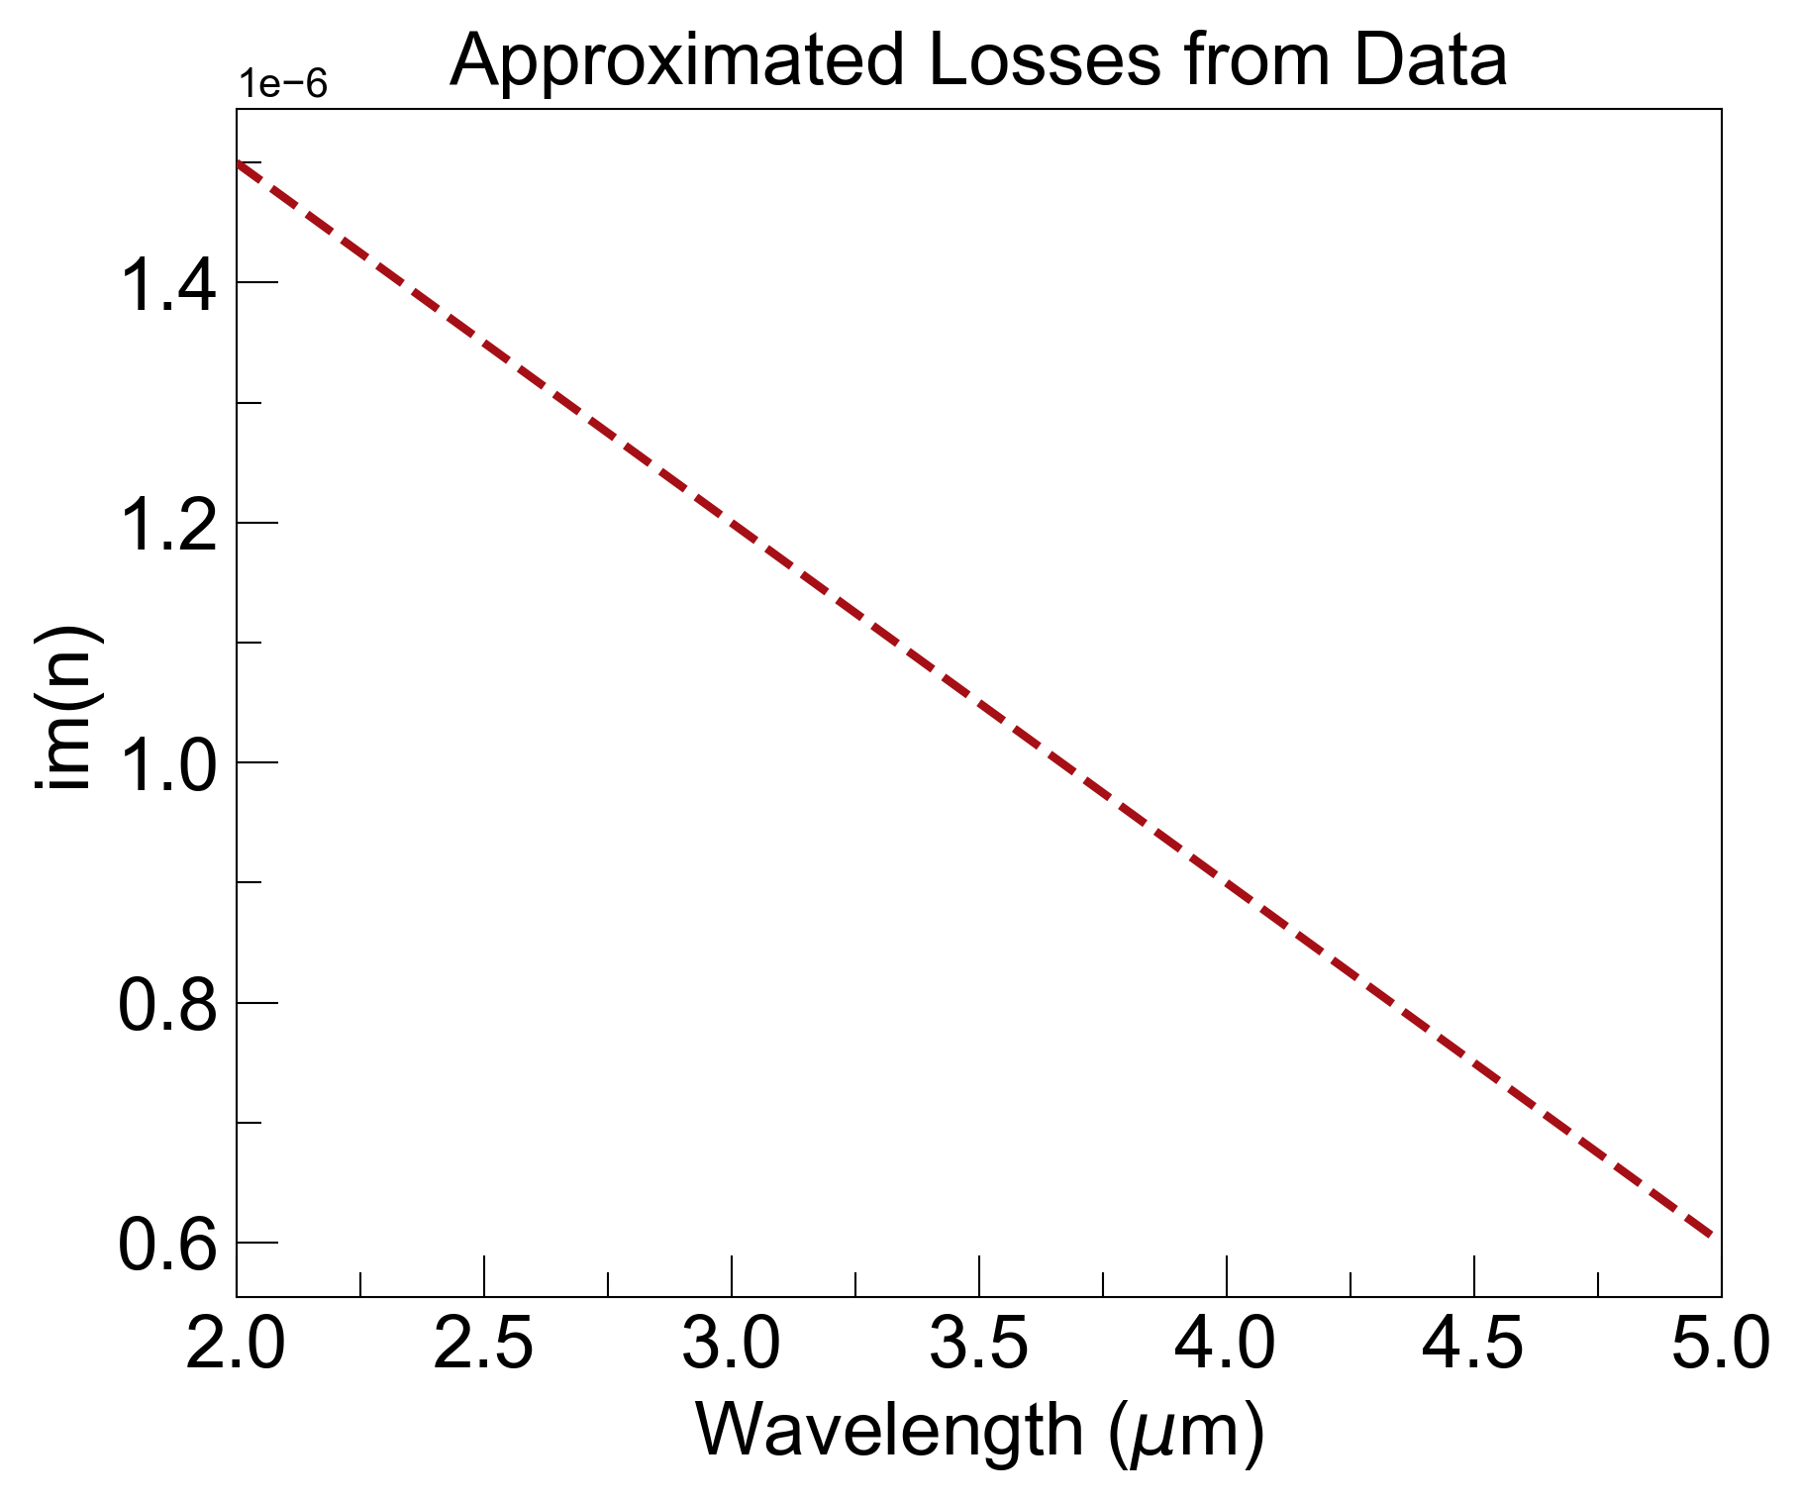
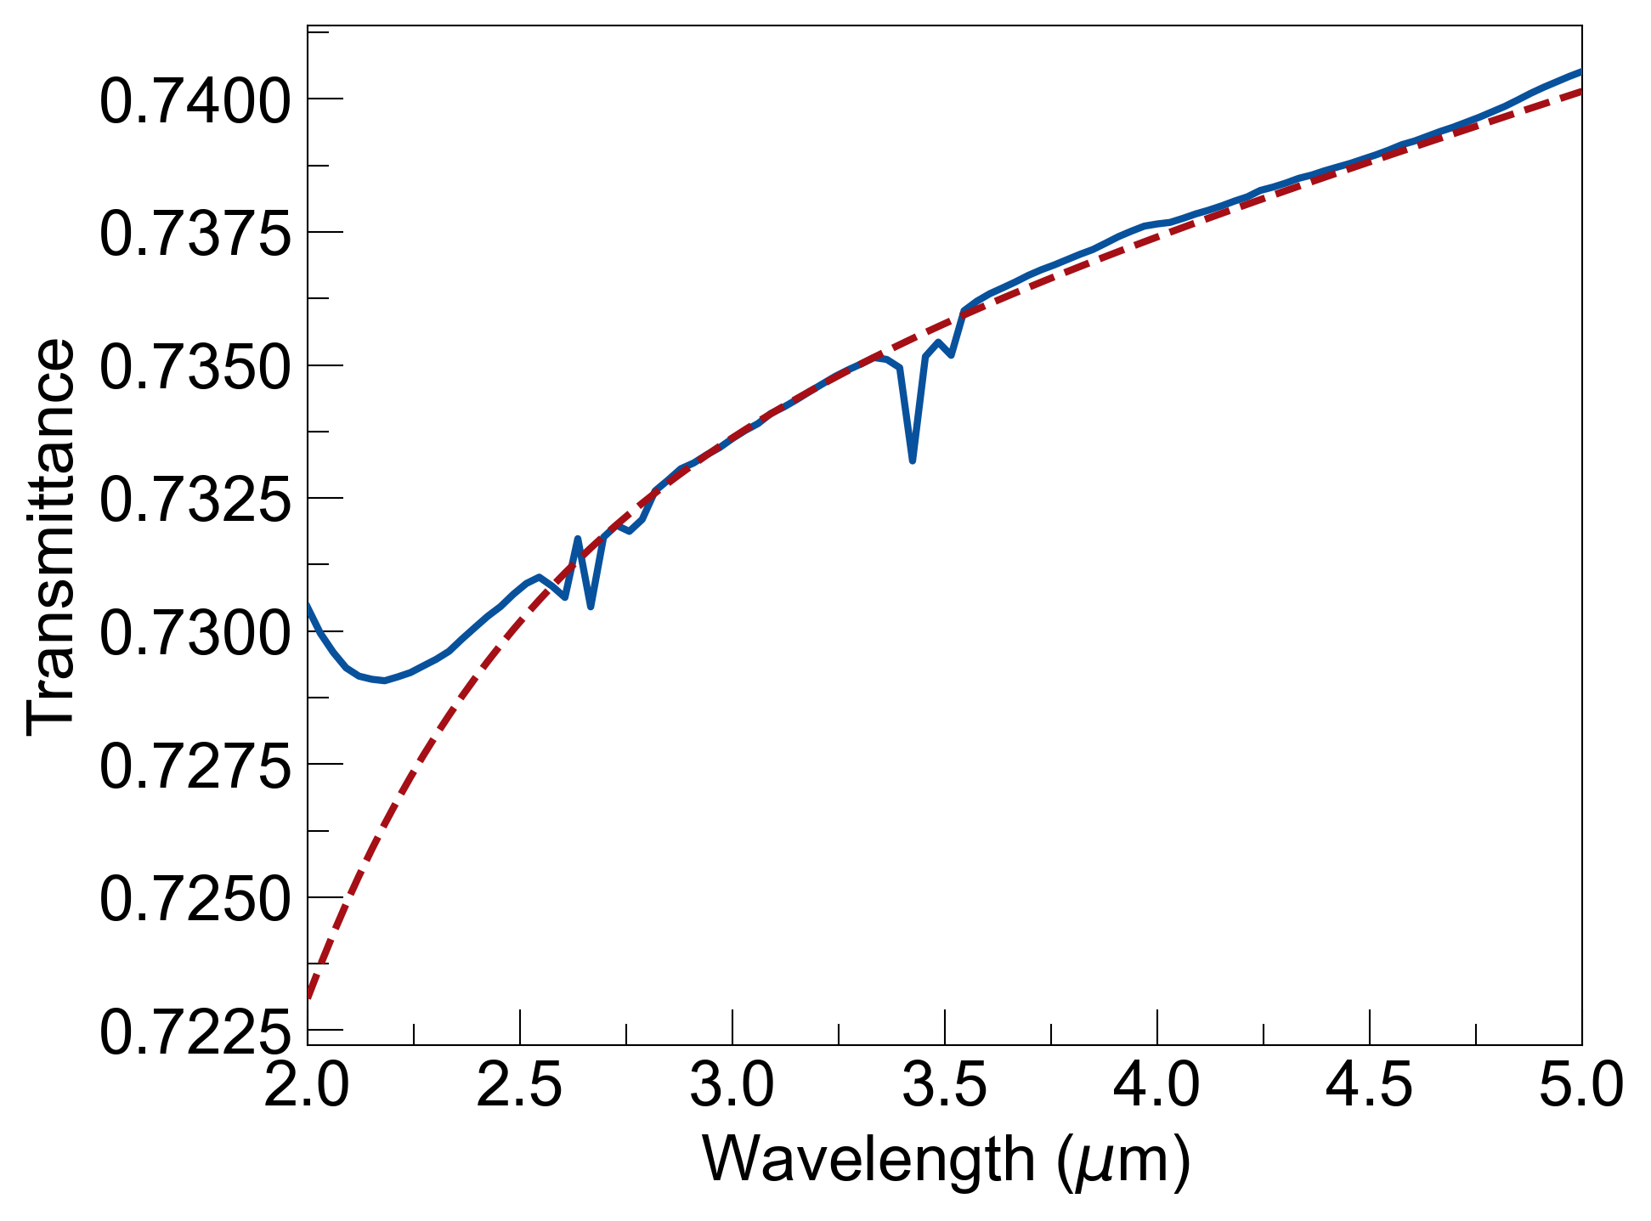
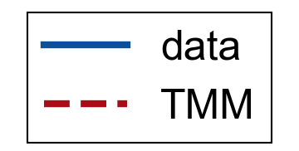
Approximated losses from ZnS data
k(λ) = m(λ – 2[um]) + b , with
m = -3 x 10⁻⁷ and b = 1.5 x 10⁻⁶
Ignore feature close to 2 microns

Slide 3
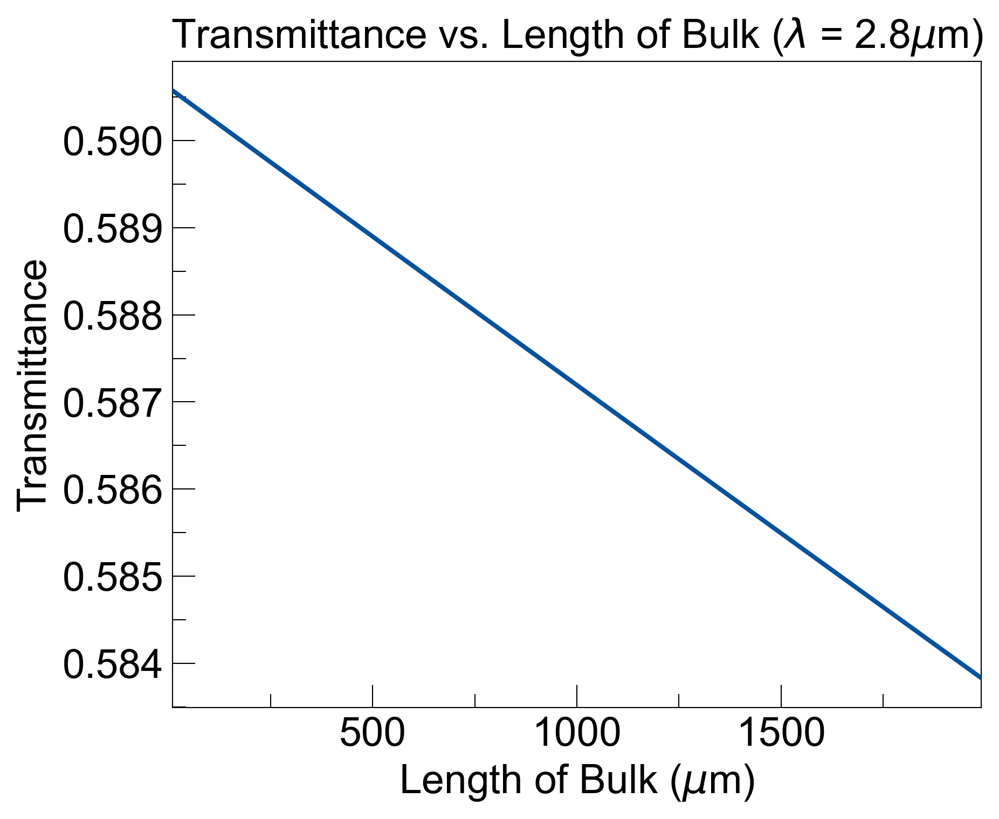
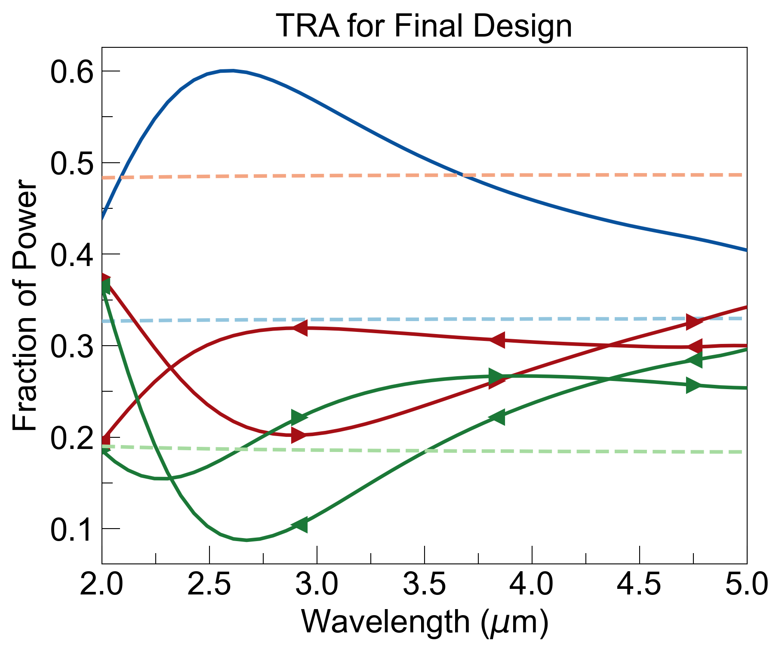
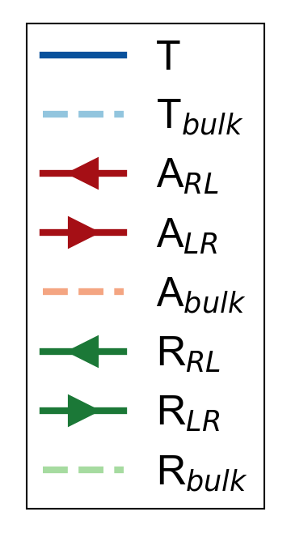
Adding losses to 300μm bulk yields 0.1% change in transmittance
…
n_{Si}
n_{SiO2}
…
@ λ = 2.8μm:
n_{ZnS} = 2.25
n_{Si} = 3.56
n_{C} = 4.53 + 3.64i
n_{SiO2} = 1.42
Final design:
n_{ZnS}
n_{C}
n_{ZnS}
thicknesses (μm)
[300, 0.1, 0.02, 0.1, 0.2]

