Slide 1
Coating on a Window for Asymmetric Absorption
window
(1)
Number | Material | Thickness (μm)
(1) | Zinc Sulfide | 300
(2) | Silicon | 0.1
(3) | Graphite | 0.02
(4) | Silica | 0.1
(5) | Zinc Sulfide | 0.2
coating
(2)
(4)
(3)
(5)
RL
LR
thank you for helping us fabricate this!
arrows signify direction of incident light

Slide 2
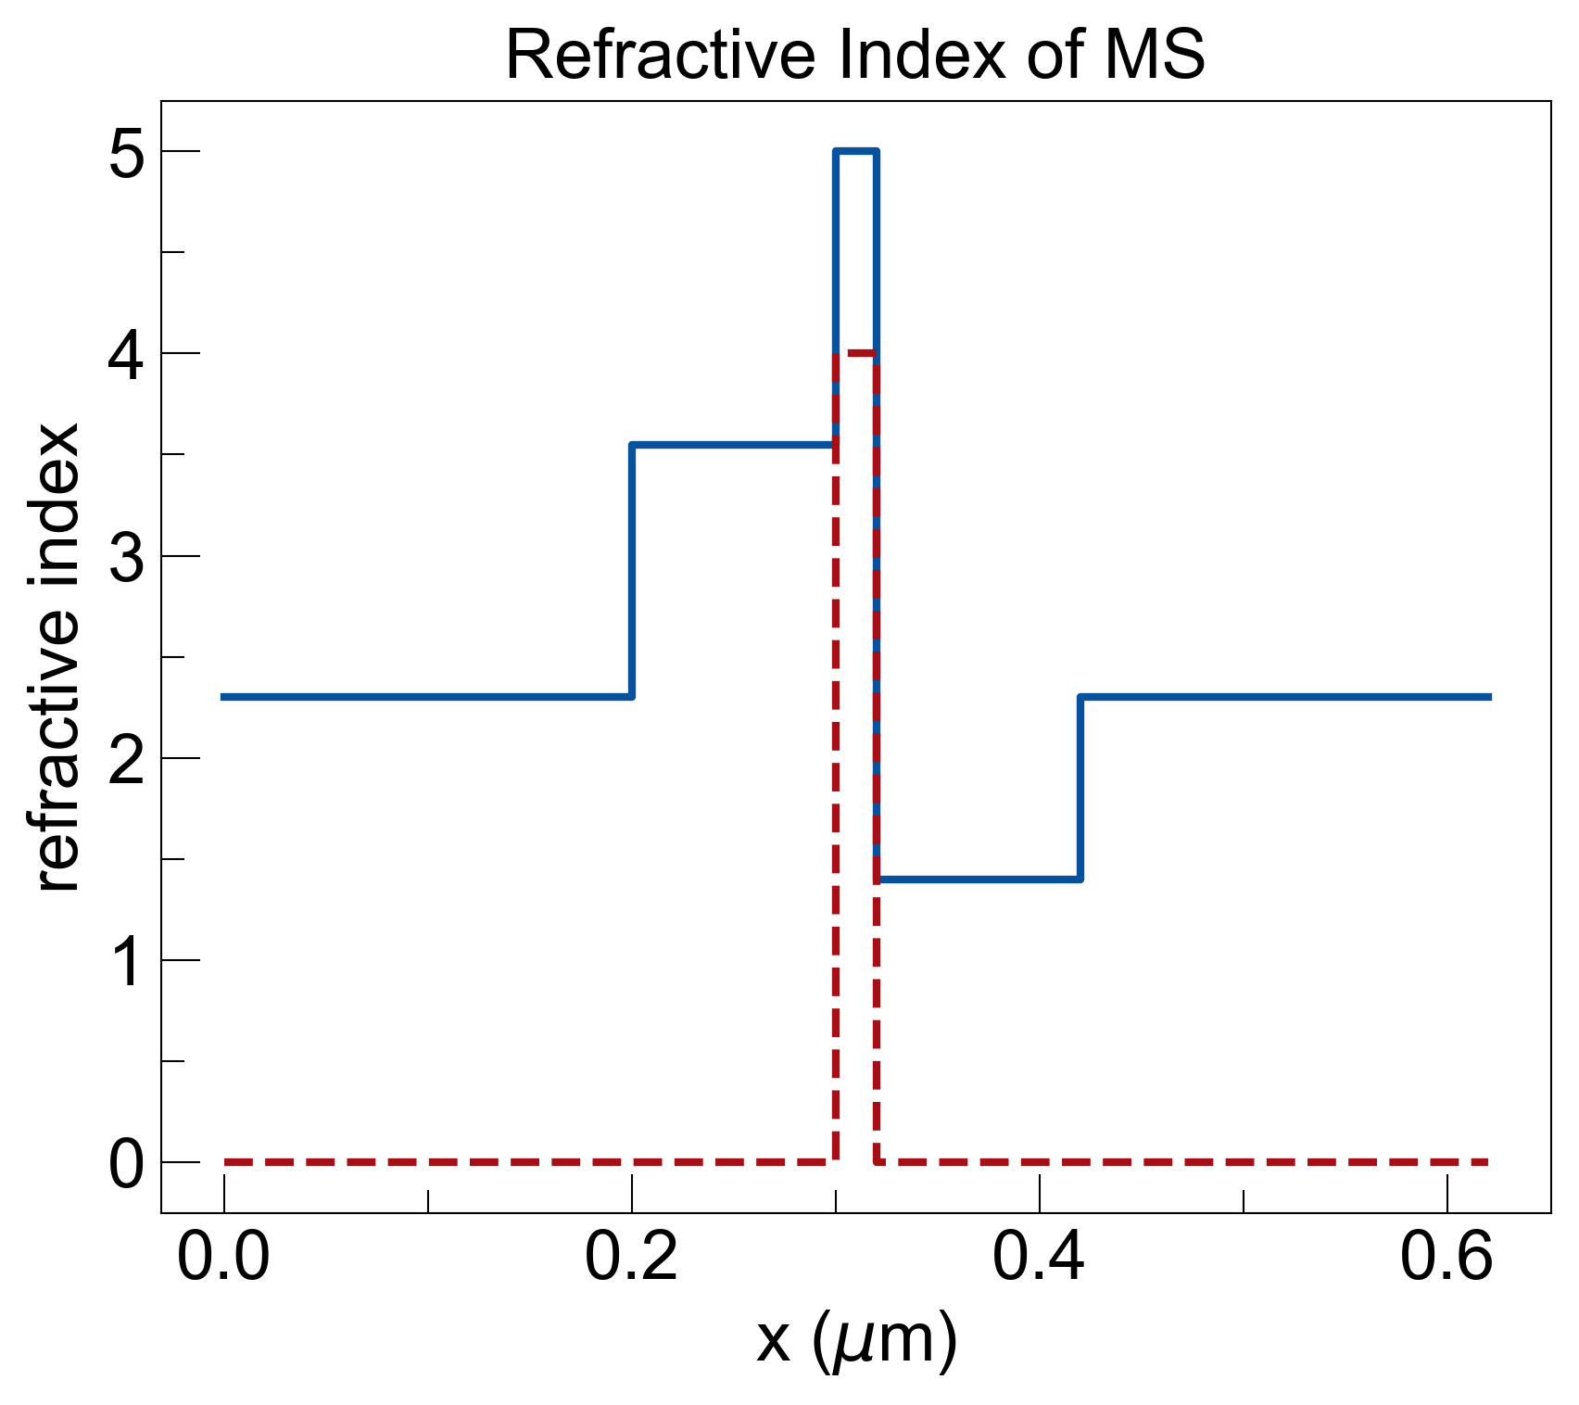
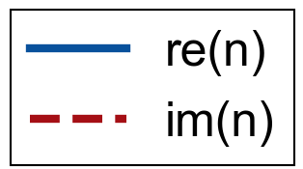
window
(1)
coating
Number | Material | Thickness (μm)
(1) | Zinc Sulfide | 300
(2) | Silicon | 0.1
(3) | Graphite | 0.02
(4) | Silica | 0.1
(5) | Zinc Sulfide | 0.2
(2)
(4)
(3)
(5)
graphite
silicon
ZnS
ZnS
silica

