Slide 1
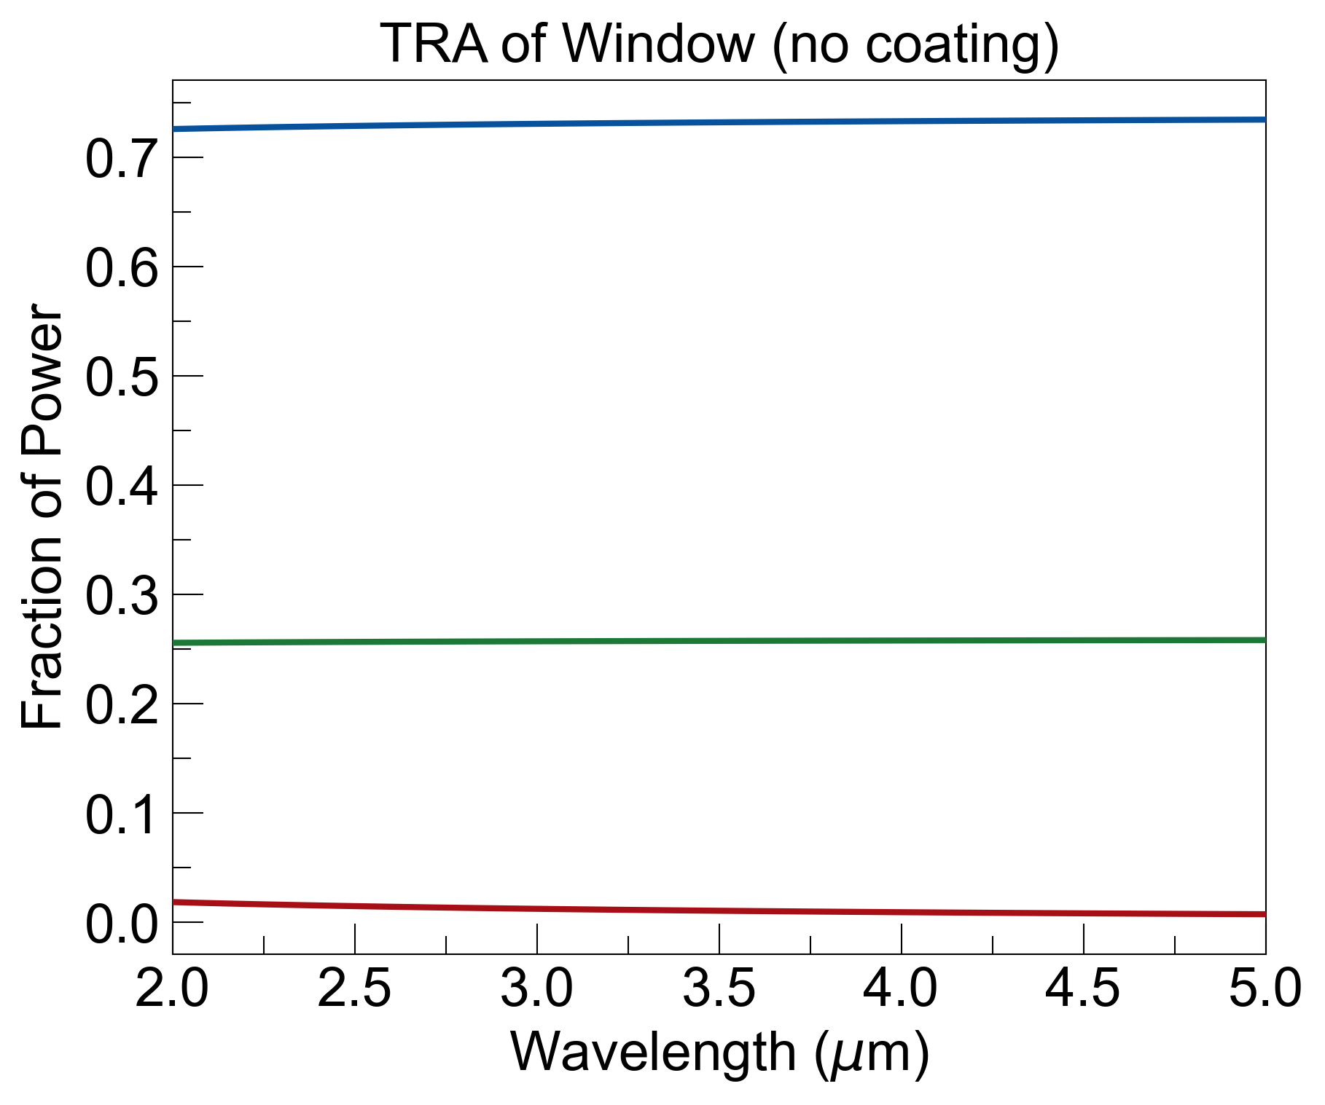
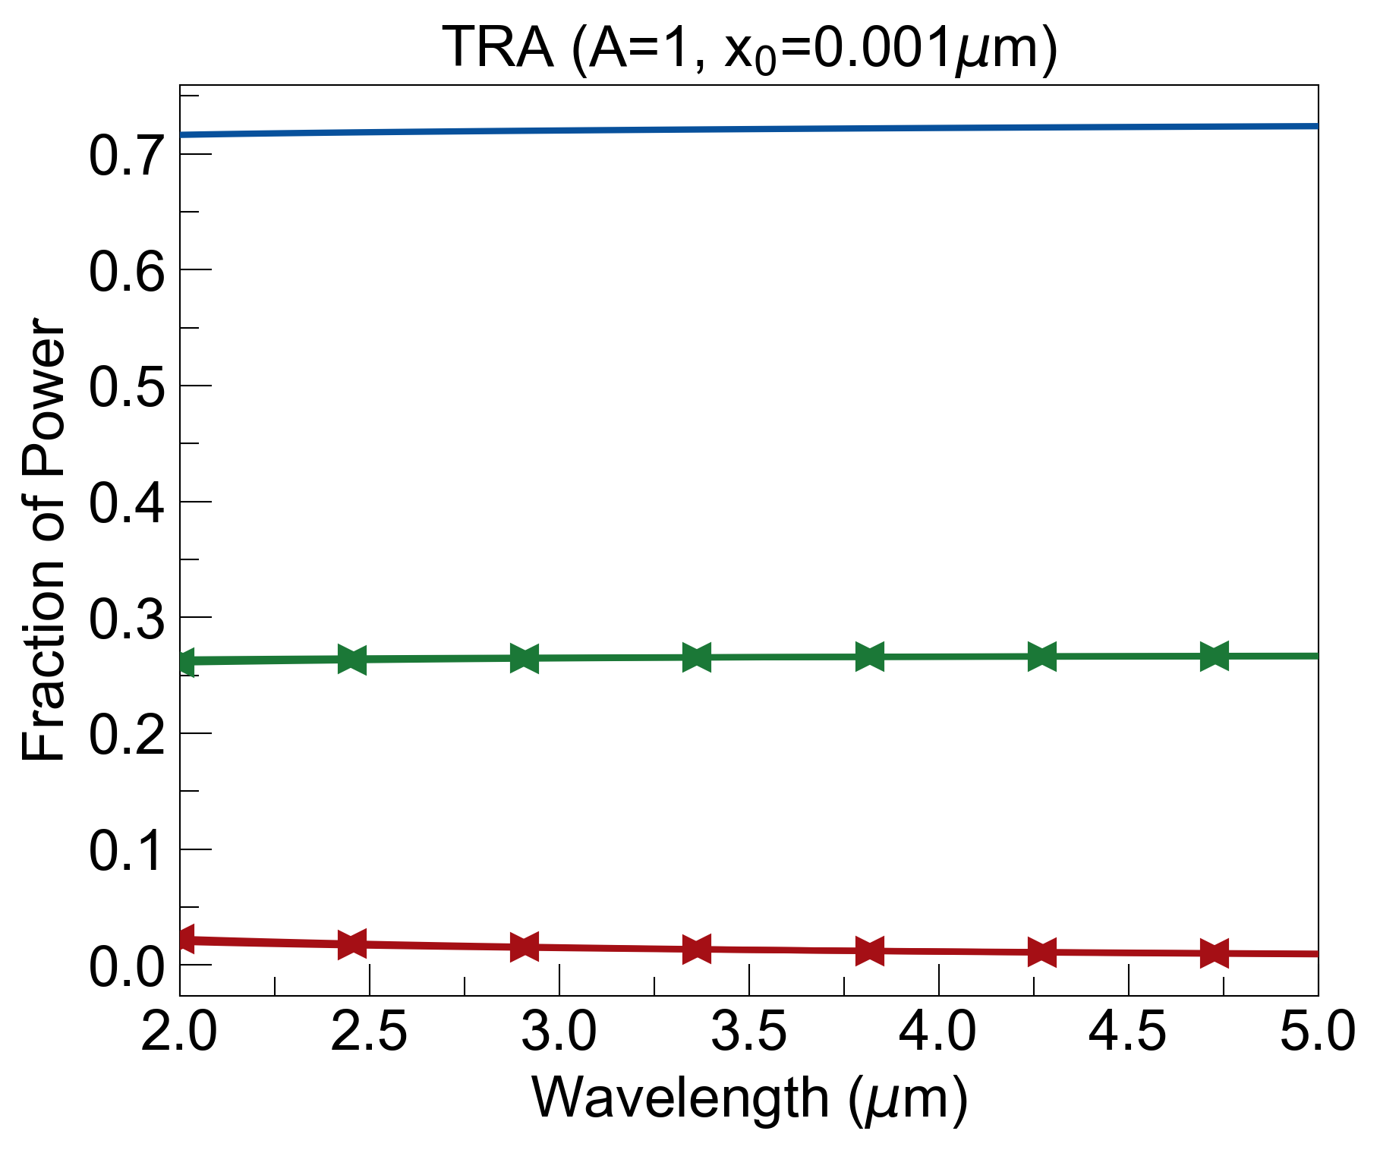
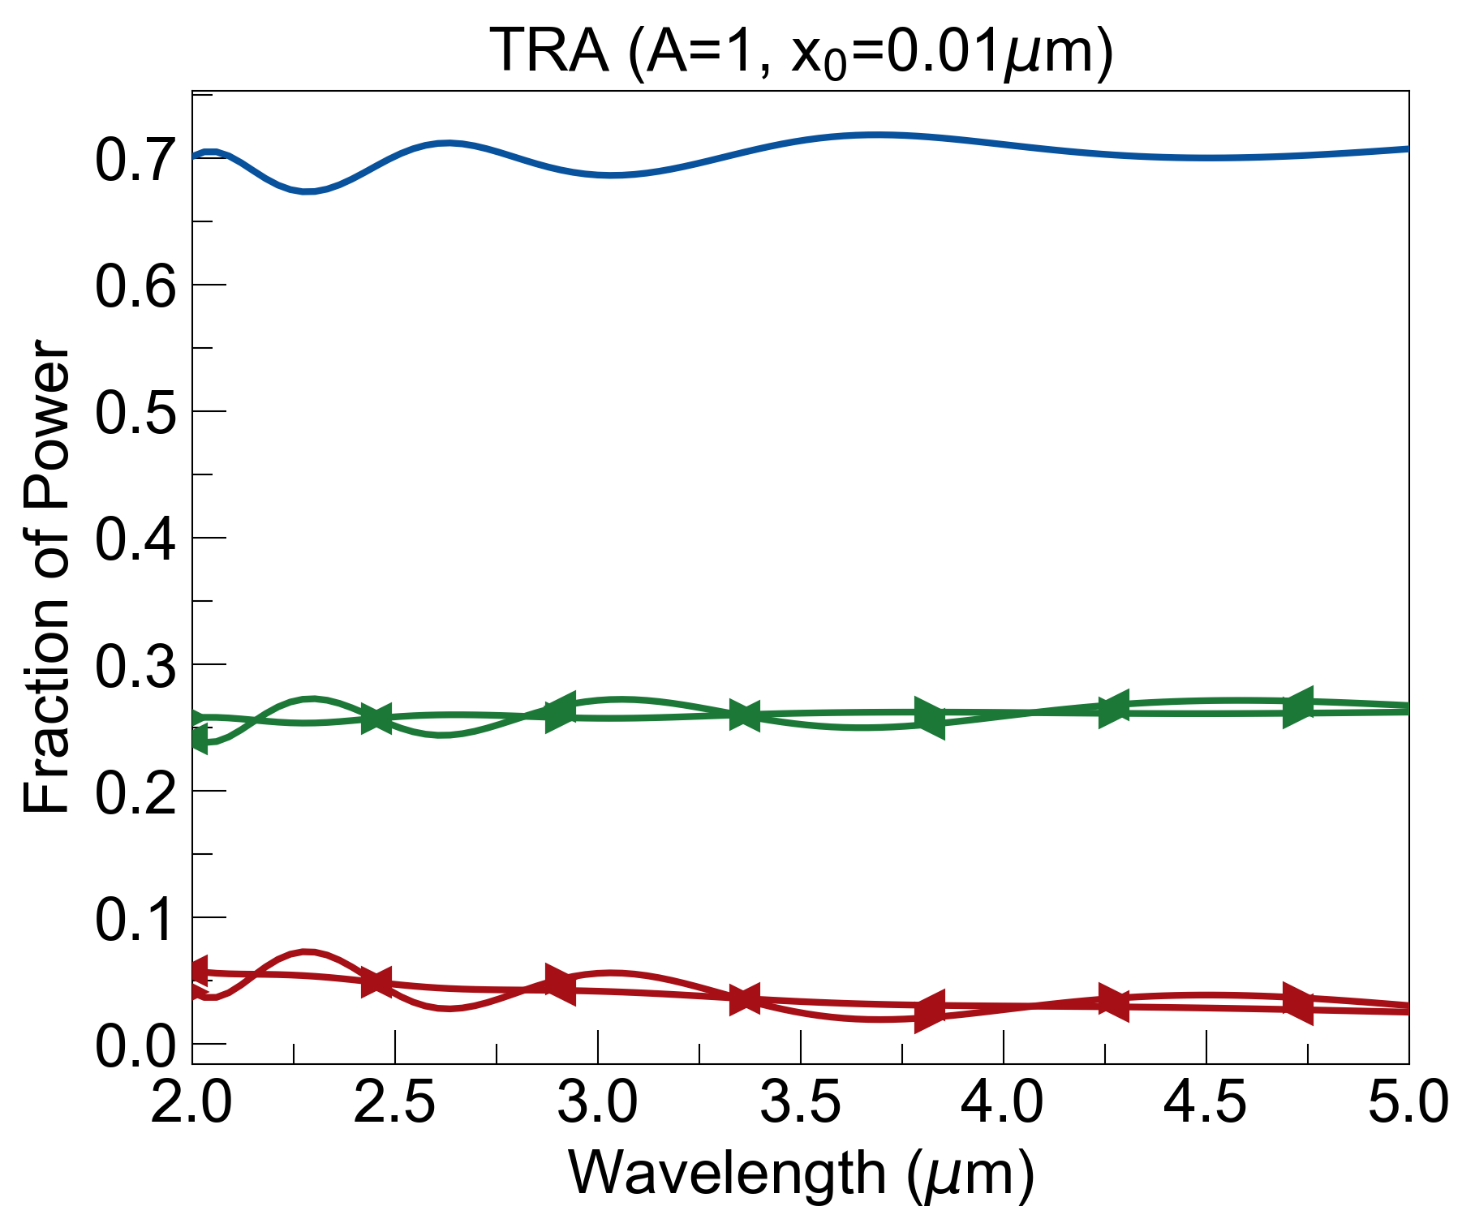
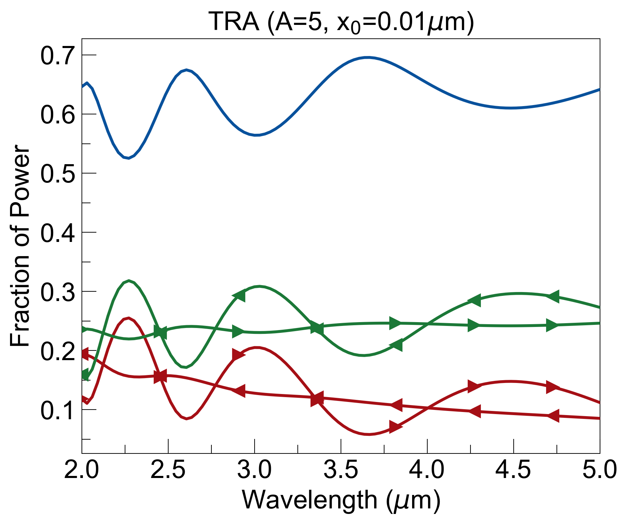
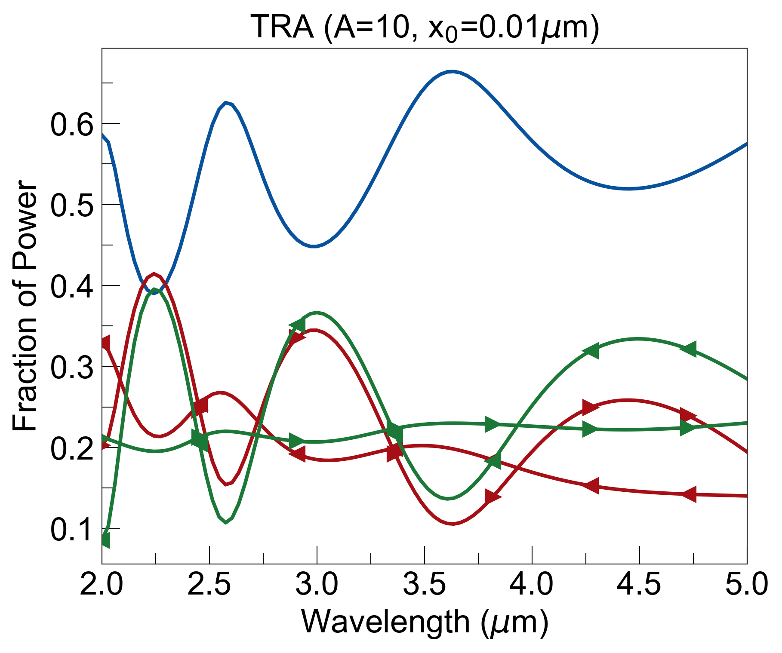
window thickness: 2mm
adding a coating with low losses (top middle plot) does not introduce any asymmetry.
Increasing losses, while introducing some asymmetry in parts of spectrum, reduces signal-to-noise consistently.

Slide 2
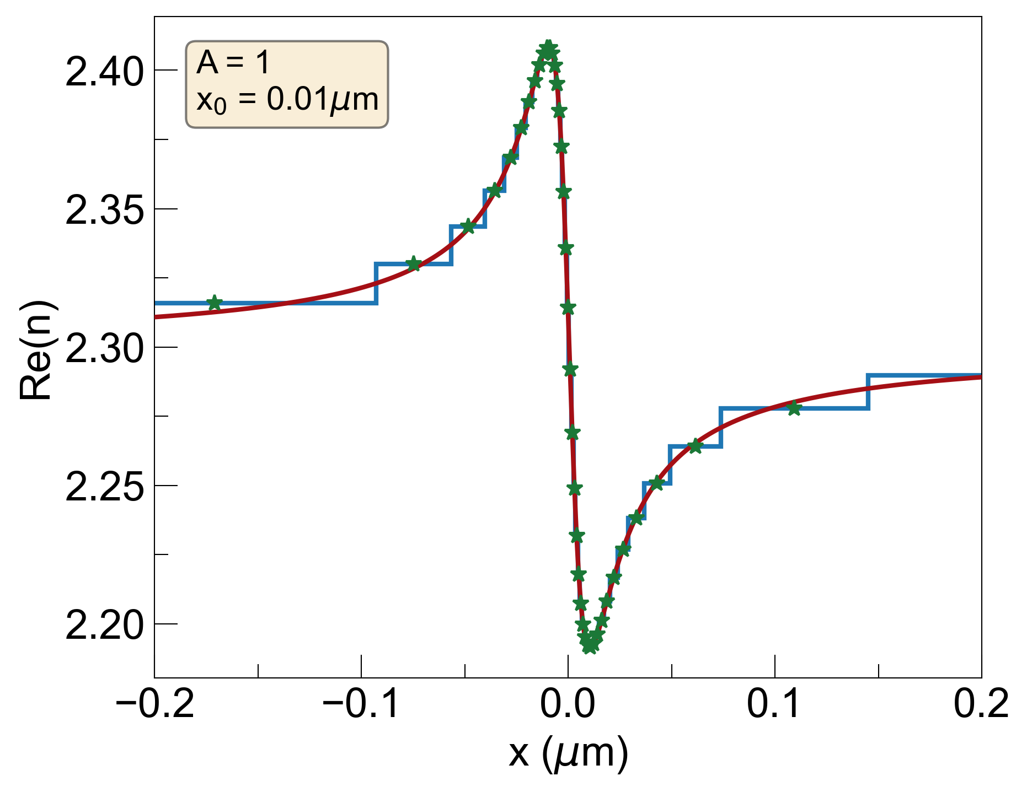
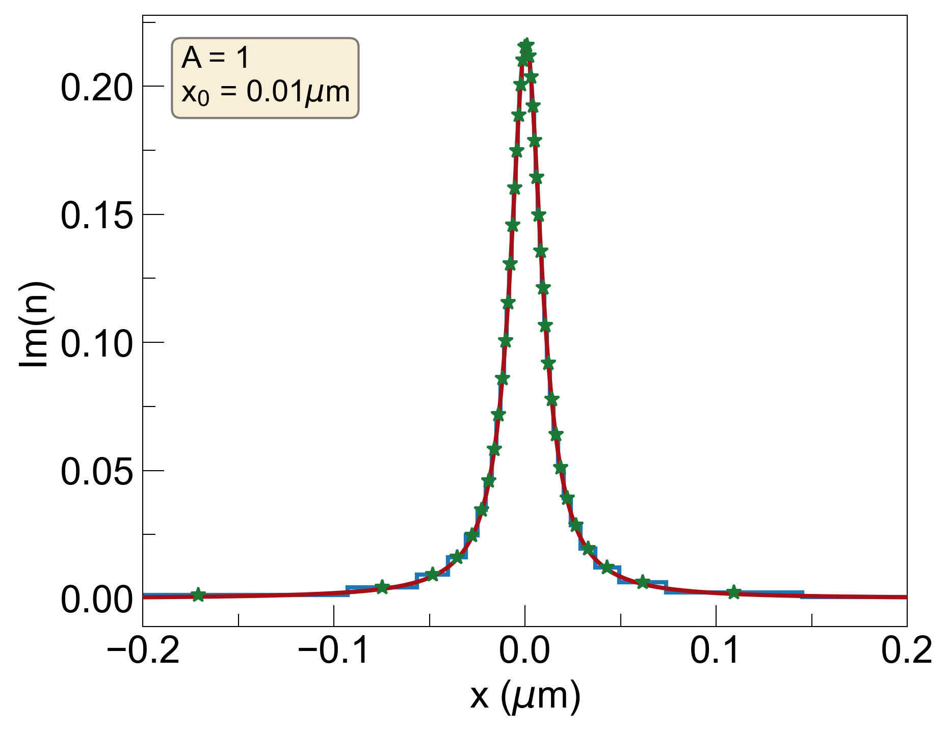
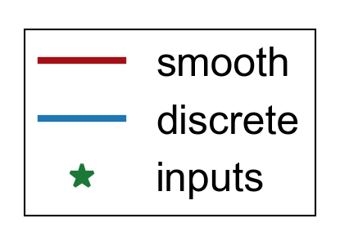
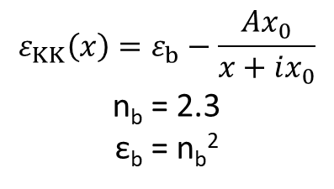
Smooth Spatial KK Coating
$$ε_{KK}\left(x\right)=ε_{b}−\frac{Ax_{0}}{x+ix_{0}}$$
n_{b} = 2.3
ε_{b} = n_{b}²
Add this in front of bulk window to see if there is an advantage

Slide 3
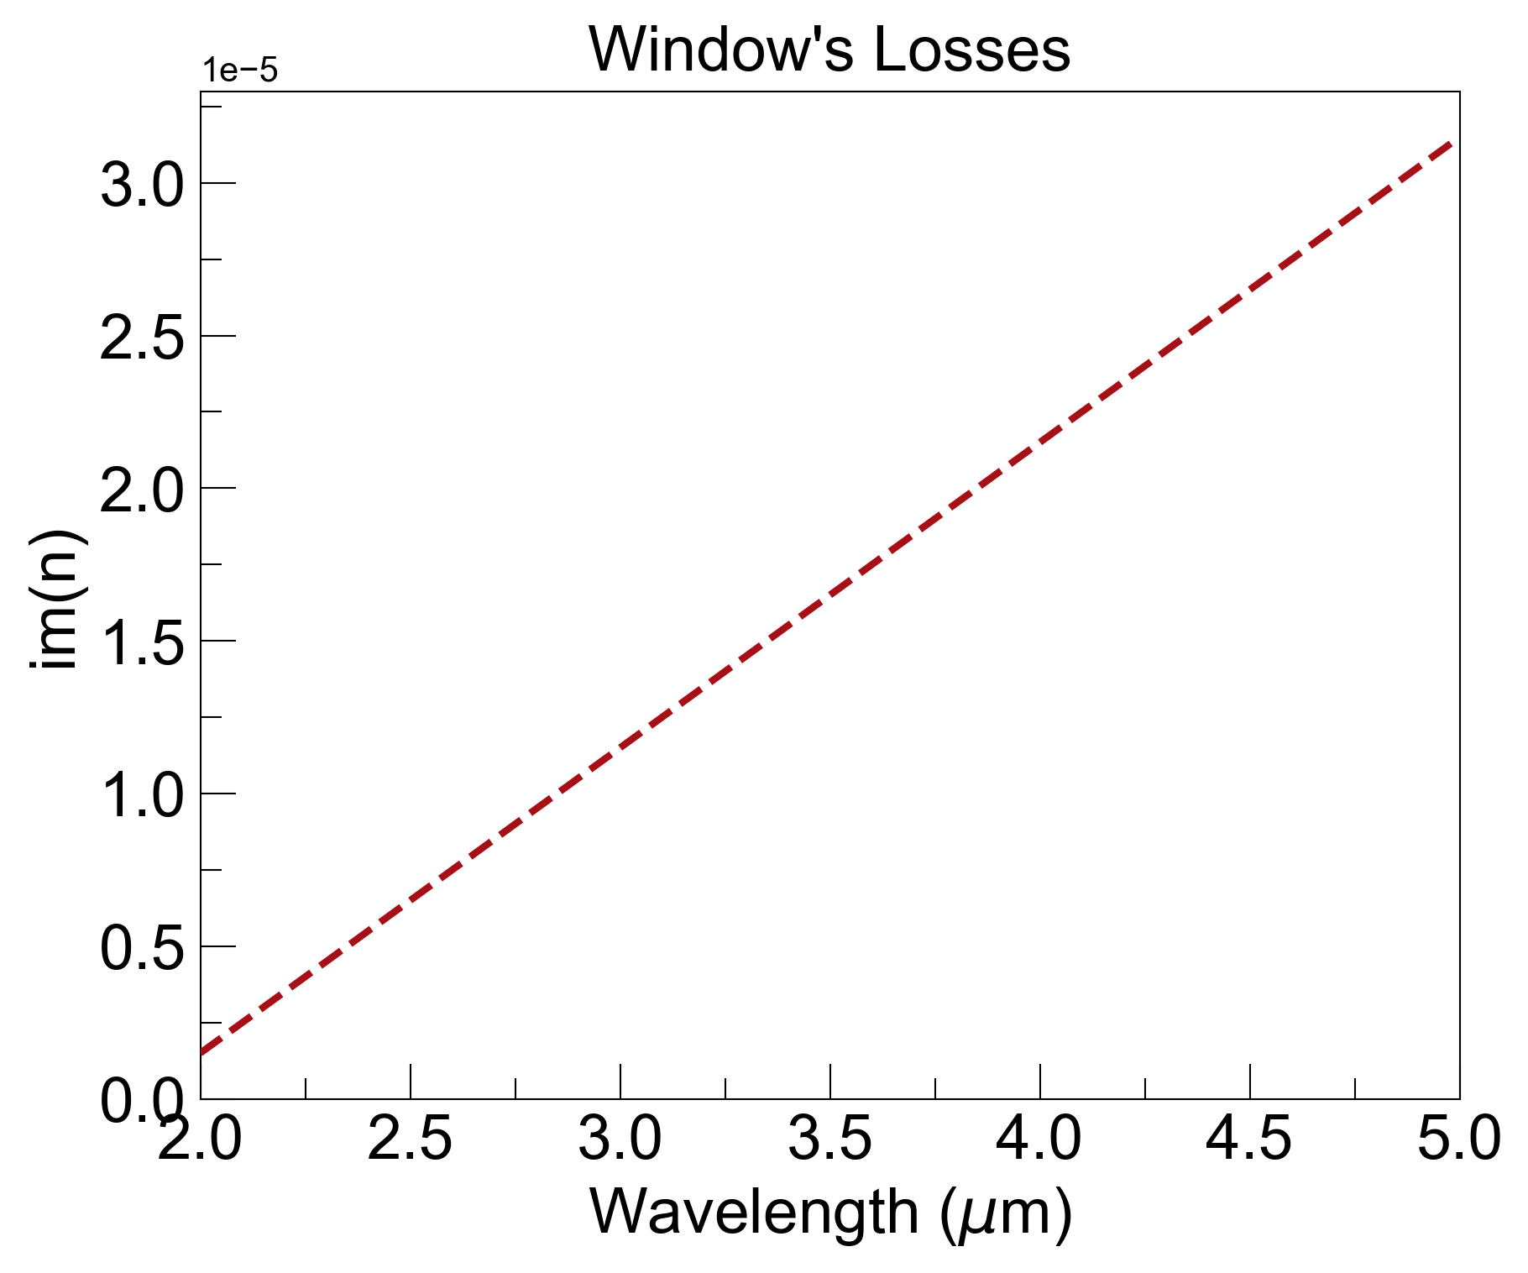
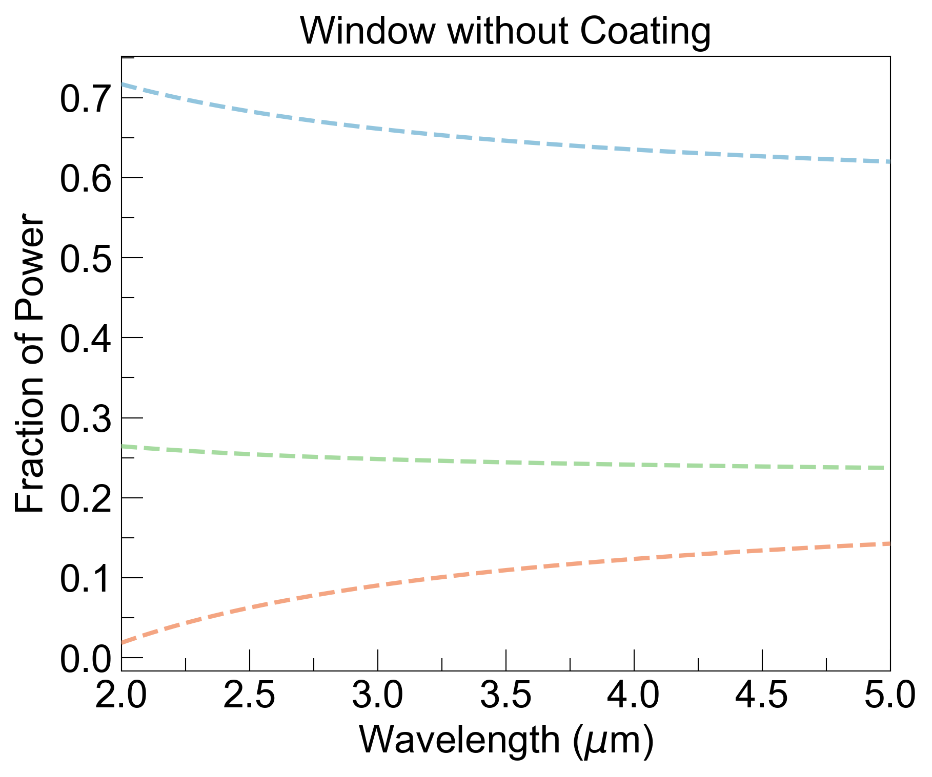
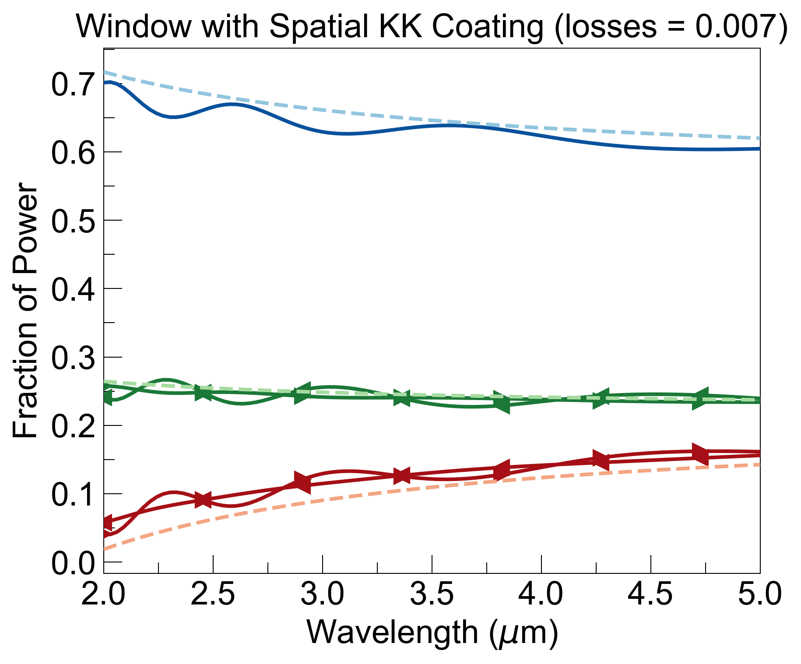
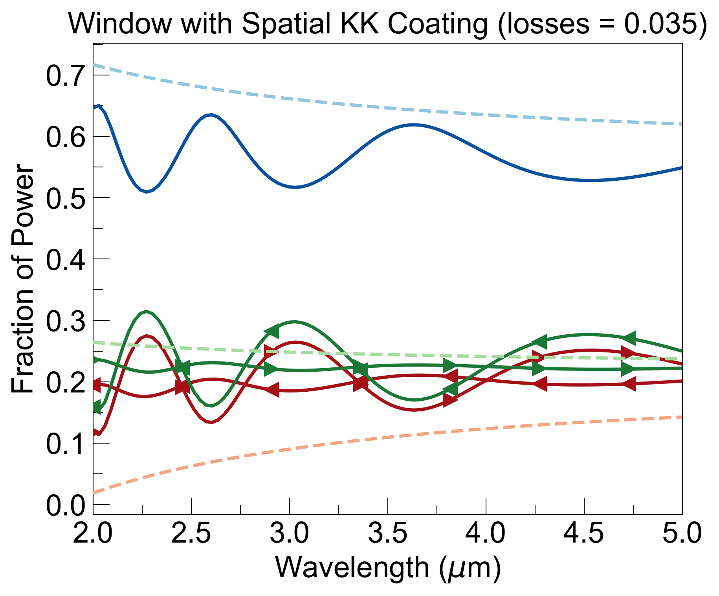
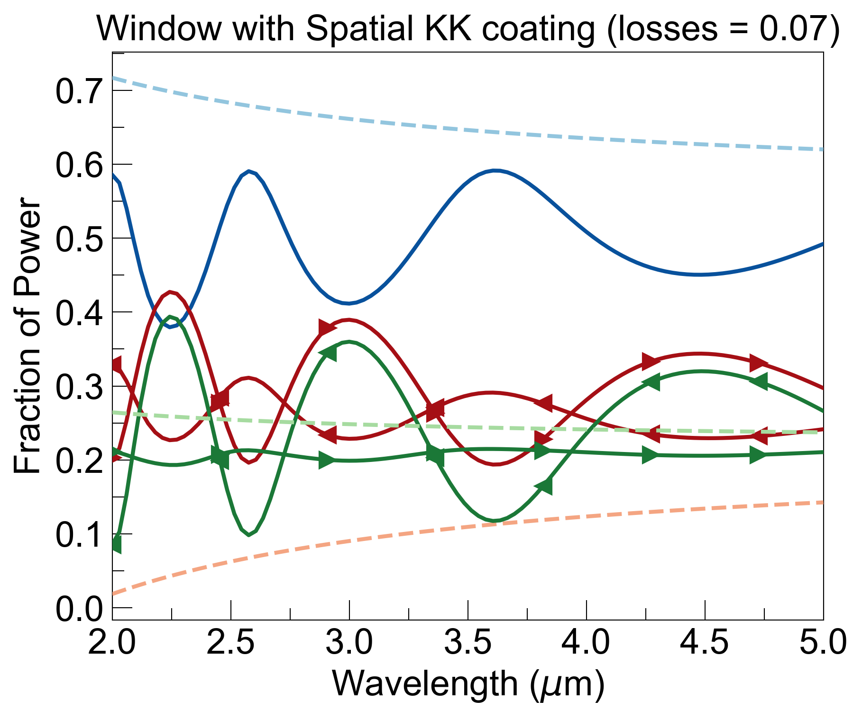
window thickness: 2mm
Adding a coating, while introducing some asymmetry in parts of spectrum, reduces signal-to-noise consistently.

Slide 4
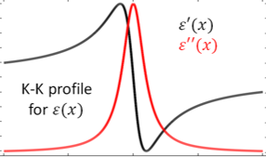

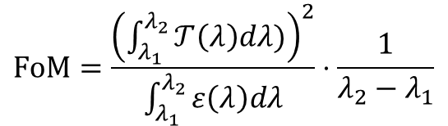


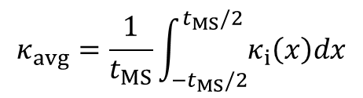
“Stack of KK Stacks” idea
1 Stack
…
…
$$t_{MS}$$
…
…
$$κ_{avg}=\frac{1}{t_{MS}}\int_{{−t}_{MS}/2}^{t_{MS}/2}{κ_{i}\left(x\right)dx}$$
$$FoM=\frac{{\left(\int_{λ_{1}}^{λ_{2}}{𝒯\left(λ\right)dλ)}\right)}^{2}}{\int_{λ_{1}}^{λ_{2}}{ε\left(λ\right)dλ}}⋅\frac{1}{λ_{2}−λ_{1}}$$
$$T_{Bulk}\left(λ\right)=e^{−\frac{4π}{λ}κ_{avg}t_{MS}}$$
$$ε_{Bulk}\left(λ\right)=1−T_{Bulk}\left(λ\right)$$

