Slide 1
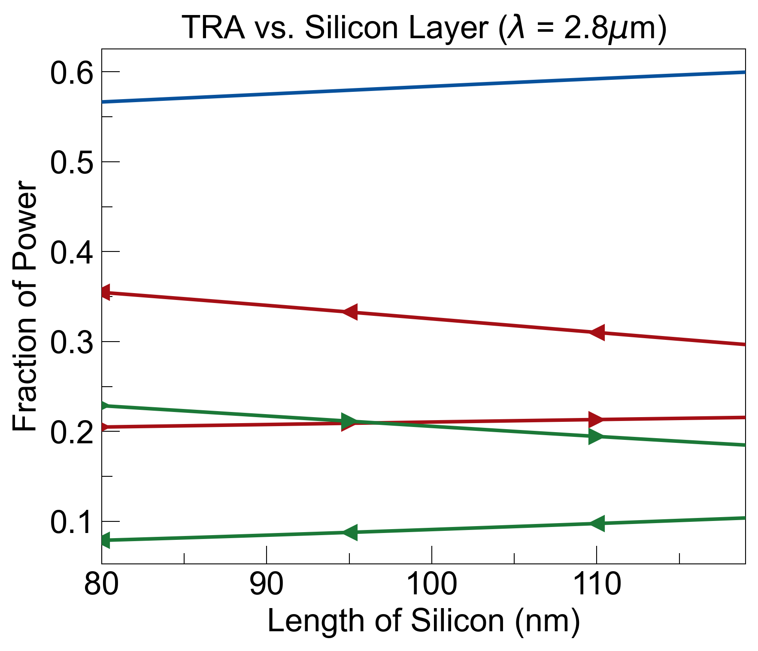
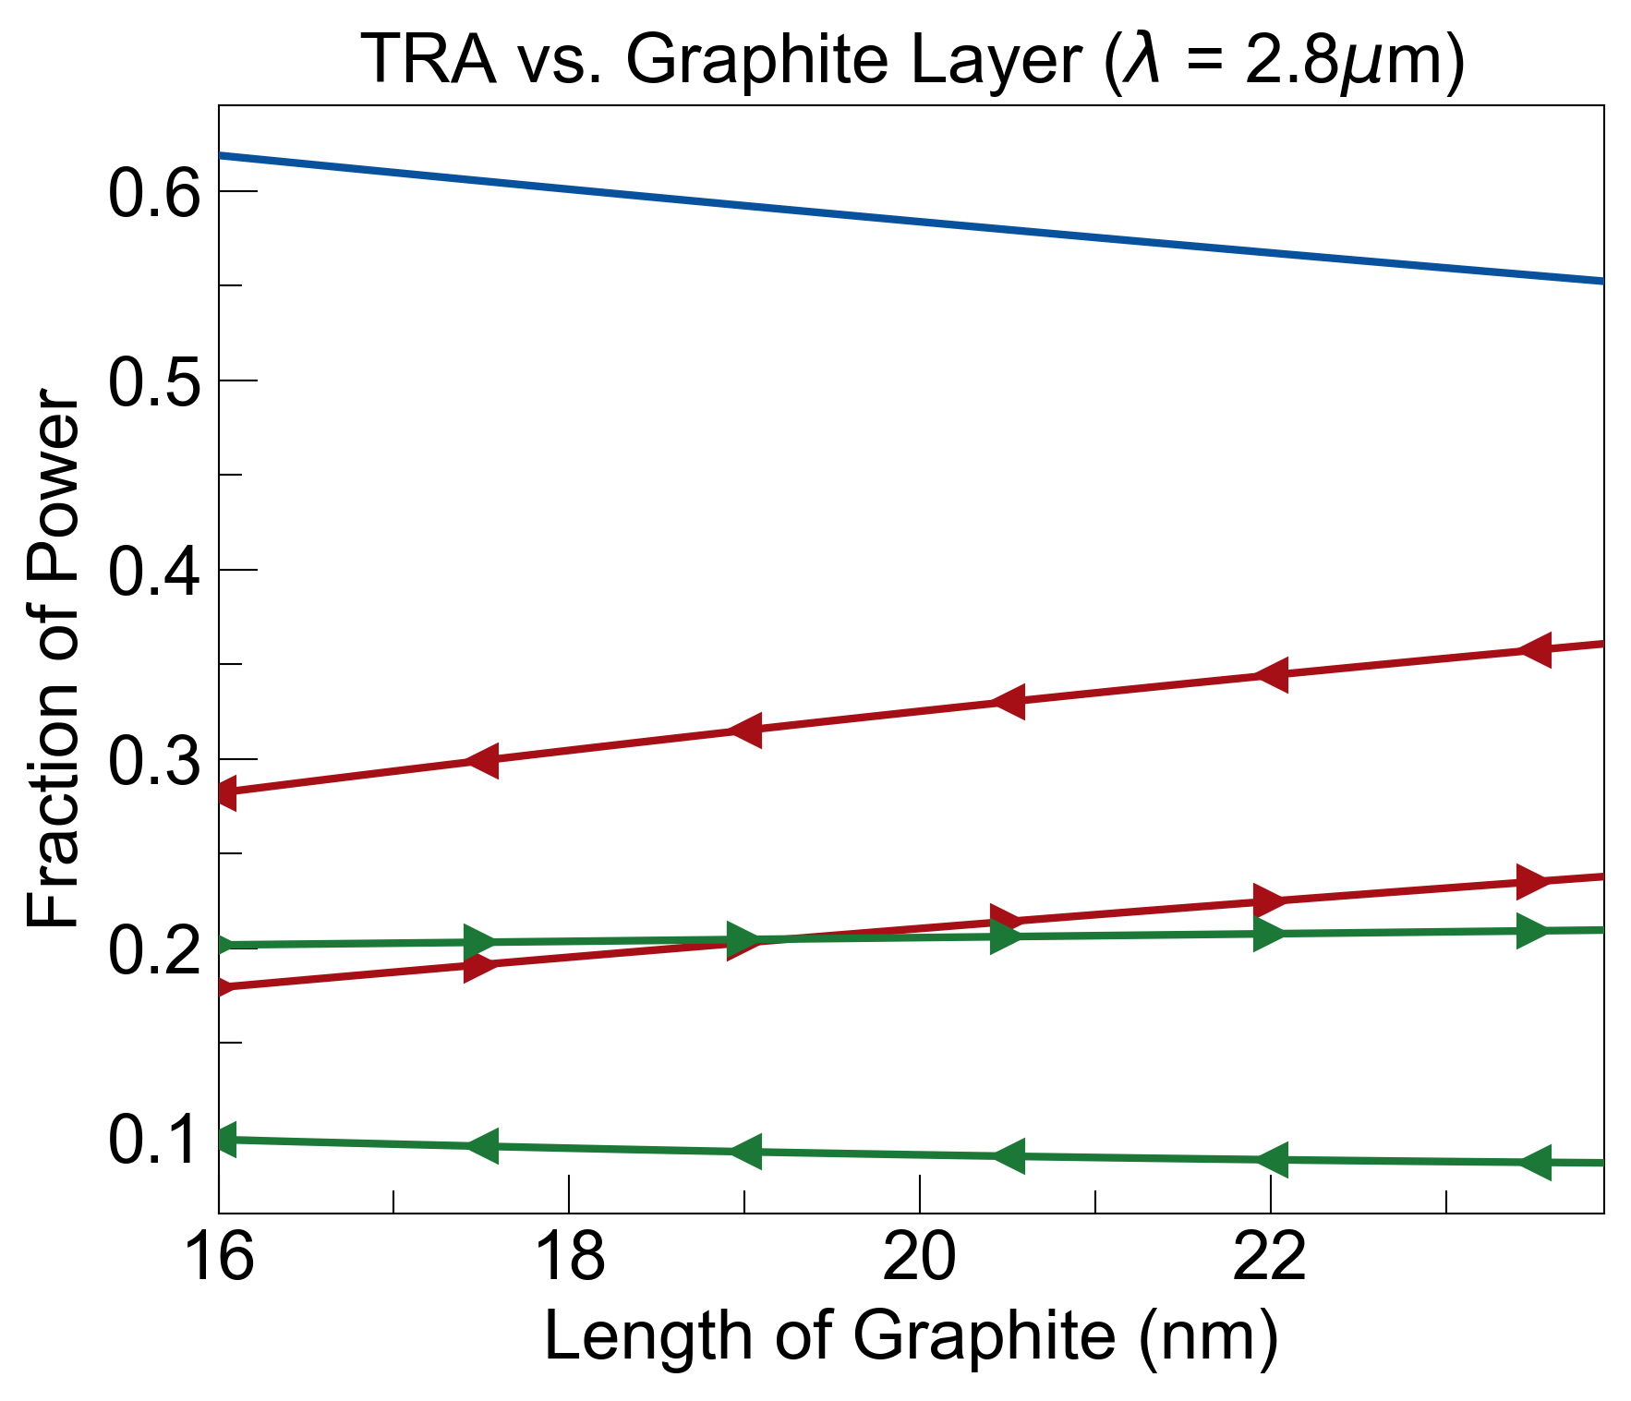
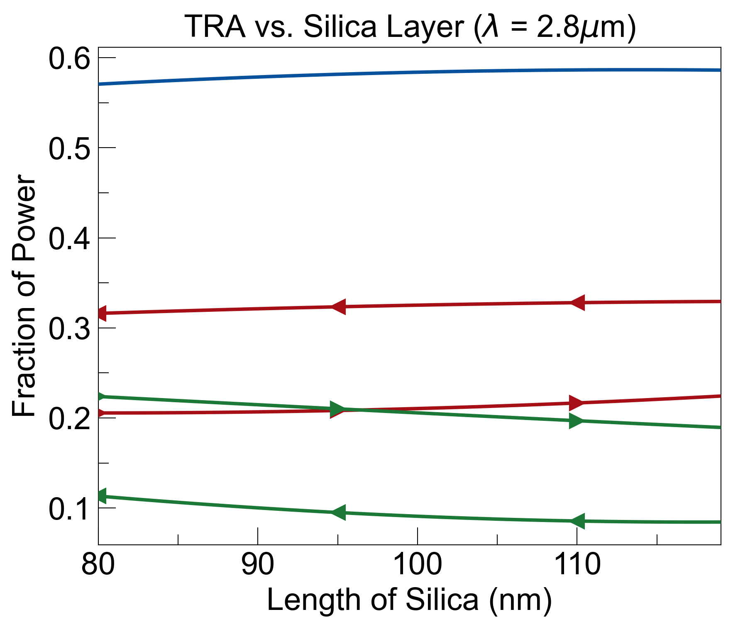
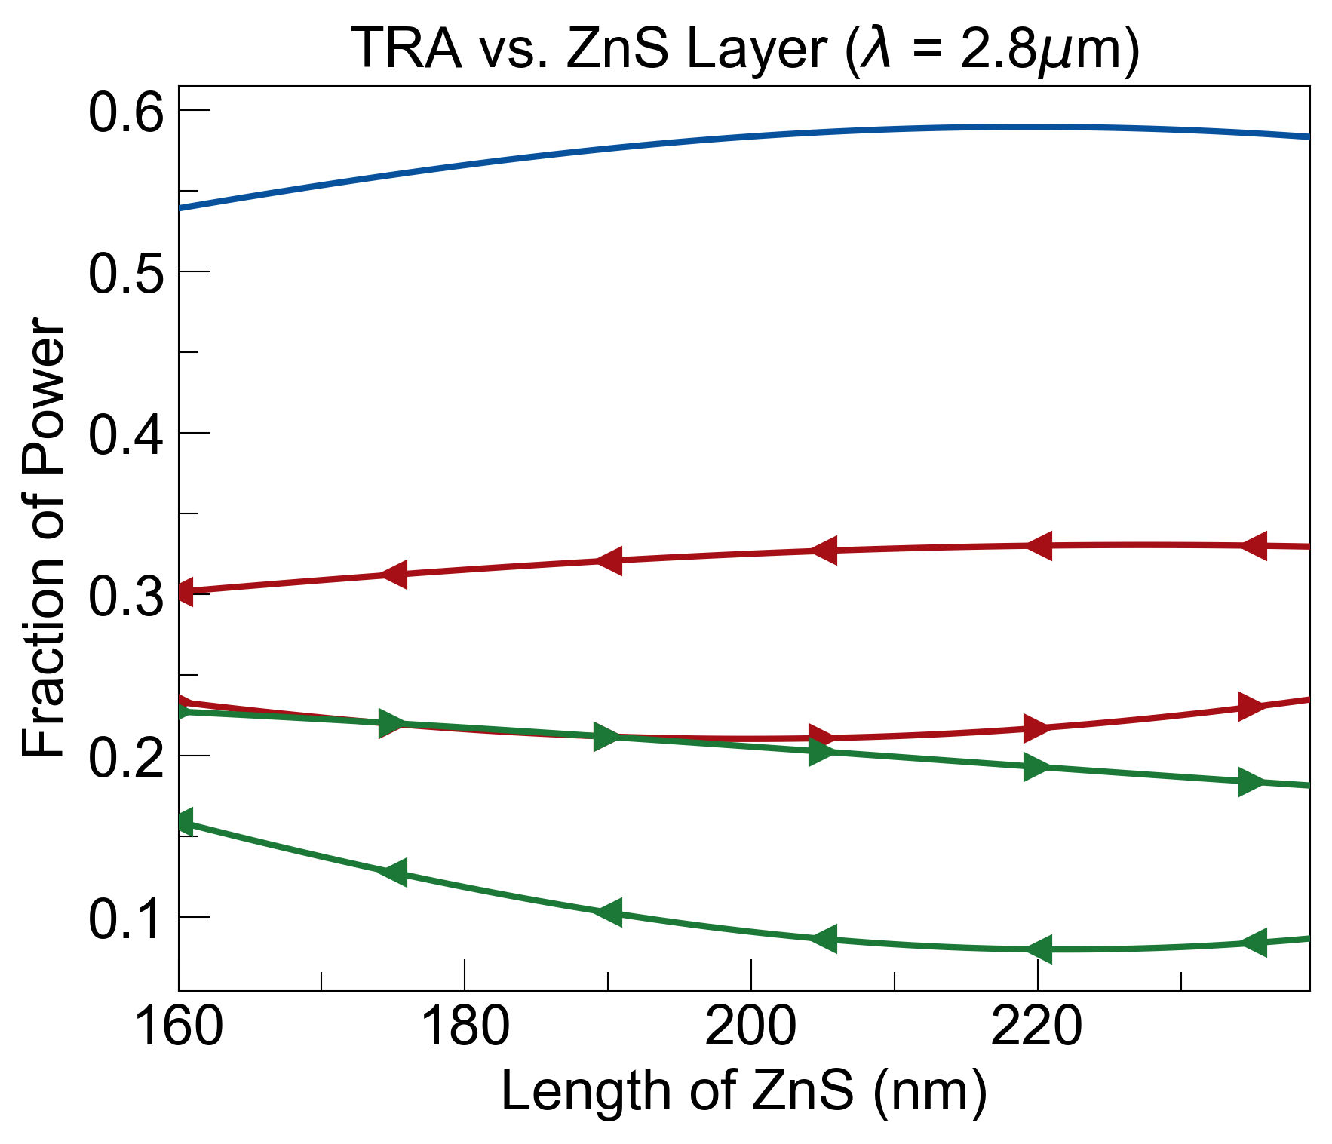
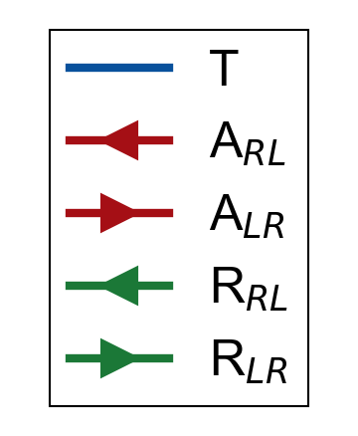
sensitivity analysis of length of each layer in coating was performed
change of ±20% in silicon and silica layers did not affect transmittance, reflectance, and absorbance (TRA) much
increasing length of graphite layer caused transmittance to decrease and, equivalently, absorbance to increase
change of ±20% in Zinc Sulfide layer saw more drastic changes, especially at smaller values. still comfortable within ±10%
silicon
silica
graphite
Zinc Sulfide (ZnS)
Material | Length (nm)
Silicon | 100
Graphite | 20
Silica | 100
ZnS | 200

