Slide 1
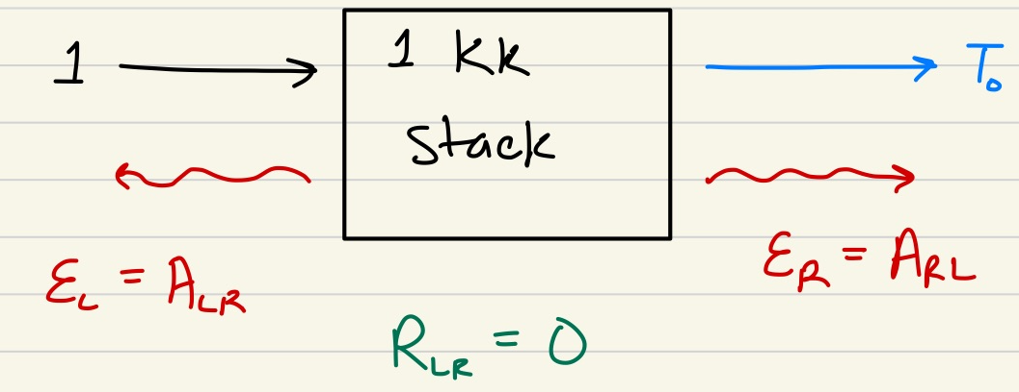
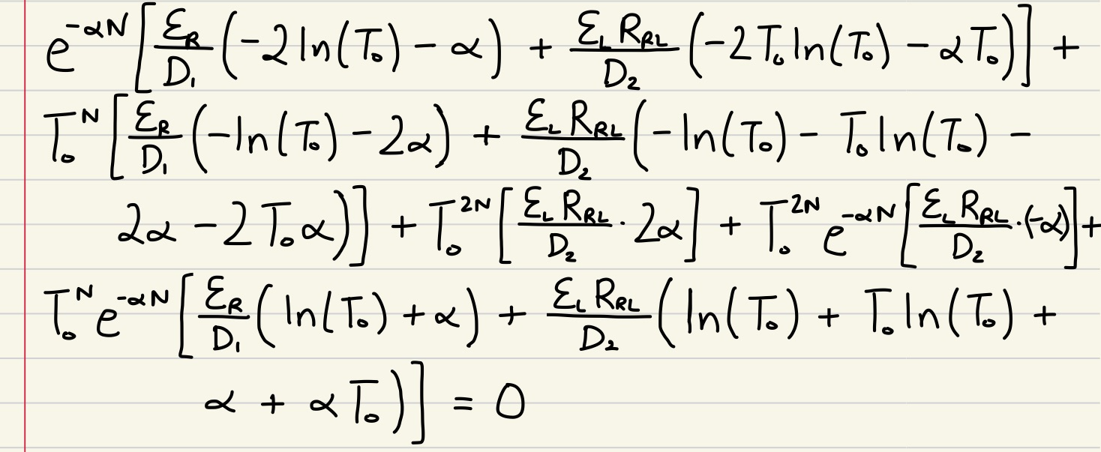
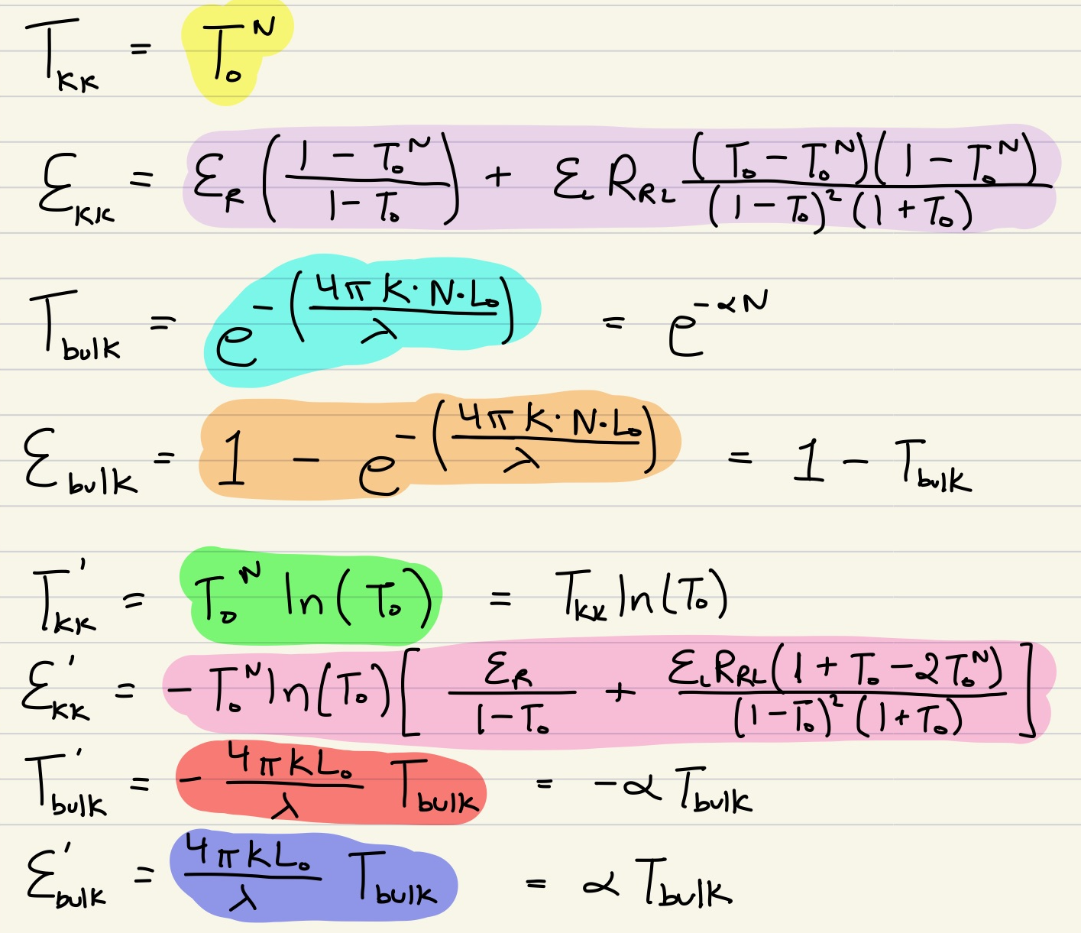
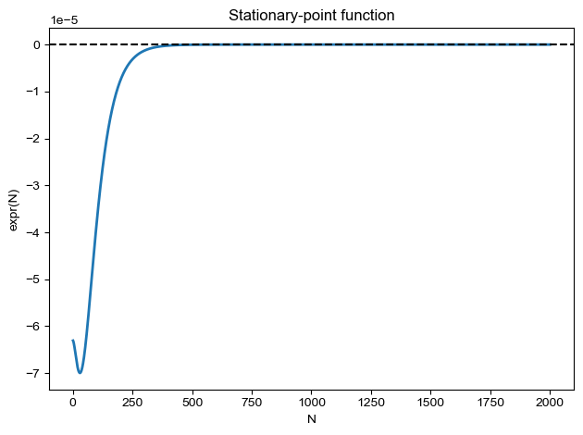

$$\frac{d(FOMenh)}{dN}= \frac{d}{dN}\left(\frac{TKK2Ebulk}{Tbulk2EKK}\right)=$$

Slide 2
