Slide 1
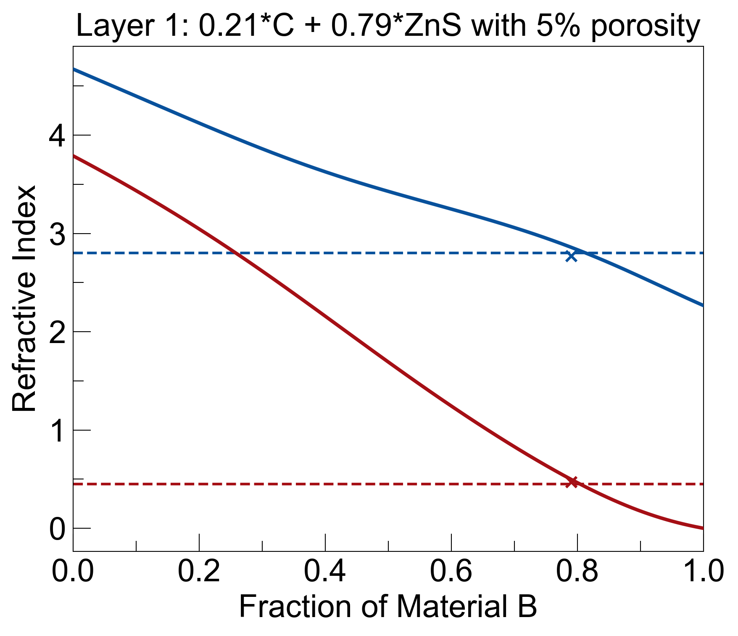
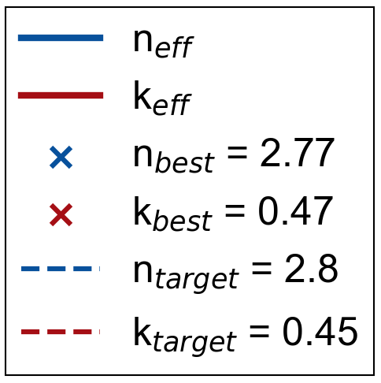
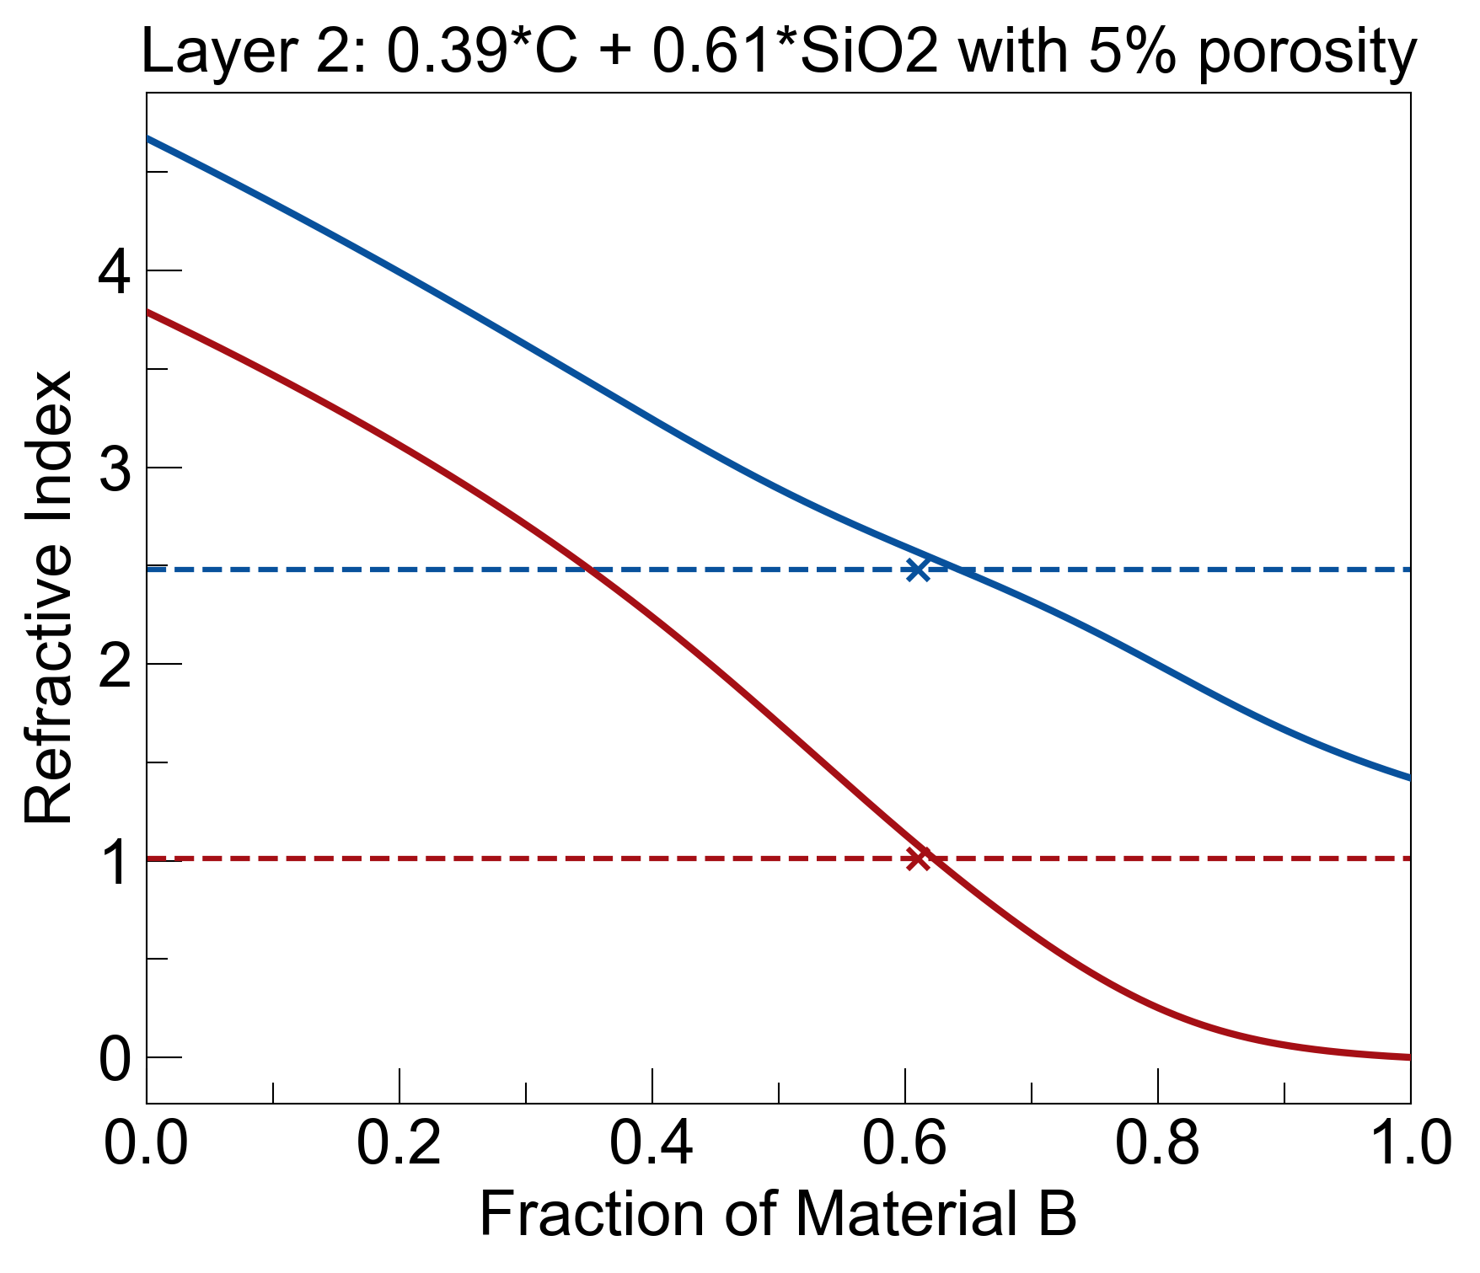
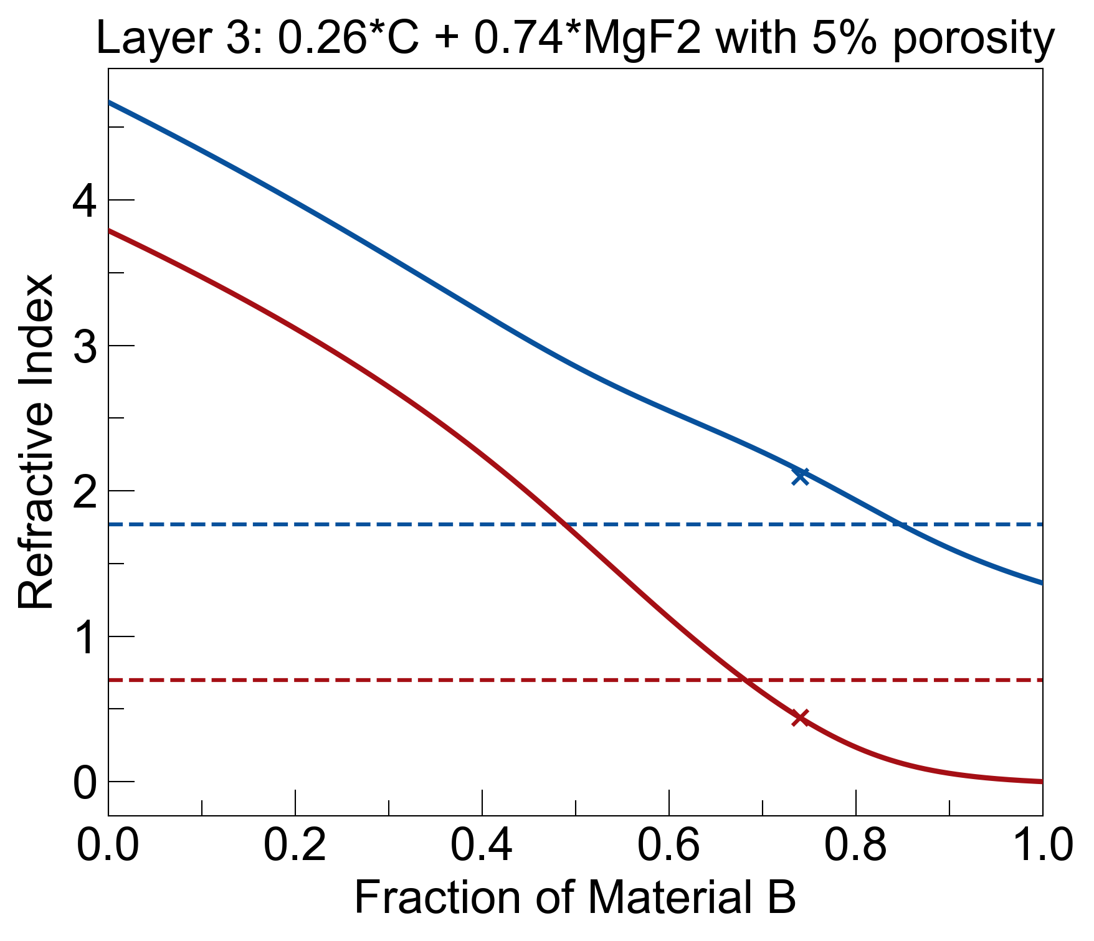
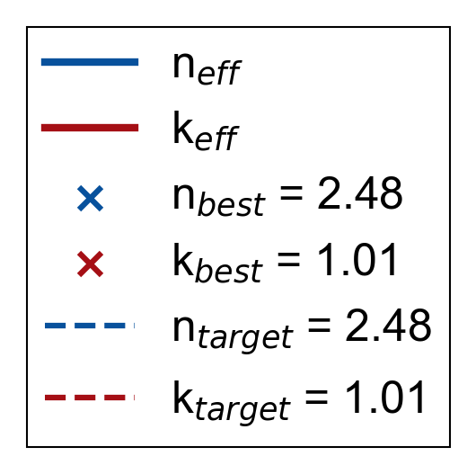
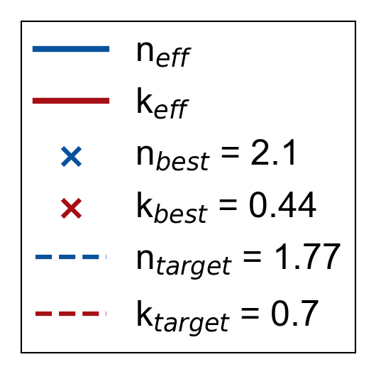
3 Key Layers to Fabricate
Layer | Material | Thickness (nm)
1 | Zinc Sulfide (79%) + Graphite (21%) | 80
2 | Silica (61%) + Graphite (39%) | 40
3 | Mag. Fluoride (74%) + Graphite (26%) | 80
λ = 3um
added porosity, which made concentrations shift a bit
start with fabricating individual mixed layers on gold substrate, to test effective RI
once verified, build multilayer structure

Slide 2
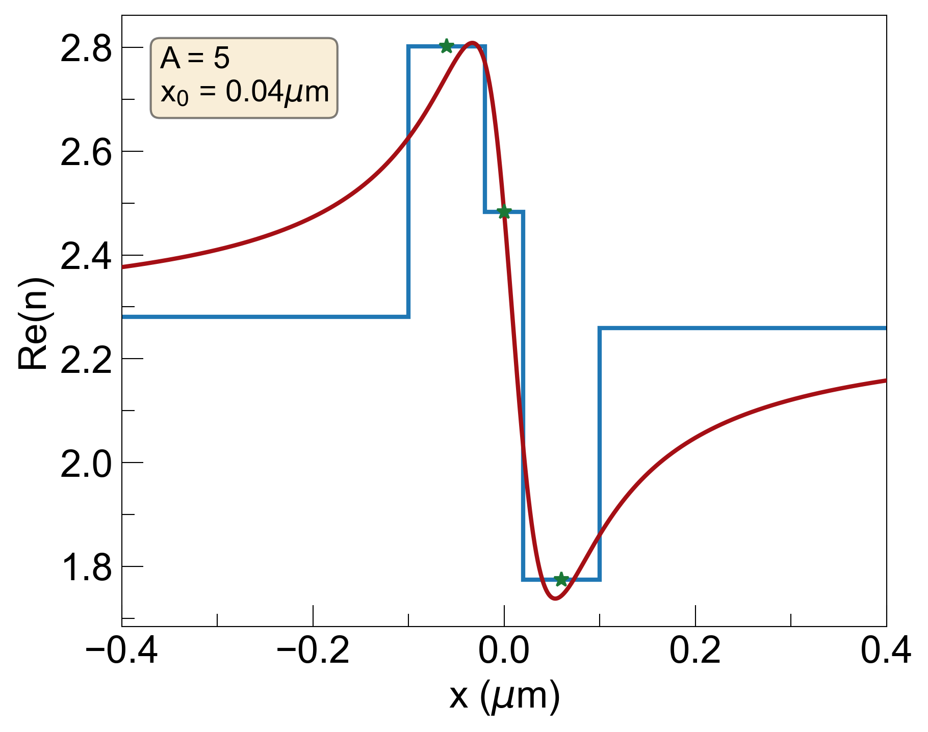
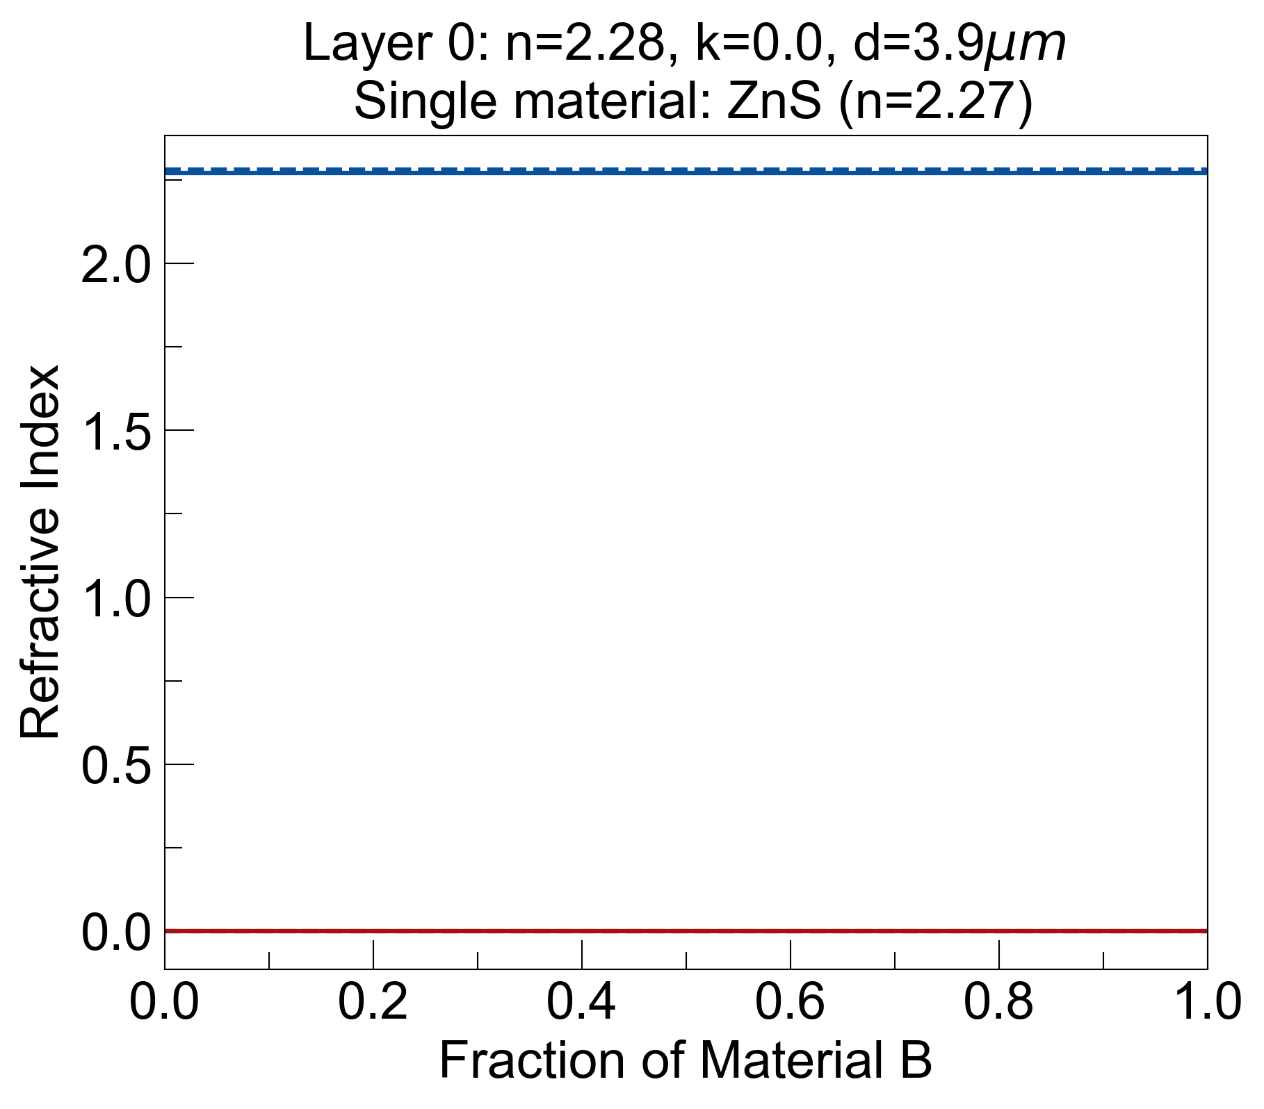
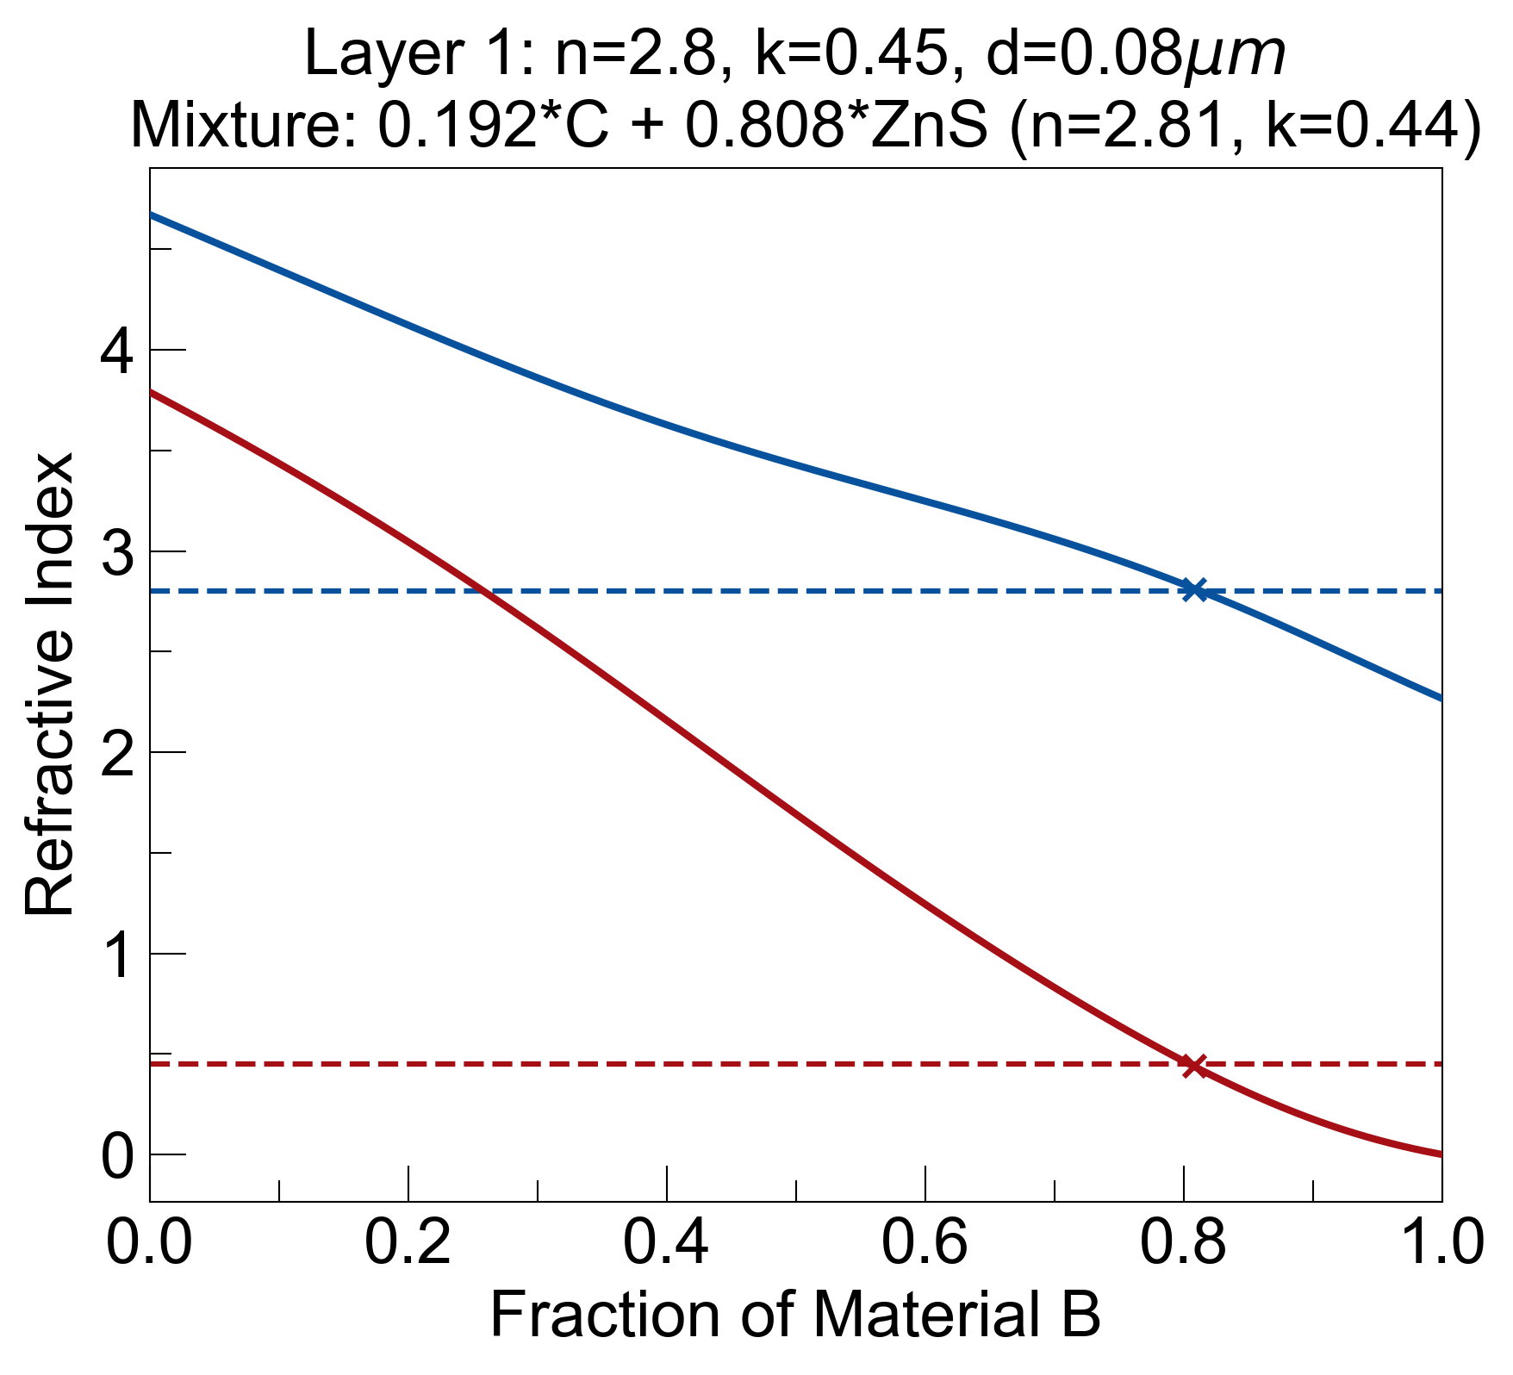
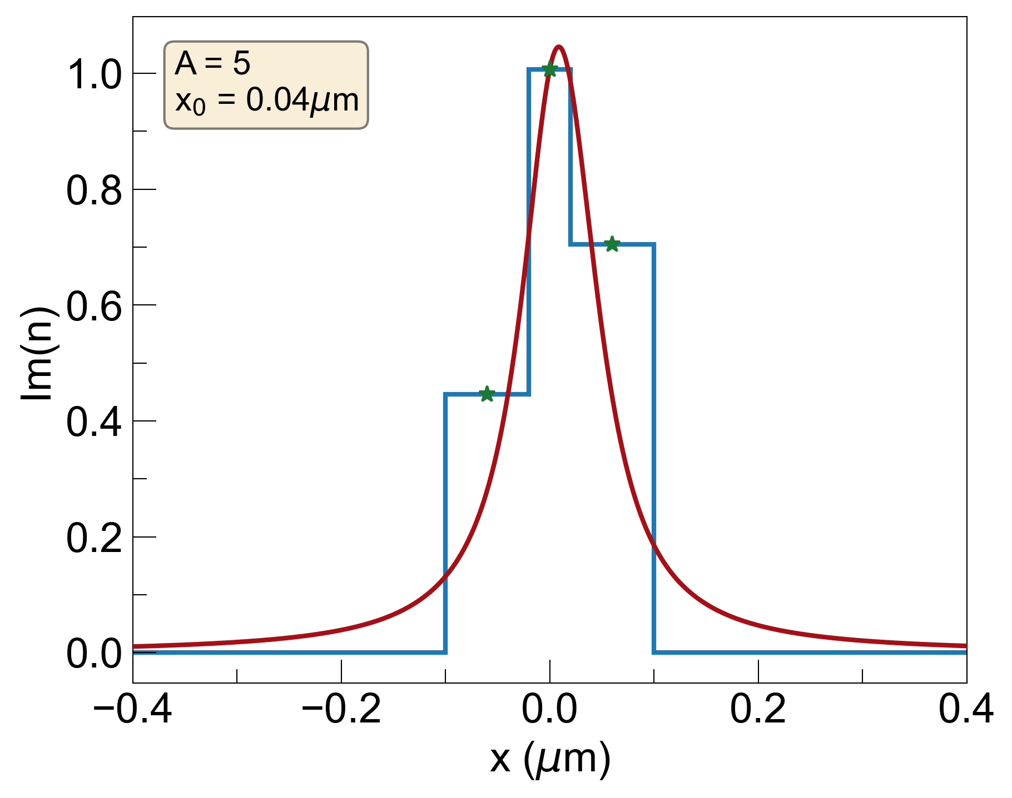
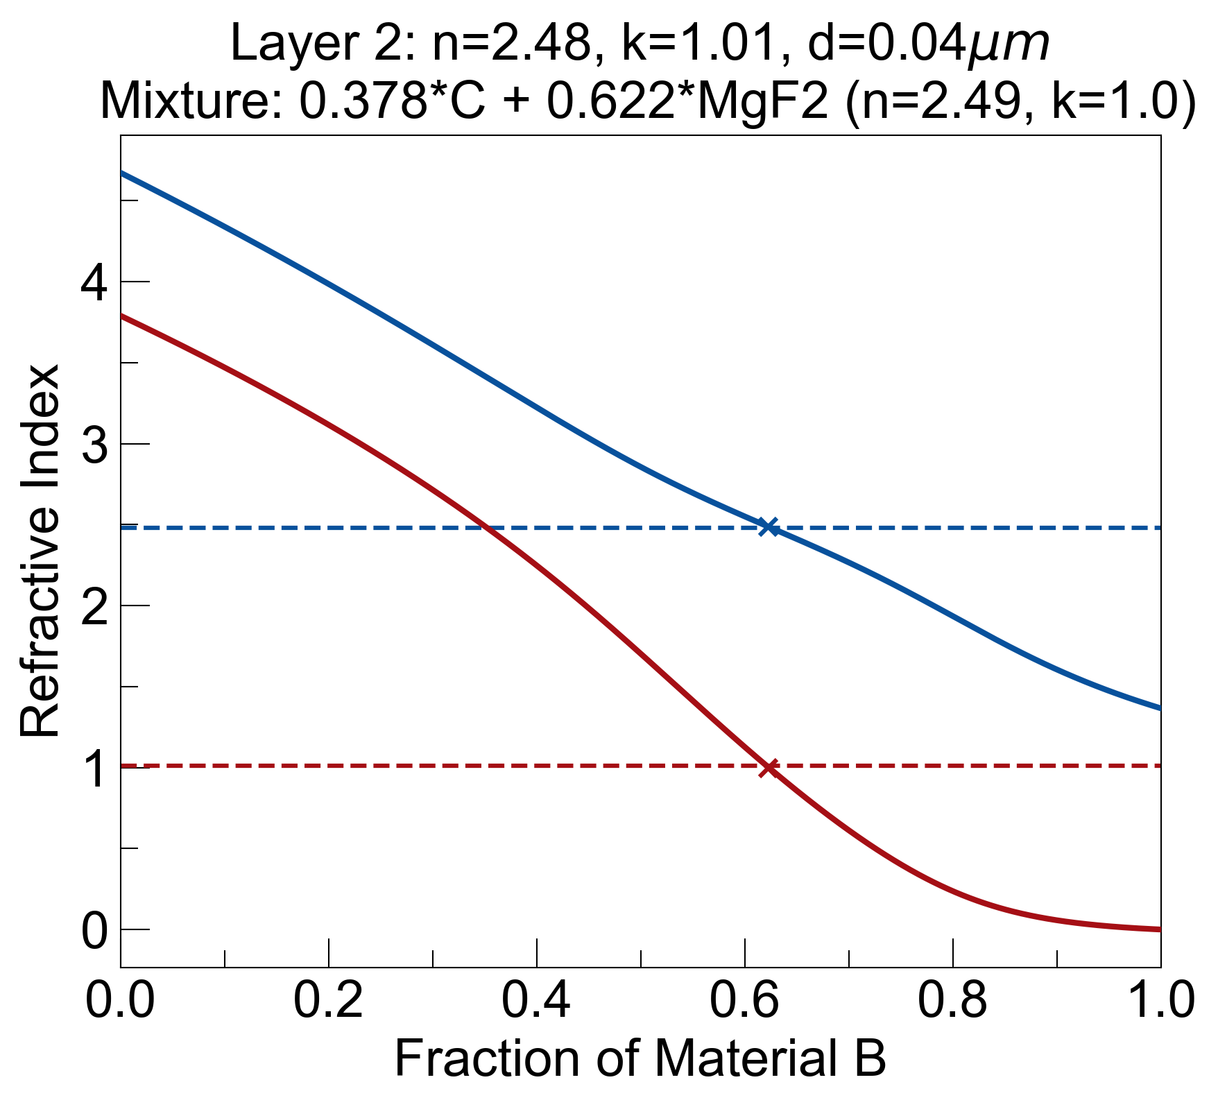
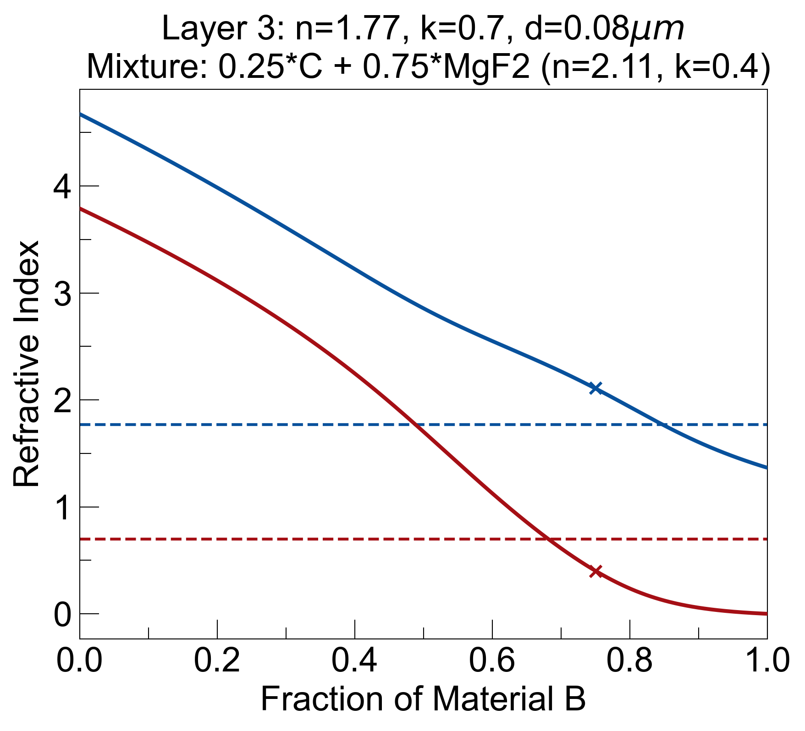
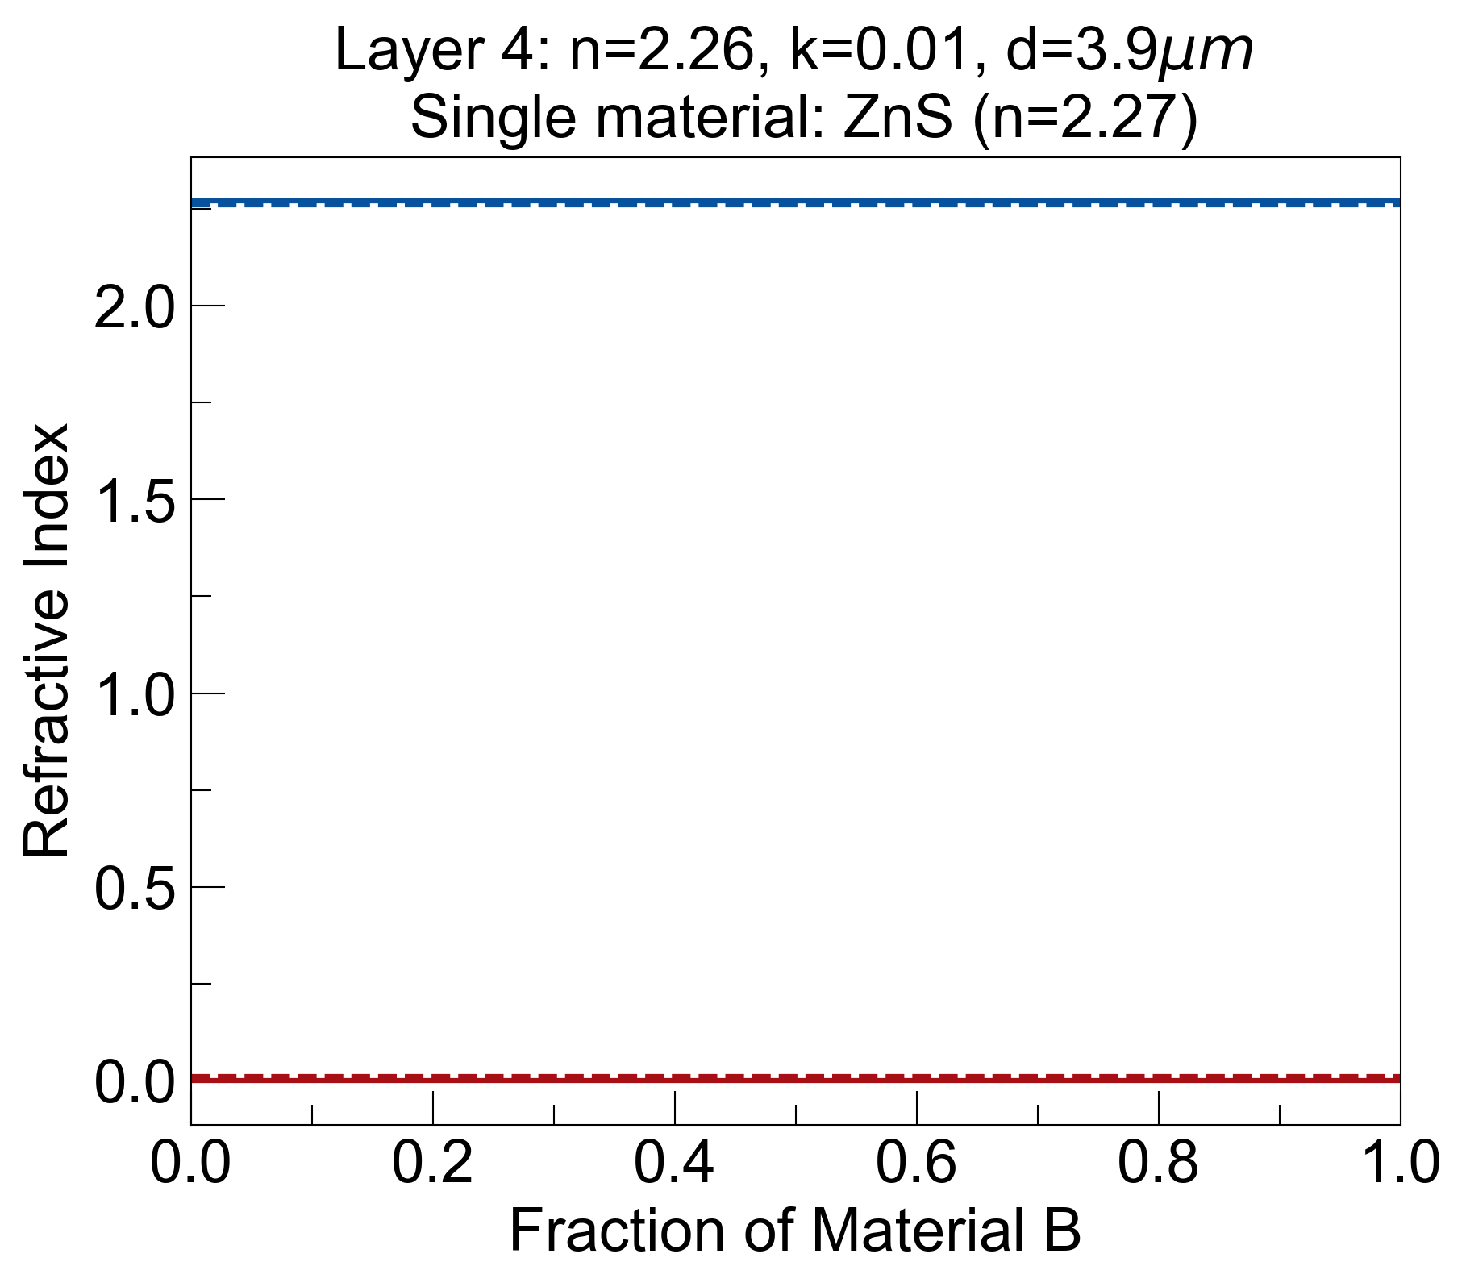
Bruggeman on 5 Layer Design

