Slide 1
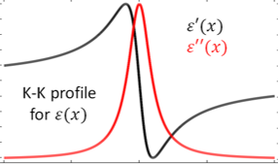

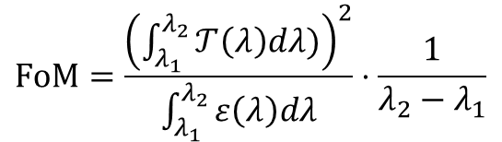


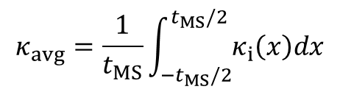
1 Stack
…
…
$$t_{MS}$$
…
…
$$κ_{avg}=\frac{1}{t_{MS}}\int_{{−t}_{MS}/2}^{t_{MS}/2}{κ_{i}\left(x\right)dx}$$
$$FoM=\frac{{\left(\int_{λ_{1}}^{λ_{2}}{𝒯\left(λ\right)dλ)}\right)}^{2}}{\int_{λ_{1}}^{λ_{2}}{ε\left(λ\right)dλ}}⋅\frac{1}{λ_{2}−λ_{1}}$$
$$T_{Bulk}\left(λ\right)=e^{−\frac{4π}{λ}κ_{avg}t_{MS}}$$
$$ε_{Bulk}\left(λ\right)=1−T_{Bulk}\left(λ\right)$$

Slide 2
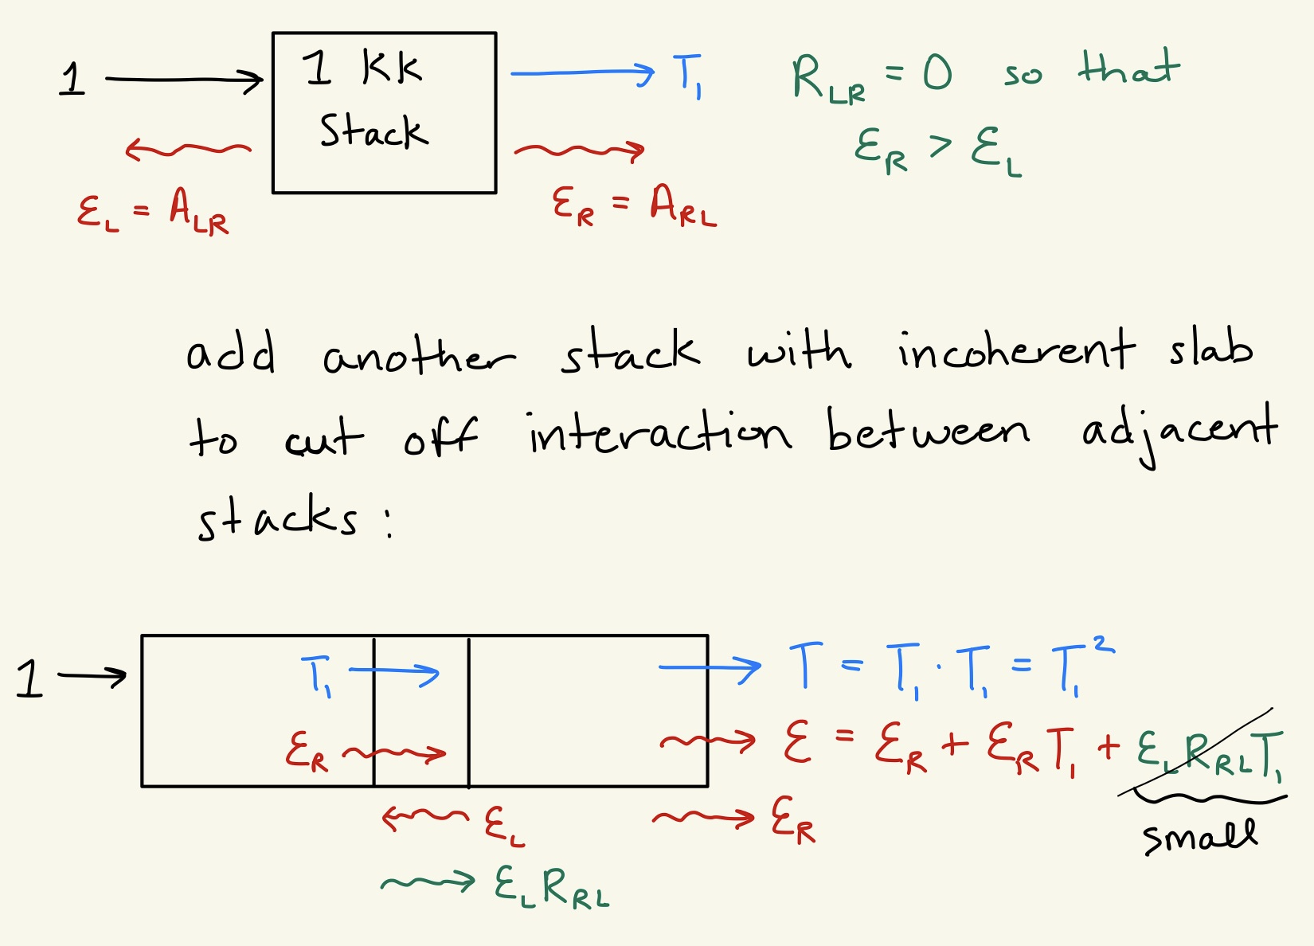
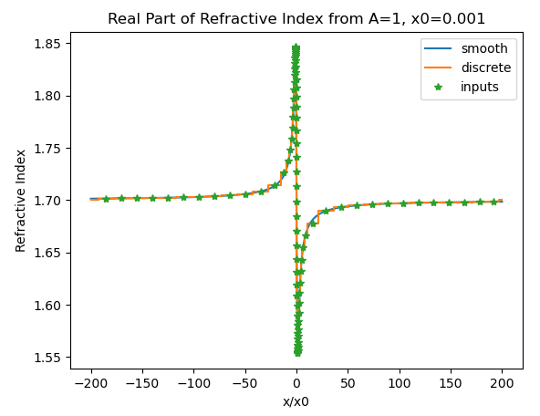
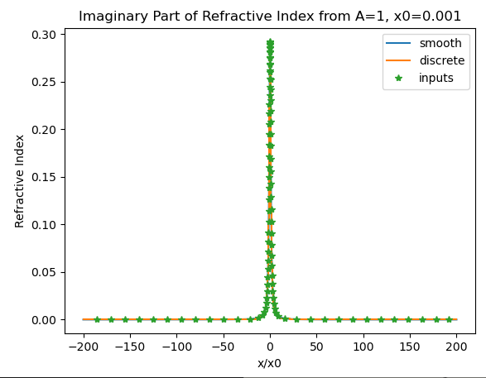
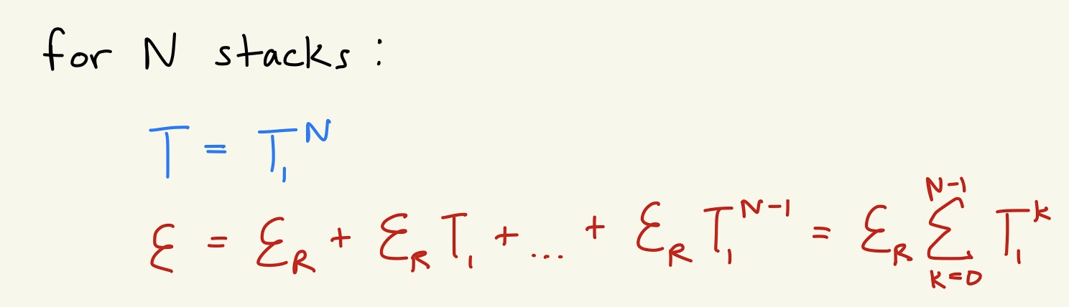

Slide 3
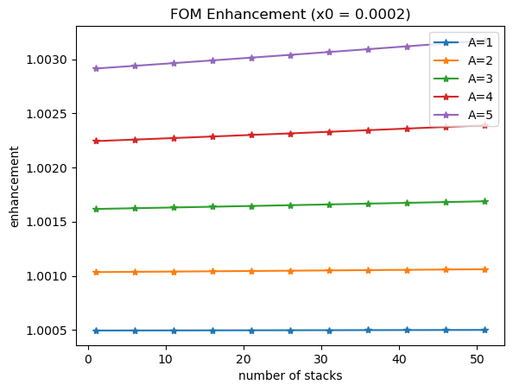
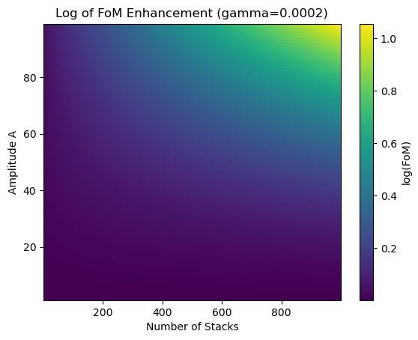
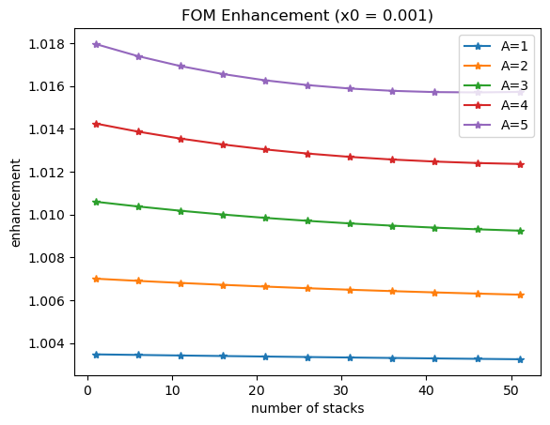
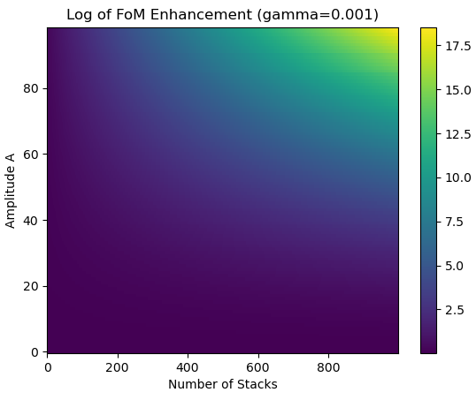
Computational (TMM software):
Semi-analytical:

Slide 4
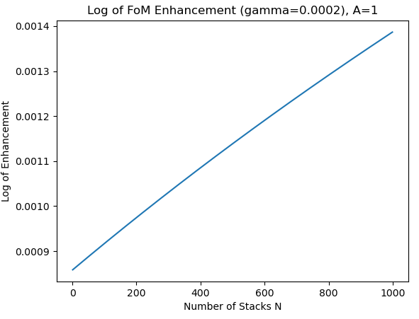
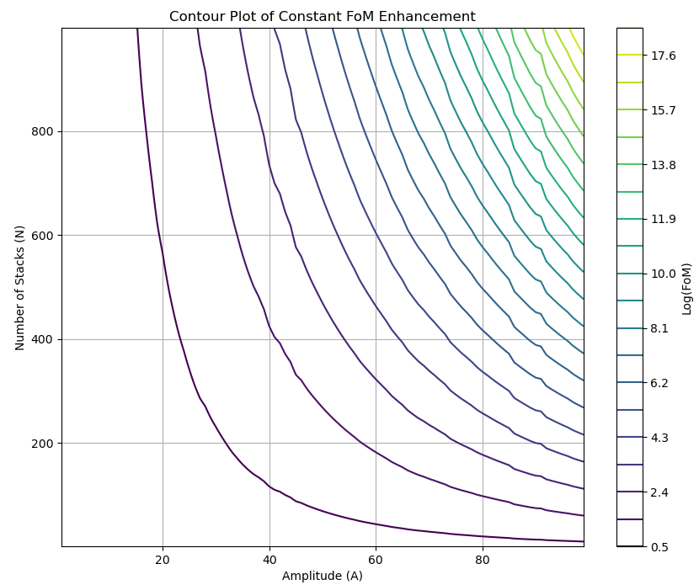
Computational (TMM software):
Semi-analytical:

Slide 5
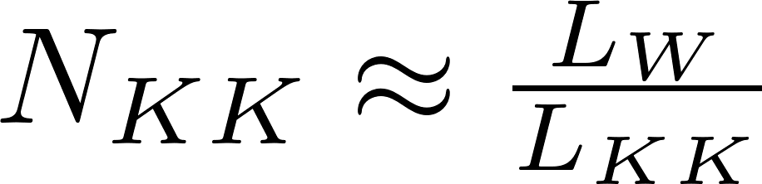
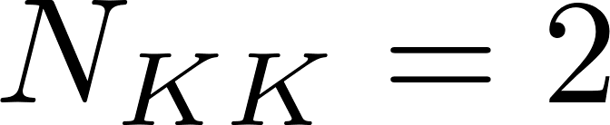
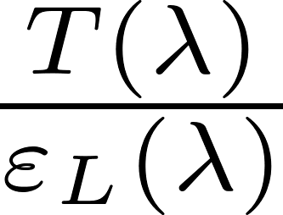
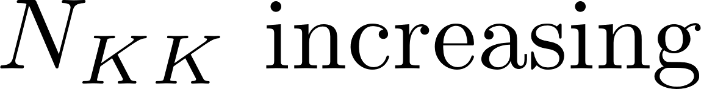
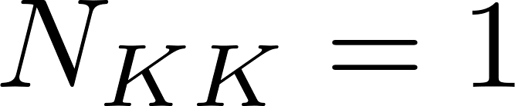
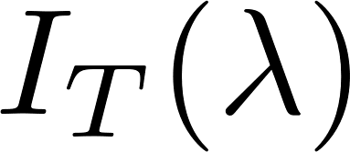
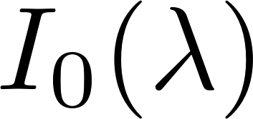
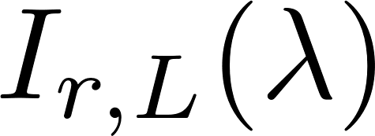
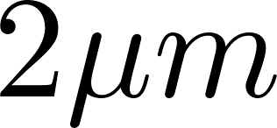
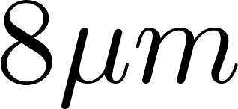
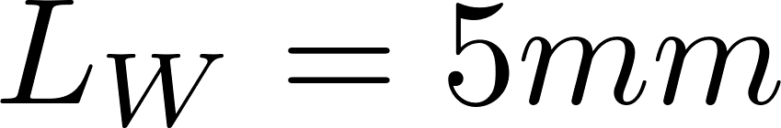
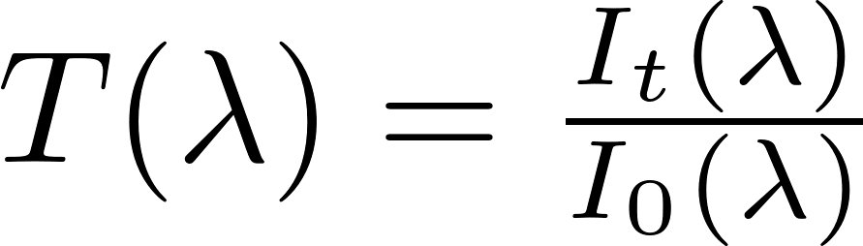
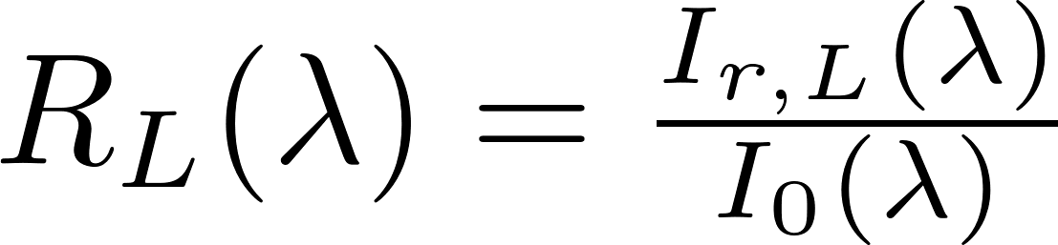
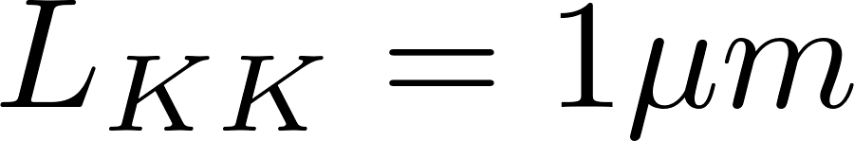
We want to see how a FIXED LENGTH sapphire window can be improved (using, as FOM, transmissivity divided by emissivity on one side) over the spectrum between 2 and 8 um.
The idea is that there could be a spectral region (at longer wavelengths, closer to the main phonon mode) where KKs can enhance the FOM, depending on their number.
Type of plot we want as a final result (hopefully)
Add the KK one (or more ) at a time to understand how an increasing number of KKs (e.g., with symmetrical distribution within the bulk window) improves the FOM. The detector is assumed to be on the Left (L) of the window.
Sapphire window
Consider the dispersion of the sapphire across the spectrum and ensure that, at each wavelength, the total loss of the KK over its length equals the bulk sapphire over the same length. (You will have different KK permittivity profiles for different wavelengths)
The length of the window (L_W) and the KK (L_KK) are indicative but I would start from these numbers. We can then change them.

Slide 6
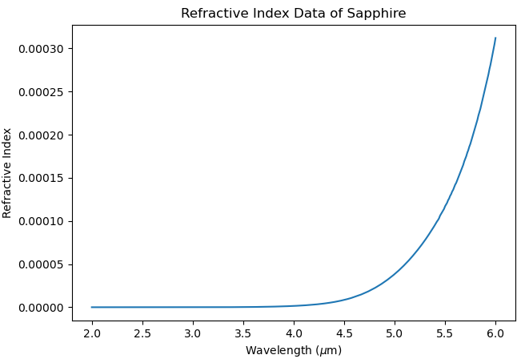
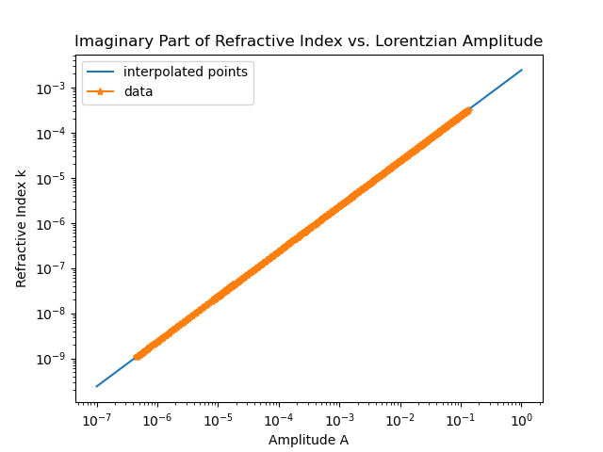
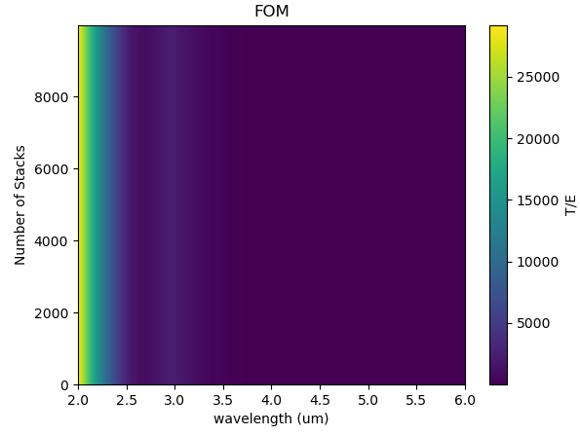
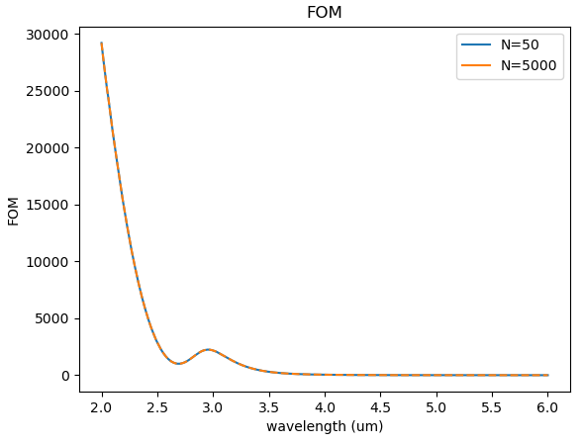
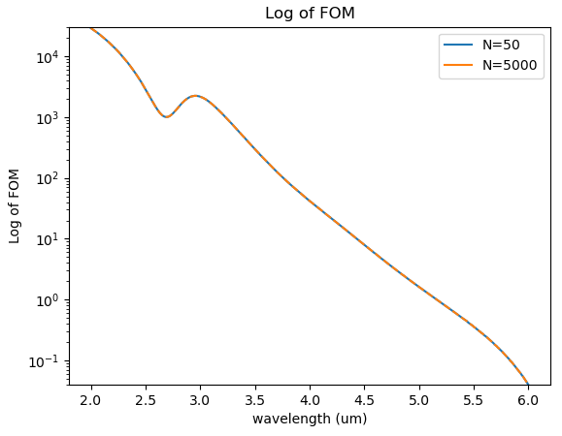
Fix x0 = 0.001

Slide 7
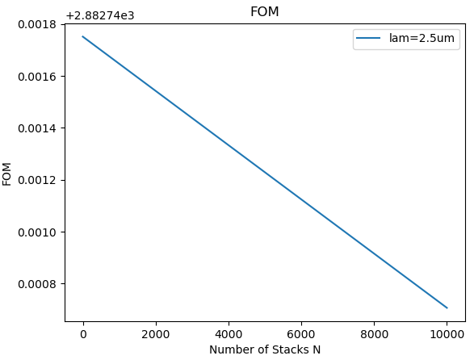
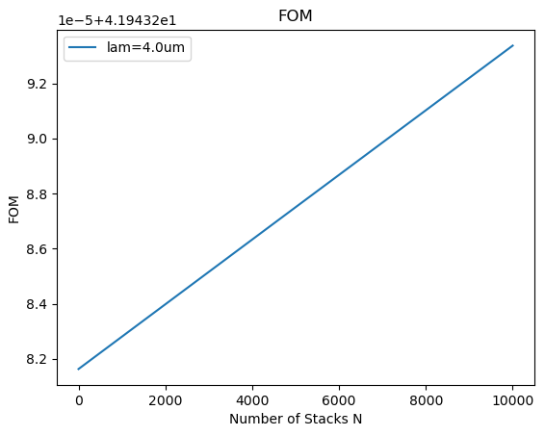
Procedure:
1. Sweep over wavelengths and find amplitude A for corresponding losses k_bulk
2. Generate KK list of refractive indices and thicknesses
3. Calculate TRA for single KK stack using TMM software
4. Sweep over number of stacks N, using semi-analytic approach to get trans_KK and emiss_KK
5. Make remaining length bulk sapphire: L_bulk = L_total – N * t_KK
6. Calculate trans_bulk and emiss_bulk from L_bulk and k_bulk using usual equations
7. Calculate TOTAL trans (trans_KK*trans_bulk) and total emiss (?) , either:
a) emiss_KK * trans_bulk + emiss_bulk, or
b) emiss_bulk * trans_KK + emiss_KK
=?

