Slide 1
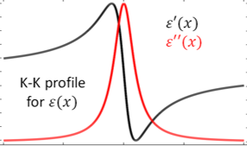

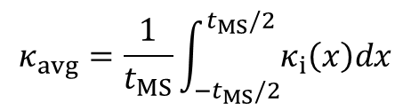
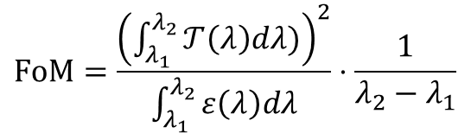


1 Stack
…
…
…
…

Slide 2
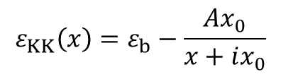
1
T_{o}
E_{L} = A_{LR}
E_{R} = A_{RL}
R_{LR} = 0 ∴
E_{R} < E_{L}

Slide 3
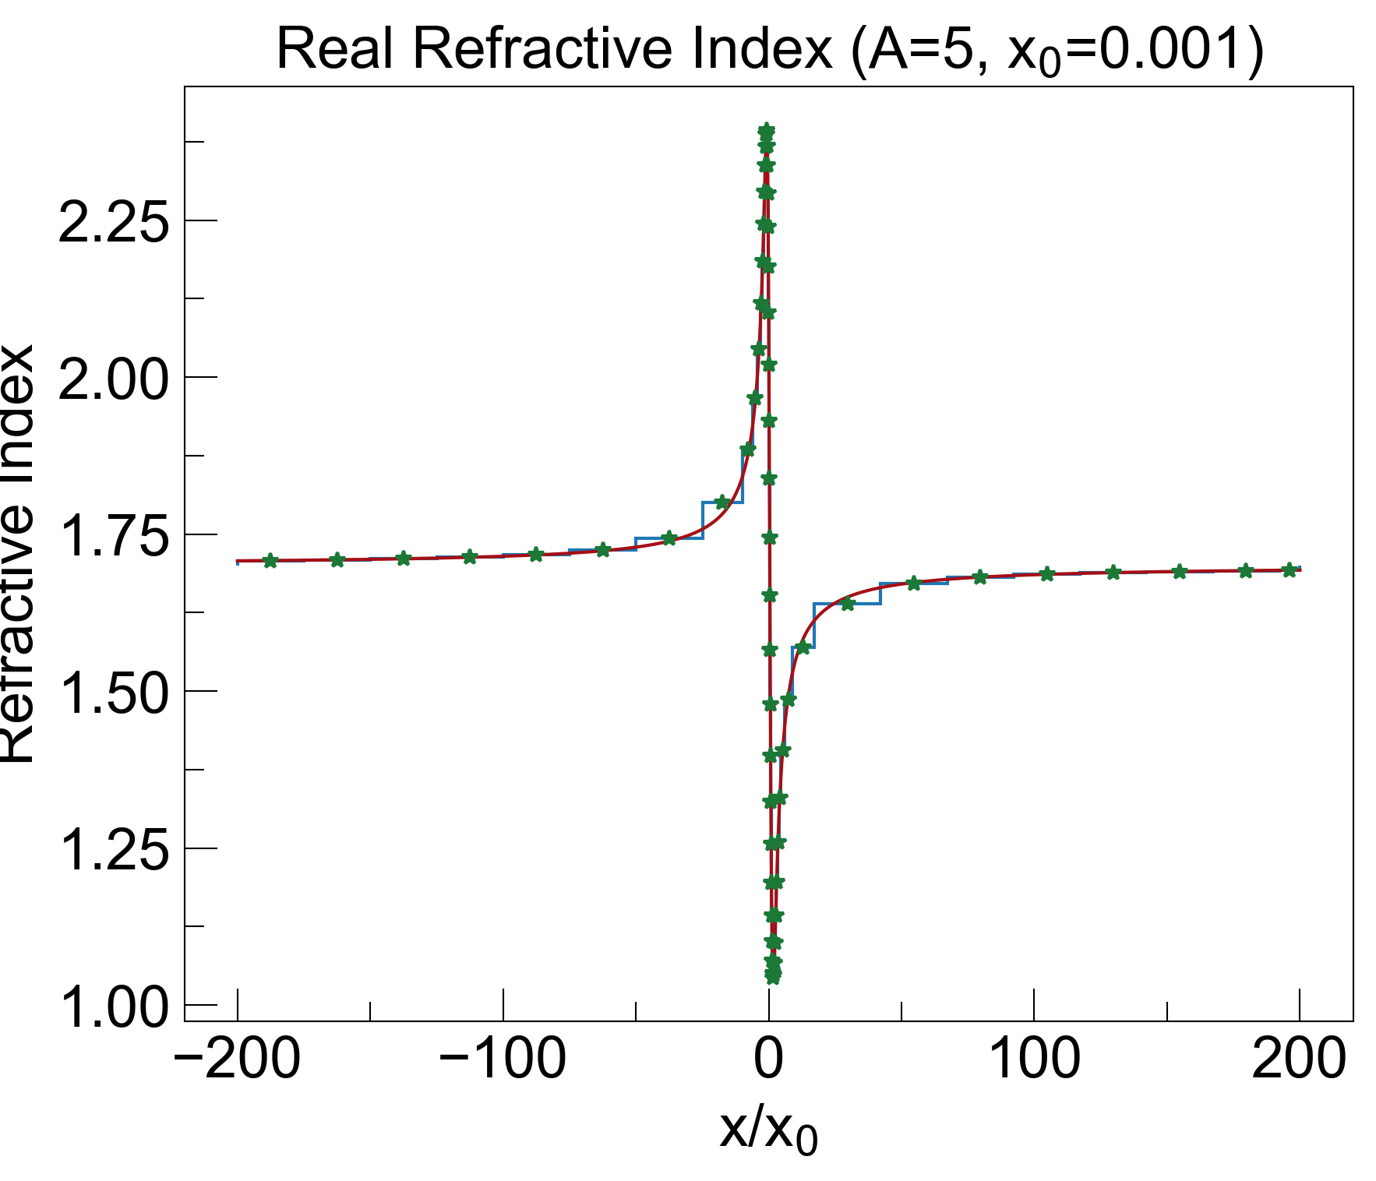
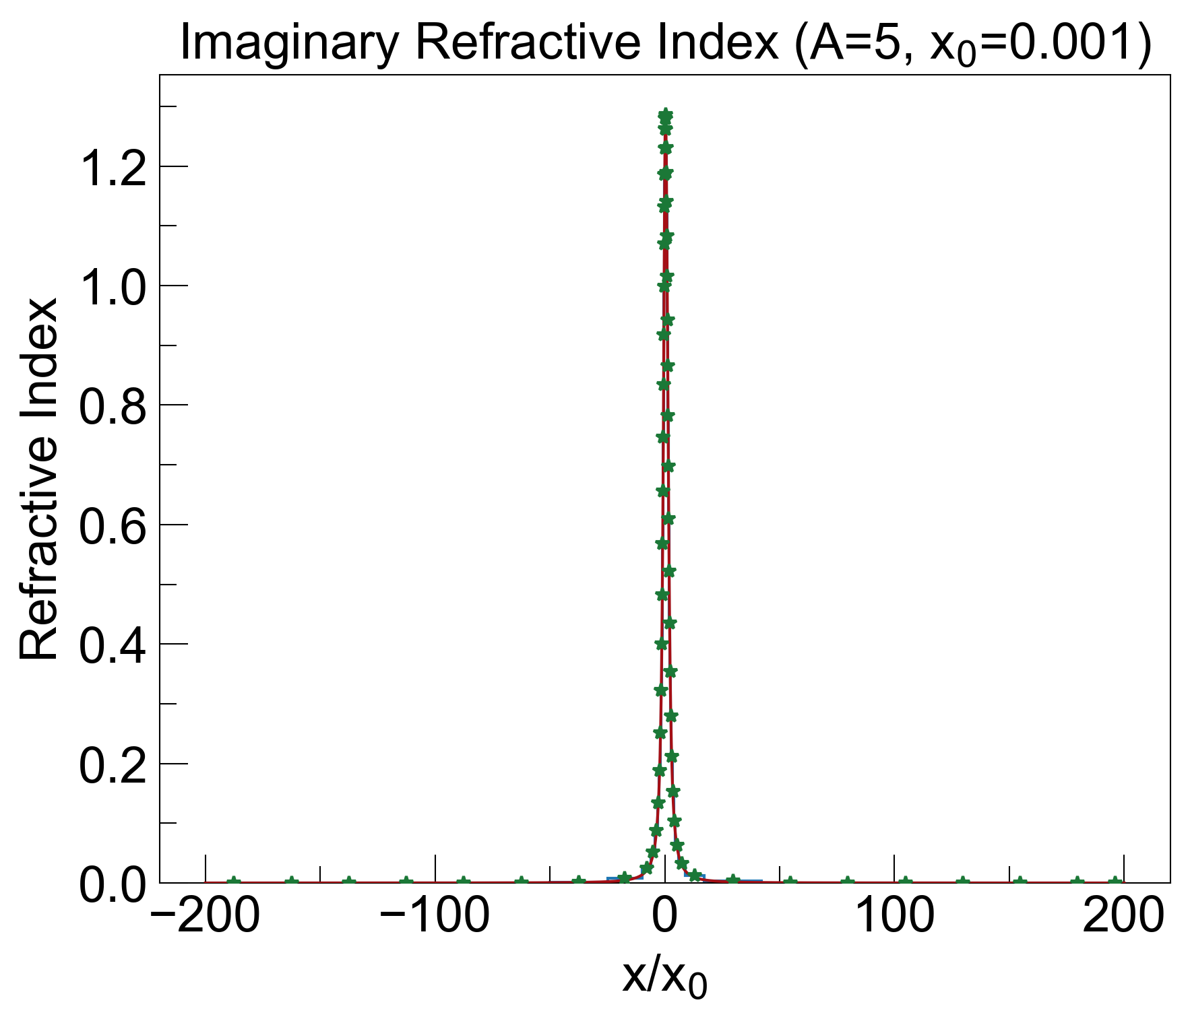
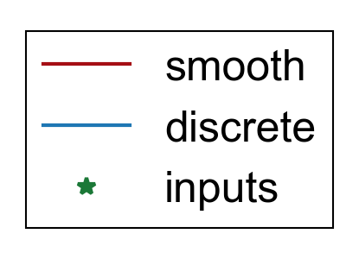

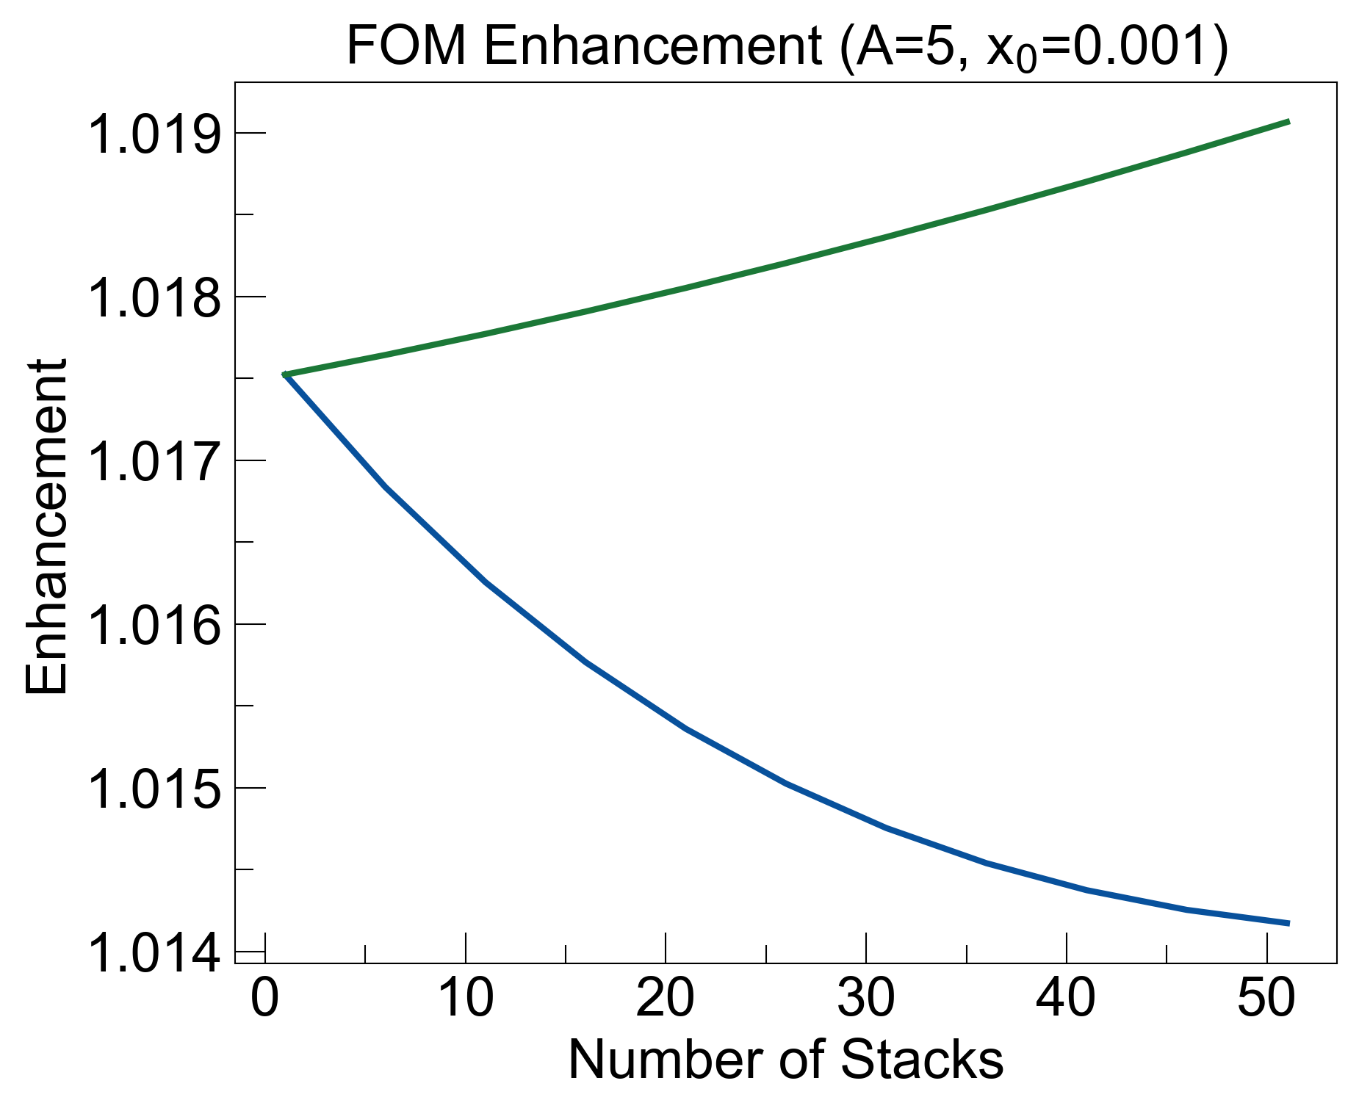
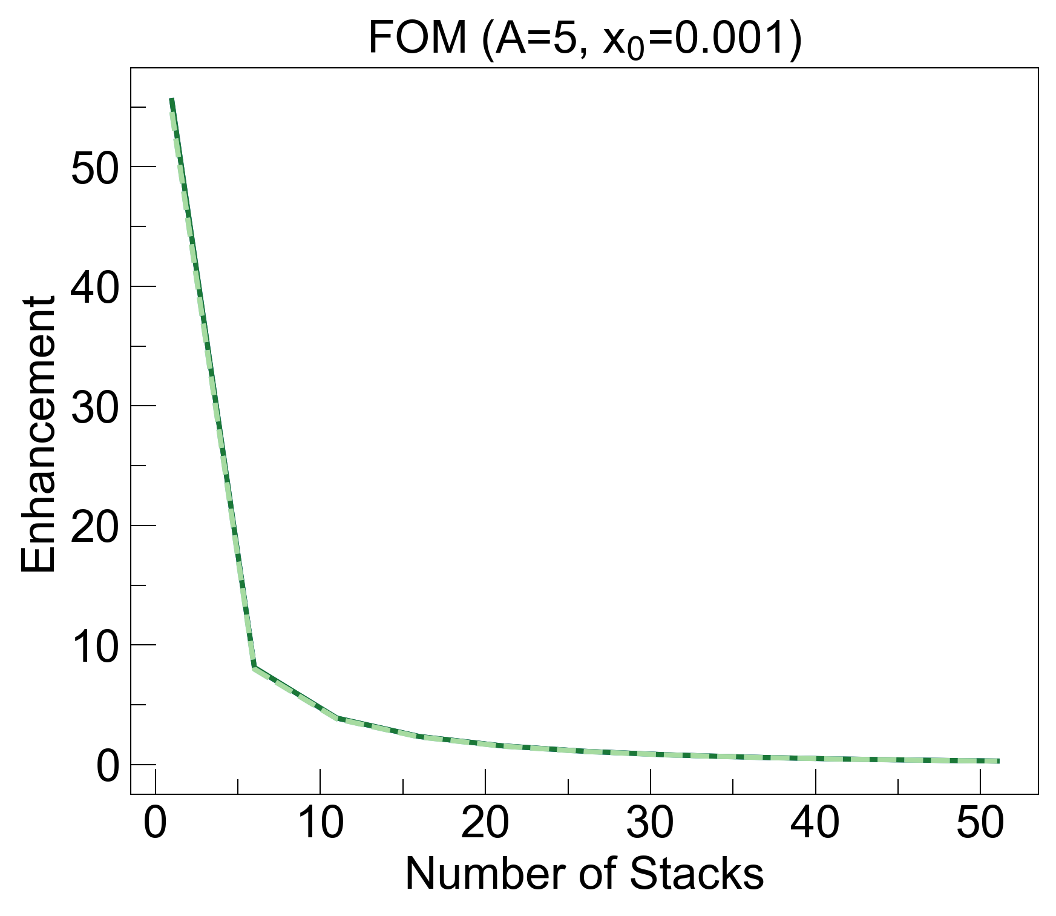
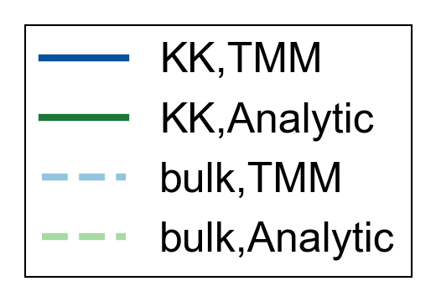
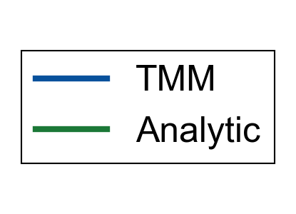
Thickness of 1 KK layer: 0.4 um
k_bulk = 0.0116
FOM enhancement decreases with number of stacks when calculated by TMM, but increases with semi-analytical approximation.

Slide 4
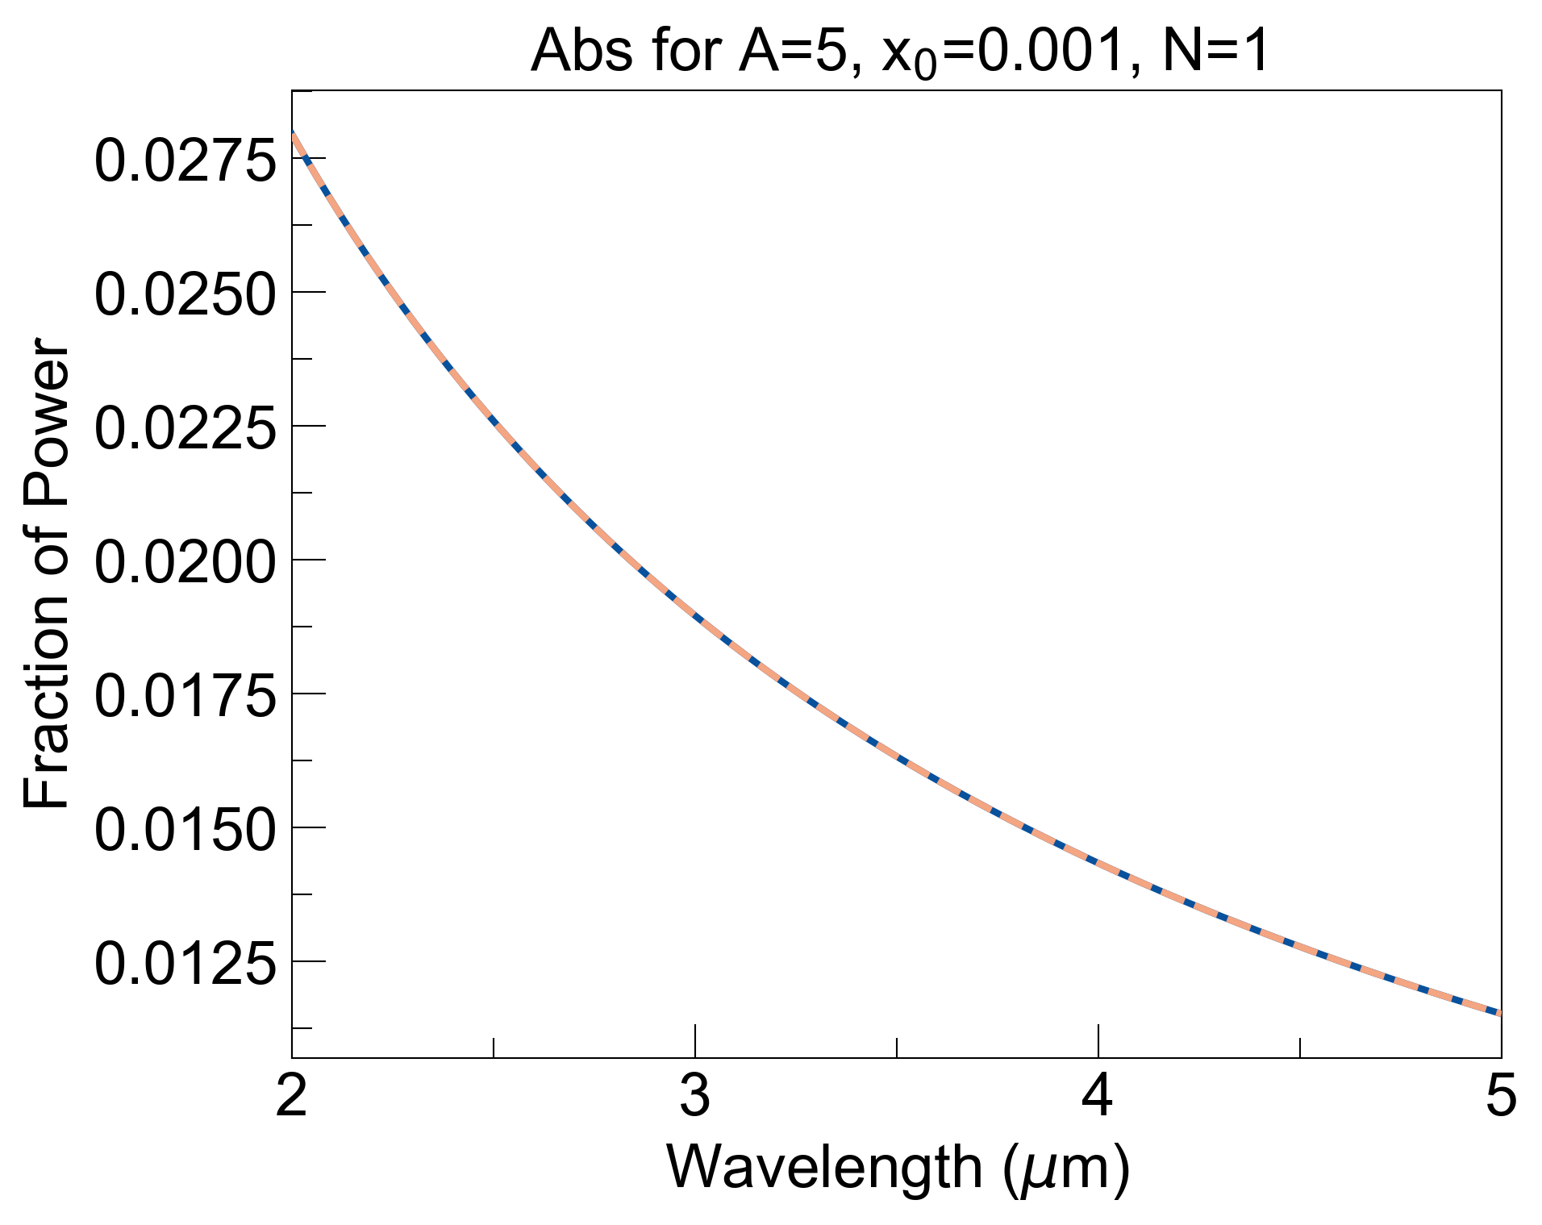
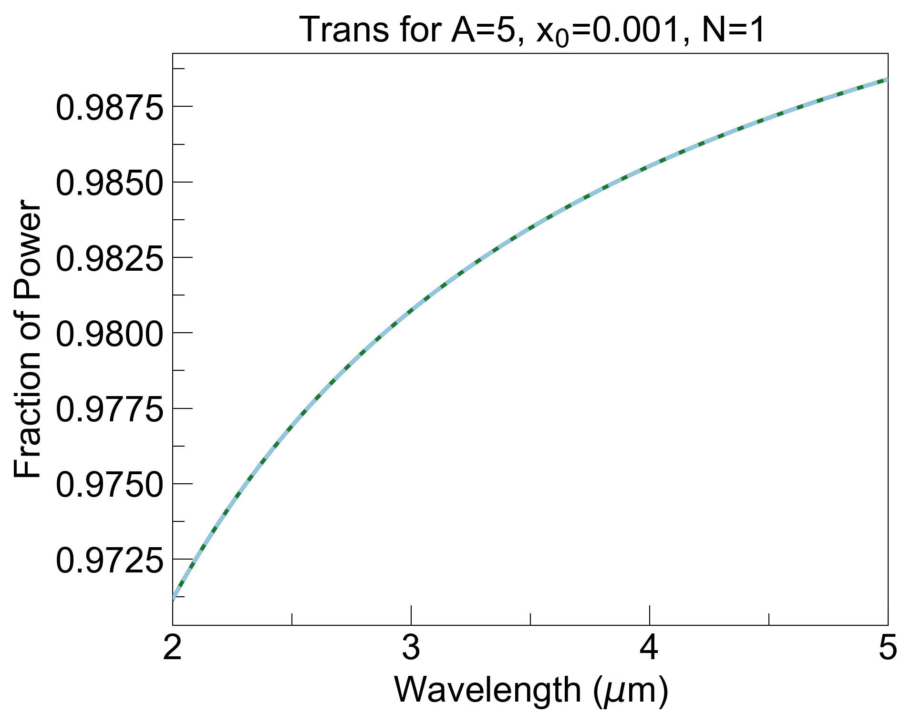
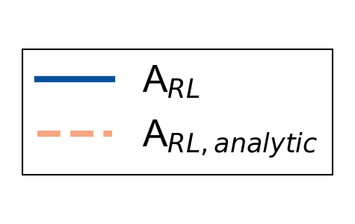
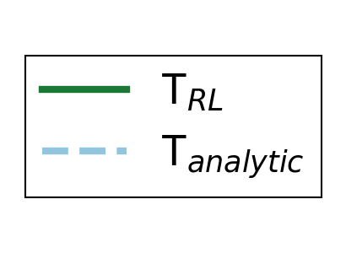
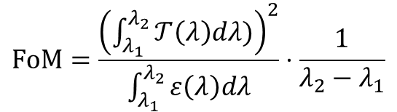
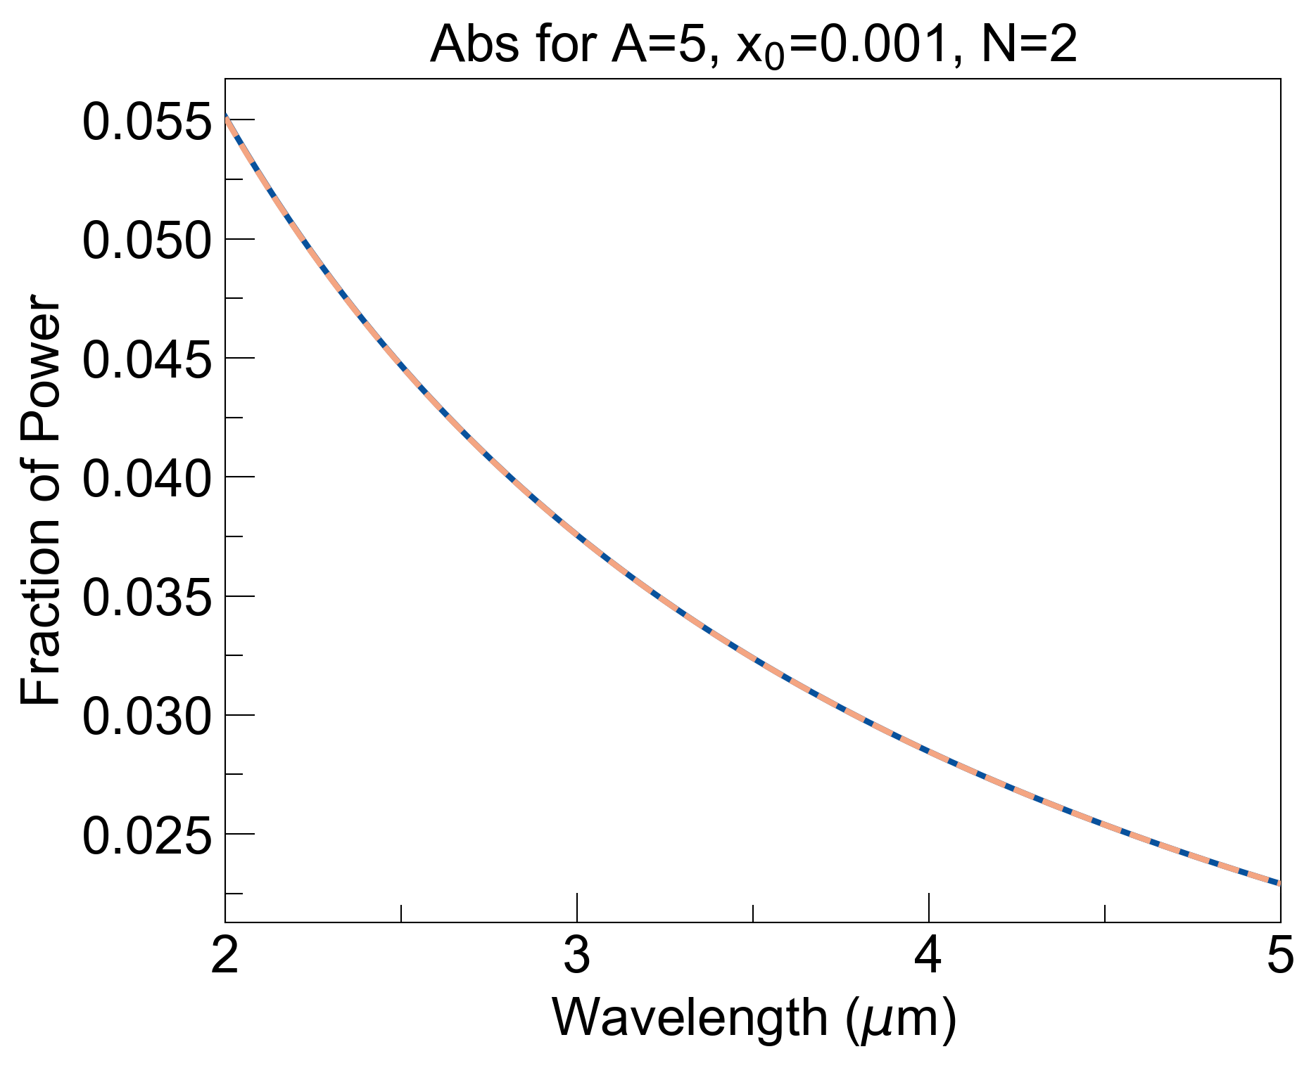
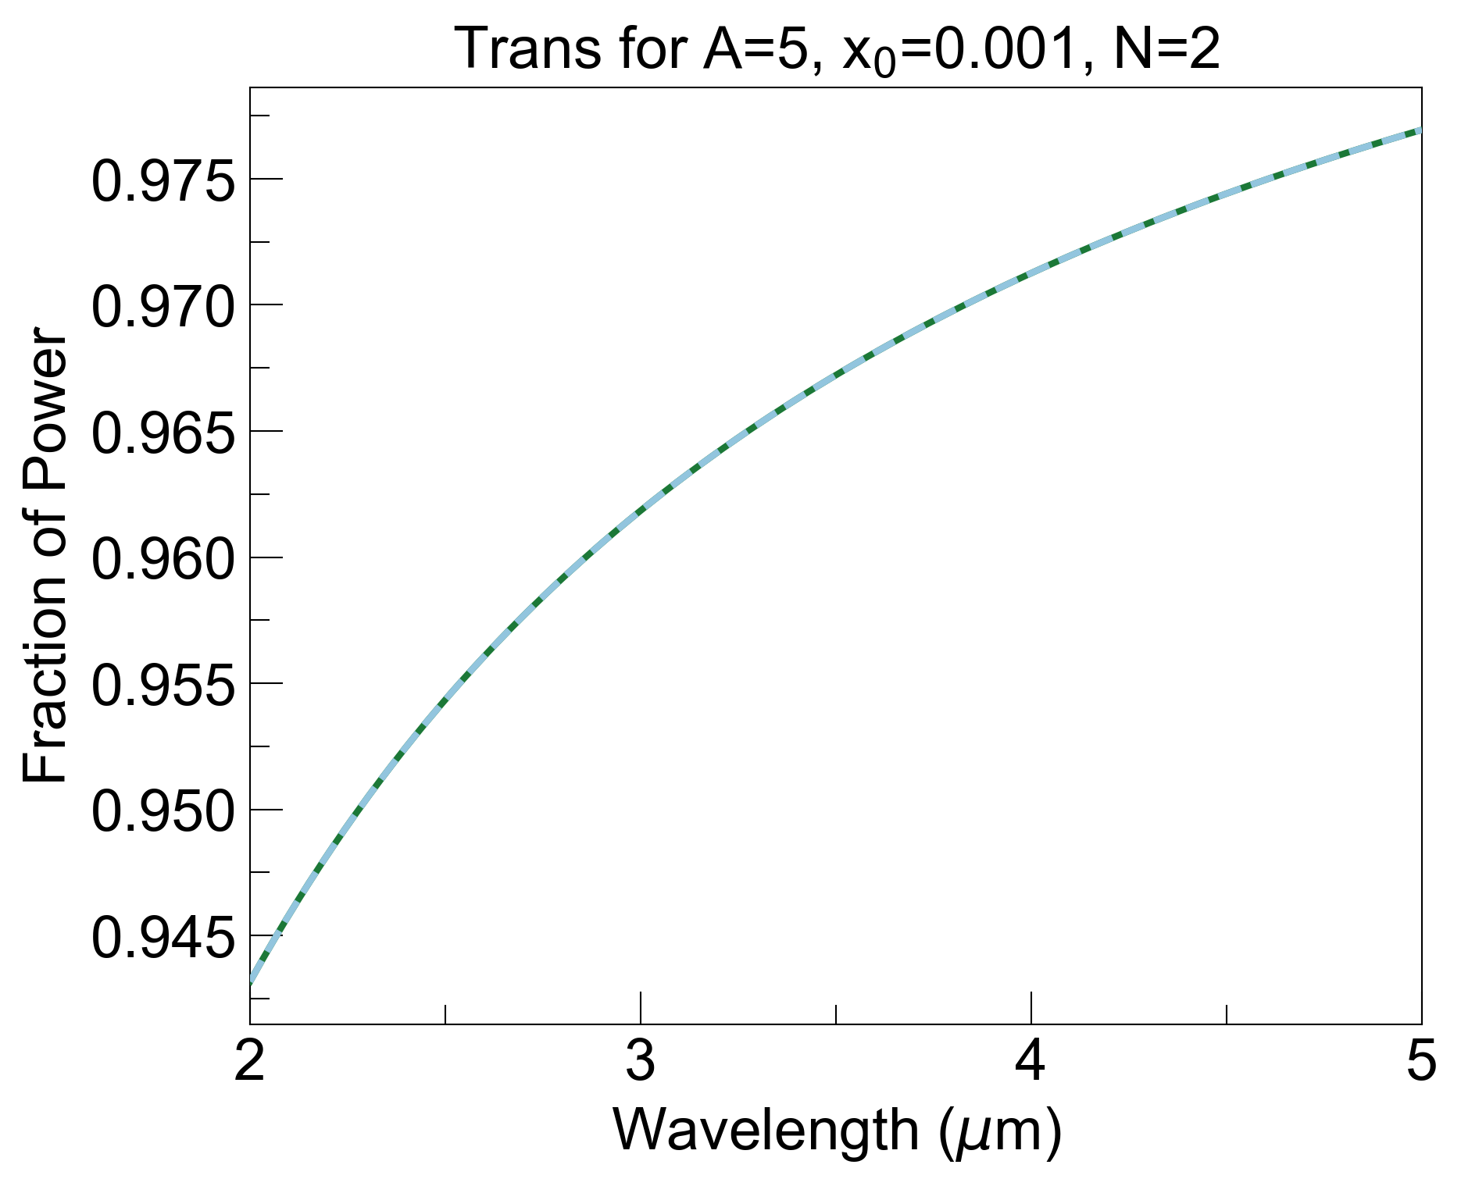
N = 1
FOM_RL is: 55.5313 FOM_RL_analytic is: 55.5313
FOM enh. (TMM) is: 1.01752
FOM enh. (analytical) is: 1.01752
FOM_bulk is: 54.58
FOM_LR is: 54.67
N = 2
FOM_RL is: 27.0458 FOM_RL_analytic is: 27.0503
FOM enh. (TMM) is: 1.01737
FOM enh. (analytical) is: 1.01754
FOM_bulk is: 26.58
FOM_LR is: 26.63

Slide 5
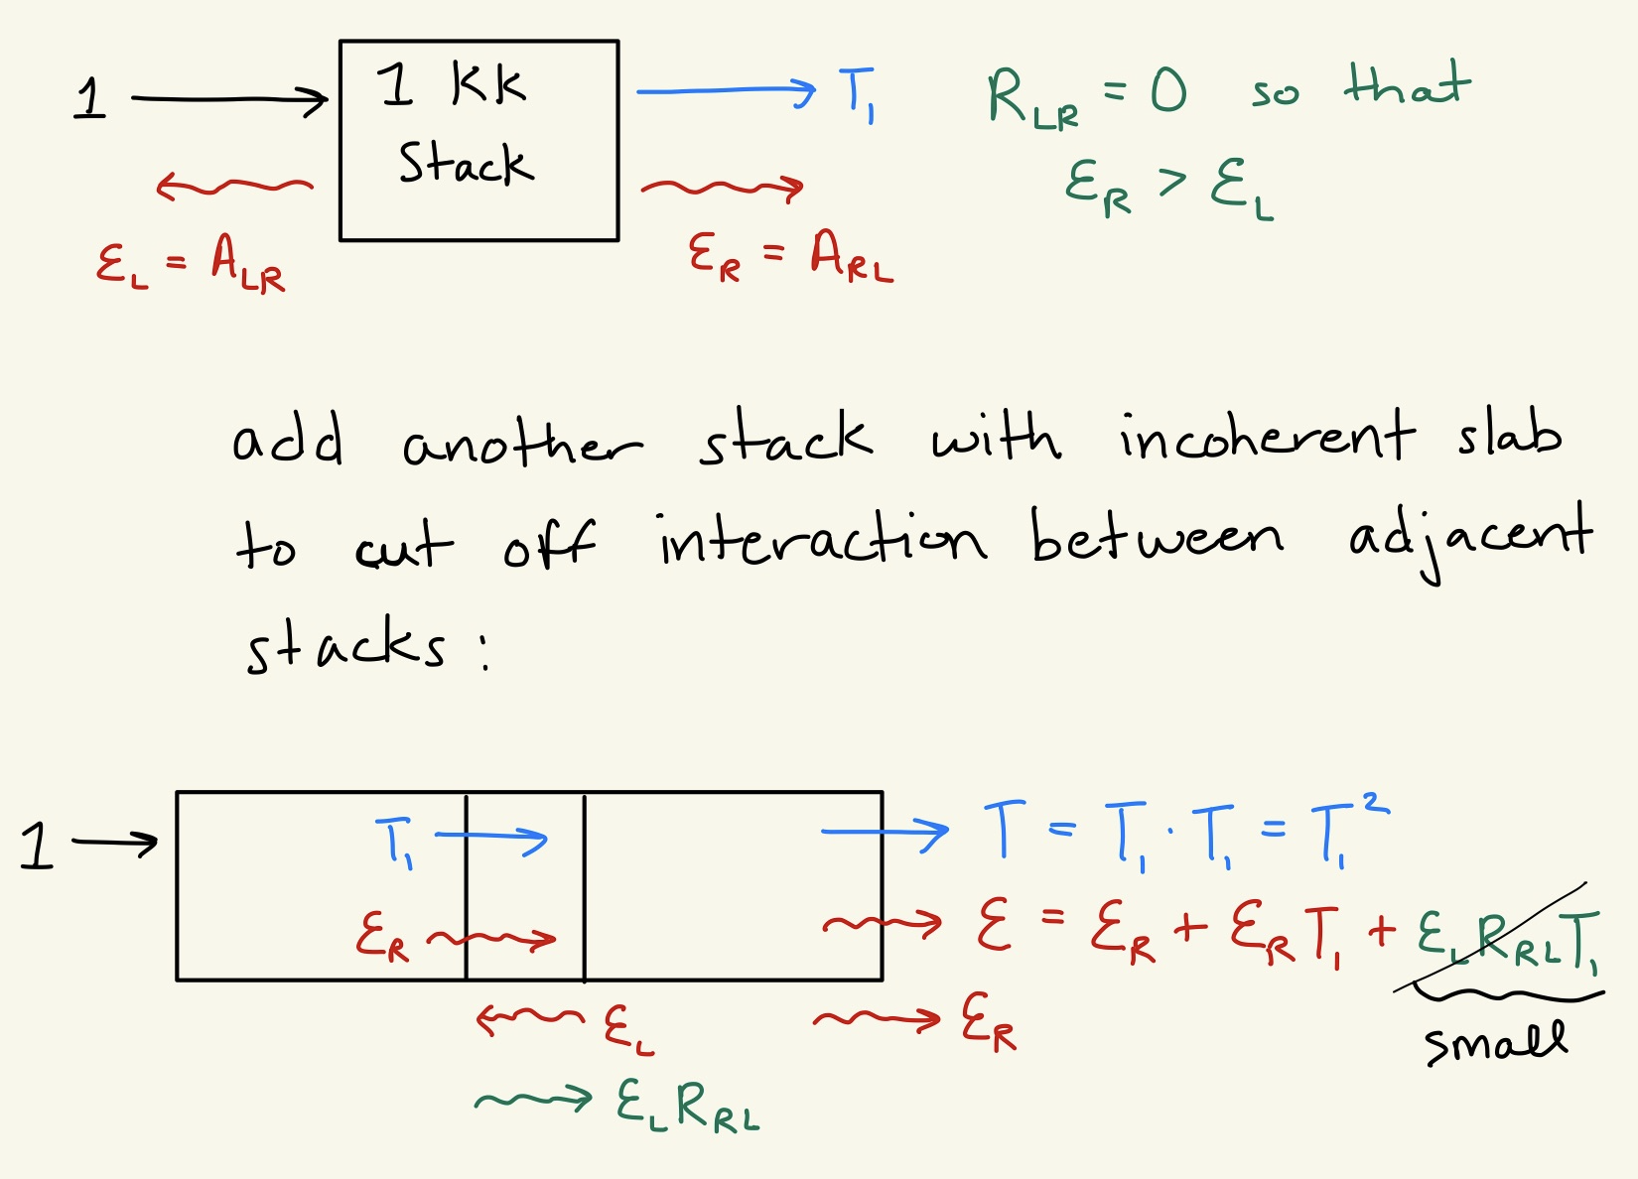
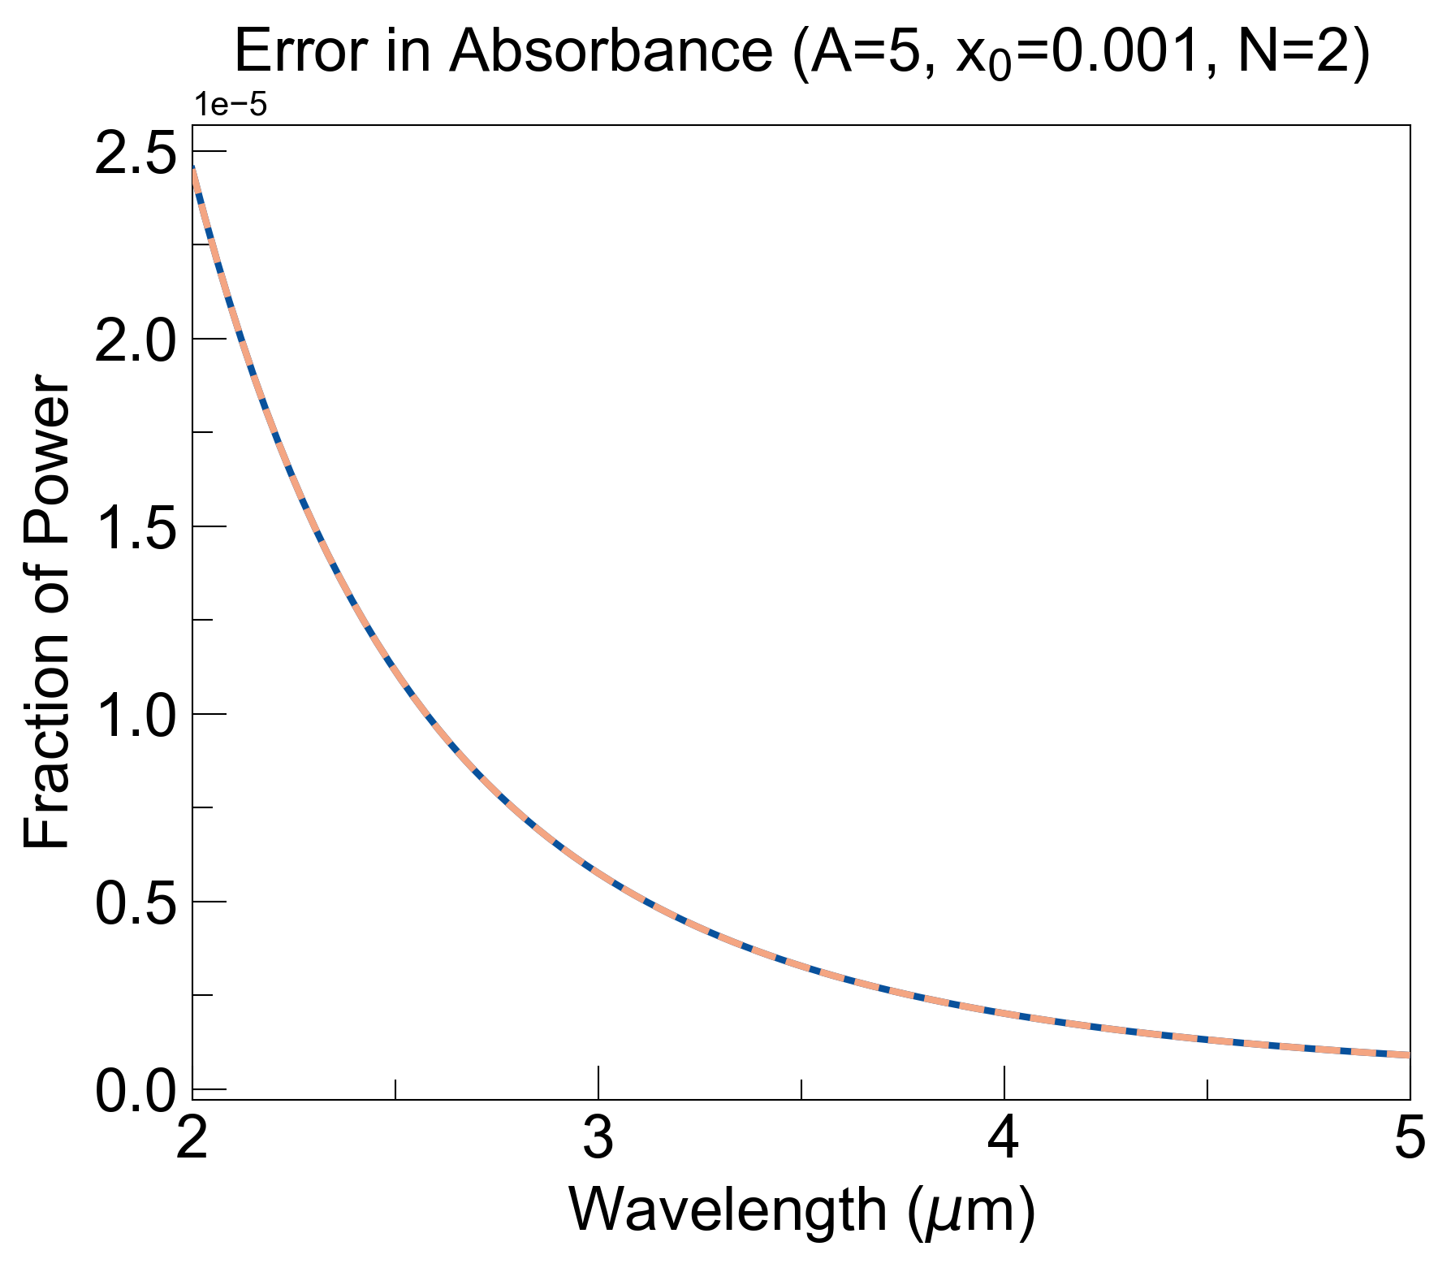
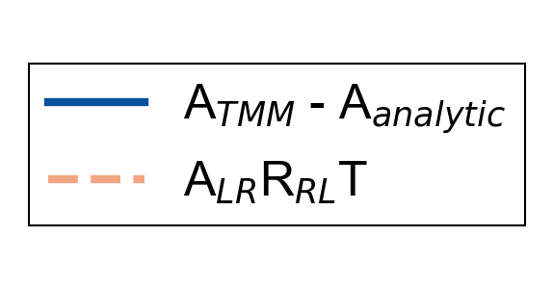
Plotting the ‘small term’ over the supposed error in absorbance suggests that TMM code is correct.
Have not verified for other combinations of A and x0, or for N > 2 (unsure how to do that).

Slide 6
Show previous plots and hone into A=5, x0=0.001 case
Plot of FOM vs num_stacks at these vals (TMM and semi-analytical)
Plot of n and k at these vals
Plot of TRA at N = 1, N = 50 to show difference
Plot of TRA at N = 2
Plot of Error in Absorbance

