Slide 1
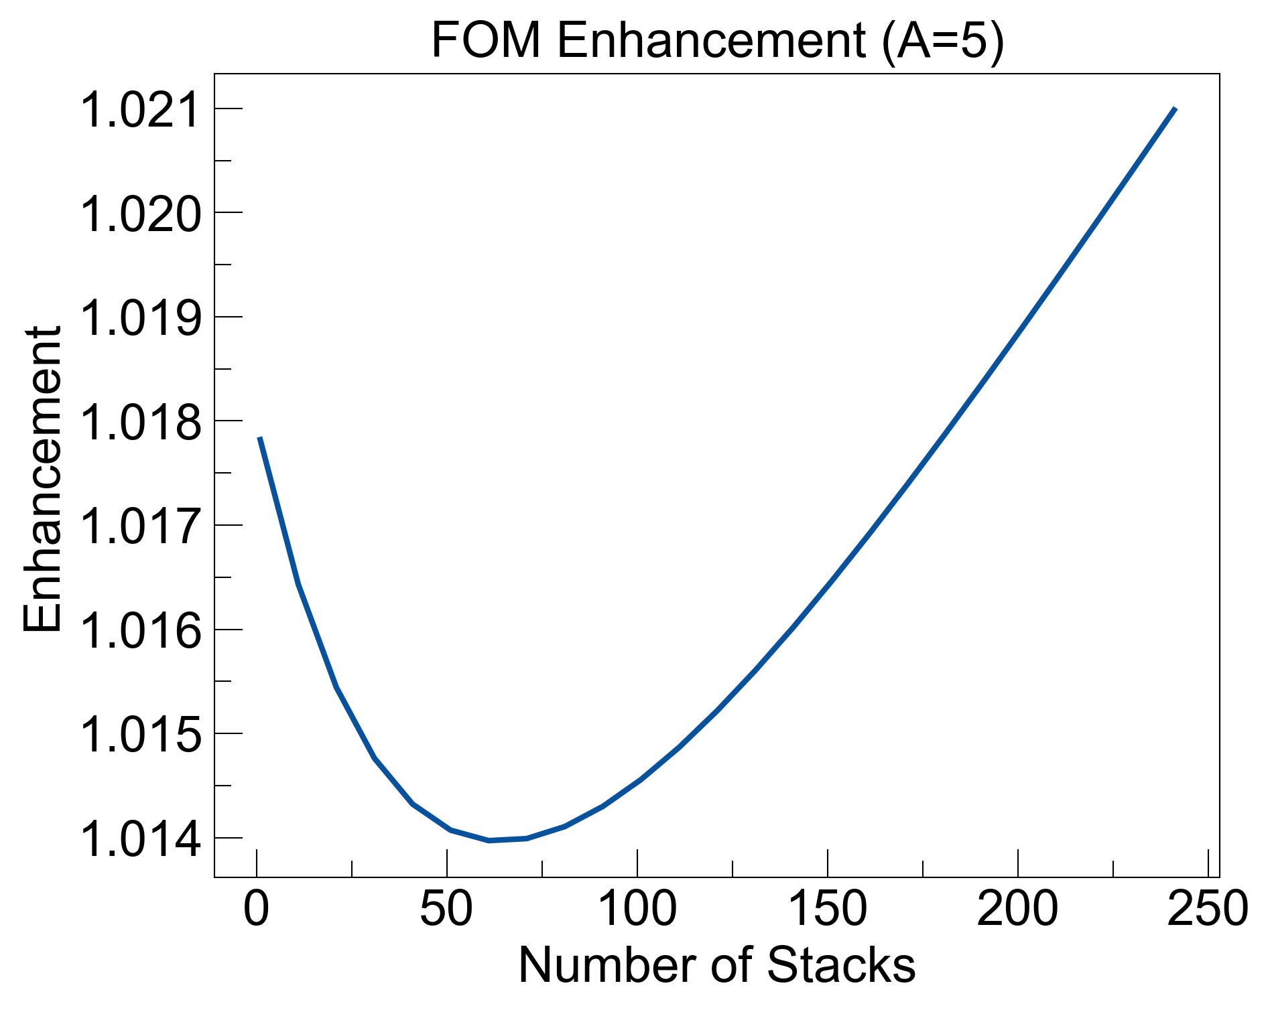
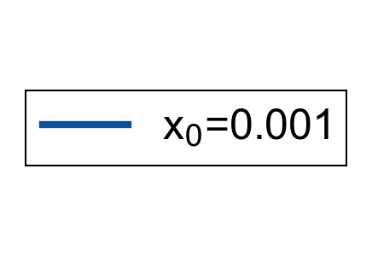

Slide 2
Function that takes in minimum Trans_avg (or Trans(lambda) ), minimum layer thickness, maximum # layers, and returns best possible KK refractive index profile, showing corresponding TRA_KK, TRA_bulk and FOM (either old one or new one)
New FOM: T*A_LR/A_RL
Look at how lowering k but keeping n same (deviating from KK profile) helps increase transmission while keeping asymmetry similar
Look into tmm_fast

