Slide 1
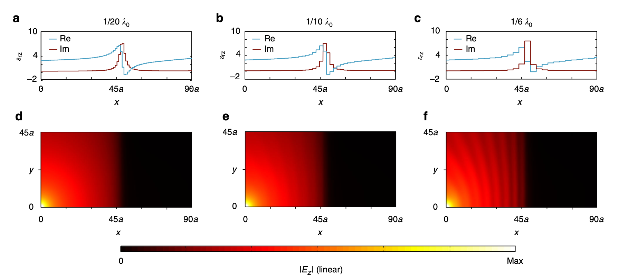
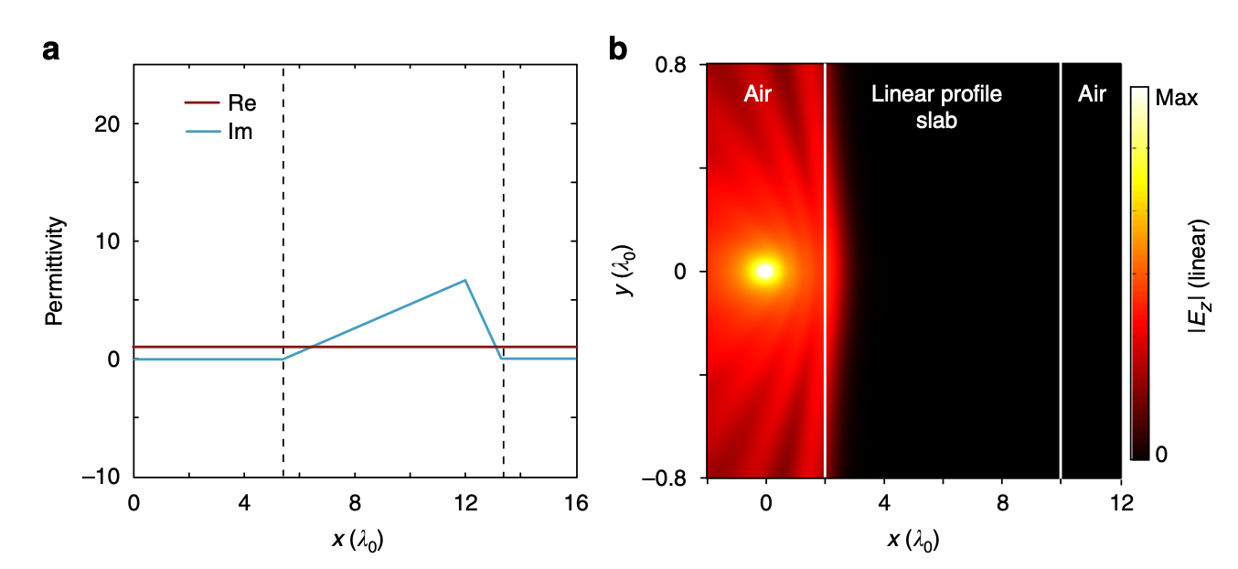
Spatial KK Literature Review: Experimental Papers
Matryoshka metamaterials, anechoic chambers, mesoscopic metastructures, imaging
Do any of them cover discretization / Hilbert-transform deviation? Not really
One paper discusses discretization briefly: Ye et al. “Observation of reflectionless absorption due to spatial Kramers–Kronig profile”
The “1/10 λ” rule-of-thumb was adopted by future experiments (Q. Li et al. 2022 Advanced Optical Materials, Q. Li et al. 2024 Communications Physics), but merely picked as a “good enough” metric

Slide 2
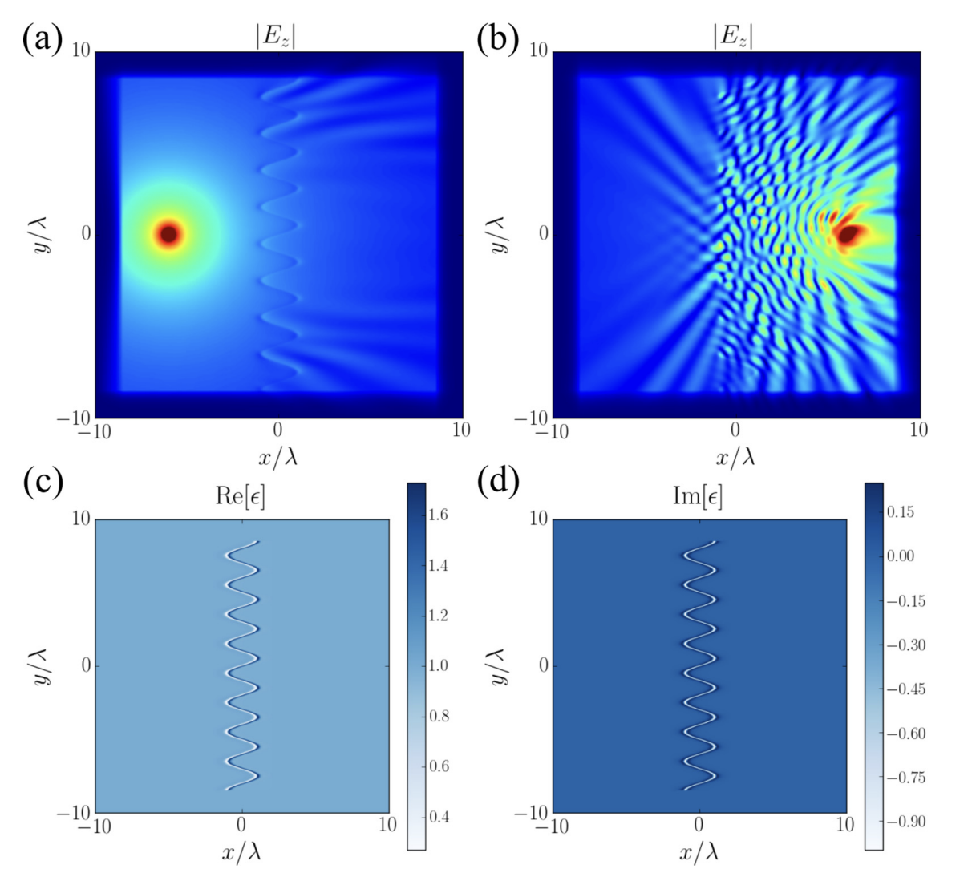
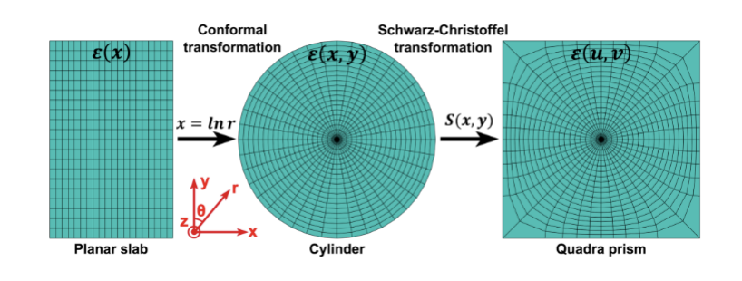
Spatial KK Literature Review: Theory/Comp Papers
Do any of them cover discretization / Hilbert-transform deviation? No
Horsley et al. : Spatiotemporal deformations of reflectionless potentials
S. Longhi: Bidirectional invisibility in Kramers–Kronig optical media
Philbin et al. : Zero reflection and transmission in graded index media
S. Longhi: Kramers-Kronig potentials for the discrete Schrödinger equation
Liu et al : Designing Spatial Kramers–Kronig Media Using Transformation Optics
Zheng et al. : Spatial Kramers-Kronig relation and unidirectional light reflection induced by Rydberg interactions

Slide 3
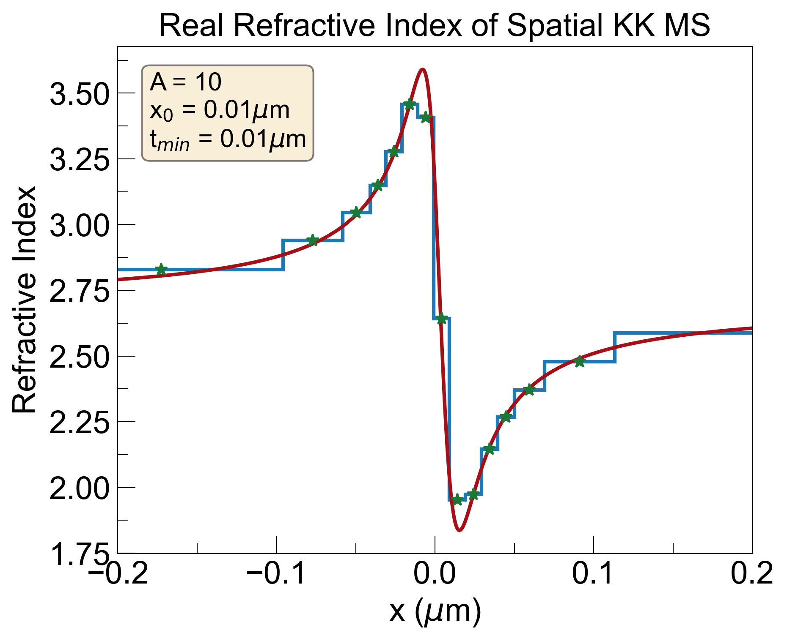
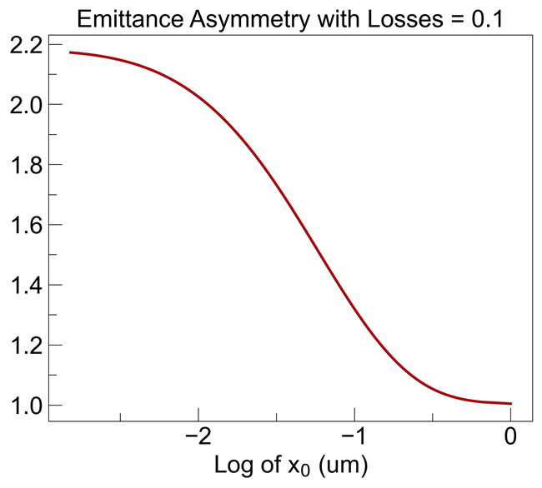
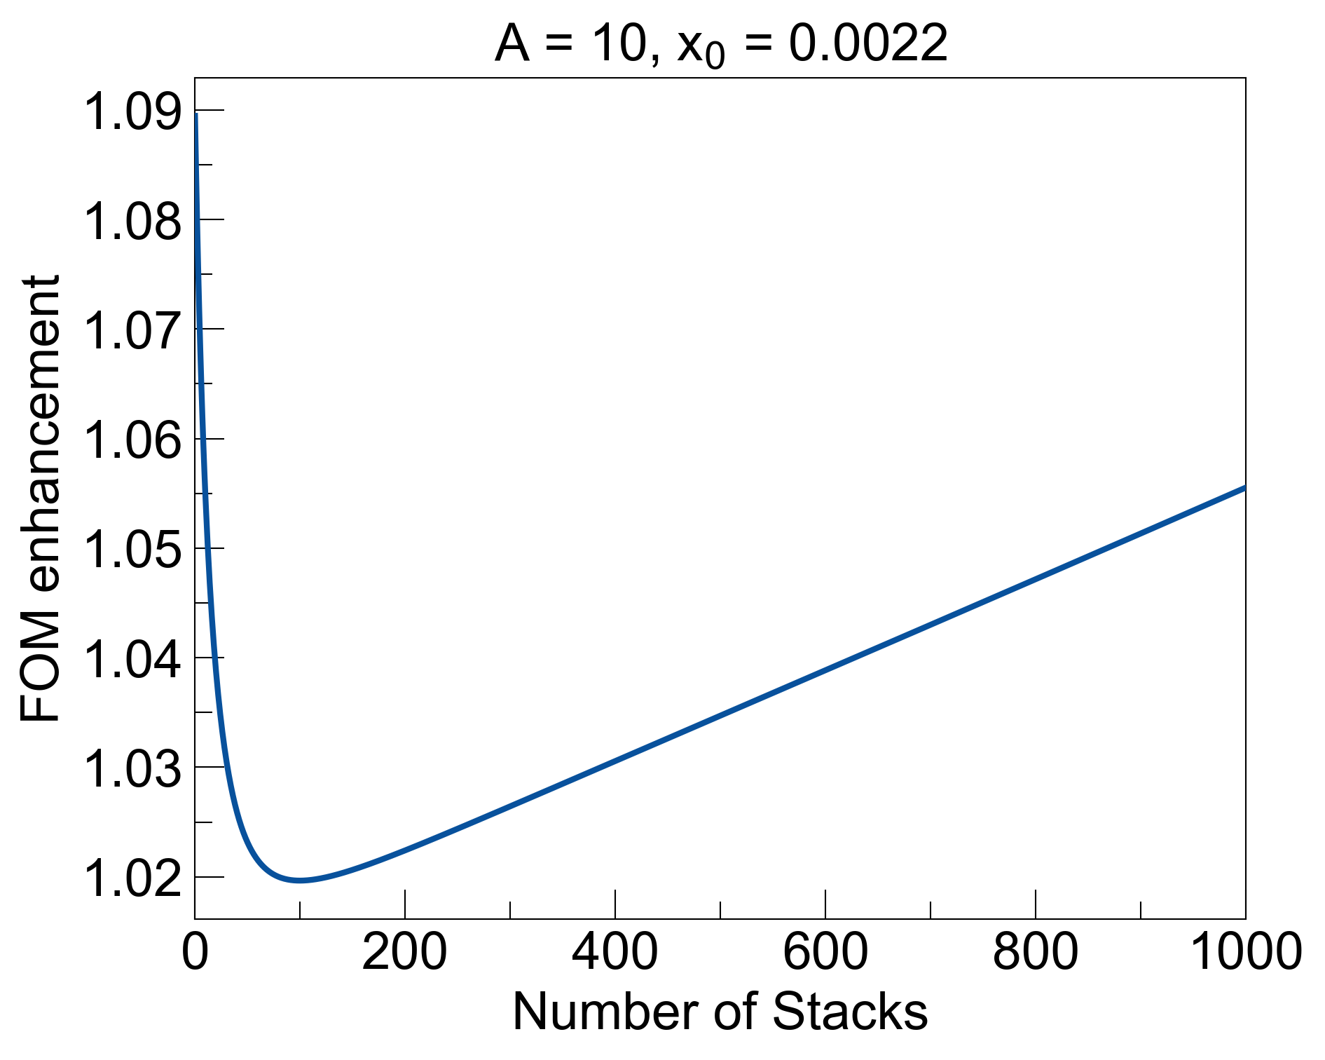
Research Gaps
1. A rigorous analysis of discretization of spatial KK profiles, and its effects on reflectionless properties
2. The effects of deviating from Hilbert-transform pairs (modifying n and k independently)
3. Enhancement from composite design by stacking multiple KK stacks together (stack-of-stacks analysis)
Bonus: Provide open-source code (GitHub repo) for reproducibility: journals might like that

Slide 4
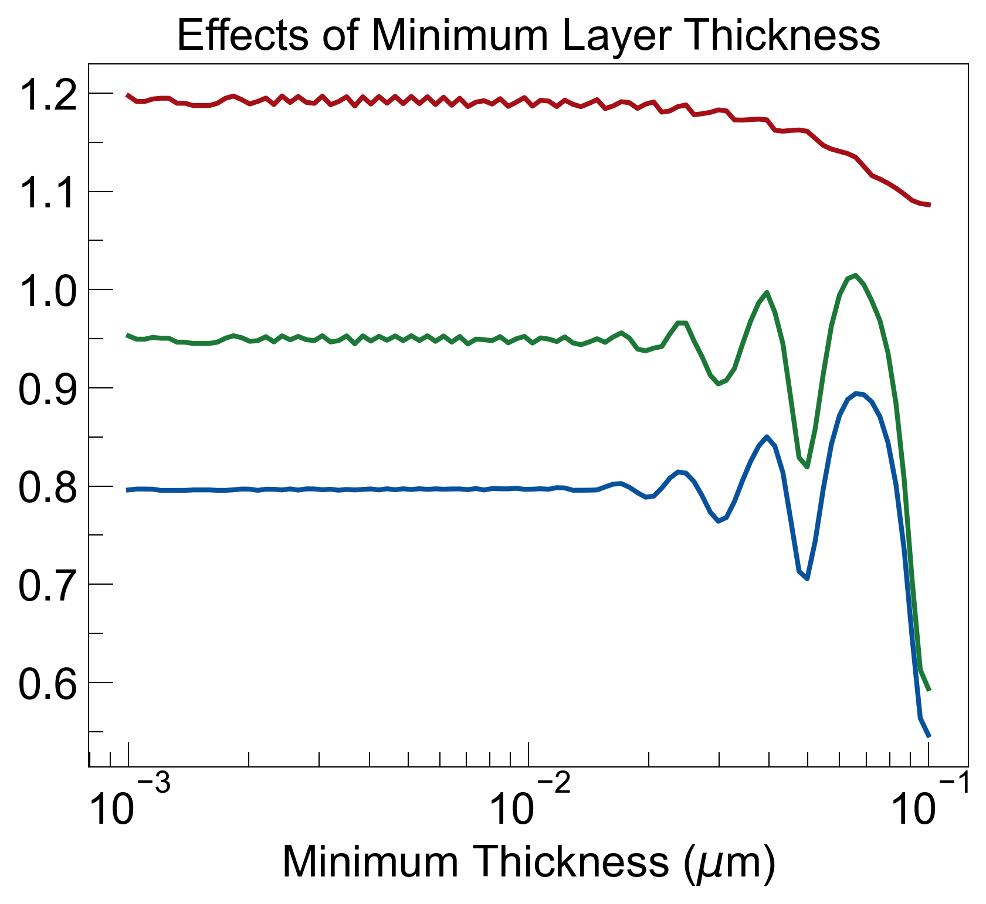
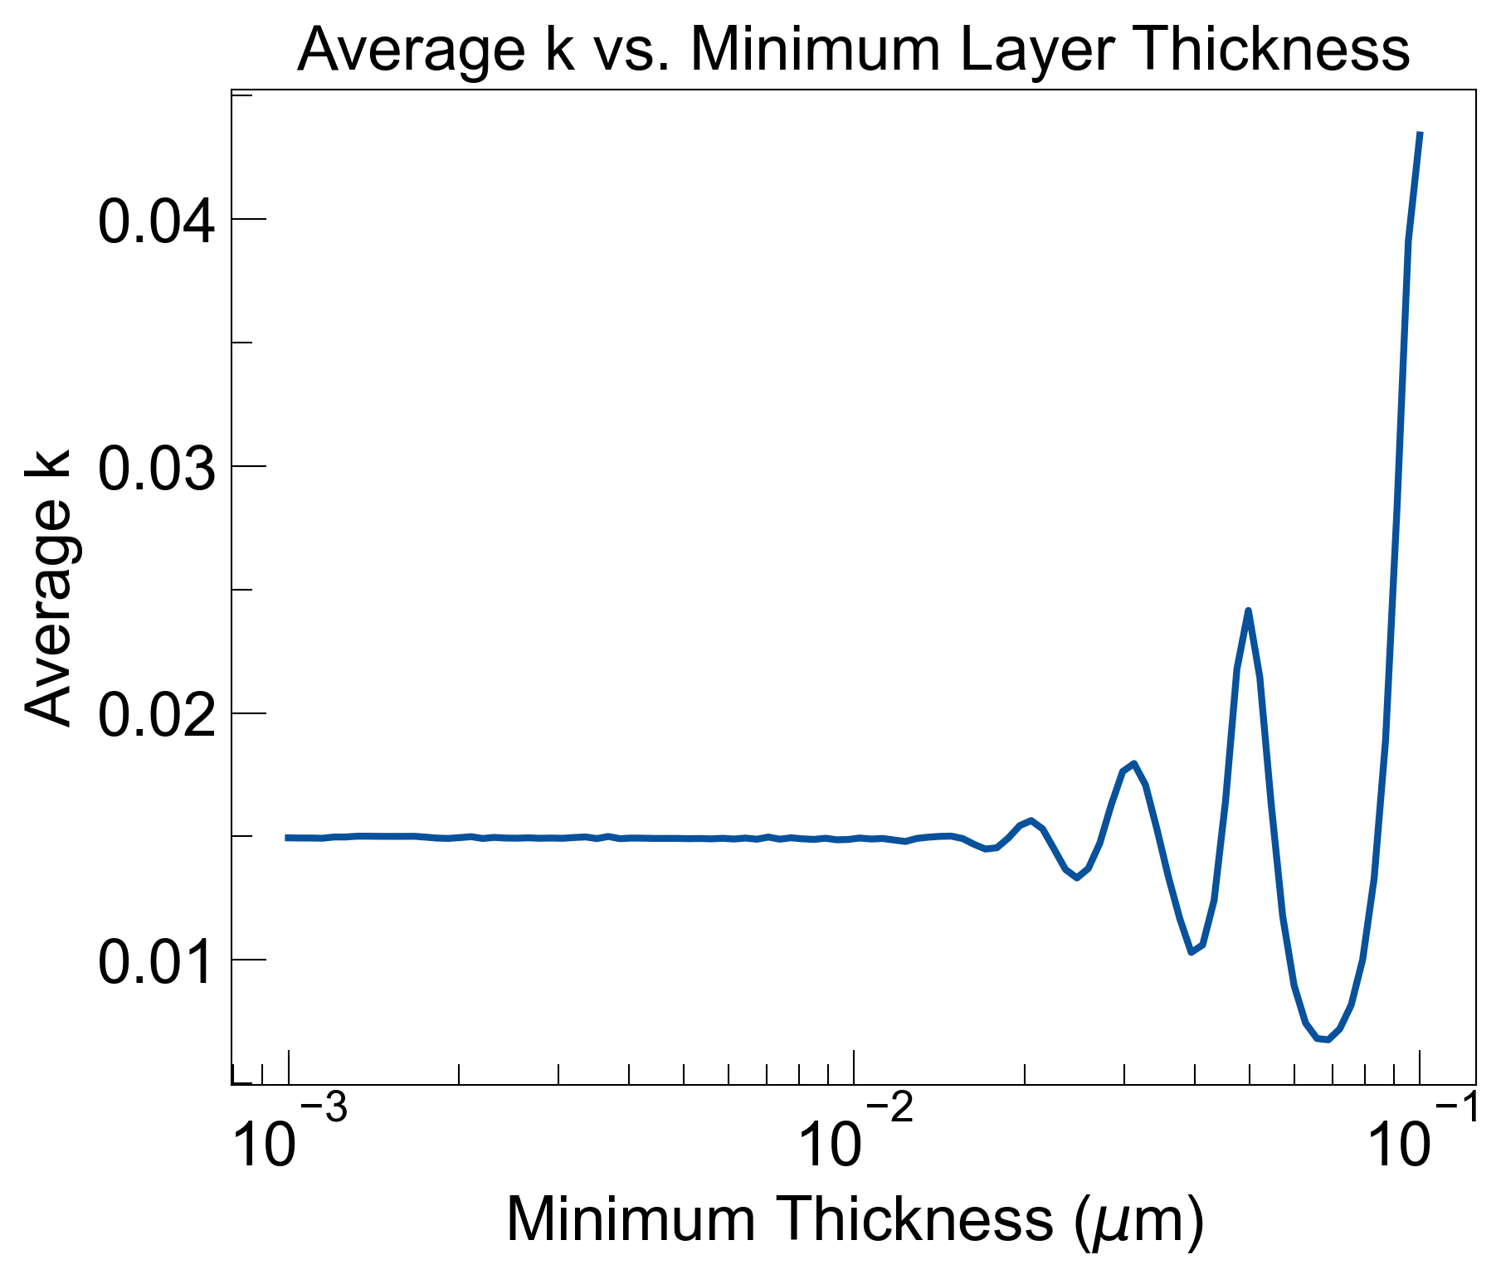
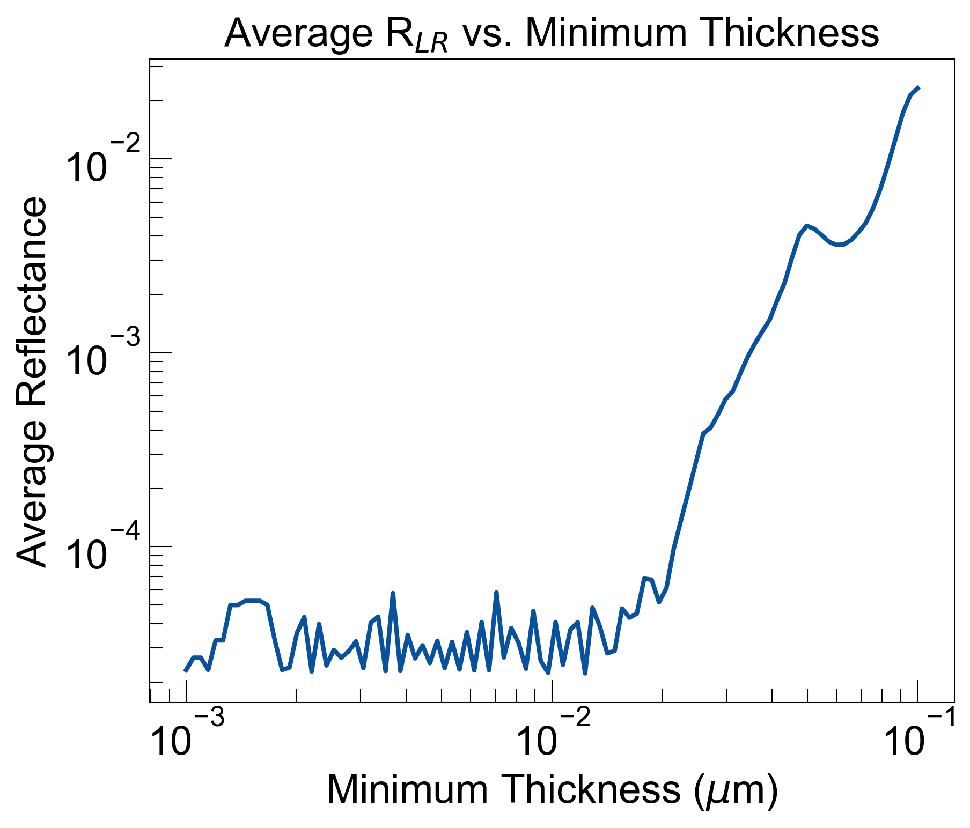
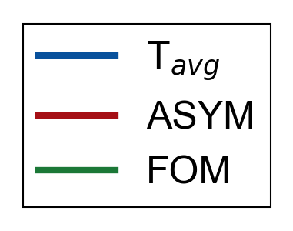
Maximum thickness t_{min} ≈ x₀ for best results
A = 10, x₀ = 0.01um
x₀
2x₀
Could go up to 2x₀ and still maintain zero-reflectance properties of spatial KK materials.

Slide 5
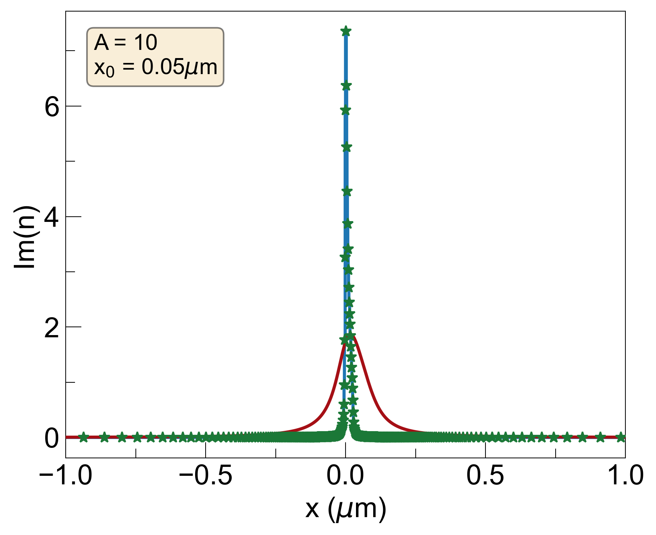
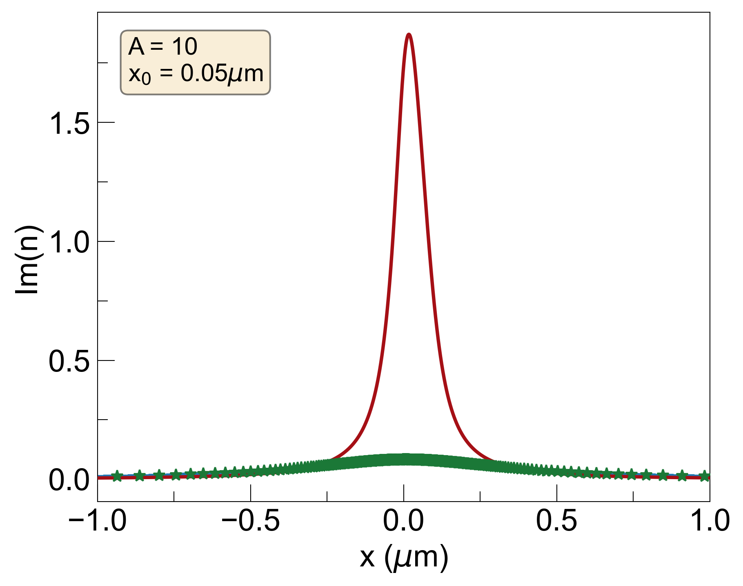
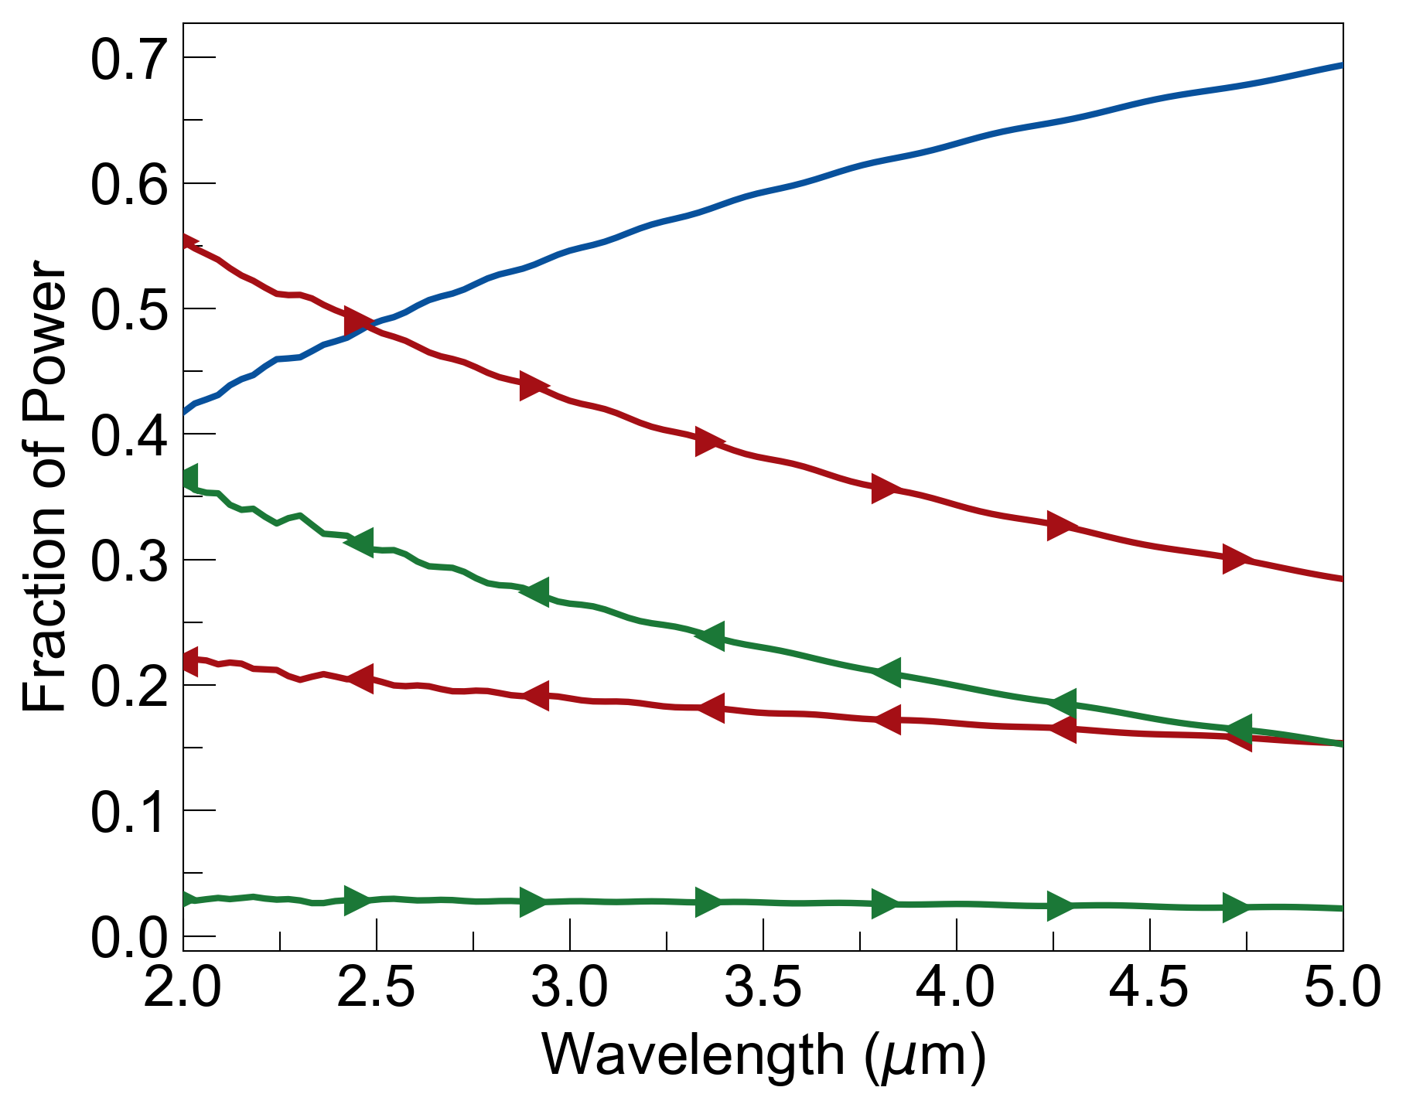
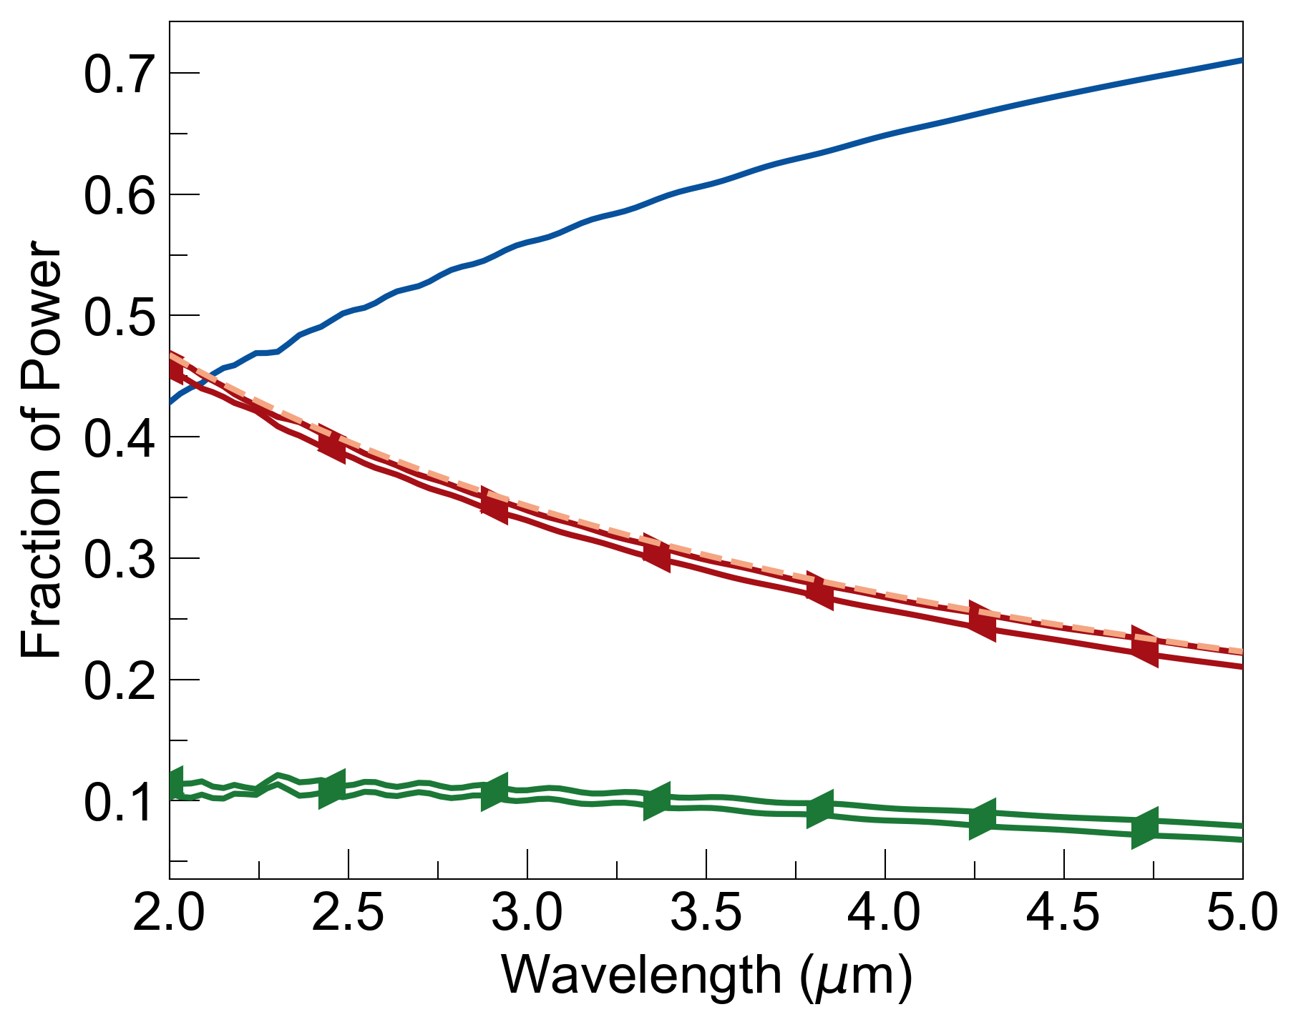
A_{new} = 100 , x_{0,new} = 0.0015 um
A_{new} = 0.38 , x_{0,new} = 0.4 um
Losses = 0.1

Slide 6
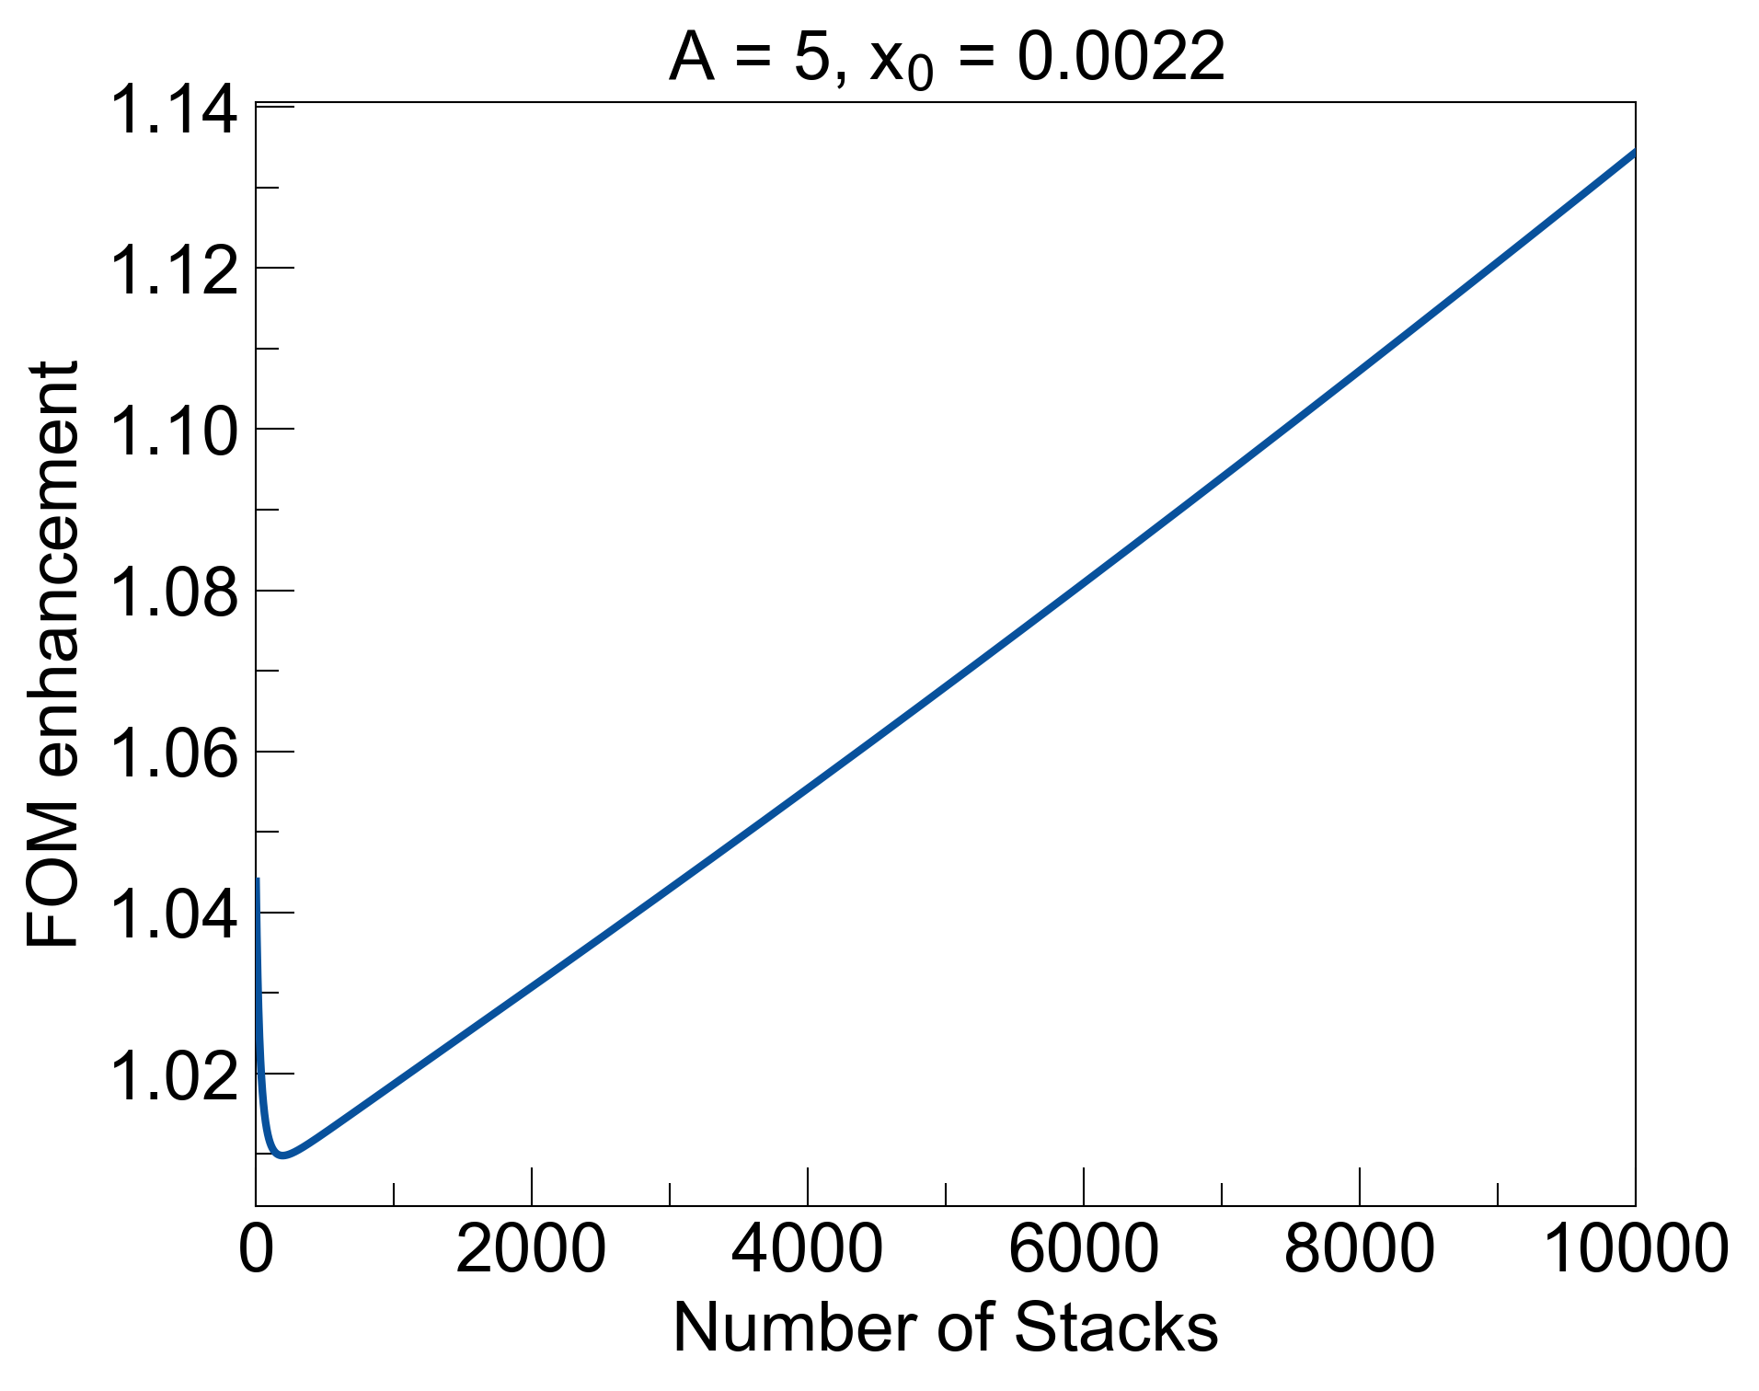
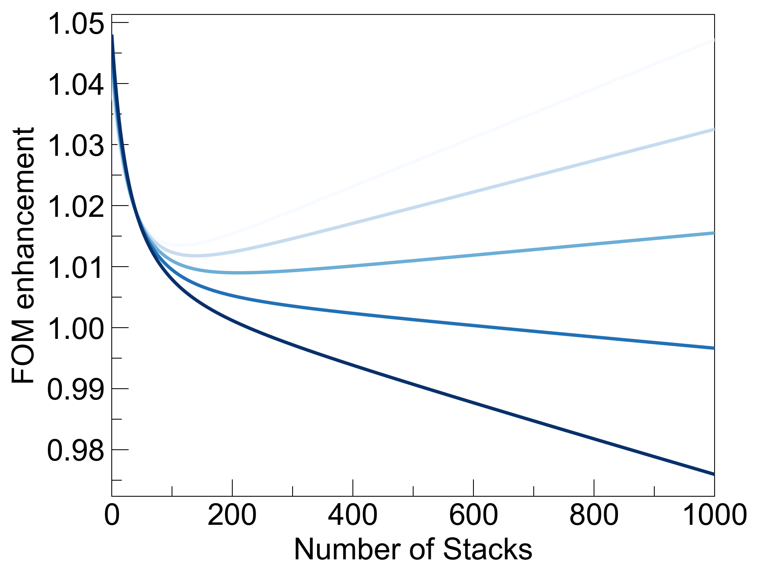
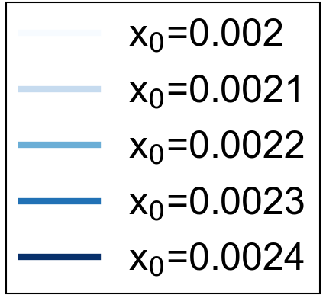
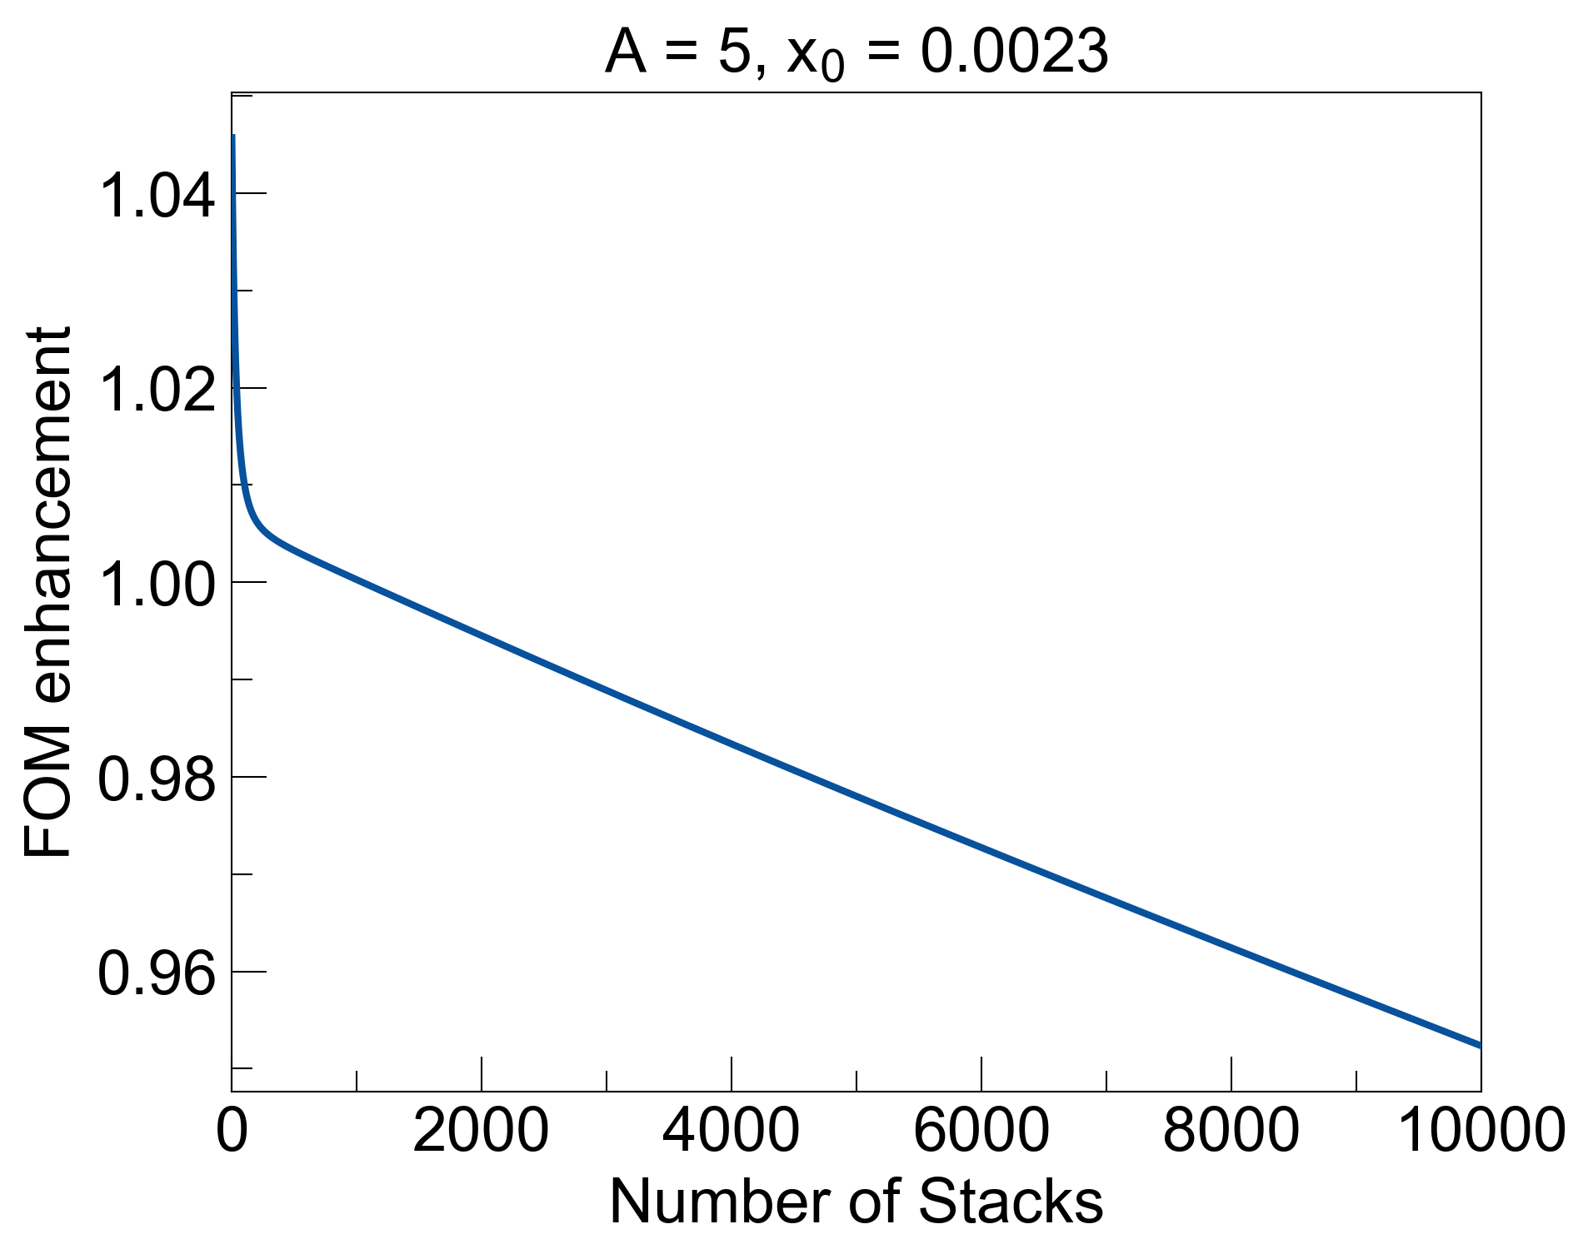
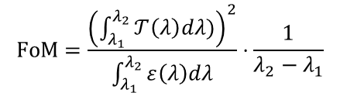
Increasing x₀ dramatically changes FOM enhancement
$$FoM=\frac{{\left(\int_{λ_{1}}^{λ_{2}}{𝒯\left(λ\right)dλ)}\right)}^{2}}{\int_{λ_{1}}^{λ_{2}}{ε\left(λ\right)dλ}}⋅\frac{1}{λ_{2}−λ_{1}}$$
A = 5
Increase stacks to confirm trends of transition points
changing x₀ from 0.0022um to 0.0023um causes FOM enhancement to transition from increasing to decreasing with respect to number of stacks

Slide 7
Working title: “Robustness and Limitations of Spatial Kramers-Kronig Metastructures under Discretization, Hilbert-Transform Deviation, and Composite Design”
Alternative title to highlight experiment/fabrication: “Design roadmap towards experimental realizations of Spatial Kramers-Kronig materials”
Journal to aim for: APL Photonics (IF: 5.4)
Other journals:
PRApplied (IF: 3.8)
APL Letters (IF: 3.6)
Optics Express (IF: 3.2)
Optics Letters (IF: 3.1)
JOSA B (IF: 1.8)

Slide 8
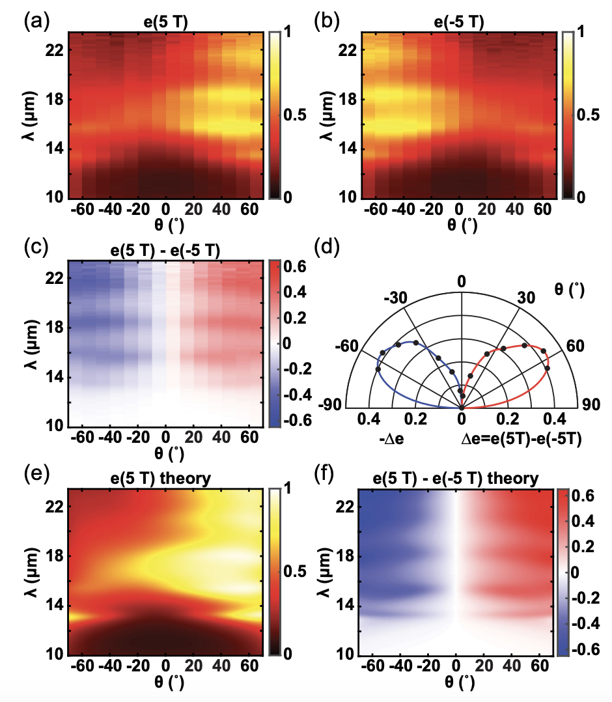
Nonreciprocal thermal emission paper (PRL)
First observation of strong asymmetry in absorption and emission
as high as 0.43, while previous papers reported much smaller values (~0.05)
breaking Kirchoff’s Law (absorption = emission) by breaking Lorentz reciprocity in a nonisotropic metamaterial placed in a magnetic field
α(θ, B) = e(θ, -B) so nonreciprocity can be measured by: Δe = e(θ, B) - e(θ, -B)

