Slide 1
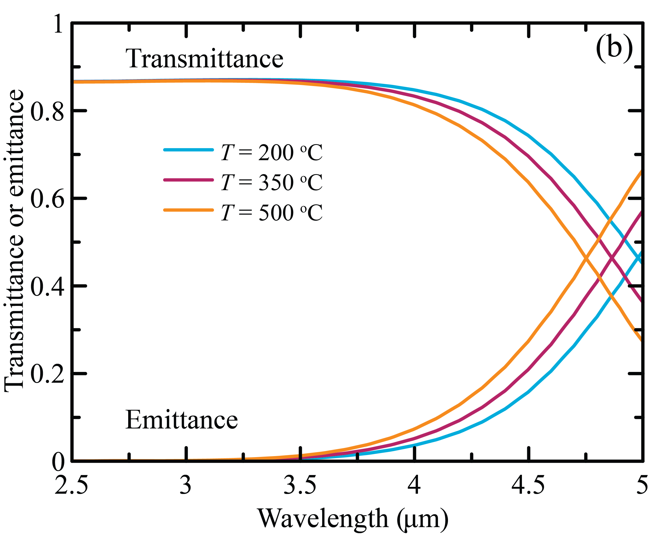
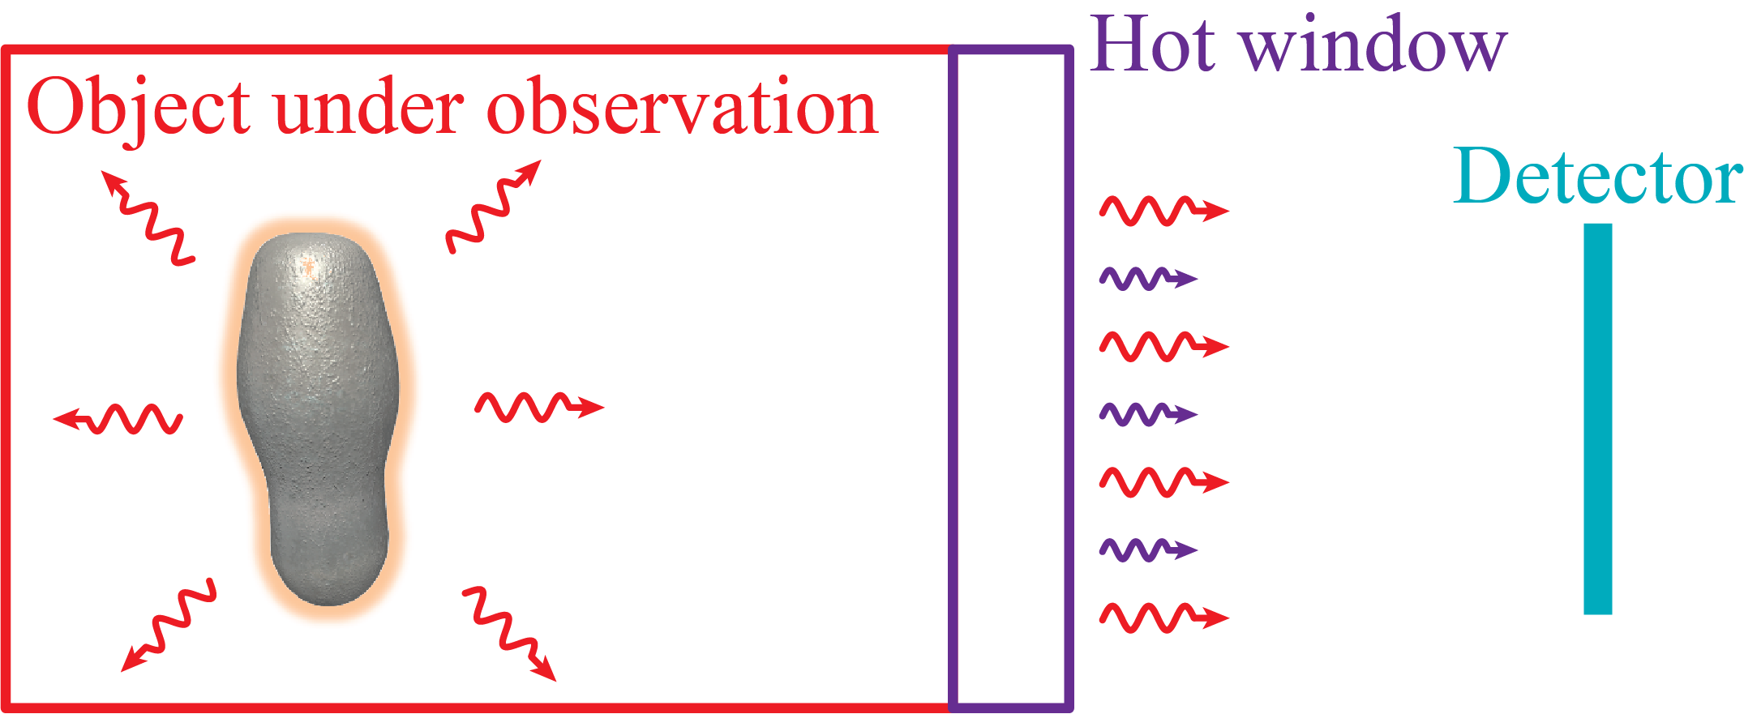
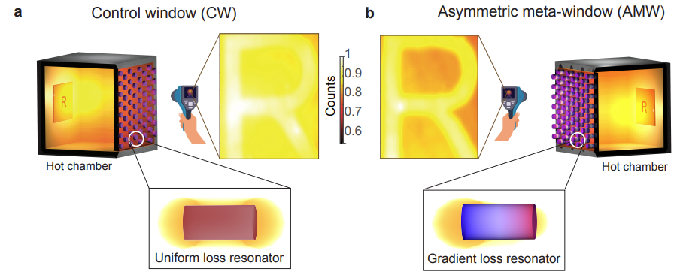
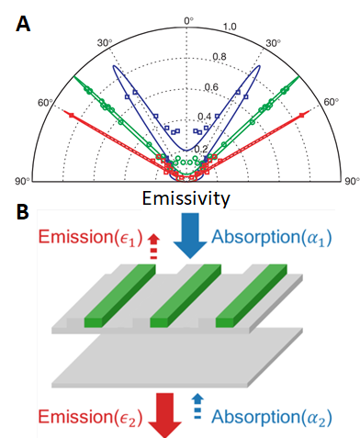
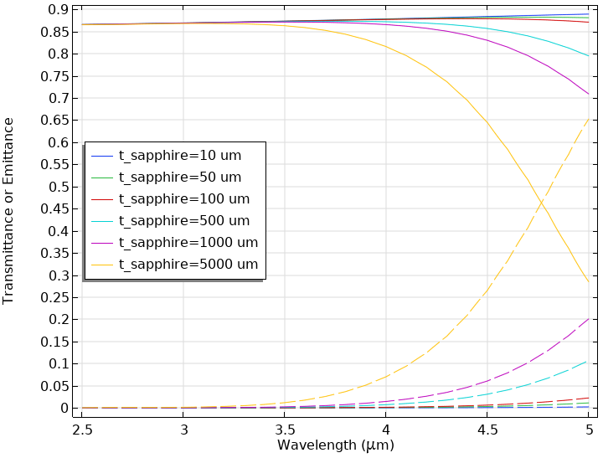
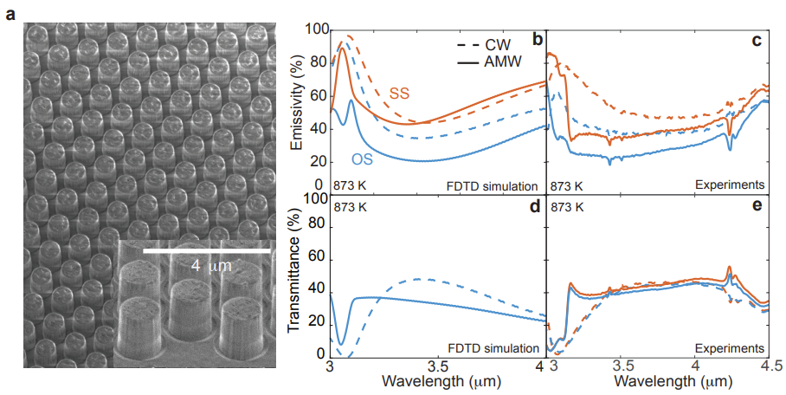
Looking through a hot (emissive) window
Why look through a hot window?
Need insulated environment
Spacecraft
Why is it hard to look through a hot window?
Kirchoff law (absorption=emission)
Absorption increases with temperature

Slide 2
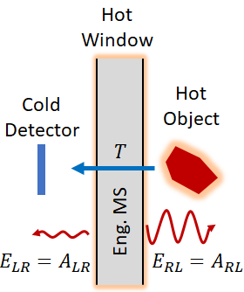
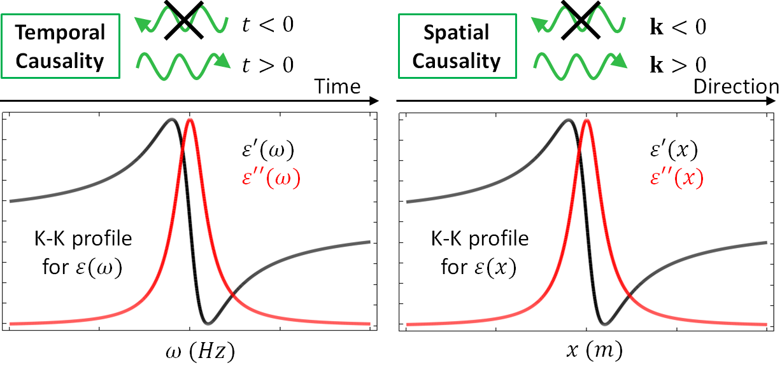
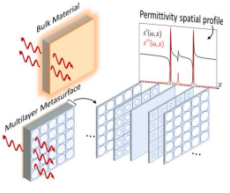
Spatial Kramers-Kronig Metawindow
A spatial Kramers-Kronig (KK) metawindow (MW) is capable of redirecting its own emission
Broadband zero reflectivity for any incident angle
Intuition:
KK in frequency enforces temporal causality (waves only move forward in time)
KK in space enforces momentum causality (waves only move forward in space)

Slide 3
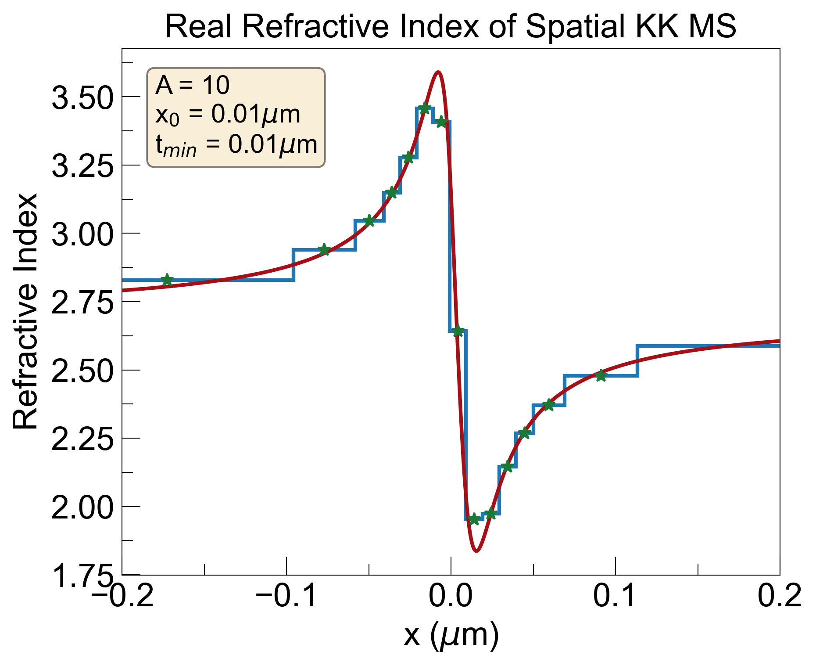
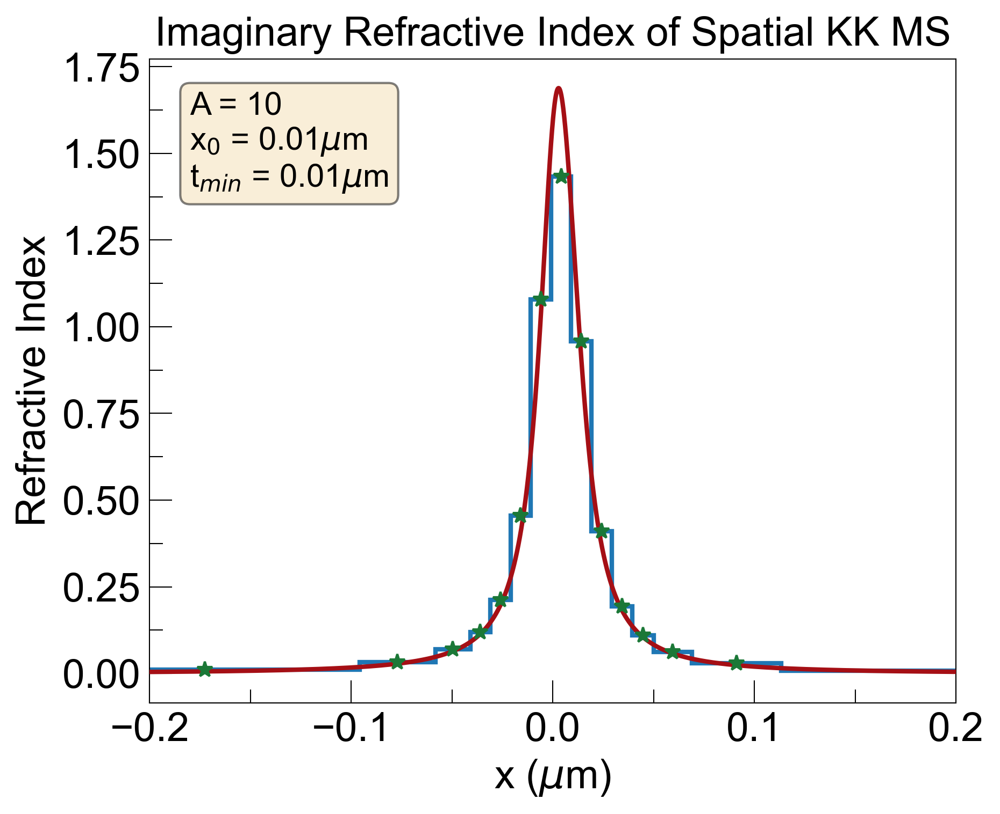
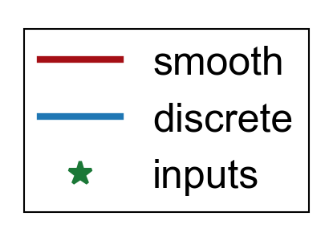
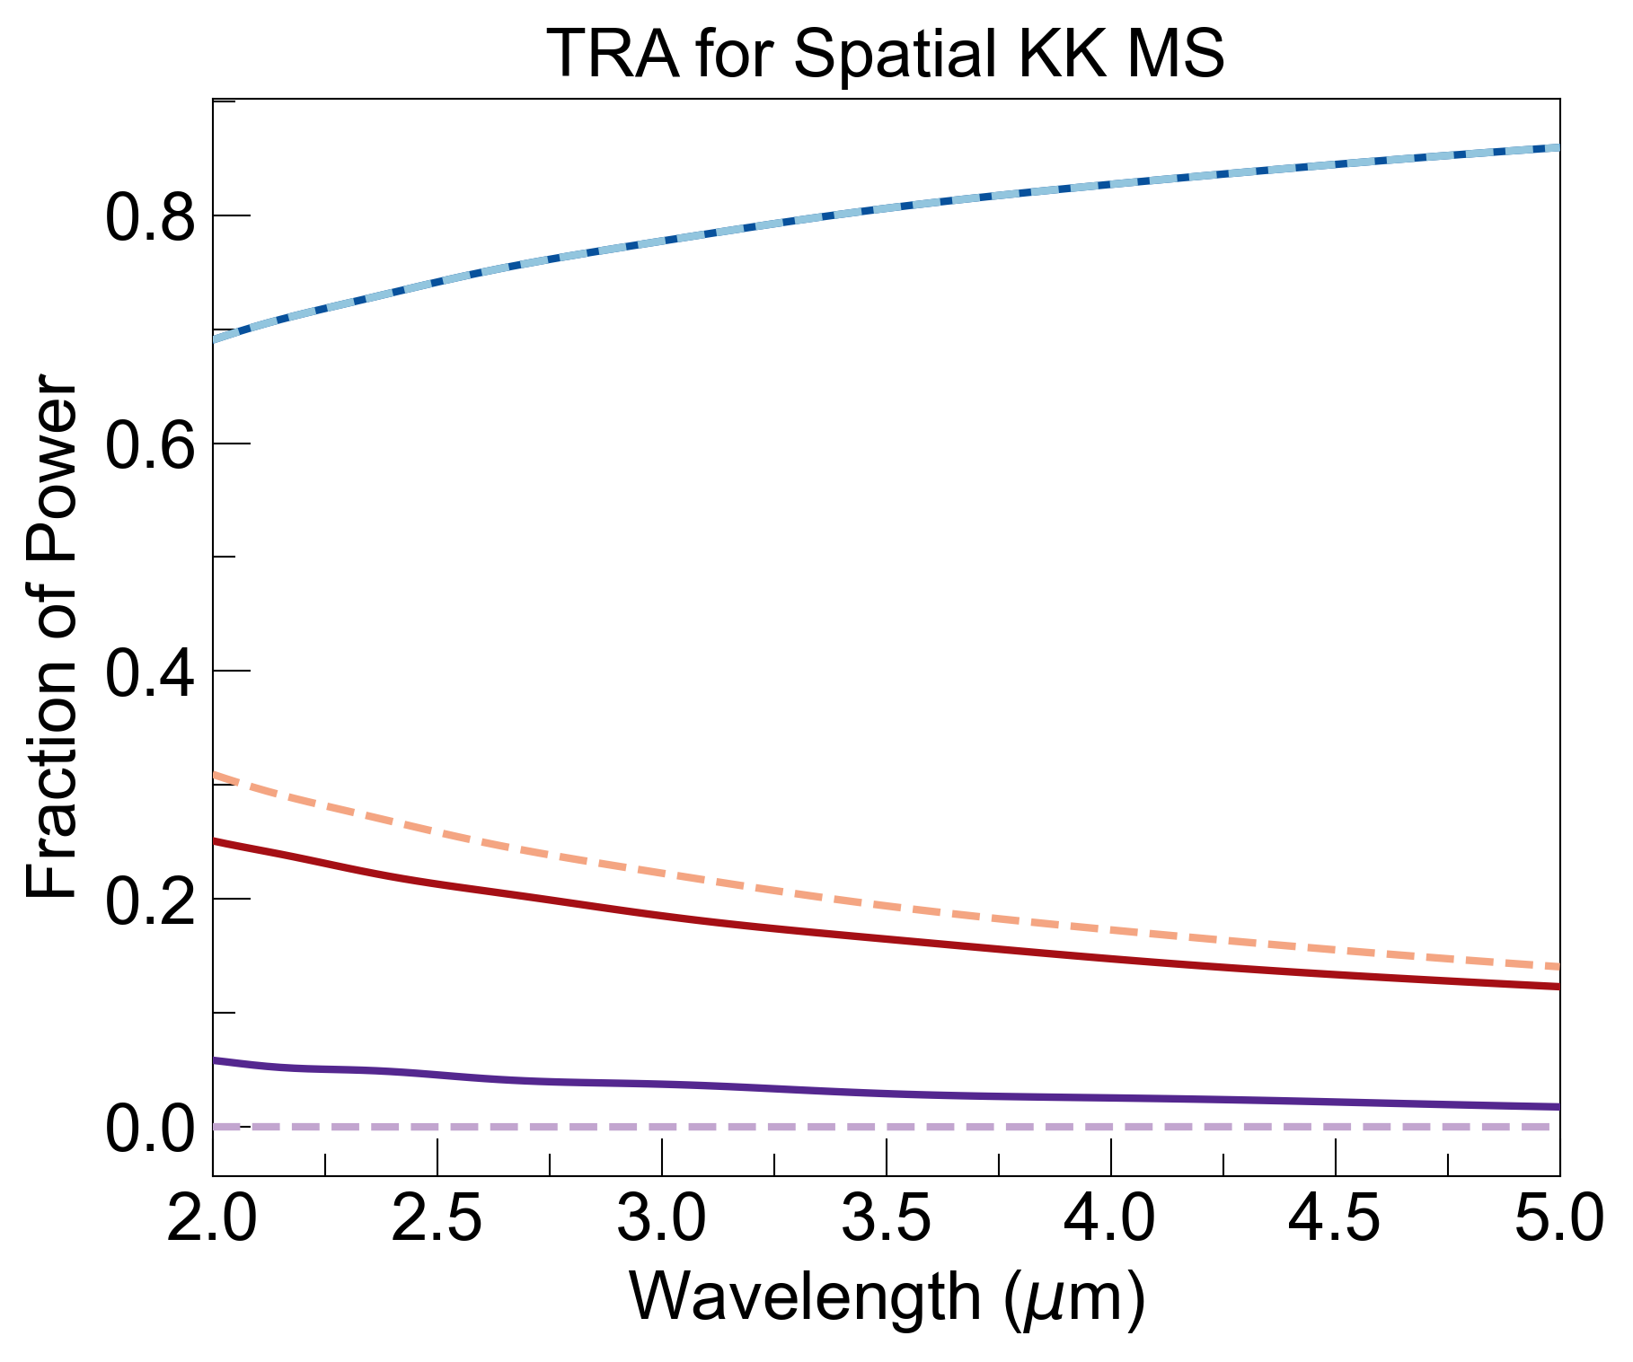
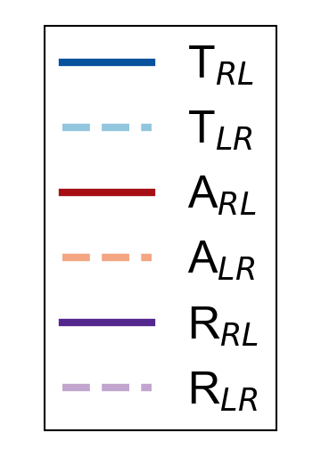
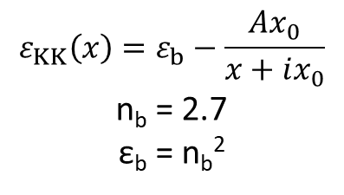
Calculation of Transmittance, Reflectance, Absorbance Using TMM
$$ε_{KK}\left(x\right)=ε_{b}−\frac{Ax_{0}}{x+ix_{0}}$$
n_{b} = 2.7
ε_{b} = n_{b}²

Slide 4
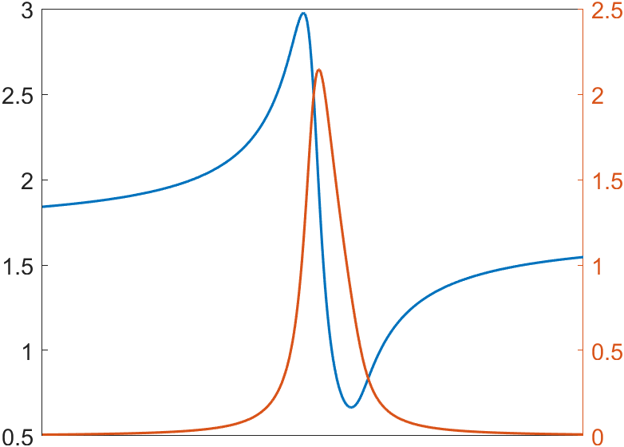



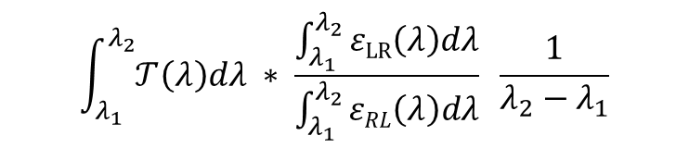

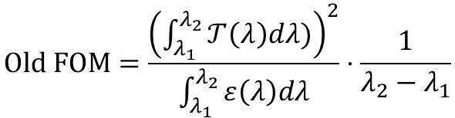
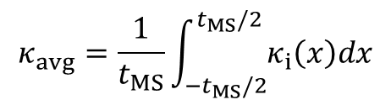



Figure of Merit
$$n_{KK}(x)$$
We used the following figure-of-merit to compare our KK meta-window with an equivalently lossy bulk window:
Spatial KK MS
$$n_{avg}$$
$$κ_{KK}(x)$$
$$Old FOM=\frac{{\left(\int_{λ_{1}}^{λ_{2}}{𝒯\left(λ\right)dλ)}\right)}^{2}}{\int_{λ_{1}}^{λ_{2}}{ε\left(λ\right)dλ}}⋅\frac{1}{λ_{2}−λ_{1}}$$
$$t_{MS}$$
$$t_{MS}$$
Extra factor of integrated transmission to avoid good SNR but diminishing signal.
However, when looking at FOM enhancement (FOM_{KK} / FOM_{bulk}), transmittance dropped out. Use new FOM:
Bulk MS
$$κ_{avg}=\frac{1}{t_{MS}}\int_{{−t}_{MS}/2}^{t_{MS}/2}{κ_{i}\left(x\right)dx}$$
$$\int_{λ_{1}}^{λ_{2}}{𝒯\left(λ\right)dλ} ∗ \frac{\int_{λ_{1}}^{λ_{2}}{ε\text{LR}\left(λ\right)dλ}}{\int_{λ_{1}}^{λ_{2}}{εRL\left(λ\right)dλ}} \frac{1}{λ_{2}−λ_{1}}$$
FOM =
$$T_{Bulk}\left(λ\right)=e^{−\frac{4π}{λ}κ_{avg}t_{MS}}$$
T_{avg}
emission asymmetry
$$ε_{Bulk}\left(λ\right)=1−T_{Bulk}\left(λ\right)$$

Slide 5
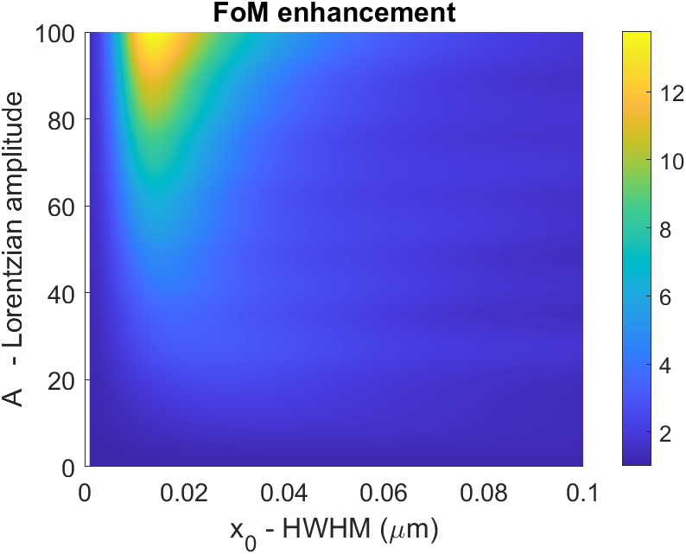
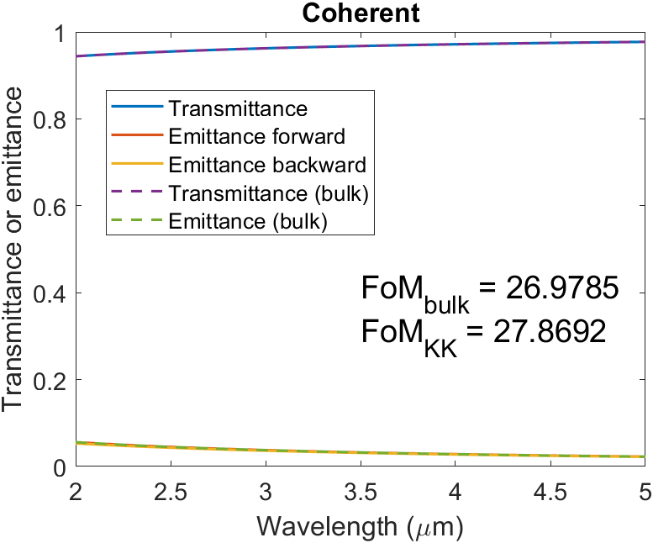
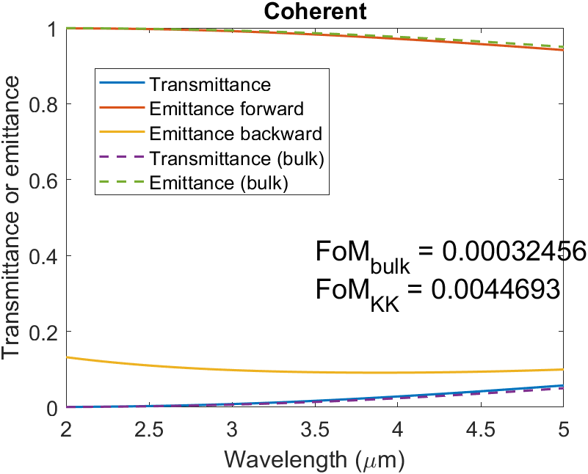
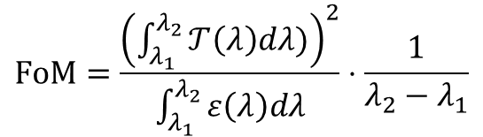


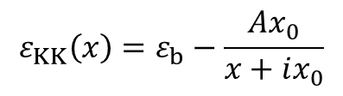
Old FOM Calc.
$$FoM=\frac{{\left(\int_{λ_{1}}^{λ_{2}}{𝒯\left(λ\right)dλ)}\right)}^{2}}{\int_{λ_{1}}^{λ_{2}}{ε\left(λ\right)dλ}}⋅\frac{1}{λ_{2}−λ_{1}}$$
$$ε_{KK}\left(x\right)=ε_{b}−\frac{Ax_{0}}{x+ix_{0}}$$
$$T_{Bulk}\left(λ\right)=e^{−\frac{4π}{λ}\int_{MS}{κ(x)dx}}$$
$$ε_{Bulk}\left(λ\right)=1−T_{Bulk}\left(λ\right)$$
Largest enhancement happens for large A & small x_{0,} but FoM is terrible there (too lossy)
Regions of good absolute FoMs show low enhancement

Slide 6
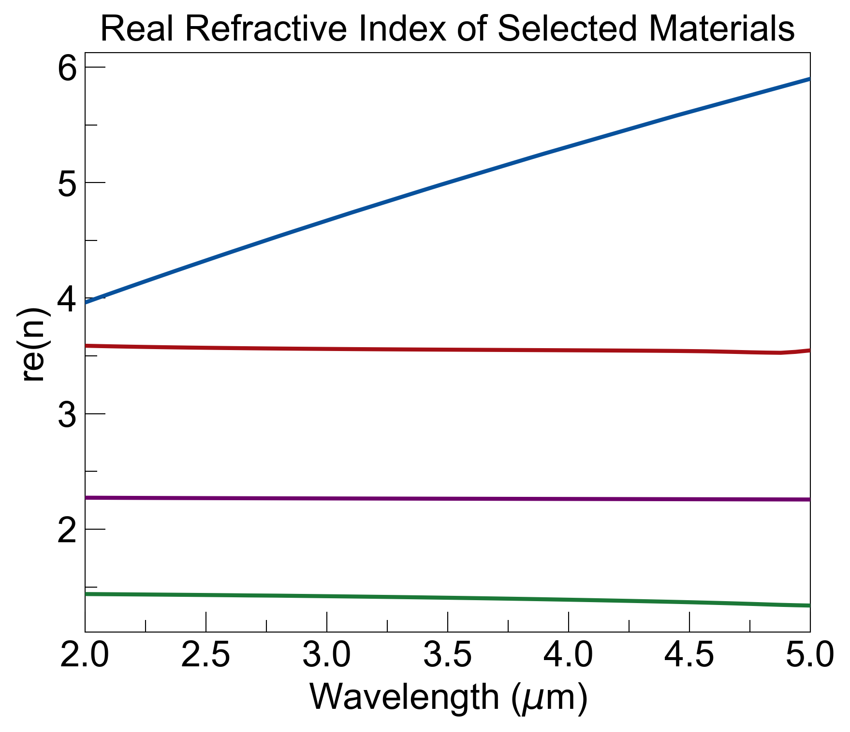
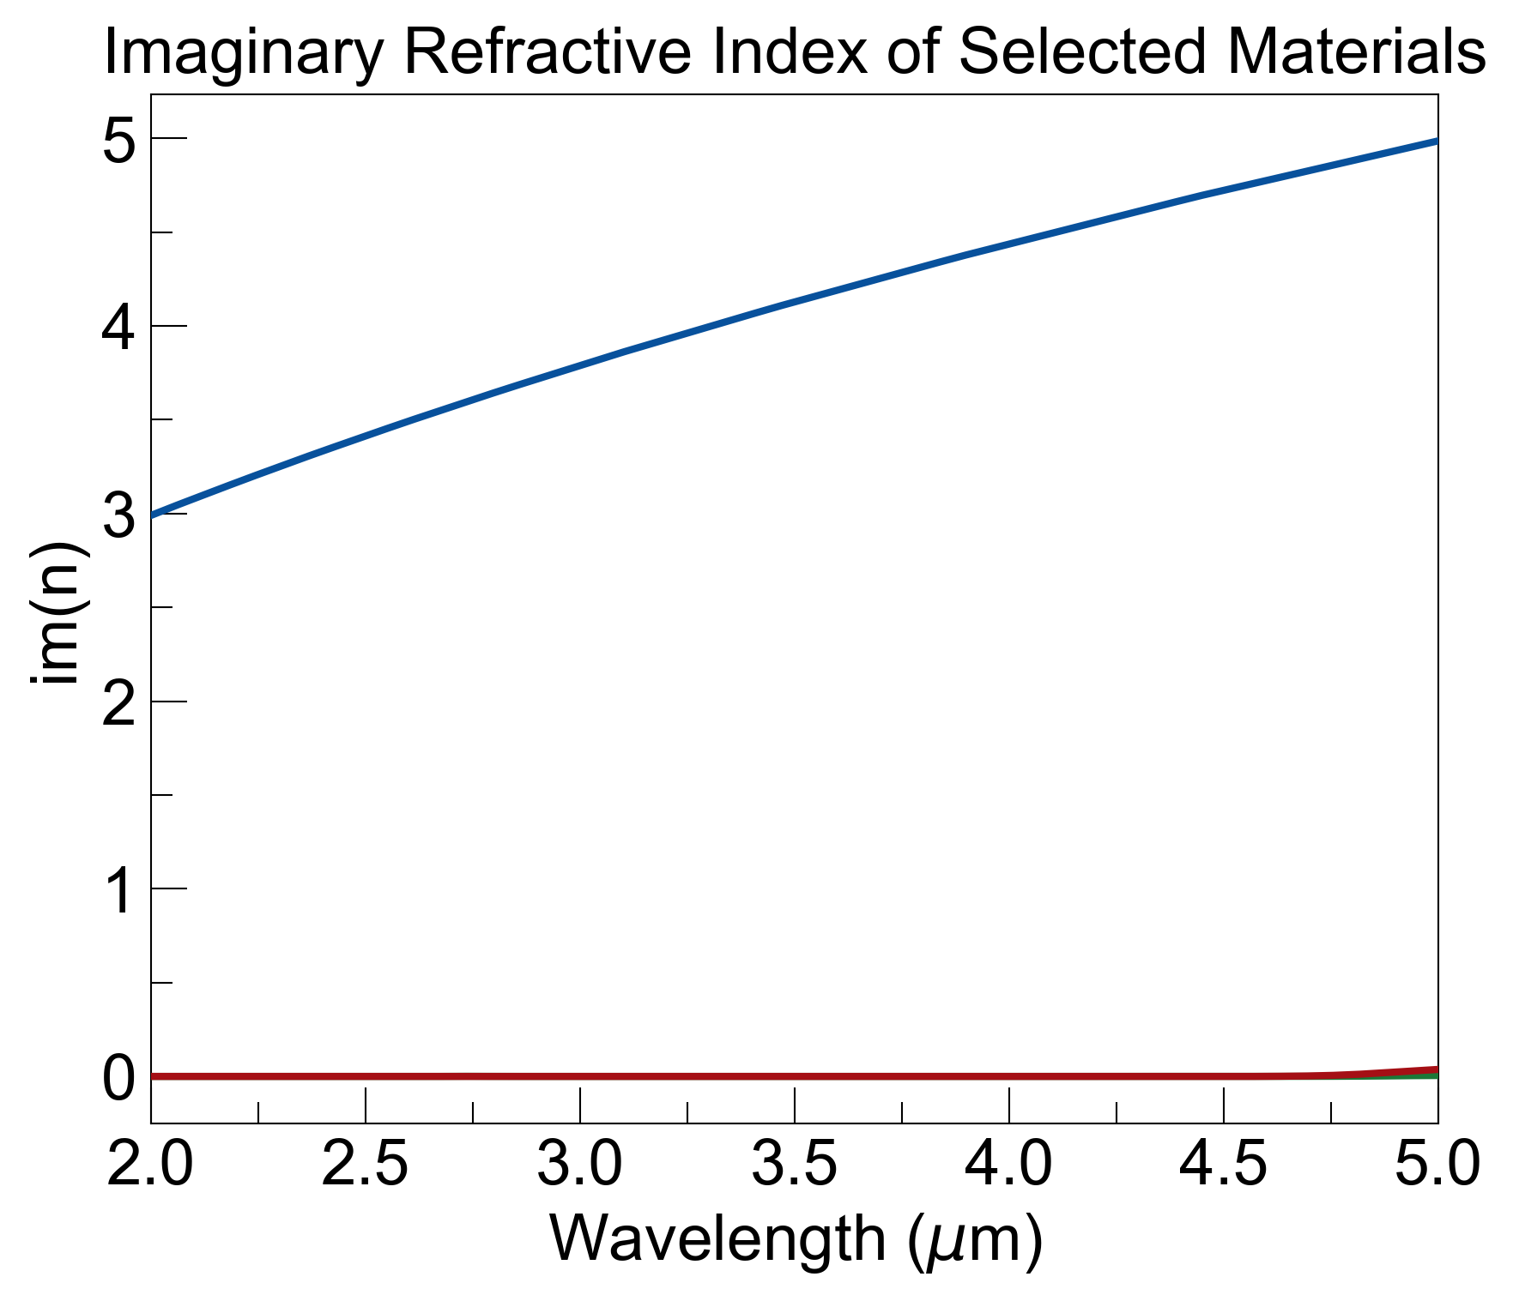
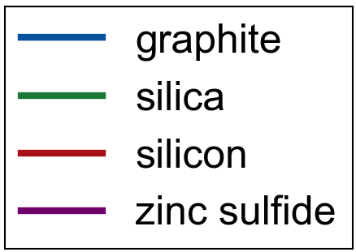
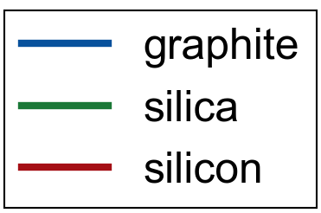
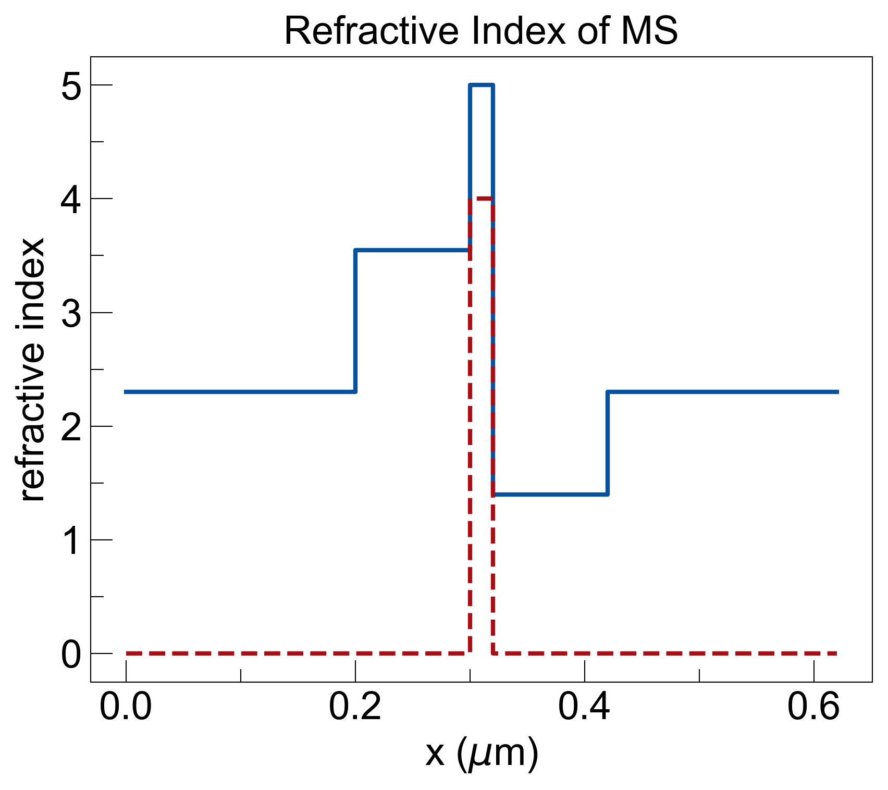
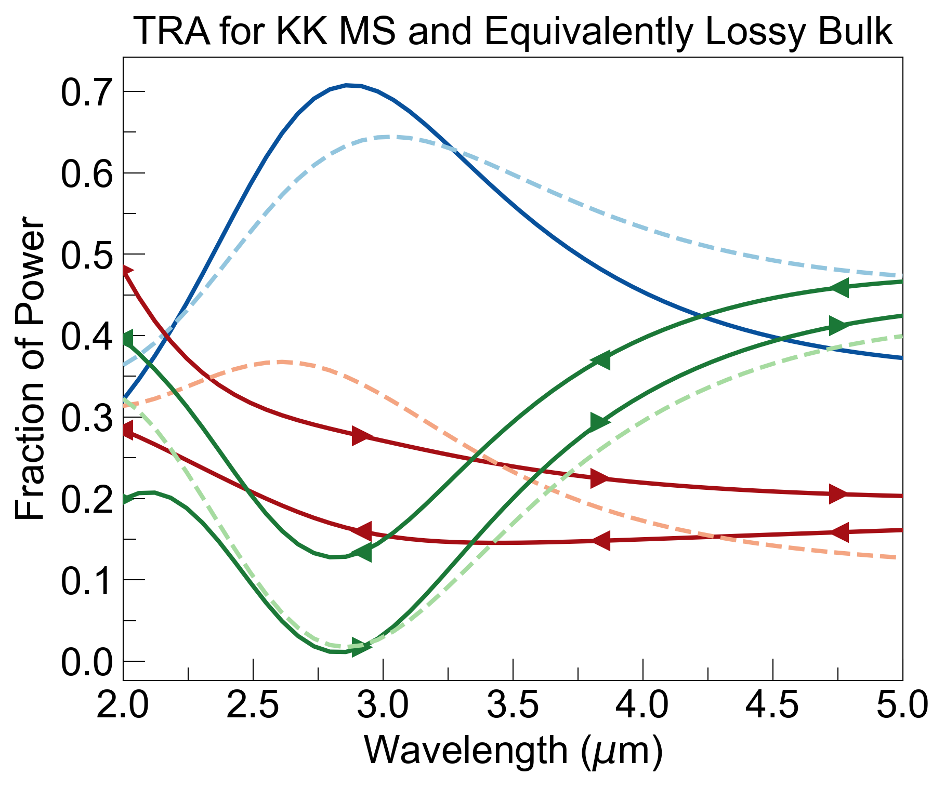
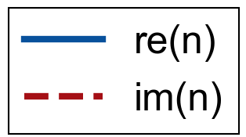
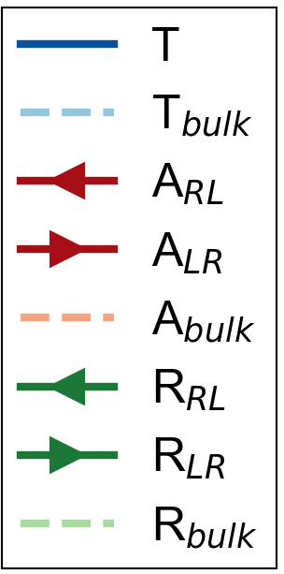
d_list (um) = [0.2, 0.1, 0.02, 0.1, 0.2]
graphite
constant RI over wavelength = 3.5um:
silicon
ZnS
ZnS
silica

Slide 7
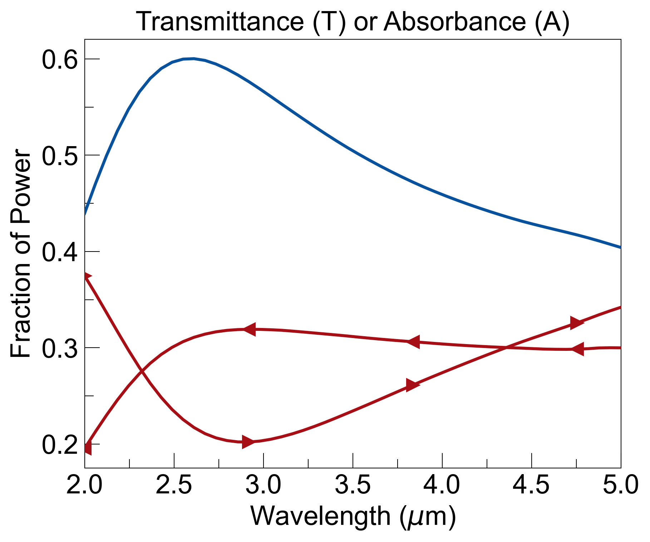
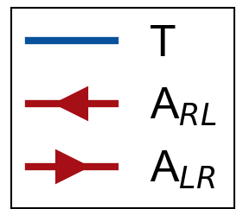
Coating on a Window for Asymmetric Absorption
window
(1)
Number | Material | Thickness (μm)
(1) | Zinc Sulfide | 300
(2) | Silicon | 0.1
(3) | Graphite | 0.02
(4) | Silica | 0.1
(5) | Zinc Sulfide | 0.2
coating
(2)
(4)
(3)
(5)
RL
LR
arrows signify direction of incident light

