Slide 1
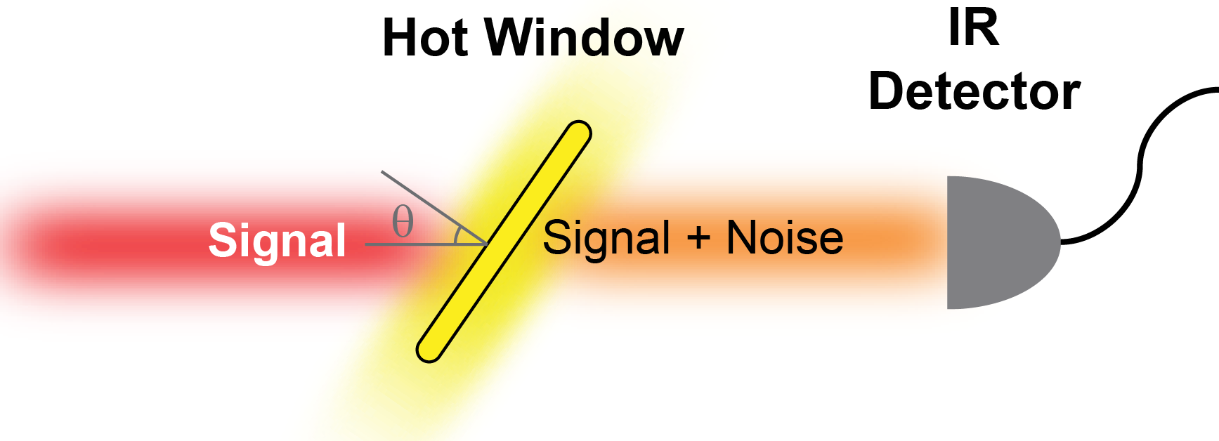
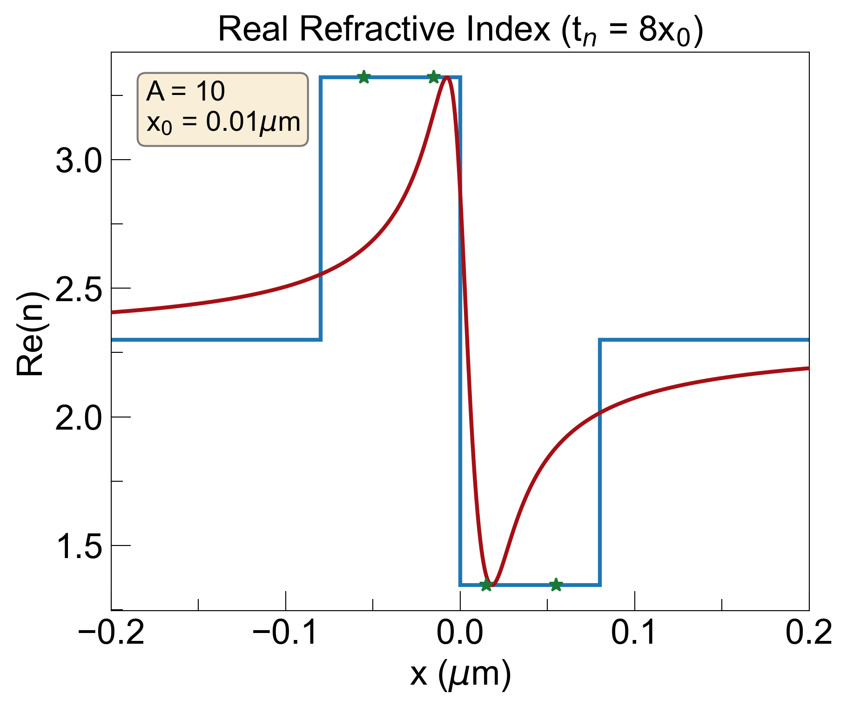
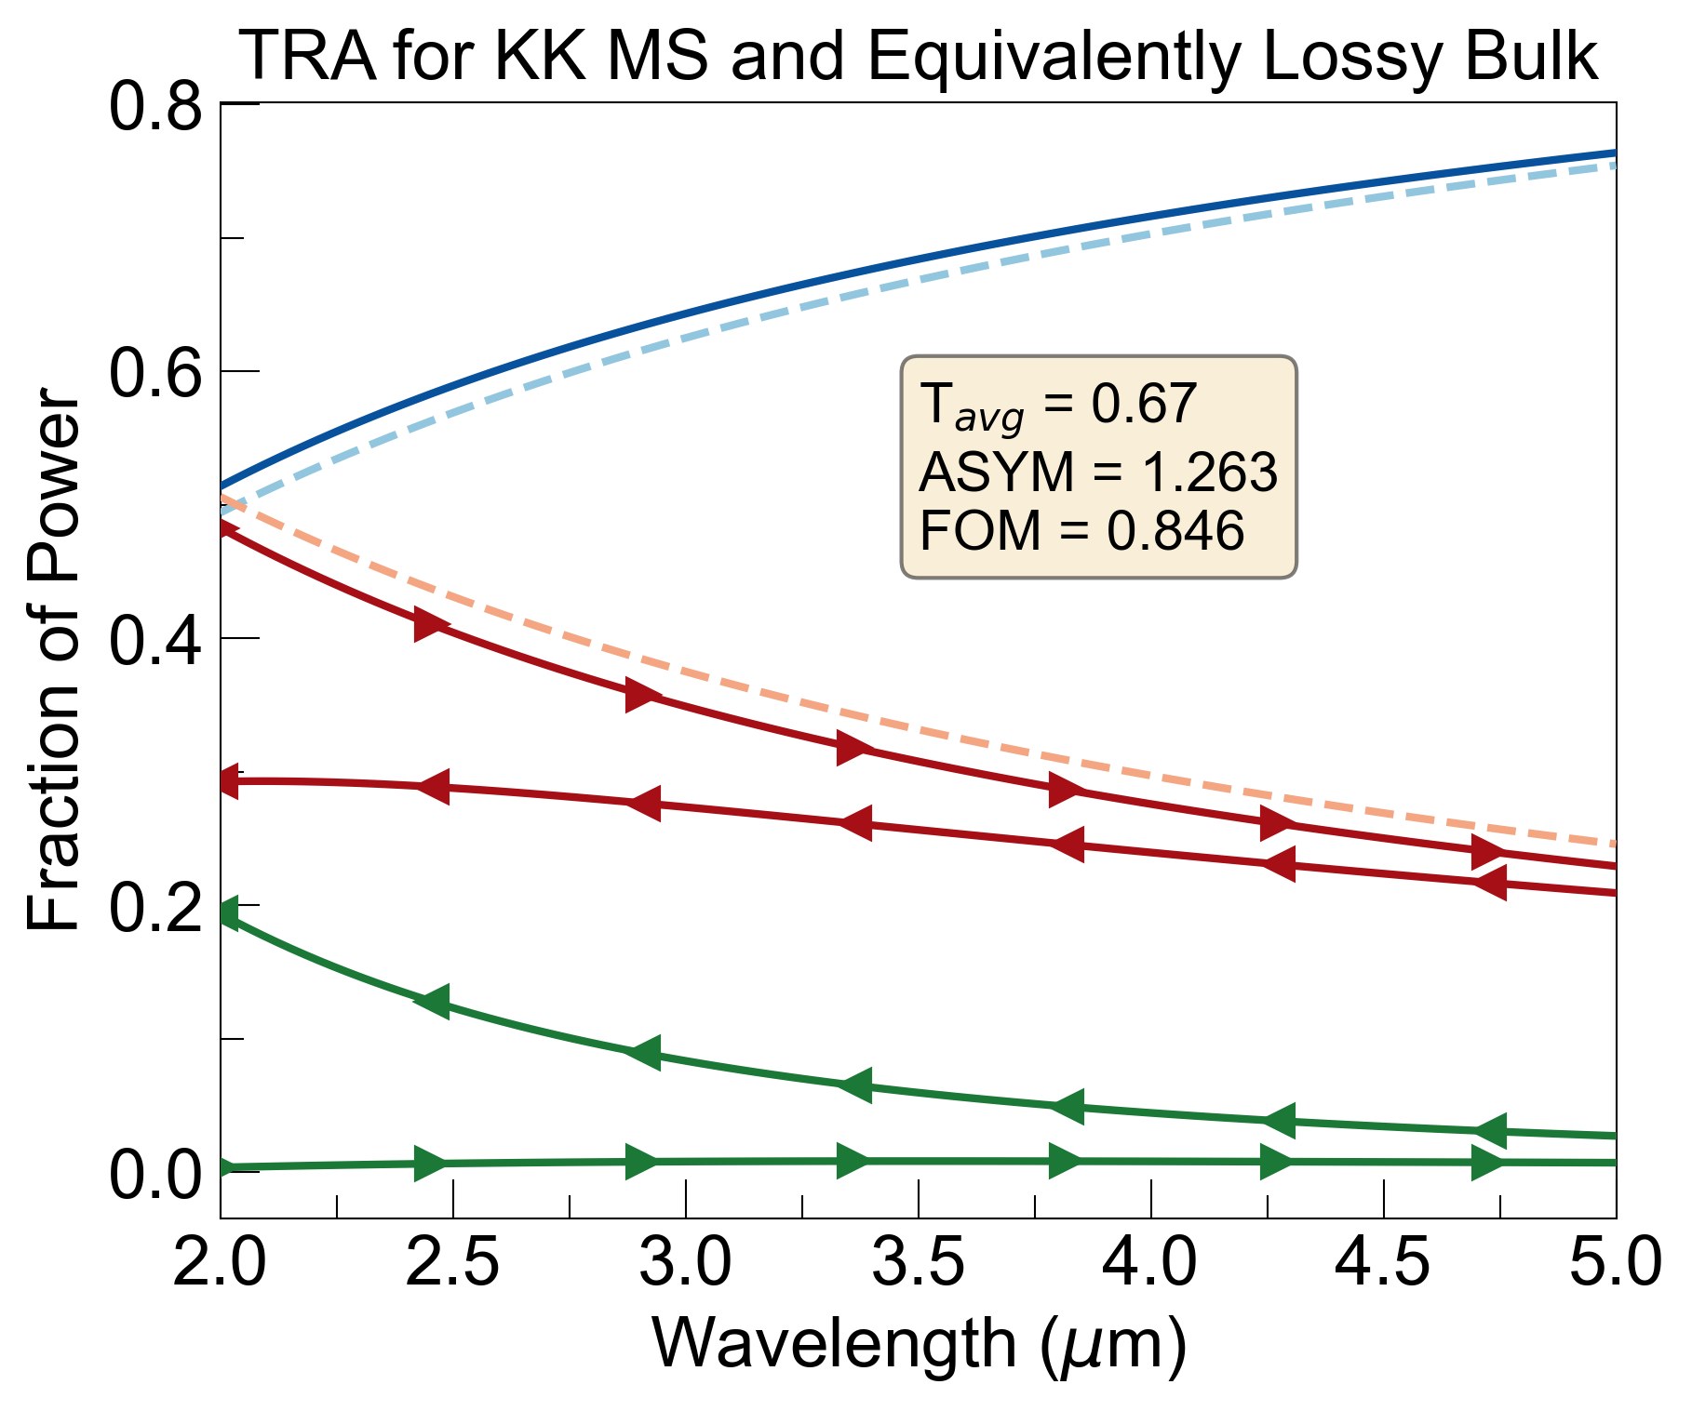
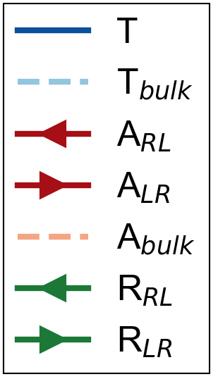
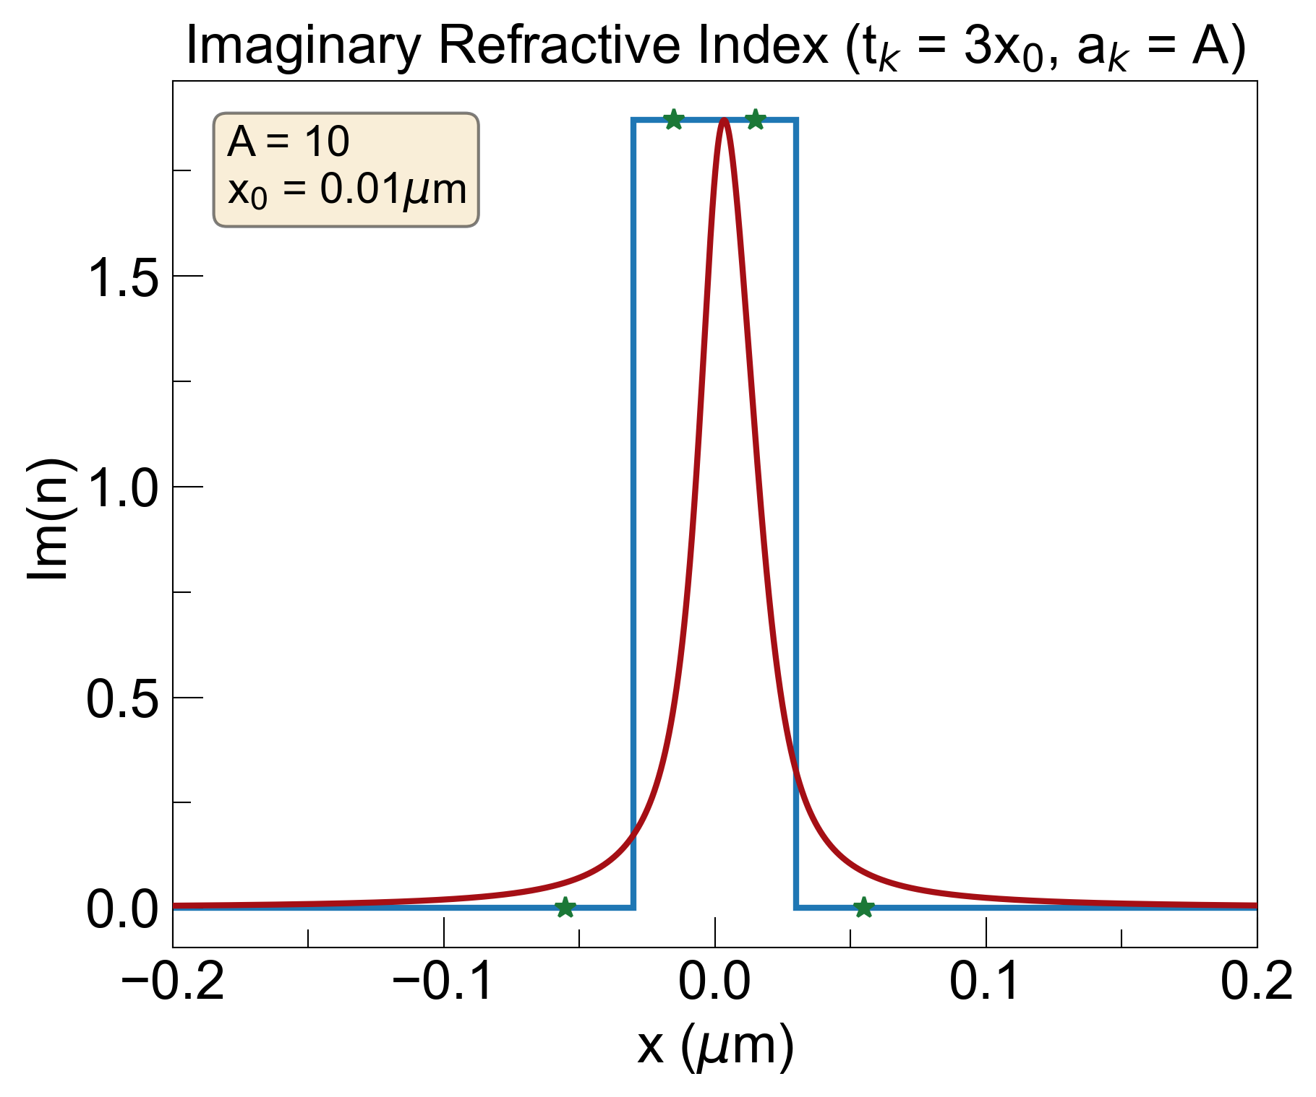
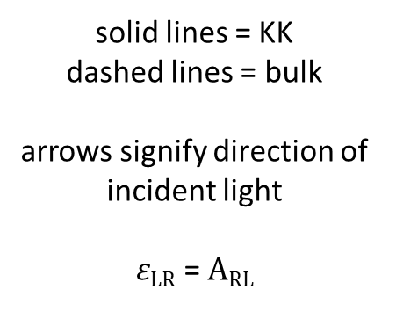
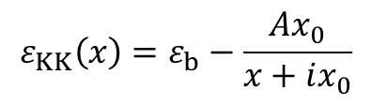
Last time (need to include air background + dispersion)
$$ε_{KK}\left(x\right)=ε_{b}−\frac{Ax_{0}}{x+ix_{0}}$$
RL
LR
solid lines = KK
dashed lines = bulk
arrows signify direction of incident light
$εLR$ = $ARL$

Slide 2
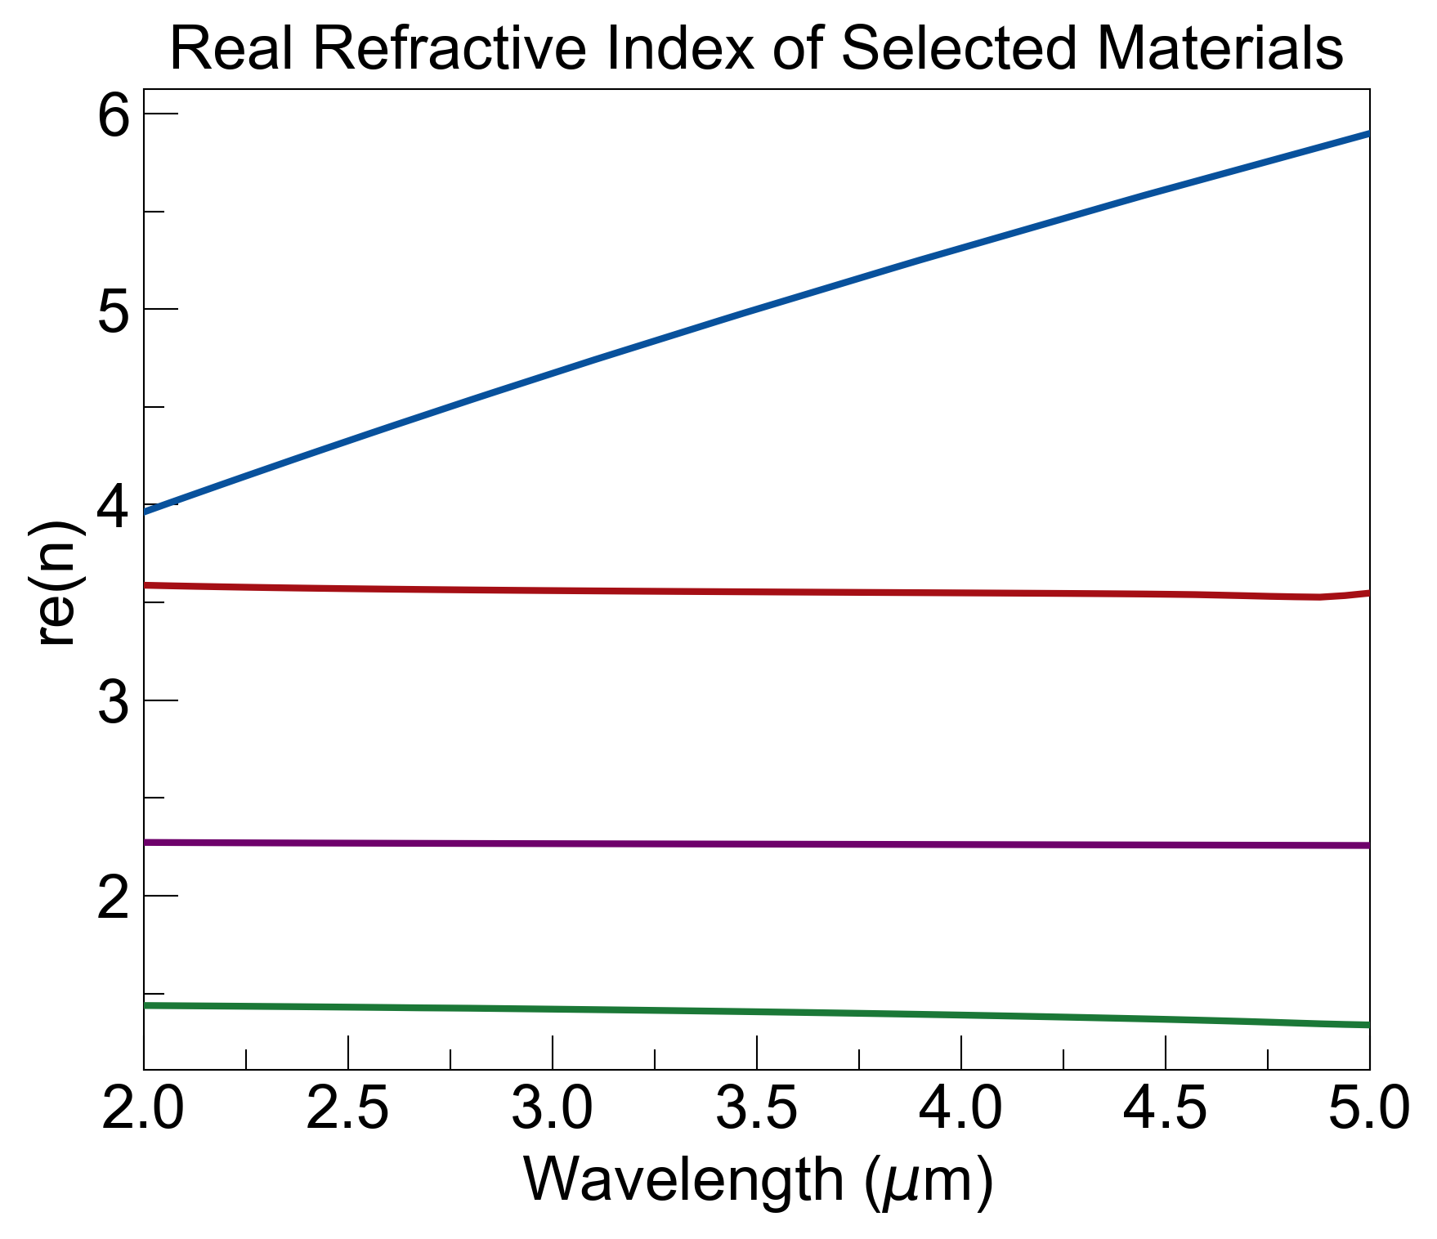
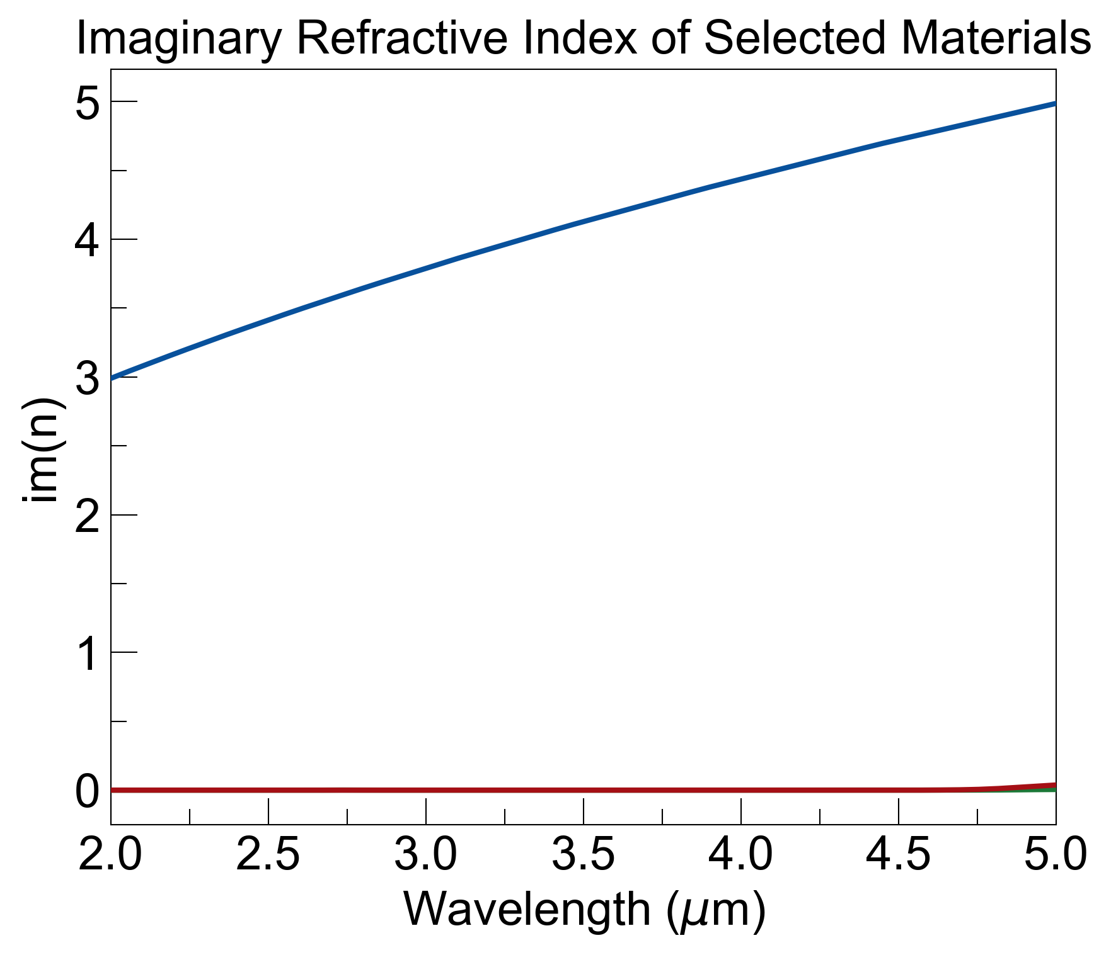
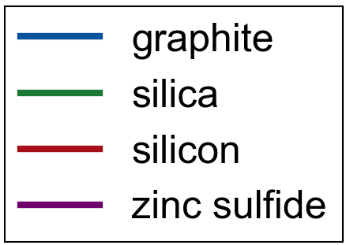
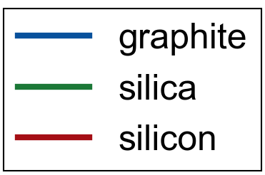
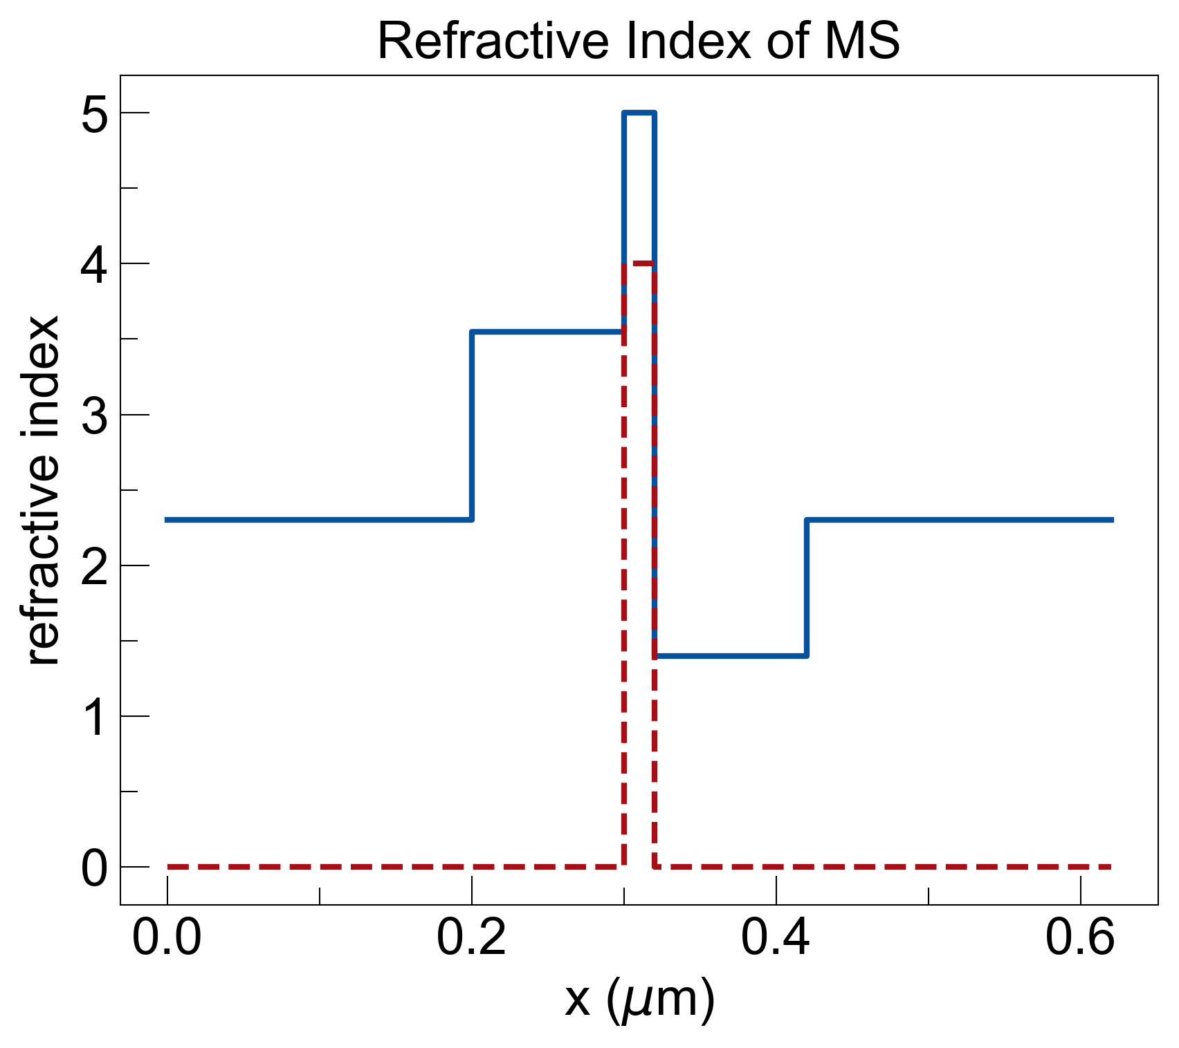
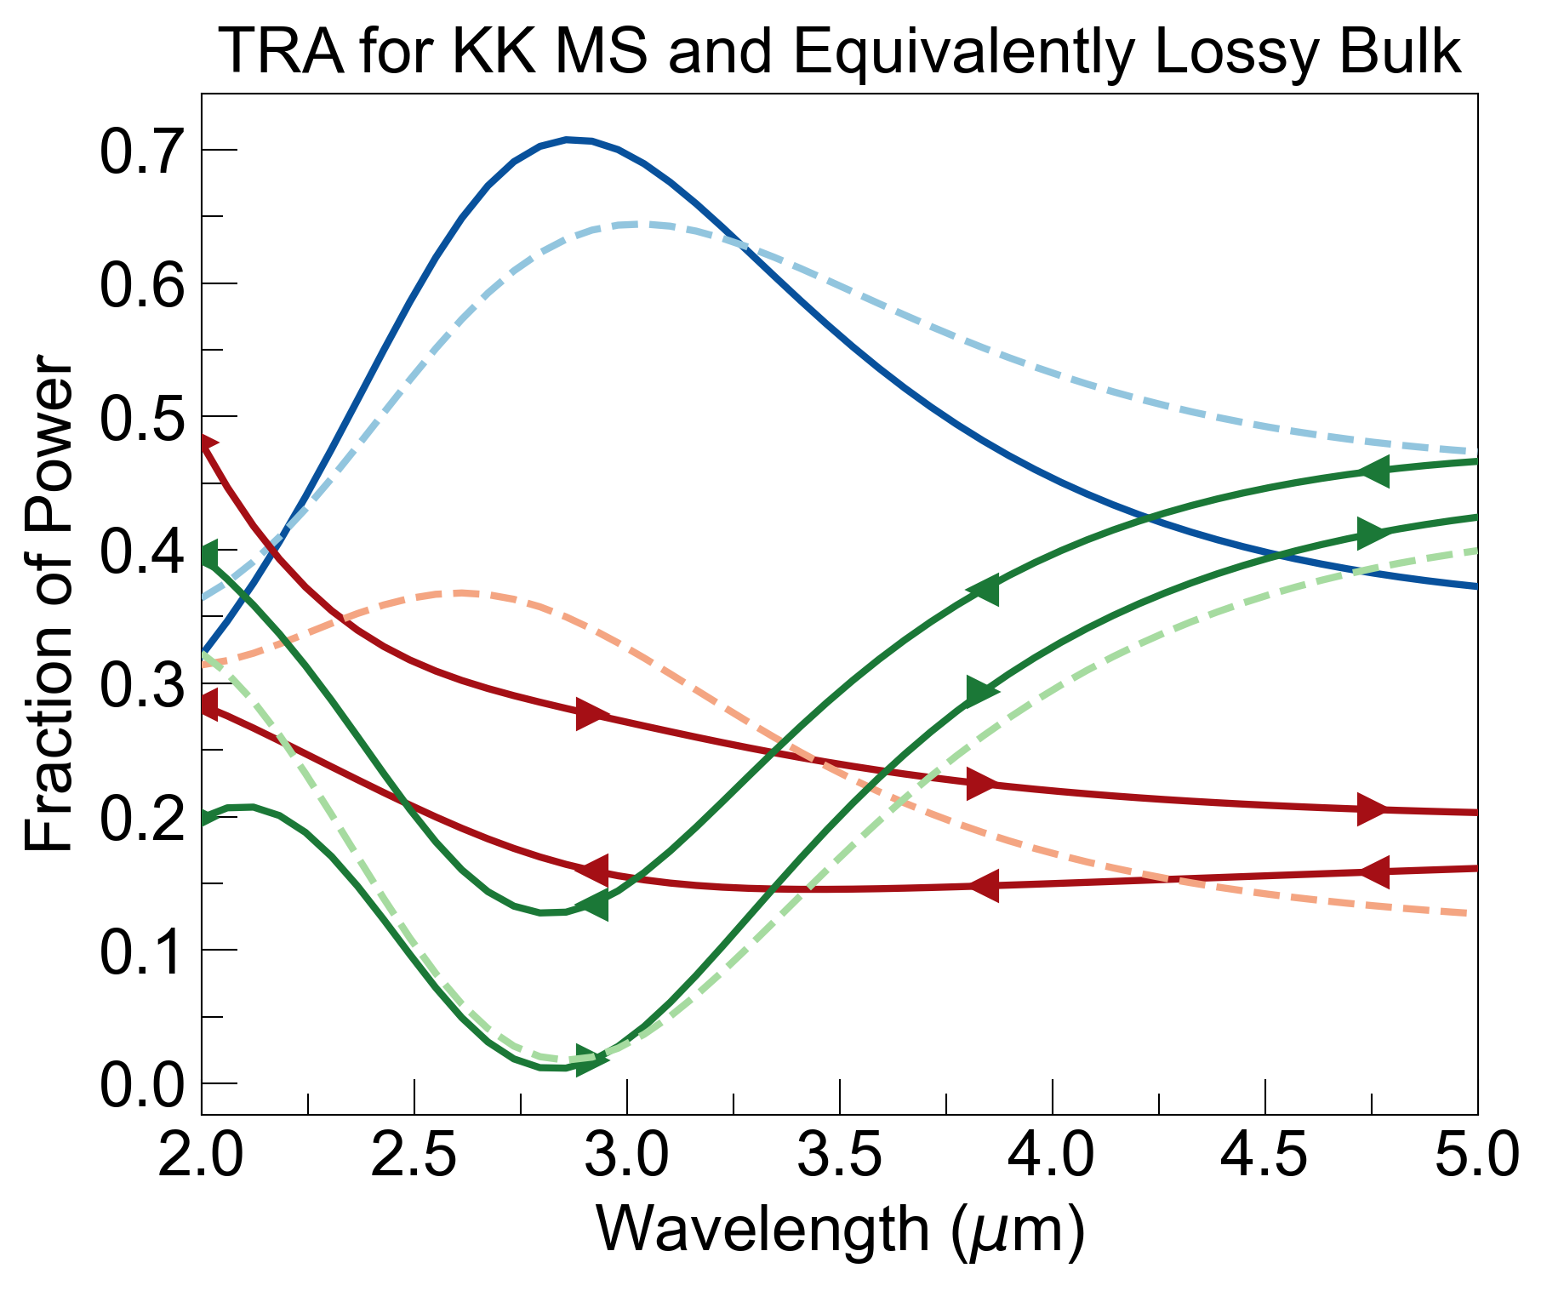
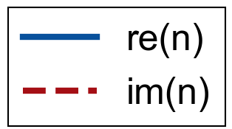
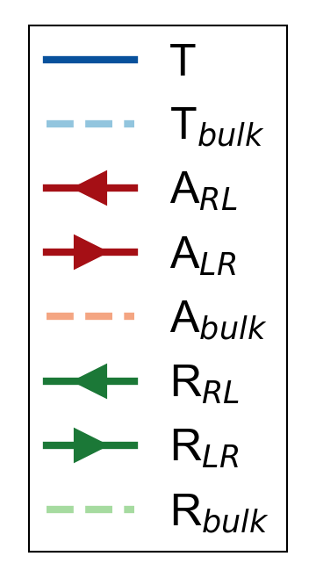
d_list (um) = [0.2, 0.1, 0.02, 0.1, 0.2]
graphite
constant RI over wavelength = 3.5um:
silicon
ZnS
ZnS
silica

Slide 3
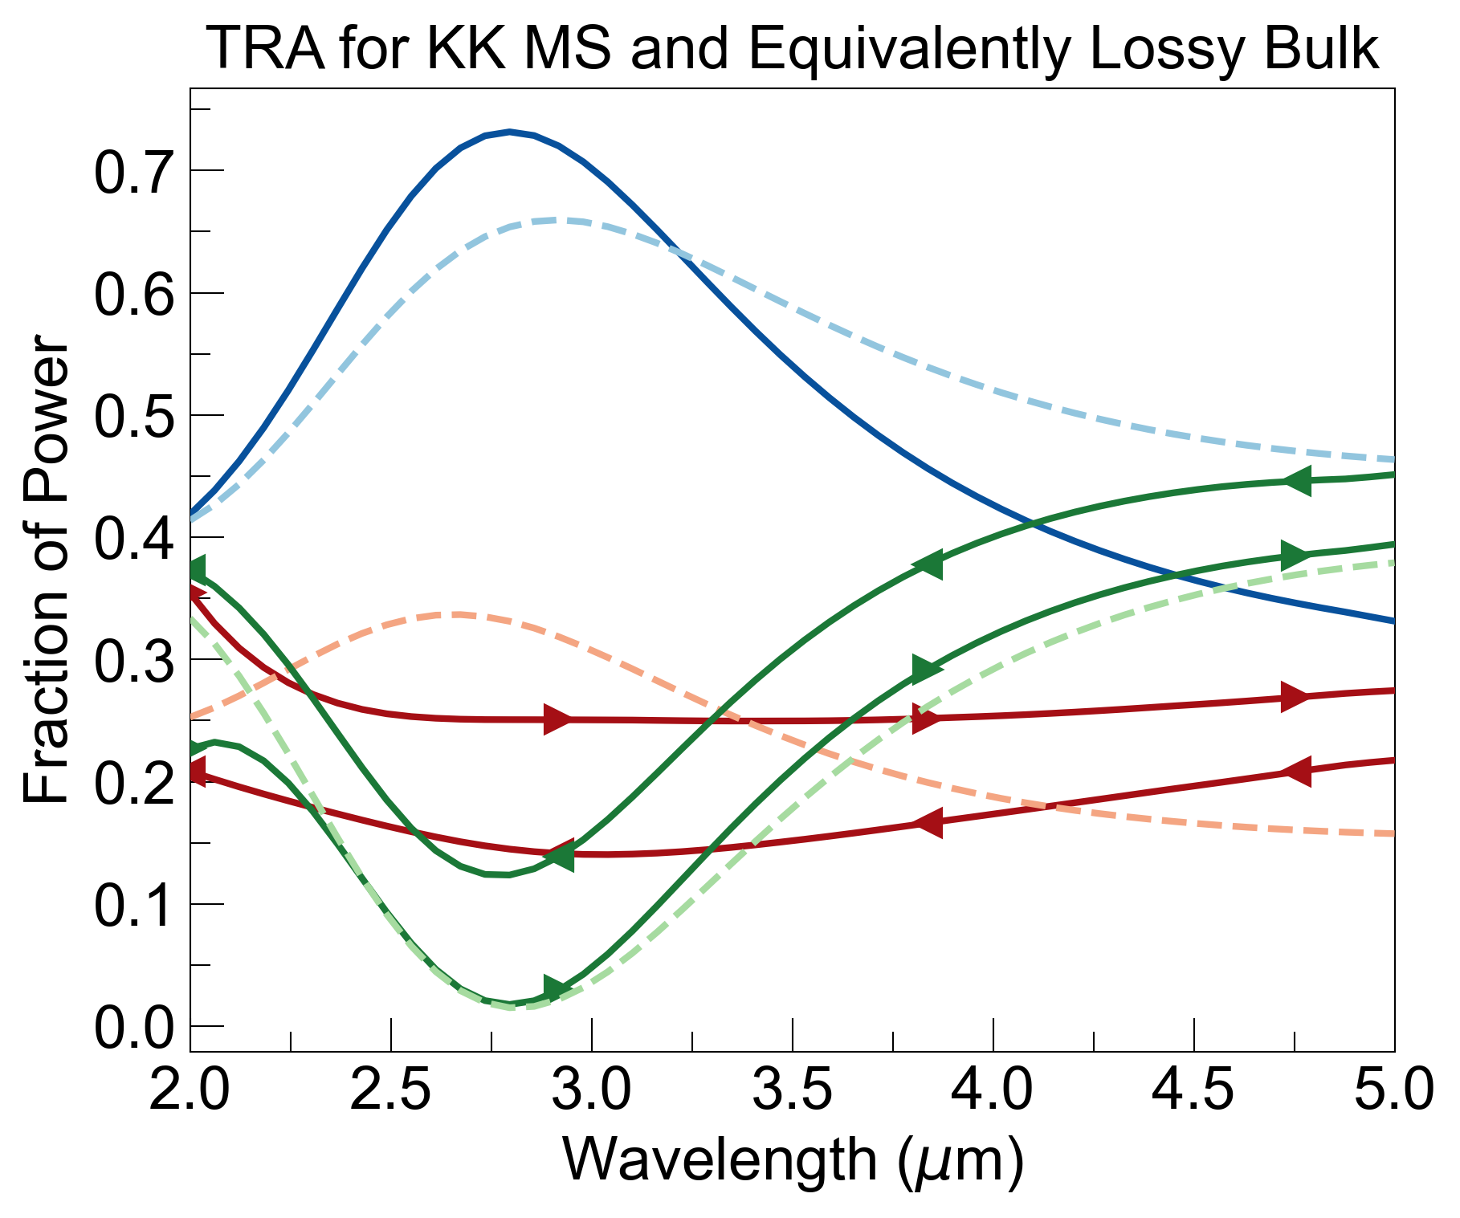
dispersionless:
with dispersion:
Question: Is the absorbance asymmetry coming from some variation of spatial KK, or simply from difference in n when entering lossy layer?

Slide 4
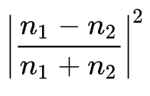
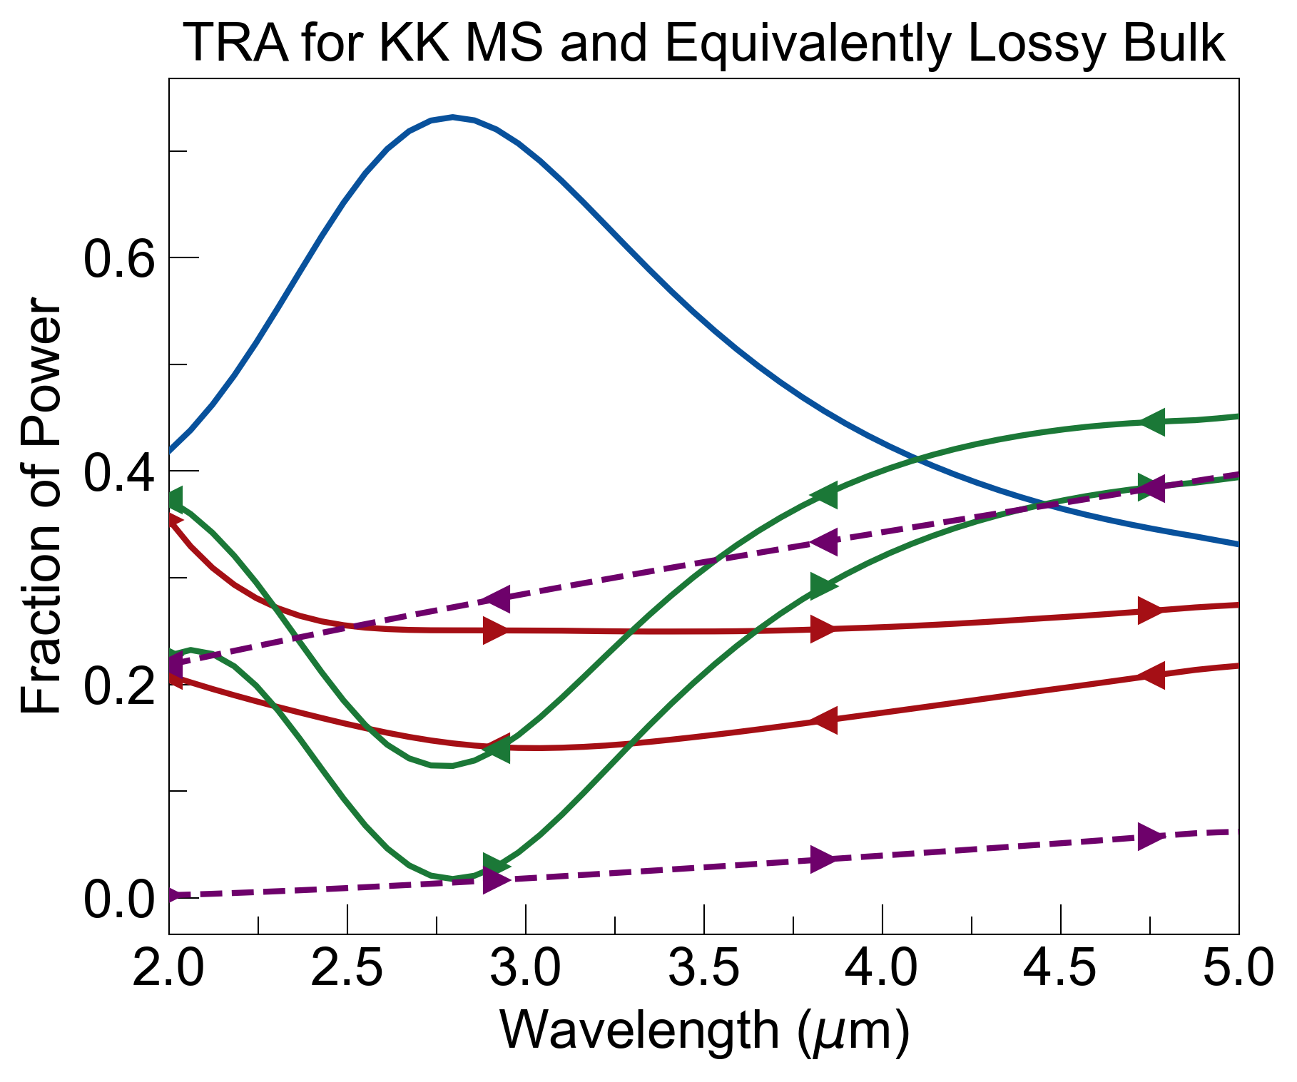
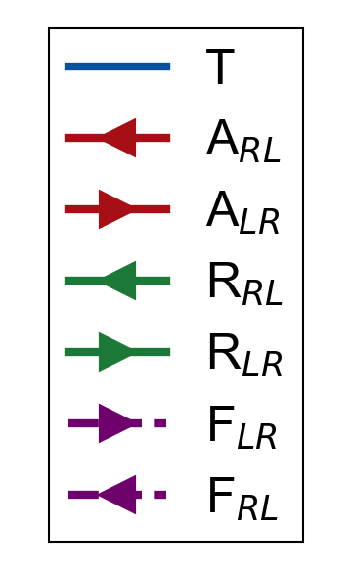
fresnel coefficient for reflectance:
Is there a way to ‘deconvolute’ the system in order to get rid of multiple reflections from air-window interfaces?
Isolate effects from ‘spatial KK’ region

