Slide 1
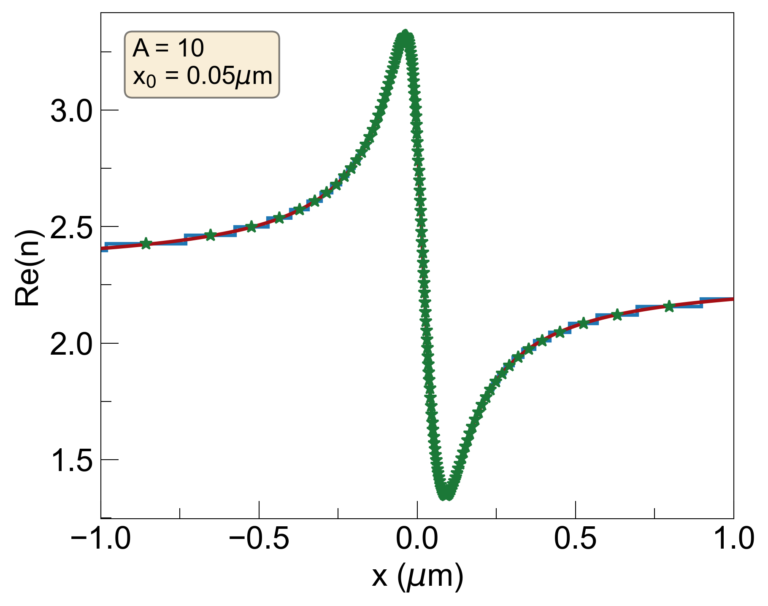
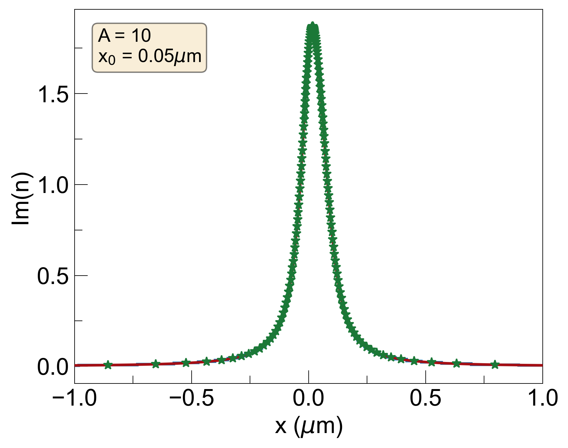
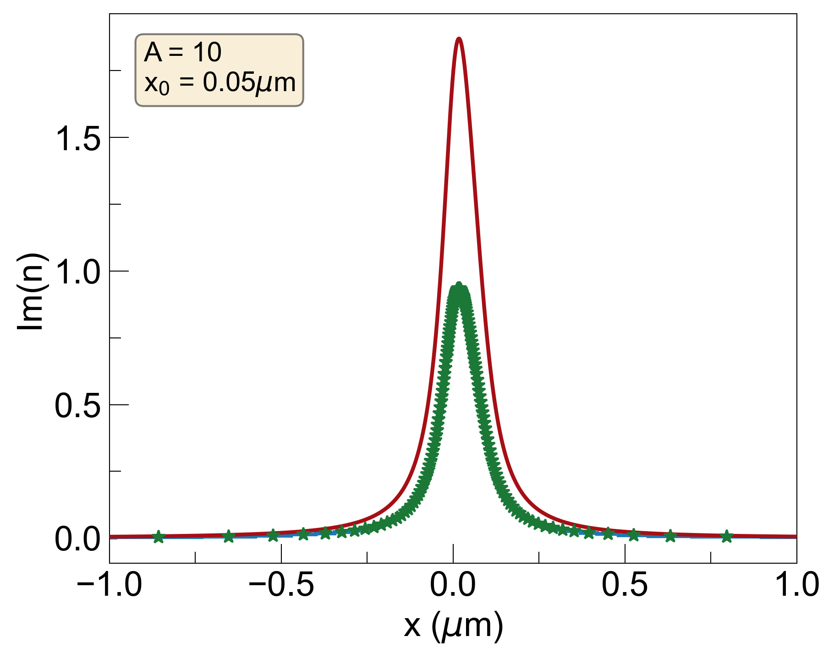
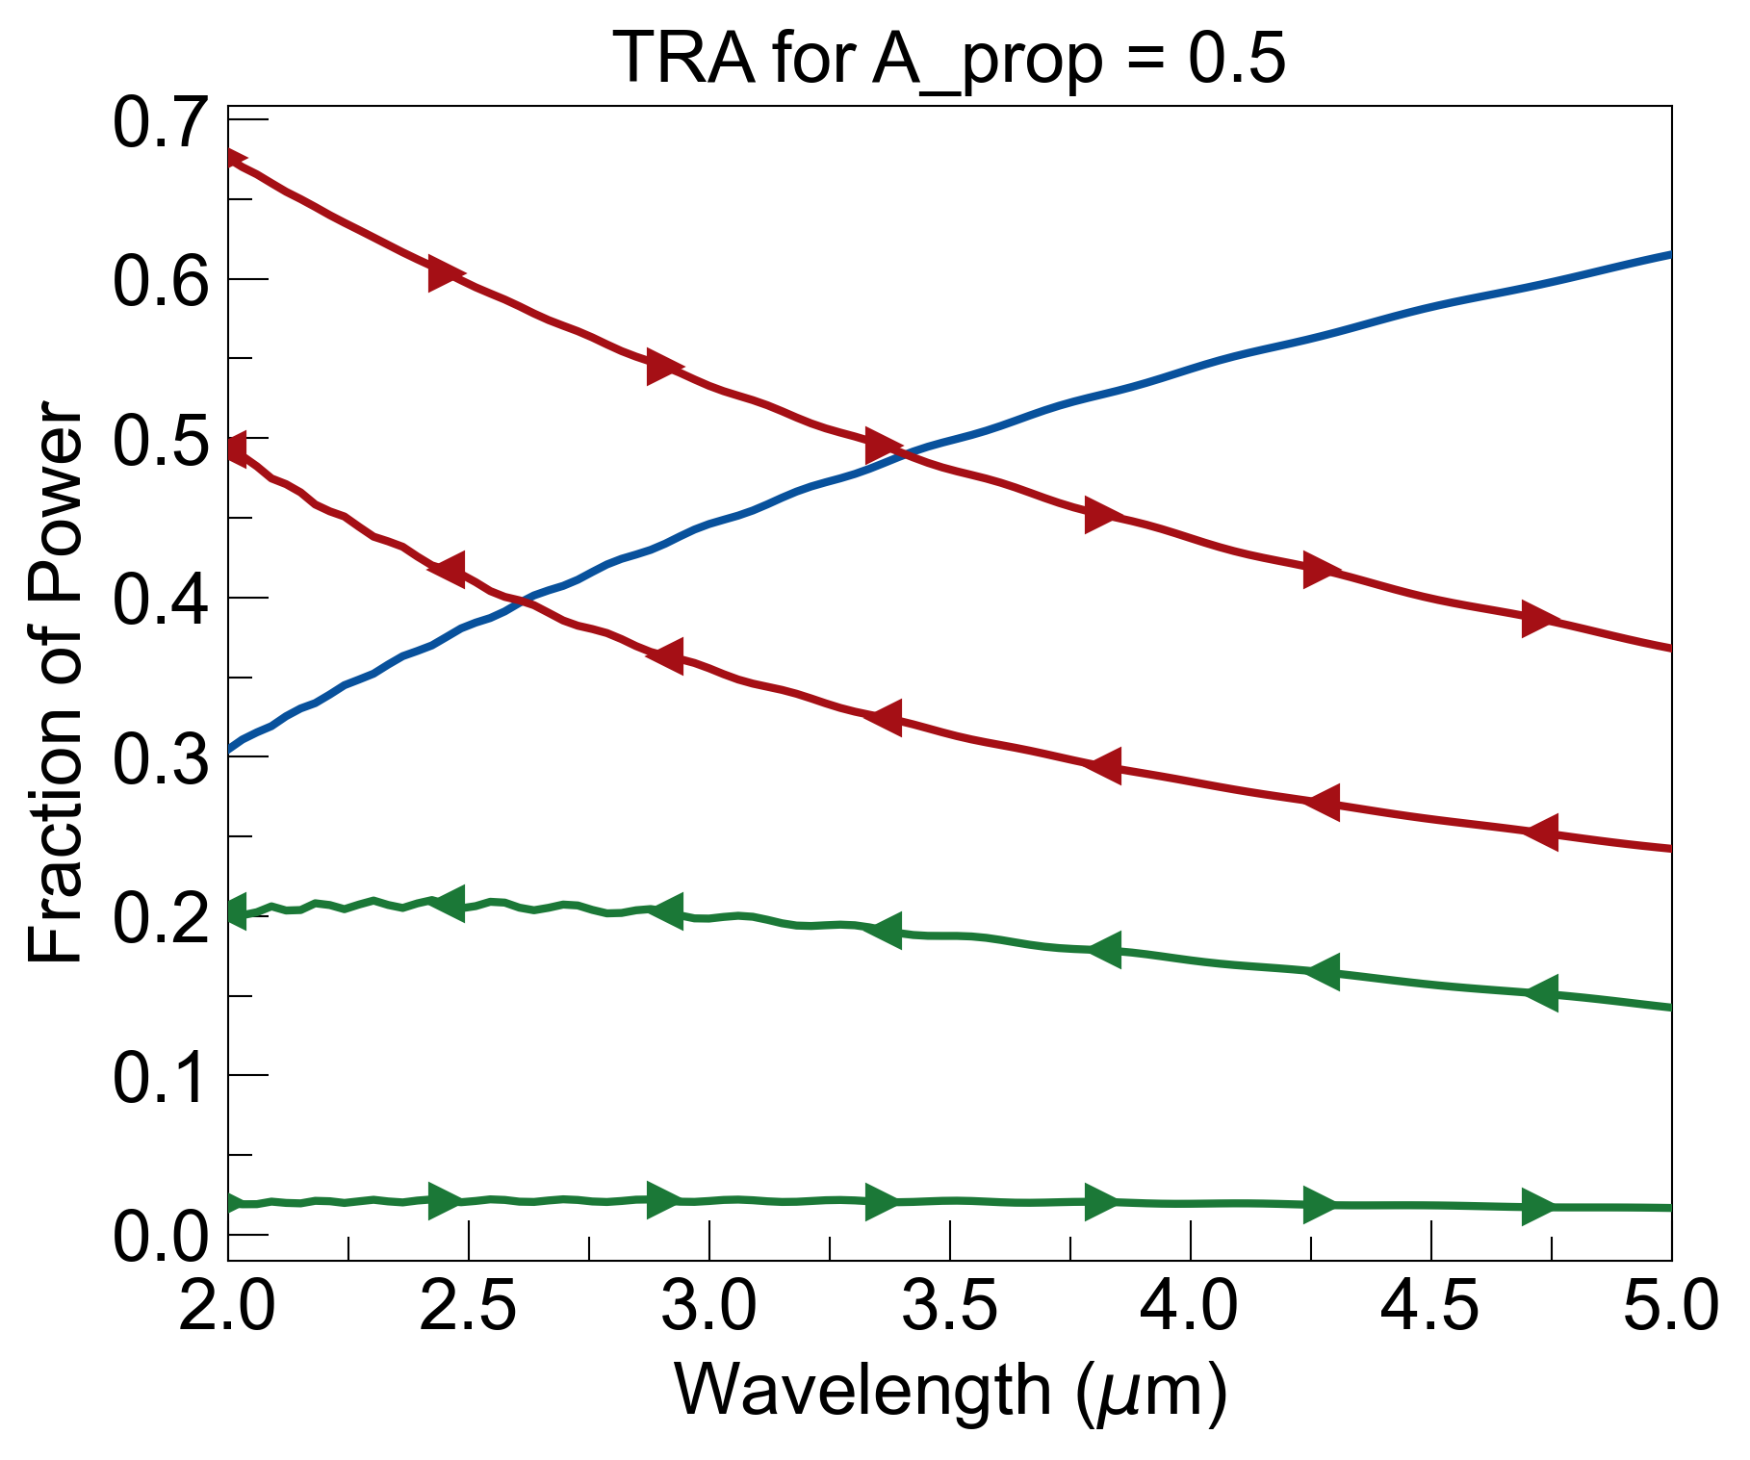
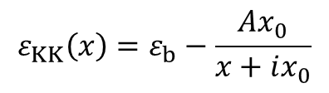
Multiply imaginary part of refractive index by factor A_{prop} to see effects of reducing losses while keeping the real part the same:
$$ε_{KK}\left(x\right)=ε_{b}−\frac{Ax_{0}}{x+ix_{0}}$$
+ A_{prop} *
=
+

Slide 2
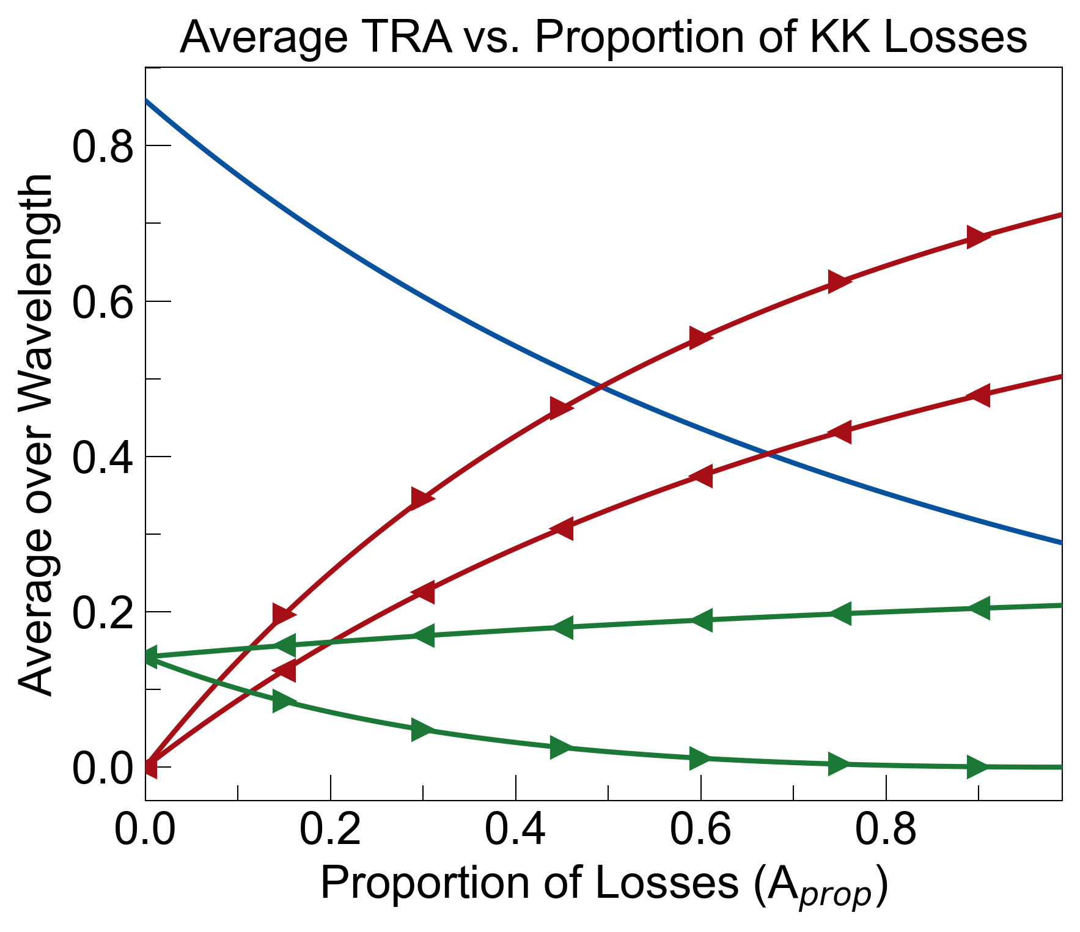
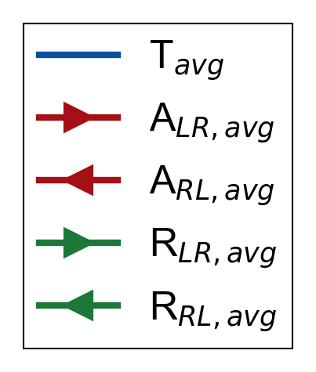
Sweep A_{prop} from 0 to 1 and plot average transmittance, reflectance, and absorbance as a function of A_{prop}:
A_{prop} = 0 means no losses, and hence, R_{LR} = R_{RL} (transmittance is the same both ways)
A_{prop} = 1 recovers reflectionless property of spatial KK (R_{LR} = 0)

Slide 3
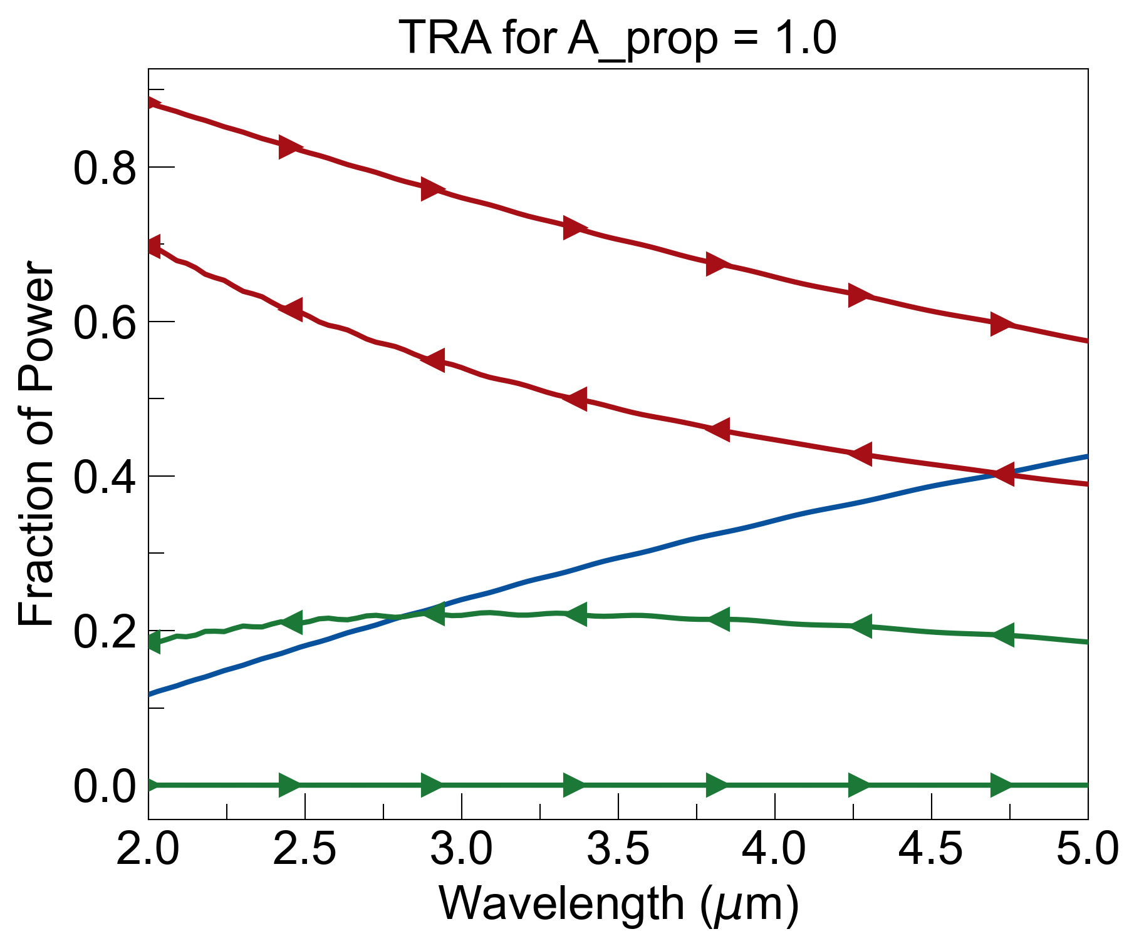
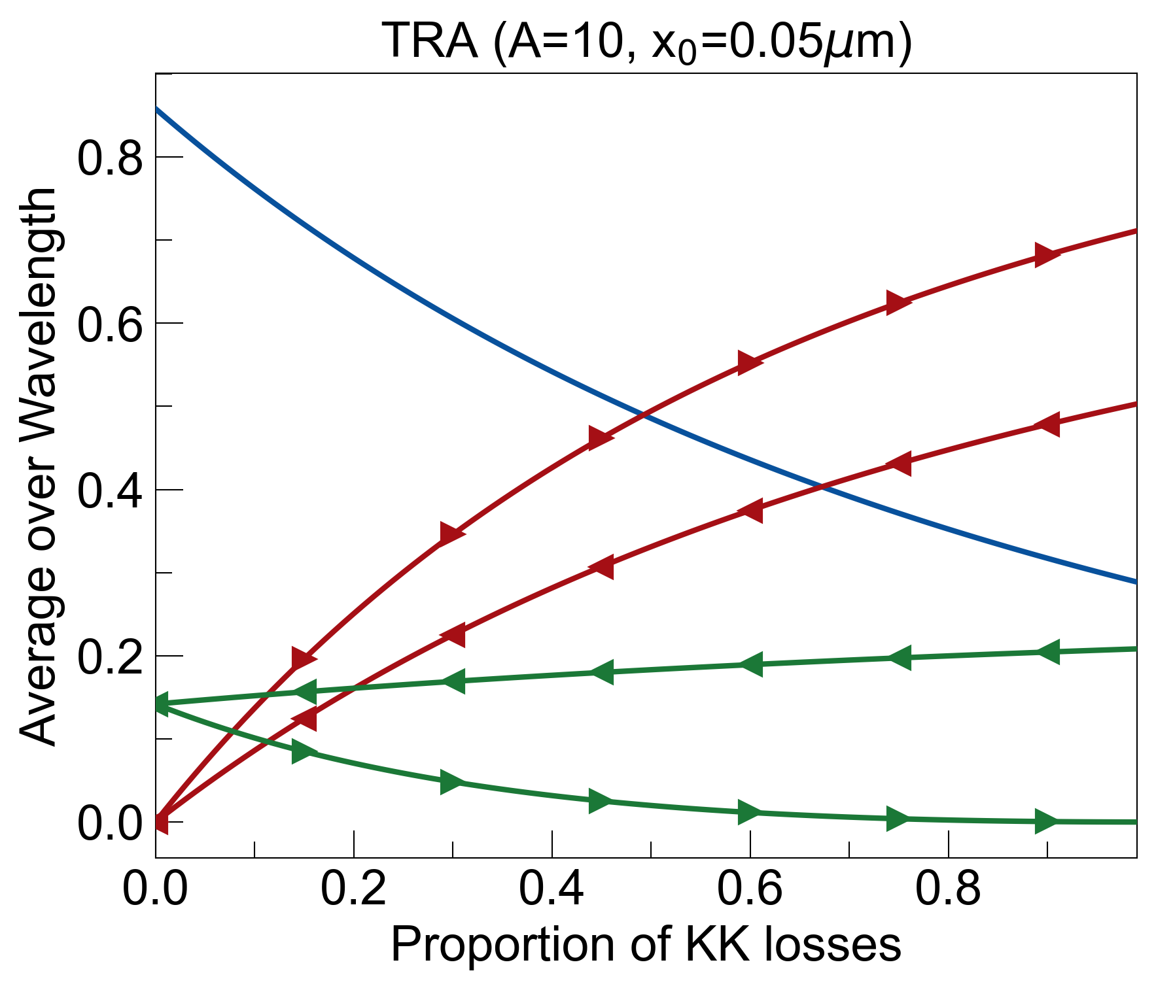
A_{prop} = 1
Broadband reflectionless and good asymmetry, but bad signal-to-noise

Slide 4
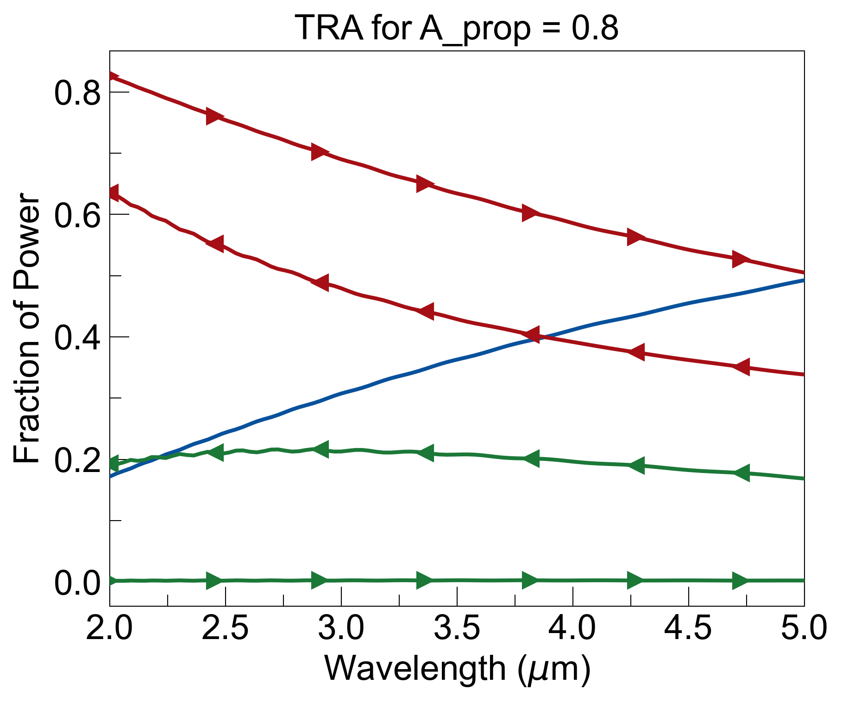
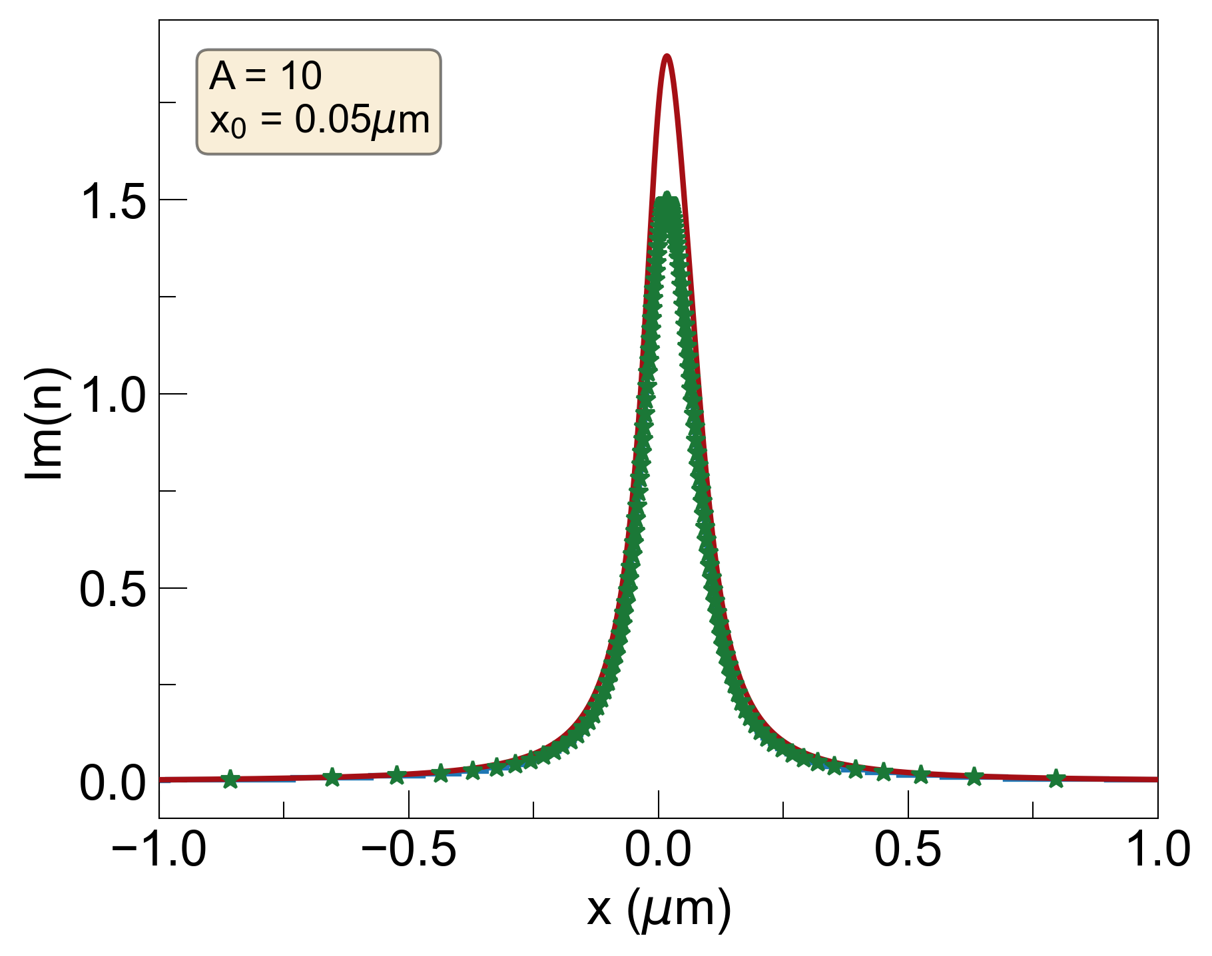
A_{prop} = 0.8
Still reflectionless, better signal-to-noise

Slide 5
A_{prop} = 0.5
R_{LR} is no longer strictly equal to 0

Slide 6
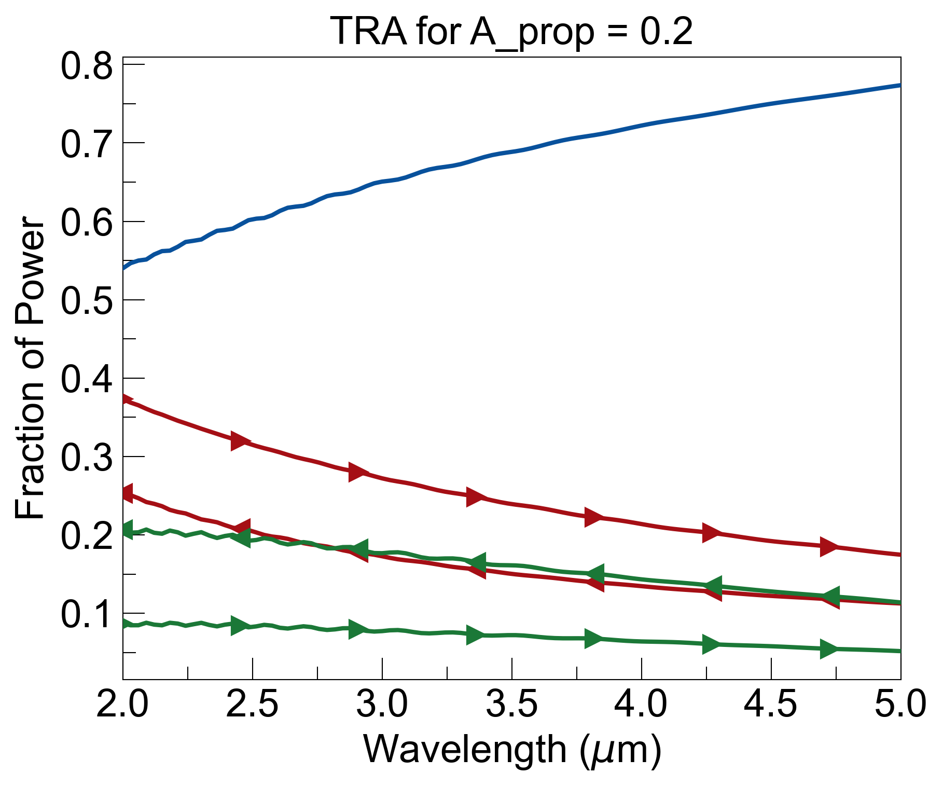
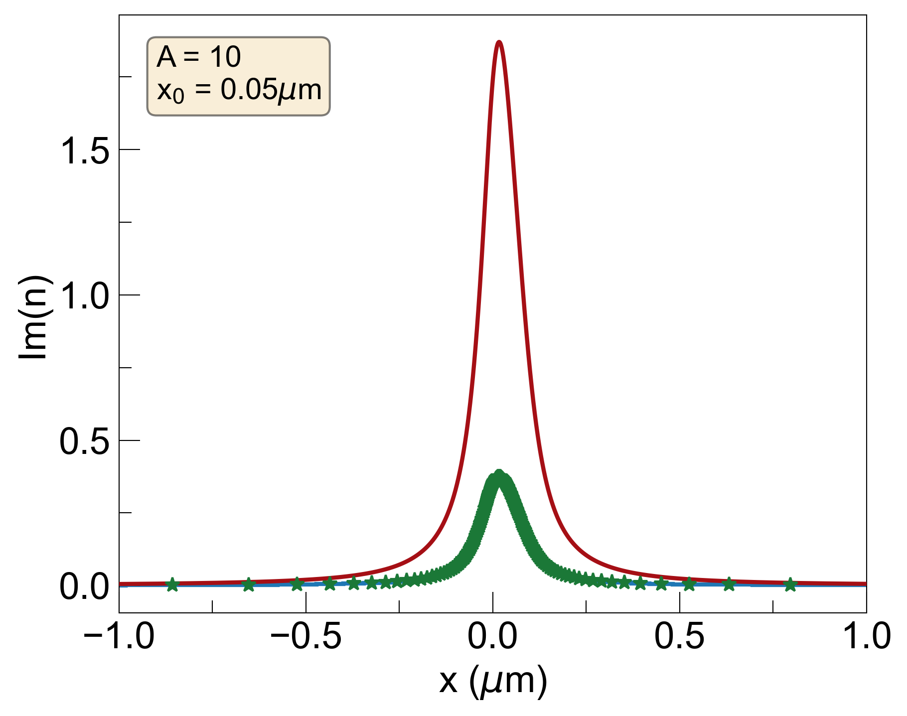
A_{prop} = 0.2
Much better signal-to-noise, but not broadband reflectionless

Slide 7
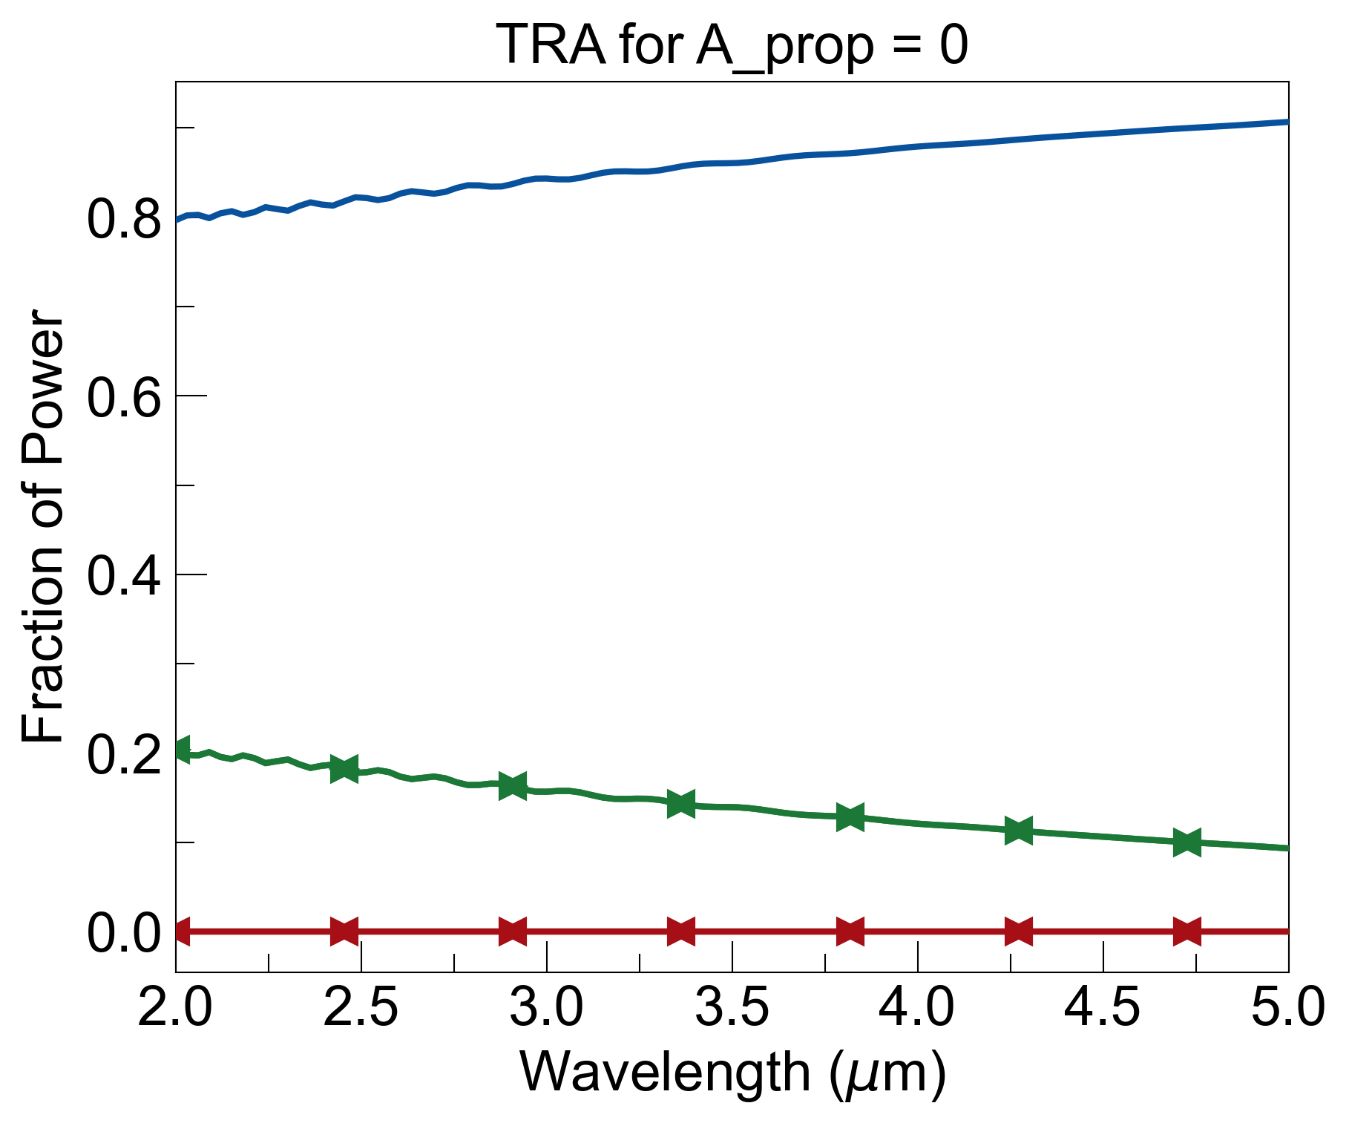
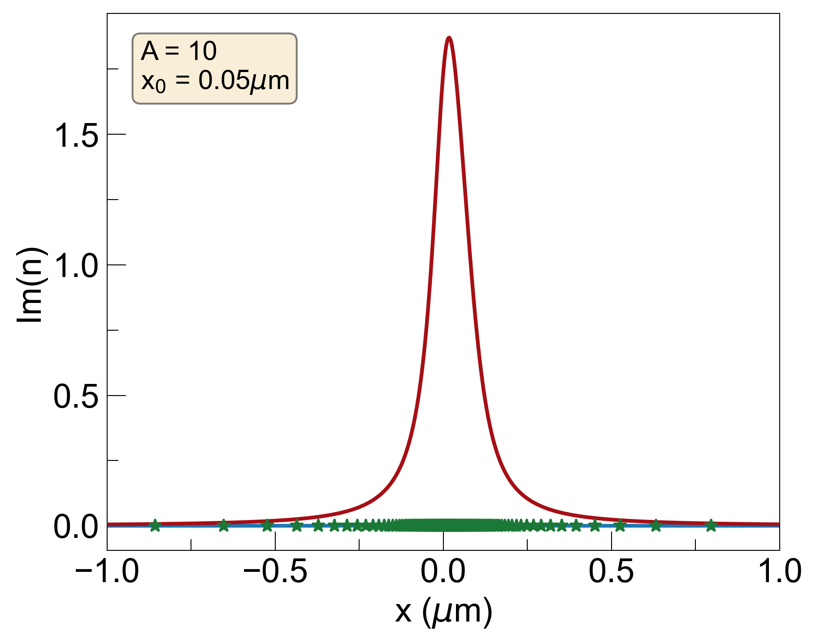
A_{prop} = 0
No losses so no absorption and asymmetry

Slide 8
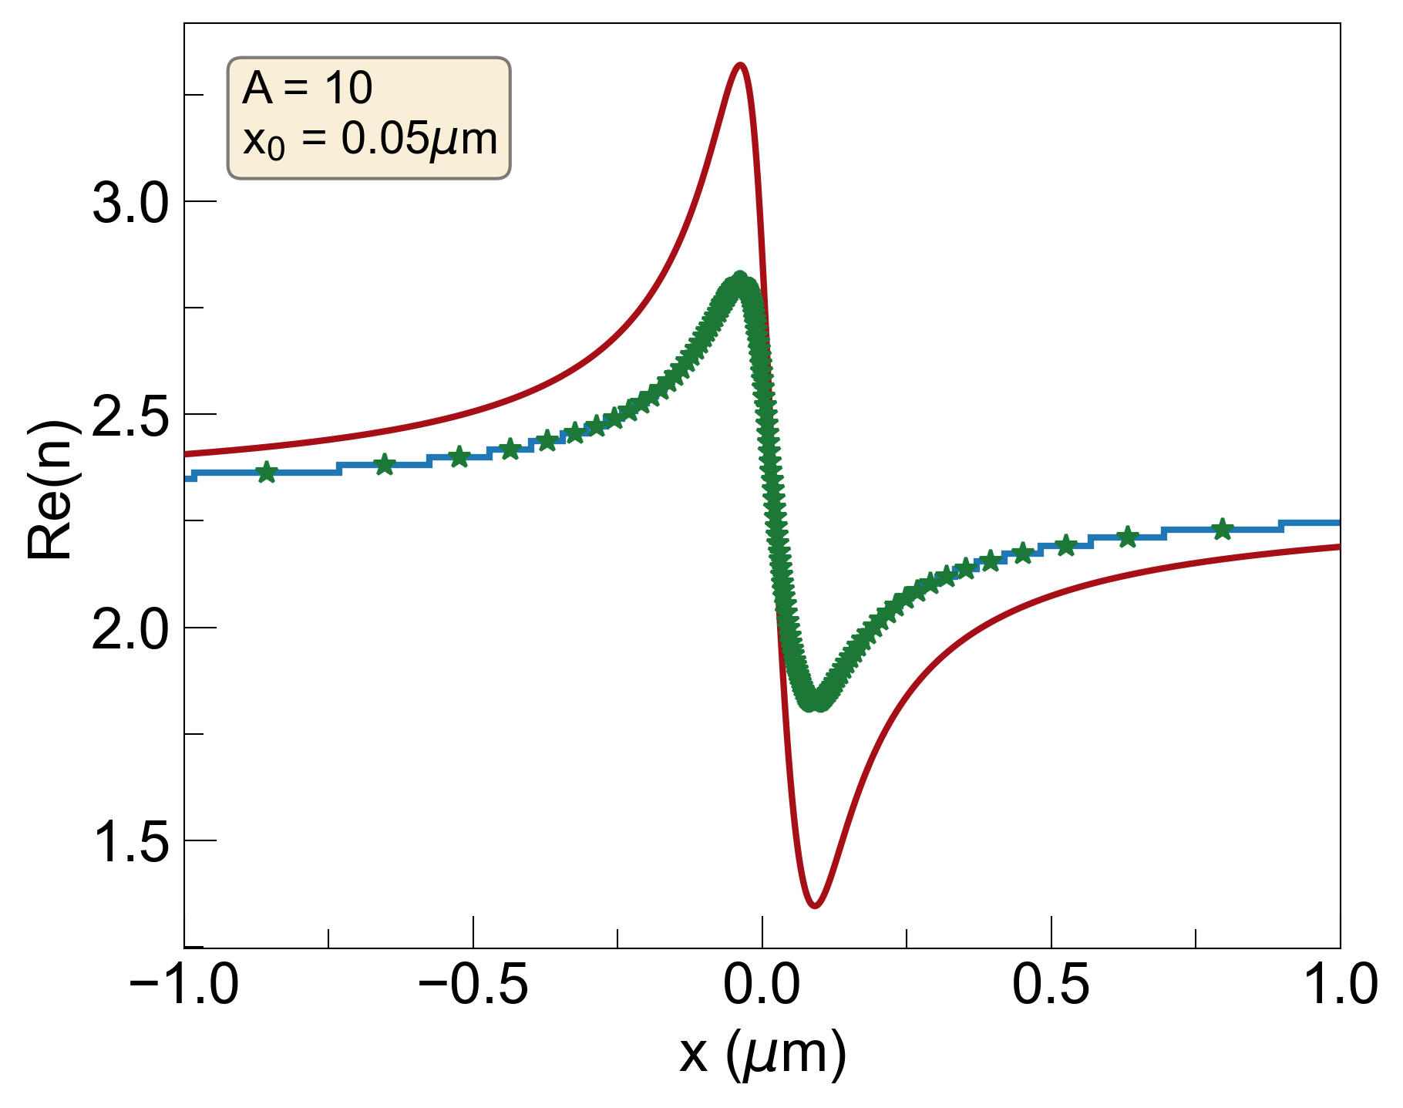

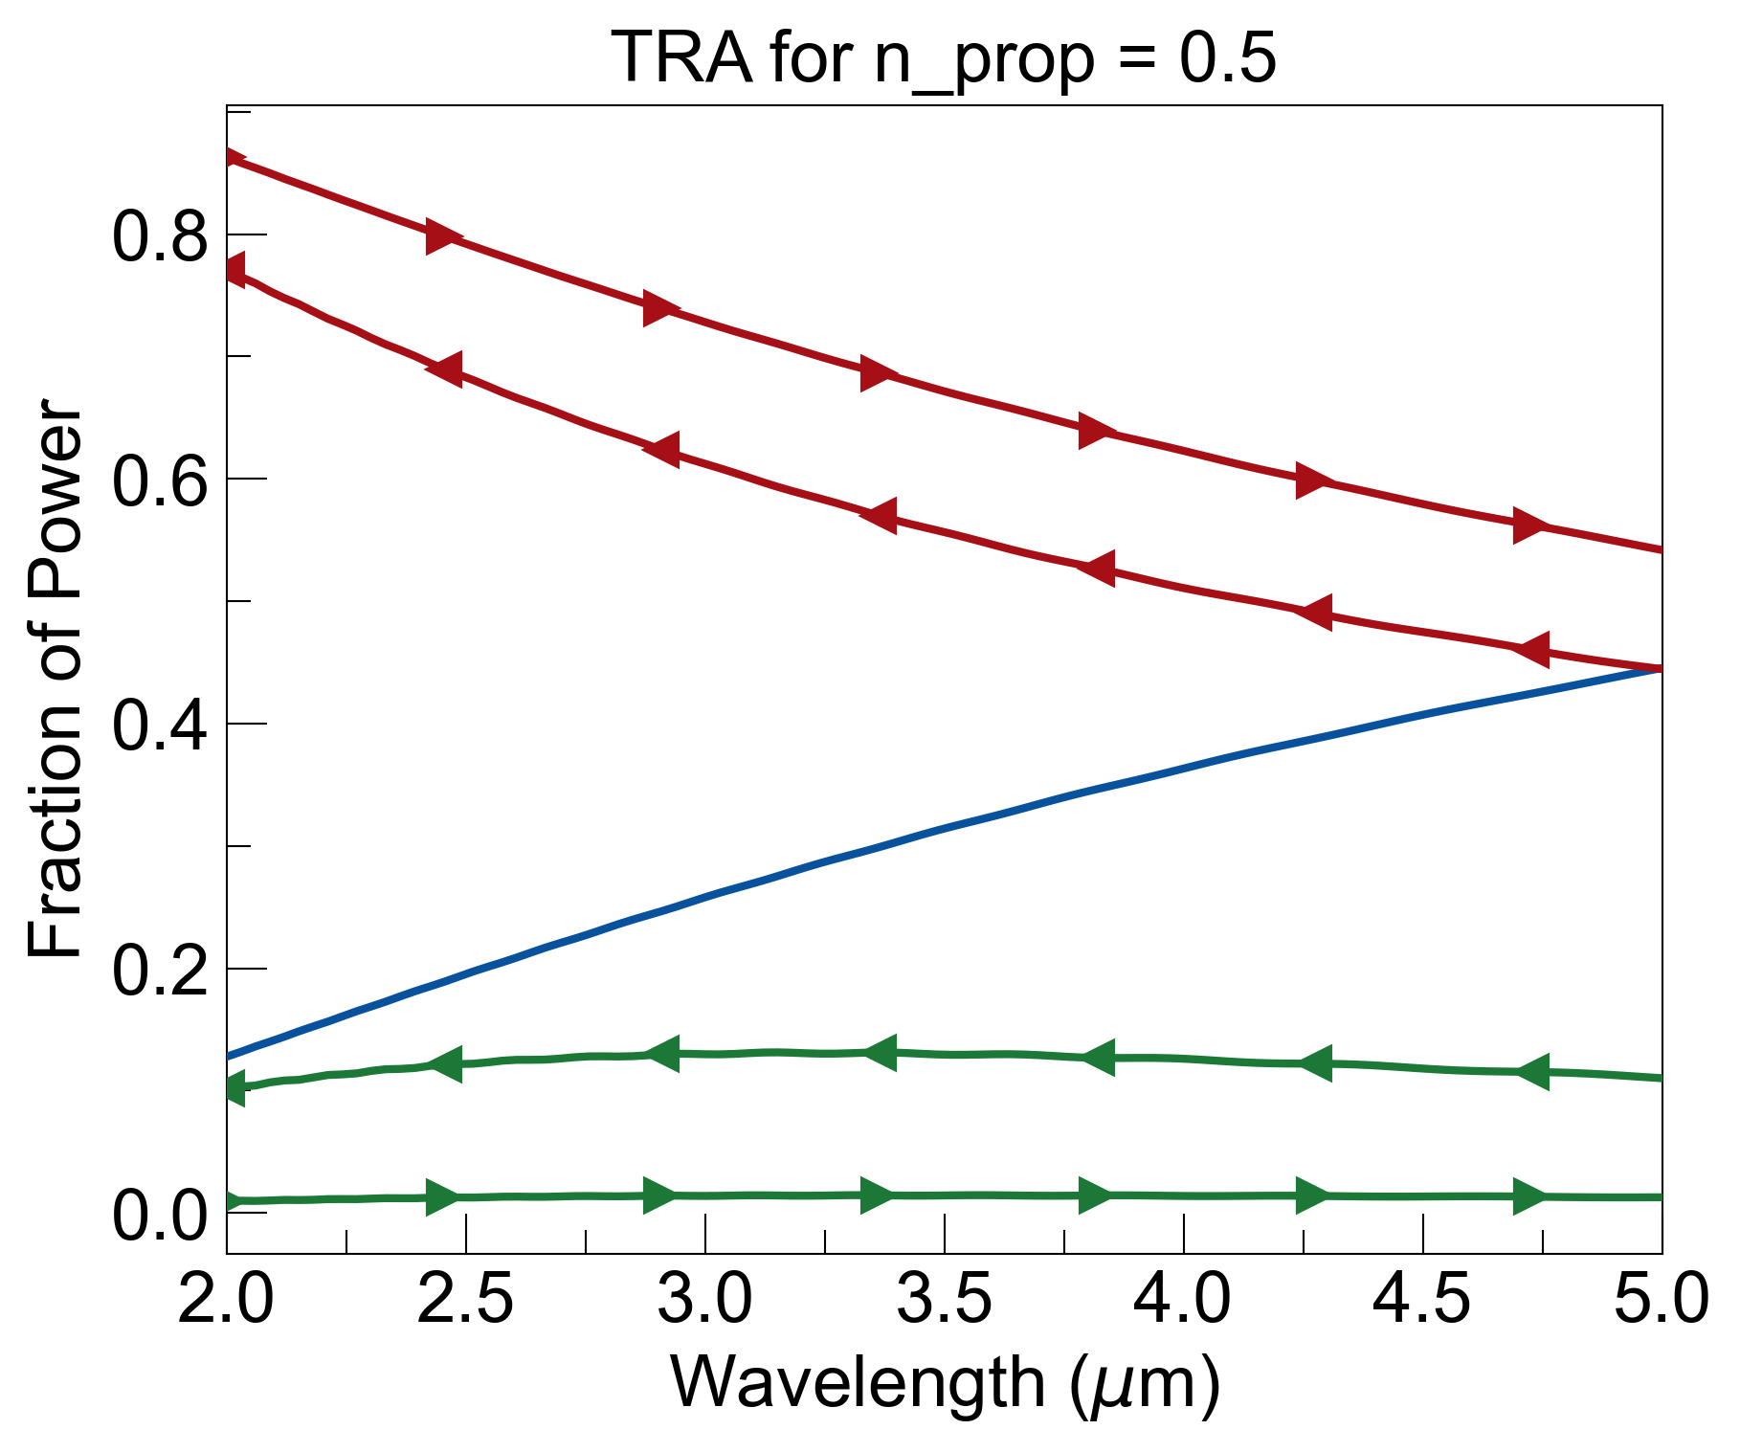
Now, multiply real part of refractive index by factor n_{prop} to see effects of reducing real part while keeping the losses the same:
$$ε_{KK}\left(x\right)=ε_{b}−\frac{Ax_{0}}{x+ix_{0}}$$
+ n_{prop} *
=
+

Slide 9
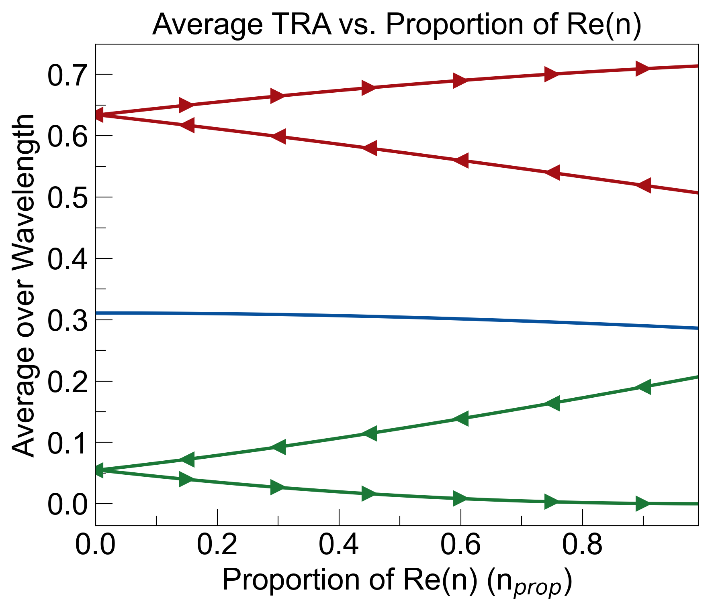
Sweep n_{prop} from 0 to 1 and plot average transmittance, reflectance, and absorbance as a function of n_{prop}:
n_{prop} = 0 means structure is isotropic from left and right (R_{LR} = R_{RL}, A_{LR} = A_{RL})
n_{prop} = 1 recovers reflectionless property of spatial KK (R_{LR} = 0)

Slide 10
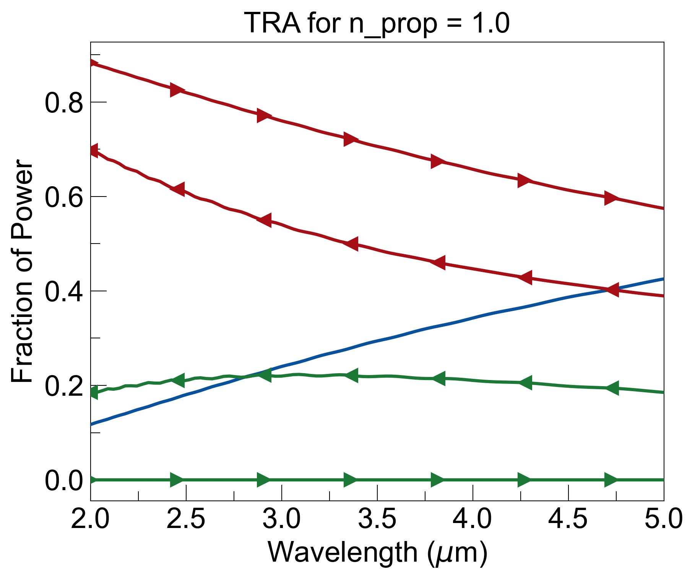
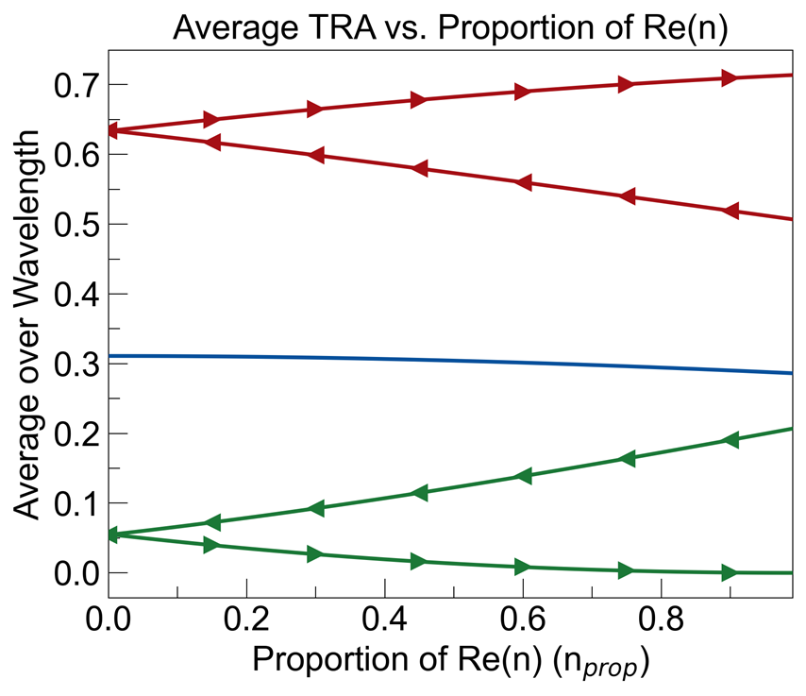
n_{prop} = 1
Broadband reflectionless and good asymmetry, but bad signal-to-noise

Slide 11

n_{prop} = 0.5
Asymmetry drops, but transmittance stays the same (same losses)

Slide 12
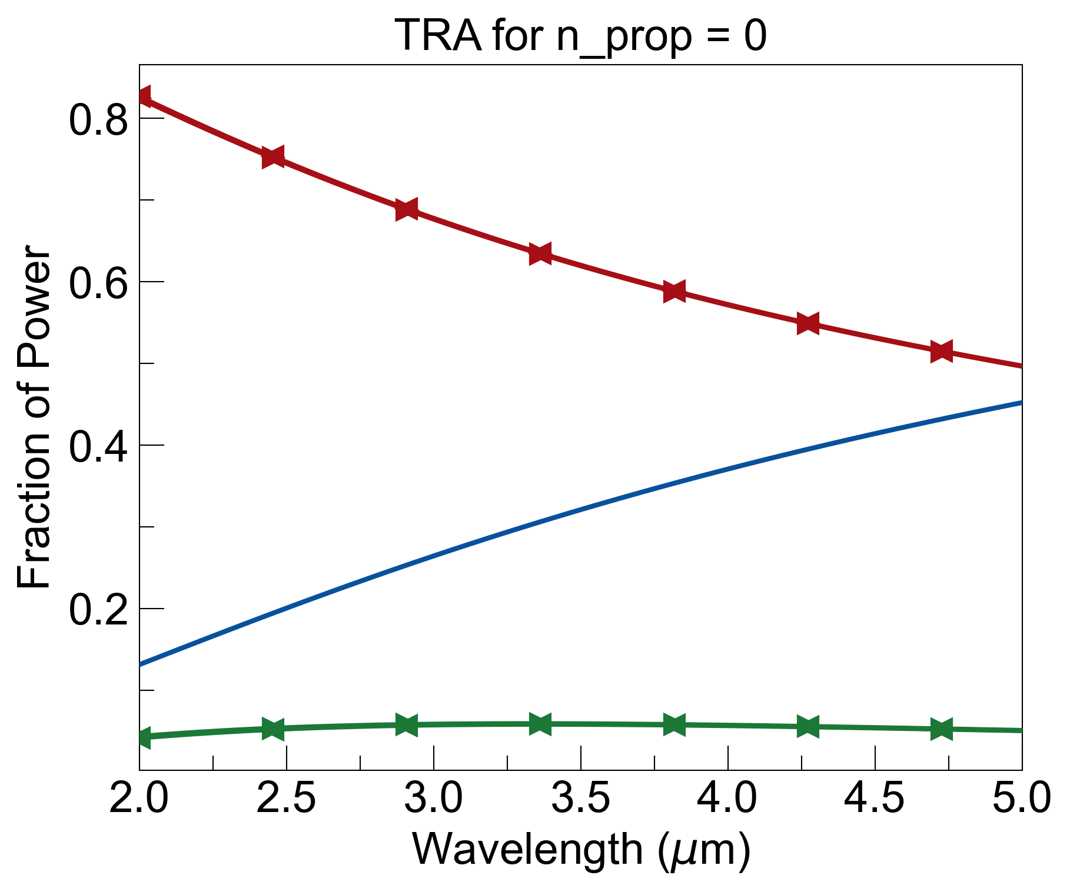
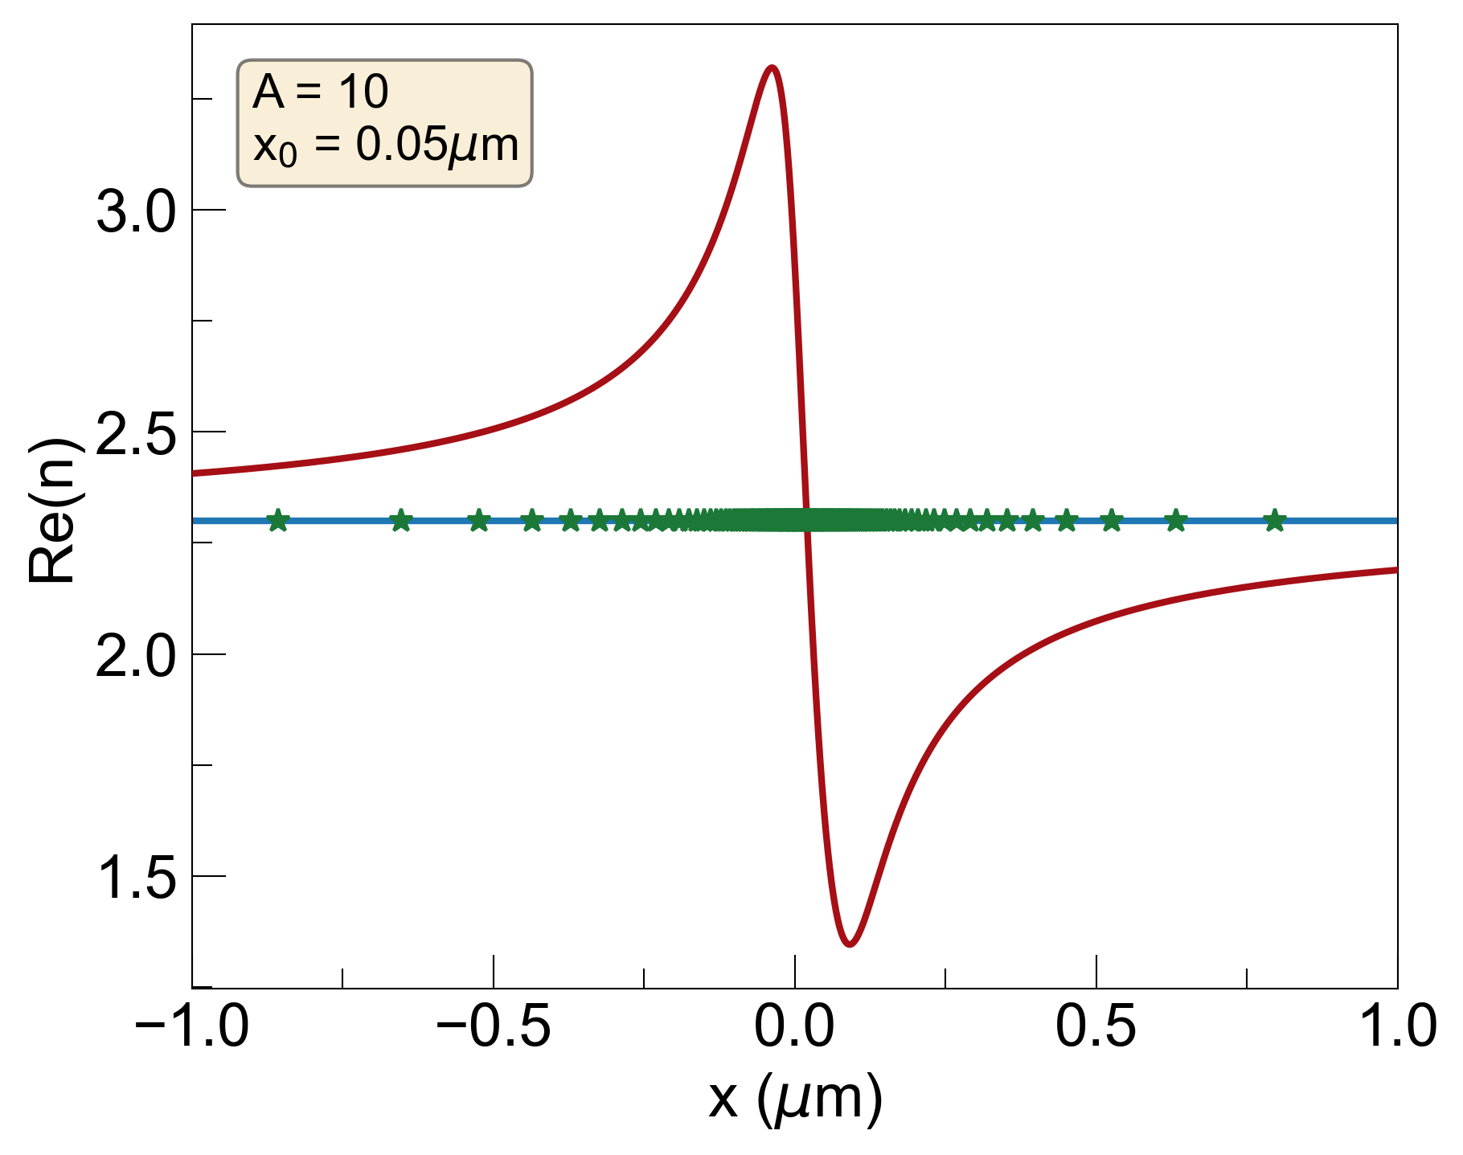
n_{prop} = 0
Symmetric structure, no longer reflectionless

