Slide 1
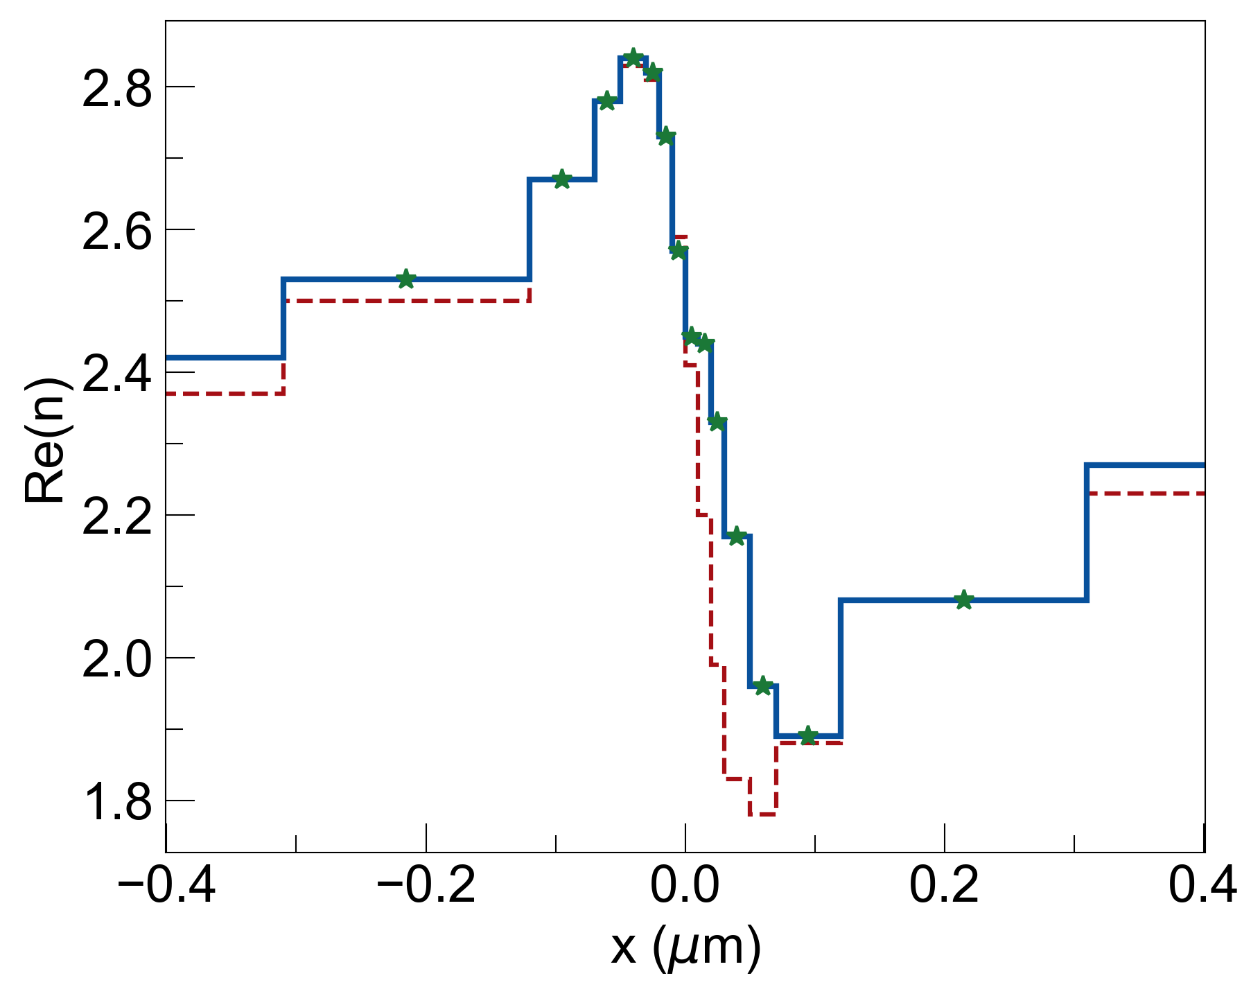
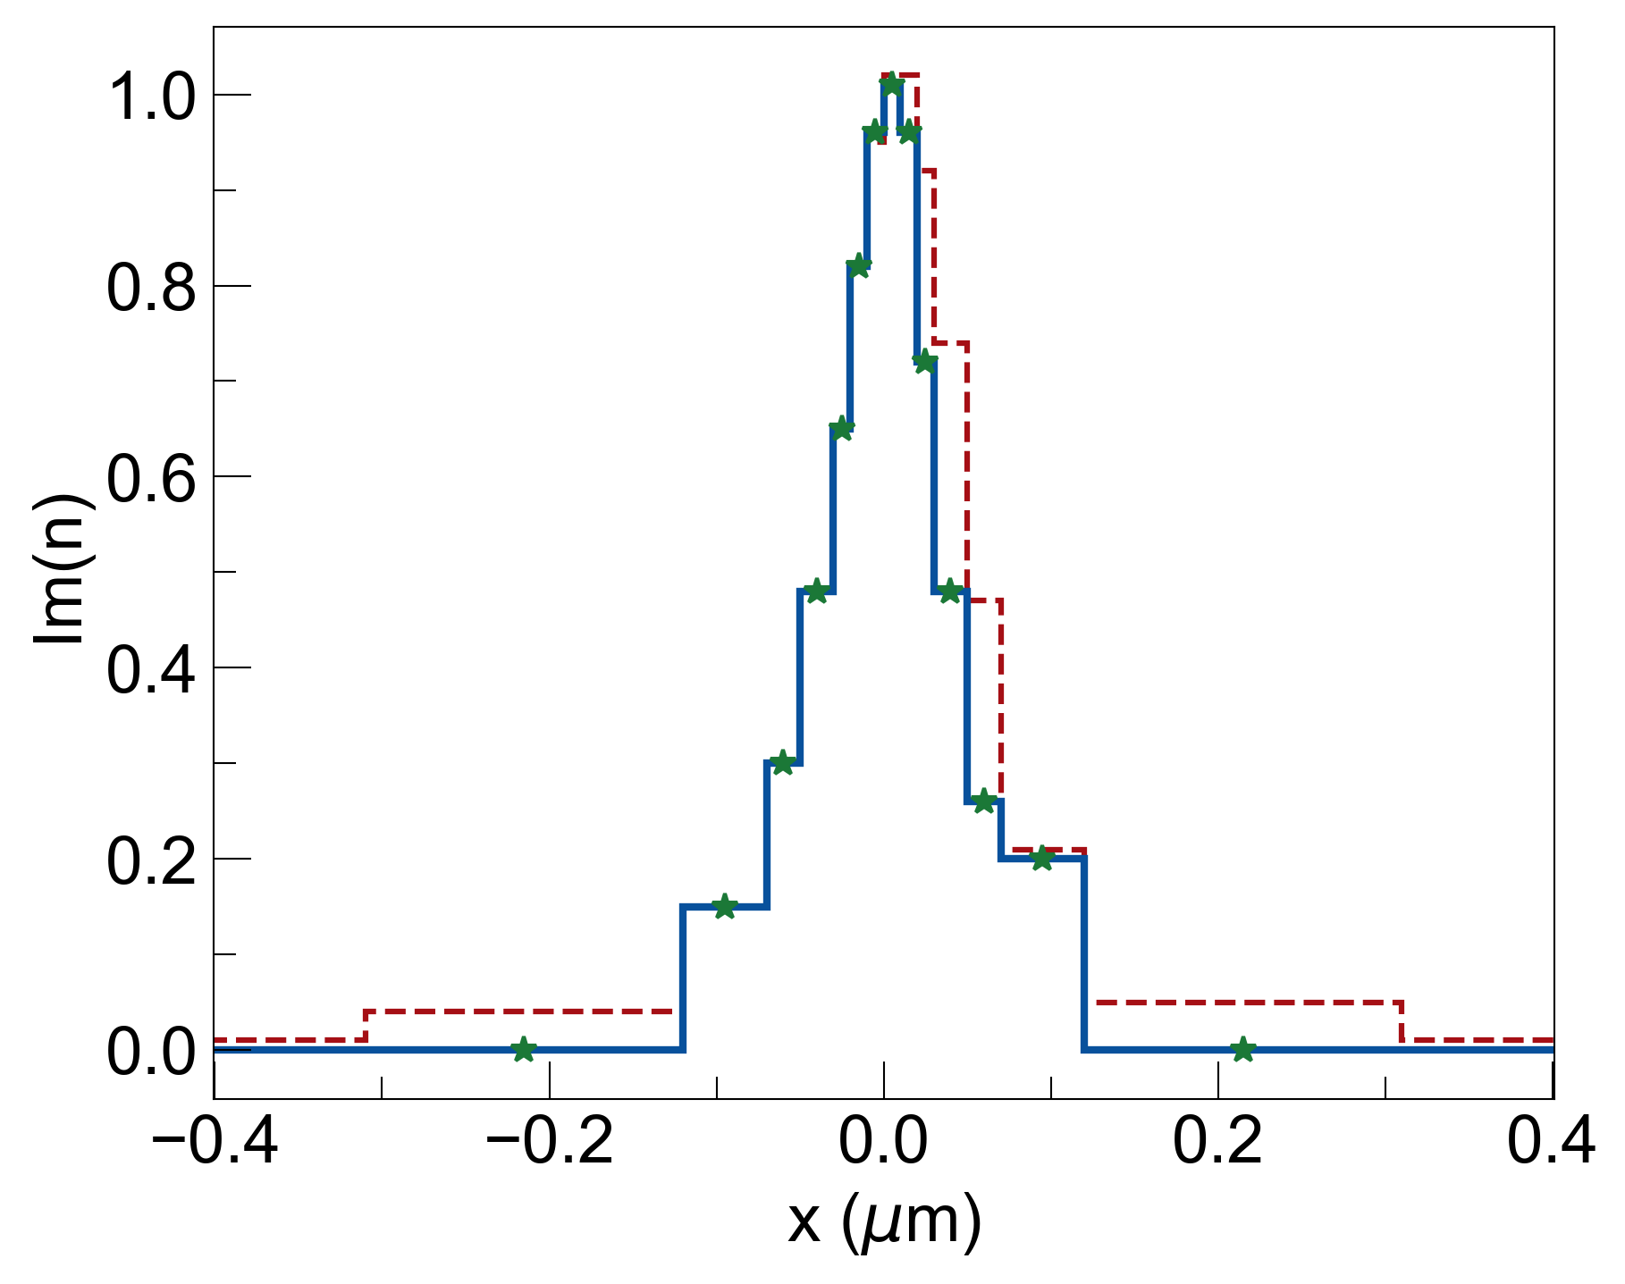
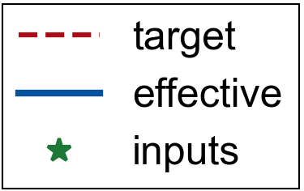
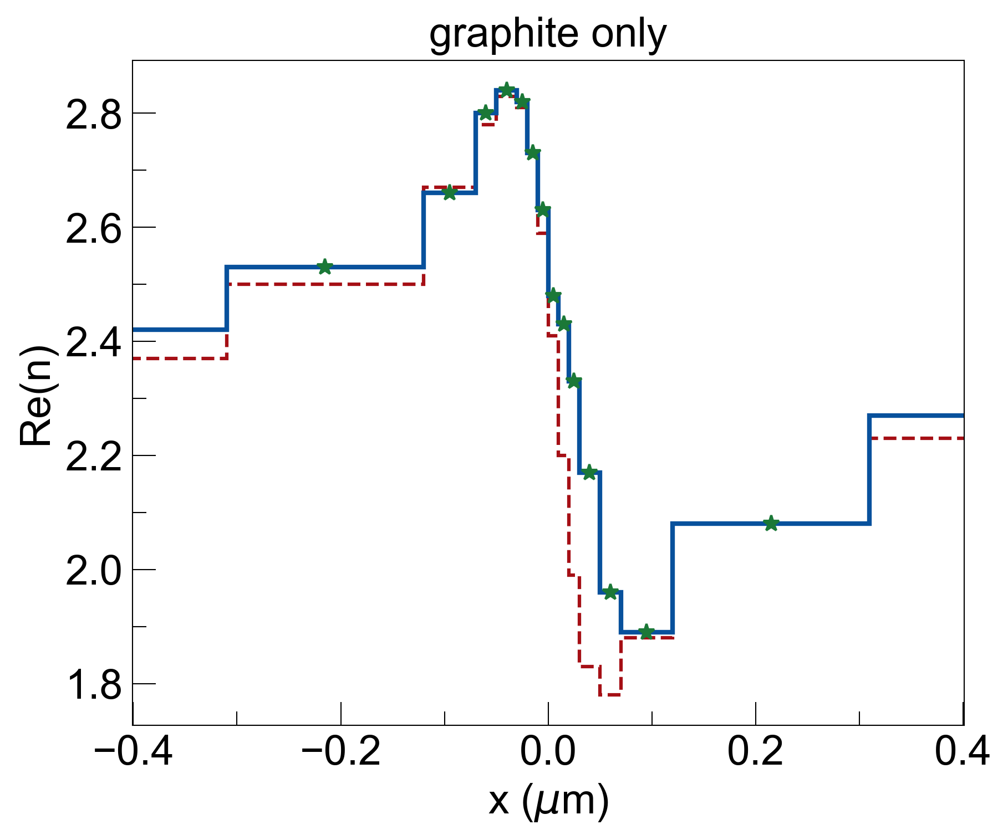
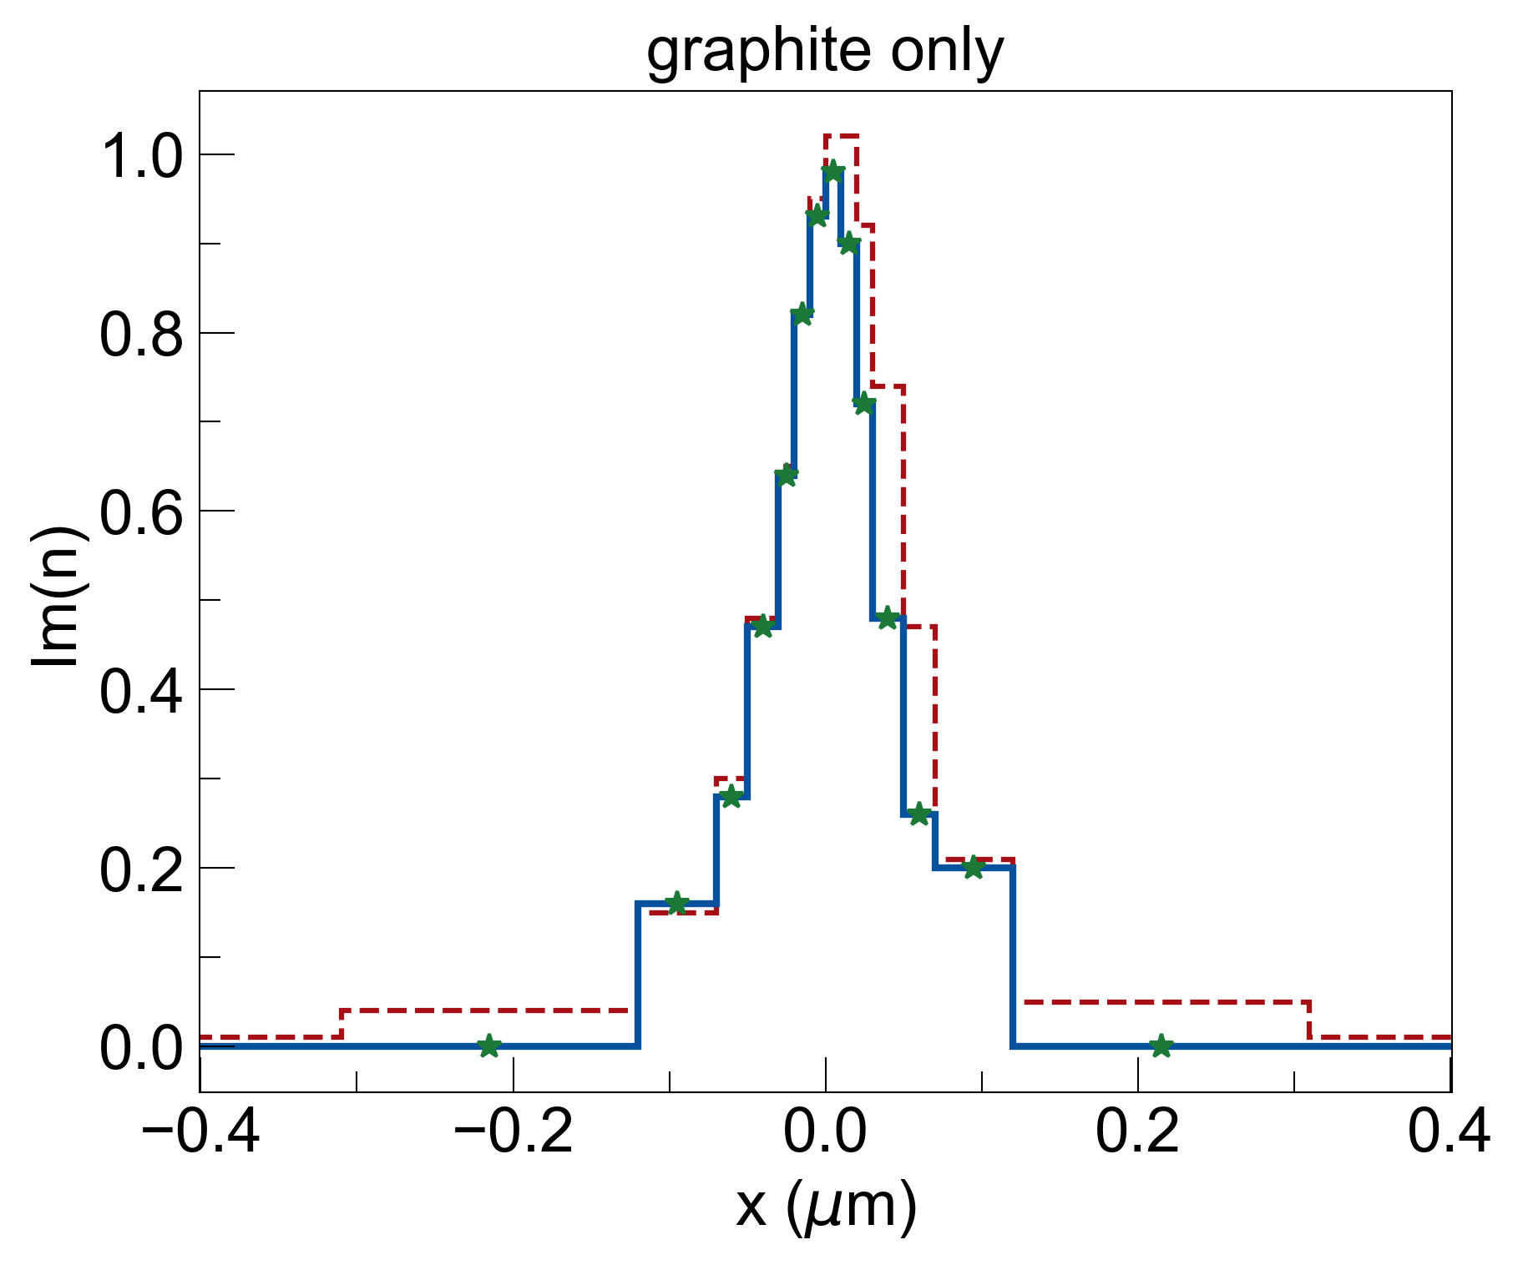
Restricting Lossy Material to Graphite Hardly Changes (n,k) Profile
original design (including metals)
Bruggeman model was able to find graphite mixtures for each layer without losing accuracy to target s-KK profile
Replacing metals with their oxide counterparts did not work (most oxides are relatively lossless)
Pure material (no mixtures) designs did not work either (algorithm was either picking materials with no losses, or materials with losses but very high/dispersive n)
graphite-only design

Slide 2
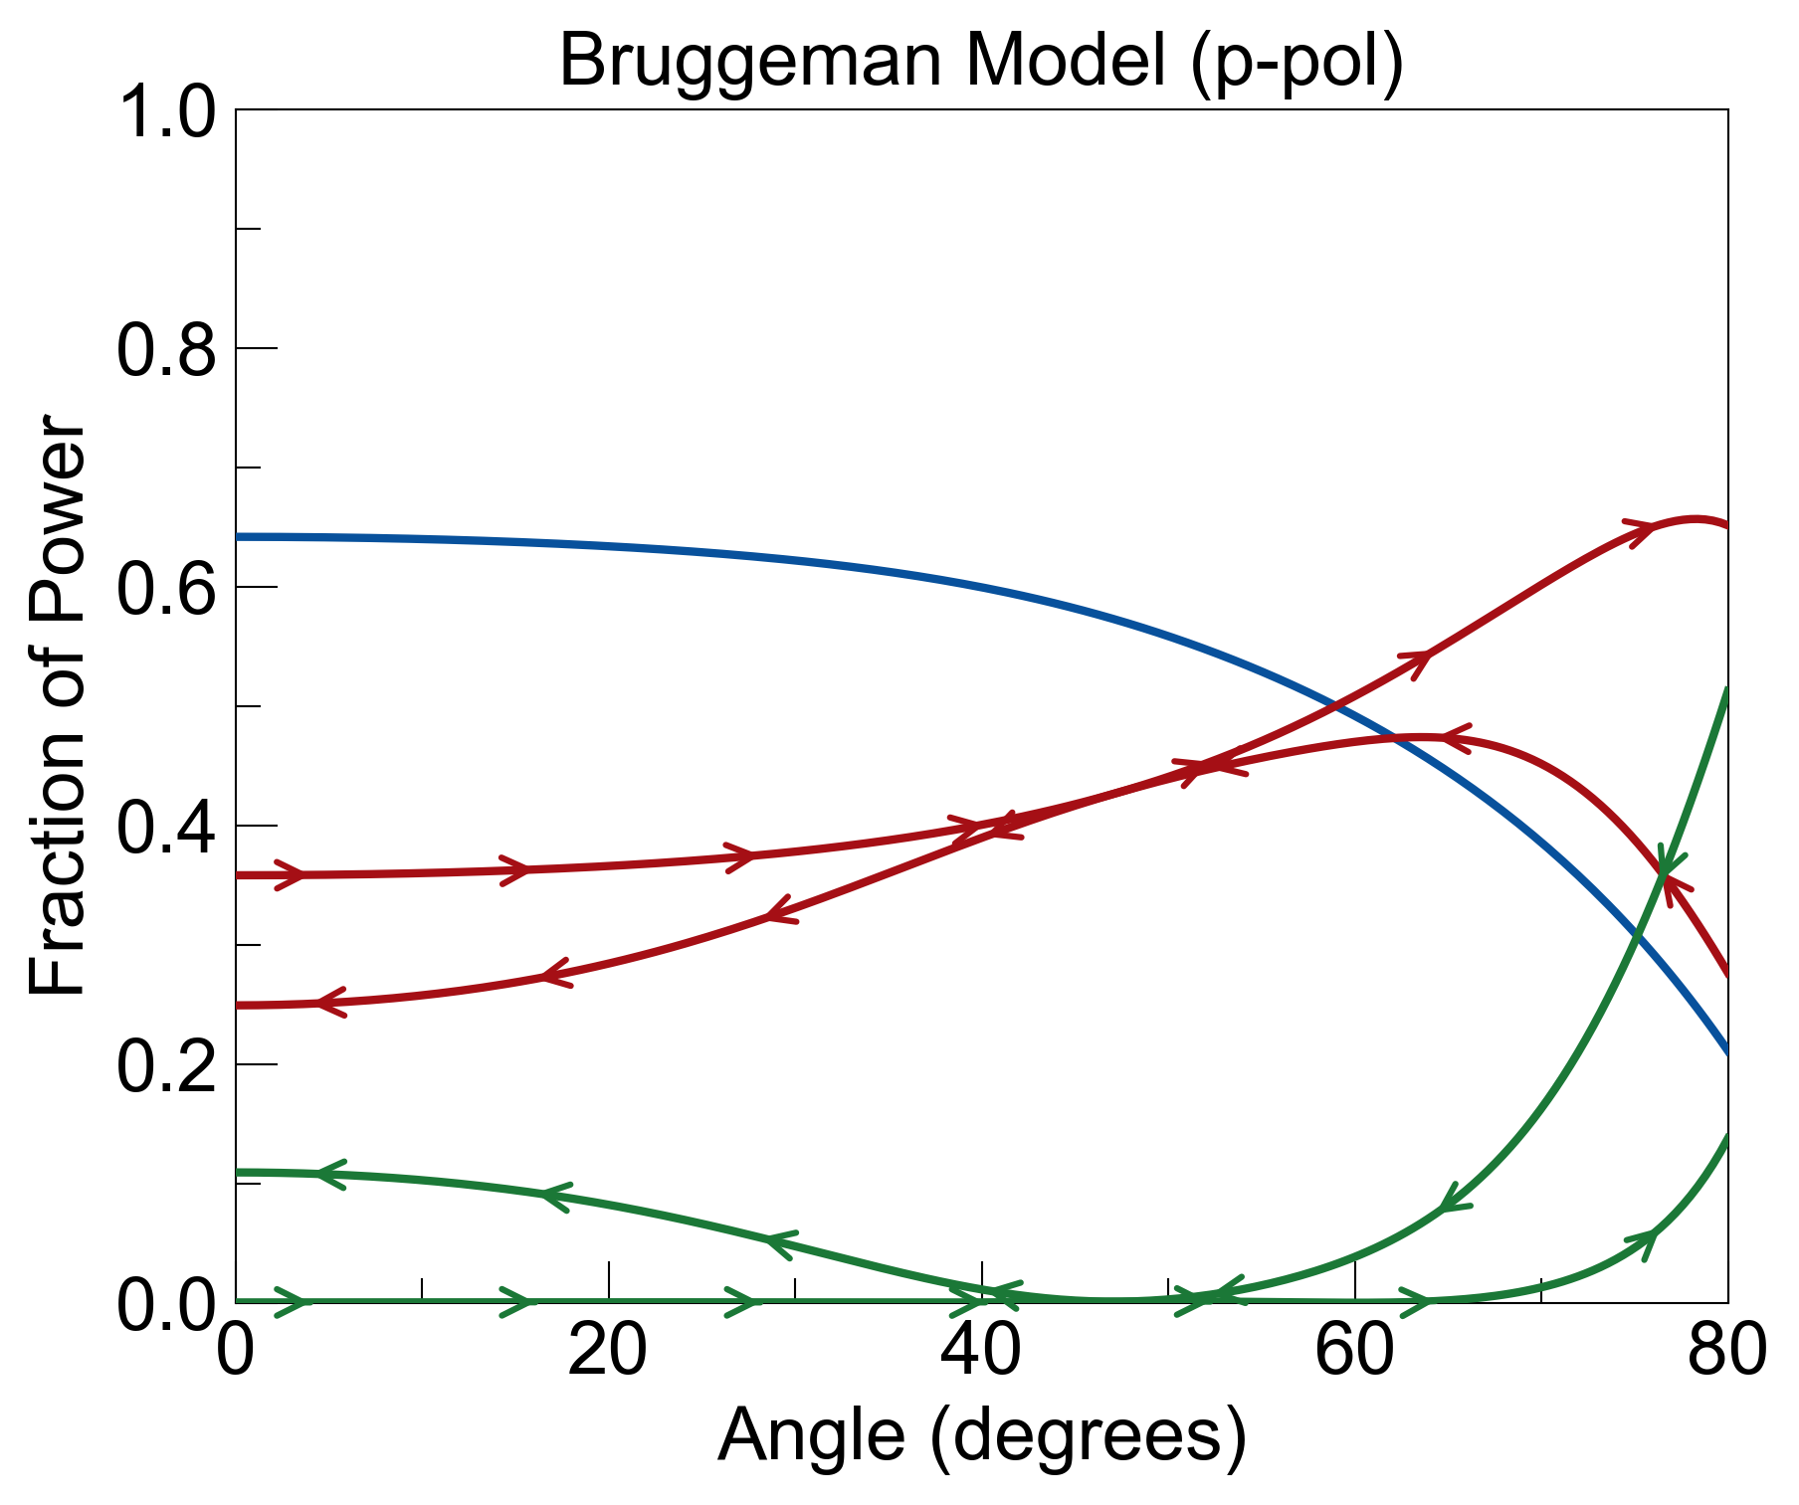
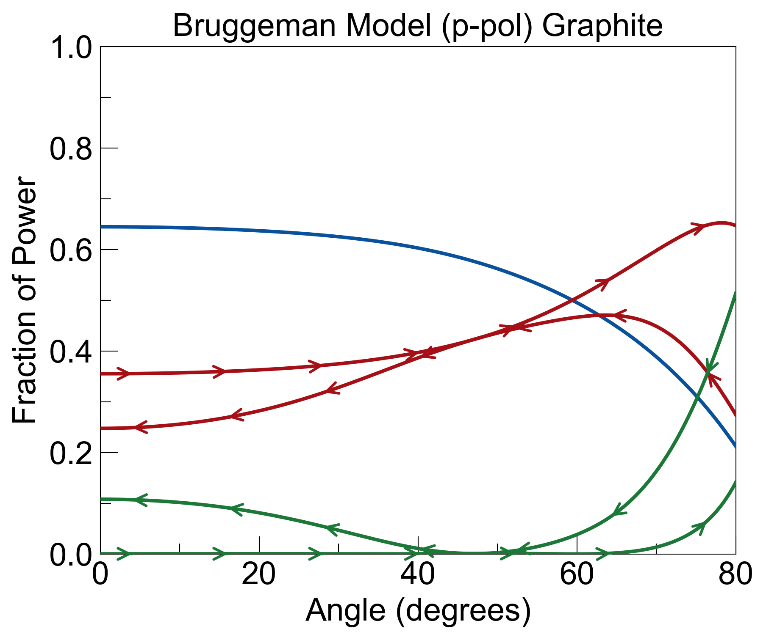
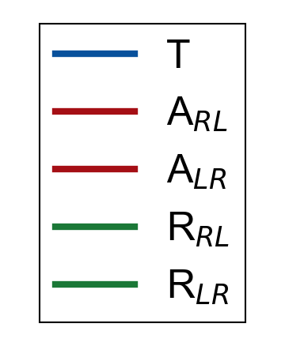
Identical Optical Response Between Original and Graphite-only Design
quick sanity check to make sure we can safely switch to graphite-only design. now to look for critical layers…

Slide 3
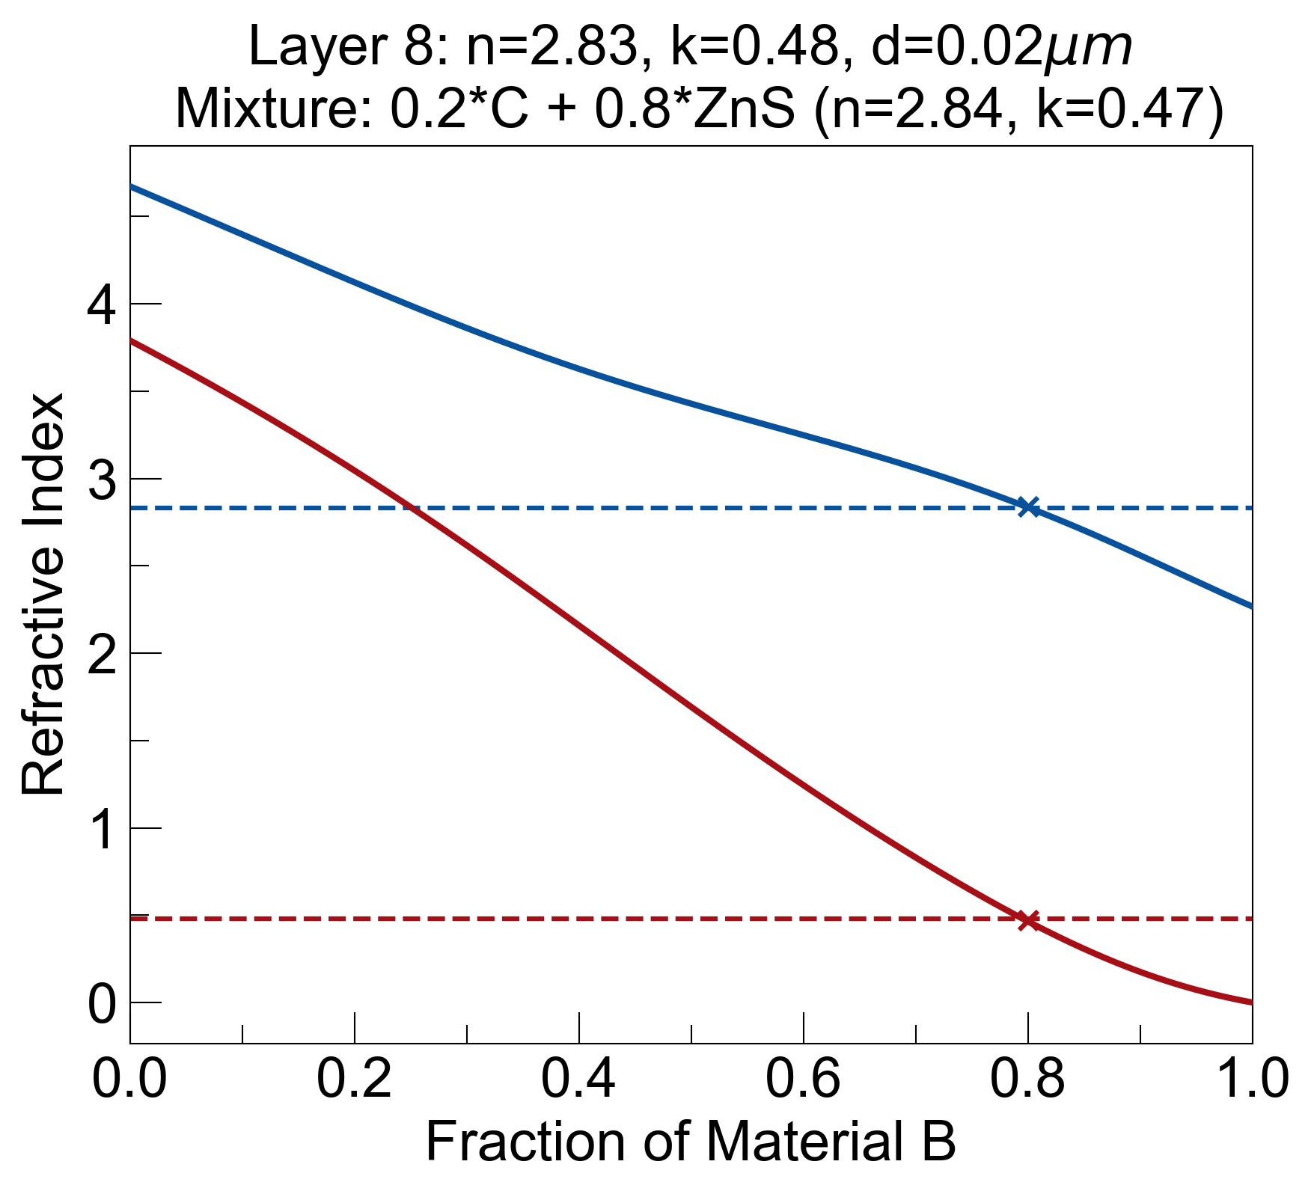
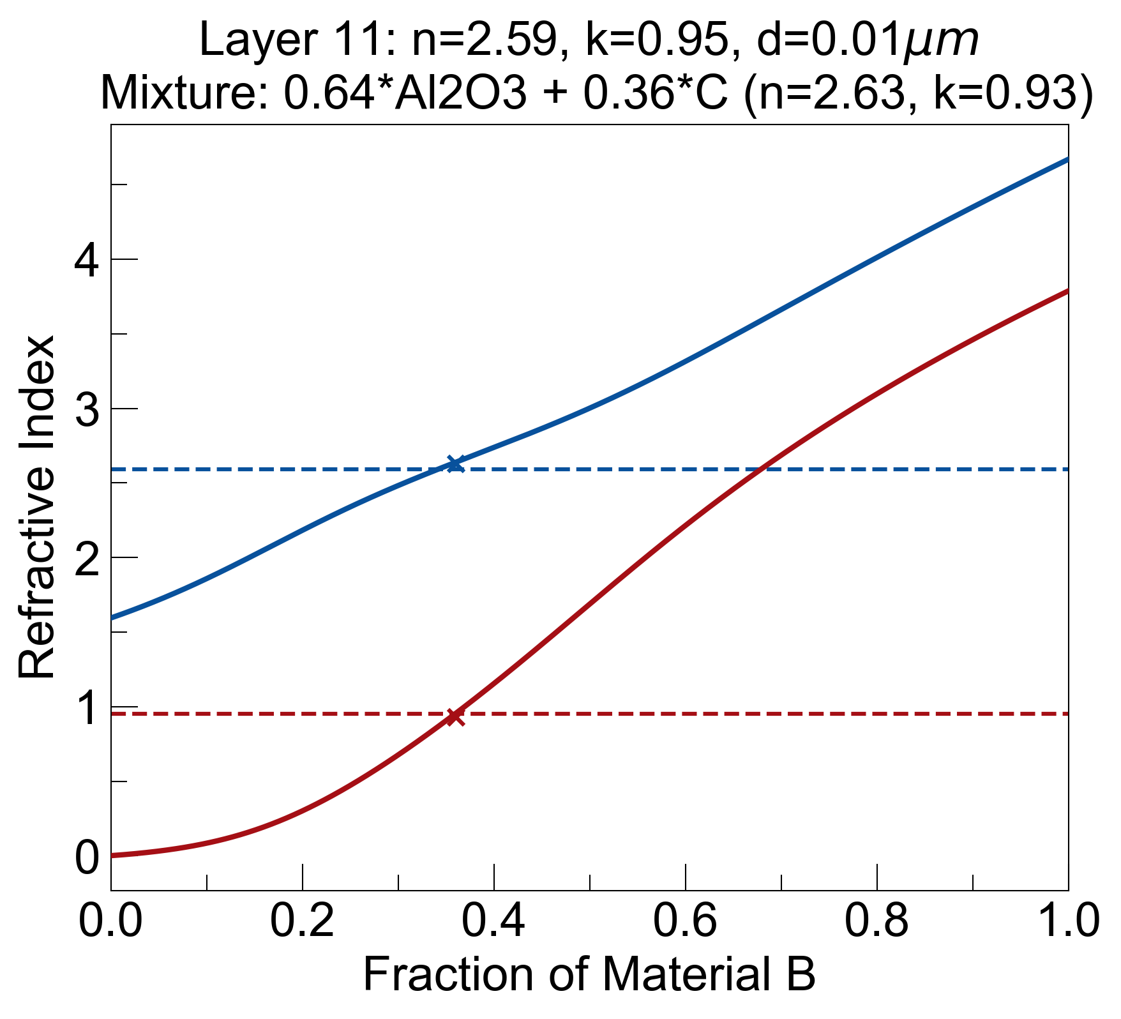
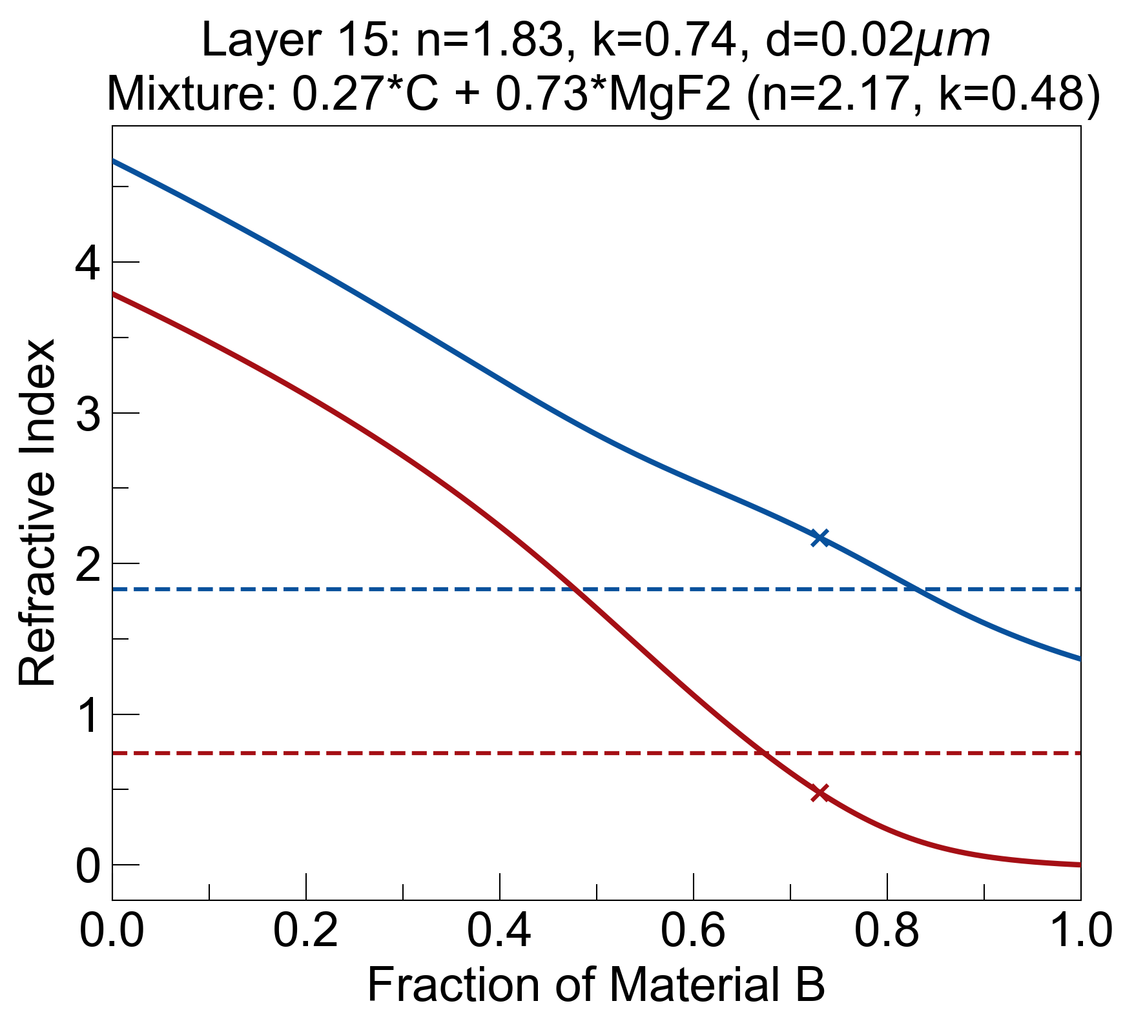
Single Layers Of Interest
Fundamental features of spatial Kramers-Kronig profile:
Layers with similar Im(n), but very different Re(n) (Ex. LAYER 8 and LAYER 15)
Central layer with high Im(n), medium Re(n) (Ex. LAYER 11)
LAYER 8
LAYER 11
LAYER 15

Slide 4
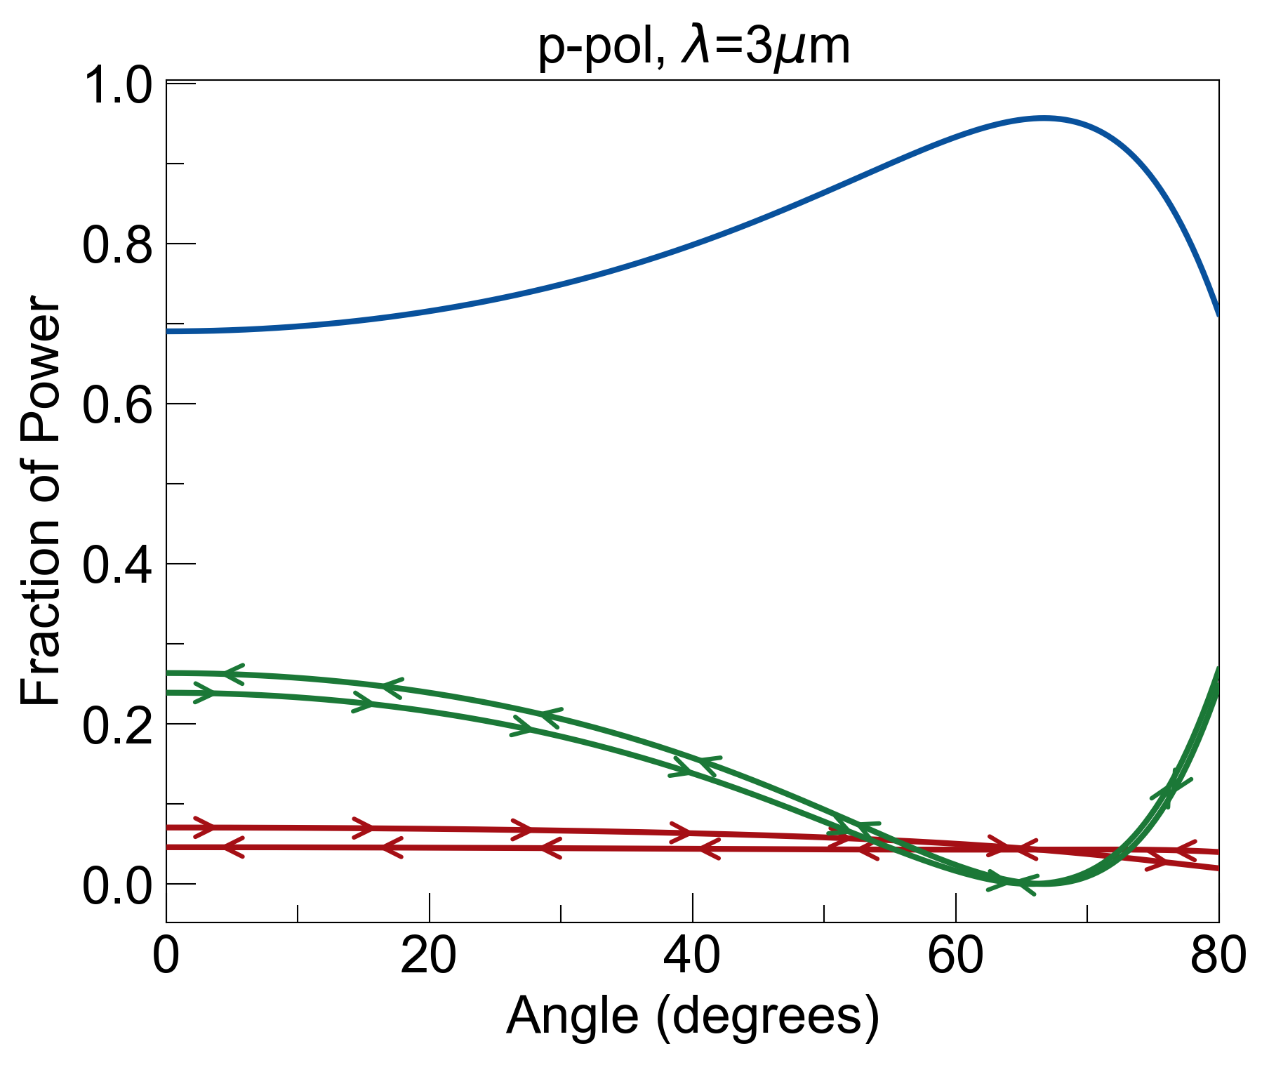
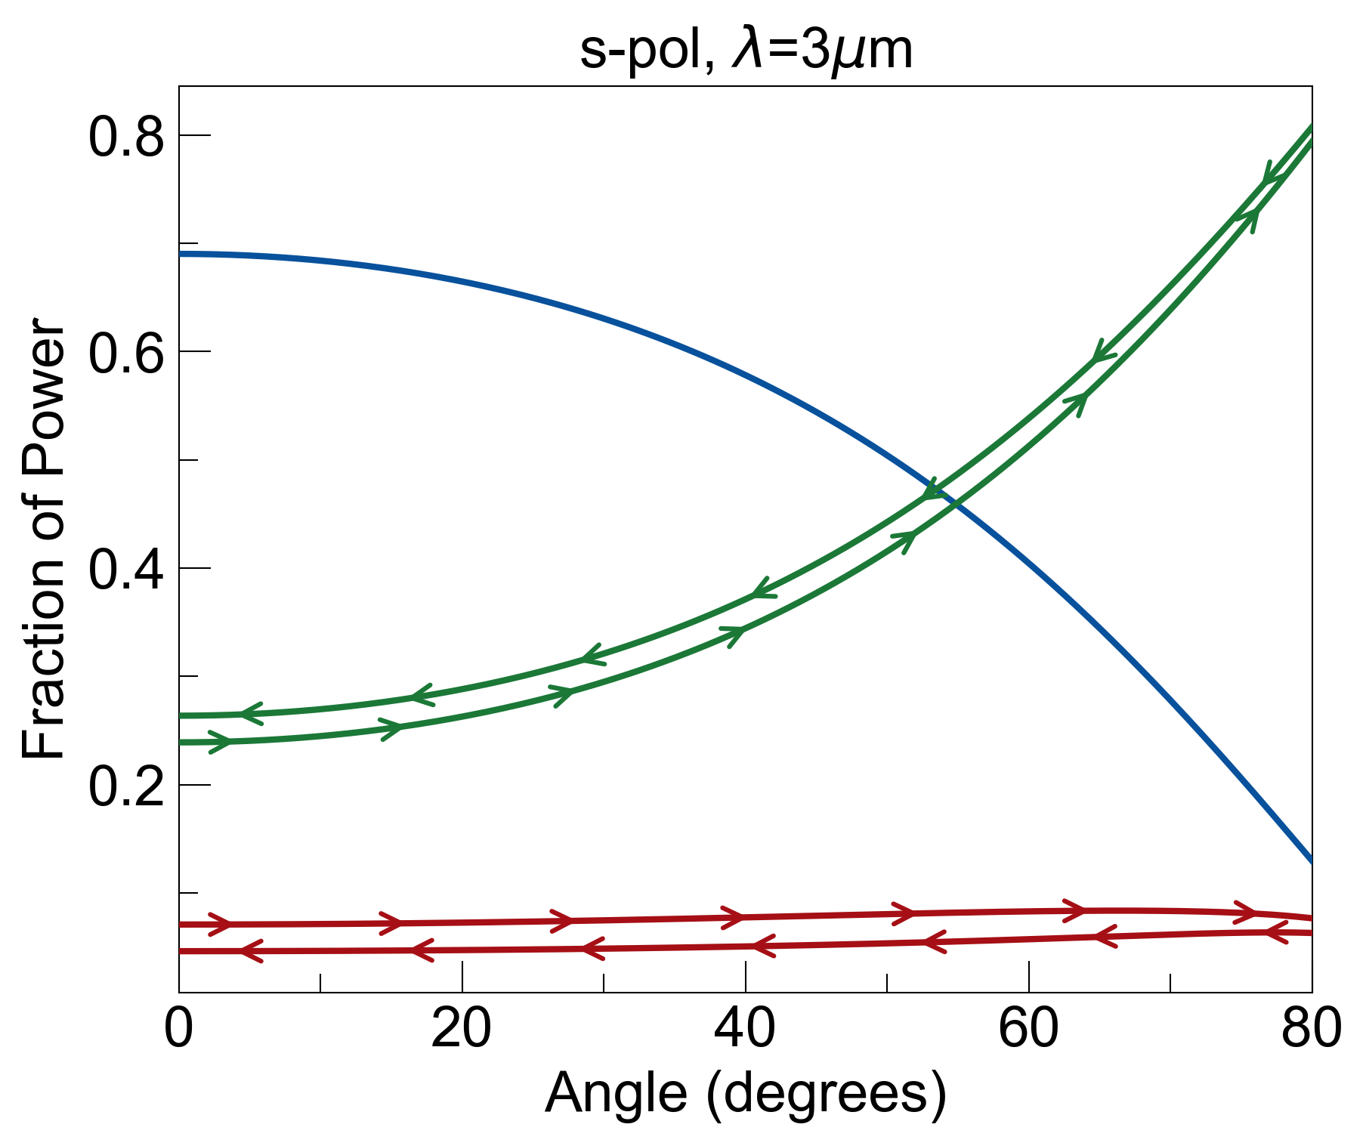
ZnS substrate
Single Mixed Layer to Test Mixing: 64% Sapphire & 36% Graphite
mixed layer
Chose a central layer in s-KK with appreciable losses, and common material (sapphire)
From Bruggeman Model: n_{eff} = 2.63, k_{eff} = 0.93 @ λ=3um
For 10nm thick layer deposited on 300um ZnS substrate (air background included):
Thickness of layer, type of substrate, and % of graphite mixed can be modified and recalculated
Will include dispersion of graphite for wavelength dependence

Slide 5
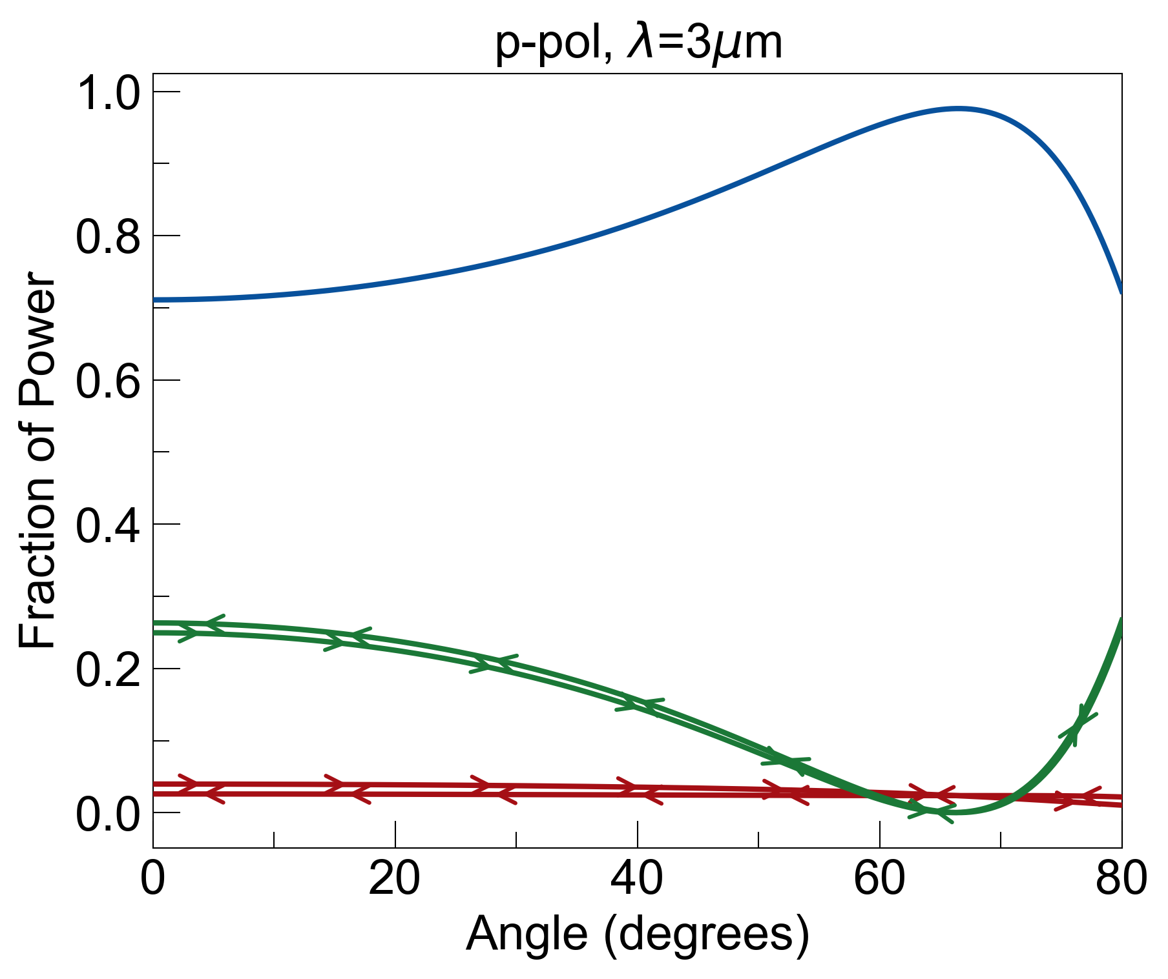
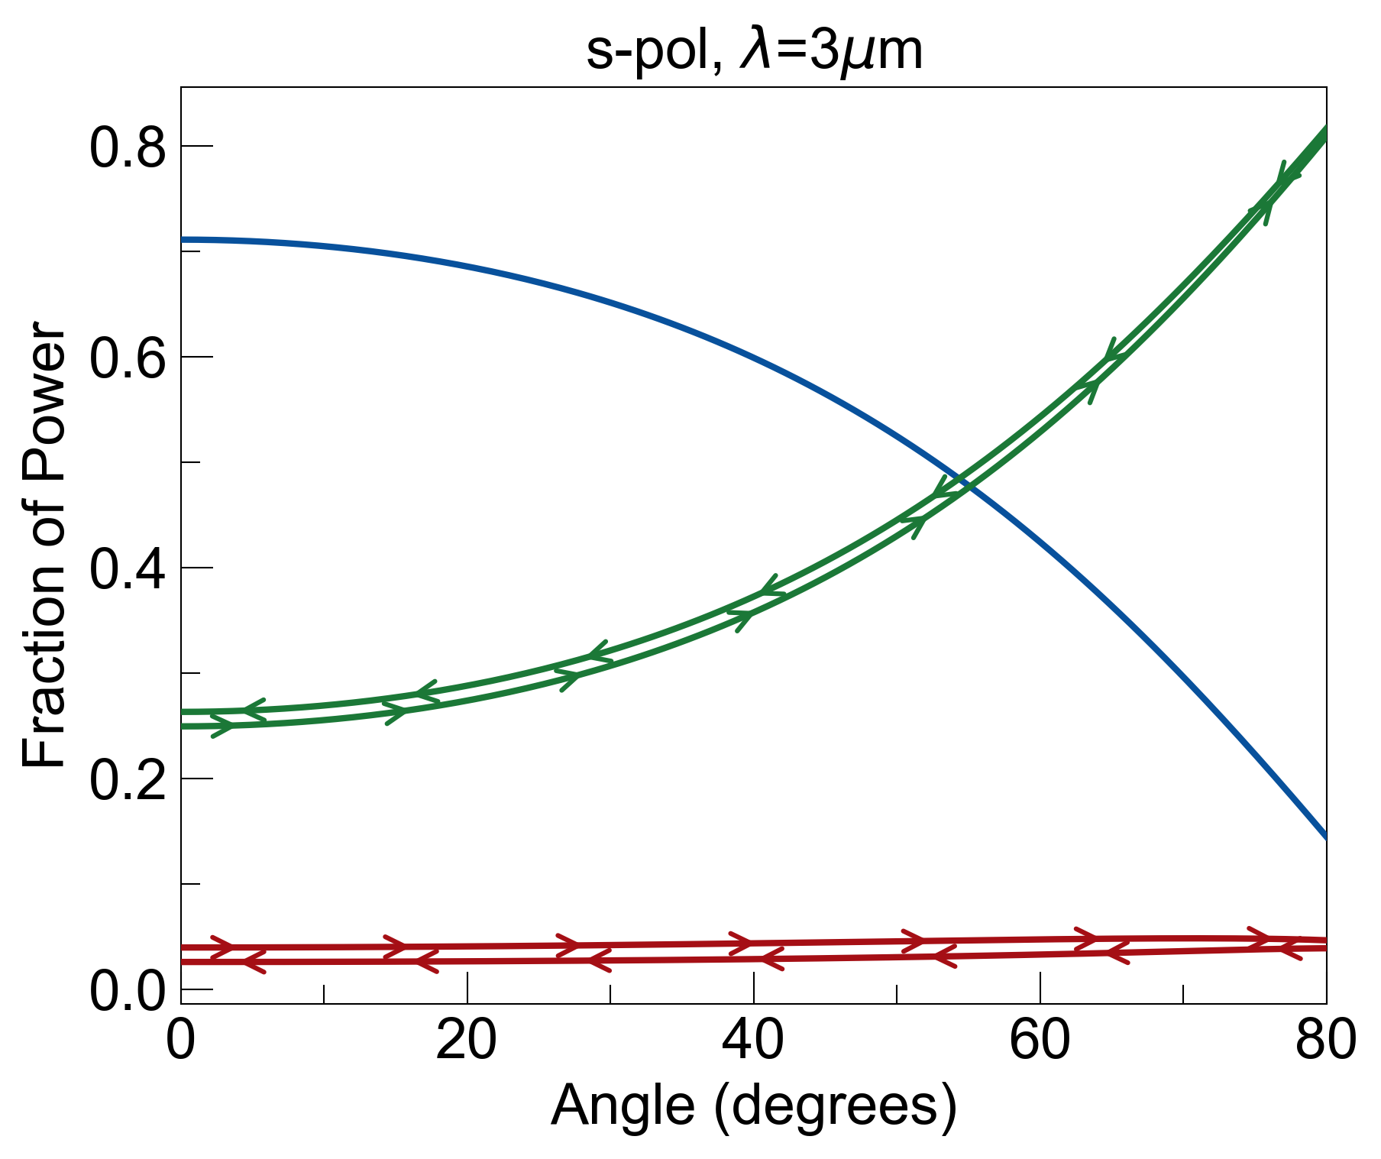
ZnS substrate
Layer with High n, Appreciable k: 80% ZnS & 20% Graphite
mixed layer
Left side of spatial Kramers-Kronig profile, high Re(n) and appreciable Im(n)
From Bruggeman Model: n_{eff} = 2.84, k_{eff} = 0.47 @ λ=3um
Same thickness of layer (10nm) and substrate:
Hopefully thin layer composing of same material as substrate (ZnS) is not a problem (graphite diffusing into the substrate)

Slide 6
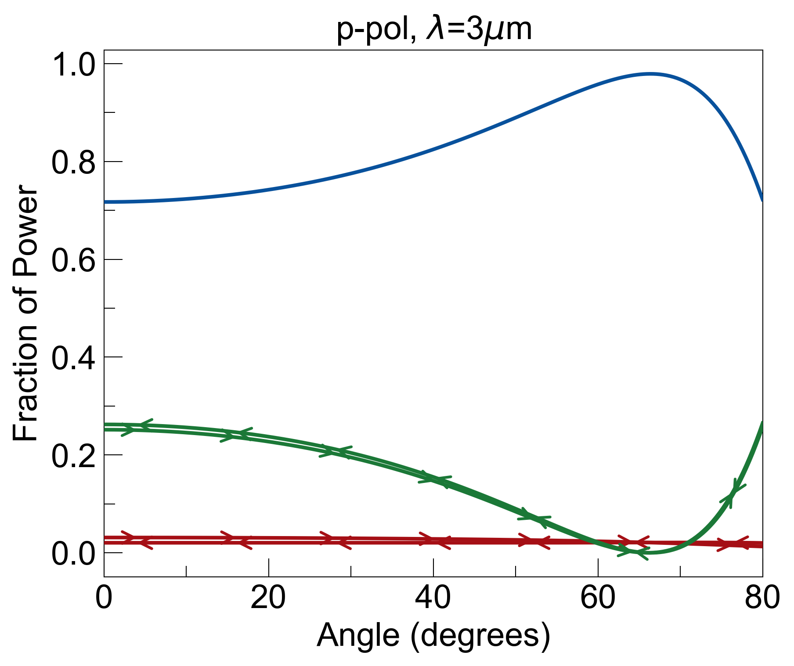
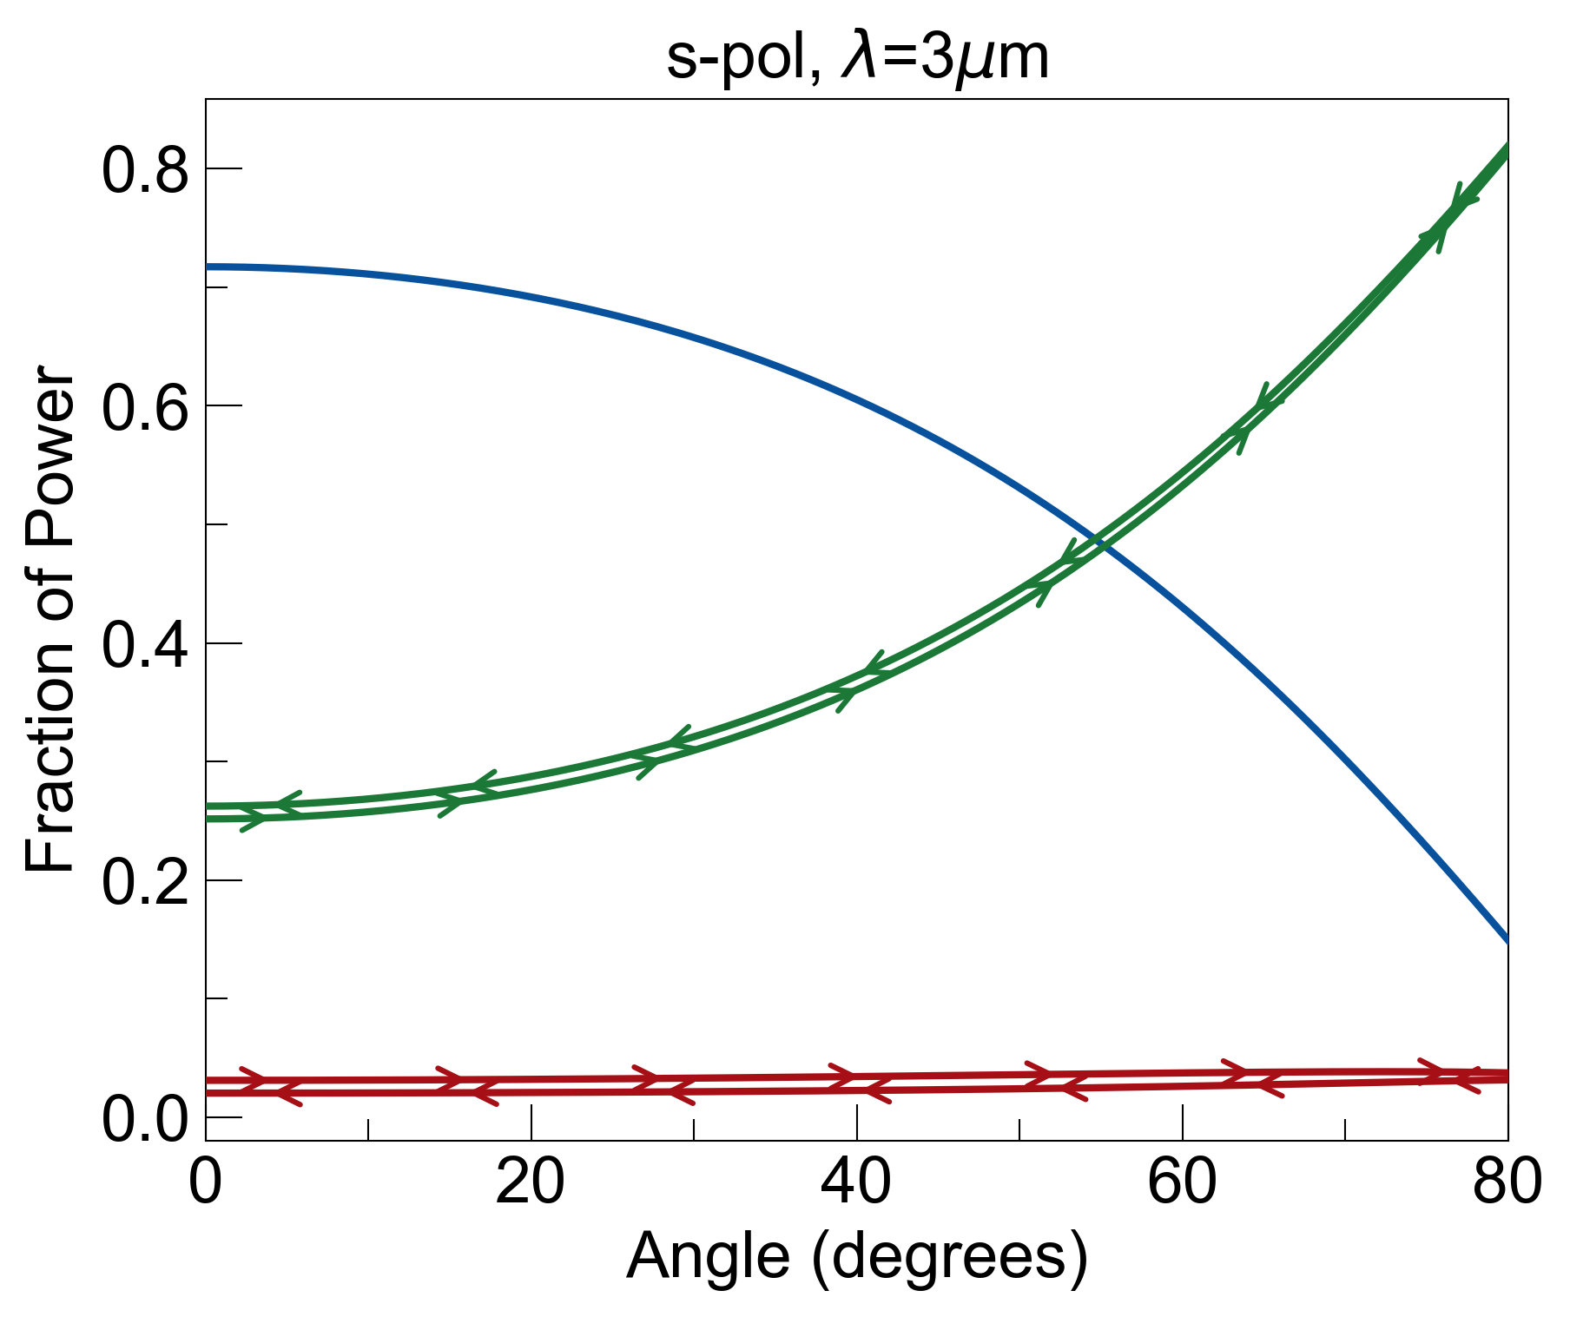
ZnS substrate
Layer with Low n, Appreciable k: 73% MgF₂ & 27% Graphite
mixed layer
Right side of s-KK profile: layer with similar Im(n) as previous layer, but lower Re(n)
From Bruggeman Model: n_{eff} = 2.17, k_{eff} = 0.48 @ λ=3um
Same thickness of layer (10nm) and substrate:
After fabrication team has made one (or several) of these mixed thin layers, we will compare their (n,k)_{eff} with Bruggeman model
If very different, need to use different effective medium theory (Maxwell Garnet) or empirically fit model to data.

