Slide 1
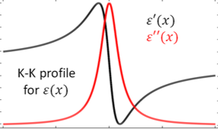

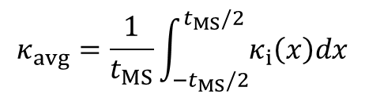


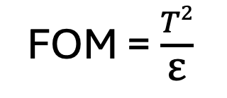
1 Stack
…
…
…
…
FOM =$\frac{T2}{\text{ε}}$

Slide 2
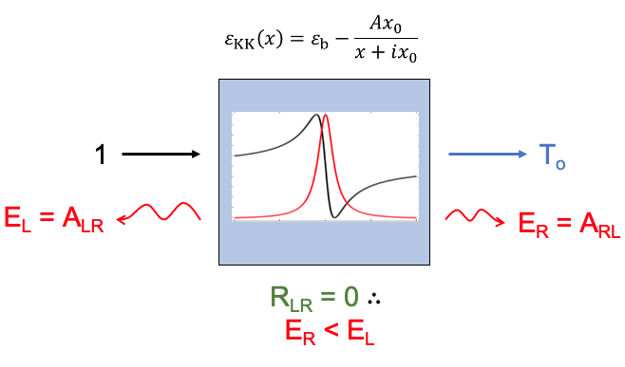
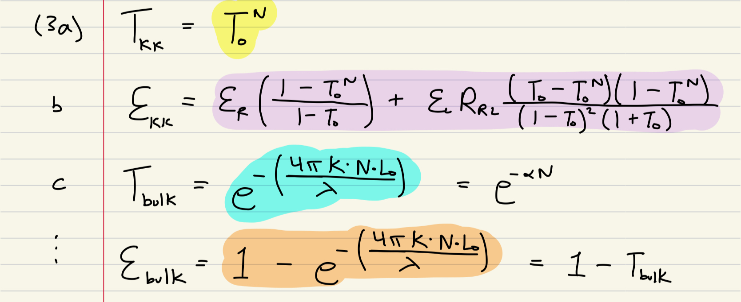
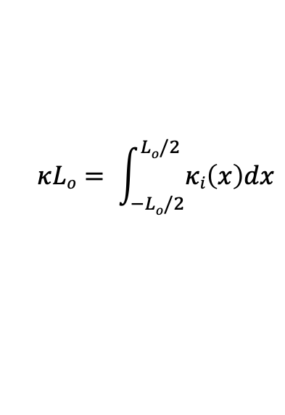

$⍺=4πκLo$ / λ
$$κLo= \int_{−Lo/2}^{Lo/2}{κi\left(x\right)dx}$$

Slide 3
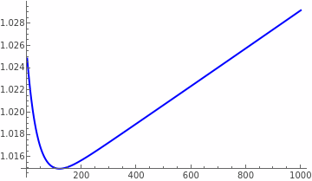
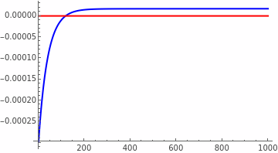
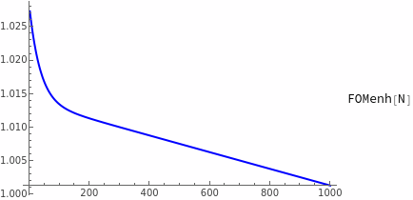
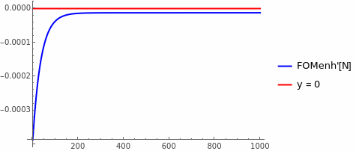
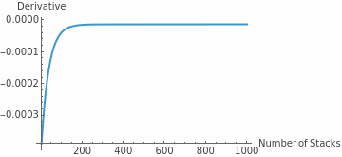
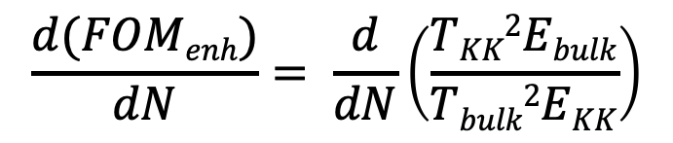
A = 5, x₀ = 0.0013μm, n_{b} = 1.7, λ = 3μm
$$\frac{d(FOMenh)}{dN}= \frac{d}{dN}\left(\frac{TKK2Ebulk}{Tbulk2EKK}\right)$$

Slide 4
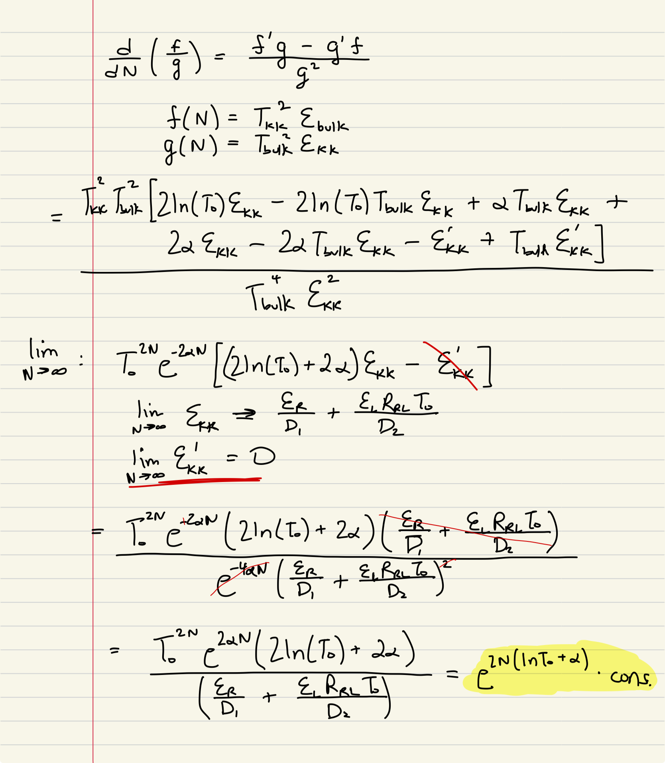
Large N limit:
Sign of ln(T_{o}) + ⍺ determines large N behavior
Since T_{bulk} = e^{-⍺} , ⍺ = -ln(T_{bulk})
Small differences in T_{bulk} and T_{o} affect FOM enhancement

Slide 5
A = 5, x₀ = 0.0013μm, n_{b} = 1.7, λ = 3μm
ln(To) + ⍺ = + 8.3 x 10⁻⁶

Slide 6
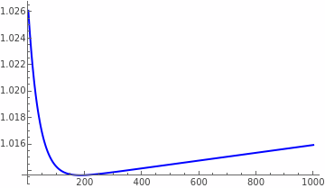
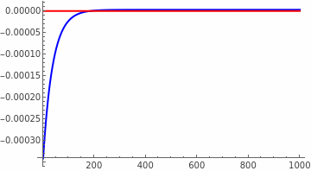
A = 5, x₀ = 0.00135μm, n_{b} = 1.7, λ = 3μm
ln(To) + ⍺ = + 1.4 x 10⁻⁶

Slide 7
A = 5, x₀ = 0.0014μm, n_{b} = 1.7, λ = 3μm
ln(To) + ⍺ = - 6.2 x 10⁻⁶

Slide 8
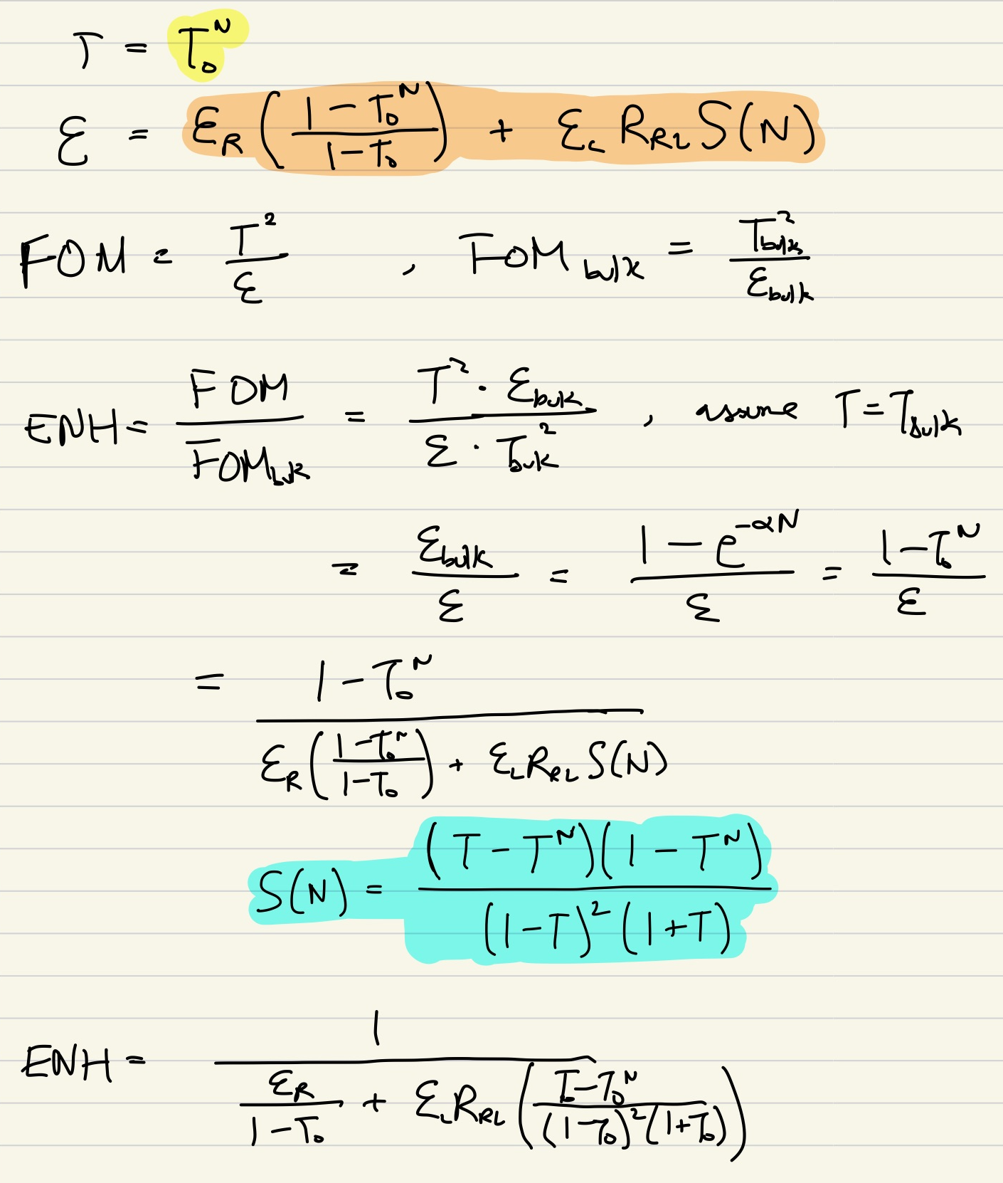
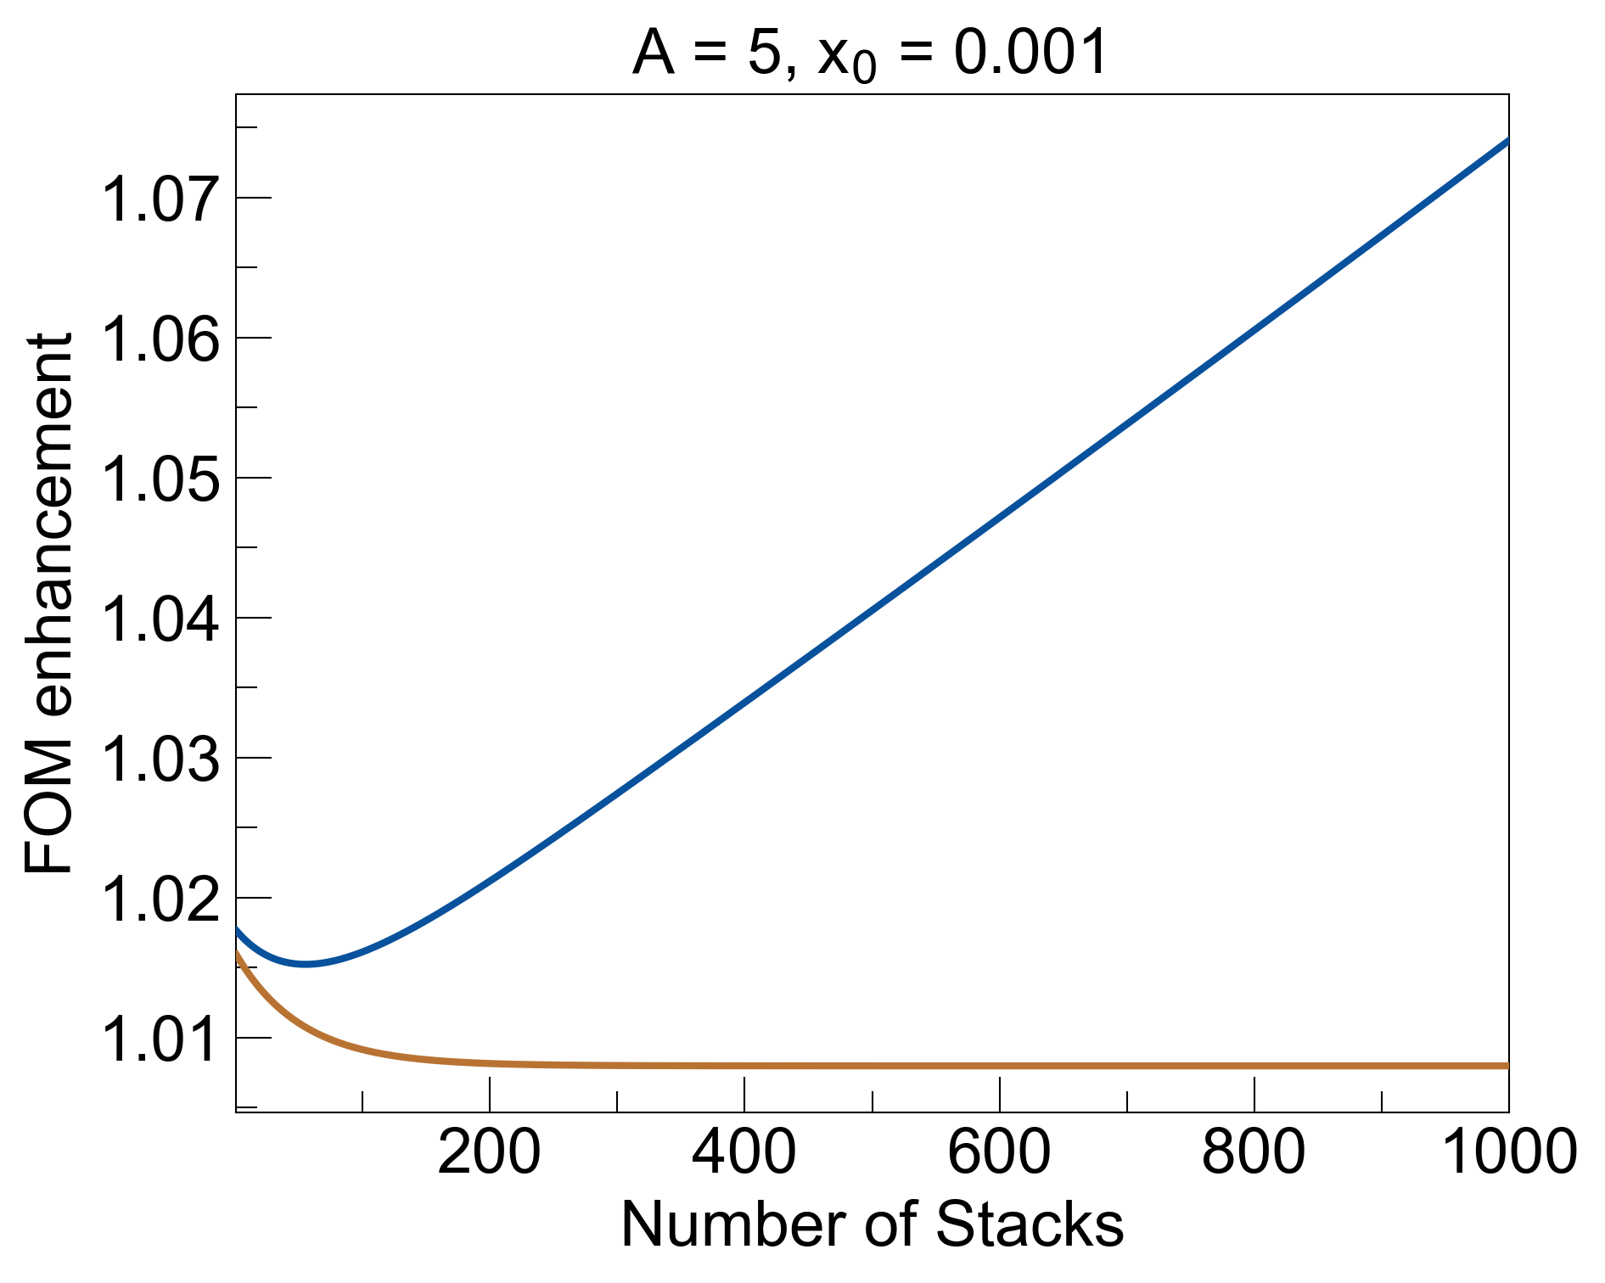
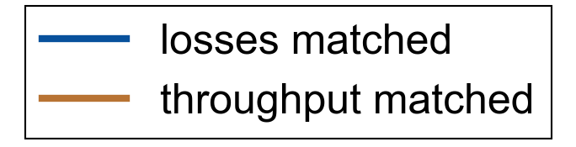
ln(To) + ⍺ = 0
Thoughput matched: enforce T_{bulk} = T₀
Since T_{bulk} = e^{-⍺} , ⍺ = -ln(To)

Slide 9
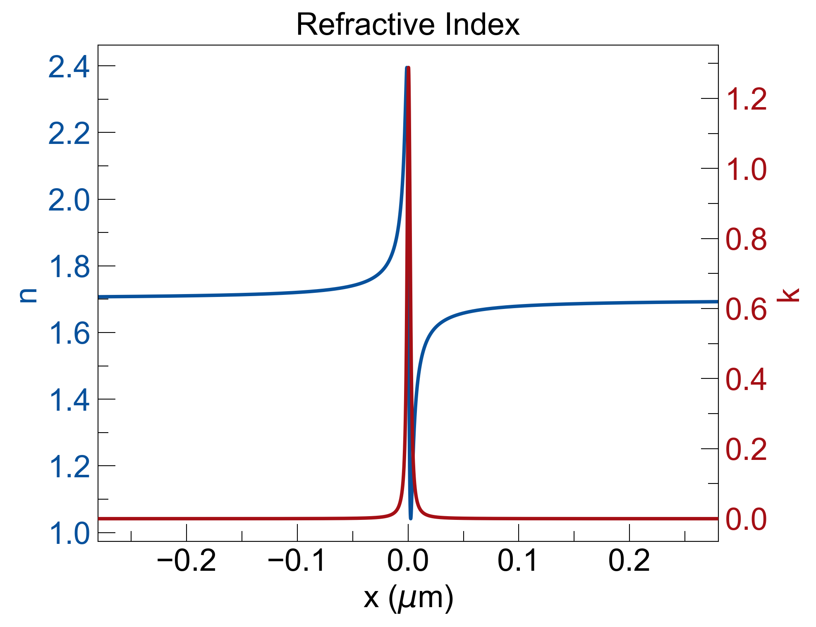
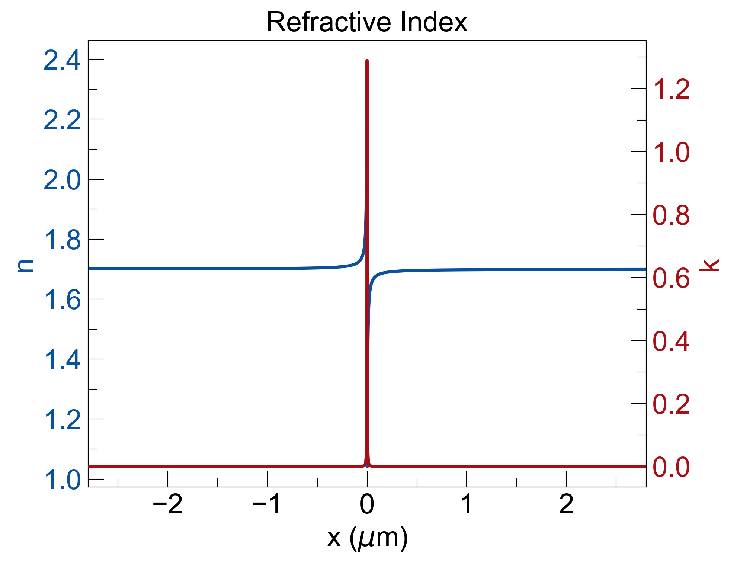
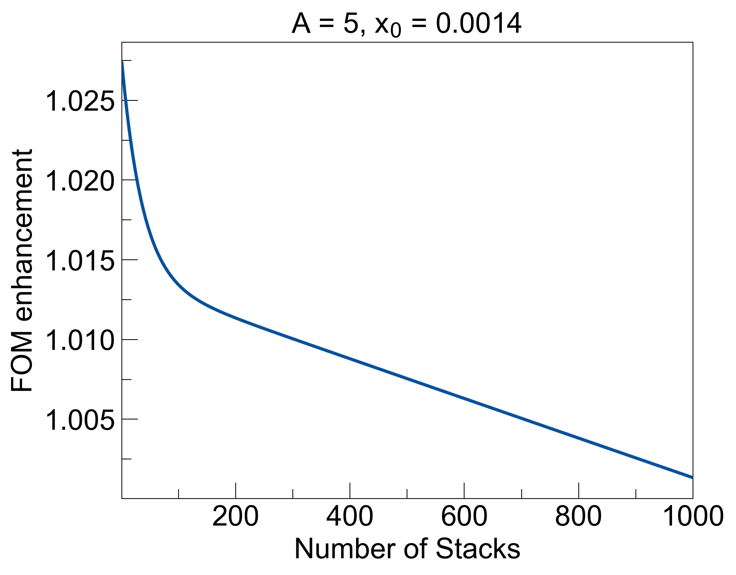
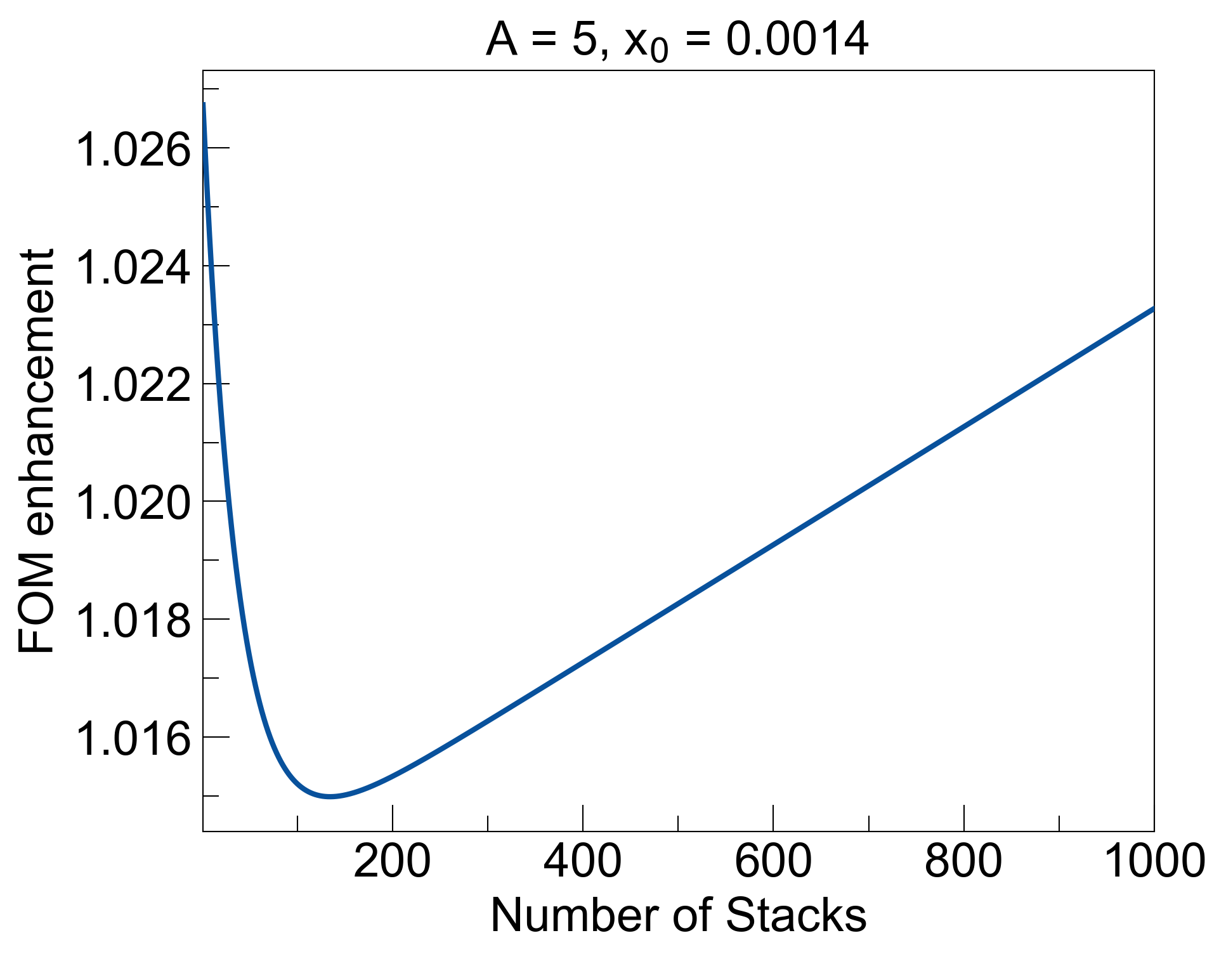
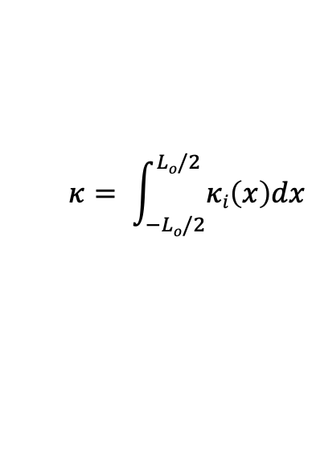

ln(To) + ⍺ = - 6.2 x 10⁻⁶
ln(To) + ⍺ = + 4.9 x 10⁻⁶
Increase endpoints of structure by 10x:
Xmin = -200*x₀ ->
-2000*x₀
1.707
1.692
1.701
1.699
$⍺=4πκLo$ / λ
$$κ= \int_{−Lo/2}^{Lo/2}{κi\left(x\right)dx}$$

Slide 10
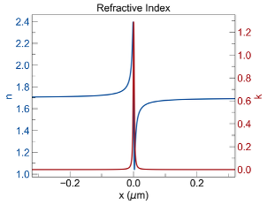
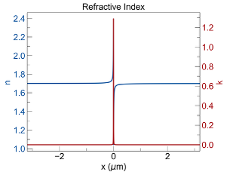
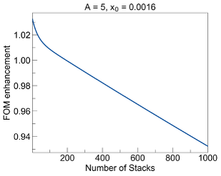
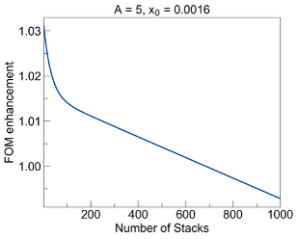
ln(To) + ⍺ = - 6.2 x 10⁻⁶
ln(To) + ⍺ = + 4.9 x 10⁻⁶
Increase endpoints of structure by 10x:
Xmin = -200*x₀ ->
-2000*x₀
$⍺=4πκLo$ / λ
$$κ= \int_{−Lo/2}^{Lo/2}{κi\left(x\right)dx}$$

